Slide 1
Financial Barriers to Apprenticeships take-up for 16-18 year olds

Slide 2


Acknowledgements
Thank you…
We would like to express our gratitude to everyone who took the time to talk to us as a part of this research.
Thank you for your time and energy in sharing your experiences and views with us.
[Please note that all names in this report have been changed to protect anonymity.]
List of Authors:
Dr Kholoud Mohsen – University of Essex
Rabiya Asif – University of Essex
List of Contributors:
Peter O’Loughlin - Essex County Council
Poppy Reece - Essex County Council
Kim Trennery - Essex County Council
Louise Fry - Essex County Council

Slide 3
Contents
Overview
What data tells us
Research Participants
Participants’ perspectives
Key findings and Recommendations
Resources

Slide 4
Levelling Up Goal
“Every young person and adult to have the choice of a high-quality route in education, employment or training.”

Slide 5
Overview
University of Essex conducted research on behalf of Essex County Council to explore barriers to apprenticeships for 16- to 18-year-olds in Essex.
The research findings will be used to help inform the county’s approach to making apprenticeships more attractive and accessible for young people, particularly those from low-income families.
The research findings will enable policy makers to develop better incentives to meet the third levelling up goal of positive destination aiming at enabling young
people to have the choice of a high-quality route in education, employment or training.
In-depth interviews were carried with influential parties followed by online surveys targeted at young people aged 16-18, parents and schools/training providers.
This report will present the following:
Secondary data published on apprenticeships in Essex.
Analysis of the primary data collected from different cohorts.
Data driven policy recommendations.
Links to important resources and organisations promoting apprenticeships
in Essex.

Slide 6
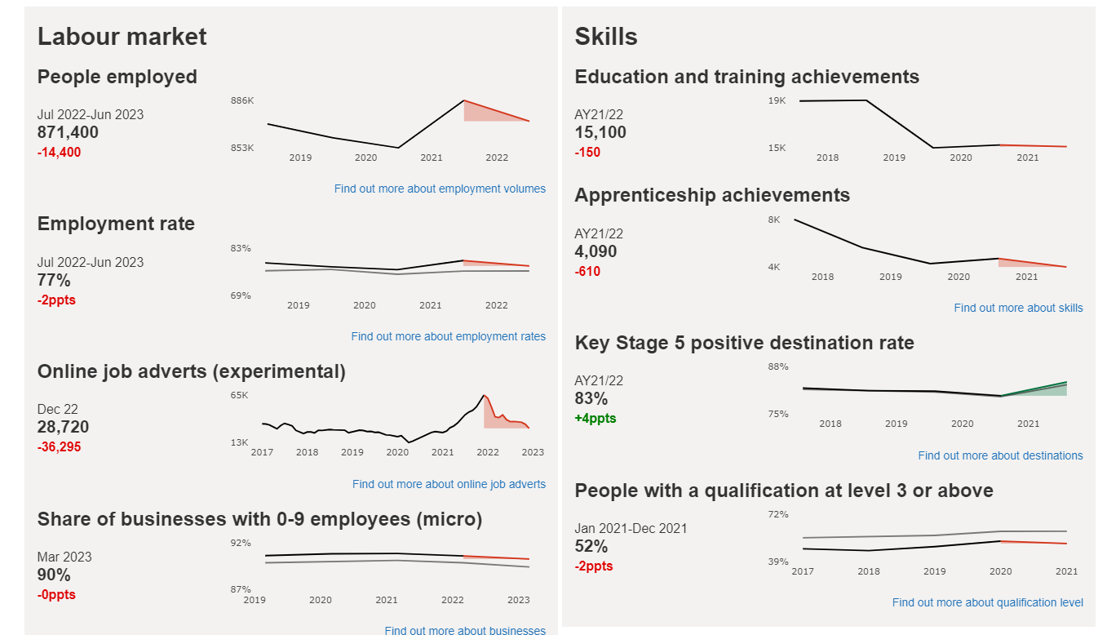
What the data tells us
To change image:
Delete existing image and insert new by clicking on icon
or
Right-click, change picture
If new picture causes placeholder to resize or rotate
Click on ‘Reset’
under ‘Slides’ tab
on Ribbon
To resize or reposition image within placeholder:
Picture Format> Crop
Resize using white circles at corners
Move by click+hold on grey area of image then drag to position
Overview of local landscape in Essex, Southend-on-Sea and Thurrock Local Skills Partnership Area (LSIP)
Data presented in the above image indicates that there is a decrease in several important indicators related to labour market, jobs and skills.
Employment in Essex, Southend-on-Sea and Thurrock LSIP has decreased in the period between Jully 2022- June 2023.
The number of online job adverts Essex, Southend-on-Sea and Thurrock LSIP has decreased in the last two years.
90% of businesses in Essex, Southend-on-Sea and Thurrock are micro businesses with 0-9 employees.
The number of further education and apprenticeship achievements in Essex, Southend-on-Sea and Thurrock LSIP has decreased in the last five years.
Source: department-for-education.shinyapps.io/local-skills-dashboard/

Slide 7
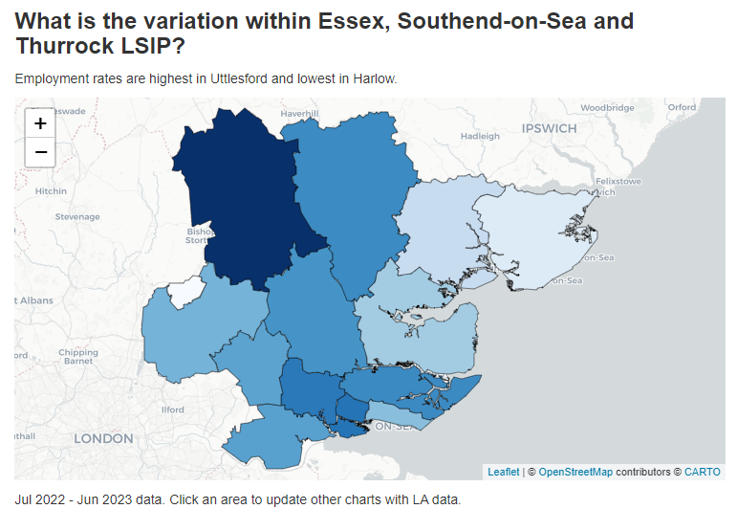
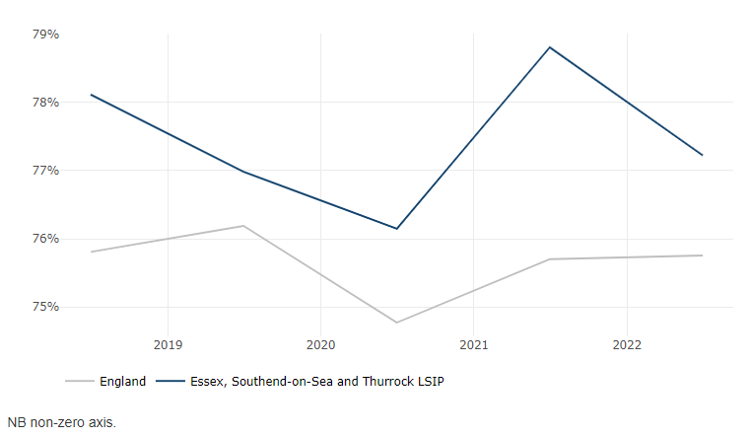
What the data tells us
The employment rate in Essex, Southend-on-Sea and Thurrock LSIP is higher than the national average. It is ranked 18th of the 38 LSIPs.
How are employment rates changing over time?
The employment rate in Essex, Southend-on-Sea and Thurrock LSIP has decreased faster than the national average in the last five years.
Source: department-for-education.shinyapps.io/local-skills-dashboard/

Slide 8
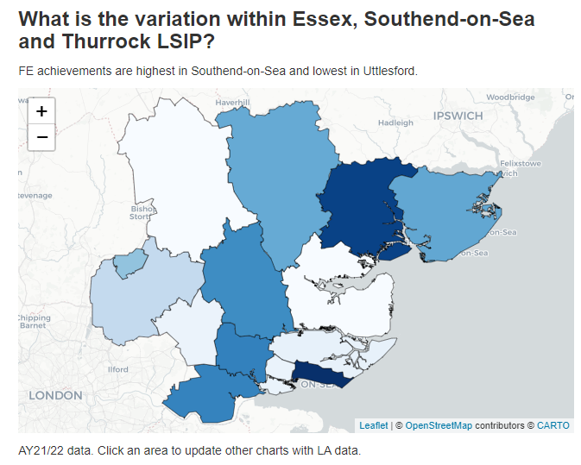
What the data tells us
Essex, Southend-on-Sea and Thurrock LSIP has a higher share of FE achievements in Apprenticeships than the national average.
Source: department-for-education.shinyapps.io/local-skills-dashboard/

Slide 9
Sources of insight
  Young People (YP)
  Parents
  Schools/Colleges
  Online survey of YP aged 16-18 years.
  35 responses.
  Data collected from July 2023 – October 2023.
  Promoted via Essex newsletter, ECC’s social media channels, and a range of partners including personal networks and schools.
  Essex-wide responses, with over-representation from Basildon and Chelmsford, and under-representation from Tendring, Maldon and Uttlesford
  Online survey of parents / carers / guardians of 11- to 18-year-olds.
  32 responses.
  Data collected from July 2023 – October 2023.
  Promoted via Essex newsletter, ECC’s social media channels, and a range of partners including personal networks.
  Essex-wide responses, with over-representation from Basildon and Chelmsford, and under-representation from Tendring, Maldon and Uttlesford.
  Online survey of Career Advisors/Head of Colleges.
  20 responses.
  Data collected from September 2023 – October 2023.
  Promoted via Essex newsletter, ECC’s social media channels, and a range of partners including personal networks.
  Essex-wide responses, with over-representation from Brentwood, Epping Forest and Great Baddow and under-representation from Maldon district.
This report brings together the insights from across these three sources along with insights from in-depth interviews from employers, independent training providers and other stakeholders.

Slide 10
Interviews
  In addition to the survey data, interviews were conducted to get insights from other stakeholders. This approach will enable us to provide a holistic understanding to identify barriers and how to effectively promote apprenticeships to young people aged 16-18.
  Interviews were conducted with representatives from:
  Essex Providers Network
  Essex Chamber of Commerce
  A Local employer
  A digital company promoting skills and apprenticeships.
  * The researchers also attended events and roundtable discussions to understand the landscape of apprenticeships in Essex.
  Getting by
  No longer managing

Slide 11
The Parents' Perspective

Slide 12
Parental knowledge around advantages of taking up an apprenticeship
While most parents are aware of the advantages of taking up an apprenticeship, their actual knowledge about where to find information about apprenticeships is limited.
94% of parents expressed a positive interest in their child taking up an apprenticeship.
However, only 64% of parents agreed they felt confident that their child has the required skill set to take up an apprenticeship.
Further, most of the parents responded that they look on gov.uk, local companies, other government websites and school/colleges websites to find information related to apprenticeships.
Why do you encourage your child to take up an apprenticeship?
“They’ll learn new skills that they can use in future employment.”
“Cheaper than university and will already have working experience at the end, so more of an incentive to children.”
“It is a good way to gain a qualification and experience whilst earning a wage.”
“As he is looking to specialize in cyber security and current courses are limited within the Essex area.”

Slide 13
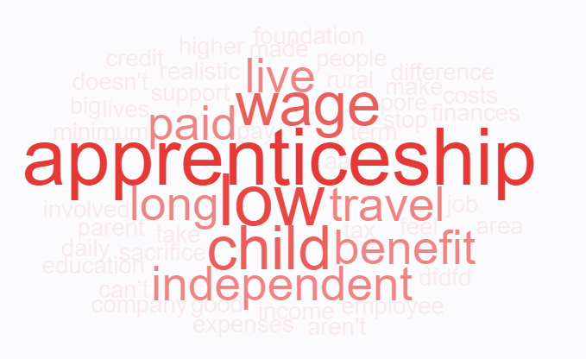
What parents said about why they would not suggest an apprenticeship to their child
“I will no longer get Tax Credits or Child Benefits so it will make a big difference to our finances. I know he will be paid but it is a low income, and he will have more expenses so we will be worse off overall.”
“They are REALLY poorly paid.”
“Wages aren't good enough for them to be independent, especially when daily travel costs are involved and live in rural area.”
“I feel the minimum apprenticeship wage should be higher as they are realistically doing the job of another employee in the company.”
“Apprenticeship wage is low, travel takes up most of the wage and the child benefit is stopped so parents then can’t help them out.”
“Worried about the long term. What if the apprenticeship doesn't work out?
“The apprenticeship wage is very low, and my child wants to live independently.”

Slide 14
Parents’ Perspective: What can be done to make apprenticeships more attractive in Essex?
There are three main areas that should be considered jointly to improve apprenticeship take-ups in Essex: Better wage structure, travel cost and other benefits support, and more local and diverse apprenticeship options.
Better wages
Travel cost support + keeping existing childcare & tax benefits
Local & diverse apprenticeships options
Improved apprenticeship wage structure would help make YP financially independent as they can contribute to household expenses.
Learning while earning is a much cheaper option than funding a university course.
Most of the “specialized skill based” apprenticeships are based out of Essex, resulting in high travel costs for families.
Variety of apprenticeship disciplines should be offered such as game design, photography, cyber security etc.
Progression to permanent employment role.
Easy accessibility to different employers and apprenticeship programs.
What might work…
Employers offer a higher rate than the national minimum apprenticeship wage.
The council recommends a higher minimum apprenticeship wage.
What might work…
  Expanding the criteria for subsidised transport to reduce the financial burden for families and minimise barriers to participating in apprenticeships.
What might work…
Improved Quality of...
Interview help
Career guidance from School/College
More skill-based apprenticeships.
Employer led awareness sessions in Schools/Colleges.

Slide 15



Case study: Lucy’s family
Lucy’s family
The mother of a teenager from South Essex contacted Essex County Council for support in November 2022. Her Daughter Lucy had recently started a Childcare Apprenticeship with a local employer. With much emotion, she explained that her financial situation was an impediment to her daughter sustaining the placement, that she wanted to feel proud of her daughter for successfully gaining an apprenticeship but that the financial worry was stopping her.
Lucy’s mother said that she was struggling to pay the £5 a day bus fare and the first month was of particular concern as her daughter wouldn’t get her first pay cheque until 10th December. In addition, she needed to pay for her daughter’s uniform.
She was scared about informing the Child Benefit Agency that her daughter had started an apprenticeship because she was reliant on the money (at least in the short-term) and would be pushed into further poverty without it.
Lucy’s mother confided that she had her own mental health needs, that she does not work and is on medication. She also supports an adult son with additional needs.
She was struggling to put food on the table/provide toiletries etc. When the subject of Christmas came up, she had what seemed like an emotional disintegration.
She struggled to research financial information, possibly not understanding some of it, and had received conflicting advice.
Partial Solution:
The Youth Service had one-off funding for a Holiday Hunger scheme for disadvantaged young people. In this instance, ECC was able to supply a Supermarket Voucher (taking care of food/toiletry needs) and some bus tickets (on a temporary basis) to get Lucy to/from her apprenticeship placement prior to pay day. Having reiterated that she was technically committing fraud by claiming Child Benefit while her daughter was in an employed position, it was advised that she speak to the Citizens Advice Bureau about this.
What happened Next: Ultimately, Lucy did not sustain the apprenticeship and she left her placement in Spring 2023. When asked about the reasons, financial stress regarding travel to/from her placement was a contributing factor. Lucy went on to take up an unskilled role at a factory through a recruitment agency where she earned more money.
Summary: The fact that the Holiday Hunger scheme was operating in November 2022 was purely down to chance. It ceased in Dec 2022. The decision to offer bus scratch cards as a one-off helped Lucy. However, this could not be offered to all struggling families seeking to sustain placements. In addition, the scratch cards were only eligible for one bus company. It was sheer luck that this company operated the route to/from Lucy’s apprenticeship placement.
The apprenticeship ultimately breaking down demonstrates that a consistent solution is needed to support families for which the take-up of an apprenticeship is a financial challenge.

Slide 16
The Young Peoples’ Perspective

Slide 17
Young people’s knowledge around apprenticeships
While most YP are aware of the advantages of taking up an apprenticeship, their actual knowledge about apprenticeship wage structures and support from school/college is limited.
77% of YP surveyed feel confident in finding and applying for apprenticeships.
However, only 54% of YP agreed that taking up an apprenticeship would be beneficial for them, 33% are unsure and 13% do not consider apprenticeships beneficial for them.
75% of the YP responded that they do not receive any support from their School/College in finding and applying for apprenticeships.
85% of the YP surveyed do not know the wage structure for apprenticeships.
92% of the YP surveyed responded stating that their families are supportive of them taking apprenticeships.

Slide 18
What young people think are the benefits of taking up an apprenticeship
“More money in short term , a lot of young people think short term.”
“Even if it's a low skill job it pays more which is imperative during a cost-of-living crisis.”
“The apprenticeships scheme is brilliant as it's a good way of earning while you learn, you get to learn truly about yourself and what you'd like to do. you get a qualification at the end of it which looks great on your CV.”
“Clear professional path with no cost to the education. Ability for a student to earn and learn.”
“I think they are a great entry way to the workforce.”
“Give you more work experience than just a degree but give you similar qualifications.”
“It gets people into work.”

Slide 19
What other financial deterrents prevent young people from taking up apprenticeships?
“Cost of living, need better job.”
“Benefits stop.”
“Parents don’t get any benefits, can cause conflict and parents asking their child to leave , if the young person is living in supported accommodation this affects their rent and they will have to pay more and they think it’s not worth doing it because of their benefits . Councils should help more.”
“Low wages so earning less than your colleagues especially if it's apprenticeship rate, the employer could be discriminatory and not regard you plus you may not like the apprenticeship.”
“Not respected as highly as a degree.”
“Societal understanding of the qualifications, limiting to changing future career. Availability and range of options.”
“Pay is much less.”
“No wider options and no access to higher levels guaranteed.”
“High transport costs, and no lower-level apprenticeships for people who didn’t take GCSE or got low grades.”
“It's an entry level position, stop putting so much demand on qualification/education.”

Slide 20
The School/Colleges’ Perspective

Slide 21
School/college perspective around apprenticeships
71% of Schools/Colleges surveyed responded that they do have a career guidance department.
54% of representatives from Schools/Colleges feel that apprenticeships are designed to fill the skill gap in the industry. 38% are unsure and 8% responded with “No”.
38% of the respondents believe that apprenticeship related information should be shared once a term, 23% responded once every two months and 15% responded once every year.
62% of Schools/Colleges share alumni success stories with YP.
Other mentions = Emails, careers fair, apprenticeships bulletin

Slide 22

Some apprenticeships stats…
Top 3 Industry sectors for Apprenticeships as reported by the survey group.
45%
Beauty Salons
30%
Construction
25%
Healthcare
  What is currently on offer to support:
  A variety of disciplines for apprenticeships to schools?
  What else may need to be developed? How to make schools aware of the support, when available?

Slide 23
What support should be provided to schools/colleges to promote apprenticeships take-ups?
“Success stories, local businesses with vacancies coming in.”
“Local opportunities, employer visits, workplace visits.”
“Career events for students to talk to providers.”
“Many students are interested in apprenticeships though they may find it difficult to find a suitable vacancy in the sector that interests them.”
“More information for parents and employers. Wider range of opportunities.”
“Lists of local vacancies and guest speakers.”

Slide 24
The Employers' Perspective

Slide 25
An Employer’s Perspective
  We conducted an interview with a local company to understand their perspective.
  Issues highlighted include:
They are willing to recruit about 9 apprentices per year. However, they are selective in who they take on.
“We usually prefer young people who have had some work experience like working over the weekend, helping dad in his business.”
They use their own network to promote apprenticeship opportunities.
“We promote apprenticeships through word-of-mouth, we never advertise externally, however we do attend School/college apprenticeship events”.
They support apprentices with travel costs.
“We reimburse the travel costs for our apprentices”.
Young people need to understand apprenticeships.
“YP need to understand that work experience and apprenticeships are two different things… our apprenticeships might last for 3-4 years, and they need to be committed as there is no proper set structure to follow. Our apprentices get the chance to work in the different departments to learn the whole process. They get the chance to learn everything as we have 12-13 departments.”
Recently many schools in Essex stopped finding work experience for students and leave this task to students and their families. This will disadvantage some students.
How can we ensure a better engagement between local businesses and schools so that more work experience is offered to students ?

Slide 26
An Employer’s Perspective
  Issues highlighted include:
There are some challenges in taking on apprentices.
  “A 3-4 year apprenticeship is a long commitment and sometimes people leave before completion either to take on other jobs, go to education or for personal reasons”.
  “We face some communication challenges with colleges and getting the approvals from colleges is usually not easy ”.
There are some simple things that can be done to improve apprenticeships.
    “Promote this option to YP”.
    “Local companies should attend events and engage with schools/colleges”.
    “Employers should speak to candidates directly to explain what is expected from them”.
SMEs should be linked with Independent Training Providers (ITPs) as they can offer bespoke training courses in a smaller learning environment.
ITPs can be more flexible than colleges in meeting the demands of SMEs.

Slide 27
The EPN’s Perspective

Slide 28

The Essex Provider Network (EPN)
  The Essex Provider Network has been set up with the specific aim of providing a single voice for all Essex based learning and training providers including Further Education Colleges with a focus on work-based learning.
  EPN’s Website provides links to available training and apprenticeship opportunities in Essex.
  We conducted an interview with a representative of EPN and here is a summary of the issues highlighted in the interview.
  Schools need to promote apprenticeships as a valuable path early on.
  Schools need to help with finding good work experiences as they used to do before as this inspires students to try different career paths.
  There is a shortage of tutors in specific sectors which hinders young people from pursuing their interest in some careers.
  A need for better coordination between colleges, independent training providers and schools for promoting apprenticeships and courses.
  Promoting apprenticeships should be a sustainable process.
  Financially, apprenticeships are challenging for families on benefits.
  SMEs are less engaged and need support to take young apprentices.
EPN is developing a template for a presentation to promote apprenticeships in schools.
This could be used by the different ITPs so that a consistent message is provided to schools.

Slide 29
The Essex Provider Network (EPN)
  Issues highlighted include:
  Young people and their families are disadvantaged by the costs of apprenticeships.
  “I think that the introduction of bursaries could support certain cohorts of young people, particularly those on benefits as that might be an extra support… It is not just the travel cost, it is also food, clothing.. there is a cost of going to work, isn’t it”.
      “I don't think I've ever met a young person who didn't want a job, but it's just a case of is it affordable to have that job? Not just yourself, but for that wider sort of family unit… this is a huge barrier especially for the socially deprived sections of our society”.
  There is a problem with low ambition of young children.
  ” Their ambition level is quite low in schools… also the types of apprenticeships usually promoted in schools are very limited depending on the available sectors going to schools for promoting apprenticeships opportunities”.
  A coordinated effort is needed to inspire young children to explore opportunities.
  “We need to make sure that we build the aspirations by showing them
  the routes that possibly are available to them.”
  Promoting apprenticeships should be a sustainable process.
  “There was a huge national campaign for apprenticeships backed by the government. It came on the TV, and it was great, and things started to move, and then that went. The money went for that. There's nothing sustainable”.
A bursary to support apprentices from disadvantaged families will encourage take up of apprenticeships.
It is suggested that large transport companies could subsidise the cost for young people in Essex. It is also suggested that employers could also support with the cost of transportation.

Slide 30
The Essex Provider Network (EPN)
  Issues highlighted include:
  Companies are also finding it challenging to recruit apprentices, this is particularly the case for small businesses, mainly because they don’t have enough information.
    “ If you're a small size company, and the majority are very small in Essex, and they want to offer an apprenticeship, they will not know where to start…. It's again a problem…. I think it's the holes in the career system, particularly, now, if you offer something new or premium …. As colleges and training providers are probably sticking with training to the employers that they know”.
    “ Small-Medium size companies might be hesitant because they don't know if they'll be able to facilitate the whole program”.
  There should be a plan for filling skills' gaps for important sectors in the region, like construction and engineering.
      “Just in Essex, look at the infrastructure that's going to be built over the next 10 years. it's immense, and there are just so many construction and engineering jobs that will be needed and how it will be filled”.
  Covid-19 had a severe impact on the independent training providers because of loss of funding.
  “The independent training provider sector really found that difficult because there was no funding coming in. It
  is the independent sector across the country that deliver the majority of apprenticeships… I think a lot of colleges tend to work with larger organisations. While the independent training sector tend to work more with small size companies that tend to have this rapport
  and the flexibility that possibly suits both”.
Big companies have moral responsibilities to support local communities and young people.
  “When we're looking at bursaries, we're looking at support for travel. I think big companies have a moral responsibility to start supporting the local communities… they need to invest money in the community in making sure that people are able to access the right training.”

Slide 31
The Chamber of Commerce’s Perspective

Slide 32
The Chamber of Commerce’s Perspective
  We conducted an interview with a representative of Essex Chamber of Commerce, who is also involved in developing the Local Skills Improvement Plan (LSIP) for Essex. Here is a summary of issues highlighted in the interview.
  Disadvantaged families are struggling financially, and they are not able to support their children in pursuing apprenticeships.
    “In areas of deprivation where you've got multiple generations of unemployed….sometimes parents will care for other people that young people live with, they struggle to find the time to support the young person”.
  Transportation is a major barrier for young people, especially at the age of 16, and they struggle to get to work.
  “As soon as you start to get into apprenticeships provision where it moves around, into some of the construction area for example, it's quite difficult to get to those workplaces for particularly a 16-year-old. If you then compound that, probably in Essex with the challenges of that mix of rurality as well… it becomes quite difficult”.
Cost of food is also another challenge.
“If you've had 16 years of your life in school and suddenly you are off into an industrial estate to go into an apprenticeship. The cost of feeding yourself increases. The cost of food increases, and the access to it does as well.”
  Young people are not provided with proper career guidance in schools to enable them to pursue apprenticeships.
      “I probably say, the biggest challenge is probably about the advice and guidance they've had up to the age of 16 about how well apprenticeships are promoted to them as a as a kind of viable route and an opportunity”.
  Schools have an interest to promote Sixth Form as a first option to populate their programmes.
      “I'm not trying to blame the schools. I think It's a tough system. So, through the school system what tends to happen is to encourage young people to go to your Sixth form because you need to populate your own Sixth Form.”

Slide 33
The Chamber of Commerce Perspective
  Issues highlighted include:
  Young people are not presented with information inspiring them to take apprenticeships outside the school system.
      “We don't seem to promote apprenticeships particularly well outside of the school system. You might get the odd advert on the radio and on the Telly. But you don't see constantly a push out promotion…you don't see lots of apprenticeship stuff in media, and that's the way to see it into the DNA of everybody's life and living.”
The importance of presenting apprenticeship success stories.
      “ I've been an apprentice, you know, and I went through that route. I spent 10 years working in the garage, and at the end of that 10-year period I look for a change, and I went back to the local college to teach vehicle electrics to people. So, I've done my experience. So, my knowledge and understanding of what apprenticeships will do is, you know, is much better than someone who have not been through an apprenticeship route if that makes sense.
Lack of awareness of the role of independent training providers in Essex.
      “Probably 50 to 60 % of apprenticeships are done by independent training providers…if you ask a young person about an independent training provider, they might understand the college. They won't know any training providers around at all. They have no clue at all in what they are trying to provide ”.
The number of level 2 and level 3 apprenticeships are declining in some areas.
      “A lot of companies that are trying to use their levy money will retrain and reskill their existing workforce high level qualifications, which is fine as part of the system. But it's losing the focus on young people coming in at the bottom at level 2 and level 3, and I think longer term the pipeline is stifled.”
Schools play a major role in promoting apprenticeships as a creditable career path. They need to engage local businesses to proactively promote apprenticeships.
Amazing Apprenticeships provides interesting stories to tackle the misconceptions about apprenticeships and promote its benefits.

Slide 34
The Chamber of Commerce Perspective
  Issues highlighted include:
  Better financial incentives for small businesses.
      “At some point the Government has paid around 3,000 pounds per apprenticeship start to employees, and that actually stimulates the market. You do get more apprenticeship starts and always the best quality apprenticeships. But you don’t get more people going into apprenticeships when the incentive payments down to 1,500 or 1,000, or even less than that. Then the number of apprenticeship starts dropping off, particularly in areas like Essex, because most of the companies are small companies. If you’re a small company that's got 2 employees. How do you find the time and the capacity to do that?”
Small business don’t engage with schools.
      “ Small companies very rarely engage with schools, it’s not because they don’t want to, but they don’t have the capacity to do it as they work very hard to keep their companies moving… bringing young people in is a challenge. So, the apprenticeship model doesn't fit all employees because of that.”
The system is quite bureaucratic.
      “The system is quite bureaucratic as well, and I think that puts off a lot of employers in taking on people .If you navigate through the government's portal to take an apprentice on, that's really difficult to do again. If you got a training manager who's used to, you know, deal with 100 apprentices, it is easy. But it's not easy for the hairdresser with 2 people that work there.”
      Ensure SMEs are aware of the apprenticeships levy and transfer opportunities.

Slide 35
ECC Employability & Skills Team

Slide 36
Essex County Council Employability and Skills team
The Essex County Council Employability and Skills team offers a range of services to support employers with:
  recruitment
  employee learning and development
  offering apprenticeships (including funding)
  promoting and filling vacancies
Essex Apprenticeship Levy Transfer Service (EALTS)
EALTS helps SMEs to fund apprenticeship training through levy transfers.
The service matches small businesses with larger organisations that are registered with EALTS. Larger companies who have unused levy can transfer a proportion of this to help SMEs cover apprenticeship training costs.
EALTS is managed by an expert and impartial team. They offer free support and guidance on levy transfers and will help Essex SMEs every step of the way.
Looking to recruit an apprentice? The Apprenticeship Hub can:
promote vacancies
connect employers to schools where young people are seeking apprenticeships
connect employers to local training providers
provide free and impartial advice on apprenticeships
organise workplace visits for prospective applicants and their parents/carers
Find out more:
EALTS website
Email: info@essexalts.co.uk
Telephone: 0161 2454845
Apprenticeship Hub web page
Email: apprenticeship.hub@essex.gov.uk

Slide 37
Learn2Advance
Apprenticeships for Essex schools
Learn2Advance is a new apprenticeship and skills initiative for staff at Essex schools. This gives the workforce access to Essex County Council’s unused apprenticeship levy.
Schools can use the levy to cover apprenticeships training costs for their staff.
There is a wide range of apprenticeships on offer, including:
  teaching assistance
  site maintenance
  business support
  catering
Email: ecctrainingforschools@essex.gov.uk
The Council might consider developing similar Schemes for big sectors in Essex where there is a need to retrain/upskill force work by tapping on the unused apprenticeship levy.

Slide 38
What could help?
Summary of areas where help and support could be beneficial

Slide 39

What could help?
To change image:
Delete existing image and insert new by clicking on icon
or
Right-click, change picture
If new picture causes placeholder to resize or rotate
Click on ‘Reset’
under ‘Slides’ tab
on Ribbon
To resize or reposition image within placeholder:
Picture Format> Crop
Resize using white circles at corners
Move by click+hold on grey area of image then drag to position
While ECC do not have a direct responsibility
from central government to support post-16+
progression, Essex County Council can influence this
important element of levelling up in various ways:
Providing information and promoting apprenticeships.
Providing financial assistance to disadvantaged families.
Engaging SMEs in offering apprenticeships.
Overcoming the shortage of tutors.
The next slides outline some specific areas for action which could be explored.

Slide 40
What could help?
  Provision of information, advice & guidance
  Recommendations
  Young people would benefit from advice and guidance focused on apprenticeship options. They should be directed to the different resources available to explore this option.
  More targeted promotion in schools for apprenticeships at the time when young people are exploring their options.
  Promoting routes to progress if opting to take an apprenticeship.
  Inviting role models to schools to present their success stories. Providing examples from different sectors to enable young people to understand the options available for them.
  Information and guidance should also be provided for parents as they are influential in motivating their children to take up apprenticeships.
Essex County Council has funded the portal “Essex Opportunities” which is aimed to be a one stop shop for information and advice on jobs, careers, skills and training opportunities in Essex. There is a need to promote this website further in schools and local media to raise awareness of the information provided on the website.
  Answering the question “Where do you usually look for potential apprenticeship opportunities for your child?”
  A parent highlighted the challenge of finding local information.
  “I Research the web and companies. It is a minefield and very difficult to find the information or enough to help make good choices. Guidance for timelines are needed for parents to help their children with this. The prelude to this is work experience so they can try out potential matches but that is terrible, nothing local for jobs that will be in demand such as IT, Engineering and sciences…. The information is generally disjointed and parents desperately trying to do the best thing so anything that helps achieve better results is welcomed.” (A Parent)

Slide 41
What could help?
  Providing Financial Support
  Recommendations
  Small bursaries could be given to apprentices coming from disadvantaged families. A start up bursary to cover the cost of transport, clothes and equipment will enable the start of a good apprenticeship.
  Some financial support to families to compensate for the cut-off of child benefits could motivate families to encourage the take up of apprenticeships.
  Transportation companies can provide support by lowering the transportation cost for people aged 16-18 on an apprenticeship.
  Companies offering apprenticeships could provide financial support to cover the cost of transportation.
  Large industries might offer shuttles to their employees and apprentices.
    Improving apprenticeship wage.
Apprentices earn the National Minimum Wage for apprentices which is currently £4.30* per hour. Local employers could be encouraged to pay above the minimum wage!
The council might consider pushing the minimum wage up, similar to initiatives in other regions. For example, in Buckinghamshire in the first year of apprenticeship, regardless of age, the wage rate is £5.28 per hour.
Second year onwards - national min wage limit applies.
If apprentice is aged between 16 - 18 years, a one-off payment of £1,000 is given during apprenticeship tenure.
In Devon , the standard minimum national wage across all domains and levels starts from £7.78 per hour.
Work with local transport companies to offer discounted schemes to young people.
Examples from other regions:
Free Transport for disabled and special needs children in Herefordshire. Free monthly bus passes for 16-18 attending apprenticeship events within Lancashire
A discounted Post-16 Travel bus card in Kent

Slide 42
What could help?
  Targeted support for SMEs
  Recommendations
Essex has a thriving SMEs sector. Of a total of 80,910 businesses, 90.3% are in the micro category employing 0-9 people.
Small businesses often require additional support to engage with apprenticeships, something which was highlighted in interviews.
Targeted promotion and guidance is needed to motivate these companies to offer apprenticeship opportunities.
  Incentive payment systems for small businesses to offer more opportunities will boost the number of apprenticeships.
  Providing incentive schemes to SMEs (a fixed fund) per apprenticeship to motivate more small businesses to take up young apprentices.
  Providing incentives for Independent Training Providers to tailor programmes and apprenticeships suited for small businesses by building stronger engagement opportunities.
  Encourage employers to engage with colleges and training providers to design employer led apprenticeship training programmes. This could be advertised in Essex Careers magazine to signpost apprenticeship opportunities in different sectors.
Ensure SMEs are aware of the apprenticeship levy and transfer opportunities.

Slide 43
What could help?
  Overcoming the shortage of tutors
  Recommendation
There is a shortage of Tutors which has a direct impact on the level of apprenticeships in Essex.
It will be critical to ensure this challenge is addressed as it will impact the offering of valuable apprenticeships.
There have been some initiatives developed to address this challenge.
More information could be found in the Local Skills Improvement Plan (LSIP).
It will be vital to support and promote initiatives such as A ‘Become a Lecturer’ site to address the tutor shortage problem.

Slide 44
The future
Participants’ thoughts about the future

Slide 45
Promising Initiatives
There are many good initiatives in Essex to bring together different parties with a common goal for promoting apprenticeships. For example:
Greater Essex Careers Hub
  “They work to ensure every young person receives outstanding, relevant careers education throughout their time at school and college. We aim to bridge the gap between education and employment by bringing together schools and colleges with local employers to support them in delivering high quality, inspirational careers programmes for their students”.
The Local Skills Improvement Plan
  Essex Chambers of Commerce have been chosen by the Department for Education as lead for the Essex Local Skills Improvement Plan (LSIP). The plan provides an employer voice and perspective of skills needs locally. The plan captures skills needs and identify action-based solutions required to enable local colleges and skills providers to effectively meet that need.
Skills2bank
  Skills2Use have produced an initiative app to support young people to show case their employability skills via online CVs and link in with locally available apprenticeship opportunities.
The skills improvement plan should feed into the work provided by the career hub, local colleges and ITPs in developing specific apprenticeships to fill skills gaps in Essex.

Slide 46
What shapes young people's inclination to take up apprenticeships?

Slide 47
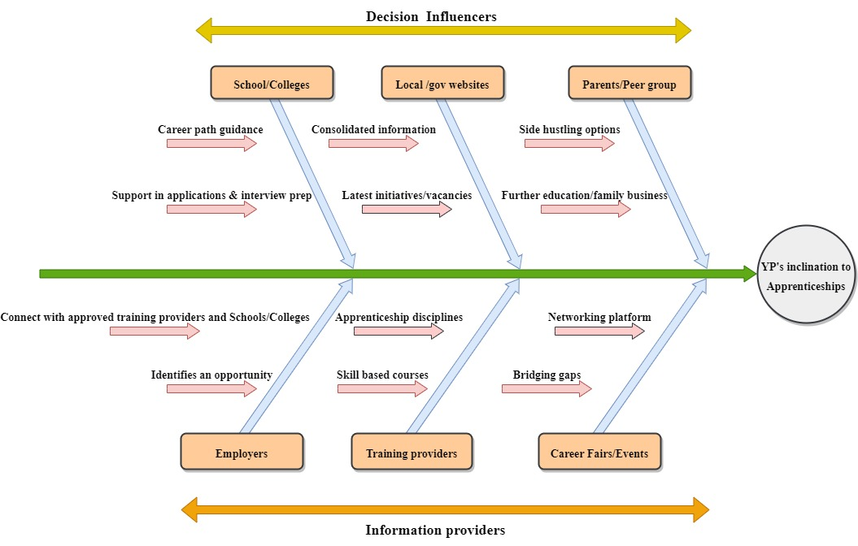

Slide 48
Apprenticeships Resources and Guidance
Find an apprenticeship – GOV.UK
Institute for Apprenticeships and Technical Education (IFATE)
Essex Opportunities
Essex Youth Service
Essex Provider Network
Greater Essex Careers Hub
Useful websites:
https://greateressex.yourfutures.uk/
https://www.ecl.org/services/learning-disability-autism-support/inclusive-employment
https://www.basildon.gov.uk/theadvicestore
https://www.papworthtrust.org.uk/work/community-connections/essex/
https://www.uttlesford.gov.uk/
https://www.futuresforyou.com/jobs-or-training-in-essex.html
https://youth.essex.gov.uk/young-people/volunteering/
https://www.volunteeressex.org/
https://greateressexcareershub.co.uk

Slide 49


This information is issued by: Essex County Council
Contact us:
research@essex.gov.uk
Research & Citizen Insight Team, Chief Executive’s Office
Essex County Council
County Hall, Chelmsford
Essex, CM1 1QH
Essex_CC
facebook.com/essexcountycouncil
The information contained in this document can be translated, and/or made available in alternative formats, on request.
Published February 2024

