Slide 1
Tax Vulnerability Index
Mapping localities vulnerable to claiming council tax support
DATA AND ANALYTICS

Slide 2
Introduction
Council tax is one of the main sources of local authority funding.
Falling central government grants coupled with increased service demand and council tax arrears may pose a threat to overall revenues
Council tax arrears rose during the COVID-19 pandemic. As the cost-of-living crisis escalates, this trend is likely to re-emerge.
Limited financial data below district level around council-tax collection means a new approach to vulnerability had to be taken: the Vulnerability Index.

Slide 3
“I am paying what I can. But I’m not going to pay council tax and then be sitting at home cold, eating bread and soup when I work six days a week.”
Sharron Spice, The Heat or Eat Diaries
https://www.theguardian.com/commentisfree/2022/nov/30/i-work-50-hours-a-week-and-im-still-in-arrears-on-my-council-tax-what-more-can-i-do

Slide 4
Vulnerabilities
Identifying cohorts vulnerable to the cost-of-living crisis
DATA AND ANALYTICS

Slide 5
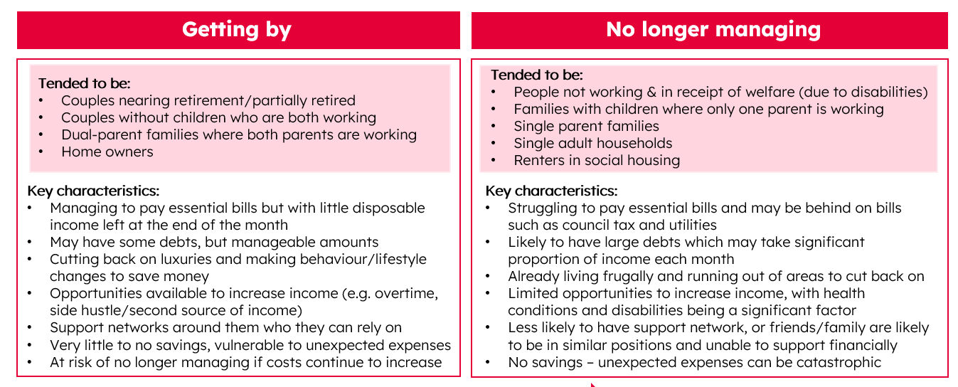
Characteristics of struggling residents
Source: Cost of living qualitative research | Essex Open Data

Slide 6
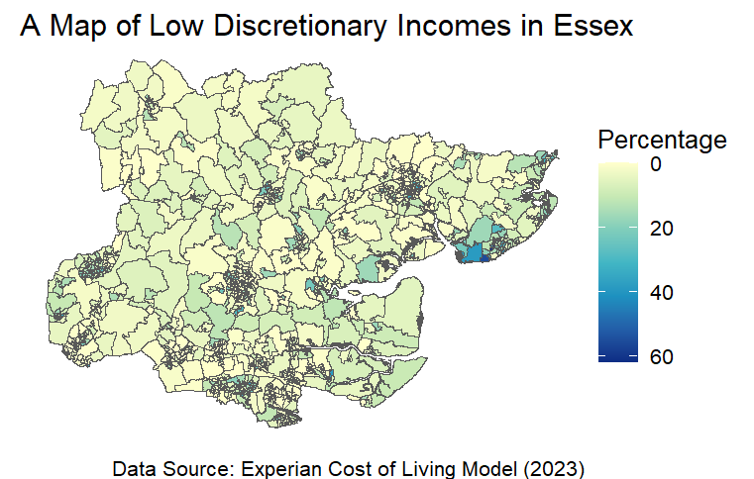
Area Characteristics
Collection rates for Tendring and Harlow were some of the lowest in Essex during the pandemic.
A previous analysis we conducted also highlighted these districts as potentially high risk areas.
Discretionary incomes (income after essential costs, such as council tax, fuel bills and rent) are lowest in Tendring.
To understand vulnerability, we need to understand the factors which may influence how people are affected by the cost-of-living crisis.

Slide 7
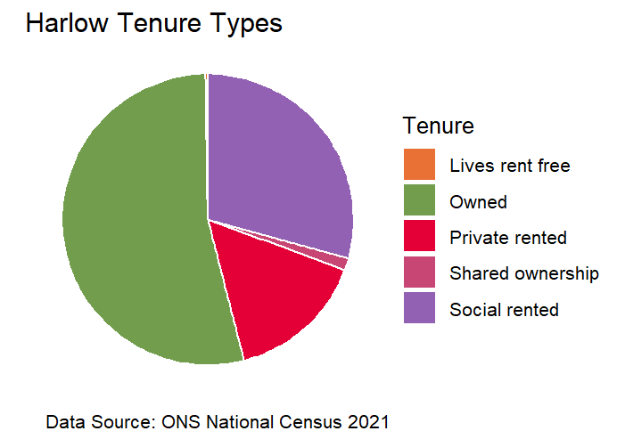
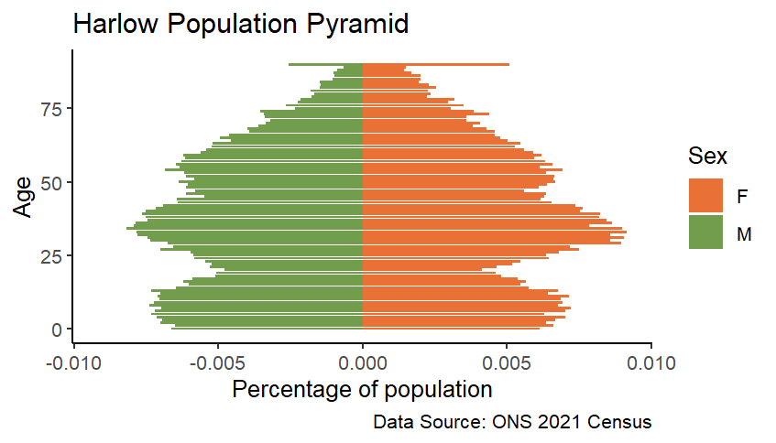
Harlow
A mostly working-age population: most of Harlow's population fall into the 26-35 and 36-45 age range (ONS Census, 2021)
Hit hard by inflation: in an inflation scenario of 11%, approximately 29% of people in Harlow were likely to have a discretionary income of under £30 a week (ECC Data and Analytics Team, 2022)
A high proportion of social housing tenants: in 2021 29% of Harlow residents were social renters (ONS Census, 2021).

Slide 8
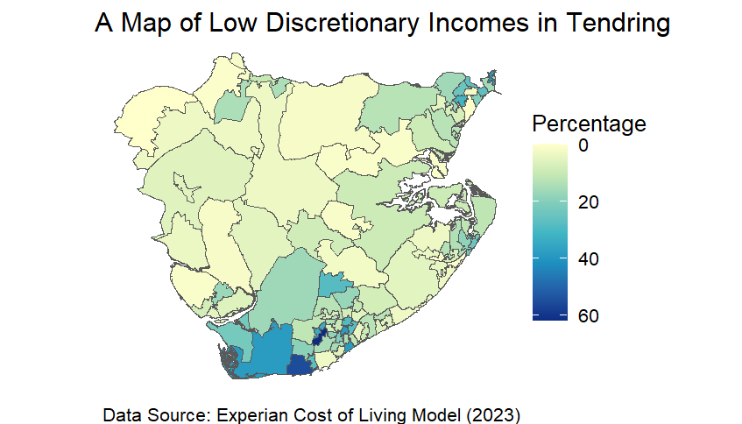
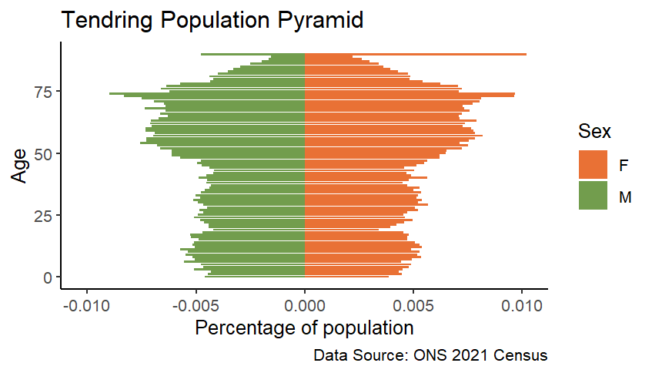
Tendring
An older population: 33% of people are over the age of 66
Low discretionary incomes: approximately 37% of people have a discretionary income of under £30 per week (in an inflation scenario of 11%) (ECC D&A Team, 2022)
Household composition: the majority of households are single females (23%) or families (24%). Single female households are especially vulnerable to the cost-of-living crisis (Experian, 2022)
Coastal deprivation: areas along the coastline have especially high levels of deprivation. Some of the highest proportions of people in financial hardship (discretionary income <£125 p/m) in Essex.

Slide 9
Personas
Single People
We are forecasting for an increase in people claiming single person discount which will lead to a reduction in tax income. Single females are notably more vulnerable to the cost-of-living crisis. However, single males are also likely to be a struggling cohort, albeit to a lesser extent.
Older People
Work by the Research and Citizen Insight team indicates that people in later life are hit hard by the cost-of-living crisis. These findings are mirrored in external academic research, and have been observed by charities such as Age UK.
Single Parents / single income parents
Supporting work has found that single parents are heavily affected during the cost-of- living crisis. Families with only a single source of income have said to be no longer managing during the current crisis (ECC Research & Citizen Insight, 2023)
People coming off fixed term mortgages.
An upcoming risk will be residents coming off fixed term mortgages. Essex has always had a high proportion of homeowners. Mortgages rates have sharply risen in recent years which will lead to a decrease in disposable income.

Slide 10
Vulnerability Index
Mapping areas vulnerable to claiming council tax support in Essex.
DATA AND ANALYTICS

Slide 11
What is a Vulnerability Index?
Inspired by the Vulnerable Schools Index, created by colleagues in the Data and Analytics team at ECC.
Adapted version of the UK government's Vulnerable Localities Index (VLI).
A vulnerability index takes the factors that make an area vulnerable to something, and scores them in index form.
Unable to access data around LSOA collection rates, meaning creating a financial model is not possible.
The vulnerability index takes a more holistic approach, and instead focuses on identifying areas with vulnerable characteristics.

Slide 12
Method
Calculate the proportion of characteristic within LSOA.
Calculate the average proportion for all of Essex.
Take away each LSOA proportion from the average.
Multiply this by 100 to get a score.
Repeat for all other factors
Once all of the factors of interest are scored, calculate an average score for the LSOA based on all of the factors.
What is an LSOA?
Lower Level Super Output Areas are geographically bounded areas with populations of 1,000-3,000. They are similar to wards. Most public sector data is organised at LSOA level.

Slide 13
Vulnerability Factors
Lone parents with dependents. Our previous analysis, and ECC led research, identified single parents and single income parents as vulnerable to the cost-of-living crisis. Data: NOMIS, 2021 Census
Deprivation in three or more dimensions. Data sourced from NOMIS, 2021 Census
Low discretionary income. Previous analyses by Data and Analytics indicate that discretionary incomes of under £125 are classed as in financial hardship. Data: Experian Cost of Living Model
Band A-C properties. Analysis of finance data indicates that property bands with the highest proportions of LCTS claims are A-C.
Single people over 65. In our previous analysis we identified people in later life as an ‘at risk’ cohort for the cost-of-living crisis. Data: NOMIS, 2021 Census

Slide 14
Interactive maps
Choropleth (colour-coded) maps based on vulnerability scores.
Broken down into 2021 LSOAs.
Click to view the LSOA name and vulnerability score.
Scoring based on recommended boundaries by the VLI.
Scores over 200 are most vulnerable.

Slide 15
Trends
High vulnerability scores are concentrated in:
The urban centres of Braintree, Basildon and Harlow
Areas along the Tendring coastline
Lower vulnerability scores are concentrated in:
The cities of Colchester and Chelmsford
Areas of North Essex, for instance parts of Uttlesford and Braintree
These trends may change due to the addition of new data released by the VOA this month

Slide 16
The Hidden Cohort
What can’t the vulnerability index include? Which cohorts are vulnerable but may not be included?
DATA AND ANALYTICS

Slide 18
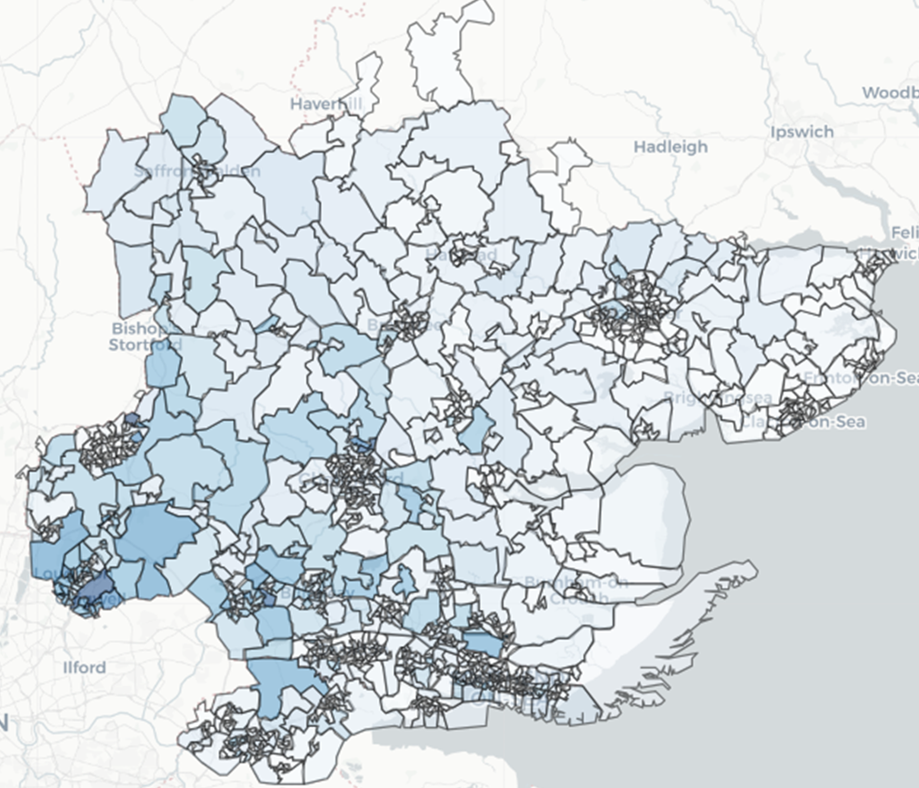
Outstanding Mortgages
People coming of fixed term mortgages are likely to be a vulnerable group.
We expect households with mortgages to move out of fixed rate mortgages, impacting discretionary income.
In Essex there are an estimated 37,000 households with an outstanding mortgage over £250,000 (we don’t hold data for mortgages over this value).
Data used in our maps is from Experian Mosaic. This is estimate based

Slide 19
Conclusions
What trends have we identified, and what is next?
DATA AND ANALYTICS

Slide 20
Conclusions
A mixture of falling central government grants, growing service demand, and an increased dependence on council tax revenue
During the pandemic council-tax payment rates fell, whilst LCTS claimant rate peaked.
With inflation now at its highest in 40 years, it is likely that collection rates will be impacted
Cohorts most affected by the cost-of-living crisis include single person households, lone parents with dependents, and people in later life
The vulnerability index identifies areas which are likely to be on the sharpest end of the cost-of-living crisis, and therefore will have high rates of council-tax support claims
The Tendring coastline and the New Towns of Basildon and Harlow have the highest vulnerability scores

Slide 21
This information is issued by: Essex County Council
Essex County Council County Hall, Chelmsford Essex, CM1 1QH
The information contained in this document can be translated, and/or made available in alternative formats, on request.

