Slide 1
Barriers and motivations around physical activity for children and young people in Essex

Slide 2
Overview
Supporting people to live healthy lifestyles is one of the Everyone’s Essex commitments, and increasing levels of physical activity among children and young people is a key priority.
The Find Your Active campaign is being expanded to include a specific focus on children and young people. Research was needed to better understand children and young people’s attitudes and behaviours around physical activity, to inform the campaign and ensure it resonates with the audience.
The key research questions were:
What are the barriers to being active?
What motivates and influences young people?
What environment do young people need to enable physical activity?
What opportunities do young people want to see?
What messages resonate most with them?
Engagement approach
Over June-July 2023, the Research & Citizen Insight and Active Essex teams visited two primary schools and two secondary schools to carry out group sessions with students (including Year 5 and Year 9-10), and also engaged with young people and teachers at the Chelmsford Skills Festival (Year 8s) and Essex Special School Games (children and young people with special educational needs and disabilities). In total we engaged with over 200 children and young people.
The insights gathered include findings which may be useful beyond the campaign, and are presented in this report.

Slide 3
Physical Literacy overview
Active Essex is committed to optimising the levels of physical activity and Physical Literacy among school pupils across Greater Essex. Physical literacy is made up of the following key elements:
Motivation and enjoyment: Young people are motivated to do physical activity and enjoy being active.
Confidence:
Young people feel confident when being active.
Competence:
Young people find sports and being active easy.
Understanding: Young people understand why being active is good for them and the benefits it brings.
Knowledge: Young people know how to get involved in and access sports and physical activities, and what opportunities are available to them.
This report uses Physical Literacy as a framework to explore the key themes from the research.
There is a strong positive association between Physical Literacy and activity levels.
Children and young people who express positive feelings around attitude statements linked to these areas are more likely to be active.
58% of children reporting four positive attitudes are active, compared to just 31% who report no positive attitudes.
More information available here.

Slide 4
Key insights
The biggest barriers to physical activity for children and young people and areas of Physical Literacy that were lacking the most are motivation, confidence and enjoyment, as well as knowledge of opportunities.
Motivation and enjoyment:
Many children and young people participate in a wide range of physical activities and enjoy the mental and physical health benefits it brings, along with opportunities for socialising.
Younger children in particular were often doing a number of sports clubs and activities, however motivation and enjoyment among some groups (particularly older girls) was very low.
Confidence:
Enjoyment and confidence are often interlinked, with a lack of confidence affecting enjoyment. Many young people we spoke with do not enjoy physical activity because they feel self-conscious, fear being judged by peers and associate it with negative experiences, particularly around PE in school.
Competence:
Many young people who regularly participate in physical activity expressed that they enjoyed seeing their skills develop.
Where young people suggested they did not find physical activity easy, this was often linked to confidence. Some expressed that they would like to join beginner classes but did not feel they had physical competence or confidence to take part.
Knowledge and understanding:
Understanding around sports and physical activity among young people is generally very high. However there are limitations in young people’s knowledge which present barriers, including knowing about what opportunities are available locally and finding activities that they find enjoyable.

Slide 5
General themes among different groups
We engaged with a diverse range of children and young people, including those who enjoyed doing lots of different physical activities as well as those who were very uninterested and unmotivated in doing any physical activity.
All the children we spoke to within primary schools appeared to be very engaged in physical activity and many were enthusiastic about doing a number of activities both in and
out of school, and mostly enjoyed being outside.
Among secondary school students although many were still active, this age group was much more split with girls in particular being less likely to do any physical activity, saying they don’t enjoy it.
“Every second you spend on a screen is a second of your life wasted, but every second spent outside is a second well spent.” [Primary School Pupil]

Slide 6
Activities young people enjoy include:
Football
Basketball
Badminton
Tennis
Rounders
Gymnastics
Swimming
Trampolining
Volleyball
Pickleball
Dodgeball
Danish longball
The gym
Lifting weights
High jump
Dancing
Hockey
Running
Rock climbing
Kick boxing
And more…!

Slide 7
Enjoyment and motivation
Many children and young people we spoke with participate in a wide range of physical activities.
Younger children in particular were often doing a number of different sports clubs and activities.
Things young people enjoy about being active include being outside in nature (especially younger children), spending time with friends and socialising (important for older children), seeing skills/confidence develop, and keeping fit and healthy.
Motivations
These themes also provided motivation for young people.
Additional factors important for motivation include:
The influence of PE teachers
Wanting to do something fun
Having someone to do physical activity with
The right environment – some feel more comfortable at home however some commented that it is easy to feel unmotivated at home
Teachers also commented that opportunities are important to keep young people engaged:
What helps:
"Doing it with friends, especially when feeling awkward and you can encourage one another.” [Secondary School Pupil]
“Showing children how fun it is!” [Secondary School Pupil]
“Some young ones join gangs because they are bored; providing activities that will keep them busy could help to reduce gangs and troubles they get into.” [Secondary School Teacher]

Slide 8
“When at the gym, you can’t just sit and stare at the gym equipment… but at home you can just be on your phone or lay in bed.”
[Secondary School Pupil]

Slide 9
Enjoyment and motivation
Social media can also be motivating, however this can have a negative impact too.
Many young people said that influencers and celebrities can provide someone you can look up to, and can be a source of encouragement and motivation.
However some girls in particular mentioned the pressure of being "that girl" and joked that there are lots of people on TikTok selling unrealistic lifestyles e.g. freezing 5am shower, crash diets, being ‘super fit’. They knew they weren’t necessarily realistic or good for you but admitted to trying some of the things themselves.
Young people said influencers as part of campaigns would have to be “legit” – they want to see people doing activities themselves and not just telling others what to do.
“Watching celebrities on TV and social media is a source of encouragement and makes me work harder to be like them.”
[Primary School Pupil]
“Celebrity pictures inspire and motivate me as it gives me the belief that if celebrities can do something, I can do it as well.” [Secondary School Pupil]
Both young people and teachers commented that technology can be a big distraction too.
“Phones and devices are the biggest barriers stopping them (young people) being outside and active.” [Secondary School Teacher]
“Watching influencers wouldn’t help motivate me, it will just exercise my thumb.” [Secondary School Pupil]

Slide 10
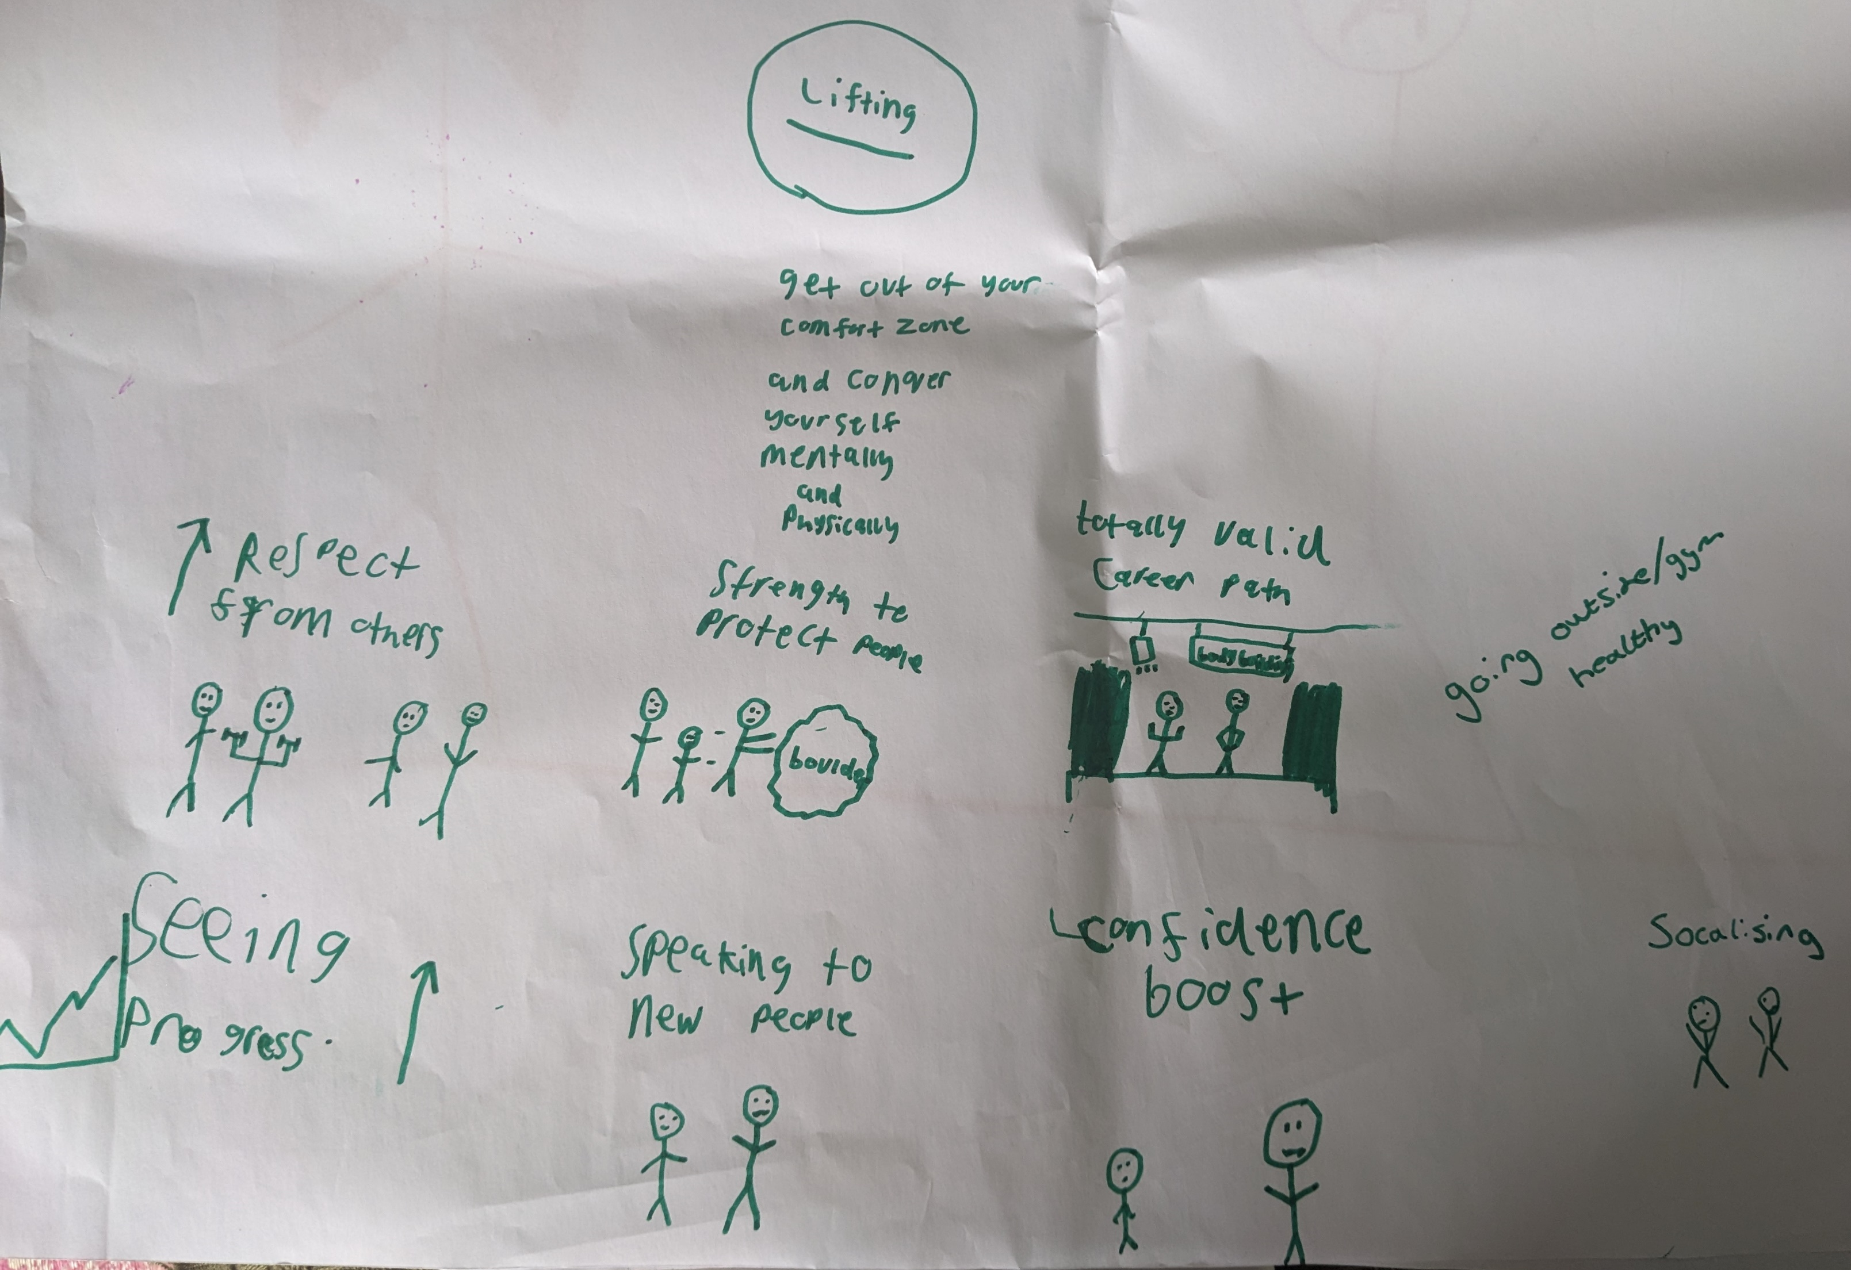
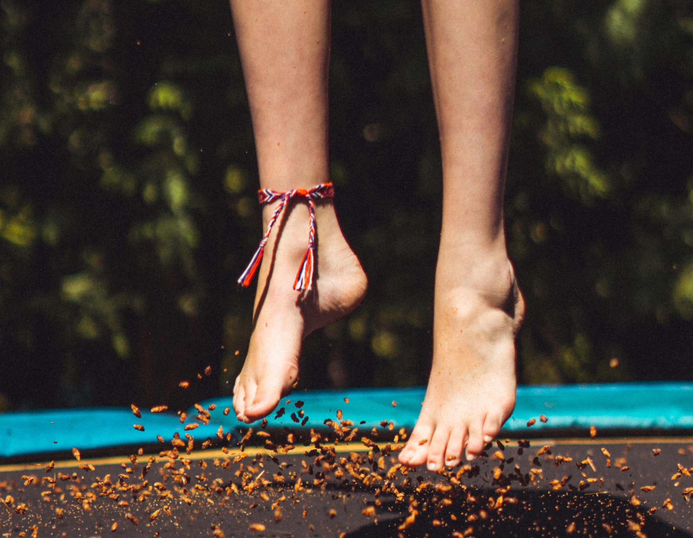
What do young people enjoy about being active?
One boy in Year 10 who weightlifts expressed in drawings that he enjoys seeing the progress he’s making, speaking to new people, getting respect from others, getting a confidence boost and mental health benefits, and is considering how it could be a career path.
One girl in Year 10 said she hated any kind of physical activity, but when her PE teacher reminded her that she had previously enjoyed trampolining she agreed with this.
Those less engaged with sports and activity were more likely to say they liked activities that are more ‘fun’, calming or less competitive, suggesting things like trampolining, badminton and dodgeball.
Primary school pupils also loved being outside in nature:
“I’d like to see more green areas where animals like squirrels, foxes and birds move freely.”

Slide 11
Motivation, enjoyment and confidence
Many young people we spoke with do not enjoy physical activity because they feel self-conscious, fear being judged by peers and associate it with negative experiences, particularly around PE in school.
Enjoyment and confidence are interlinked in many cases, with a lack of confidence affecting enjoyment.
Some are also highly unmotivated and uninterested in doing any physical activity, despite knowing it’s good for them.
Lack of interest or enjoyment
To function well and have good resilience, humans need to be in a sociable group, a supportive environment and have a purpose.
We need to feel safe, belonging, and valued.
These things are fundamental to have in place in order for young people to engage with and ENJOY physical activity.
Some young people (particularly older girls) said they had no interest in physical activity, didn’t enjoy it and/or didn’t want to do it out of ‘laziness’ or lack of motivation.
Often these young people had not found a sport or activity that they enjoyed, and did not enjoy the sports on offer in PE. "When you're not in the mood, it’s hard to do any sports.” [Secondary School Pupil]
Self-consciousness and fear of judgement
Some felt very self-conscious when doing physical activity (particularly older girls) and this was a significant barrier for some.
There can be a fear of judgement from others, as well as actual experiences of others behaving negatively towards them in PE (e.g. being excluded, called names).
There is also a ‘fear of the unknown’ when wanting to try new activities, e.g. exercise classes, and not knowing what to expect.
[Dr William Bird – more information.]

Slide 12
“It is difficult to do new things when you don’t know anyone else who is doing them.”
[Primary School Pupil]

Slide 13
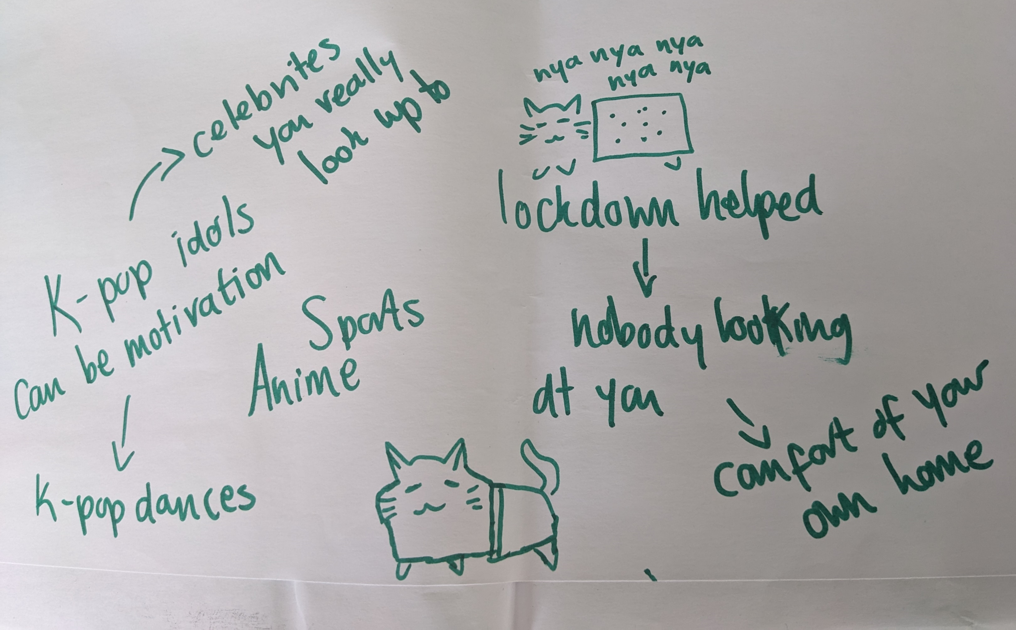
Lack of confidence: not wanting to be seen
Some young people felt self-conscious doing physical activity, with older girls in particular not wanting to be seen doing this and especially not by people they know.
One girl in Year 10 mentioned an influencer on TikTok who does videos going to the gym in her slippers to prove that nobody is looking at you and that it doesn’t matter what you look like.
The girls generally liked the message, but felt it would be different for them as “she doesn’t live here”, and they would still be too scared to go to their local gym.
When asked if they would feel different going to a gym/being active in their local area compared to somewhere 100 miles away, they said: “Yes…would rather it was 5,000 miles away!”
They stressed that they did not want to ‘risk’ being seen by anyone they know.
One teacher also commented: “There is need to get children to do things at a young age, so when they are older, they are more confident and comfortable with doing those activities.”
Another girl in Year 10 expressed in drawings that she enjoyed learning K-pop dances during lockdown and that this helped as there is “nobody looking at you”.

Slide 14
Experiences of PE
Some young people in secondary schools had very negative experiences of PE lessons, and this impacted on their enjoyment of physical activity. However some still found activities outside of school that they enjoyed.
Exclusion and bullying
Competitiveness
Gender-specific experiences
Some had experiences of being made fun of or excluded in PE lessons. This included being picked last for teams, or peers laughing and making jokes when they were placed into teams by teachers.
Many young people in both primary and secondary schools said that boys tended to be overly competitive and could be aggressive and exclude girls, particularly when playing football in PE, which included not passing the ball, shouting at them when they had the ball, and generally taking it ‘too seriously’.
Some of the boys in secondary schools agreed that boys can be too serious/competitive with football.
Many generally felt uncomfortable/ more self-conscious in mixed gender PE groups, and all genders said they would prefer single gender groups for PE.
Girls can feel uncomfortable being coached by male coaches and suggest they can be too tough on them. They would prefer female coaches and feel this would create a more supportive environment.
There was also a perception that boys get more options and opportunities than girls when it comes to PE and physical activities, and things are more catered to boys.
“Teachers putting us into groups can be even worse… [others making fun] ‘haha you’ve got her in your group, unlucky’…choosing own groups would be best.”
[Secondary School Pupil]
“The boys are too competitive… can ruin experience for others…we just want to chill.”
[Secondary School Pupil]
“The boys underestimate us.”
[Primary School Pupil]

Slide 15
“Women PE teachers help. Men are less interested and with a woman teacher you can relate, feel safe and comfortable.“
[Female Secondary School Pupil]

Slide 16
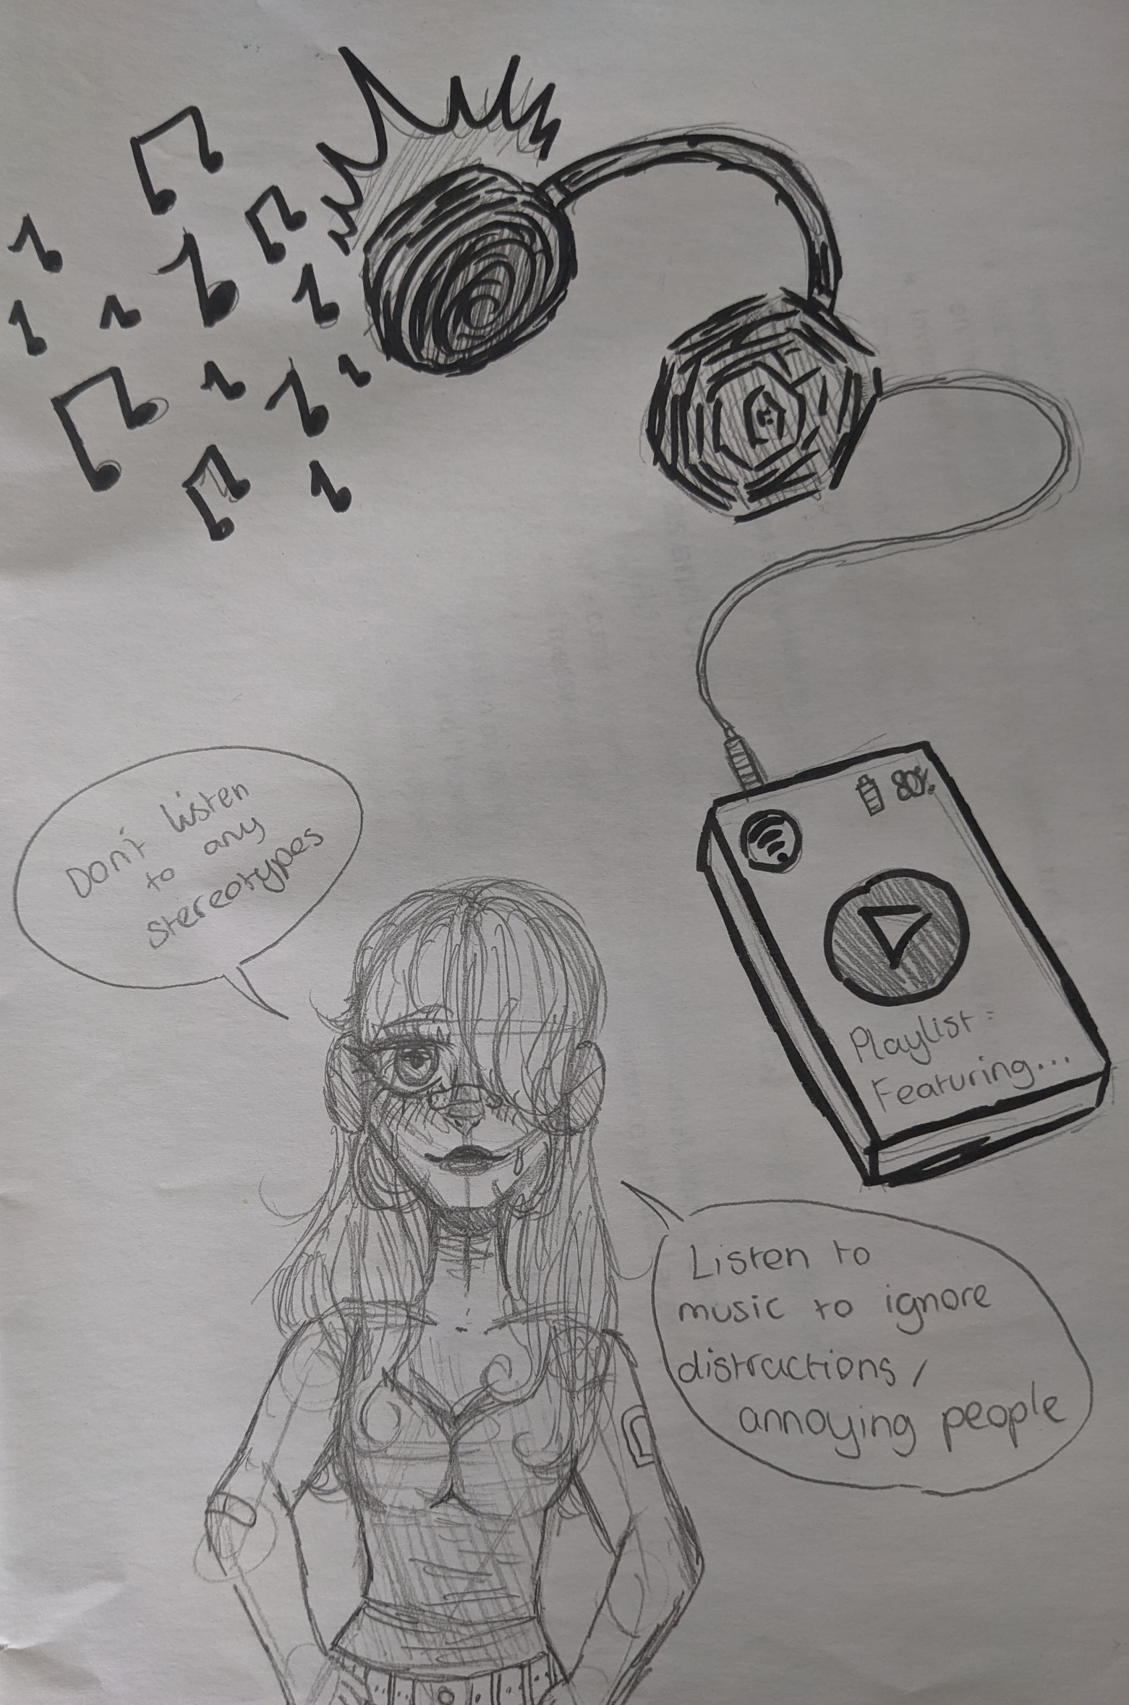
Getting the right environment
What kind of environment is needed to motivate young people to be active, find something they enjoy, and feel confident in doing so?
At home
For some, they feel most comfortable in their own home.
However they said that motivation to do this at home can be a struggle.
Together is better
It’s important for young people to have a friend they can do physical activity with. Some suggested that even doing something virtually at home at the same time as a friend could be motivating.
Non-competitive
To encourage young people to be active among others, a relaxed, friendly and non-competitive environment is key for confidence and enjoyment.
Music
Music can be important and helps to block out the environment.
“Makes it less awkward…covers sound of being out of breath.”
“Listen to music to ignore distractions/annoying people.”

Slide 17
Competence
Many young people who regularly participate in sports and physical activity expressed that they enjoyed seeing their skills develop as a result.
Where young people suggested they did not find physical activity easy or enjoyable, this was often closely linked to confidence and fear of judgement.
Key themes:
Those who participate in sports enjoy seeing their skills develop – e.g. running speed, football skills, getting stronger.
Some we spoke to had experiences of being told they weren’t good enough to be part of a team, but either persevered or joined a different team – this requires confidence and resilience.
Some expressed that they would like to join beginner classes for activities but had previous experiences where they did not feel ‘beginner’ and were more advanced – they did not feel they had the physical competence or confidence to take part.
For those who did not feel physically competent or expressed that they didn’t find physical activity easy or enjoyable, this was often closely linked to confidence and fear of judgement.
“I was kicked out of my last netball team. They said I wasn’t good enough, but I found a new netball team through a friend at school.” [Secondary School Pupil]

Slide 18
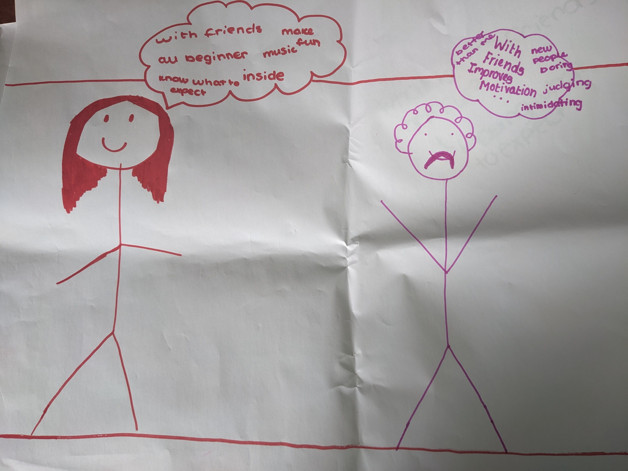
Competence
“Beginner is not beginner…people there [at clubs/activities] are already good at it.” [Secondary School Pupil]
Things that could help increase feelings of competence:
Beginner classes and clubs that are truly for beginners
More opportunities to get an idea of what to expect when trying a sport or exercise for the first time (e.g. videos demonstrating, virtual or physical tour of the place)
Encouraging young people to find a friend to go with, or creating a buddy system for new people

Slide 19
Knowledge and understanding
Young people’s understanding around physical activity is generally very high. However despite understanding that physical activity is good for them, there are limitations in knowledge which may prevent young people from participating.
Many of these knowledge barriers relate to knowing about what opportunities are available locally, as well as finding activities that they find enjoyable.
Good understanding
Limited knowledge of opportunities
Influences on knowledge
Level of understanding among young people is good. Some likened it to ‘having your 5 a day’ fruit and vegetables - they already know physical activity is something they should do, and don’t need to be educated on this.
Some young people have limited knowledge around what types of physical activities are available locally beyond traditional sports. However there may also be a lack of facilities available in some areas.
This limits young people’s ability to find something enjoyable, particularly if they are not keen on ‘traditional’ sports, and we know that enjoyment is key for sustaining physical activity.
For many, activities such as walking the dog/cycling are not ‘top of mind’ as physical activities, and there could be opportunities to promote this more.
The influence of adults such as teachers and sports coaches may play a big role in young people’s knowledge and understanding, as well as encouragement to explore/try things.
Many watch videos on social media and are influenced by both athletes and influencers/celebrities, also using social media as a source of information. Most young people seem quite ‘savvy’ with knowing how far they can trust this information.
N.B. Understanding relates to understanding why physical activity is beneficial, and knowledge relates more to the practical application of this and knowing how young people might go about doing physical activity, e.g. knowing what is available to them and how they might access opportunities.

Slide 20
Additional barriers
Young people spoke about several additional barriers which can limit opportunities, such as a lack of facilities locally, transport, safety concerns, financial constraints, time limitations and academic pressure, and feeling too tired.
Access and opportunities
Not all young people have access to sports clubs, activities and equipment (e.g. basketball nets) in their local area.
Lack of transport options particularly in rural areas and reliance on parent/carers for lifts to and from clubs can further limit opportunities to access activities further afield.
Costs
Financial constraints are also a barrier – in previous research on the cost of living parents spoke about having to limit the number of clubs and activities their children were doing due to the expense.
Time constraints and tiredness
Many spoke about having limited time due to homework and studying, and academic pressure (for both the 11+ for younger students and those preparing for GCSEs). This meant they often had limited time or were too tired to do any physical activity.
Tiredness was mentioned by several young people as a key barrier, with many saying when they are done with school and homework they just want to chill/go to bed/relax on their phones etc, rather than doing physical activity.
In the Young People’s Survey 2022, tiredness and wanting to sleep more also featured heavily.
Safety concerns
Some mentioned safety concerns as a barrier to being active, e.g. fears around going to local park, particularly if it’s dark outside.
Fear of getting hurt following injuries concerned some (though younger children had previously broken bones and this didn’t stop them!)
Technology distractions
Technology was mentioned as a barrier and distraction for many young people who spend a lot of time on devices.
Outdoor environment
Off-putting for some – e.g. bad weather, insects, hay fever.

Slide 21
Time constraints
“As you get older you have less time outside in school. When in Year 7-8 you get 2 hours outside to play, and when you go into Year 9, you only get 1 hour unless you choose to do PE as a lesson.” [Secondary School Pupil]
Financial constraints
“I enjoy dance but it is so expensive, you have to pay to train, pay for each match, pay for the dresses, the shoes, the travel etc.” [Secondary School Pupil]
Lack of access
“Poor transport network and resources limit access to facility centres.” [Teacher]
Safety concerns
“Parents do not let me play outside due to safety and also weather.” [Primary School Pupil]
Financial constraints
“As soon as you say your child has autism, it’s twice or more expensive…other children without autism paid £20, but we were asked to pay £50.” [Teacher & parent of child with autism]
Time constraints
“I am always busy with my school work which leaves me with limited time for outdoor activities.”
[Secondary School Pupil]
Safety concerns
“Some parents are worried about the safety of their children outside, and they prefer to keep them indoors.” [Teacher]
Tiredness
“I am already tired by the time I come back from school so the next thing I do is to go straight to bed.” [Secondary school pupil]
Financial constraints
“Some things cost money and you don’t want to put your parents under pressure so it would be better if there was more free stuff to do.” [Primary School Pupil]
Safety concerns
“There is more awareness of bad activities happening out there which discourage parents from allowing their children to go out to play.” [Teacher]
“If you have had a bad day, you just want to get into bed.” [Secondary School Pupil]

Slide 22
Campaign messaging
Feedback and ideas

Slide 23
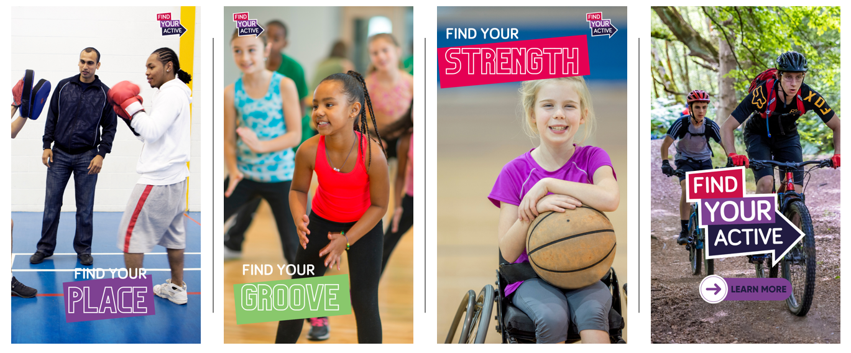
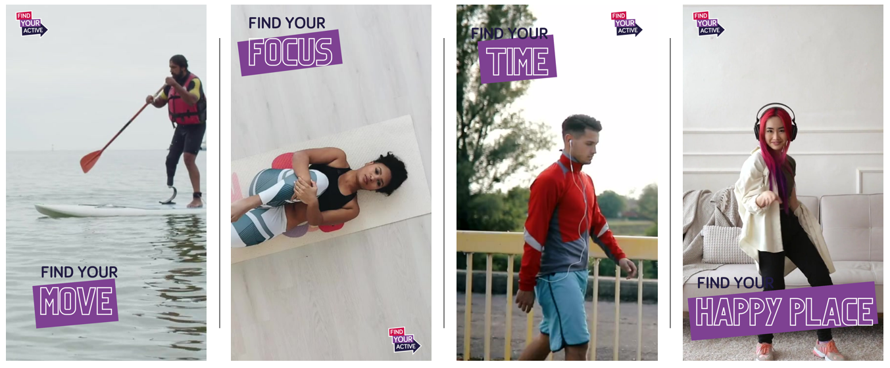
What resonates with young people?
During focus group sessions, young people were shown a selection of draft materials (pictured right) for the planned campaign, and asked for their thoughts.
The response was mixed, with young people liking the diversity shown in images, but being less positive about some of the messaging.
Several also commented that some of those featured in the bottom photos “don’t look happy”, and felt it came across too seriously.
Based on young people’s feedback and other insights captured throughout this research, work is now underway to develop materials and messages which will resonate more strongly with young people.

Slide 24
What resonates with young people?
Young people had a preference for bright and colourful images featuring a diverse range of people, and don’t want to feel like they are being ‘told’ what to do.
Look and feel
Young people expressed that they would like to see bright and colourful images.
It’s important that those in photos look happy and like they are enjoying the activity they are doing.
They would like to see more images of friends doing activities together rather than people on their own, as they prefer to do things with others.
Young people would like to see a diverse range of people shown and it’s important that they can see themselves represented in the images.
Messaging
Some young people felt that the ‘Find Your Active’ messages came across as too directive/demanding, as if they were under pressure. Many suggested that language which encourages young people to ‘try/explore/have a go’ instead would be better and more motivating.
Some liked ‘find your happy place’ and felt this could work well as an overarching message for the campaign.
Young people spend a lot of time watching videos on social media, and many said seeing short videos of young people who look like them doing sports and activities or talking about why they like doing specific activities would be motivating.

Slide 25
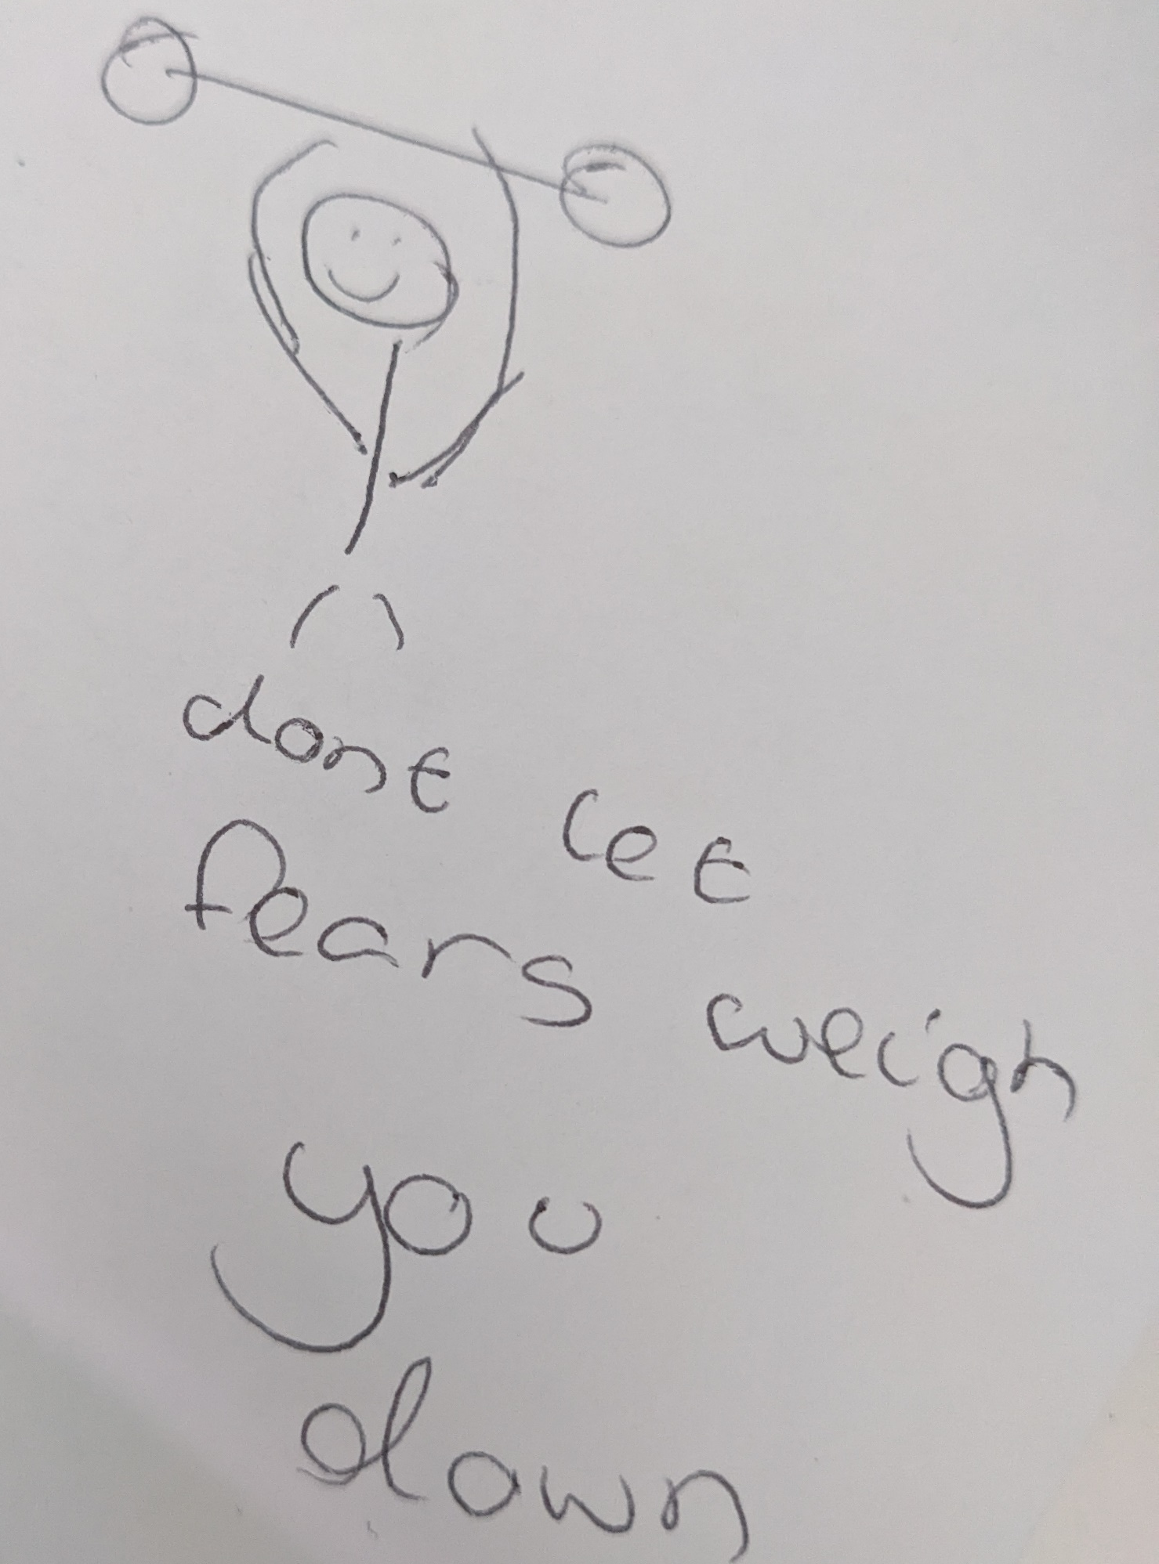
Many of the girls in both primary and secondary schools shared lots of ideas for inspirational messages that resonated with them, and that they felt would be motivating as part of a campaign:

Slide 26
Opportunities
Suggested interventions and approaches to increase physical activity levels

Slide 27
“There should be more activities and clubs and people should be encouraged to try new things and skills. You should be able to try new sports in school to see if you like them.”
[Primary School Pupil]

Slide 28
Opportunities
Interventions should be focused on increasing young people’s confidence, enjoyment and knowledge of what kinds of physical activities are available through encouraging them to explore and try things. It’s also essential that interventions are developed with the aim of removing barriers to ensuring that young people feel safe, belonging and valued.
Confidence and enjoyment
Improving experiences of PE
Overcoming barriers
The right environment is essential for young people to feel confident.
This could include:
Creating a relaxed and non-competitive environment.
Focusing on a social element e.g. exercising with a friend.
Incorporating music into activities.
True ‘beginner’ classes/clubs and opportunities to get a feel for this ahead of trying out.
Some young people (particularly older girls), may only feel confident exercising at home and ways to do this should still be encouraged.
Research shows that young people’s experiences in PE can shape their attitudes and behaviours around physical activity into adulthood.
Ideas to make this a more positive experience include:
Single sex classes if this is not already in place, but with equal access to activities.
Consider preferred coaching styles for students.
Try more inclusive approaches to grouping students into teams (e.g. those who want to compete/have fun/work on skills), and a zero tolerance approach to bullying from students.
Expand range of activities and offer more choice so students can try more and find something they enjoy, particularly more ‘fun’ and less competitive activities e.g. yoga, pickleball and dodgeball.
Additional interventions to remove barriers include:
Greater promotion of free/low-cost activities available locally, including ideas for things young people can do with minimal equipment or facilities.
Suggestions for managing competing demands – e.g. building activity into daily routine so it becomes the norm and doesn’t take up lots of time.
Utilising technology and the social connections this can provide to aid physical activity rather than fighting against it.

Slide 29
This information is issued by:
Essex County Council
Research & Citizen Insight
Contact us:
research@essex.gov.uk
Poppy.reece@essex.gov.uk
County Hall
Market Road
Chelmsford
CM1 1QH
Sign up to Keep Me Posted email updates:
Essex.gov.uk/keepmeposted
Essex_CC
Facebook.com/essexcountycouncil
The information contained in this document can be translated, and/or made available in alternative formats, on request.
Published August 2023

