Slide 1
Healthy Life Expectancy in Essex, 2018-22
An analysis of small-area HLE across Essex

Slide 2
Mortality analysis workplan
This is the first in a series of products focusing on mortality in Essex. By combining local mortality and census data, the Public Health Intelligence team are able to produce small-area estimates of healthy life expectancy in Essex. This gives a more granular breakdown of healthy life expectancy in Essex, allowing us to quantify where healthy life expectancy is increasing, which areas have seen decreases in healthy life expectancy, and inequalities in healthy life expectancy across Essex. Data is presented at MSOA level – small areas containing 7,500 residents on average.
Detailed data used in this report will be made public and shared on Essex Open Data where possible. For further bespoke analysis, or if you have mortality related questions you would like the PHI team to work on in future, please get in touch with the team at PHI@essex.gov.uk.
Product | Short description | Planned completion date
Small area healthy life expectancy | MSOA level healthy life expectancy for Essex, 2018-22. Estimates produced for all residents and split by sex | 31/1/24
Preventable & treatable mortality | Recreating public figures for the ‘under 75 mortality considered preventable’ measures. Aim is to better understand which conditions are driving preventable mortality, demographics of preventable deaths, and the number of deaths from conditions considered treatable | 25/2/24

Slide 3
Essex residents have better-than-average HLE…
HLE in England and Essex, 2018-22. Essex districts ranked by HLE, high to low
Essex residents can expect to live an additional 1.5 years in good health compared to England.
Across England healthy life expectancy ranges between 57.8 years in Blackpool to 72.3 years in Richmond upon Thames. The inequality in HLE across is England is 14.5 years
Healthy life expectancy varies across Essex, ranging from 71 years for a female born in Uttlesford to 61.9 years for a male born in Tendring
Area | Persons | Male | Female
England | 65.8 | 65.1 | 66.5
Essex | 67.5 | 66.8 | 68.2
Uttlesford | 71.7 | 70.3 | 71
Brentwood | 69.7 | 67.7 | 69.8
Chelmsford | 69.7 | 68.9 | 69.8
Epping Forest | 68.8 | 67.7 | 69.2
Rochford | 68.7 | 67.5 | 68.6
Maldon | 68.2 | 66.1 | 67
Colchester | 67.4 | 66.5 | 67.9
Braintree | 67.2 | 66.4 | 67.3
Castle Point | 66.5 | 65.3 | 66.3
Basildon | 65.7 | 64.8 | 66
Harlow | 64.1 | 63.5 | 63.7
Tendring | 62.6 | 61.9 | 63
England & non-Essex death counts are sourced from Nomis, and are rounded to the nearest 5. This may have resulted in small underestimation of values and underestimation of the gap in HLE. Public data for 2018-20 found a gap of 21 years across England
Data sources: mortality (Nomis), health (census 21) Analysis by ECC public health

Slide 4
…and large inequalities
A baby born in Clacton Central can expect to reach poor health by age 52, almost 25 years faster than a baby born in Billericay North-East.
The HLE gap in Essex is wider than the HLE gap across all of England.
Billericay North-East: 75.2 years
Clacton Central: 51.7 years
England: 67.5 years
Essex MSOAs – small local areas with ~7500 residents
Data sources: mortality (Nomis), health (census 21) Analysis by ECC public health

Slide 5
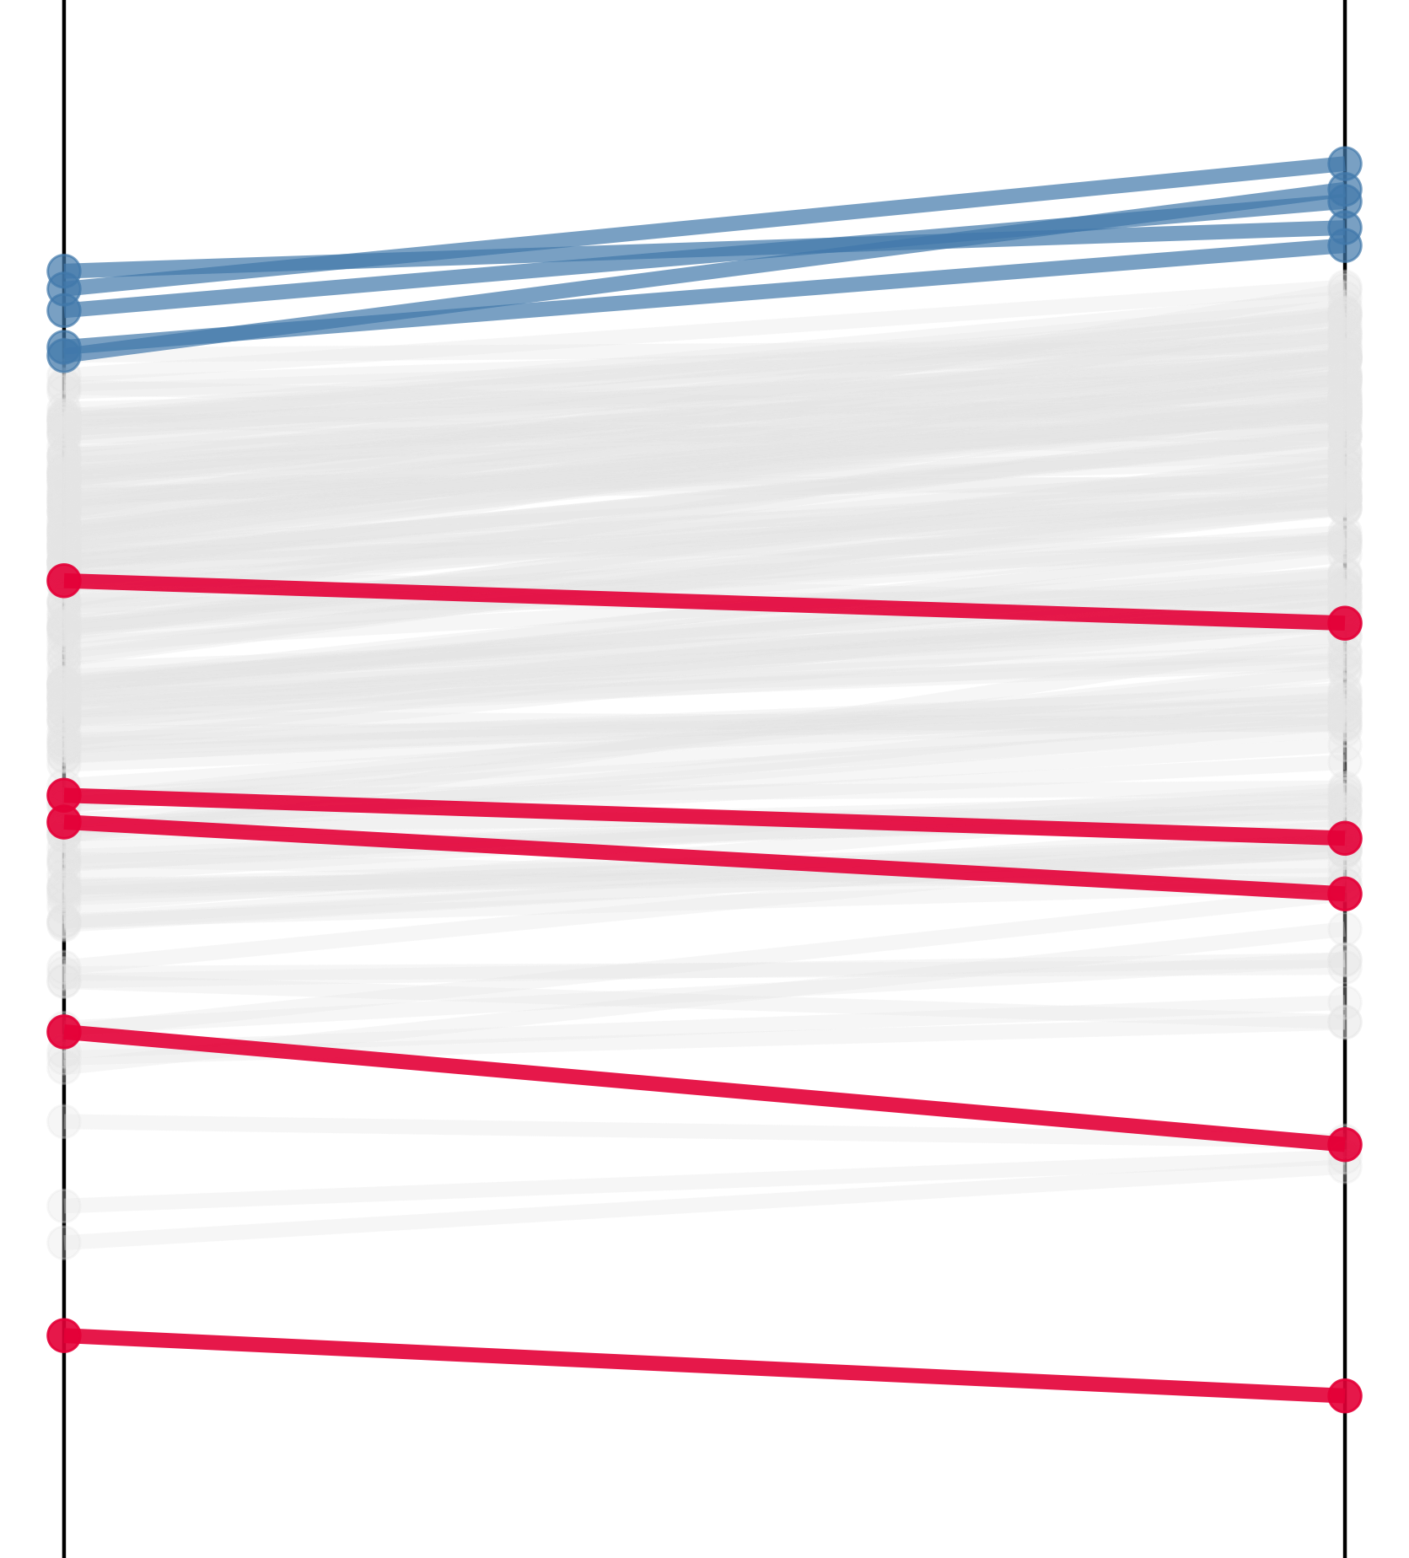
Most areas have improved, and inequalities widened
HLE is improving – particularly in already healthy areas HLE in Essex MSOAs, 2008-12 and 2018-22
Healthy life expectancy has increased across most of Essex. On average healthy life expectancy has increased by 1.6 years over the past decade.
14 areas have experienced declines in HLE.
The areas with the largest increases are shown in blue, and those with the largest decreases in red. The largest increases occurred in areas with the highest HLE. The largest decreases occurred in areas with relatively low HLE.
Because of these changes, inequality in HLE is increasing in Essex. The gap between the highest & lowest HLE between 2008-12 was 20.3 years. In 2018-22 the gap was 23.5 years – an increase of 3.2 years.
Billericay North-East: 75.2 years
20.3 years
23.5 years
Clacton Central: 51.7 years
2008-12
2018-22
Data sources: Internal ECC data, health (census 11), health (census 21). Analysis by ECC public health

Slide 6
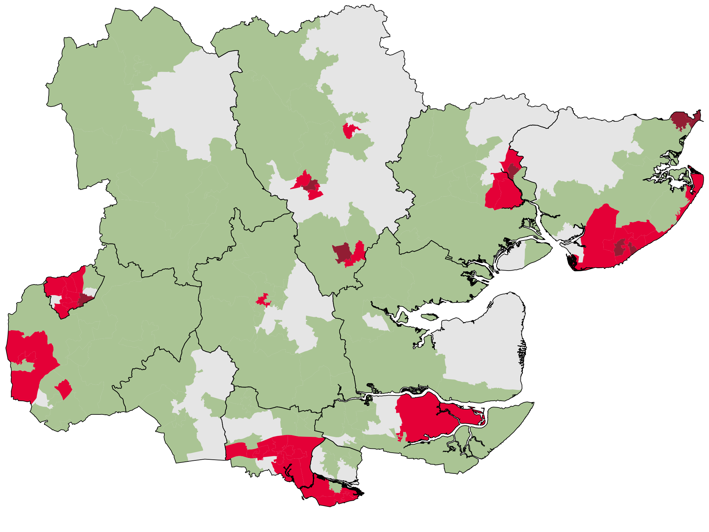
There are clusters of low healthy life expectancy
HLE across Essex, 2018-22. Focusing on areas which…
Almost all of Essex has either improved or maintained healthy life expectancy over the past decade, with some notable exceptions:
HLE is significantly lower in all of Clacton and Jaywick. Clacton Central and Rush Green have both experienced decline in HLE in the last decade, as has Harwich & Dovercourt.
Central Colchester – New Town & Hythe, Old Heath, Parsons Heath, and Monkwick are all significantly lower than England. HLE has also decreased in Greenstead.
Old Harlow & Newhall is the only part of Harlow which saw improvements in HLE. Almost all of Harlow has significantly lower HLE compared to England, and HLE declined in Potter Street.
Almost all of Canvey Island (aside from Winter Gardens).
Improved HLE by 2+ years
Have significantly lower HLE vs England
Uttlesford
Braintree
Have declining & significantly lower HLE
Harwich
Central Colchester
Tendring
Colchester
Harlow
Chelmsford
Clacton & Jaywick
Epping Forest
Brentwood
Maldon
Basildon
Rochford
Castle Point
Data sources: Internal ECC data, health (census 11), health (census 21). Analysis by ECC public health

Slide 7
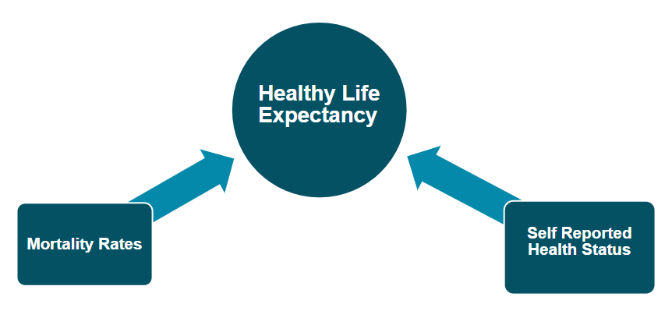
HLE depends on mortality and good health
Healthy life expectancy is an estimate of how long a baby born today will live in ‘good health’.
It depends on (1) how likely someone age 20-24 is to die, and (2) how likely someone age 20-24 is to be in good health.
These age-specific rates are calculated using current data.
The HLE calculation assumes that there is no change in these rates over time.
This is unrealistic – it ignores improvements in prevention, treatments and healthcare, which the calculation does not factor.
Because of this, healthy life expectancy is an underestimate of the actual years lived in good health.
This report uses census data to estimate good health. The public HLE uses Annual Population Survey data. Results are broadly similar, but numbers in this report should not be compared with public HLE figures

Slide 8
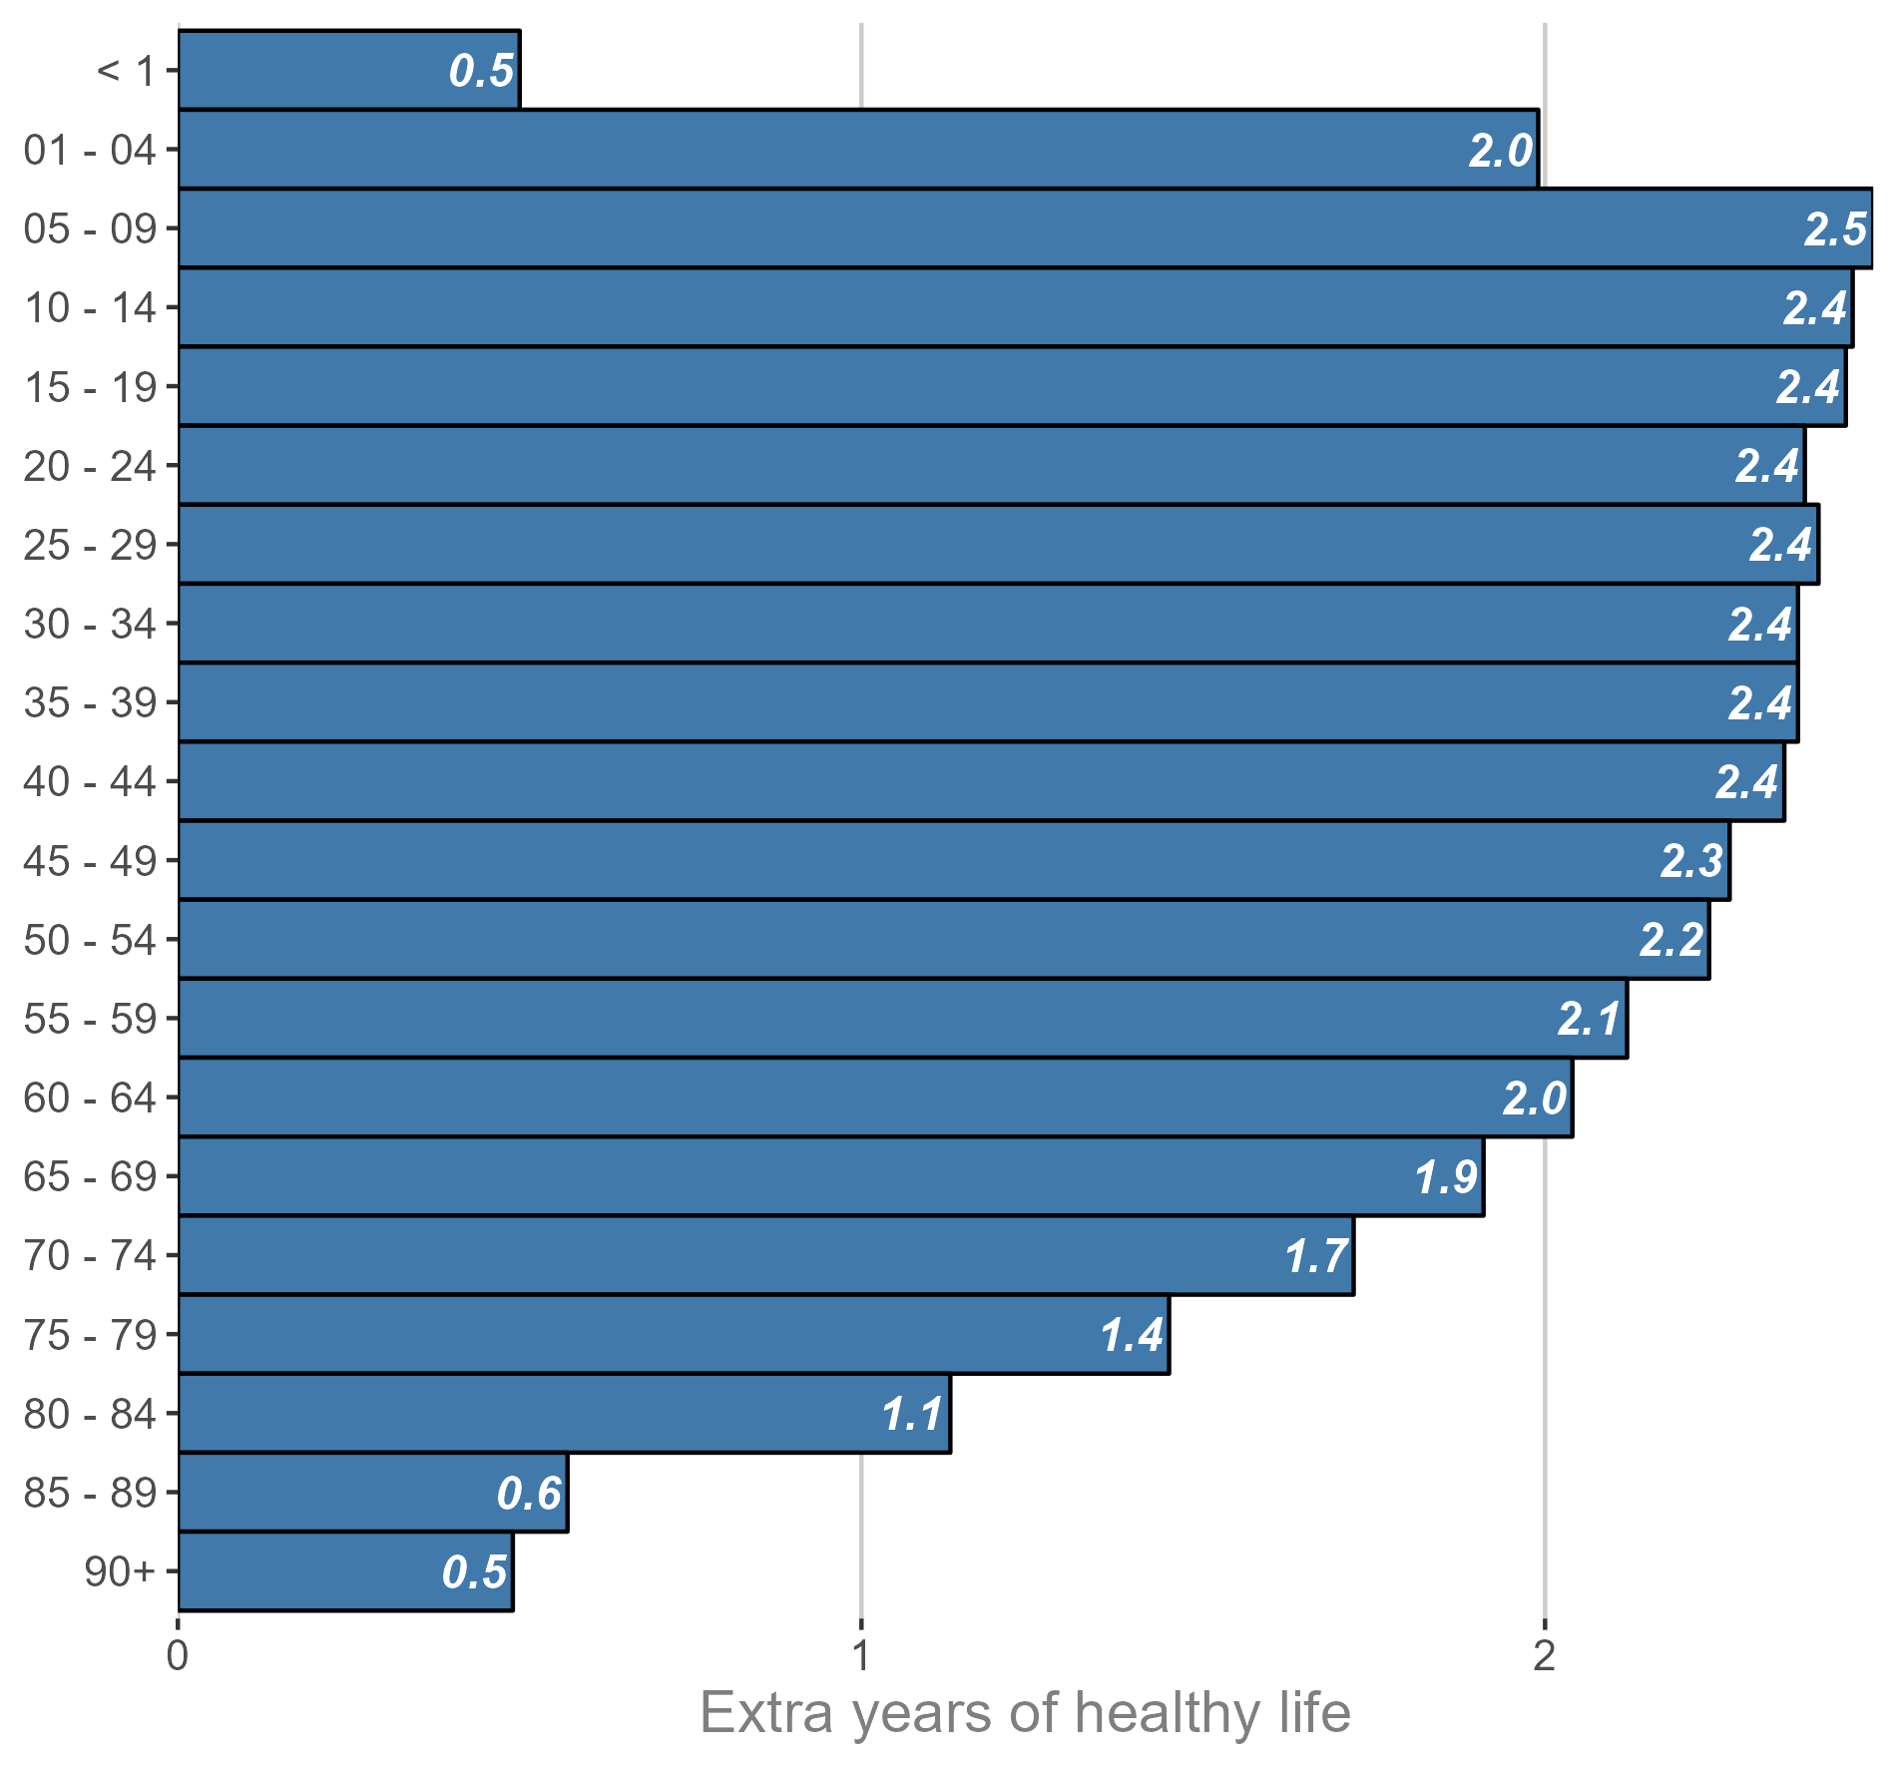
Improving health has the highest impact on HLE
Extra years of good health due to (population) health improvements Effect of increasing good health prevalence by 50% in age band, keeping all other groups unchanged
Improvements to good health are 15x more effective at improving healthy life expectancy compared to mortality improvements. Improving good health prevalence by 1% increases HLE by 9 months. Improving mortality rates by 1% improves HLE by 3 weeks.
If we aim to increase HLE by 5 years, we would need to increase good health prevalence by 7% in all ages.
The chart shows what the effect of increasing the prevalence of (census estimated) good health by 50% in an age band, leaving all other age bands unchanged. Increasing good health is beneficial in all ages, and particularly in younger age groups. High proportions of young people are healthy, so the focus should be on maintaining good health in the young, and improving good health in the older ages.
Data sources: Internal ECC data, health (census 21) Analysis by ECC public health

Slide 9
We know the drivers of poor health
Health conditions
Health behaviours
Chronic health conditions – particularly musculoskeletal, heart & circulatory, nervous system (including dementia), and mental disorders – are strongly associated with poor self-reported health.
The effect is cumulative. Multimorbidity (having more than 1 of these conditions) strongly increases the odds of poor self-reported health.
Diabetes is a significant driver of poor health (OHID evidence review).
OHID analysis of health survey data found similar results. They also found strong associations between cancer and poor self-reported health.
Lack of physical activity, and being a former or current smoker are strongly associated with poor self-reported health.
Obesity / overweight and poor diet were also associated, though the evidence found in the evidence review was less strong.
Socioeconomic drivers are more complex. Higher education and higher income levels were associated with higher levels of good self-reported health, but there’s little evidence that these cause good health.
Data sources: OHID literature review & analysis of Health Survey for England

Slide 10
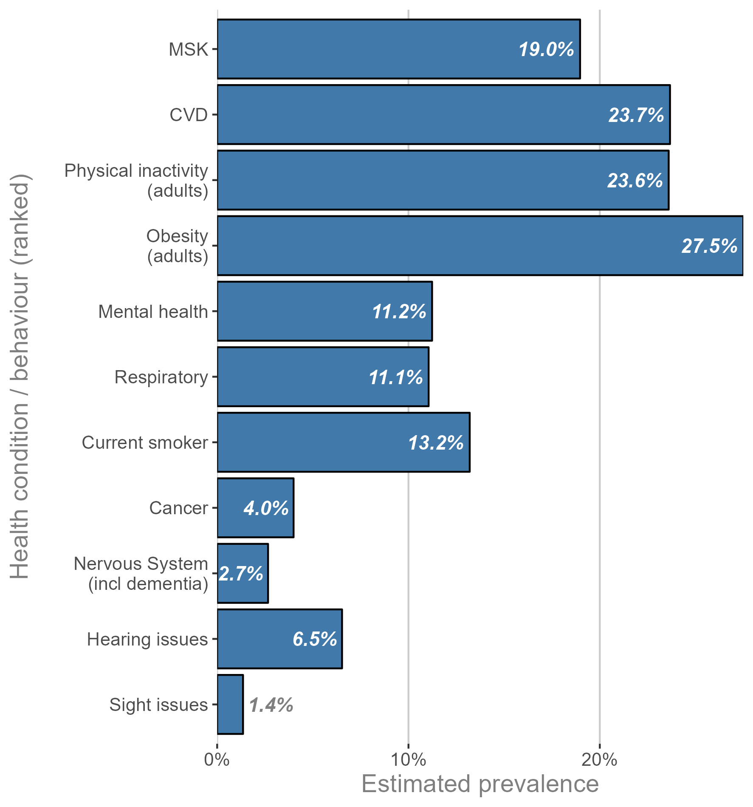
Drivers & prevalence suggests areas of focus
Estimated prevalence of various health conditions & behaviours – Essex Health conditions / behaviours have been ranked by their prevalence & association with poor health
Survey data can be used to estimate the prevalence of these conditions in Essex.
There is some bias here – most of the data is self-reported from the GP survey, so will miss people who aren’t registered with a GP and may result in an over-estimation of observed prevalence.
The chart shows the estimated prevalence of various conditions and behaviours in Essex. These have been ranked by their impact on poor-health in the population.
Musculoskeletal and cardiovascular disease both have strong associations with poor health and high prevalence in Essex. For health behaviours, physical inactivity and obesity are potential areas of focus.
Nervous system conditions (including dementia) had the strongest link to poor health, followed by cancer. These are relatively rare conditions so are ranked lower than other more common drivers.
Data sources: GP patient survey, annual population survey, active lives survey. Estimated poor-health associations from OHID analysis of health survey for England data.

Slide 11
This information is issued by: Essex County Council
Contact us: PHI@essex.gov.uk Essex County Council County Hall, Chelmsford Essex, CM1 1QH
Essex_CC
facebook.com/essexcountycouncil

