Slide 1
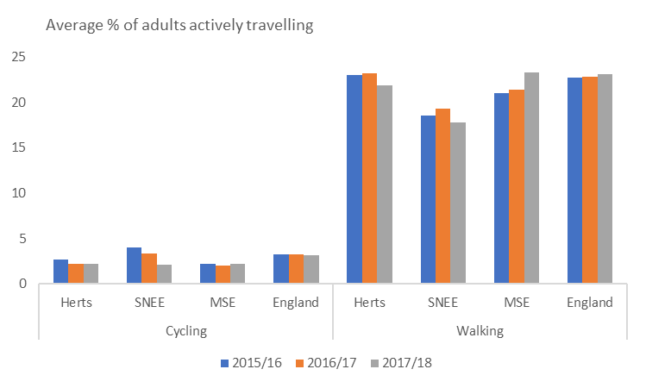
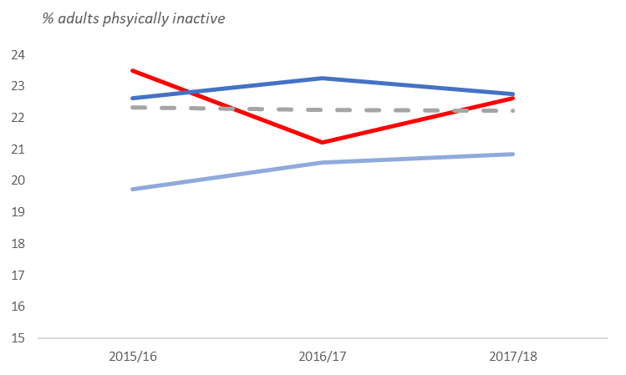
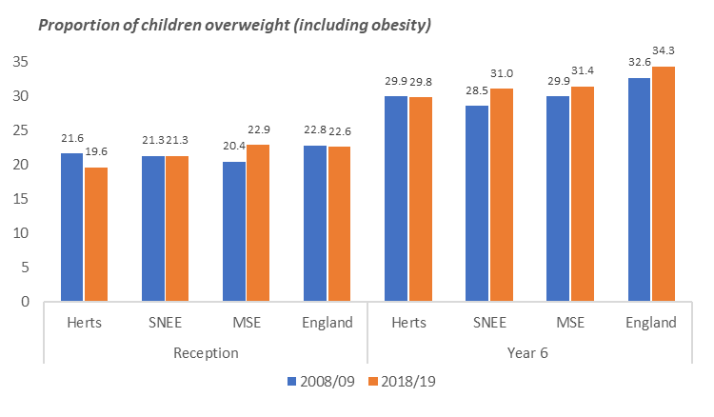
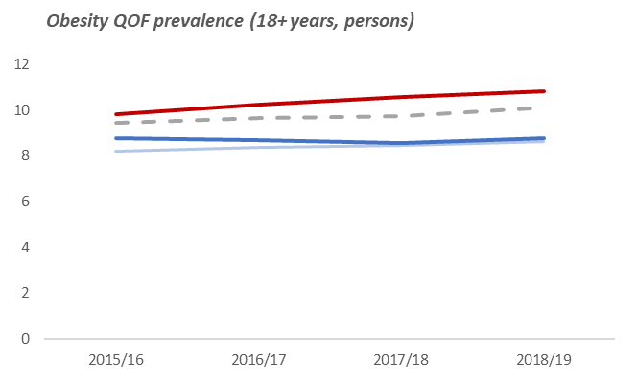
Physical Activity
Approximately 65% of adults on average in each STP met recommendation of 150 minutes of moderate intensity physical activity per week in 2017/18, similar to across England¹.
Active travel levels were mostly lower than England in 2017/18 and decreasing, with exception of Mid and South Essex STP (2.3% increase in walking) ¹.
Approximately a fifth of the population on average in each STP and ICS was classed as physically inactive (below 30 minutes per week) in 2017/18¹.
Hertfordshire and West Essex STP saw both a decrease in proportion physically active, and an increase in proportion physically inactive.
Local Authority level data is available on the reverse side.
% Adults physically active | 2015/16 | 2016/17 | 2017/18
Herts & West Essex | 67.64 | 67.80 | 66.76
Suffolk & North East Essex | 63.80 | 66.83 | 65.02
Mid & South Essex | 64.62 | 65.24 | 65.38
England | 66.13 | 66.01 | 66.26
 | Herts and West |  | Mid and South Essex
 | SNEE |  | England
Obesity and Related Outcomes
The prevalence of childhood (Year 6) and adult obesity is increasing slightly across the STPs and ICS, with the largest increases and highest current adult obesity levels in Suffolk and North East Essex. ^{2,3}
A whole systems obesity JSNA (2017) by Thurrock Council cites that physical inactivity is the 4th largest cause of disease and disability in the UK and directly contributes to 1 in 6 deaths in the UK⁴.
There is increasing prevalence of ill-health conditions² associated to physical inactivity and obesity across the STPs and ICS, for example:
Diabetes QOF Prevalence (17+):
 | Herts and West |  | Mid and South Essex
 | SNEE |  | England
CCG level QOF data is available on reverse side, including Hypertension QOF prevalence.
Joint Strategic Needs Assessments and Recommendations
The 2019 Essex Countywide JSNA recommends that increasing physical activity in adults, and reducing excess weight and obesity among all age groups be potential areas of future focus⁵.
Physical activity JSNA’s by Southend Council (2018) and Suffolk Council (2017) found many barriers to exercise, including: time, confidence or motivation, health issues and/or disability, costs, and awareness and provision of local facilities^{6,7}. Other main determinants include neighbourhood environment and physical environment design⁴.
The need to develop a whole systems approach to tackling physical activity is therefore highlighted, with recommendations spanning the individual level to social and community development^{4,7,8}.
Sources: PHE Fingertips: Physical Activity¹; PHE Fingertips: National General Practice Profiles²; PHE Fingertips: NCMP and Child Obesity Profile³; Thurrock Council (2017) JSNA: Whole Systems Obesity⁴; Essex County Council (2019) JSNA: Essex Countywide⁵; Southend Council (2018) JSNA: Physical Activity⁶; Suffolk Council (2017): Physical Activity⁷; Hertfordshire County Council (2016) JSNA: Activity and Weight⁸

Slide 2
 | % adults physically active (2017/18) | % adults physically inactive (2017/18)
England* | 66.26 | 22.23
Herts and West Essex | 66.76 | 20.84
Epping Forest | 69.78 | 18.48
Harlow | 63.31 | 25.36
Uttlesford | 70.72 | 19.21
Broxbourne | 59.49 | 27.91
Dacorum | 68.27 | 19.59
Hertsmere | 63.16 | 20.72
North Hertfordshire | 64.39 | 22.75
Three Rivers | 69.78 | 16.53
Watford | 60.52 | 25.63
St Albans | 73.72 | 13.33
Welwyn Hatfield | 73.44 | 17.20
East Hertfordshire | 70.92 | 18.86
Stevenage | 60.35 | 25.30
Mid and South Essex | 65.38 | 22.74
Southend-on-Sea | 62.97 | 24.44
Thurrock | 60.91 | 26.65
Basildon | 61.87 | 25.30
Braintree | 67.55 | 19.17
Brentwood | 65.79 | 22.51
Castle Point | 68.43 | 21.43
Chelmsford | 62.73 | 23.74
Maldon | 68.39 | 19.09
Rochford | 69.75 | 22.37
Suffolk & North East Essex | 65.02 | 22.63
Colchester | 67.74 | 18.45
Tendring | 62.55 | 25.09
Babergh | 62.65 | 23.52
Ipswich | 67.55 | 21.03
Mid Suffolk | 66.15 | 21.93
East Suffolk | 65.16 | 23.73
West Suffolk | 63.32 | 24.66
Better*
Similar*
Worse*
 | Obesity QOF prevalence (2018/19) | Diabetes QOF prevalence (2018/19) | Hypertension QOF prevalence (2018/19)
England* | 10.12 | 6.93 | 13.96
Suffolk and North East Essex | 10.83 | 6.68 | 15.49
Ipswich and East Suffolk CCG | 11.52 | 6.32 | 15.20
North East Essex CCG | 11.05 | 6.85 | 15.71
West Suffolk CCG | 9.44 | 7.03 | 15.64
Mid and South Essex | 8.78 | 6.80 | 15.09
Basildon and Brentwood CCG | 8.23 | 6.50 | 14.75
Castle Point and Rochford CCG | 9.37 | 7.38 | 17.46
Mid Essex CCG | 8.29 | 6.70 | 14.52
Southend CCG | 8.75 | 6.85 | 15.33
Thurrock CCG | 10.21 | 6.87 | 14.18
Herts and West Essex | 8.65 | 6.09 | 13.29
East and North Hertfordshire CCG | 8.96 | 6.01 | 13.47
Herts Valleys CCG | 8.33 | 6.03 | 12.67
West Essex CCG | 8.68 | 6.37 | 14.22
Higher*
Similar*
Lower*
* Compared to England value.

