Slide 1
Population Health
Jo Broadbent, Deputy Director Healthcare Public Health
PHE East of England

Slide 2
What is Population Health?
Notes:
From PHM Flatpack. Definitions as agreed by ALBs

Slide 3
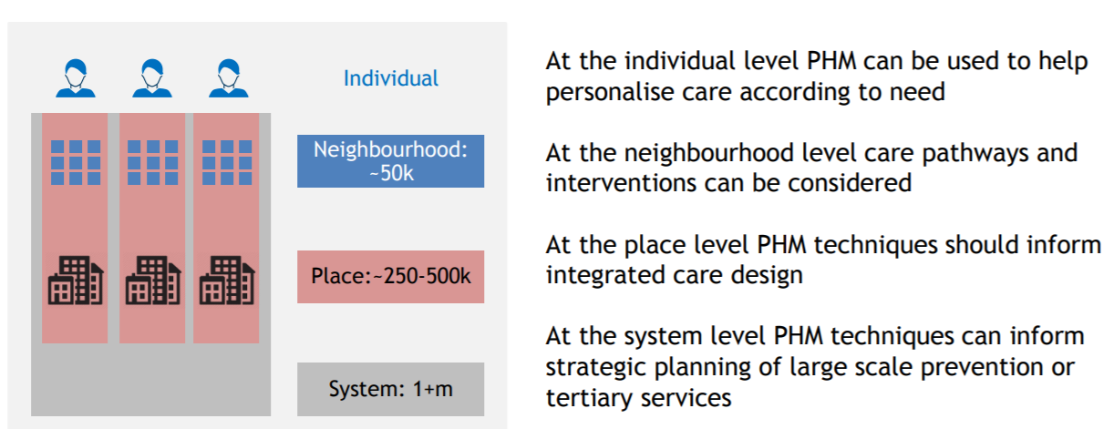
Intention is to improve care and outcomes for individuals, population groups and whole communities
Source: PHM Flatpack, NHS England

Slide 4
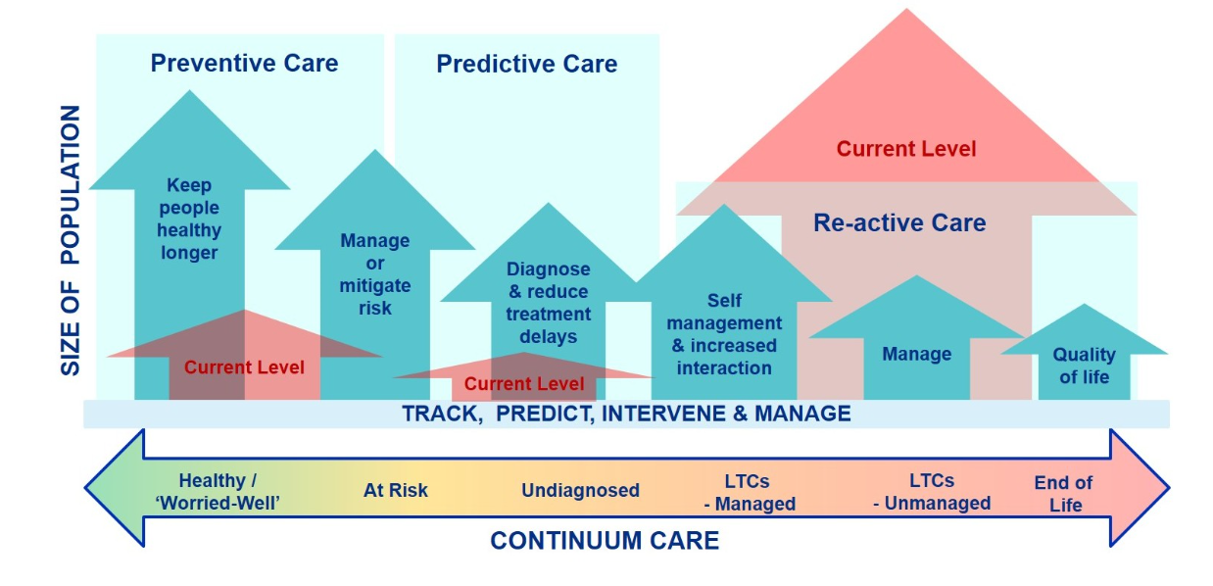
Action across the continuum of care
Reproduced from PHI a 5 minute guide, Charlotte Harris, NHS Futures https://future.nhs.uk/Home/view?objectId=376115

Slide 6
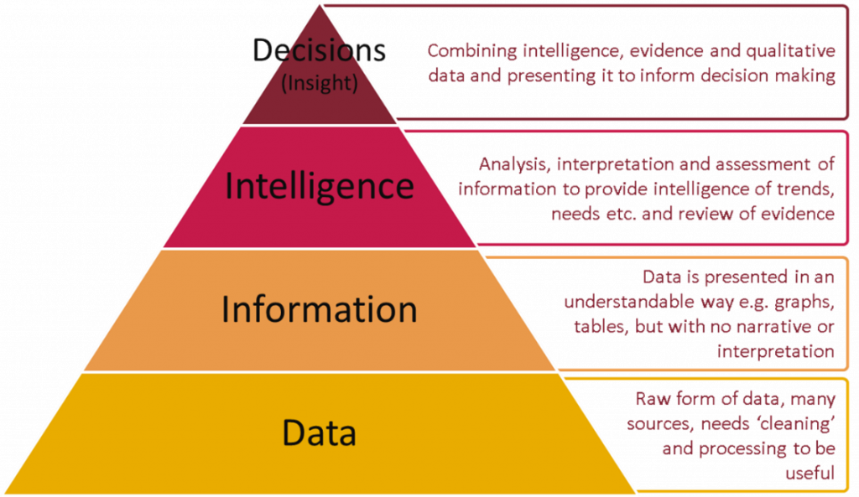
….in part
Do we have the data needed to undertake data-driven planning for population health gain?
Lots of data
Need to ensure decision-makers can access and act on it
But also need to join up data across care pathways (integrated services need integrated data)

Slide 7
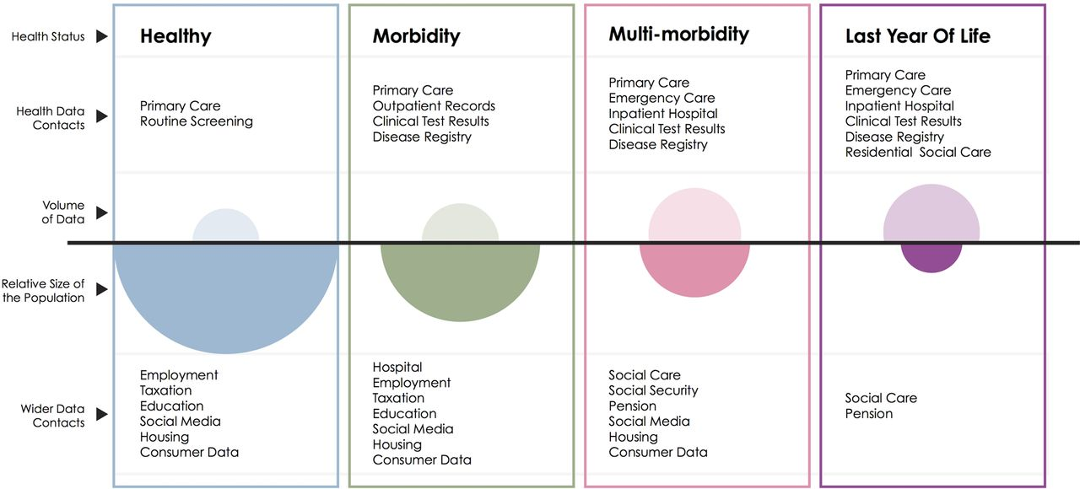
The second boundary of routinely collected data.
Sarah R Deeny, and Adam Steventon BMJ Qual Saf 2015;24:505-515
Copyright © BMJ Publishing Group Ltd and the Health Foundation. All rights reserved.
Notes:
The second boundary of routinely collected data. This schematic illustrates the volume of data available (open ovals) from health datasets for each group of the population defined by health status in contrast with the size of that population (filled ovals).
https://qualitysafety.bmj.com/content/24/8/505

Slide 8
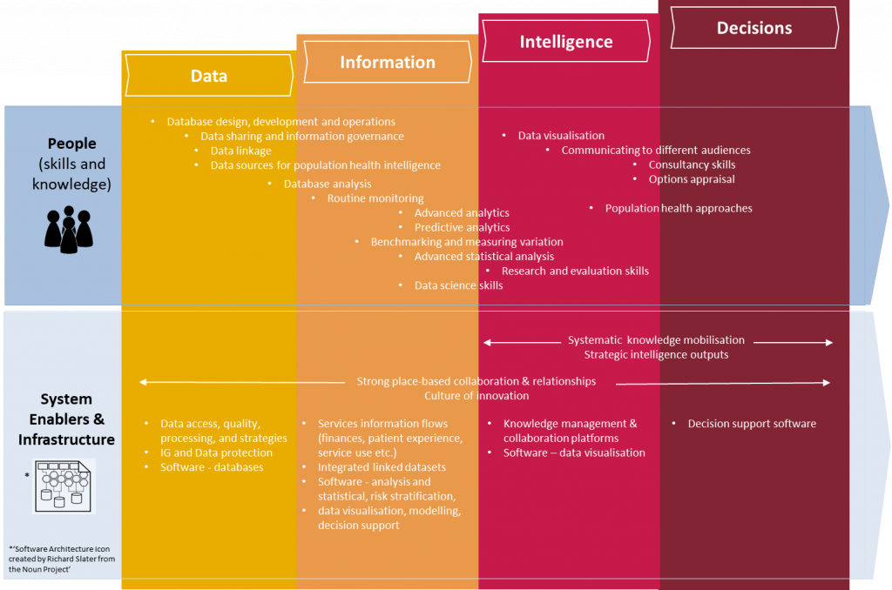
Place-based population health intelligence
https://publichealthmatters.blog.gov.uk/2018/12/05/from-data-to-decisions-building-blocks-for-population-health-intelligence-systems/

Slide 9
Population Health Data

Slide 10
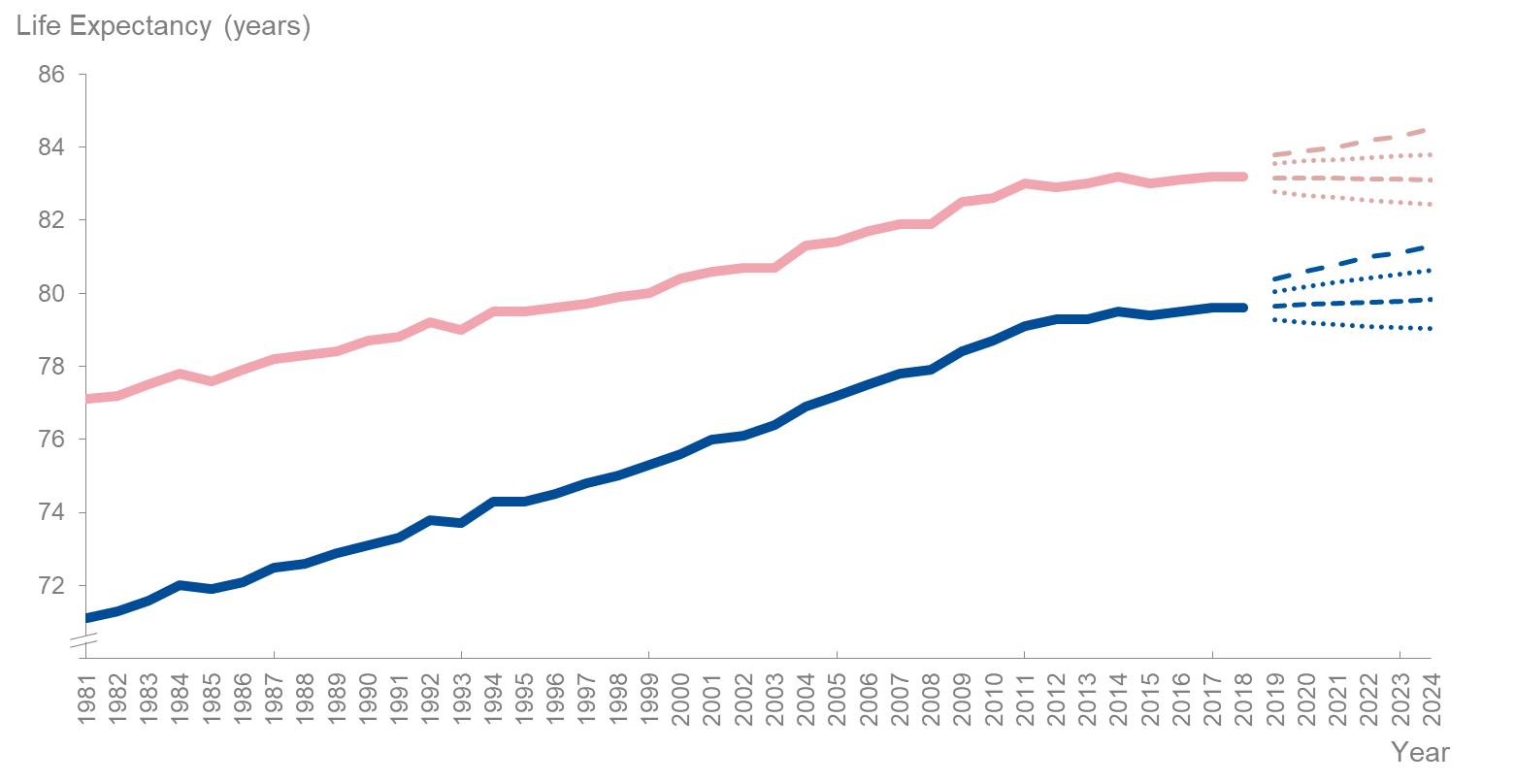
There was no increase in life expectancy between 2017 and 2018, and the future trend is uncertain
Health Profile for England 2019
Notes:
- LE reached 79.5 years for men and 83.1 years for women

Slide 11
Variation in life expectancy

Slide 12
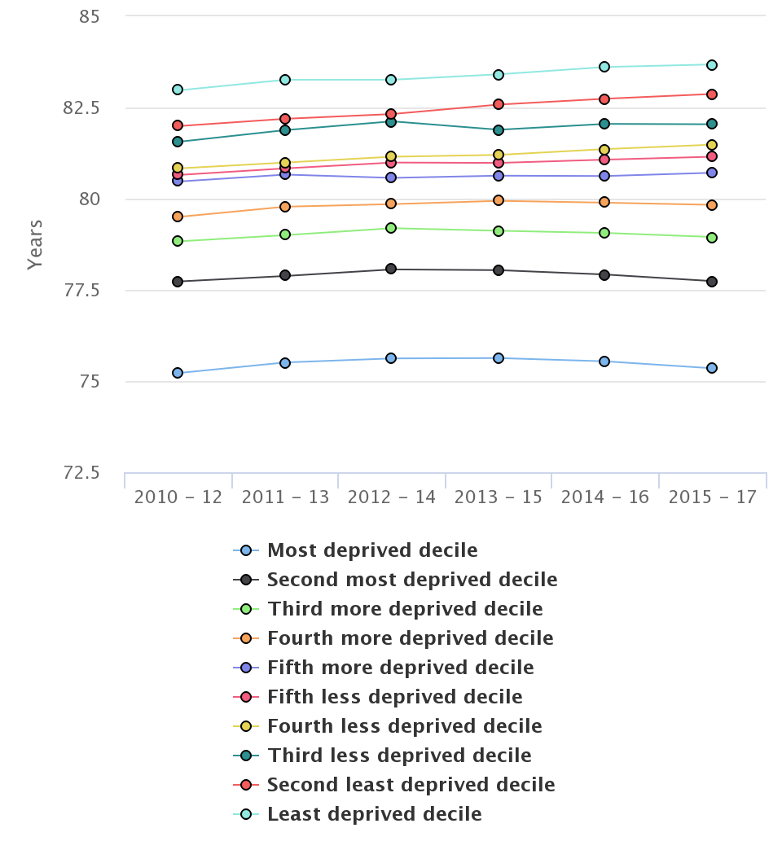
Males living in most deprived areas of East of England have seen decline in life expectancy since 2014
Life expectancy at birth (Males) East of England Region, 2015-17

Slide 13
Healthy Life Expectancy
Notes:
- Healthy Life Expectancy is c. 63.4 for men and 64.1 for females.
- This means 16.1 years of (20% of life) in poor health for men and 19.0 years (or 23%) for women

Slide 14
Notes:
Healthy life expectancy is women in EoE is falling.

Slide 15
Healthy Life Expectancy and Deprivation

Slide 16
Population-Level Health Improvement requires Universal and Targeted approaches to: 1. Reduce risk at a whole population level, at the same time as 2. Reducing health inequalities

