Slide 1
ELDP Physical Activity
Dashboard
Training and User Guide
Emma Farrow, Public Health Analyst; Jevon Harper, Senior Analyst
Be part of the equation

Slide 2
Contents
How to use the tool
How to access the tool
Definitions
Step-by-step guides to each page:
Physical Activity in Essex
LSOA profiles
Clusters & cluster definitions
Data by theme
Data by decile
Other Resources
Be part of the equation

Slide 3
How to use the tool
By using the range of data included in this dashboard you can profile your communities to identify physical activity and inactivity levels, and to identify the extent of possible key drivers of activity levels down to an LSOA level.
Together, this information could provide you with a springboard for further research; actionable insight enabling ELDP and Active Essex to deploy targeted resources to communities most in need; and an evidence-base to inform your commissioning decisions, intervention development and implementation.
Be part of the equation

Slide 4
How to access the tool
The ELDP Physical Activity Dashboard is hosted on the Essex Open Data Platform:
https://data.essex.gov.uk/dataset/emkw5/eldp-physical-activity-dashboard
Supporting documentation is also provided here. This includes:
Additional Resources and Datasets Guide: Overview description of the materials available alongside the ELDP Physical Activity Dashboard. It is recommended to read this document first, and prior to use of the dashboard.
ELDP Mosaic Analysis Report: Report based on Experian Mosaic household classifications to profile the ELDP target areas and Experian Mosaic customer segments to identify ELDP target populations.
Dashboard Meta Data: Full list of variables underlying this dashboard, with information including the variable theme, date and source.
England LSOA indicator data: Full dataset covering every LSOA in England of the variables underling this dashboard.
England LSOA indicator deciles: Dataset of the decile score of the 253 variables used to calculate the Physical Activity Risk Score.
England LSOA theme decile scores and rankings: Dataset of the average decile score for each theme for every LSOA in England. The weighted and unweighted average deciles are also provided.
Be part of the equation

Slide 5
Definition of Themes
Health Indicates the level of health of the Essex LSOAs, with measures covering life expectancy, health outcome prevalence, self-reported mental health and wellbeing, hospital admissions and mortality.
Economy Provides information on the state of the economy of Essex LSOAs, including around the workforce and employment, income and debt.
Vulnerable Groups This theme includes information around claimants of a range of benefits, carers, pensioners, lone-parents, and child and household poverty.
Active Lives Indicates the level of physical inactivity and activity at a low geography level, MSOA level, across Essex.
Crime The level of a range reported crimes across the Essex LSOAs, including anti-social behaviour, drug crime and violent crime.
Access and Transport Indicates how well-connected the Essex LSOAs are in terms of accessibility such as through the internet, use of cars, and public transport and walking.
Housing Provides an overview of the housing sector and market, including in type of housing, ownership, house prices and affordability, in the Essex LSOAs.
Education Indicates the level of education and skills of the Essex LSOAs, with a range of information provided around pupil attainment and absences, and qualification levels.
Community and Environment Indicates the state of the community and environment of Essex LSOAs, including around road safety, community cohesion and satisfaction, and the physical environment such as air quality green spaces.
Population Provides demographic information of the population of the Essex LSOAs, including information on age, gender, ethnic groups and marital status.
Be part of the equation

Slide 6
Glossary
Decile Deciles split a dataset into ten equal parts, ranking the data in order from lowest to highest on a scale of 1 – 10. Each LSOA was sorted into a decile for every appropriate indicator in the dataset. Polarity was standardised across each measure, so that a decile of 1 represents the worst performers and a decile of 10 represents the best performers.
LSOA A Lower Layer Super Output Area (LSOA) is a small, low-level geographical area. LSOAs typically consist of a 1,000 minimum – 3,000 maximum population, and 400 minimum – 1,200 maximum households. LSOAs align to other geographical boundaries and can be aggregated up, including to MSOAs, Wards and Local Authority Districts.
MSOA A Middle Layer Super Output Area (MSOA) is a geographical unit constructed from groups of LSOAs. They consist of a 5,000 minimum – 15,000 maximum population, and 2,000 minimum – 6,000 maximum households. MSOAs align to other geographical boundaries, including Local Authority Districts.
Be part of the equation

Slide 7
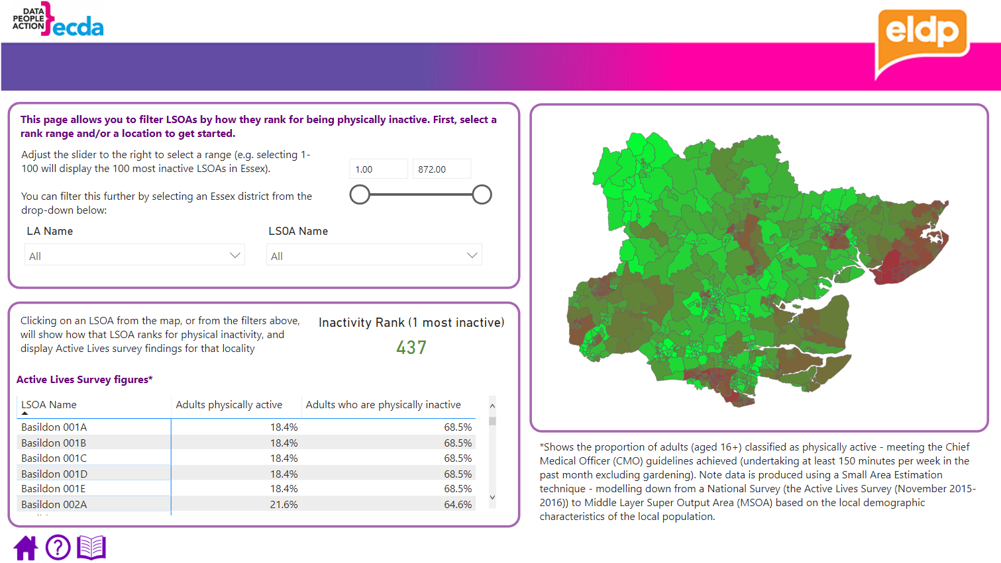
Physical Activity in Essex
This page provides information on the percentage of residents that are physically active and inactive. Percentages are at MSOA level, with the MSOA percentage used for every LSOA within that MSOA.
Be part of the equation

Slide 8
Physical Activity in Essex
Use filters
Filter to the Local Authority (LA) and / or LSOA to view data for. Select the downward arrow next to the LA / LSOA Name box to view the drop-down options, and select the box next to the area of interest. A scroll-bar appears on the right of the drop down to navigate down the drop down options. Filters can be cleared by pressing the eraser icon that appears when hovering over the LA Name / LSOA Name box.
You can also further filter to show all areas across Essex (with no LA filter applied) or areas within a LA (with LA filter applied) that fall within a range of how they rank for inactivity levels compared across the Essex LSOAs. Adjust the slider on the right of the filter box. A lower rank represents a higher level of inactivity.
2. Tables
When a local authority is selected in the filters, values for all LSOAs within that local authority is automatically shown. When a LSOA is selected in the filters, values for that LSOA is automatically shown. Use the scroll-bar on the right hand side of the table to navigate through the areas presented.
Above the table presents an ‘Inactivity Rank’. This shows how the LSOA selected ranks for inactivity levels across all Essex LSOAs. , whereby a lower rank represented a higher level of inactivity.
3. Map
The map shows Essex LSOAs ranked on the proportion of adults physically active on a colour gradient, whereby darker colours (red) reflect less active and lighter colours (green) reflect more active. Hovering over an area shows the LSOA code and physical activity rank. Selecting an area on the map will update the table, to show percentage activity values for that area selected.
Be part of the equation

Slide 9
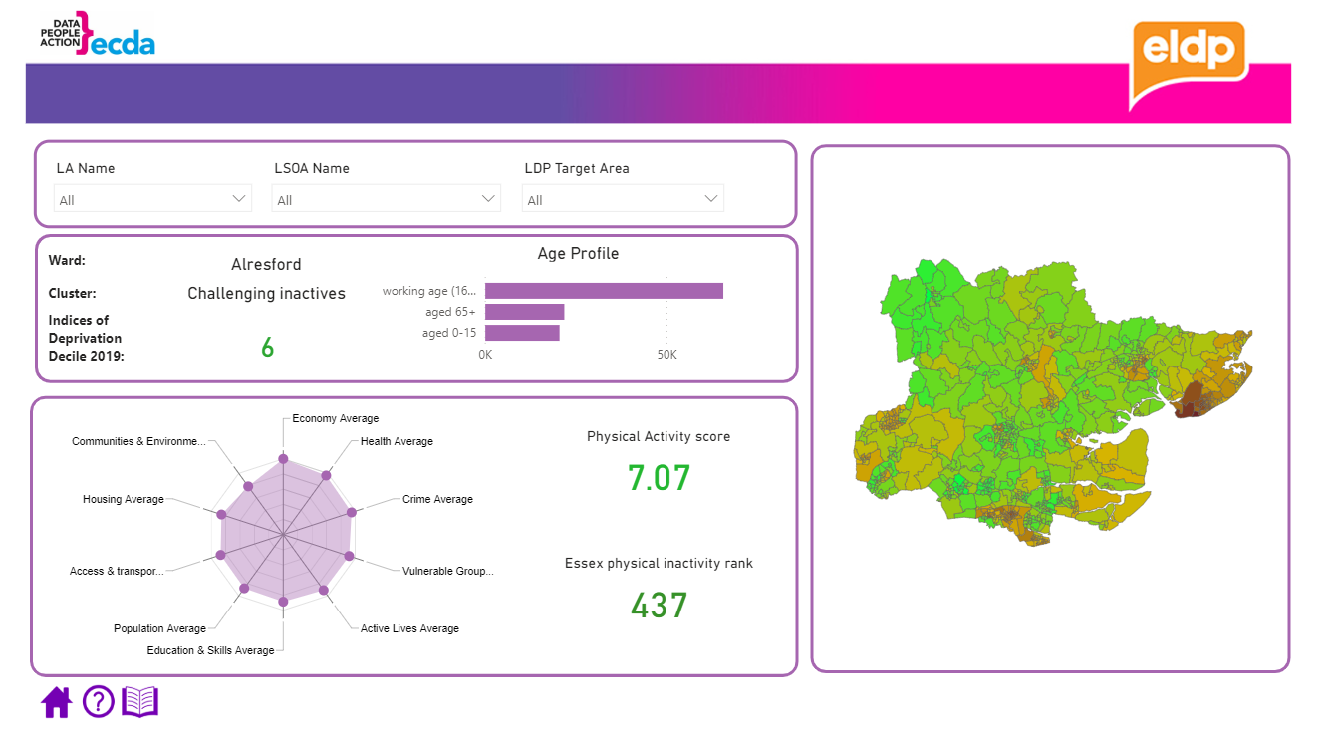
LSOA Profiles
This page provides an overview of a LSOAs demographics, such as age and deprivation, and physical activity levels and potential drivers of this.
Be part of the equation

Slide 10
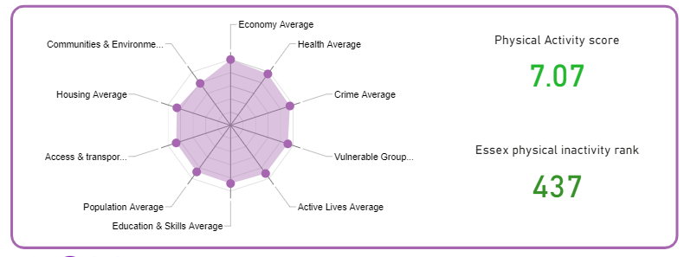
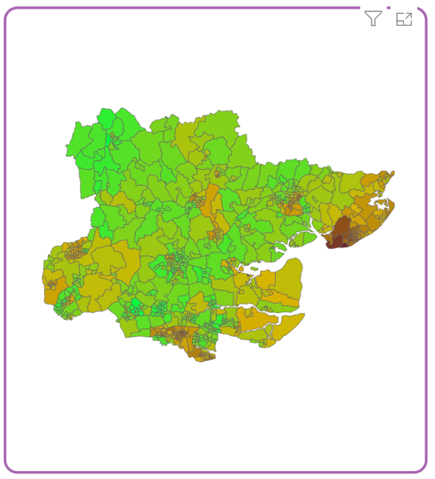
LSOA Profiles
Use filters
Filter to the Local Authority (LA) and / or LSOA to view data for. Select the downward arrow next to the LA / LSOA Name box to view the drop-down options, and select the box next to the area of interest. A scroll-bar appears on the right of the drop down to navigate down the drop down options. Filters can be cleared by pressing the eraser icon that appears when hovering over the LA Name / LSOA Name box.
2. Demographics Box
When a LSOA is selected in the filters, this box shows what ward this LSOA is located in, the IMD 2019 decile (1 most deprived; 10 least deprived) and the age profile.
3. Radar Chart Box
The radar chart shows the average decile score for each driver theme in the data. This gives a snapshot into possible themes for further exploration in the ‘by theme’ pages. A lower score is worse, and a higher score is better. The Physical Activity Score to the right of this chart shows the score of how active that LSOA area is, where a higher score is more active. The Rank below shows how this LSOA ranks for inactivity compared across all Essex LSOAs. When a LA is selected, the radar and scores are the average for that LA based on the LSOAs within that LA.
3. Map
The map shows Essex LSOAs ranked on the proportion of adults physically active on a colour gradient, whereby darker colours (red) reflect less active and lighter colours (green) reflect more active. Hovering over an area shows the LSOA code, ward and physical activity score. Selecting an area on the map will update figures presented in the boxes above to be for that area selected.
Be part of the equation

Slide 11
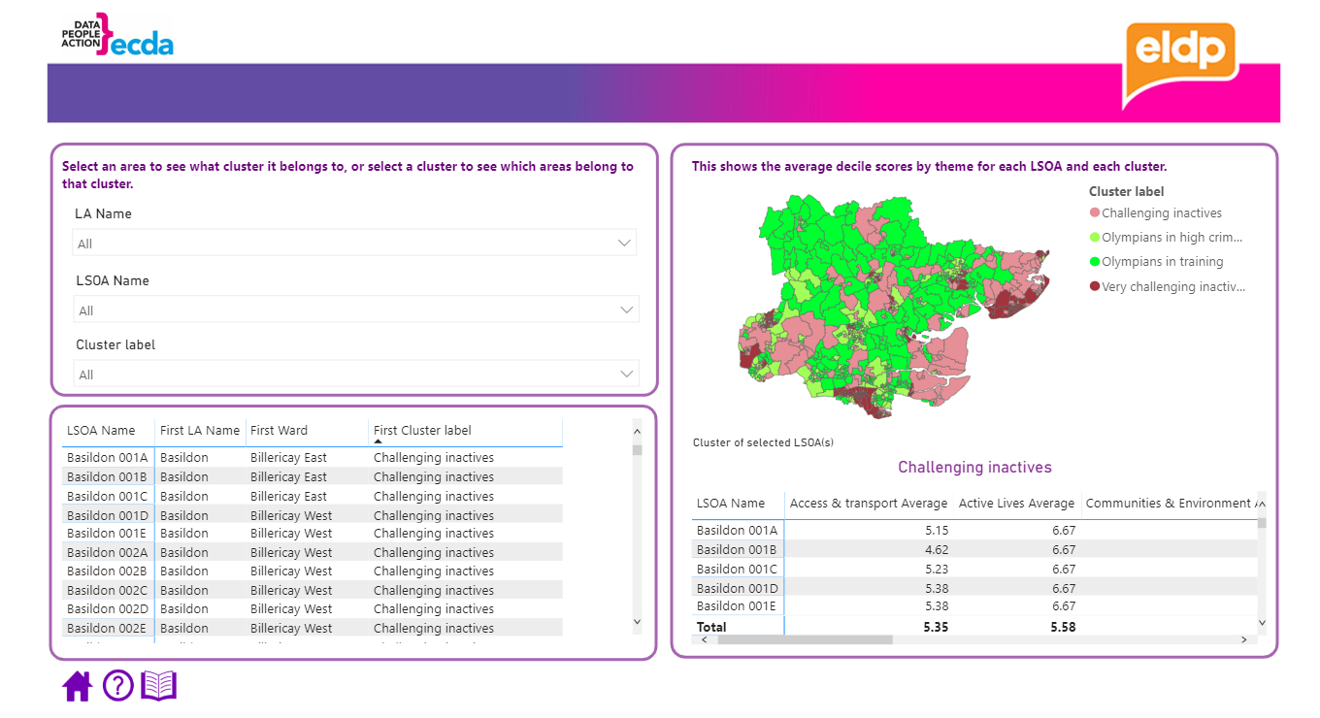
Area Clusters
This page provides information on where each cluster type are located across Essex, including what LSOAs fall into each cluster, and the average theme score for each of the LSOAs within each cluster.
Be part of the equation

Slide 12
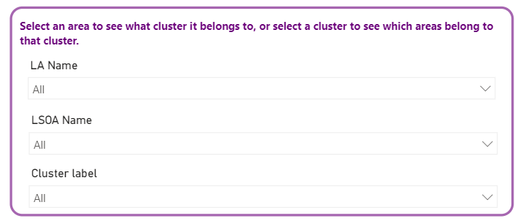
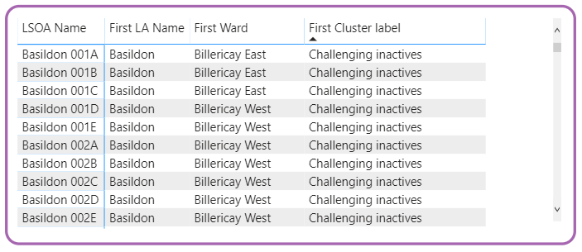
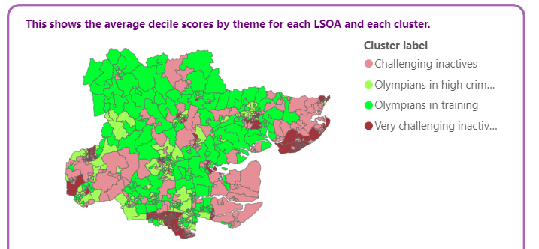
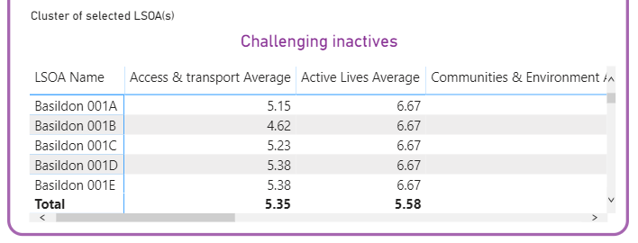
Area Clusters
Use filters
Filter to the Local Authority (LA) and / or LSOA to view data for. Select the downward arrow next to the LA / LSOA Name box to view the drop-down options, and select the box next to the area of interest. A scroll-bar appears on the right of the drop down to navigate down the drop down options. You can also further filter to show all LSOA areas across Essex (with no LA filter applied) or areas within a LA (with LA filter applied) that fall within each Cluster. A cluster definition page is provided on the next page of the dashboard. Filters can be cleared by pressing the eraser icon that appears when hovering over the LA Name / LSOA Name / Cluster Label box.
2. Table (1)
This table shows the ward and cluster LSOAs are in*. When a local authority is selected in the above filters, this information is presented for every LSOA in that local authority. When a LSOA is selected, this information is presented for that specific LSOA. When a cluster label is selected, this information is presented for every LSOA within that cluster.
3. Map
The map shows Essex LSOAs classified by their cluster label. When a local authority is selected, every LSOA in that local authority is shown. When a cluster label is selected, every LSOA in that cluster label is shown. Hovering over an LSOA on the map will show the LSOA code and cluster label. Selecting an area on the map will update the above* and below table to show all LSOAs within the same cluster label as the LSOA selected.
4. Table (2)
This table shows the average decile score separated by the theme for each LSOA within each cluster. When a local authority is selected, every LSOA in that local authority is shown. When a cluster label is selected, every LSOA in that cluster label is shown. A lower score (to 1) indicates relatively worse performance in that theme, and a higher score is better (to 10).
Be part of the equation

Slide 13
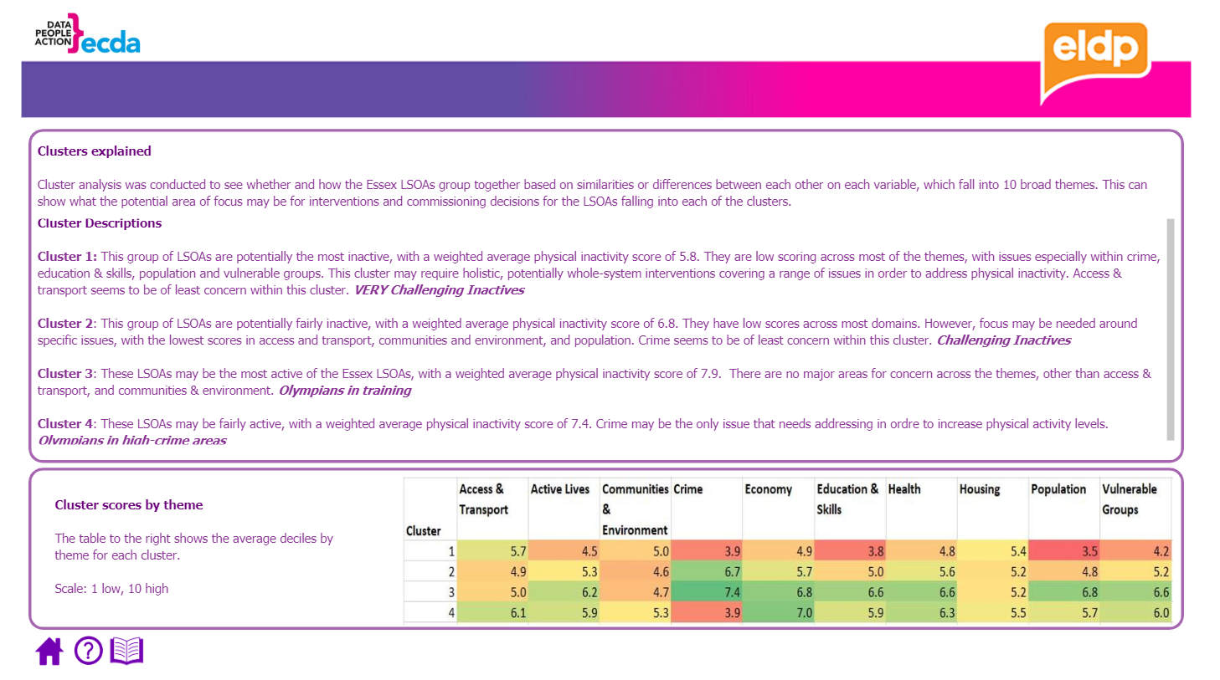
Clusters Definitions
This page provides the definitions of the clusters of LSOAs across Essex, showing what barriers to physical activity may be shared by the LSOAs within each cluster. The scroll bar to the right of the text box allows you to navigate through the text.
Be part of the equation

Slide 14
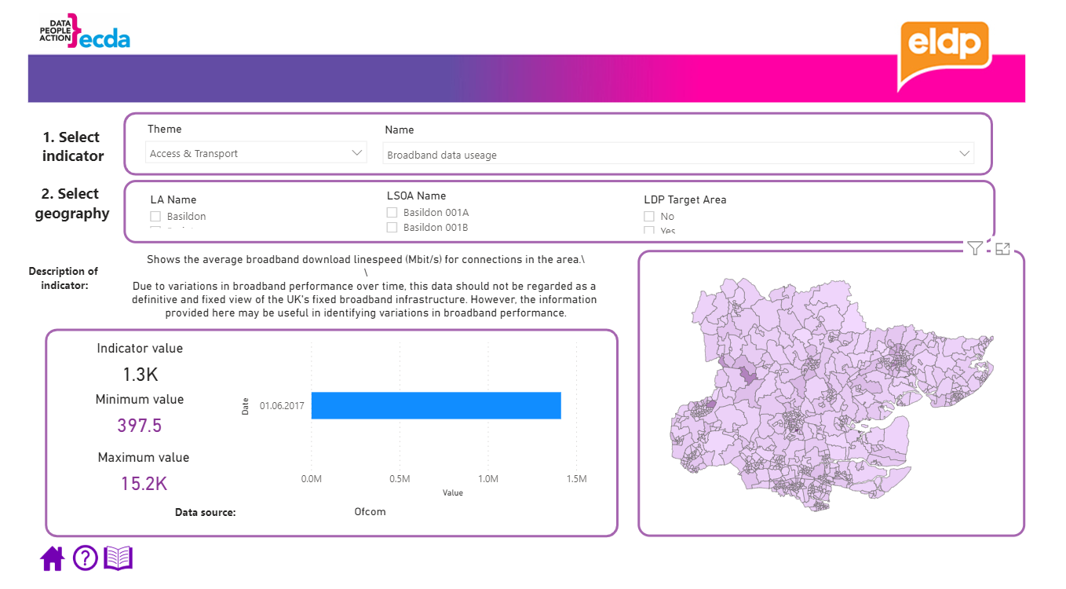
Data by Theme
This page provides the values for every measure in the data set, split by the driver theme that the variable is in.
Be part of the equation

Slide 15
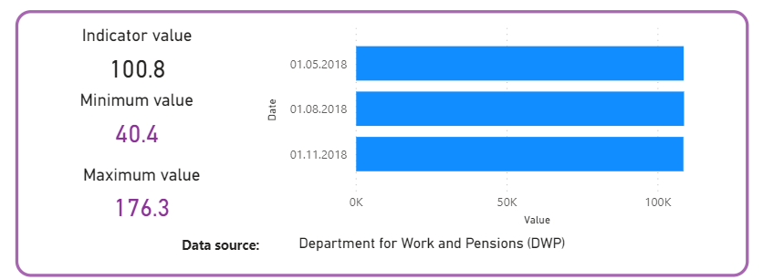
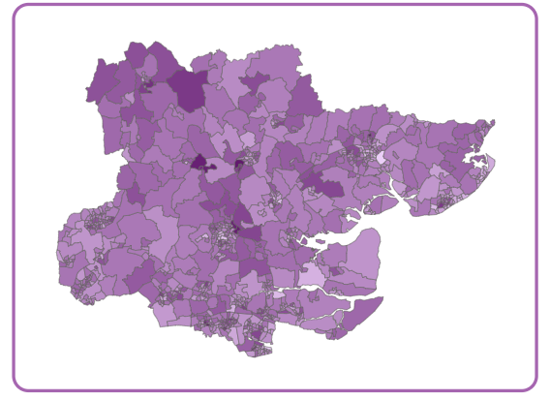
Data by Theme
Use filters
Filter to the Theme to view data for. Select the downward arrow next to the box to view the drop-down options, and select the box next to the Theme of interest. Next, select a variable to view the data for. Select the downward arrow next to the box to view the drop-down options, and select the box next to variable to view data for.
Next, filter to the Local Authority (LA) and / or LSOA to view data for. Select the downward arrow next to the LA / LSOA Name box to view the drop-down options, and select the box next to the area of interest. A scroll-bar appears on the right of the drop down to navigate down the drop down options. Filters can be cleared by pressing the eraser icon that appears when hovering over the LA Name / LSOA Name box.
2. Indicator Description and Values
A description and calculations of the indicator selected in the filter process is first provided.
The value for that indicator is presented, along with the range of values on that indicator seen across the Essex LSOAs. The bar chart to the left shows the values for each time point on that indicator in the dataset. The source of the indicator data is also presented below this information.
3. Map
The map shows Essex LSOAs values for the selected indicator, on a colour gradient whereby darker colours (purple) represent a higher value and lighter colours represent a lower value. When a local authority is selected in the filters, only LSOAs in that local authority are shown. Hovering over an area on the map shows that area’s LSOA code and indicator value.
Be part of the equation

Slide 16
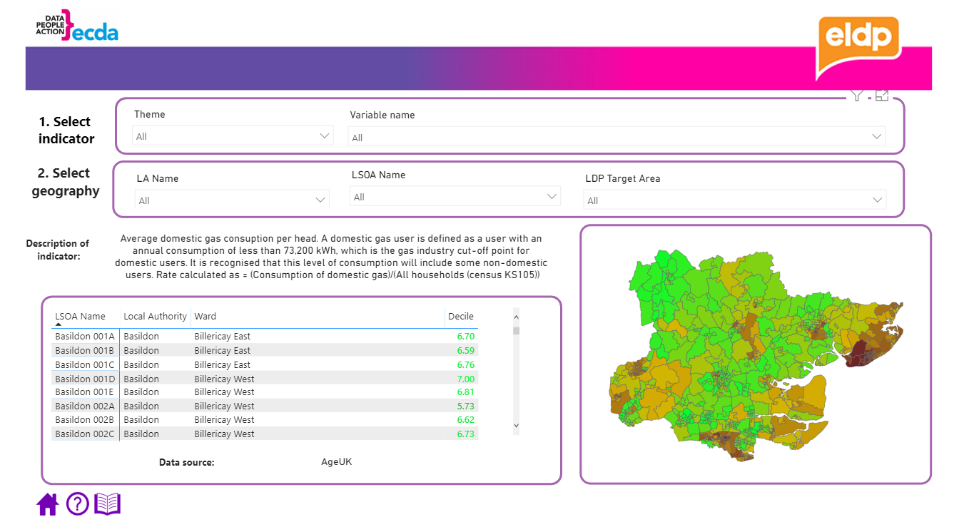
Decile by Theme
This page provides the decile score for each measure within the themes. This is a standardised view of the score data, allowing for better comparison between areas. A score of 1 indicates poor performance, and a score of 10 indicates good performance on all measures.
Be part of the equation

Slide 17
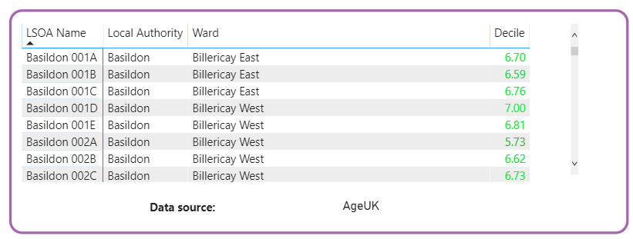
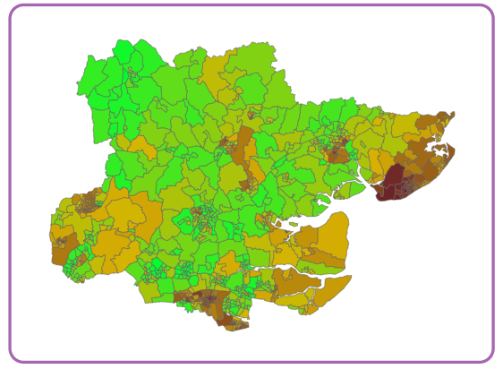
Deciles by Theme
Use filters
Filter to the Theme to view data for. Select the downward arrow next to the box to view the drop-down options, and select the box next to the Theme of interest. Next, select a variable to view the data for. Select the downward arrow next to the box to view the drop-down options, and select the box next to variable to view data for.
Next, filter to the Local Authority (LA) and / or LSOA to view data for. Select the downward arrow next to the LA / LSOA Name box to view the drop-down options, and select the box next to the area of interest. A scroll-bar appears on the right of the drop down to navigate down the drop down options. Filters can be cleared by pressing the eraser icon that appears when hovering over the LA Name / LSOA Name box.
2. Description and Tables
A description and calculations of the indicator selected in the filter process is first provided. The Table below shows the ward and decile score for the indicator selected. When an LA is selected, this information is shown for every LSOA within that LA. The Decile value is on a colour gradient, whereby darker colours reflect a lower decile (red, worse performance) and lighter colours reflect a higher decile (green, better performance. The source of the underlying data is also provided below this table.
3. Map
The map shows Essex LSOAs deciles scores for the selected indicator on a colour gradient, whereby darker colours (red) reflect a lower decile and lighter colours (green) reflect a higher decile. Hovering over an area shows the LSOA code and decile score. Selecting an area on the map will update the table, to show the decile score for that selected LSOA.
Be part of the equation

Slide 18
Links to other Resources
This page provides links to and descriptions of other resources available, such as the Essex Open Data Platform.
Be part of the equation

