Slide 1
MATCHED CROWDFUNDING
2018-19
CHALLENGE PROJECT
SUSTAINING SOCIAL ENTERPRISES FOR LEARNING DISABILITIES

Slide 2
Presentation Outline
Social Enterprises
Definition and Overview
Financial Barriers
Financial Support
Employability Social Enterprises
Supported Employment
Work-integration
Microenterprises
Crowdfunding
Equity Crowdfunding
Matched Crowdfunding
Challenge Project 2018-19
Notes:
Research Purpose
Social Enterprises
Overview
Financial barriers and support in Essex and UK
Employability Social Enterprises
Types and case studies of advantages for people with learning disabilities
Equity Crowdfunding as financing tool:
Benefits and risks
Matched Crowdfunding as collaborative tool for public and social sectors
Secondary and primary evidence
Recommendations

Slide 3
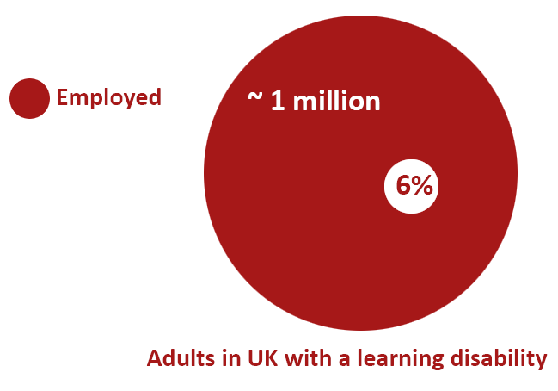
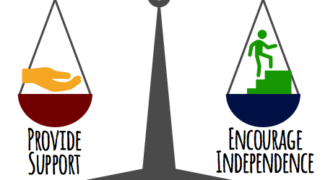
Research Purpose
People with Learning Disabilities Face Multiple Barriers to Living Independently
National Vision
All people with a learning disability are people first with the right to lead their lives like any others, with the same opportunities and responsibilities, and to be treated with dignity and respect

Slide 4
Essex County
Data on Residents with Learning Disabilities
27,000 people with a learning disability living in the county
5,600 estimated to have ‘moderate or severe’ disabilities.

Slide 5
Social Enterprises
Definition and Overview
Financial barriers
Financial support

Slide 6
Social Enterprises
HAVING A CLEAR SOCIAL PURPOSE
GENERATING A SIGNIFICANT PROPORTION OF THEIR INCOME FROM TRADING
REINVESTING THE MAJORITY OF THEIR PROFITS IN THEIR SOCIAL MISSION
VARYING BUSINESS MODELS UNITED BY:
Solving Social Issues and Generating Positive Impacts in the Community
Notes:
SE CONTRIBUTE £60 BILLION TO THE UK ECONOMY

Slide 7
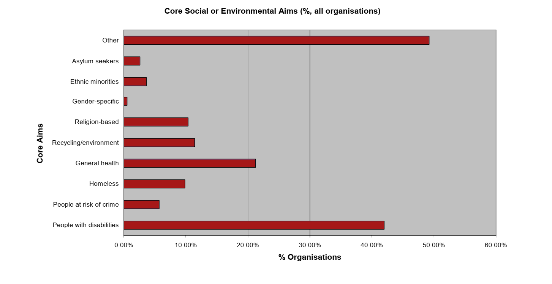
Social Enterprises
A TOTAL OF 100,000 SOCIAL ENTERPRISES IN THE UK
ONLY 430 IN ESSEX
ESSEX AREA ESTIMATE IS 1,615*
Numbers in Essex county
ONLY 1.5% OF EMPLOYEES IN ESSEX SEs ARE PEOPLE WHO ARE DISABLED – INDICATING EVEN LOWER LEVELS FOR PEOPLE WITH LEARNING DISABILITIES
* Social Enterprise in Essex report

Slide 8
Financial Barriers
High risk, low profitability: The deterrent of investment in social enterprises
Goal: the start-up and scaling of Employability Social Enterprises for people with a Learning Disability
Barrier: access to finance
Notes:
Typical Funding is very competitive:
Grants and Micro-grants?
Accelerators, incubators and challenges?
Venture capital and business angels?
Conventional Banks?

Slide 9
Financial Support: Social Finance
A range of methods through which individuals and organizations can invest in businesses that provide both a financial and a social return for the investor
SOCIAL LENDER BANKS
COMMUNITY BONDS
SOCIAL IMPACT BONDS
CROWDFUNDING
Financial Instruments
Surveys of Social Enterprises in Essex
The majority are unaware of Social Impact Bonds, Community Bonds and Community Share Issues as an option.
Around a third need for support with developing goods or services, marketing and measuring impact.
93% had heard of crowdfunding.
Notes:
Such a funding gap has led to the creation of financial instruments in the UK, known as social finance; amongst others, these take the form of social lender banks, community bonds, social impact bonds, and crowdfunding.
With this, many British public authorities have increasingly been ‘investing in localism’. These and similar policy efforts have indeed culminated in young social enterprises increasing, nationally, more than their commercial Small or Medium sized enterprise (SME) counterparts. Essex, as noted above, seems to be an exception, and most of the social enterprises are overwhelmingly unaware of these financing opportunities (with an exception held for crowdfunding), but when they are, they remain unskilled or hindered in operationalizing them.
More than half need for funding support in the future.
UK Government supportive of Social Investment, and has setup Tax Incentives
Social Finance: A range of methods through which individuals and organisations can invest in businesses that provide both a financial and a social return for the investor; including:
Social lenders: banks set up specifically to invest for social purpose, such as Triodos and Charity Bank.
Community Bonds/Community share issues: methods to enable stakeholders in a project to make investments, used particularly by the co-operative movement and, more recently by communities taking over assets such as community shops or pubs Social Impact Bonds – a specific product, operated in the UK by Social Finance – a method of third party investors providing finance to organisations delivering public services and where the public provider pays on the results delivered
Crowdfunding: next slide
The Essex Social Impact Bond:
In 2012 Essex County Council signed a contract with the Children’s Support Services to provide therapeutic support to adolescents at risk of going into care. Investors committed £3.1 million to fund interventions for 11–16 year olds at the edge of care or custody so that the young people can safely remain at home with their families. The Essex Social Impact Bond will fund a five-year programme which will provide intensive support to approximately 380 adolescents and their families. The target is to divert the equivalent of approximately 101 adolescents from entering care. The success of the Social Impact Bond will be measured by the reduction in days spent in care by the adolescents. If the interventions deliver successful outcomes, the investors might expect financial returns in the range of between eight and 12 per cent, as well as the satisfaction of the social outcomes achieved
- Crowdfunding has wide support but what is it? (next slide)

Slide 10
Financial Support : Donations & Grants
Sources and Characteristics
Unsustainable source of income Compared to diversified investments
Grants competitive to obtain
​
Mainly directed at start-ups
Neglecting enterprises that need to scale up​
FROM INDIVIDUALS AND THE PRIVATE SECTOR: AN AVERAGE OF £103,000 EACH
MUST BEWARE OF POTENTIAL CROWDING-OUT EFFECTS FROM GRANTS
FROM LOCAL AUTHORITIES: AN AVERAGE OF £59,900 EACH
Notes:
Grants from Public Authorities
On the other hand, grants are readily available for many social enterprises, even if such a source of funding is unsustainable (in comparison to diversified investments), competitive to obtain, and mainly directed at start-ups (disproportionately neglecting enterprises that need to scale up). Nonetheless, public authorities in Essex should be commended for the level of funding for social enterprises that they provide in grants, estimated average non-trading income of £59,900
Authorities must be wary of crowding out effects, where less amounts are donated in aggregate to an enterprise or a charity as a direct result of obtaining a grant from a single source, or by indirect effects arising from the consequences of deprioritizing fundraising activities following success in obtaining a grant. - Andreoni and Payne (2011). Always a chance nonetheless with current level of grants.
Unsustainable - compared to diversified investments ​
Competitive to obtain​
Mainly directed at start-ups – neglecting enterprises that need to scale up​

Slide 11
Employability Social Enterprises
The Social and Economic Integration of the Disadvantaged and Excluded
Supported Employment
The provision of job-matching and skills-training services
Work-integration
The direct creation of new jobs
Microenterprises
Self-employment
Notes:
- Mention that Work Integration IS ALSO KNOWN AS Sheltered Employment (for those experienced in the field)
- Mention these are three models, we will describe them, THEY ARE NOT mutually exclusive (some SEs can be hybrids) : MUTUALLY INCLUSIVE PARTNERSHIPS (hybrid supported employment and microenterprise)
- SHOULD be equally fostered.

Slide 12
Supported Employment Model
The Current Prevalent Model in Essex: Mitigating for the difficulties people with learning disabilities may face in typical recruitment processes
CV CREATION
HELP WITH APPLICATION FORMS
INTERVIEW PREPARATION
SKILL DEVELOPMENT
IN-WORK SUPPORT AND AFTERCARE
Provided since 2012
Referral system through social workers
Funded by National Department for Work and Pension, and European Social Fund
Provided since 2001
Recruits clients from schools
Funded by City of Edinburgh, Falkirk Fund, and the Big Lottery Young Start Fund
Notes:
The clients’ skills are assessed; their job preferences are set; and a process to search for suitable vacancies is kickstarted
Skill Development: helping them learn new skills by targeting suitable training or volunteering schemes.
In-work Support and Aftercare: In-work support and aftercare to help the clients with: settling in at work; understanding their rights and obligations; ensuring wages and benefits are correct , and dealing with any arisen problem
Action Group is a social enterprise that delivers Real Jobs, a supported employment service for adults with learning disabilities and other support needs in Scotland.
Realise Futures is a social enterprise, partnered with the Essex County Council, that delivers supported employment programmes for people with learning disabilities across Suffolk and Essex. Their European source of funding is now an uncertainty that is contingent on the outcomes of the British Exit from the European Union.
- Provided service time is limited by funding -> make argument why Action group is providing service for a longer time (more funding), check pictures attached in the appendix for funding numbers to build argument

Slide 13
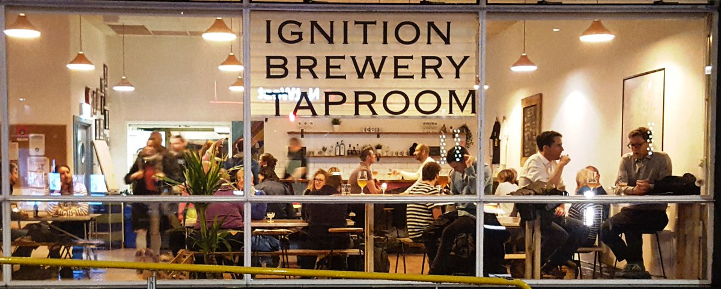
Work-integration Model
Social Enterprises that hire people with learning disabilities
Provided benefits:
Improved capability and autonomy in daily life
Improved socio-cultural skills
Improved professional skills
A Social Enterprise in Lewisham, that not only brews beer, but aims to create jobs for people with Learning Disabilities
A Social Enterprise run by The Camden Society, not just to serve coffee, but to be staffed by people with a range of physical and learning disabilities
Worldwide model
Austria, Ireland, Canada, Germany, Portugal, Sweden, Spain, France, Belgium, Italy, the UK, and South Korea
Notes:
Highlight that it is a CASESTUDY
Add emipirical studies line

Slide 14
Micro-enterprise Model
Enterprises run by people with learning disabilities
ENGAGEMENT WITH THE WIDER COMMUNITY
MINIMAL CAPITAL (HUMAN AND FINANCIAL)
ENTREPRENEURSHIP
HONE CONFIDENCE AND SKILLS TO ACCESS THE JOB MARKET AT A LATER STAGE
LOW COST
Founded by Jen, a girl with down syndrome that found it very difficult to access dance classes in her locality that could accommodate her disability
With the help of a grant she received, she formed a team of professionals to deliver numerous workshops to those socially excluded who may wish to learn to dance
Notes:
Not all practitioners call it a social enterprise, but most do
While we acknowledge the potential risk of business failure that this kind of initiative may entail, we also find in Microenterprises a way for the ECC to tackle two main issues that are determinant for the long-term wellbeing of people with Learning Disabilities. First, setting up an enterprise would not only help the entrepreneur to build the required confidence and skills to access the job market, but it would also push him or her to be an active member of the local community. Second, financing such activities is significantly inexpensive in relation to the costs of care that would be incurred were this initiatives are non-existent. Hence, the returns of the investment in a supported self-employment scheme would not only be potential income for the entrepreneur, but also an innovative approach to build skills and enhance inclusion at a lesser cost.

Slide 15
Crowdfunding as a financing tool
Advantages for local authorities
Equity crowdfunding
Making impact investments
Matched crowdfunding
Seen as a Collaborative Public-Private Sector Initiative

Slide 16
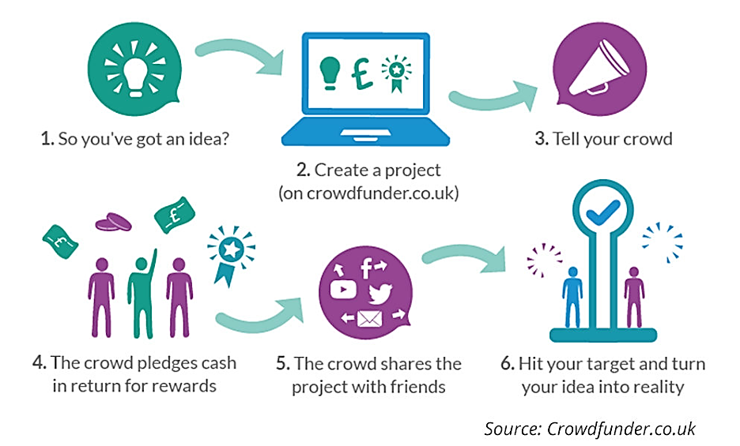
Crowdfunding
An alternative financial mechanism in emerging digital economies
THE FINANCIAL CONDUCT AUTHORITY CREATES A SUPPORTIVE REGULATORY ENVIRONMENT
U.K CROWDFUNDING MARKET RANKED AS THE LARGEST IN EUROPE.
Notes:
Crowdfunding is a method of financing that runs on an online platform, mediating transactions between a crowd of people and a project pitcher.
Crowdfunding platforms operate on different models, differing, for example, on whether backers keep the amounts raised – Keep-it-All – or discards of the funds raised if the target goal set by the projected pitcher has not been reached in the fundraising round – All-or-Nothing –.
Generally, although new models have evolved that are hybrids or thematic (example: Spacehive), crowdfunding can come in the forms of:
Donations and Rewards- where the project pitchers rely on the philanthropic spirit of the crowd or incentivize them with a promise of a reward, service, or product. Example: GoFundMe
Loans - where the project pitchers rely on the crowd to act as lenders; with their aim being to recover their contributions and earn interest. Example: Fundingcircle.
Equity - where the project pitchers rely on the crowd to act as investors purchasing shares or debentures. Example: Crowdcube.

Slide 17
Equity Crowdfunding
Targets a majority of the UK population interested in making impact investments
Investing with the intention to generate social and environmental impact alongside a financial return
56% of British people are interested in
purchasing social impact investment products.
90% of those that have invested previously in impact investments are likely to do so again.
Notes:
Equity Crowdfunding, its Benefits and Risks for Social Entrepreneurs
For British social enterprises, the equity model of crowdfunding is promising as it targets a majority of the UK population who are interested in making impact investments.
Only 9% have actually invested in the sector.

Slide 18
Benefits and risks
of Equity Crowdfunding
Helps fill the funding gap
Grants social entrepreneurs more autonomy
Acts as a marketing tool
Attracts volunteers from the local community – addressing the human capital gap
Fraud
Process could prove inefficient
Investors who are unaware of the risks of failure could retract further funding
Failure to raise the desired amount could discourage the management – public exposure

Slide 19
Equity Crowdfunding for Social Enterprises
Social Enterprises at an advantage, but this can’t be taken it for granted..
ENTERPRISES WITH A PRO-SOCIAL ELEMENT FARE BETTER AGAINST THE ‘WISDOM OF THE CROWD’
Toucan Employment is the UK's longest-running supported employment charity (est. 1989) for people with learning difficulties/disabilities.
Last year, despite their track record, they failed to reach their crowdfunding target to set-up a microbrewery that would have followed the Work-integration model.
SEs MAY LACK AWARENESS OF THIS ROUTE
SEs MAY LACK THE SKILLS CAPACITY NECESSARY TO RUN A CAMPAIGN
SOMETIMES FAILURE IS INEVITABLE
Notes:
There is, of course, no guarantee that project pitchers will be successful, but research has shown that enterprises with a pro-social element fare better against the ‘wisdom of the crowd’ than they do with professional investors and their due diligence processes; and so, bearing notable risks, social enterprises should be incentivized and trained in this form of social finance.

Slide 20
Matched Crowdfunding
Benefits and Risks
Benefits for Local Authority
Making your money go further by spreading grants out to more SEs
Publicity and awareness
Steering funding towards policy priorities and connecting with other funders
Benefits for Fundraising Project Pitchers
More likely to crowdfund
Risks for Public Authority
Public Perception of Moral Hazard: “The effect snowballs, and crowdfunding becomes an excuse to leave more and more basic services up to the crowd.”
SEs being created just to draw money from the crowd without ever delivering their social promise
If on an equity platform: turning grants to profit-making investments
More likely to succeed
Notes:
MATCHES – GRANTS – ARE MADE ALONGSIDE THE CROWD’S DONATIONS OR INVESTMENTS
CAN BE FROM VARIOUS PRIVATE AND PUBLIC INSTITUTIONS
RESTRICTED FOR SPECIFIC PROJECTS
By doing the following:
Providing guidance on the equity crowdfunding process
Setting up Match-funds
Local authorities can increase access to impact investments or donations and incentivize specific types of (social) enterprises

Slide 21
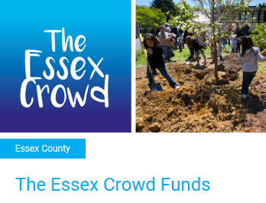
Matched Crowdfunding
A practice that has multiplied in Europe the past 5 years..
Big Society Capital set-up a 10 Million GBP to match-fund charities and social enterprises eligible for the Social Investment Tax Relief (SITR)
Essex County Council has already joined an array of local authorities in the UK in setting up a modest match-fund on the platform ‘Spacehive’ for enterprises featuring sustainable elements

Slide 22
Matched Crowdfunding
Data from crowdfunding platforms
Data from a Spanish Crowdfunding Platform that has a match-funding model indicates match-funding can increase the:
Chances of a campaign’s success
Average amounts donated
NESTA ran a nine-month pilot of Matched-crowdfunding for cultural projects with £251,500 worth of funds through the platform Crowdfunder.
86% (from a total of 4,970 backers) had not previously supported such cultural projects before
63% of the enterprises would not have crowdfunded if it were not for the match-fund
45% of projects discovered new partners or collaborators
Notes:
The National Endowment for Science Technology and the Arts (NESTA) together with the Department for Digital, Culture, Media & Sport (DCMS), Heritage Lottery Funds and the Arts Council England ran a nine-month pilot programme to explore the opportunities for matched crowdfunding as an innovative way of supporting under-funded cultural projects

Slide 23
Testing Our Proposal
First-hand data survey on a Matched Crowdfunding experiment

Slide 24
Matched Crowdfunding
Our own survey experiment on a randomized sample of 1025 British adults on the ProlificAcademic Panel
Following a definition of equity crowdfunding, respondents were shown this:
Imagine you have £20 to invest in a project on an equity crowdfunding platform. You will be presented with two business profiles, and can allocate all your money to buy a share in one of them, or divide the investment between them as you wish. Organizations that do not reach their target cannot keep or transfer the money they have raised, and it will be refunded to the investors. In that case, your allocation would be wasteful. Below are the two business profiles, read them carefully then please scroll down to allocate your money. The progress bar indicates the progress the organization has made to reach the necessary target in this round.

Slide 25
Matched Crowdfunding
Our own survey experiment on a randomized sample of 1025 British adults on the ProlificAcademic Panel
Coffee Shop and Wine Bar Invest in a coffee shop and wine bar, selling quality coffee and selected wines from its own roaster and vineyard. The coffee market currently stands at 2.3bn cups per year in the UK, and customer tastes are moving towards quality.
The project has been endorsed by a government authority who will, upon reaching the target goal, invest in the business, matching 25% of what was raised in this crowdfunding round.
Online Grocery Marketplace Invest in an online grocery marketplace featuring and delivering high quality groceries that wouldn’t be widely found in supermarkets. The independent grocery sector is worth over £10bn and there is a need for an online market. This business would be perfectly poised to take advantage of this gap.
Notes:
Draft Slides - incomplete

Slide 26
Matched Crowdfunding
Our own survey experiment on a randomized sample of 1025 British adults on the ProlificAcademic Panel
Coffee Shop and Wine Bar Invest in a coffee shop and wine bar, selling quality coffee and selected wines from its own roaster and vineyard. The coffee market currently stands at 2.3bn cups per year in the UK, and customer tastes are moving towards quality.
The project has been endorsed by a government authority who will, upon reaching the target goal, invest in the business, matching 50% of what was raised in this crowdfunding round.
Online Grocery Marketplace Invest in an online grocery marketplace featuring and delivering high quality groceries that wouldn’t be widely found in supermarkets. The independent grocery sector is worth over £10bn and there is a need for an online market. This business would be perfectly poised to take advantage of this gap.
Notes:
Draft Slides - incomplete

Slide 27
Matched Crowdfunding
Our own survey experiment on a randomized sample of 1025 British adults on the ProlificAcademic Panel
Coffee Shop and Wine Bar Invest in a coffee shop and wine bar, selling quality coffee and selected wines from its own roaster and vineyard. The coffee market currently stands at 2.3bn cups per year in the UK, and customer tastes are moving towards quality.
The project has been endorsed by a reputable investor who will, upon reaching the target goal, invest in the business, matching 25% of what was raised in this crowdfunding round.
Online Grocery Marketplace Invest in an online grocery marketplace featuring and delivering high quality groceries that wouldn’t be widely found in supermarkets. The independent grocery sector is worth over £10bn and there is a need for an online market. This business would be perfectly poised to take advantage of this gap.
Notes:
Draft Slides - incomplete

Slide 28
Matched Crowdfunding
Our own survey experiment on a randomized sample of 1025 British adults on the ProlificAcademic Panel
Coffee Shop and Wine Bar Invest in a coffee shop and wine bar, selling quality coffee and selected wines from its own roaster and vineyard. The coffee market currently stands at 2.3bn cups per year in the UK, and customer tastes are moving towards quality.
The project has been endorsed by a reputable investor who will, upon reaching the target goal, invest in the business, matching 25% of what was raised in this crowdfunding round.
Online Grocery Marketplace Invest in an online grocery marketplace featuring and delivering high quality groceries that wouldn’t be widely found in supermarkets. The independent grocery sector is worth over £10bn and there is a need for an online market. This business would be perfectly poised to take advantage of this gap.
Notes:
Draft Slides - incomplete

Slide 29
Matched Crowdfunding
Our own survey experiment on a randomized sample of 1025 British adults on the ProlificAcademic Panel
Coffee Shop and Wine Bar Invest in a coffee shop and wine bar, selling quality coffee and selected wines from its own roaster and vineyard. The coffee market currently stands at 2.3bn cups per year in the UK, and customer tastes are moving towards quality.
The project has been endorsed by a reputable investor who will, upon reaching the target goal, invest in the business, matching 50% of what was raised in this crowdfunding round.
Online Grocery Marketplace Invest in an online grocery marketplace featuring and delivering high quality groceries that wouldn’t be widely found in supermarkets. The independent grocery sector is worth over £10bn and there is a need for an online market. This business would be perfectly poised to take advantage of this gap.
Notes:
Draft Slides - incomplete

Slide 30
Matched Crowdfunding
Our own survey experiment on a randomized sample of 1025 British adults on the ProlificAcademic Panel
Coffee Shop and Wine Bar Invest in a coffee shop and wine bar, selling quality coffee and selected wines from its own roaster and vineyard. The coffee market currently stands at 2.3bn cups per year in the UK, and customer tastes are moving towards quality. This business would be perfectly poised to take full advantage of this trend.
Its core mission, simultaneous with making profits, is hiring and training people with learning disabilities who struggle with employment.
Online Grocery Marketplace Invest in an online grocery marketplace featuring and delivering high quality groceries that wouldn’t be widely found in supermarkets. The independent grocery sector is worth over £10bn and there is a need for an online market. This business would be perfectly poised to take advantage of this gap.
Notes:
Draft Slides - incomplete

Slide 31
Matched Crowdfunding
Our own survey experiment on a randomized sample of 1025 British adults on the ProlificAcademic Panel
Notes:
Draft Slides - incomplete

Slide 32
Matched Crowdfunding
Our own survey experiment on a randomized sample of 1025 British adults on the ProlificAcademic Panel
The social element of hiring people with LD boosted average-size of contributions by ~£1.60 (17%).
Notes:
Draft Slides - incomplete

Slide 33
Matched Crowdfunding
Our own survey experiment on a randomized sample of 1025 British adults on the ProlificAcademic Panel
The progress of the crowdfunding round at 75% (as opposed to 25%) boosted average-size of contributions by ~£1.26 (13%).
Notes:
Draft Slides - incomplete

Slide 34
Matched Crowdfunding
Our own survey experiment on a randomized sample of 1025 British adults on the ProlificAcademic Panel
The top-up match-fund of 25% by a private entity boosted average-size of contributions by ~£0.22 (2%).
The top-up match-fund of 50% by a private entity boosted average-size of contributions by ~£0.74 (8%).
The top-up match-fund of 25% by a local authority boosted average-size of contributions by ~£2.12 (23%).
The top-up match-fund of 50% by a local authority boosted average-size of contributions by ~£1.20 (13%).
Notes:
Draft Slides - incomplete

Slide 35
Key Recommendations
For the Essex County Council
Working with social enterprises towards accessing social finance in Essex
Dedicating resources to training social entrepreneurs and current social enterprises in organizing crowdfunding rounds for seed and scale up money
Collaborating with a crowdfunding platform to provide access to an investment match-fund for Employability Social Enterprises focused on Learning Disabilities, thereby incentivizing entrepreneurship and growth in this sector
Notes:
Fosters partnerships with Social Enterprise UK in order to diversify the institutional support that social enterprises in Essex receive
Develops and maintains a comprehensive database of the characteristics and number of social enterprises in Essex

Slide 36
Thank You
2018-19
Sorin Bobeica
Mahdi Ghuloom
CHALLENGE PROJECT
Giulia Nava
Mariona Nogueras
Gabriel Perez
Anamika Shaivya
Special thanks to:
Mr. Thomas Aldworth
Professor Han Dorrusen
Professor Robert Johns
Dr. Denise Lovett

Slide 37
References
ACTION GROUP UK. (2018). Annual Review 41.
ACTION GROUP UK. (2019). Home - The Action Group. Retrieved from https://actiongroup.org.uk/
Andreoni, J. and Payne, A. (2011). Is crowding out due entirely to fundraising? Evidence from a panel of charities. Journal of Public Economics, [online] 95(5-6), pp.334-343. Available at: https://www.sciencedirect.com/science/article/abs/pii/S0047272710001714 [Accessed 13 Jan. 2019].
Anglia Ruskin University. (2016). Social Enterprise in Essex. Retrieved from https://www.anglia.ac.uk/-/media/Files/3rd-sector-futures/Social-Enterprise-in-Essex-final.pdf?la=en&hash=807DD93A5DD74985CE2B66B7DF6EA862
Ballantyne, P. and Kennedy, R. (2016). Great Expectations. Exploring the life ambitions of young people with disability. The Public Office. Essex County Council.
Barclays (2015). The Value of Being Human: A Behavioural Framework for Impact Investing and Philanthropy. [online] Barclays. Available at: http://www.centapse.com/wp-content/uploads/2016/10/Value-of-Being-Human.pdf [Accessed 11 Dec. 2018].

Slide 38
References
Bergamini, T., Navarro, C. and Hilliard, I. (2017). Is Crowdfunding An Appropriate Financial Model For Social Entrepreneurship?. Academy of Entrepreneurship Journal, [online] 23(1), pp.44-57. Available at: https://www.abacademies.org/articles/is-crowdfunding-an-appropriate-financial-model-for-social-entrepreneurship-1528-2686-23-1-104.pdf [Accessed 11 Dec. 2018].
Bone, J. and Baeck, P. (2016). Crowdfunding Good Causes: Opportunities and Challenges for Charities, Community Groups and Social Entrepreneurs. [online] NESTA. Available at: https://ofti.org/wp-content/uploads/2016/06/crowdfunding_good_causes-2016.pdf [Accessed 14 Jan. 2019].
British Council (2015). Social Enterprise in the UK: Developing a Thriving Social Enterprise Sector. [online] Available at: https://www.britishcouncil.org/sites/default/files/social_enterprise_in_the_uk_final_web_spreads.pdf [Accessed 11 Dec. 2018].
Brussels, Belgium: European Crowdfunding Network. Available at: https://eurocrowd.org/wp-content/blogs.dir/sites/85/2018/07/ECN_CF4ESIF_Report_Triggering-Participation_2018.pdf [Accessed 12 Jan. 2019].
Cambridge Centre for Alternative Finance. Available at: https://www.jbs.cam.ac.uk/fileadmin/user_upload/research/centres/alternative-finance/downloads/2018-5th-uk-alternative-finance-industry-report.pdf [Accessed 13 Jan. 2019].

Slide 39
References
Charity Finance Group. (2016). How is local government using social investment?. [online] Available at: https://cfg.org.uk/how-is-local-government-using-social-investment [Accessed 11 Dec. 2018].
Cosma, S., Grasso, A., Pagliacci, F. and Pedrazzoli, A. (2018). Is Equity Crowdfunding a Good Tool for Social Enterprises?. Centro Studi di Banca e Finanza (CEFIN) (Center for Studies in Banking and Finance) 0067, Universita di Modena e Reggio Emilia, Dipartimento di Economia "Marco Biagi".. [online] Available at: https://ideas.repec.org/p/mod/wcefin/0067.html [Accessed 11 Dec. 2018].
Davies, R. (2014). Three provocations for civic crowdfunding. Information, Communication & Society, [online] 18(3), pp.342-355. Available at: https://www.tandfonline.com/doi/abs/10.1080/1369118X.2014.989878 [Accessed 13 Jan. 2019].
Endeva. (2011). Microenterprise and People with Learning Disabilities. Retrieved from http://www.thecamdensociety.co.uk/upload/public/microenterprise_and_learning_disability_nov_11_final_copy_1_.pdf
Hazam, D., Karimova, D. and Olsson, M. (2017). Crowdfunding as a Source for Social Enterprise Financing. Undergraduate. Jönköping University.
Mollick, E. (2014). The dynamics of crowdfunding: An exploratory study. Journal of business venturing, 29(1), 1-16.

Slide 40
References
REALISE FUTURES UK. (2018). Annual Report 2017-2018.
REALISE FUTURES UK. (2019). Home | Realise Futures. Retrieved from https://www.realisefutures.org/
Senabre, E. and Morell, M. (2018). Match-Funding as a Formula for Crowdfunding. Proceedings of the 14th International Symposium on Open Collaboration - OpenSym '18.
Social Enterprise East of England (2017). Social Investment in Essex. [online] Social Enterprise East of England. Available at: http://www.seee.co.uk/media/108310/social_investment_in_essex_final.pdf [Accessed 11 Dec. 2018].
Social Enterprise UK (2018). Hidden Revolution: Size and Scale of Social Enterprise in 2018. Social Enterprise UK. Available at: https://www.socialenterprise.org.uk/the-hidden-revolution.
The Social Innovation Partnership (2018). Putting the Pieces Together: A Practical Guide to Matched Crowdfunding. [online] Available at: https://tsip.co.uk/images/features/Putting-the-Pieces-Together-A-Practical-Guide-to-Matched-Crowdfunding.pdf [Accessed 12 Dec. 2018].
Vidal, I. (2005). Social Enterprise and Social Inclusion: Social Enterprises in the Sphere of Work Integration. International Journal of Public Administration, 28(9-10), pp.807-825.
Walthoff-Borm, X., Vanacker, T. and Collewaert, V. (2018). Equity crowdfunding, shareholder structures, and firm performance. Corporate Governance: An International Review, [online] 26(5), pp.314-330. Available at: https://onlinelibrary.wiley.com/doi/full/10.1111/corg.12259 [Accessed 11 Dec. 2018].

Slide 41
Appendix

Slide 42
Types of Match-funding

Slide 43
Forms of Crowdfunding
INVESTMENT-BASED
EQUITY OR LOAN
DIFFERING FUNDING MECHANISMS
KEEP-IT-ALL VS ALL-OR-NOTHING
NON-INVESTMENT BASED
DONATIONS VS REWARD

Slide 44
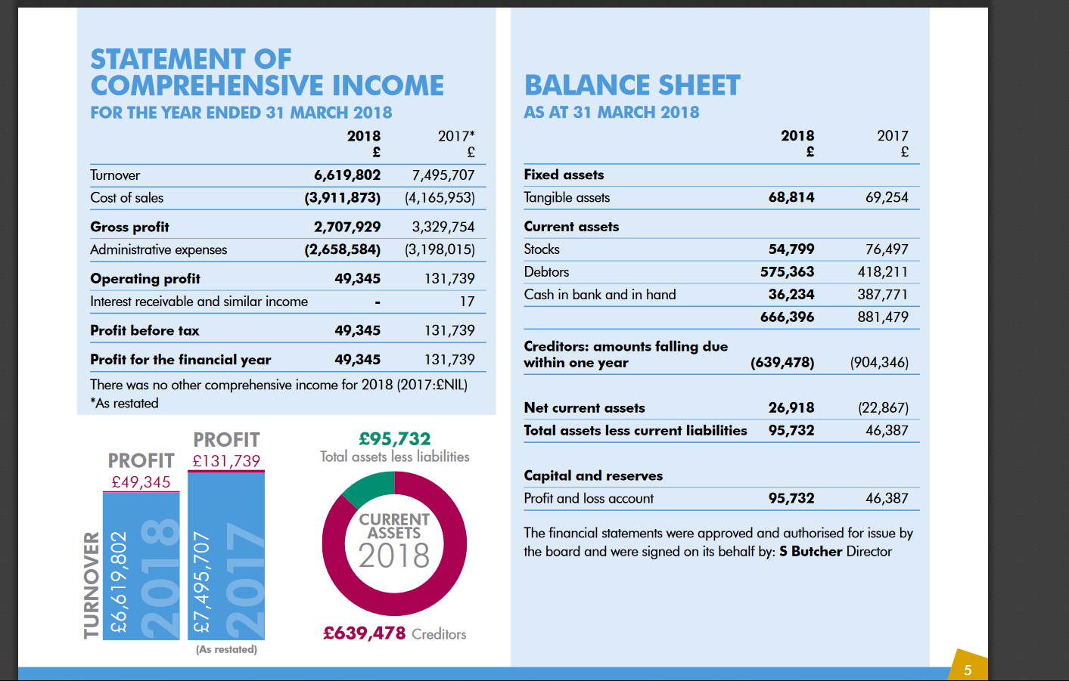
Realise futures 2018 statement

Slide 45
Action group Finance

Slide 46
Extrapolated information according to population for SE in Essex

Slide 48
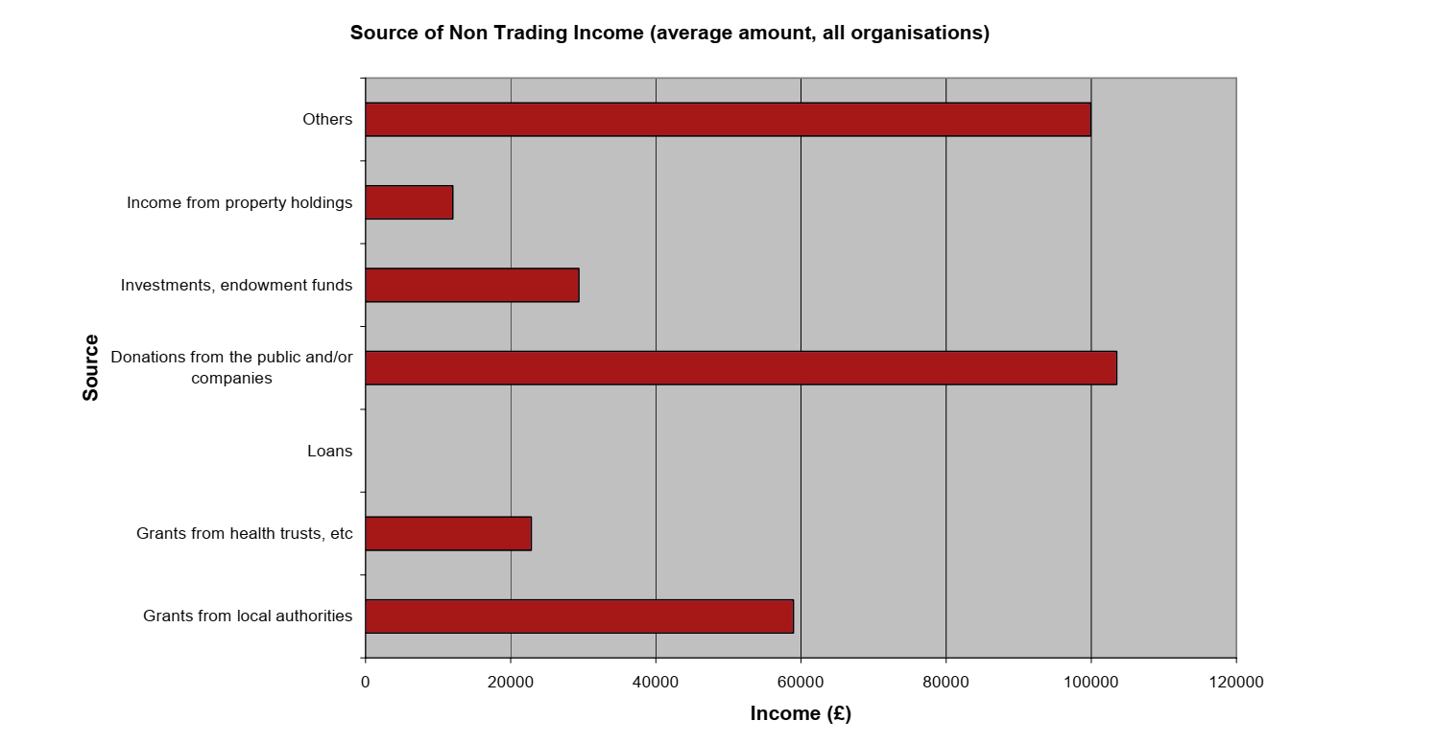
Source of non-trading income for SE in Essex

Slide 49
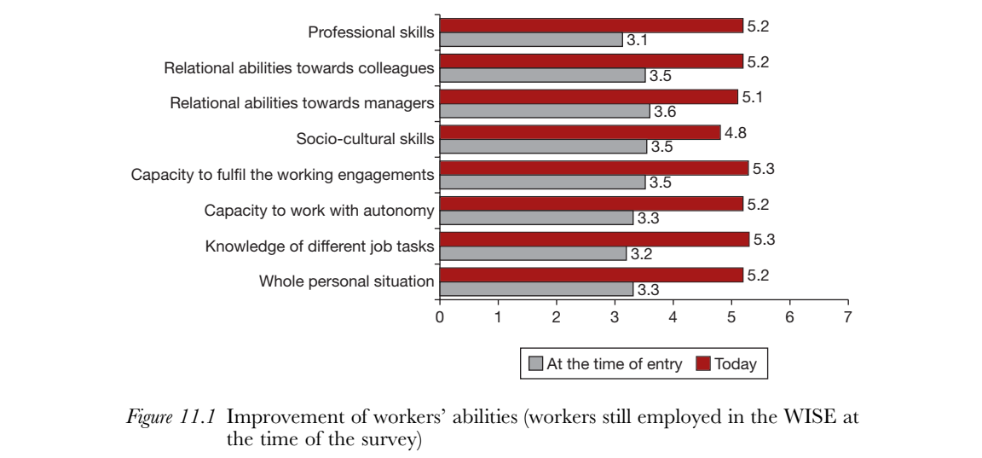
WISE skills improvement – benefits

