Slide 1
“Neighbour friendships have been formed that will last permanently"
Neighbourliness, community and volunteering
Interviews with Essex residents about their attitudes and experiences during the COVID-19 pandemic
September 2020
Version 1.0
The 2019 English Indices of Deprivation
ESSEX
2019
Research & Citizen Insight
Strategy, Insight & Engagement
Essex County Council

Slide 2
Introduction
Introduction
This research aimed to track resident attitudes and experiences during the COVID-19 pandemic to:
Explore how different types of residents and households were impacted.
Understand what day to day life was like for different types of households.
Record how experiences and attitudes changed over the lockdown period and beyond.
The insight was obtained through a series of video/telephone interviews (mostly via Teams) with fifteen Essex residents recruited from respondents to the Essex Residents survey 2020 who volunteered to take part in further research.
Research areas
This specialist topic report explores the themes of neighbourliness, community and volunteering.
It brings together the views of all participants.
These insight slides include: case studies, quotes and provocation questions aimed at decision makers to facilitate discussion and determine actions to improve the lives of Essex residents.

Slide 3
Supporting each other, neighbourliness and volunteering
Participants have become part of local support networks in their neighbourhoods that keep an eye out for each other
Existing networks are more active or stronger since lockdown
People are looking to friends, family and neighbours first before formal support
People have become more innovative at keeping face-to-face contact while social distancing; over the fence conversations, driveway coffees and technology are in far more use
The situation has triggered an increase in ‘neighbourliness’, with people organising events while adhering to social distancing, reaching out more to each other.
Many did not describe their community activities as ‘volunteering’; messaging for communications and promotions may need to be rethought.
Largely not volunteering unless they have in the past, due to other priorities and vulnerability
Those new to the area, in less active communities, with few neighbours nearby or no other adult company are less likely to be involved in mutual support
Many hope this increased neighbourliness and community spirit will continue in the future, although some feel it has already decreased as restrictions ease

Slide 4
Personas by Neighbourliness
There are some differences between our different personas
Our participants are independent and mostly self-reliant. Most have existing support networks, some of which have got stronger since the lockdown. None would expect support from a formal organisation.
Families with Children
Employed
Self-employed
Retired
Less likely to be volunteering due to family commitments
Involved within the school, e.g. school governor
Less likely than self-employed to be volunteering and less likely to have volunteered in the past
Most likely to be volunteering
Experience of volunteering in the past
Less likely to be volunteering at the moment due to age/other vulnerability
Some volunteered and currently do so online
64% agreed that other local community members would support them if they needed help during the coronavirus (COVID-19) pandemic and 78% said they thought people are doing more to help others since the COVID-19 pandemic. In the past seven days, 63% said they had checked on neighbours who might need help at least once and 38% said they had gone shopping or done other tasks (such as dog walking) for neighbours
Source: Source: Coronavirus and the social impacts on Great Britain: ONS bulletin 23.4.20 (survey 3-13 Apr)

Slide 5
Neighbourliness
Participants have become part of local support networks in their neighbourhoods.
They haven’t needed any help or support, formal or informal. Instead, they have become part of local support networks in their neighbourhoods.
Helping family and friends
Mutual support within the neighbourhood
Increased neighbourliness
Checking on family or friends; running occasional errands for them (shopping or getting items).
Concerned over their elderly relatives, who they cannot care for or support as they wish, with some living far away.
Neighbours have offered to get items for each other as part of their own shopping
Some proactively offered help in their communities
Mutual support has developed or grown stronger gradually for most.
Some draw on these offers for shopping occasionally
Technology has been used in some cases to facilitate contact, e.g. WhatsApp groups.
3 participants were not in touch with their neighbours, due to being new to the area, no neighbours close by, or were just not part of an active community.
“We share the care for my father-in-law with my brother-in-law and his wife, both in their 70s. We do a week each, a shopping run etc.”
“We live in a fabulous road. We have a little chat over the garden wall, someone dropped some plants around earlier in the week. I’m going to drop a cake round to someone.”
“Six of us now have a little WhatsApp group. So if somebody needs something, they'll just say ‘Has anybody got?’.”

Slide 6
Neighbourliness
People have become more innovative at keeping face-to-face contact while social distancing
Many people have stayed connected by:
Having conversations over the fence
Having a coffee or meal on their driveway/terrace
Parties outside houses to celebrate birthdays
Replacing a holiday to France with a 'French food day’ in their family's garden once restrictions were lifted.
Participants were hopeful that this sense of community will continue. However some feel that this will not be long lasting and will likely end as people spend more time outside the home or move from the area.
If participants ever needed help, they would approach friends, family or neighbours and would not rely on formal organisations.
Many would not particularly know where to look for formal support, but if the need arose, they would most likely start with looking online or through social media. One participant would approach his local church.
“If we're going to be like this for a couple of years, then it probably will fundamentally change us, or won’t. … But if this is just going to go on for another few months then it will become a distant memory, I don't think there will be a lasting change.”
“Sure we could survive with our friends around us rather than any sort of formal help from organisations or that sort of thing.”
How can we ensure the neighbourliness remains supportive longer term?
How can we identify and encourage less active communities to help each other in this way?

Slide 7
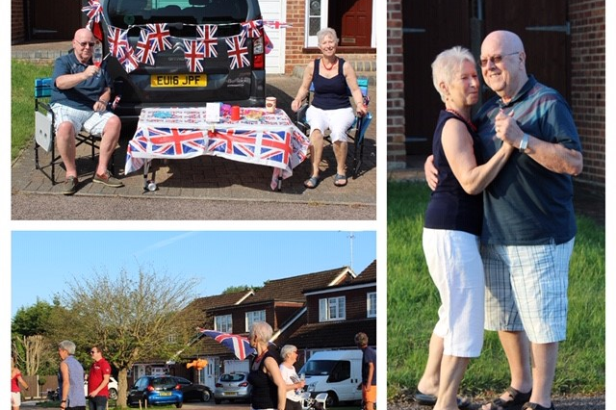
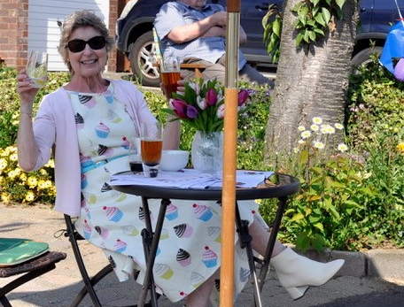
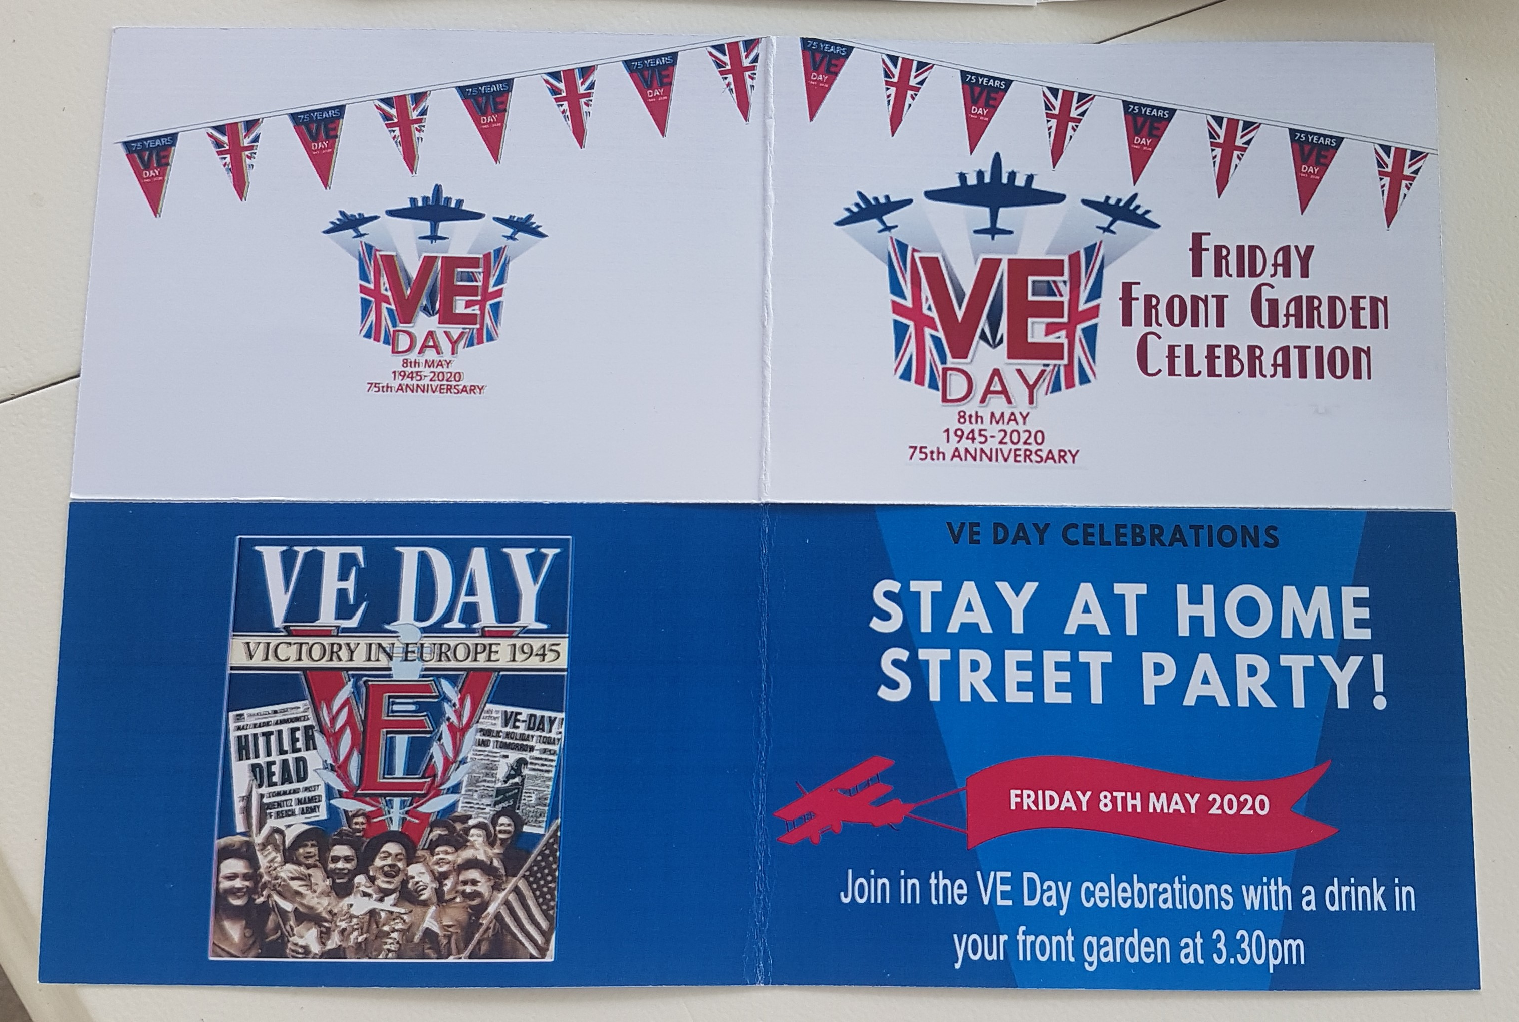
Half of respondents mentioned very lively VE Day (8th May) street parties, which are unlikely to have happened if lockdown was not in place.
However, organisation of such events depended on pro-active individuals within these neighbourhoods.
“You have to make it happen; I mean to be honest if us oldies hadn’t have planned it nobody would have come out at all, I don’t think!”
“We had a great time with going over to the neighbours’ gardens and chatting and that kind of thing.”
“Neighbour friendships have been formed that will last permanently. We had it already but talking about other people here, they will know each other better, be more willing to help.”

Slide 8
Neighbourliness
Many did not describe their community activities as volunteering
Around half of participants volunteered in some shape or form but did this even before the lockdown. However, they often did not describe these activities as volunteering. Some of these activities have either paused, been altered or are currently being done online, others are new since lockdown, which created a different demand. One has stopped volunteering, as her business has reopened and she can no longer afford a day off to do volunteering.
Two participants specifically mentioned coming forward as a volunteer during the lockdown, but not being contacted back.
Others (especially working parents) were not considering volunteering, predominantly due to other priorities or vulnerability.
Future work focusing on volunteer recruitment may need to consider using wider terminology surrounding ‘volunteering’, as it may not be as widely recognised as expected.
Several were active in facilitating local Brownie groups, sat on Parent Teacher Associations or were school governors.
Other activities included:
Making refreshments at a local event or editing a village magazine
Cleaning elderly people’s homes
Delivering items e.g. shopping to homes or food banks
Providing safety advice and guidance
Batch cooking
Befriending
“I wasn’t enjoying my business life and wanted to work 4 days a week. I was bored after the first week so looked for something else. Volunteering enriched my life more than the clients. I love my ‘volunteering Wednesdays’.”

Slide 9
Other specialist topic reports
This report is just one of a series. Have you seen the others?
“I don’t think there’s ever going to be a ‘normal’ as we knew it” – A summary of key themes
“It’s like the whole world has stopped and there is nothing else happening anywhere” - Response to coronavirus outbreak and the day-to-day impact
“Being with your child 24/7 is tough” – Experiences of Essex working parents
“I’m still working at home… and saving money” – Experiences of employment and personal finance
“Being able to go for a proper walk is really important” - Health and wellbeing

Slide 10
Contact Us
This information is issued by:​
Essex County Council​
Strategy, Insight & Engagement ​
Research & Citizen Insight​
​
​
You can contact us in the following ways:​
​
By email: ​
katerina.glover@essex.gov.uk​
maresa.beazley@essex.gov.uk; maura.o-malley@essex.gov.uk; poppy.reece@essex.gov.uk
​
Visit our website:​
www.essex.gov.uk​
​
By telephone:​
033301 30874​
​
By post:​
Essex County Council, Research & Citizen Insight (SIE)​
D202, County Hall, Chelmsford, Essex CM1 1QH

