Slide 1
“It’s like the whole world has stopped and there is nothing else happening anywhere"
Response to the coronavirus outbreak and the day to day impact
Interviews with Essex residents about their attitudes and experiences during the COVID-19 pandemic
September 2020
Version 1.0
The 2019 English Indices of Deprivation
ESSEX
2019
Research & Citizen Insight
Strategy, Insight & Engagement
Essex County Council

Slide 2
Introduction
Introduction
This research aimed to track resident attitudes and experiences during the COVID-19 pandemic to:
Explore how different types of residents and households were impacted.
Understand what day to day life was like for different types of households.
Record how experiences and attitudes changed over the lockdown period and beyond.
The insight was obtained through a series of video/telephone interviews (mostly via Teams) with fifteen Essex residents recruited from respondents to the Essex Residents survey 2020 who volunteered to take part in further research.
Research areas
This specialist topic report explores the themes people’s initial responses to the Coronavirus outbreak and their subsequent day to day impact for them.
It also covers more detail on how participants accessed information during the pandemic, keeping in touch with others (digital), shopping habits and their hopes for the future.
The report brings together the views of all participants.
These insight slides include: case studies, quotes and provocation questions aimed at decision makers to facilitate discussion and determine actions to improve the lives of Essex residents.

Slide 3
Response to the coronavirus situation
Initial government measures were welcomed by most, and seen as necessary although caused some initial concerns and anxieties
Some people took active steps to plan for lockdown to ensure they could stay at home as much as possible
As measures were lifted, some began to question the logic and clarity of the guidance, resulting in frustration and some deviation from the rules
They seek out official sources for information, but some are switching off due to the repetition and negative news
As time goes on, all have adapted well and settled into a routine, finding things to do to keep busy, active and positive
Many have continued to ‘stay home’ despite the ‘stay alert’ message
Some of those living alone and working and/or caring for children are finding lockdown more difficult, whereas retired people continue to thrive

Slide 4
Life in Lockdown by personas
Retirees settled into the routine of lockdown the quickest
Families with Children
Employed
Self-employed
Retired
Most finding it more difficult than others managing both work and childcare, particularly single parents or those with younger children
Getting used to working from home and finding routines that work took a bit more time
Most have considerable impacts to working life and finance
Some enjoying more free time despite the difficulties
Managing better than the other personas due to fewer responsibilities (childcare and work) and stable incomes
In a national survey conducted 20-22, 41% of people had not left their home at all on five or more of the previous seven days, indicating the seriousness with which people are still treating the crisis. 14% did not leave their home once in the previous week, despite restrictions being eased to the ‘stay alert’ message earlier in the month (11 May Prime Minister announcement).
Source: King’s College London and MORI (2020), Getting used to life under lockdown? Coronavirus in the UK
An online survey by Ipsos MORI finds 47% are spending more time on social media, 39% are gardening, 33% read books, 25% playing board games / puzzles and 25% trying new types of exercise
Source: Ipsos MORI Coronavirus polling Public 10-13 April 2020 (Adults aged 18+ in GB)

Slide 5
Initial response to measures
Initial government measures were welcomed by most and seen as necessary.
While there was a degree of anxiety and concern among some when lockdown measures were first introduced, this did not come as a surprise to most participants, many of whom were following events unfold around the world.
All felt the guidance was clear and easy to understand – all participants accepted the restrictions.
Some took the ‘stay home’ message very seriously, and felt they were keeping safe and doing their civic duty by following this, particularly if family members had underlying health issues.
Several also described the moment it hit them that life was about to change significantly.
“We’re locked down, we don’t go out… we get the click and collect shop once a week… it’s my choice not to go out, I just can’t be bothered to be honest, but they [government] don’t want me to go out, so I’ll go along with it… I don’t see how it can be any clearer.”
“When WHO declared it a pandemic then it really hit home. It hit home if we do stay indoors, then in theory we’ll be ok if we do the other things, too.”
“Initial thinking was we were overreacting. In hindsight my thought process has completely changed and perhaps we should have done it [lockdown] earlier… the first week, saw reaction, death count rise, you do have fears.”

Slide 6
Initial response to measures
Some took active steps to prepare or make arrangements for lockdown.
Some made changes to living arrangements before lockdown, e.g. older children moving out to live with partners, ex-partners moving in to help with parenting, or relatives moving in with elderly parents.
“We told our son if work stops and you're here, you're not going to see her [girlfriend]. You gotta stay here or go there. So he went to stay with her just before lockdown.”
[Ex-partner moved in to help with parenting] – “He only lasted 5 days and then left... We obviously have a completely different approach to childcare.”
Some also made preparations to ensure they had enough food for the immediate term in case of lockdown or were already in the habit of having stocked cupboards.
Others took steps to prepare for working from home when they realised the measures could be in place for some time.
“I'm at the end of the village and we have been snowed in twice. There are no shops so from the beginning my habit has been to have storage cupboards with all the non-perishables.”
“My son got a cough two weeks before lockdown. We went into self-isolation for 14 days. I masked myself and put gloves on and said to my boss I'm going to get my work laptop and my paperwork, and these are the things I can do from home. I knew at that point when I said goodbye to my boss that I probably wouldn't be back at work for quite a long time.”

Slide 7
Life in lockdown
As measures were lifted, some began to question the logic and clarity of the guidance, resulting in frustration and some deviation from the rules.
Responses to the measures and experiences as time goes on seem to be more influenced by individual’s attitudes and personal ways of coping, rather than key features of their lives such as employment or whether they have children or not.
Some are becoming more frustrated, bored or stressed, whereas others are becoming ‘acclimatised’.
W/C 11th May
Unlimited outdoor exercise and can meet one other person outside (not private garden)
W/C 18th May
2nd interviews with
participants
1st June
Can meet up to 6 people outdoors, including private gardens
“We’ve been having people round in small groups in the back garden distancing. I know we shouldn’t be doing that, but I think people are… You can meet in a park and I think we might as well meet in my garden. In a park you are probably more near other people. To me there’s no harm in it.”
“I felt a bit confused really. My friend wanting to meet her son, but does that mean he can’t bring the baby? These half measures mean it’s a bit too unclear.”
“It's almost like ‘acclimatised’. I just think it's become so normal now that I don't think of it as ‘isolating’ anymore.”

Slide 8
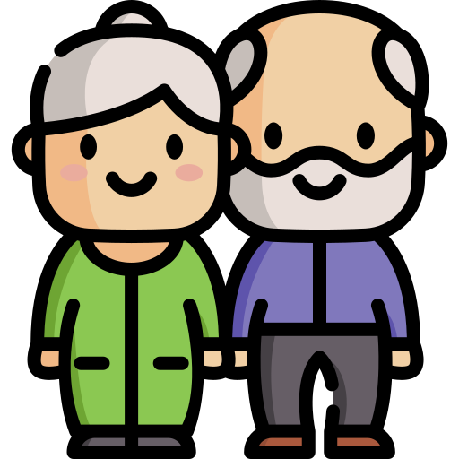
Life in lockdown
As time goes on, all have adapted well and settled into a routine. Some of those working and/or caring for children are finding lockdown more difficult, whereas retired people continue to thrive.
Self-employed
Families with Children
Employed
Retired
Struggling/higher risk of difficulties
Coping/managing
Thriving/minimal risk of difficulties
Despite a minority of retired people feeling they may soon ‘run out of things to do’ or feeling fed up, all in this group are still managing very well. Their main concerns are for their families and the potential impacts on the lives of their adult children and grandchildren.
While some of those with children are struggling with balancing childcare and work, most are managing well having settled into a routine and found ways of coping, with many enjoying the extra family time. Their main concerns are for their children’s health and education.
“It’s still so unknown whether there are long term health implications if my children get it. It's new and there's not enough research.”
“I don't think there's enough feedback coming from teachers which puts more pressure on me to review work. I think if it went on for a long time, it wouldn’t be enough really. We're not home schooling really. It wouldn’t be sustainable for them to be able to get a good education.”
“It took me pretty much a full year to settle him into nursery. Now he's gonna be at home with me every single day for about 6 months. By the time he starts school it will be a nightmare trying to settle him. I wanted him to have a nice experience of starting school. No now the question is, do we send him to school in September?”
Is there a role for ECC to support families and schools in preparing for pupils returning?
Some of those who are self-employed have concerns around their finances and are conscious of the unpredictability of their situation. Some are uncertain about how and when to reopen their business and feel this could set them back years.
How can ECC ensure those at greater financial risk do not ‘fall through the net’?

Slide 9
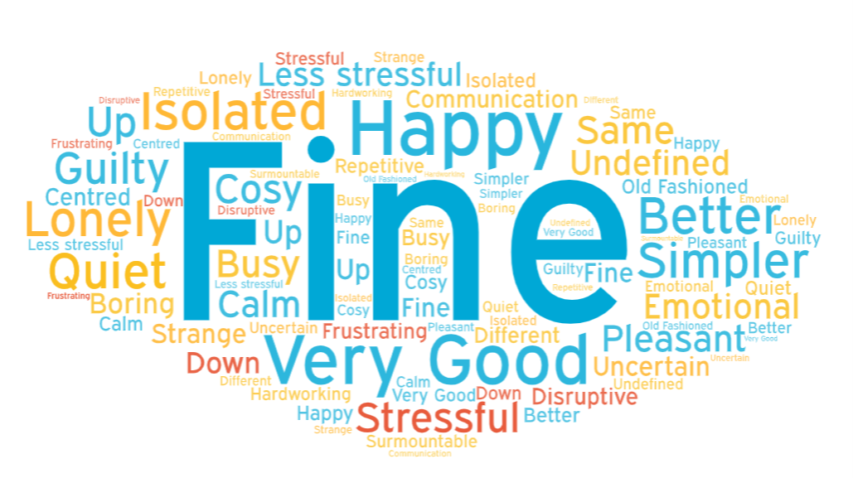
Life in lockdown
Whilst many are managing well, some of those living alone or juggling work and childcare are finding lockdown harder than others.
Generally those who are retired are managing well, whereas some of those juggling work and children, or living alone, found this harder in the first few weeks of lockdown.
Some felt bored and frustrated, while others were enjoying the extra time.
We asked participants to give us three words to describe life in their household during lockdown – this is what they said in the first interview:
“I find it quite difficult being in the house all the time.”
“I feel ever so slightly guilty about feeling so happy about it.”
“Lonely, emotional, undefined – no concept of time. First week of lockdown, I think I probably was depressed because I couldn't go and see my mum, I couldn't see my grandson. I felt very, very alone. But a few weeks on and I suppose acceptance has kicked in.”

Slide 10
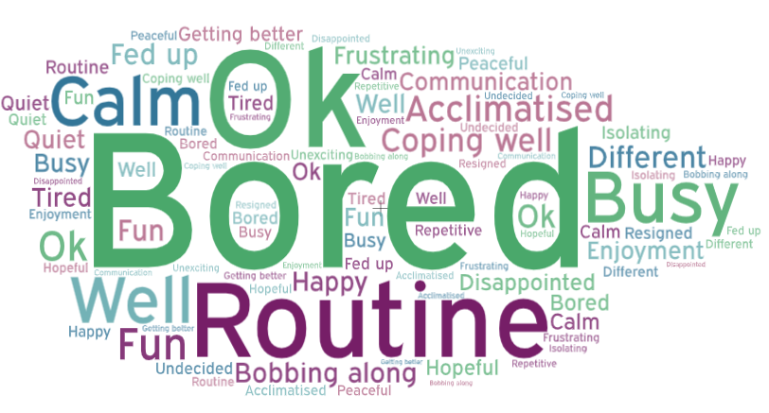
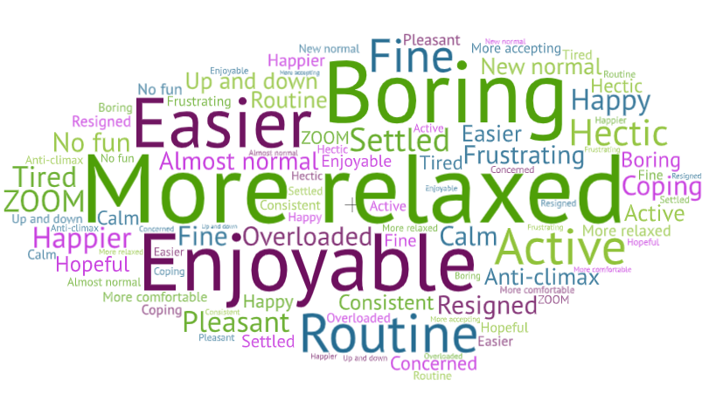
Life in lockdown
And this is how they felt as time went on:
Interview 2 (end of May):
Participants’ overall feelings about the lockdown were not changing dramatically over time.
They either got more settled into their routines, or their frustrations increased.
Interview 3
(end of June):

Slide 11
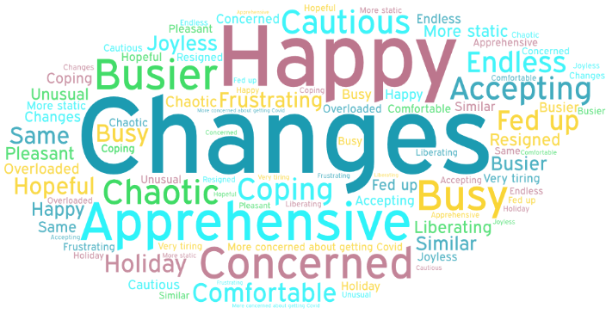
Life in lockdown
And this is how they felt by the last interview:
Interview 4 (mid Sept):
“I have just resigned to this way of working (i.e. working from home full time).”
“I’ve gone back to all the not so nice parts of my life – going to work, doing my chores… but all the stuff that actually brings you joy you’re not allowed to do.”
“We did feel relatively safe a couple of months ago but now we are more concerned about getting Covid because the schools have been back, people are back at work, shops are open…”

Slide 12
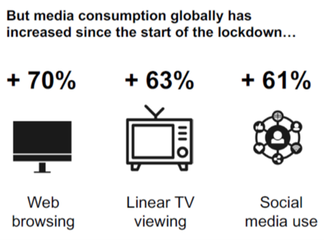
Accessing information
They seek out official sources for information, but some are switching off
When seeking information, participants look to official sources they consider to be trustworthy. Sources include: Radio, News, Daily briefings, Newspapers, internet pages (mainly BBC) and social media such as local Community Facebook.
Many are accessing some current news at least daily but the frequency of seeking out information has declined for many over time.
Some are actively avoiding daily briefings or their usual sources of news, due to bad or depressing news, “too much to process” and repetitive content that isn’t telling them anything new or is boring. One participant is keeping the child in her care away from media influences and another is more cautious about the information she is looking at and sharing since she had children.
Over time several participants have mentioned losing faith in the media and bias in reporting, rather than helping to bring clarity so that people to decide for themselves “what they should and want to do”.
“Watching the news, it’s like the whole world has stopped and there is nothing else happening anywhere and I just think no, I need a break, I don’t need to hear it twice. The death figures… I mean my husband has lost 2 members of his section to coronavirus. You don’t need to have it rammed constantly down your throat.”
Nationally, 41% are saying they are actively avoiding the news. This is +9% points from 32% in late March.
Source: Opinium, Marketing in a crisis: Brands, it’s time to find your voice (April 2020). Kantar, Covid-19 Barometer (2020)
How much could the news be contributing to people’s lack of confidence to go out or conversely deviate from current guidelines?

Slide 13
Accessing information
Some do additional research on sources they mistrust
Some of our participants mistrust social media sources and either avoid them or do research themselves into their accuracy before passing that information on. They view this as spreading dangerous misinformation, which they see as an unhelpful behaviour.
Some are seeking out positive stories to boost their mood and maintain their wellbeing.
“So if there's some ridiculous sweeping statement come up on Facebook I would always go and research it before I commented. Just because otherwise it's dangerous. And then you're spreading misinformation and then other people may not be so vigilant about checking it and then people think something is correct when it's not.”
“On Instagram, I follow something called ‘The good quote’ and what they've started to do is put out good news stories. So like recoveries from Covid, a celebrity handing out free meals… I need some positive information because everything is so negative.”
Ofcom report, 46% of respondents had “come across any information/news about Coronavirus that has been false or misleading in the last week”. By week ten this had decreased to 38% of respondents, the lowest percentage of all the weeks to date.
• In week one, 18-34s reported higher levels of false or misleading information in the past week compared over 65s (58% vs. 33%) and by week 10 the gap had narrowed.
Source: Ofcom (2020). Covid-19 news and information: summary of views about misinformation.
How easily can people find good information to help maintain their health and wellbeing?

Slide 14
Impact on day to day life
Most were able to keep busy during lockdown, with some enjoying the extra time at home
All are using technology to stay connected with family and friends, some more frequently; for some, this is a new experience
Use of digital has helped people connect more with neighbours and communities
All were able to access food and essentials independently
Many have grown fruit and vegetables this year, but usually do each year
Some have increased physical activity due to having more free time, while others are doing less due to a lack of motivation or fear of going outside
Finding the right routine is enabling people to cope better

Slide 15
Impact on day-to-day life
Most were able to keep busy during lockdown, with some even enjoying the extra time at home.
Those able to continue working are spending most of their time doing this, with free time spent on DIY around their home and garden, connecting with friends and family virtually, watching TV, and exercising (either indoors or going out on walks for daily exercise etc).
Some also have caring or volunteering roles or are spending time getting food and essentials for those who are self-isolating.
Retired people seem to be managing very well, with many suggesting they were used to spending time at home, so life had not changed significantly for them. They were keeping busy with DIY and jobs around the home/garden, watching TV, doing arts/crafts and puzzles, regular video calls with friends and family, and doing exercise.
Despite some parents struggling with home schooling children and balancing work, many have settled into a routine and have appreciated having extra time to spend together as a family, with some enjoying the ‘simpler things’ and slower pace of life.
“This is making us stay at home and do lots of DIY. We've been really busy – if we weren’t staying in it would take us longer.”
“I feel like I’ve gone back to my childhood, things we seem to be doing remind me of when I was my daughter’s age.”
“Quality time (with family)…we have spent so much time just sitting chatting in the garden. If it goes back to normal, we will try to do that again.”
“We have breakfast with daddy which is really nice. They don't usually see daddy at breakfast time.”
Children are typically spending a portion of their time doing schoolwork, and also keeping in touch with friends, watching TV, and playing on iPads and games consoles. Some parents described trying to motivate their children to do different activities or exercise more.
“He (son) tends to keep in touch with friends via his Xbox… he is a bit of a recluse, he is happy staying indoors.”
“Trying to make sure they don't just watch TV and play on their iPads. That they actually do things that are differently stimulating.”
Some have been learning new skills or taking up old hobbies (gardening, crafts, puzzles), and teaching their children ‘life skills’ such as cooking and housework.
Will people be more open to learning new skills and taking up volunteering roles once out of lockdown? What are the opportunities around this?

Slide 16
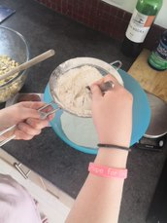
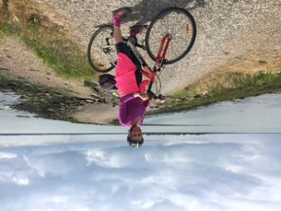
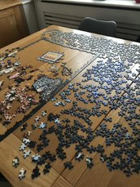
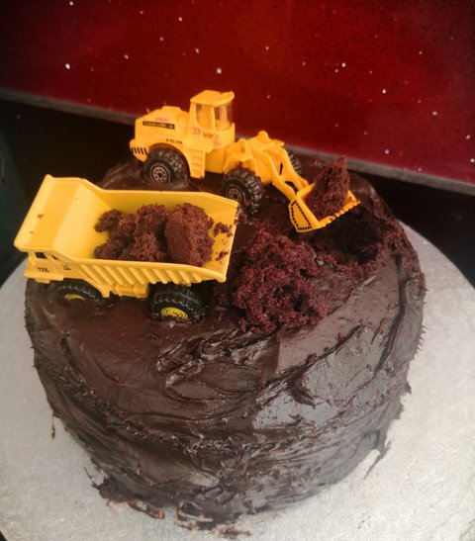
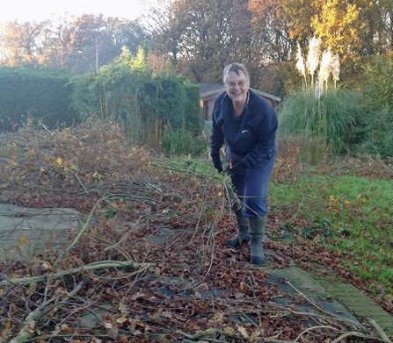
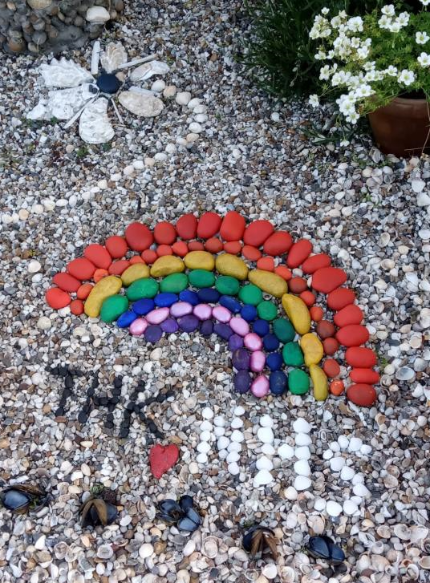
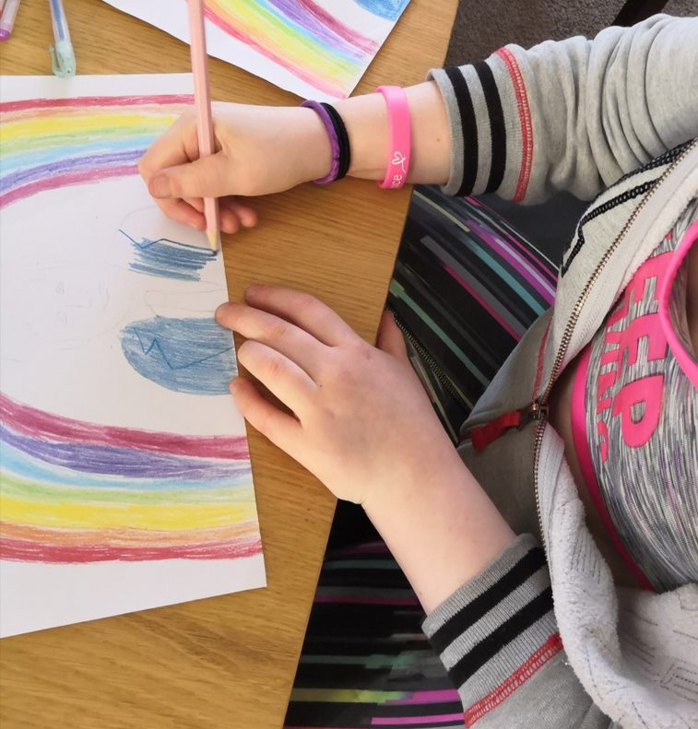
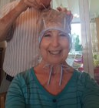
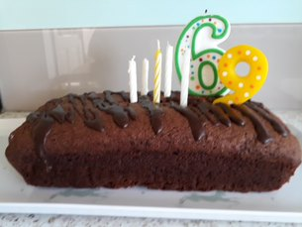
People have been keeping busy during lockdown with things like gardening, exercising, doing puzzles, baking,
and crafts.
Some have also attempted home hair cuts while not being able to go to the hairdressers.
There have been several ‘lockdown birthdays’ among our participants and their families, and there is a sense that they are trying to make the day special despite not being able to go out to celebrate as they usually would.

Slide 17
Digital and keeping in touch
All are using technology to keep in touch with family and friends
Most of those we spoke to had not previously used video calling with family and friends, but had started doing this much more regularly since lockdown to keep in touch virtually (e.g. Zoom, House Party, WhatsApp video calls).
Some are connecting virtually to replace regular social activities which have stopped (e.g. going to football matches), and are also doing ‘activities’ like virtual coffee catch ups and family quizzes, rather than just a chat.
Older people have embraced new technology for talking to friends and family, indoor exercise (e.g. virtual exercise classes/following YouTube videos), and for online shopping – some for the first time.
Some have also taught elderly parents how to use new technology, to help them stay connected.
Many have valued connecting with people virtually and found this helps them to maintain their emotional wellbeing and stay positive.
Several also commented that seeing someone’s face via video calling is better than just a regular phone call. However, there was a strong feeling that this is still not quite the same as seeing someone in person, and this could be emotional for some.
Some have reconnected with old friends they don’t often speak to, and are having more regular contact with them.
Some parents are worried about the decreased amount of contact their children are having with friends, with concerns about their social development due to being away from school for so long. Some felt that with younger children, it is reliant on parents to arrange contact.
“We've taught my mum how to do WhatsApp video calls, which is amazing! Normally with her, it's always the phone, but I've done a couple of virtual coffees with her.”
Are there more innovative ways of delivering services which better utilise technology? Will older people in particular be more receptive to using online services?
“You can’t actually hug them, you’re not there with them so it’s a bit of an emotive thing doing a video call. But we are doing it because it's our only contact really.”
“I think without Zoom my wife would have gone bananas without seeing the kids and the grandchildren. Well, me as well.”
“One friend I speak to probably twice a year (on our birthdays) – now speaking every fortnight. I will speak to him more once this is over.”
“My youngest has one friend online, so there's not a tremendous amount of social contact with her friends which is slightly worrying. Being in Year 3, none of them have got mobile phones so they are all relying on their parents.”

Slide 18
Digital and keeping in touch
Use of digital has helped people connect more with their neighbours and communities.
Several people mentioned using technology and social media in particular to get in touch with neighbours and their local communities.
“Keeping in touch more (than usual). With this House Party app, I’ve got a neighbour who is a friend and we correspond quite a bit during this period. I have made friends with someone in my road, obviously on social media, I will make more time for her as well and make more time for friends.”
“Social media has been brilliant, so beneficial, people are saying ‘does anyone know where I can get meat deliveries from’ and butchers respond saying ‘we are now doing deliveries’.”
Some noted that pre-existing online local groups have become more active, and one participant involved in the local neighbourhood watch group, said all activity around this has now moved online.
“I would probably be out at a community engagement event an average of twice a week …doing it now completely online.”
Technology has also been used to carry out large gatherings virtually. One participant had attended a friend’s funeral via Zoom:
“Unfortunately the voice recording wasn’t up loud enough so you had to strain to hear every 3rd word, it felt really hard to not be there to physically give them a hug at the end, it was just really really surreal. I just sat with my husband, tissues in one hand and holding each other’s hand through it.”
What are the business opportunities to build on people’s positive experiences of remote working?
“I think it’s been good, the way they have rolled out and changed the technology…we will be using Teams for new projects – we do work collaboratively and it is the perfect thing for that.”
Some we spoke to had moved to working from home for the first time, and were adjusting to this but finding it generally positive.
The increased use of technology has also prompted some to consider it’s wider use in business once lockdown is over – e.g. using technology to avoid unnecessary travel.
“I had to go to head office in Birmingham once a week, but virtual meetings make sense. Why drive?”

Slide 19
Shopping
All of those we spoke to were able to access food and essentials independently.
Some have changed their habits from doing multiple ‘top up’ shops during the week prior to lockdown, to now doing one big weekly shop.​
Digital access has been crucial for those accessing online supermarket orders. Many are using Click & Collect orders or deliveries from supermarkets, although some new to this were hesitant about the idea of online orders at first, and others had difficulty getting a slot early on in lockdown​ due to not meeting ‘vulnerable’ criteria or their account being in the name of a household member who was under 70.
Some said they will continue with new habits such as online orders, whereas others feel they will go back to their old habits.
“We get our main shop once a week delivered. It took me hours online to get this one. If you’re older than me and not so capable it would be tough to do.”
“When you work a lot I don't have time to keep thinking ‘I'll go here, I'll order this there, I'll go there’…I’ll probably go back to my more regular smaller shops or getting things at the petrol station, because it’s easy.”
Many have shifted to shopping more locally (e.g. corner shops and farm shops). This is due to both a conscious desire to support local businesses, and also wanting to lower their risk of infection by avoiding large supermarkets.
Some also described local businesses such as pubs and cafes who have started offering new food delivery services.
“Every Thursday we got a huge family fruit and veg box from one of the local pubs that set up a delivery service. There’s a little café in the next village, they have started offering pantry staples. All of the local businesses, they're so clever really.”
Others have been sharing food orders with neighbours, but some with more limited support networks have struggled with this.
“My neighbour added a pint of milk to her order for me...today on my list I've got flour for neighbours…at Macro you have to buy in bulk so I had five dozen eggs last week…I dropped at various places, my son, my daughter and my friend.”
“I tried the ‘next door’ social media site to find out if there are any people from my area to do a food order together.” [Struggled to get a delivery but had no replies to this.]
What support might local businesses need, and how can we sustain ‘shopping local’?
Would communities benefit from improved local resilience plans for better access to food and services in case of future emergencies (e.g. snow/floods), particularly in rural areas?

Slide 20
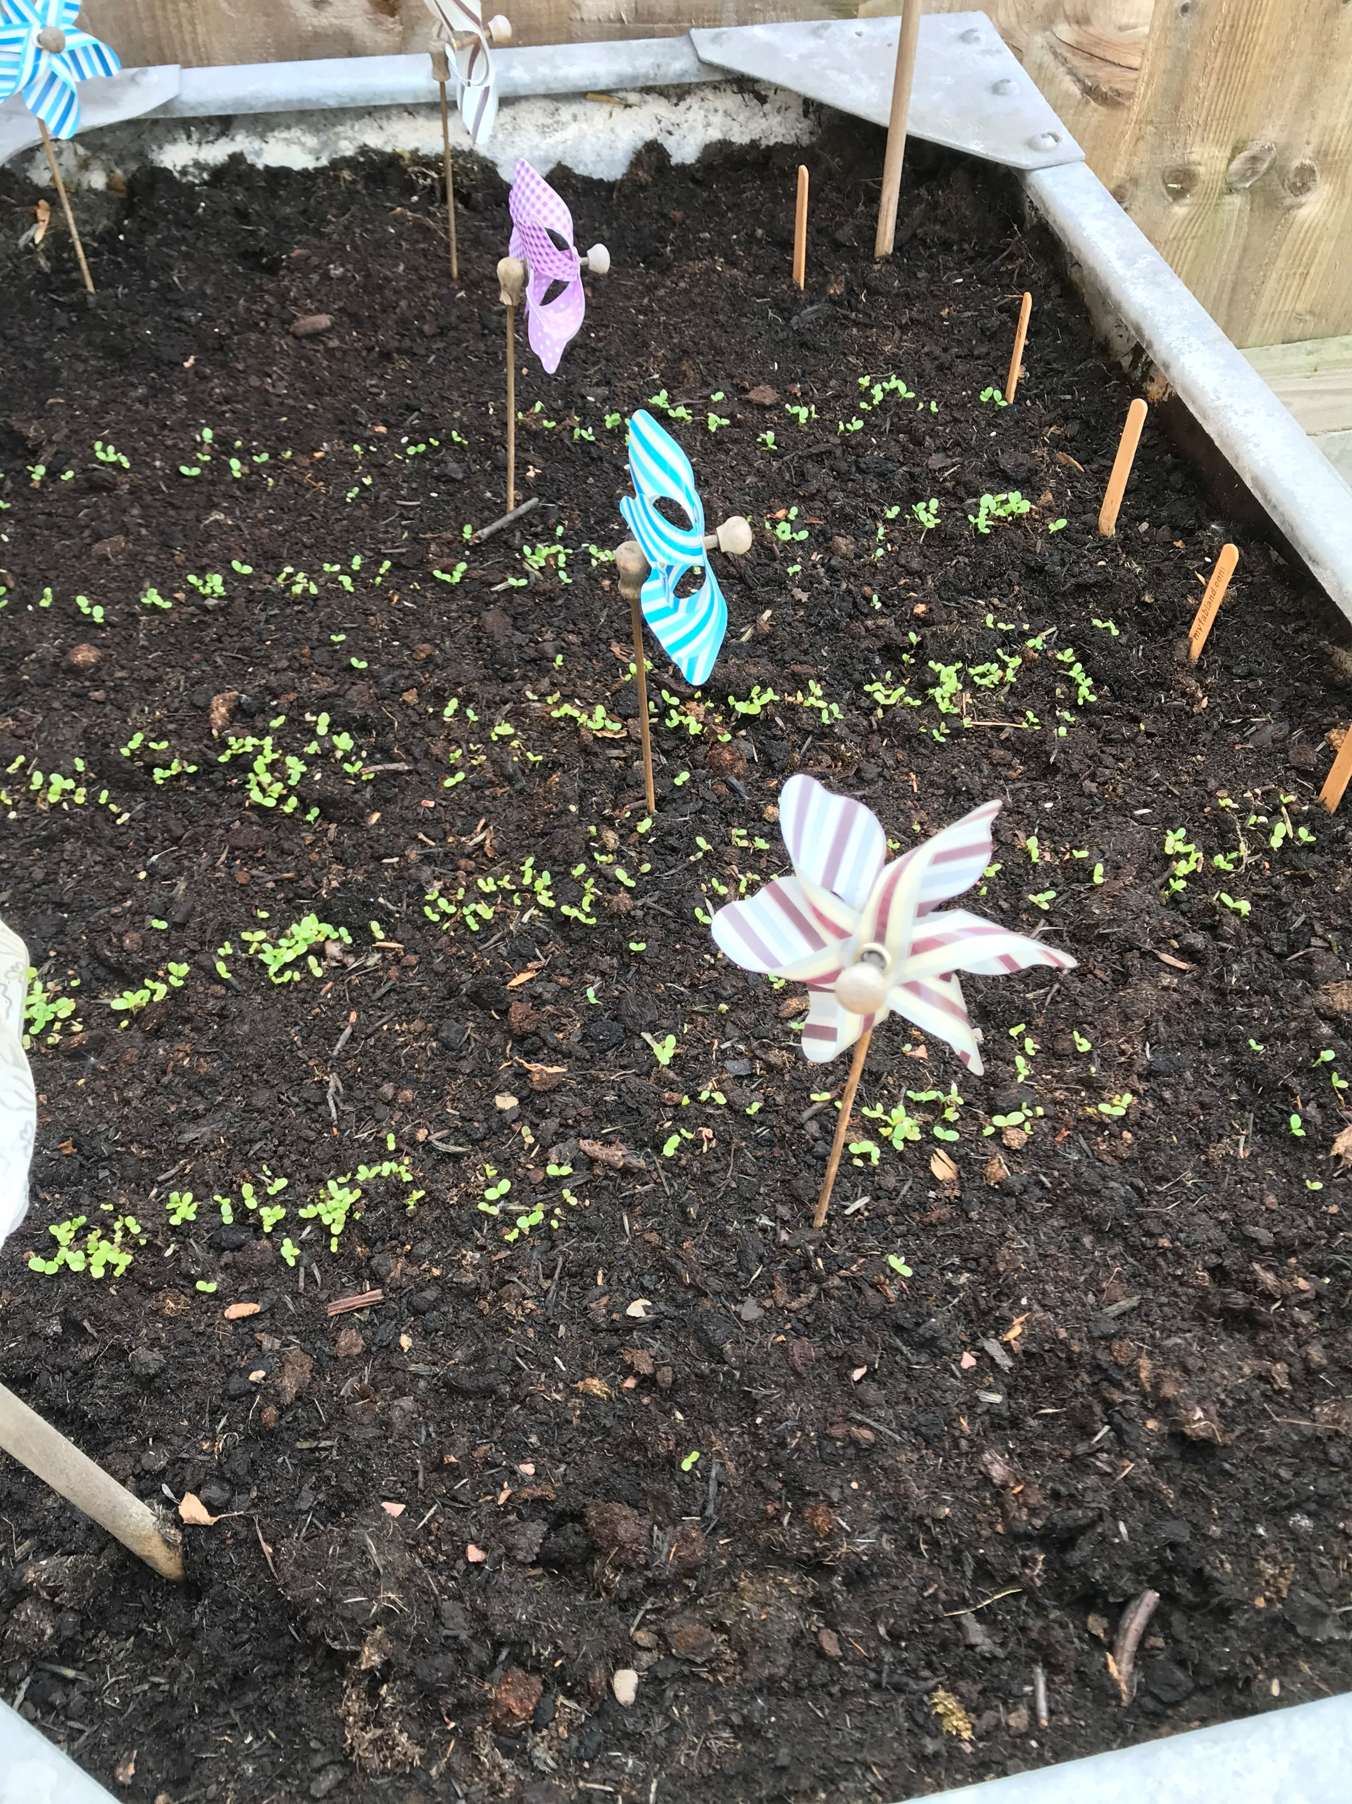
Growing fruit and vegetables
Many have been growing vegetables this year, but usually do each year
This year most of our participants have grown vegetables and fruit either in their own gardens or on an allotment. Some have planted more this year, and for some this is due to having more time. One participant also has chickens, has hatched some new ones as a project to learn from that she does with her young child and gives the eggs to neighbours.
“I've definitely planted more this year than I have done previously because I like that there's no air miles associated with moving from a patch into my kitchen, wash it down myself and I know that there's no pesticides on it and there's no plastic wrapping on, my bananas or whatever.”
“I hated when the lockdown first came in, how dependent I was on services and getting to the people providing my food… I didn't really like that. I didn't provide for my family without going to the shops.”
For others it is a hobby or it allows them to have less harmful environmental impact. Gardening is helping to keep people occupied and well.
Participants are growing:
Herbs
Apples
Potatoes
Onions
French beans
Courgettes
Cucumber
Carrots
Tomato
Peppers
What opportunities are there for those without gardens and allotments to grow their own produce?
How can people’s ‘grow your own’ efforts be made more successful?

Slide 21
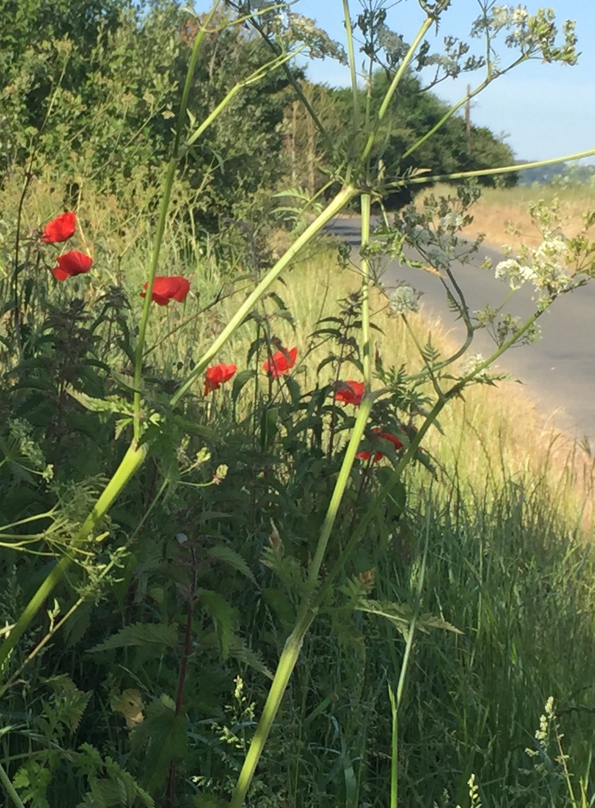
Hope for our future
Some of our participants have talked about the positive impact on our environment
And hope there is lasting change, including changes to people’s habits including fewer cars on the road.
“The effect on the environment has been wonderful, hearing the birds all the time, fewer cars on the road… and hope that Essex Country Council won’t cut back the beautiful verges.”
The impact of lockdown on the environment has been seen by our residents as an opportunity for Essex to build on.
One participant thinks that the pandemic might have been nature’s response.
“I just feel it’s Earth's way of saying we’ve got too many people. I know people say it's one in 100 years, these sort of pandemics. But I think the more people there’s on Earth, the more it's going to happen.”

Slide 22
Hope for our future
Some have mentioned the positive impact on traffic and noise pollution
Participants have notice the reduction in traffic levels and noise of cars, planes and trains and of the subsequent increases following restrictions being lifted.
“It’s quite pleasant to drive…getting off the island (Canvey) normally is a problem, but it’s very easy at the moment. It’s lovely, I wish it would stay like it.”
“For us one of the biggest impacts of lockdown has been the reduction in noise and actually a lot of people in the local villages have spoken about that, about particularly the planes. We have been a bit like ‘Oh my God, were they always that loud?!’. You don't realise what you've actually gotten completely used to.”
Hopes for the future include Essex residents to use the car less and to cycle and walk more for the environment and better health outcomes.
“Because it’s healthier and better for the environment and helps you to appreciate your community and surroundings as well… And to keep the children healthier and outdoors.”
“I’d like to think there was also an opportunity for people to think more carefully about do I need to get in my car to go, or could I car share? We're almost at the stage of thinking we really don't need a second car. We can access anywhere in Europe on the train. Why are we not doing that?”
How can we make and encourage lasting positive environmental change as people start moving about again?

Slide 23
Hope for our future
Hopes for Essex - increased community spirit and improved walking and cycling paths
Participants had a number of ideas for improvements in Essex post-lockdown.
These were mainly around building and further growing the community spirit that has emerged during lockdown.
To encourage walking and cycling, participants suggested creating more and safer cycle paths and enforcing of rules, especially no parking on pavements.
Others included investing in physical infrastructure, rural broadband and thinking more carefully about waste – its production as well as disposal, especially with the increase of disposal of PPE such as plastic gloves and face masks.
There is hope that Essex County Council and other administrative bodies learn from this experience.
“I’d hope Essex would think about this is an opportunity to really launch a kind of a 0, not zero waste because I think for most people that's unachievable, but a reduction in totally unnecessary waste.”
“It would be good if they improved access for cycling. The roads are really busy around here.”
“I’d like them to enforce people parking on pavements so we can actually walk on pavements.”
What are our plans for a reduction in unnecessary waste?
What do we need our residents to do to?
What are our plans for disposing of increased levels of PPE?

Slide 24
Coping strategies and Discussion
All participants coping relatively well during lockdown, due to these protective factors:
Why are participating families with children coping with lockdown relatively well? | Discussion points
Stable financial situation (even those with reduced incomes are not struggling financially in the short-term) | How much could the news be contributing to people’s lack of confidence to go out or conversely deviate from current guidelines? How easily can people find good information to help maintain their health and wellbeing? Will people be more open to learning new skills and taking up volunteering roles once out of lockdown? Are there more innovative ways of delivering services which better utilise technology? Will older people in particular be more receptive to using online services? What are the business opportunities to build on people’s positive experiences of remote working? What support might local businesses need, and how can we sustain ‘shopping local’? Would communities benefit from improved local resilience plans for better access to food and services in case of future emergencies (e.g. snow/floods), particularly in rural areas? How can we make and encourage lasting positive environmental change as people start moving about again?
Stable employment which continued in lockdown (from home or on reduced hours)
Understanding employers, who support working from home and who are aware of childcare needs
Pleasant living conditions (all participants have outside space)
Living in a stable relationship
Access to technology for school, communication and entertainment purposes

Slide 25
Other specialist topic reports
This report is just one of a series. Have you seen the others?
“I don’t think there’s ever going to be a ‘normal’ as we knew it” – A summary of key themes (Release 1)
“Being with your child 24/7 is tough” – Experiences of Essex working parents
“I’m still working at home… and saving money” – Experiences of employment and personal finance
“Neighbour friendships have been formed that will last permanently” – Neighbourliness, community and volunteering
“Being able to go for a proper walk is really important” - Health and wellbeing

Slide 26
Contact Us
This information is issued by:​
Essex County Council​
Strategy, Insight & Engagement ​
Research & Citizen Insight​
​
​
You can contact us in the following ways:​
​
By email: ​
katerina.glover@essex.gov.uk​
maresa.beazley@essex.gov.uk; maura.o-malley@essex.gov.uk; poppy.reece@essex.gov.uk
​
Visit our website:​
www.essex.gov.uk​
​
By telephone:​
033301 30874​
​
By post:​
Essex County Council, Research & Citizen Insight (SIE)​
D202, County Hall, Chelmsford, Essex CM1 1QH

