Slide 1
“Being able to go for a proper walk is really important"
Health and wellbeing
Interviews with Essex residents about their attitudes and experiences during the COVID-19 pandemic
September 2020
Version 1.0
The 2019 English Indices of Deprivation
ESSEX
2019
Research & Citizen Insight
Strategy, Insight & Engagement
Essex County Council

Slide 2
Introduction
Introduction
This research aimed to track resident attitudes and experiences during the COVID-19 pandemic to:
Explore how different types of residents and households were impacted.
Understand what day to day life was like for different types of households.
Record how experiences and attitudes changed over the lockdown period and beyond.
The insight was obtained through a series of video/telephone interviews (mostly via Teams) with fifteen Essex residents recruited from respondents to the Essex Residents survey 2020 who volunteered to take part in further research.
Research areas
This specialist topic report explores the themes of health and wellbeing.
It brings together the views of all participants.
These insight slides include: case studies, quotes and provocation questions aimed at decision makers to facilitate discussion and determine actions to improve the lives of Essex residents.

Slide 3
Health & Wellbeing
Some have increased physical activity due to having more free time, while others are doing less due to a lack of motivation or fear of going outside.
Most are keeping relatively active, either by doing at-home workouts, going out for walks / bike rides / runs, walking the dog, or doing physical work around the house and garden​. In combination with ‘keeping busy’, this is a way of also looking after their emotional wellbeing. Still, levels of frustration have increased for some over time.
For some levels of activity have reduced over time
Being less active for several months is now starting to take its toll on levels of fitness of some retired participants.
Families still need to access health & wellbeing services during lockdown to ensure that health doesn’t deteriorate to crisis
Many found virtual medical appointments beneficial
Levels of concern with infection have decreased over time
People are generally following the safety guidelines in the short term, but with some bending of the rules as restrictions ease

Slide 4
Keeping fit & active
Some fill up their free time with increased physical activity. Others are doing less due to a lack of motivation or fear of going outside
Most are keeping relatively active, either by doing at-home workouts, going out for walks / bike rides / runs, walking the dog, or doing physical work around the house and garden (the latter particularly for retirees).
Many are using technology to help them keep active, e.g. Zoom virtual classes, or exercising along to YouTube videos.
As exercise has been one of the permissible reasons for leaving the house during lockdown, some were making use of this and saw getting out for their daily exercise (e.g. a walk) as important for both their mental and physical wellbeing.
Some are going out to exercise as a family more regularly, however some are struggling to motivate their children.
Some are doing less exercise due to being fearful of going outside and being too close to other people.
Being less active for several months is now starting to take its toll on levels of fitness of some retired participants.
For some, levels of activity have decreased over time, e.g. due to not being able to attend leisure facilities or exercise classes or missing regular walks to work. However, many are conscious of the importance of keeping active and making a conscious effort to maintain or increase their levels of physical activity.
“We did Joe Wicks at the start. It wasn't really for us. We know a personal trainer who does some online stuff, my wife’s been doing that.”
“I still do Zumba, the teacher does an online class, that's been quite good. But it's not the same as doing it in a class and then going for coffee afterwards… I'll go back to Zumba and swimming once it's all over.”
“I basically have to force him [teenage son] to come for a walk with me.”
“The boys and I go for an extra-long walk every morning so we do a full hour out with the dog which they really enjoy.”
“I must be sitting around a lot because when I play golf now I actually feel knackered... I feel more tired than I used to.”
“I've got a Fitbit and for the first few days I was doing only 4000 steps, which is completely unacceptable… Now I've been going for a weekly proper 10K run which I’d never do. Usually I would make it out for a 5K jog maybe once a month. I'm getting a little bit addicted to running. I think because it's making me feel better.”

Slide 5
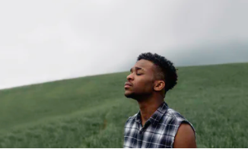
Emotional wellbeing
Emotional wellbeing is consciously on participants’ minds
Finding the right routine and ‘keeping busy’, active and positive has enabled participants to cope emotionally relatively well over lockdown and beyond. Some have experienced ups and downs, but everyone has put in place coping strategies for themselves. Still, increasing levels of frustration were noticeable among some participants in latter interviews.
Most participants have strong support networks and tend to engage in some form of regular exercise, this being active sports or gardening/DIY.
Some of those living alone and working and/or caring for children were finding lockdown more difficult.
Participants miss face-to-face contact with their loved ones. Virtually staying connected was an acceptable temporary alternative, however as lockdown eased, seeing family and friends was the first thing people did.
Some parents reported their younger children being more emotional and needier during this time.
Over time, participants reduced their news consumption about Covid-19, with some actively avoiding negative news to promote better wellbeing.
“My wellbeing had a massive dip at the beginning but it has climbed back up since then. I think I’ve found my ‘new normal’. I made going out for a walk every day an absolute must and it has really made a difference to me, just getting out in the fresh air, time to relax.”

Slide 6
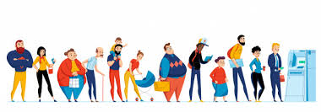
Fear of Infection & Managing the Risk
Levels of concern with infection have changed over time
Everyone has a level of concern over the spread of the infection and contracting the virus. While some appear to take a more relaxed attitude, others are clearly anxious and this tends to be borne out of their own family circumstances, e.g. having an underlying health condition or living with someone who is shielding.
Social distancing is important, there are concerns the virus could be spread by others not following the rules and numbers of people in public spaces especially when they “invade your space”. Some are keeping contacts to a minimum and most older people are not going out unless they need to.
The fear of the unknown is making people consider their daily lives, with some worried about going into work, shops, using public transport or sending children back to an educational setting. Others are looking at this with a wider view and the effect infection could have on society. For others it is about managing the risks to “get some normality back”.
Feeling safe in Essex
One person said she felt safer from infection in her local town, than if she was in an urban area.
“It hasn’t been such an issue, but If I lived in the middle of London it might have been, cos it’s much more built up.”
[In relation to fear of infection]
“I would have direct contact with children…when I was at school I come into contact with potentially that level of germs…If [boss] turned around and said I've not got enough staff because we're having to put kids in small groups to see if she needs me to come in too… I would have to think about whether I'm willing to risk again.”
How can we ensure everyone feels safe and has the confidence to go out as lockdown measures ease?
“I want to catch it, if I haven’t even had it? How many of us have had it and don’t know? I feel safe 95%. It doesn’t change times I go out…just need to be sensible. I’m not hyper anxious or stressed about illness, I’m a healthy person.”

Slide 7
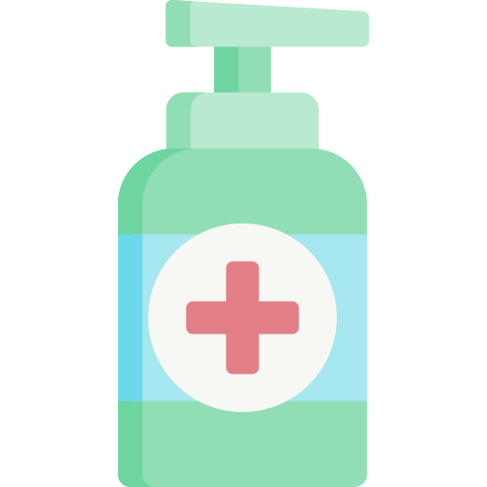
Fear of Infection & Managing the Risk
Following the rules in the short term with some bending of the rules as restrictions ease
Following the rules and keeping safe in line with national guidelines is being taken seriously, especially for those who are shielding or supporting someone who is shielding. This is happening even at the expense of putting up “barriers” from other family members.
Our initial research told us people were staying at home except for exercise or shopping. Some other precautions are:
Some minimising risk by home working
Most people food shopping online
Proactively taking exercise in isolation
No outside face-to-face family contact
Using anti-bac & face masks
Wash all bags after being outside
Some still staying in as lockdown eases
Over time people have balanced up the risks versus their priorities e.g. visiting friends. They bend the rules to suit their needs but will say they are taking safer risks. They point out others’ behaviours as worse.
Those in employment have to make changes:
Rise in home working to avoid infection
Childminder imposes strict cleaning routine
Worries about infection, balancing this risk of returning to work & potential of bringing germs home to family
Employers/managers deciding when it is safe for people to come into work if they have been unwell
“I'm not sitting around terribly worried about catching the disease. I'm more worried about keeping myself isolated as part of a much broader social pattern to make sure that the disease doesn't spread.”
“I come in (from collecting shopping order) and that’s when I do wash my hands, two happy birthdays type thing, but during the day I just wash them normally.”
“I have never been an anti bac person, but I would probably carry it now.”
How can we ensure that everyone still continues to manage the risks as we come out of lockdown?

Slide 8
Looking after your health
Families still need to access health & wellbeing services during lockdown
Physical & emotional wellbeing, prevention & early identification is just as important during lockdown. People still become unwell, and others are managing pre-disposed health conditions. Some of those we spoke with or their families have successfully sought medical attention. Others had appointments cancelled due to infection control and social distance guidelines. This is having a detrimental effect on their health & wellbeing, although feeling safe when attending appointments is very important too.
“I’d like to go visit a dentist but not until it’s safe, for the dentist and for me, as they have to get quite up close and personal.”
“My chiropractor does acupuncture on me and a bit of manipulation and massage and I would love to have an appointment with him just because of the stress of being on the computer.”
People are still able to access the following:
Virtual GP appointments, with prescribed medication
A medical review complemented by home blood pressure check
Referrals to specialist services for further investigations
Attend specialist clinics and have blood tests
Advice via 111
Private appointments (e.g. osteopath)
Increased physical activity in the beginning
Exercise helps with wellbeing, stress levels etc & most people are taking regular exercise during lockdown, with some increasing what they do & setting themselves targets. Activity levels for some have dropped overtime.
“Getting out doing regular walks, yes that helps, trying to get up to 10,000 steps a day, that’s the target, 7,000-8,000 a day now.”
How can we ensure that people feel safe accessing health & wellbeing services & that they continue with physical activity after lockdown?
Will there be long term impacts on having to delay treatments/therapies, and could this impact on our services in the future?

Slide 9
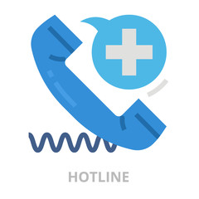
Looking after your health
Many found virtual medical appointments beneficial
Participants could clearly see the benefits & opportunities of using virtual medical appointments. Several had a direct experience pre-lockdown. While some do not want the system to lose the personal touch, the pro’s outweighed the negatives:
Infection control: lack of contamination from being in the waiting room with other patients
Professionals less likely to be late, leading to a better consultation experience
Flexible, easier to get an appointment at a suitable time
No need to take time off work, especially if self-employed, or not getting paid when taking time off for medical appointments
Very helpful if don’t work near GP
Could be seen as a more preventative approach
No travelling, positive impact on the environment, less risk of contamination when in transit
“Never had a virtual consultation, would not object, think it’s a good idea & actually it’s preferable to sitting in a room full of people who might be infectious.”
“You just see a doctor from your bed. I would use it every time if I had the option.”
“Especially xxxx being self-employed if he has ever had to go for anything he has to have a day off work for a doctors appointment sometimes, tell him it’s a 2pm one then there is no point him travelling to work & then coming back again. If he could do it virtually it would be so much better.”
Which groups could benefit more from virtual medical appointments, who is less likely to visit a health professional & why?
How could virtual appointments encourage these groups & help the prevention agenda?
Will there be long term impacts on having to delay treatments/ therapies, could this impact on our services in the future?

Slide 10
Discussion
Discussion points
How can we ensure everyone feels safe and has the confidence to go out as lockdown measures ease? How can we ensure that everyone still continues to manage the risks as we come out of lockdown? Single parents may be more concerned over falling ill, due to not being able to care for their child and fully recover themselves. Could ECC assist? How can we ensure that people feel safe accessing health & wellbeing services & that they continue with physical activity after lockdown? Will there be long term impacts on having to delay treatments/therapies, and could this impact on our services in the future? Which groups could benefit more from virtual medical appointments, who is less likely to visit a health professional & why? How could virtual appointments encourage these groups & help the prevention agenda? Will there be long term impacts on having to delay treatments/therapies, could this impact on our services in the future?

Slide 11
Other specialist topic reports
This report is just one of a series. Have you seen the others?
“I don’t think there’s ever going to be a ‘normal’ as we knew it” – A summary of key themes
“Being with your child 24/7 is tough” – Experiences of Essex working parents
“I’m still working at home… and saving money” – Experiences of employment and personal finance
“Neighbour friendships have been formed that will last permanently” – Neighbourliness, community and volunteering
“It’s like the whole world has stopped and there is nothing else happening anywhere” - Response to coronavirus outbreak and the day-to-day impact

Slide 12
Contact Us
This information is issued by:​
Essex County Council​
Strategy, Insight & Engagement ​
Research & Citizen Insight​
​
​
You can contact us in the following ways:​
​
By email: ​
katerina.glover@essex.gov.uk​
maresa.beazley@essex.gov.uk; maura.o-malley@essex.gov.uk; poppy.reece@essex.gov.uk
​
Visit our website:​
www.essex.gov.uk​
​
By telephone:​
033301 30874​
​
By post:​
Essex County Council, Research & Citizen Insight (SIE)​
D202, County Hall, Chelmsford, Essex CM1 1QH

