Slide 1
DOMESTIC ABUSE
NEEDS ASSESSMENT

Slide 2
Introduction
Domestic Abuse Act 2021
The Domestic Abuse Act places a duty on Essex County Council, as a Tier 1 Local Authority, to provide support to victims of domestic abuse.
As part of its statutory duties, Essex County Council needs to produce a Domestic Abuse Commissioning Strategy, which sets out the objectives of the local authority and actions the local authority will take towards achieving them.
The following needs assessment, which is also part of the statutory duties outlined in the Domestic Abuse Act, allows Essex County Council to identify key areas where commissioning activity needs to be focused, as such shaping the Domestic Abuse Strategy.
A note on accessibility
This report includes alt text where graphs and charts have been used. If you require any further information about our data or have additional accessibility requirements, please contact domesticabuse.data@essex.gov.uk.
Domestic Abuse is a high harm crime which remains underreported.
Anyone can be affected by Domestic Abuse, regardless of age, gender, race, sex, disability, religion or sexual orientation.
2.1 million people aged 16 years and over (1.4 million women and 751,000 men) are estimated to have experienced domestic abuse in the year ending March 2023 in England and Wales.1

Slide 3
Key Findings and Recommendations

Slide 4

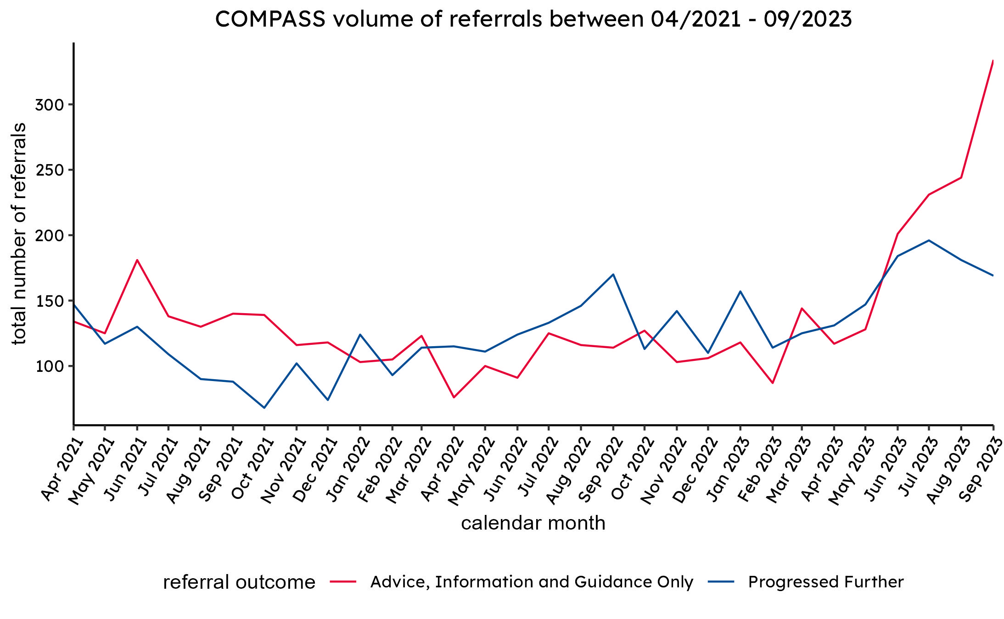
  DEMAND FOR SERVICES
  COMPASS
Compass referrals have seen a large increase since April 2023, causing significant stress on the existing resource model.
This increase has predominantly been driven by referrals received from the police. It is not reflected in an increase in domestic abuse incidents recorded by Essex Police, which have seen a stable trend for non-crime incidents and decreasing trend for crime incidents, but rather has resulted from a change in practice within the police*.
The volume of referrals received between April and September 2023 is a 59% increase when compared to the same period in the previous year, and forecasts produced in September last year suggest that this change in practice could drive as much as an additional 3,000 referrals per annum.
* Change in practice for the recording of domestic abuse incidents attended by police officers.

Slide 5
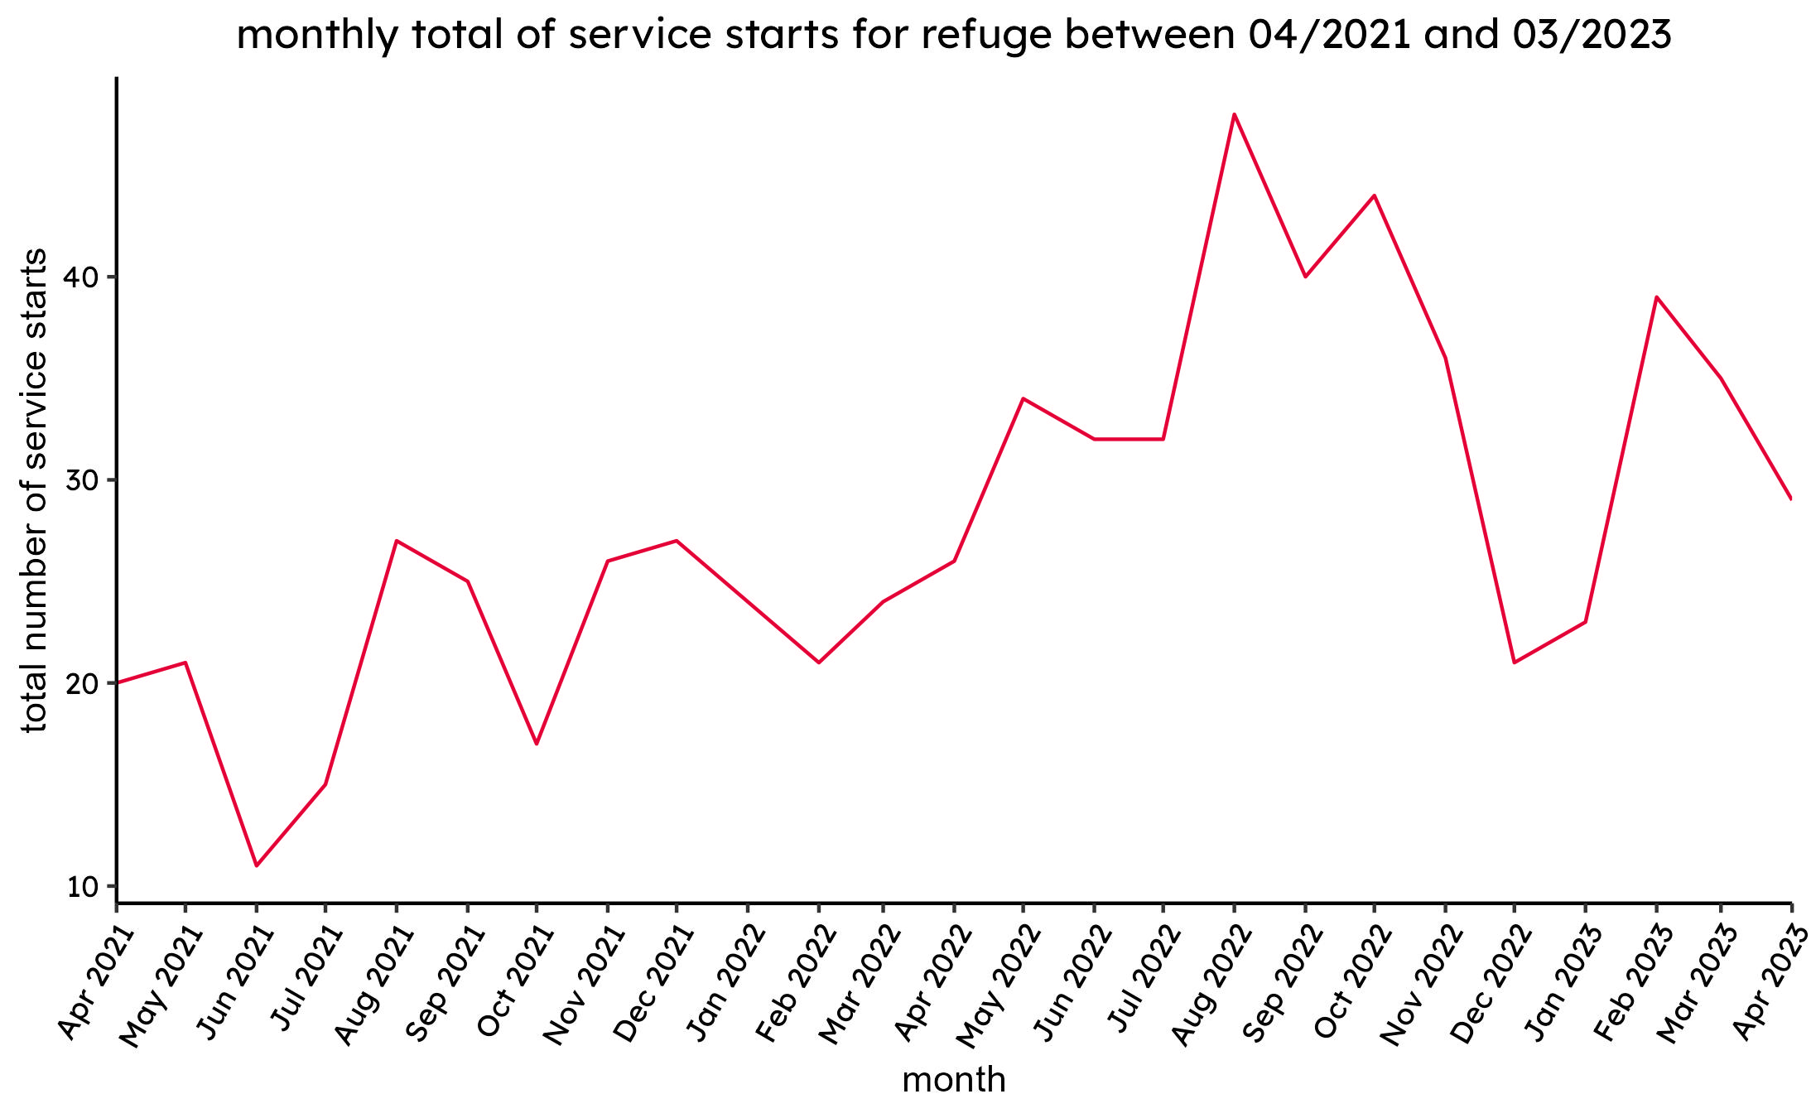
  DEMAND FOR SERVICES
  REFUGE
Demand for Refuge saw a significant increase in 2022. While this decreased in early 2023, should more growth occur, considerations around whether the current spaces will be able to meet future demand need to be taken, particularly with instances of clients not being accommodated due to lack of space already occurring.
This increase reflects the overall increase in referrals to providers and is also apparent in the increase in the overall number of services provided, which occurred in particular for North and Mid Essex services.
Between April 2021 and March 2023, 103 clients who had been referred to Refuge were not accommodated due to lack of space.

Slide 6


  HOUSING
  APPROPRIATE AND SAFE HOUSING
  Victims placed in temporary accommodation or in provider refuges spend an average of 3 to 4 months there. However, some interviewed victims expressed feeling unsafe at some point during their service journey in these types of accommodation.
  Between April 2021 and March 2023, 630 victims were provided Refuge accommodation, and at least 496 were provided Temporary Accommodation by a local authority. As such, many victims can be impacted by potential negative conditions in these types of accommodation.
  At least 266 victims were offered Council Housing or a Registered Provider Tenancy by a local authority, which has been mentioned by interviewees as requiring a financial investment to improve conditions. With at least 32% (421) of victims supported by local authorities being unemployed, finding the needed resources can be a challenge for many.
“We were put in this place, there wasn’t really any security. (…) When he [perpetrator] broke bail conditions they [Police] said…we think you should be in a more secure place. There wasn’t anything other than CCTV and I was on the bottom floor.”
[Female, 35-44]
  We will work closely with Districts, Boroughs and Cities through the Southend, Essex and Thurrock Domestic Abuse Board (SETDAB) Housing Group to explore safety and wellbeing of victims and potential options to support victim safety in relation to accommodation.

Slide 7

  NEEDS
  MENTAL HEALTH
Mental Health is one of the most prevalent needs across all services, and across multiple cohorts of victims. Qualitative analysis has found that victims believe the current mental health support provision requires improvement.
Over half of the victims supported by providers (2,977) and at least 1 in 4 of district supported survivors (332) are presenting mental health needs. Particularly in Specialist Refuge, a proportion of 77% (191) of victims are struggling with their mental health.
Survivors highlighted in interviews the need for mental health support to be provided for longer periods of time, particularly beyond the initial ‘crisis’ moment. Support was also mentioned as often being intermittent, with ongoing, regular support being needed. The timing of peer support group meetings was highlighted as well, with victims with children being unable to attend most meetings, due to their taking place outside of school hours.
  The mental health needs of victims will be considered from the outset of engagement in commissioned domestic abuse services. We will strengthen the relationship with mental health support services and with local provision in Essex. We will ensure domestic abuse commissioned support (e.g. support groups) are flexible and accessible to ensure they meet the needs of victims.

Slide 8



  INCREASED COMPLEXITY
  CHILDREN & PARENTS
Interviews with victims who are parents have highlighted concerns about the support for their children’s mental health and about their ability to continue attending school.
“Because my son witnessed it, I was more concerned about his mental health than mine…I had to chase children’s services then through school… He kept being turned down because of his age (6), they kept saying he’s not old enough…what happens to kids that are younger than him?”
[Female, 35-44, Epping]
Over two thirds of provider supported victims (3,786) and at least 57% (753) of district supported survivors have one or more children.
In Refuge alone across all providers, there were 879 children between April 2021 and March 2023. The number of children being accommodated in Refuge increased by 11% in 2022/2023 compared to 2021/2022. Should demand for Refuge continue to increase in the future, considerations for accommodating increased volumes of children as well would be required, in addition to ensuring that all children can continue their schooling throughout the move to refuge, and during their stay there.
Dedicated and specialised support to children and young people who are victims of domestic abuse will be available as part of the new domestic abuse Model. We will conduct some exploratory work with those with lived experience and colleagues in Children's Services/Education to look at how best to support children and young people's education who are victims of domestic abuse.

Slide 9

  INCREASED COMPLEXITY
  GLOBAL MAJORITY*
11% (121) of provider supported victims from a global majority ethnic group* are in the UK on a visa, or as a Refugee, and 31% (344) do not have English as their first Language.
A Visa dependent immigration status can result in insecurity for victims, and, where intimate partner abuse is present and victims are living in the UK on a Spousal Visa, victims may be in particularly challenging legal situations with which they would need specialised support.
The 344 victims whose first language is not English make up almost a third of global majority* victims supported by providers, indicating the large need for well-developed language support services.
  We will explore opportunities to develop grass roots 'By and For' support for people from the Global Majority.
  Interpretation and translation support are included in the new commissioned domestic abuse service.
* Global Majority is a collective term which refers to people who are Black, Asian, Brown, dual-heritage, indigenous to the global south, and or have been racialised as 'ethnic minorities’ (Campbell-Stephens 2020). In this document, the term also refers to clients who are Irish, Gypsy or Irish Traveller, Roma or from other White Groups.

Slide 10


  UNDER-REPRESENTED COHORTS
  MALE SURVIVORS
Over 25% of victims recorded by the Police are men, but less than 10% of victims supported across Domestic Abuse services are male, with 1 in 2 men of those whose referral did not progress to a service* withdrawing engagement from support services.
18,753 male victims were recorded by Essex Police between Apr ‘21 and Sept ’23. By contrast, 249 men were supported by providers and 60 by local housing authorities between Apr 21’ and March ’23.
“DA is [seen as] a women’s issue. Need a greater awareness of male survivors. (…) Need the same as girls, equal service.”
[Brian, 35-44, male]
41% of male survivors of domestic abuse referred to services* progressed to receive support, a slightly smaller proportion than female survivors of domestic abuse (53%).
Male survivors of domestic abuse appear to be under-represented in Domestic Abuse services. While societal factors can be a driver behind men not accessing support, interviews with male victims of domestic abuse found that men did not feel like support services were aimed at them.
We will continue to work with domestic abuse providers and those with lived experience to explore the issue of male victims referrals not progressing and withdrawal from support and will continue to work with system partners such as SETDAB to promote and raise awareness of domestic abuse in relation to male victims.
* Based on data from services in South and West Essex only due to data availability.

Slide 11

  UNDER-REPRESENTED COHORTS
  OLDER SURVIVORS
Older people are likely to be under-represented in domestic abuse support services. 4% (2,886) of Essex Police domestic abuse crimes involved people aged 66 and over, while only 2.5% (143) of survivors supported by Domestic Abuse providers were in this age group.
Within Essex, a large proportion* of provider supported victims ages 66 and over have physical support needs, significantly more than other age groups. Research on the barriers to accessing domestic abuse support for older adults has found health conditions to be a key barrier for this group, as they become more dependent on their partner or family members, and in time, more isolated due to need for care, reduced mobility, etc.
Within Adult Social Care services, between April 2021 and March 2023, 437 individuals ages 66 and above had a Domestic Abuse Safeguarding Concern and/or Enquiry raised. 11% of these were found to be fully or partially substantiated.
  We will seek to work with those with lived experience to better understand barriers and potential solutions to provide support where it is needed. We will work with system partners including Adult Social Care and local organisations to raise awareness and promote domestic abuse support with older people in Essex.
* Low figures removed to avoid risk of identification.

Slide 12

  UNDER-REPRESENTED COHORTS
  LGBTQ+
LGBTQ+ victims are likely to be under-represented in Domestic Abuse services.
National estimates suggest that 1 in 10 LGBTQ people in the UK have faced domestic abuse in the past year. Based on national estimates, 2,970 LGBTQ+ individuals will have experienced domestic abuse in Essex, By contrast, 186 LGBTQ+ victims were supported by providers between April 2021 and March 2023. 244 were referred via Compass, and low numbers approached local authorities for housing support or were heard as cases at MARAC*.
Research suggests LGBTQ+ victims can experience additional challenges and barriers to accessing support. In provider data, 70% of LGB+ victims are presenting Mental Health needs compared to 51% of heterosexual victims. Similarly, the proportion of Transgender victims* supported by providers presenting mental health needs was slightly higher than that of cisgender victims.
We will seek to work with those with lived experience to better understand barriers and potential solutions to provide support where it is needed. We will work with system partners including local organisations to raise awareness and promote domestic abuse support with the LGBTQ+ community.
* Low figures removed to avoid risk of identification.

Slide 13




ADDITIONAL RECOMMENDATIONS
  Follow-up support was found to be insufficient. Interviews with victims revealed that after the completion of a service, some victims felt they were “suddenly dropped” and received no further contact. We suggest that if it is feasible, providers should aim to follow up with victims following the completion of support.
  Some victims felt that local support services did not communicate appropriately with one another, which led to victims having to repeatedly disclose their experiences of abuse to multiple agencies. Reviewing the current communicative channels between different organisations could improve this for victims.
  Victims cited the lack of signposting to local support services, with some making specific reference to poor signposting within medical settings. We also found that most victims self-refer to Compass. Further research could be undertaken to explore how victims find out about support, particularly for minority victim cohorts who appear to be less likely to approach. Information capture regarding referral source could also be improved by domestic abuse providers.
  Travelling to access support appears to be a barrier for out of county victims. How can we support victims which travel from far and would additional analysis mapping the journeys made by the out of county victim cohort be helpful?

Slide 14

DATA RECOMMENDATIONS
A SHARED DATA STANDARD
  A shared data standard is recommended to enable consistent information capture and reporting, and to improve the overall accuracy of insights.
  The absence of a shared standard brings forward multiple challenges, among which incomplete data extraction due to technical issues experienced by external partners, varied/open text data entry within key information fields, missing data, and inconsistent information capture, with organisations recording data at different levels and recording similar information in different ways.
  To address these challenges, the following is recommended:
  A review the current case management system used by Domestic Abuse providers to better understand user limitations/system issues.
  A series of workshops to better understand and map the Essex Domestic Abuse Data landscape, with a particular focus on information capture and operational processes which may impact the consistency of data entry between external data partners.
  Setting up of a data standards working group comprised of commissioners, data analysts, data developers, and staff who process data within provider services and local authority housing teams. Use this working group to develop and implement a shared data standard with regards to information capture.
  Hosting of an Essex DA data forum at regular intervals (quarterly, biannually etc) to engage with a variety of DA data partners, including Essex Police, NHS services, Adults and Childrens Social Care, Charities/Charitable partners and colleagues from Commissioning, Data & Analytics and Performance and Business Intelligence (PBI).
  Making these changes would improve consistent information capture, allow to obtain additional insights out of data, and help to produce automated, regularly refreshed in-house reports on multiple Domestic Abuse measures.

Slide 15

DATA RECOMMENDATIONS
ADDITIONAL INFORMATION RECORDING
  A number of gaps in knowledge have been identified as part of this Needs Assessment which can be addressed through the recording of additional information in the future by domestic abuse providers.
Knowledge on child victims has been identified as a key gap. Currently, no information on children’s demographics, additional needs, or education is being recorded in providers’ case management systems. For example, concern about the ability of children to continue attending school once in refuge was highlighted through victim interviews, however, due to a lack of recorded information on the children accommodated in refuge, the scale of this occurring is currently unknown.
The presence of mental health support need is flagged by domestic abuse providers, however, further details on the type of support needed or on any identified mental health conditions is currently not recorded.
Employment status was not recorded for 51% (322) of victims supported in refuge. Current data shows that at least 45% of victims in refuge and at least 32% of local housing authority supported victims are not in full time work. Interviews with victims have highlighted that employability focused classes would be beneficial. The limited recording of employment status prevents an assessment of how many victims may benefit from this type of support.

Slide 16
Domestic Abuse Needs Assessment – Main Body

Slide 17
Needs Assessment Information
The following document looks at victims of domestic abuse in Essex who engage with a range of Domestic Abuse services.
The Needs Assessment covers the financial years 2021/2022 and 2022/2023.
This is except for the ‘Demand for DA Services’ Section, which covers the period April 2021 to September 2023 where data was available.
Domestic Abuse Victims Data
The following analysis looks at multiple groups of Domestic Abuse Victims which have been determined based on the service they engaged with. The services record information on individuals they support, which was shared with Essex County Council analysts for the purposes of completing the Needs Assessment and informing the Domestic Abuse Strategy.
Personal information such as names, addresses, or dates of birth were not shared with Essex County Council by external services, to avoid the risk of identification.
Qualitative data was collected as well as part of interviews and focus groups with victims of domestic abuse.

Slide 18

Important Details for Retention
The terms ‘domestic abuse victim’, ‘victim’, ‘survivor’, ‘service user’ and ‘client’ are used interchangeably throughout this document to refer to individuals who experienced domestic abuse and engaged with domestic abuse services.
Please note, the period April 2021 to March 2023 will be the period covered by the analysis in this document when referring to groups or sub-groups of domestic abuse victims unless otherwise stated.
The terms ‘domestic abuse providers’ and ‘providers’ will be used throughout this document to refer to the organisations commissioned by Essex County Council for providing a variety of types of support for domestic abuse victims, of which the key types of support are ‘Refuge’ (safe accommodation for victims), ‘Specialist Refuge’ (recovery safe accommodation) and ‘Community Outreach’ (support for victims who live outside of provider offered safe accommodation).

Slide 19
Important Details for Retention
  Multiple groups of victims will be mentioned throughout this document. Among these are:
When looking at Domestic Abuse Providers:
  Provider Referred Victims = distinct victims who were referred or who self-referred to domestic abuse providers for domestic abuse support
  Provider Supported Victims = of the above group, distinct victims whose referral to a provider was progressed further, resulting in a service being offered (such as housing in refuge or specialist refuge, or support in a community setting)
When looking at Tier 2 Local Authorities:
  District Approaches = distinct victims who submitted a Homelessness Application to one of the 12 Tier 2 Local Authorities due to their being on the brink of homelessness or homeless due to Domestic Abuse, in addition to all victims who sought housing support from Basildon Borough Council’s (BBC) Domestic Abuse Housing Team, as well as victims who applied for housing via Castle Point Borough Council’s Housing Register
  District Supported Victims = of the above group, distinct victims whose Homelessness Application, approach to BBC’s Domestic Abuse Housing Team, or application through Castle Point’s Borough Council resulted in the victim receiving housing support from the local authority

Slide 20




Research Questions
  To provide additional insight on how to best support those affected by Domestic Abuse in Essex, the Domestic Abuse Needs Assessment addresses the following four key themes:
What is the demand for domestic abuse services in Essex? In particular, for Safe Accommodation?
How does demand vary by area?
What services are victims accessing?
For how long do victims need the services?
  PROTECTED CHARACTERISTICS
  & NEEDS OF VICTIMS
  DEMAND FOR DOMESTIC ABUSE SERVICES
What are the protected characteristics of victims?
What other needs are they presenting?
Are any of these preventing victims from accessing services or leading to complexity in relation to their needed support?
  OUTCOMES FOLLOWING
  SUPPORT
  EXPERIENCES WITH CURRENT
  SUPPORT
What are the experiences of victims with the support they have received?
What does the typical journey to accessing support and throughout the service look like?
What outcomes do victims experience following services?
How many go on to need support again?
How can current support be improved?

Slide 21
Domestic Abuse in Essex
& Available Support
An Overview

Slide 22
The National and Local Picture
  Between April 2021 and March 2023, 4.5 million people ages 16 and over are estimated to have experienced domestic abuse in England and Wales (2.1 million in the year ending March 2023, and 2.4 million in the year ending March 2022).
  This equates to 5% of adults ages 16 and over in England and Wales.
  A total of 1,800,898 domestic abuse-related crimes were recorded in England and Wales over the same period (excl. Devon and Cornwall for 2022-2023).
1
1
  58,875 domestic-abuse related crimes were recorded in Essex over this period, equating to 3% of domestic abuse crimes recorded in England and Wales over the same period.
  22,456 non-crimes related to domestic abuse were recorded by Essex Police over the same period.
  9 domestic abuse-related homicides were recorded in Essex, making up 23% of the homicides which occurred in the county during the two-year period.
  3,891 cases were heard at Essex Multi Agency Risk Assessment Conferences (MARAC) over the same period.

Slide 23





What Support is Available in Essex?
A joint commissioning arrangement between Essex County Council and Essex Police, Fire and Crime Commissioner has been in place since 2019 to provide domestic abuse services in Essex.
The current offer comprises of a single point of access, Compass, provided by Safe Steps, and Community Outreach, Support within Safe Accommodation (Refuge) and Independent Domestic Violence Advisors (IDVAs) provided by two commissioned services, The Next Chapter and Changing Pathways. Refuge is also delivered by a third provider, Safer Places.
Since April 2021, the domestic abuse support offer to victims has been enhanced by funding additional support for children in refuge and support in safe accommodation, delivered by Safer Places, Changing Pathways and The Next Chapter, has been sustained whilst the longer-term commissioning plans are developed.
An offer of flexible funding has been introduced, facilitated by Compass, for victims seeking and needing to sustain safe accommodation.
Specialist counselling support has been funded for people who have experienced sexual assault within the context of domestic abuse.
The placing of Domestic Abuse Housing Navigators in Tier 2 Local Authorities has been funded towards assisting district Housing Teams in their support of victims trying to access information, advice and guidance on housing and related needs such as finances.

Slide 24

Supporting Housing Needs
Victims of Domestic Abuse have a variety of housing needs, and as such, the Southend, Essex & Thurrock Whole Housing Approach aims to improve and provide a range of housing options for those affected by domestic abuse through a whole system approach which is trauma informed, and across all types of housing, including private housing (rented and owned), social housing, refuges and supported housing.
The Southend, Essex & Thurrock Domestic Abuse Board Housing Sub-group have been working with multiple housing partners to develop and embed the WHA offer across Essex.
Sanctuary Scheme protocols and guidance have also been developed with Tier 2 Local Authorities, which aim to enable victims to safely remain in their homes by providing enhanced physical security measures.
Whole Housing Approach
Refuges and dispersed units
Mobile Advocacy/Specialist DA Support
Social Housing
Private rented sector
Privately owned
Sanctuary schemes
Managed reciprocals
Housing options and advice
Perpetrator housing options and support

Slide 25
Provider Safe Accommodation
As part of Essex County Councils commitment to victims of domestic abuse, three Domestic Abuse Safe Accommodation Providers in Essex, The Next Chapter, Safer Places and Changing Pathways, have been commissioned to provide support in safe accommodation in the form of refuges, a specialist recovery refuge, move-on accommodation, and dispersed units.
Together they provide in Essex:
3 family refuges for women and their children
1 specialist recovery refuge for women with active addiction
a variety of dispersed and move-on accommodation, primarily for women and, where needed, their children
a small unit of dispersed accommodation for men
95 adult victims and their children can be supported in the above forms of safe accommodation at any one time in Essex.

Slide 26

Support in Providers Accommodation
The following additional types of support are provided to victims in safe accommodation in Essex:
Advocacy support – support with development of personal safety plans and liaison with other services (for example, GPs, social workers, welfare benefit providers)
Domestic abuse prevention advice – support to assist victims and survivors to recognise the signs of abusive relationships, to help them remain safe (including online), and to prevent re-victimisation
Specialist support – for victims and survivors with relevant protected characteristics, such as, access to interpreters and translators, immigration advice, support for LGBTQTQ+ and will also include access to specialist support for victims and survivors with additional and/or complex needs such as mental health, sexual health, substance misuse, and others
Housing-related support – providing housing-related advice and support, such as with securing a permanent home, rights to existing accommodation, and advice on how to live safely and independently
Advice service – financial and legal support, including accessing benefits, establishing independent financial arrangements and support into work
Counselling and therapy – (group support, 1:1) including emotional wellbeing support
Transitional Support – supporting with planning for transition out of safe accommodation, developing local community connections, life skills and living independently

Slide 27
Domestic Abuse Offer - Detailed
Commissioned
2019-2025
For adult victims
Compass Front Door Community Support Refuge Support Independent Domestic Violence Advisors
Additional offer post 2021
Adults, children and young people
In addition to housing focused support, other needs of domestic abuse victims are being addressed through a range of actions and services.
Services and resources regarding early intervention, meeting the needs of young people and children, recovery following sexual abuse, and other areas of need have been put in place and are being further developed.
Additional Safe Accommodation
Compass capacity
Support for Children & Young People
District Housing Navigators
Flexible funding
Specialist sexual abuse services
Recovery Refuge
Early Intervention
2019 - 2025
Self-help resources in public places
Reducing parental conflict
Adolescent to parent violence
Young people & healthy relationships

Slide 28


Support from Local Authorities
The main route for domestic abuse victims to access Housing Support from Tier 2 Local Authorities is via the submission of a Homelessness Application to District Housing Services.
Following the application, and in cases where the Housing Teams conclude the applicant is homeless or threatened with homelessness due to Domestic Abuse, the Local Authority has a duty to support with either relieving homelessness or preventing it. As such, victims of domestic abuse with either be supported under the Prevention Duty or the Relief Duty in the initial stages.
If activity to relieve or prevent homelessness is not successful, the Local Authority must conduct inquiries on whether a Main Duty is owed, where usually accommodation is offered by the district. During the inquiry period, the Local Authority has a duty to provide emergency accommodation if necessary.
The support provided under the duties varies depending on the needs of the applicant and can range from the use of Sanctuary Schemes, to providing funds to secure housing, or to making an offer of permanent housing. Temporary accommodation may be provided at different stages or duties depending on need.
    N.B. Basildon Borough Council has a Domestic Abuse designated Housing Team which may support victims of domestic abuse who approach the local authority without the victims submitting a Homelessness Application. As such, these victims have been included in this analysis. Similarly, Castle Point Borough Council have advised that victims approaching the Borough may often apply for housing through the Borough’s Housing Register. As such, these victims have been included in this analysis.

Slide 29
Demand for Domestic
Abuse Services

Slide 30
Key Findings
Compass referrals have seen a significant increase, particularly in the last 6 months leading up to September 2023. While most referrals have an Advice, Information and Guidance only outcome, what is the impact of this increase on Compass’ capacity to assess and process referrals?
Police recorded DA incidents have experienced a decrease, but Compass and Domestic Abuse Provider referrals have increased. What are the factors driving the decrease in referrals to Police and an increase in referrals to Domestic Abuse Services?
Provider service starts have seen an increase, a lot of which was seen in north and mid Essex in 2022. How did this impact capacity?
Over 1,000 Compass referrals and over 500 provider referrals were not progressed further due to the client not wanting support. Could data collection of clients’ reasons help with understanding how to engage and support these individuals?
231 clients referred to providers were not progressed due to the provider being unable to meet clients’ needs.

Slide 31
Between April 2021 and September 2023 in Essex…
99,199 domestic abuse incidents were recorded by the Police
21,567
calls were made to Compass
6,662
distinct individuals had a referral to Compass
8,005 distinct victims were referred to Domestic Abuse Providers
at least*
71,578 of the recorded incidents were found to have been a crime
19,386 (90%) of the calls received by Compass were answered
3,630 (54%) of whom were referred to a Domestic Abuse service
6,349 (88%) of whom were supported in Community Outreach services
*Please note that one of the providers was able to only share data on services as opposed to all referrals. As such, service starts for this provider were counted for this figure in lieu of all referrals. The total number of referrals to all three providers was as such higher that 8,005.

Slide 32
Domestic Abuse crimes reported to Essex Police saw a decrease in late 2022, and have remained at a decreased level since
  While the monthly number of Domestic Abuse Crimes recorded by Essex Police decreased between July 2022 and February 2023, the number of Non-crimes related to Domestic Abuse has remained consistent.
  Further monitoring of the trend for Domestic Abuse crimes can aid with understanding whether this trend is temporary, or whether changes may have occurred which are resulting in fewer DA crimes being recorded in Essex, and which need further investigating.
Source: Essex Police

Slide 33
Referrals to Compass have seen a large increase
  While Domestic Abuse crimes recorded by the Police decreased, Compass saw an increase in recorded referrals.
  Both referrals with an AIG (Advice, Information and Guidance only) outcome and those which resulted in a further referral to services increased significantly.
  In particular in the last 6 months up to September 2023, both referral types reached values higher than seen previously since April 2021.
WHAT IS THE IMPACT OF THIS INCREASE ON COMPASS’ CAPACITY TO PROCESS AND ASSESS REFERRALS?
Source: COMPASS

Slide 34
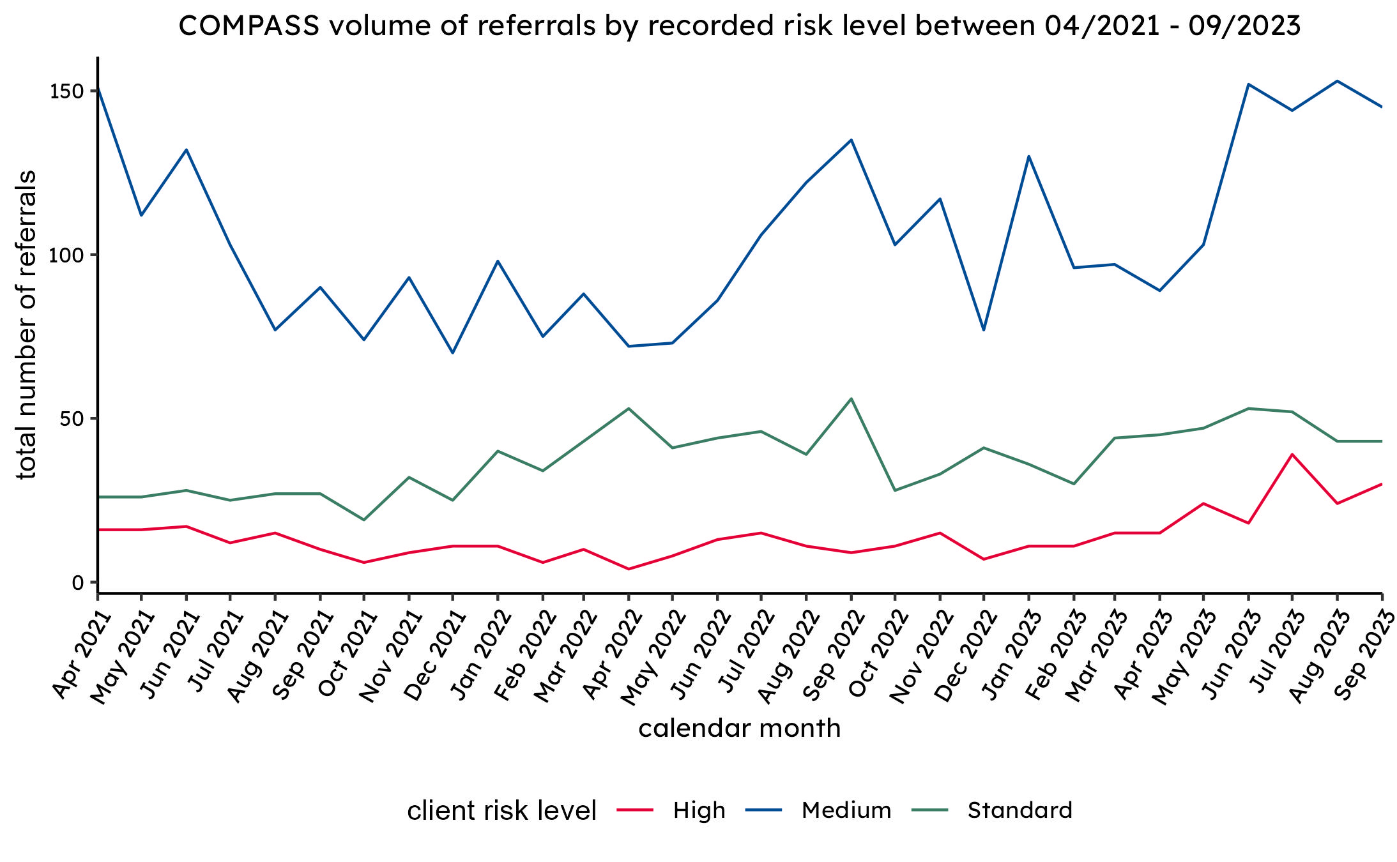
Police recorded DA incidents of all risk levels decreased, while an increase occurred across all risk level Compass referrals
  While the decreases in Police incident numbers and the increases in Compass referral numbers were of differing degrees for each risk level, this trend poses questions around the factors which may be driving the increase in Compass referrals.
  *Please note, Police recorded Standard risk DA incidents were not graphed to allow a detailed look at High and Medium risk DA incidents. Standard risk DA incidents also saw a decrease over time.
Source: COMPASS, Essex Police

Slide 35
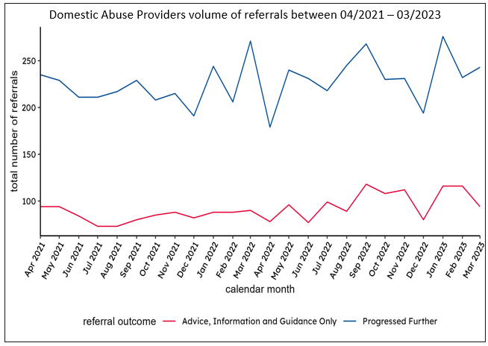
Referrals to Domestic Abuse providers have increased
  Between May 2022 and March 2023, the monthly average number of progressed provider referrals was 231. Between April 2021 and April 2022, this average stood at 216.
  For referrals whose outcomes was AIG, between April 2021 and April 2022, the monthly average was 78, while between May 2022 and March 2023, it was 96.
Source: Safer Places, Changing Pathways, The Next Chapter

Slide 36
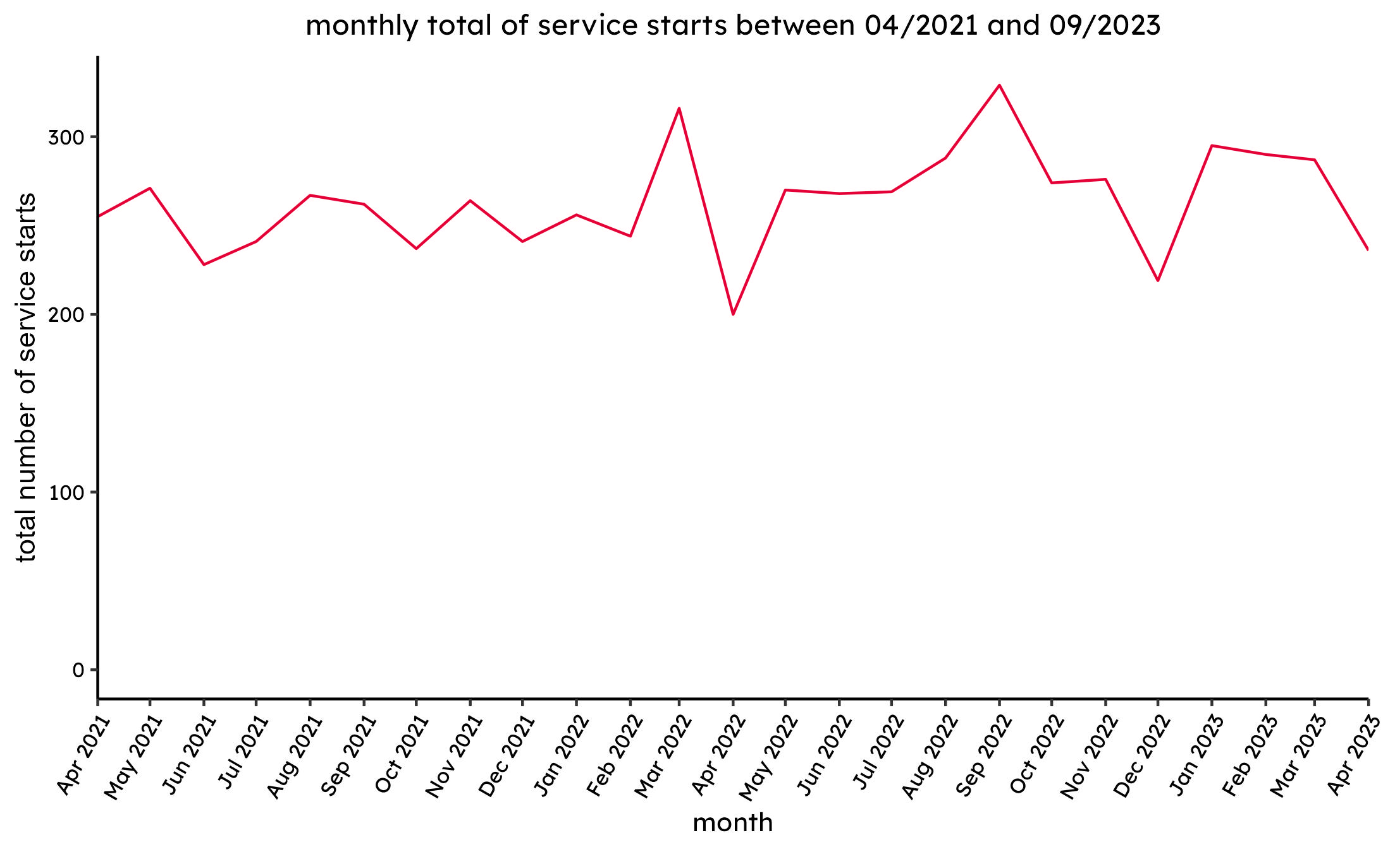
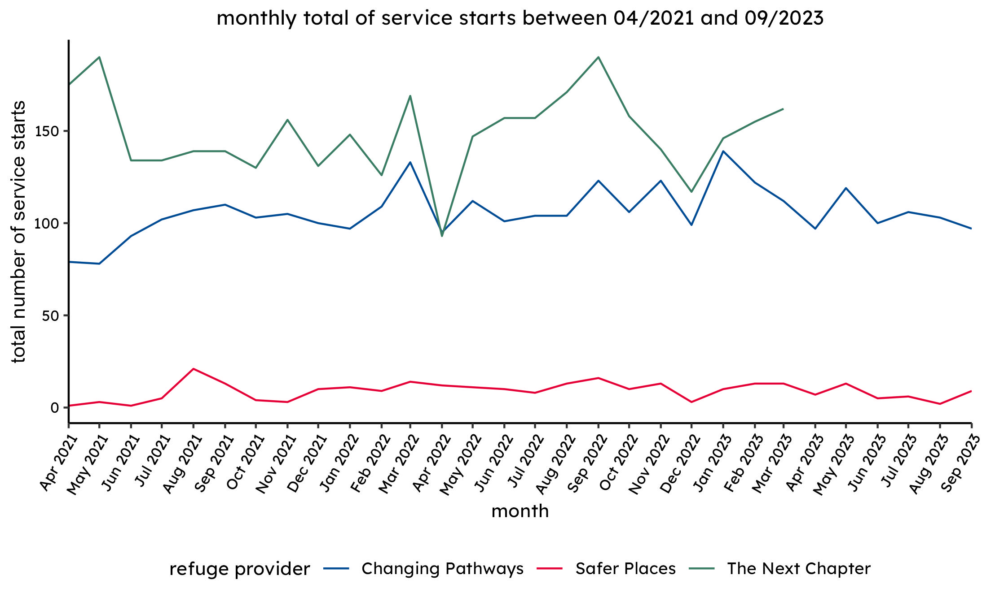
Domestic Abuse providers’ volume of services increased in 2022, particularly for North and Mid Essex providers
all providers -
  North and Mid Essex DA providers saw a large increase in 2022 in the number of Community based, Refuge and Specialist Refuge provided services, accounting for a large part of the overall increase in demand seen across all providers.
Source: Safer Places, Changing Pathways, The Next Chapter

Slide 37
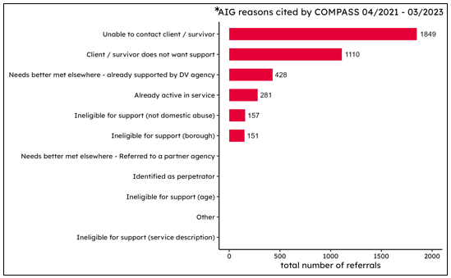
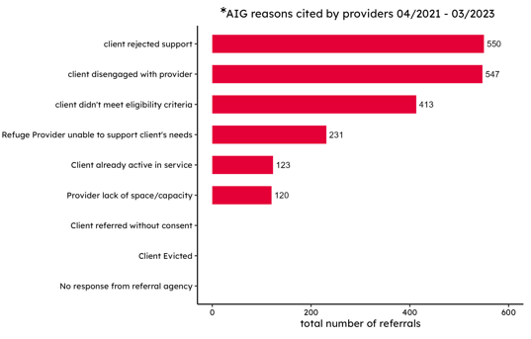
Over 1,000 Compass referrals and 500 provider referrals were not progressed due to clients not wanting support
  In addition to this, 231 clients referred to providers could not be supported due to the clients’ needs.
  These figures combined result in a large number of victims who could not be supported.
COULD DATA COLLECTION OF CLIENTS’ REASONS FOR DECLINING SUPPORT HELP WITH UNDERSTANDING HOW THESE INDIVIDUALS COULD BE ENGAGED?
* Please note that further breakdowns were removed to minimise identification risks. These can be made available upon request.
Source: COMPASS

Slide 38

What is the Demand for Safe Accommodation Services in Essex?

Slide 39
Key Findings
The monthly number of victims accommodated in Refuge and Specialist Refuge saw a large increase throughout 2022. While monthly starts in Refuge and Specialist Refuge were lower in early 2023, there have been 103 cases where clients could not be accommodated due to the lack of space. Given this, will the current number of refuge spaces meet future demand?
A large number of referrals to refuge had an Advice, Information and Guidance only outcome where the reason cited was the provider not being able to meet clients’ needs, or the provider lack of space/capacity.
Approaches to Local Authorities have seen a steady increase over time. The number of approaches resulting in support from the Local Authorities has however remained consistent over time. What may be driving the increase in approaches which do not qualify for a homelessness duty being owed?

Slide 40
Between April 2021 and September 2023 in Essex…
3,481
approaches to Local Housing Authorities were made
1,823
distinct victims were supported by a Local Housing Authority
1,056
distinct victims were accommodated in Refuge (incl. Specialist Refuge)* by domestic abuse providers
at least
at least
*Please note the this figure is a combined total of adult victims who were recorded as ‘accepted’ to refuge (including specialist refuge) and had either a service start or referral date provided.

Slide 41
The number of victims in Refuge and Specialist Refuge has seen a large increase
  The number of Refuge and Specialist Refuge services beginning in 2022 reflect the trend seen in referrals and overall service starts for providers.
  Values in the later half of 2022 for the number of victims starting to be accommodated in refuge were as large as 48 monthly cases in July of that year.
WHAT IS THE IMPACT OF THIS INCREASE ON PROVIDERS’ CAPACITY TO ACCOMMODATE VICTIMS?
Source: Safer Places, Changing Pathways, The Next Chapter

Slide 42
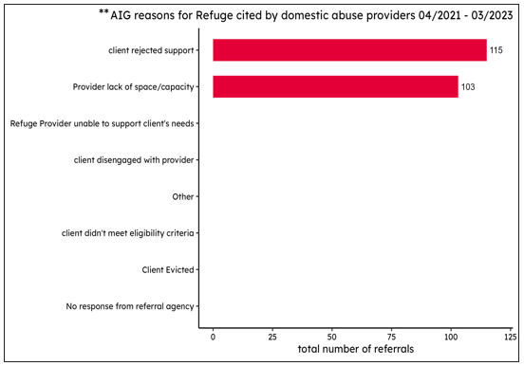
103 referrals to Refuge had an Advice, Information and Guidance outcome which providers recorded as being owed to lack of capacity to accommodate the clients.
An even larger number have rejected support or disengaged with the provider.
A large number of clients could not be accommodated in Refuge due to the lack of capacity or due to the clients’ needs
WILL THE CURRENT NUMBER OF REFUGE SPACES SUFFICE FOR FUTURE DEMAND GIVEN THE INCREASE IN PROVIDER DEMAND AND LACK OF SPACE FOR SOME VICTIMS HAVING ALREADY OCCURRED?
Source: Safer Places, Changing Pathways, The Next Chapter
*Please note that in some cases a reason was not recorded. The figures above reflects all AIG cases where a reason was cited.
** Please note that a further breakdown was removed to minimise identification risks. This can be made available upon request.

Slide 43
Approaches to Local Housing Authorities have seen an increase, while those resulting in support remained consistent
  While the number of people approaching a Local Housing Authority for housing due to Domestic Abuse has increased, this has not reflected in the number of progressed approaches.
  Increased pressures on Local Housing Authorities may occur due to the need to assess an increased number of applications.
WHAT MAY BE DRIVING THE INCREASE IN APPROACHES WHICH DO NOT QUALIFY FOR A HOMELESSNESS DUTY BEING OWED?
Source: Tier 2 Local Authorities

Slide 44
How does Demand Vary by Area?

Slide 45
Key Findings
10% (726) of Compass referred individuals were found to have been from out of county, whilst the origin area of most refuge and specialist refuge victims over the period of the needs assessment were also from outside of the county.
Transport to refuge has been highlighted as a potential barrier in qualitative analysis, where victims quoted difficulties when travelling long distances to reach the safe accommodation.
There are district level differences, with in particular Colchester, Basildon, Harlow, and Tendring being highlighted across multiple metrics as the districts with the most demand compared to the local population.
While seeing a lower Compass referral rate, Basildon ranks higher across multiple other metrics, including for victims accessing provider and Local Housing Authority support services.

Slide 46
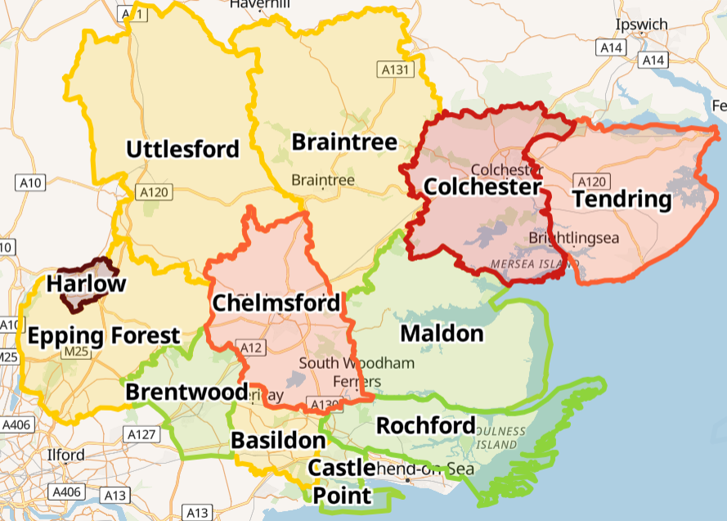
Harlow and Colchester have the highest rates per 100k of Compass referrals
Rate of Compass Referrals per 100k, Population 16+
Harlow, Colchester, and Tendring (with the last two districts being part of Essex County Council’s Levelling Up programme), have some of the highest rates of Compass referrals in Essex, aligning with their higher rates of Domestic Abuse incidents recorded by Essex Police.
Basildon has the 3rd highest rate of Police recorded Domestic Abuse Incidents but has the 8th highest Compass referrals rate.
Meanwhile, Chelmsford has the 3rd highest Compass referrals rate, but ranks 8th when looking at Police recorded DA incidents.
WHAT MAY BE DRIVING THE INCREASED COMPASS REFERRALS IN CHELMSFORD? AND COULD BASILDON’S LOW COMPASS REFERRAL RATE BE OWED TO VICTIMS APPROACHING THE LA’S DOMESTIC ABUSE HOUSING TEAM INSTEAD, OR TO OTHER FACTORS?
20+
17-19
15-16
11-14
Under 10

Slide 47
Volumes of supported victims vary in line with population size
The volume of victims supported by providers and by Local Housing Authorities* varies from area to area, with, as expected based on area size and population, Basildon, Colchester, Tendring and Chelmsford presenting the highest volumes.
*Please note that this graph makes use of information on victims’ origin area. As such, there may be victims with an out of county origin who may have lived in Essex at the time of abuse who could not be accounted for.
From Compass referrals, to Police DA incidents, and to rates of victims accessing services, Colchester, Tendring and Harlow are showing higher rates of domestic abuse across multiple metrics. Similarly for Basildon, where high rates can be observed for both provider and district services, which is more in line with the Police DA incident rates recorded for this area, as opposed to the Compass referrals rate.
* Please note that district level figures for approaches due to DA have been removed to minimise identification risks. These can be made available upon request.

Slide 48
COMPASS data shows that between April 2021 and September 2023, 11% (726) of clients who approached the service were from out of county.
Source: Compass
**Essex figures include Southend and Thurrock.

Slide 49
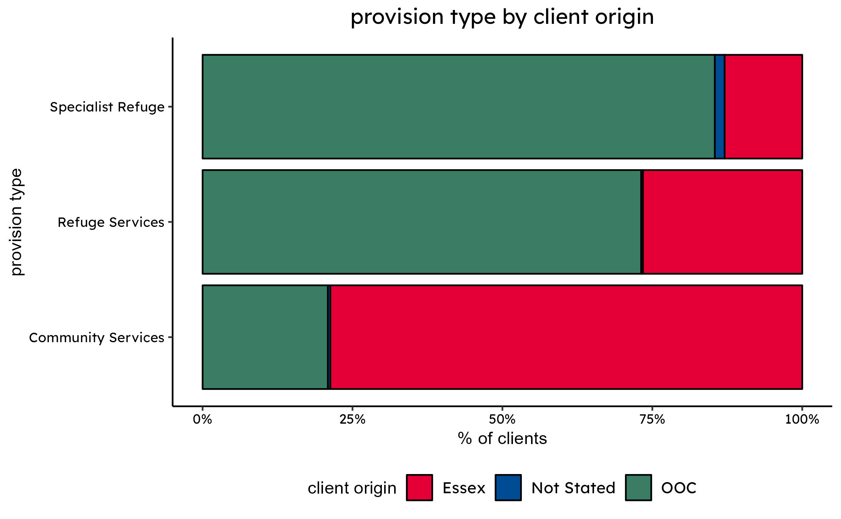
Out of county victims make up a large proportion of Specialist Refuge and Refuge clients, and of Compass referrals
  1,605 who started services with domestic abuse providers between April 2021 and March 2023 were recorded as having an out of county origin location.
  Whilst most clients were from within Essex, breakdown at the provision level shows that out of county clients made up a large proportion of Specialist Refuge and Refuge Services.
  Please note that, due to the origin location of victims being the most consistently recorded location across all three providers, this was the location information used for the adjacent graph. Please be aware as such that there may be victims with an out of county origin who may have lived in Essex at the time of abuse whom could not be accounted for.
Source: Safer Places, Changing Pathways, The Next Chapter
*Out of county figures include Southend and Thurrock.

Slide 50


“I was vulnerable I have social anxiety… I was expected to get on a 3-hour train to London and then however long from London to here by myself. I have never been to London before. It was my first time, and I was doing it completely alone. I had a panic attack on the train and at the station…a full-on mental breakdown. And no one helps you, they look right past you because they are all busy, I considered going back home.”
A victim from Out of County (OOC) recalled travelling three hours by train to access support…
WITH A LARGE NUMBER OF VICTIMS BEING FROM OUT OF COUNTY, HOW CAN VICTIMS WHICH TRAVEL LONG DISTANCES BE SUPPORTED? AND WOULD ADDITIONAL ANALYSIS MAPPING THE JOURNEYS MADE BY THE OUT OF COUNTY VICTIM COHORT BE HELPFUL?
[Female, 25-34, Colchester]

Slide 51
Which Services are Victims Accessing and for how Long?

Slide 52
Key Findings​
Domestic abuse victims are accessing a wide range of services, housing related or otherwise.
The majority of provider supported victims are receiving services in a Community setting, while in the Local Housing Authority context, most are supported with finding suitable housing through the Relief Duty.
The victims who were in Refuge and the nearly 500 victims who stayed in district provided Temporary Accommodation while looking for housing spent on average 3 to 4 months in these settings.
Instances where Temporary Accommodation and Refuge had not felt safe to victims were identified as part of the qualitative analysis. This could result in extended periods for victims where they do not feel safe in their accommodation, impacting their wellbeing, or motivating victims to no longer stay in the provided accommodation.

Slide 53

Victims of Domestic Abuse spend on average over 2 months in Specialist Refuge, and over 3 months in Refuge or Community based support
88% (6,349) of domestic abuse victims who went on to have a service with a provider were supported in a Community setting.
These clients spent on average* 105 days in community services.
11% (781) of domestic abuse victims who went on to have a service with a provider were accommodated in a Refuge setting.
These clients spent on average* 116 days in refuge services, close to a four-month period.
4% (275) of provider supported victims went on to be accommodated in Specialist Refuge.
These clients spent on average* 66 days in Specialist Refuge.
*Please note that average refers to the mean of the combined total number of days clients spent in provision as calculated at the point of service discontinuation. Those still in service at the time of data submission have been excluded from this calculation due to not having an end date recorded.

Slide 54




At least a quarter of district clients needed support to remain in their own home, and at least 22% were owed a Main Housing Duty
At least 334 distinct domestic abuse victims were owed a Prevention Duty by a local authority. This equals to 25% of all individuals supported by districts. This cohort also made up 12% of all approaches to districts.
At least 990 domestic abuse victims were owed a Relief Duty by a local housing authority. This equals to 74% of all individuals supported by districts. They also made up 35% of all individuals who approached the districts.
300 distinct domestic abuse victims were recorded as being owed a Main Duty, making up 22% of all individuals supported by districts. This cohort also makes up 11% of all approaches to districts.
At least 496 people were provided with Temporary Accommodation as part of duties, making up 37% of all who had a housing duty owed.

Slide 55
Victims spend on average 3 to 4 months in temporary accommodation
102 days is the average length of the period for which domestic abuse victims were supported by districts as part of the Prevention Duty*, meaning that on average, victims of domestic abuse require support over the span of over 3 months with activities towards enabling them to remain safely in their home.
Victims of domestic abuse placed in Temporary Accommodation spend, on average, 128 days in the offered accommodation, close to the amount of time spent by the victims who stay in Refuge.
Engagement with survivors has highlighted instances where Temporary Accommodation did not feel safe.
“There wasn’t really any security. (…) When he [perpetrator] broke bail conditions they [Police] said…we think you should be in a more secure place. There wasn’t anything other than CCTV and I was on the bottom floor.”
[Female, 25-34, on temporary accommodation]
With victims of domestic abuse spending on average 3 to 4 months in this accommodation, this could result in an extended period where victims felt exposed to factors impacting their wellbeing or motivated to no longer stay in the provided accommodation.
HOW CAN WE SUPPORT VICTIMS TO FEEL SAFER IN ACCOMMODATION?

Slide 56
Case study: Local Authority Housing
“We were put in this place, there wasn’t really any security and I don’t think there was anyone else in there was fleeing DV, they were more people who had become homeless. So there wasn’t really any support there…When he [perpetrator] broke bail conditions they [Police] said…we think you should be in a more secure place. There wasn’t anything other than CCTV and I was on the bottom floor.”
Jenny endured an abusive relationship for around 8 years, experiencing both physical and emotional abuse. The turning point came when her perpetrator broke her nose in front of their son. This triggered Jenny to contact the Police, who advised she and her son go into a refuge for their own safety.
Jenny contacted the district council where her brother lived as a place to relocate and be near family. The Domestic Violence Lead at the district council quickly arranged a place for Jenny and her son to move into. Jenny believed she was moving into a refuge however then discovered on moving in that it was actually temporary accommodation, which she felt lacked security. Following her perpetrator breaking bail conditions, the Police raised concerns for Jenny’s safety.
After 2 months of living in temporary accommodation, Jenny was later provided with a council property, but had to spend a significant amount of money making the property adequate for her son.
“...I couldn’t have my 6-year-old walking on floorboards with nails sticking out…there was damage to the property and it was another stress to add when we’re trying to start our lives again.”
[Jenny, 35-44, 6-year-old son,
On Temporary Accommodation]

Slide 57



While data on this is limited, victims of domestic abuse are accessing housing support via other channels as well
In addition to the main routes of accessing housing via homelessness applications or via providers of safe accommodation, there are other channels through which victims of domestic abuse are accessing housing support, depending on their needs.
At least 173 in victims have been supported via official Sanctuary Schemes across Basildon, Braintree, Castle Point, Epping Forest and Tendring between April 2021 and March 2023. Please note however that the data available on this is limited and this figure is likely to be higher, as it doesn’t include data from DA providers who have supported victims with additional security measures. Also there may be overlap between victims recorded as having had a Prevention Duty owed in Local Authority data and the 173 victims recorded separately as having been supported through Sanctuary Schemes.
A look at Castle Point Housing Register data shows that, between April 2021 and March 2023, a small number* of domestic abuse victims applied for housing and were successful in securing a Local Authority Tenancy.
Basildon Borough Council’s Domestic Abuse team recorded having provided Advice and Guidance for 356 individuals between April 2021 and March 2023.
* Low figures removed to avoid risk of identification.

Slide 58
Nearly 1 in 4 Drug & Alcohol service clients reported having experienced Domestic Abuse
Domestic Abuse victims also access other services apart from housing related support and DA providers to meet their needs.
Among these are the Drug & Alcohol Support Services commissioned by Essex County Council, Phoenix Futures and Essex Young People’s Drug and Alcohol Service.
In the financial year 2022/2023, 457 individuals receiving support across these services for Drug Dependency reported having experienced Domestic Abuse. This cohort made up 23% of all recipients of support for drug dependency across services.
314 individuals who were receiving support for Alcohol Dependency over the same period reported having experienced Domestic Abuse, making up 23% of all recipients of support for alcohol dependency.

Slide 59

On a monthly average, over a quarter of Children & Families Assessments in Essex Childrens Social Care flag domestic abuse
Domestic Abuse victims may also be supported or identified in other settings or services.
One such example is the social care setting, where domestic abuse in the family can be identified when victims are accessing Adults’ or Children’s Social Care.
In the Children’s Social Care context, between April 2021 and January 2023, 2,789 distinct children had Domestic Abuse flagged as part of a Children & Families’ Assessment which they had conducted.
On a monthly average over this period, 151 children had domestic abuse flagged in an assessment, making up an average 28% of the monthly opened Children & Families Assessments over this period.

Slide 60

In the Adult Social Care context, identifying domestic abuse is more challenging compared to other types of abuse
1,380 Safeguarding concerns related to Domestic Abuse were raised in Adult Social Care Services in Essex between April 2021 and March 2023, making up 4% of all concerns raised during this period.
Of these, 15% (204) were escalated to the Safeguarding Enquiry level. These made up 2% of all Safeguarding Enquiries over this period.
Over the same period, the conversion rate from concern to enquiry across all Safeguarding concerns in Essex was 27%. This is 12% higher than the conversion rate for domestic abuse related concerns, potentially indicating the added difficulties with identifying the occurrence of domestic abuse compared to other types of abuse in the Adult Social Care context.
The occurrence of domestic abuse in concordance with support needs around memory and cognition, mental health, or physical and sensory support appears to bring additional challenges in investigating and identifying this type of abuse.

Slide 61
What are the Characteristics & Needs of Victims?

Slide 62
What are the Protected Characteristics of Victims Accessing Domestic Abuse Support?

Slide 63
Key Findings
8% (107) of district supported victims and 4% (249) of provider supported victims are male.
Most victims are in their 30s, with the average age of victims supported by districts, Compass and domestic abuse providers being between 35-36. The most common age range found across victims within all services is 26-45. Under 25s and over 60s are less common within the data.
Proportions of Global Majority* victims are slightly higher across Domestic Abuse services than in Police recorded incidents. However, Essex Police recorded 7,128 global majority victims between April 2021 and Sept 2023 (10% of all victims). By comparison, 1,114 global majority victims* were supported by providers between April 2021 and March 2023 (19% of supported victims).
3% (186) of provider supported victims are LGBTQ+. The figure for local authority supported victims who are LGBTQ+ is smaller**. LGBTQ+ Victims appear to be under-represented in Domestic Abuse services when comparing to national estimates.
*Global Majority is a collective term which refers to people who are Black, Asian, Brown, dual-heritage, indigenous to the global south, and or have been racialised as 'ethnic minorities’ (Campbell-Stephens 2020). In this document, the term also refers to clients who are Irish, Gypsy or Irish Traveller, Roma or from other White Groups.
**Please note that figures were removed due to low numbers, to avoid risk of identification. A district level breakdown can be provided upon request.

Slide 64
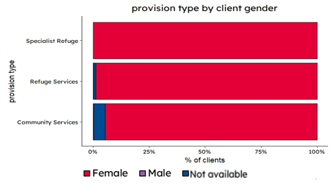
The proportion of female and male victims varies across services
  Of the 4,834 individuals referred to Compass between April 2021 and March 2023, 89% (4,304) were female and 7% (341) were male.
  Of the 630 victims who had Refuge starts over the same period, the overwhelming majority were female.
  In the Community setting, 4839 of service users were female clients and 241 male.
  Overall, across all provider services, 4% (246) of supported victims were male.
  Meanwhile, of the 1,332 district supported victims over this period, at least 64% (855) were female, and 8% (107) male. Please note that for 28%, gender was not available.
  4% (175) of cases heard at MARAC over the two-year period were recorded as including male victims.
* Please note that figures for non-binary and transgender victims were removed due to low numbers, to avoid risk of identification.

Slide 65
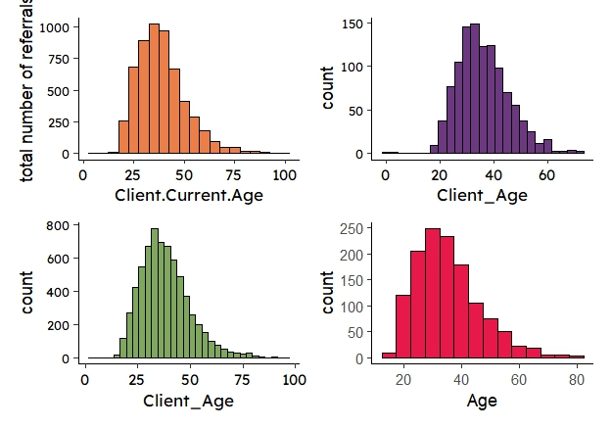
Most Domestic Abuse Victims are ages 26 to 45
Total number of victims
  The average age of DA victims supported by providers is 36, while for those supported by districts it is 35.
  Two thirds (3,803) of provider supported victims and at least 56% (742) of district supported victims are ages 26 to 45.
  Proportions are low for under 25’s and in particular those over the age of 60, with all services presenting similar age trends.
  This trend is present in Police Domestic Abuse data as well, with 53% (36,023) of DA crimes assessed by Essex Police between April 2021 and September 2023 having been committed against victims ages 26 to 45.
recorded age
ORDER: Compass, Refuge (including Recovery Refuge), Community Services (Domestic Abuse Providers), Local Authority Housing
*Where ages of all Compass referred individuals at time of referral was counted. For Providers, all those with a Refuge, Specialist Refuge, or Community-based service were counted, by age at service start. For Local Authorities, age at time of homelessness application or approach to District Council was considered.

Slide 66

Proportions of Global Majority* victims are slightly higher across services than in Police recorded incidents
  While in Essex Police data for the period April 2021 to Sept 2023, 4% (3,077) of victims of Domestic Abuse incidents are from a Black ethnic group, this proportion is higher across all Domestic Abuse services, except for Compass, where it is equal.
  Similarly for Asian victims, they make up 3% of victims recorded in Essex Police Domestic Abuse incidents, equal to the proportion across victims supported by districts, and lower than the other Domestic Abuse services in Essex.
  While the proportions of global majority* victims are higher across DA services than those captured in Police data, Essex Police recorded 7,128 global majority victims between April 2021 and Sept 2023. By comparison, 1,114 global majority victims* were supported by providers between April 2021 and March 2023.
* Global Majority is a collective term which refers to people who are Black, Asian, Brown, dual-heritage, indigenous to the global south, and or have been racialised as 'ethnic minorities’ (Campbell-Stephens 2020). In this document, the term also refers to clients who are Irish, Gypsy or Irish Traveller, Roma or from other White Groups.

Slide 67
LGBTQ+ Victims appear to be under-represented in Domestic Abuse services when comparing to national estimates
3% (186) of provider supported victims are LGBTQ+.
This proportion is higher than the percentage of people ages 16 and over in Essex who identify as LGBTQ+ (2.2% according to 2021 Census).
However, more than 1 in 10 LGBTQ+ people in the UK are estimated to have faced domestic abuse in the past year. This would be the equivalent of 2,970 people ages 16 and over in Essex (2021 Census).
By contrast, between April 2021 and March 2023, 244 LGBTQ+ domestic abuse victims were referred via Compass, and a small number* approached local authorities for housing support due to domestic abuse. The number of LGBTQ+ cases heard at MARAC* was minimal.
2
* Please note that LGBTQ+ figures for district supported victims and for MARAC cases were removed due to low numbers, to avoid risk of identification. District level figures can be provided upon request.

Slide 68
What other Needs are Clients presenting?

Slide 69
Key Findings
Two thirds (422) of clients in Refuge and over half (753) of those supported by local authority housing teams had at least one dependent child. Although pregnant victims only account for 5% (309) of provider clients, nearly 75% (231) of these clients already had a dependent child. These proportions indicate a large number of victims may require support for their children, and that most pregnant victims are likely to already be parents.
54% (338) of clients in Refuge and at least 27% (332) of districts supported victims have presented Mental Health needs. Mental health need is one of the most prevalent within specialist refuge services, accounting there for 75% (191) of clients seen by the service. Overall, this need is seen widely across victims of domestic abuse being supported.
13% (741) of provider supported victims had a recorded disability and mostly went on to receive support in specialist refuge or refuge settings. Learning disability was the least common disability type, accounting for less than 10% (276) of the victim population overall.
1 in 2 victims (120) within Specialist Refuge had alcohol support needs, whilst a large proportion* of those supported by Drug & Alcohol Services had experienced Domestic Abuse. Similarly, over two thirds (167) of victims in Specialist Refuge have Drug Dependency Needs, whilst 22% (107) of Drug Support service clients have experienced DA.
7% (41) of clients accommodated in Refuge (excl. Specialist Refuge) have No Recourse to Public Funds (NRPF). Disclosure of sexual abuse is not common in the data. Based on the available data, 7% (386) of provider supported victims experienced sexual abuse.
*Low figure was removed to avoid risk of identification.

Slide 70
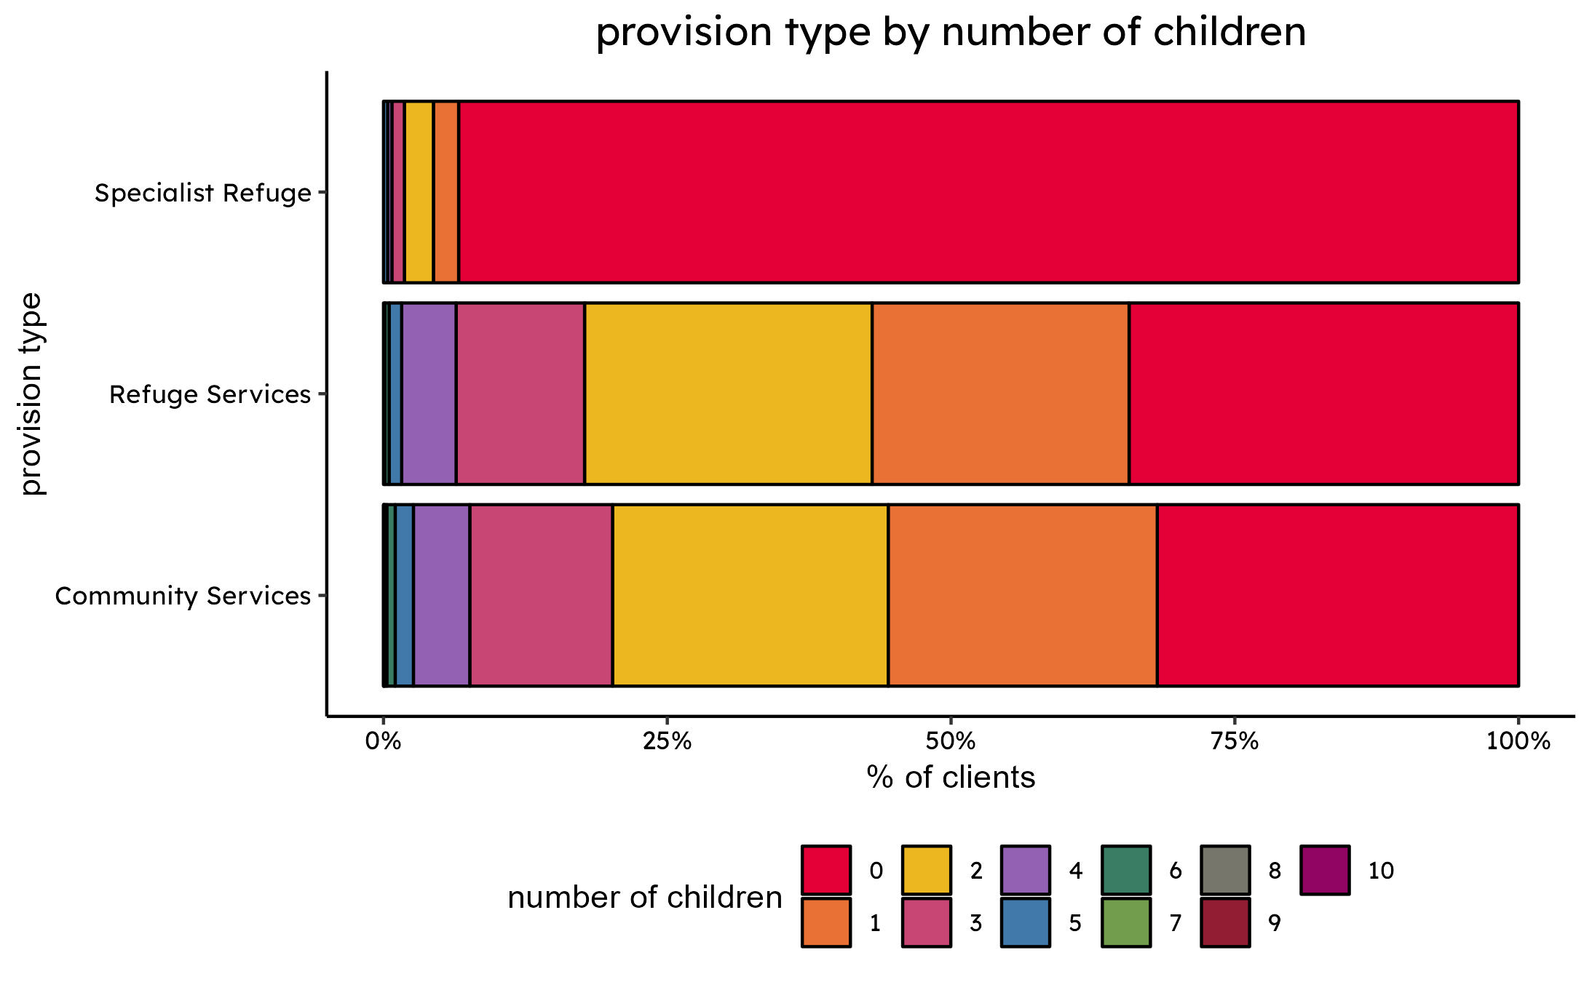
66% of victims supported by providers and at least 57% of those supported by districts have children
  753 district supported victims and 3,786 provider supported victims between April 2021 and March 2023 had one or more children.
  In Refuge alone across all providers, there were 879 children between April 2021 and March 2023.
  As such, a large cohort of victims would benefit from and rely on support focused on children.

Slide 71
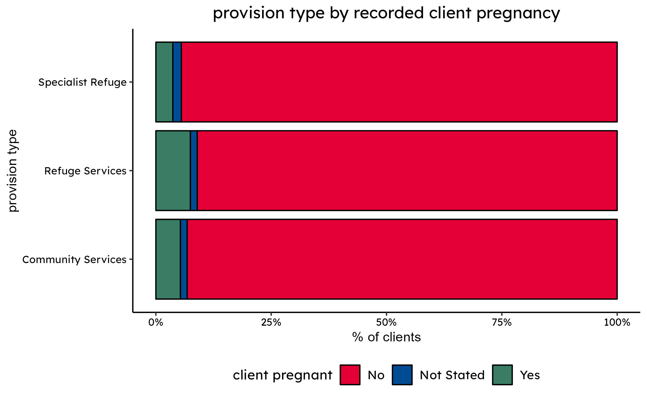
5% of provider supported victims are pregnant, of which 75% already have one or more children
  This is the equivalent of 309 pregnant individuals in a Refuge, Specialist Refuge or Community setting, of which 231 also have one or more children.
  Across districts which capture pregnancy, at least 2% of supported domestic abuse victims were pregnant at the time when they approached the local authority.

Slide 72
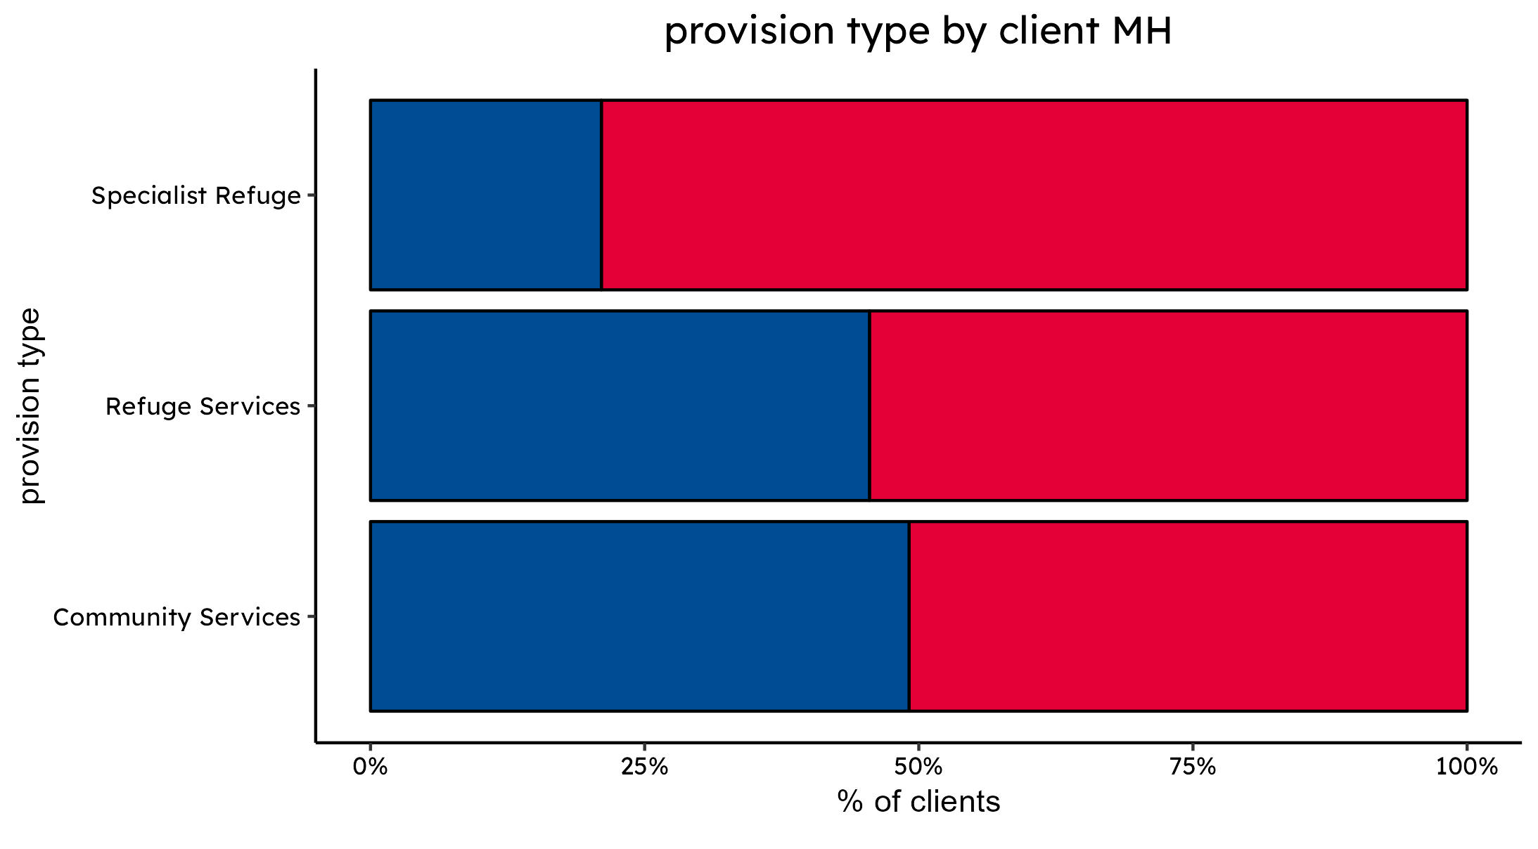
Over half of victims supported by providers and at least 1 in 4 of district supported ones have Mental Health Needs
  338 of Refuge supported DA victims, 2,582 Community Supported victims, and 191 of Specialist Refuge victims have presented a need for Mental Health Support.
  For districts capturing mental health needs, at least 27% (332) of supported DA victims have presented a need for Mental Health Support. Please note that for 55% of district supported victims, mental health information was not available.
INSUFFICIENT MENTAL HEALTH SUPPORT WAS HIGHLIGHTED THROUGH INTERVIEWS – A LARGE GROUP OF VICTIMS COULD BENEFIT FROM ENHANCED MENTAL HEALTH SUPPORT SERVICES

Slide 73
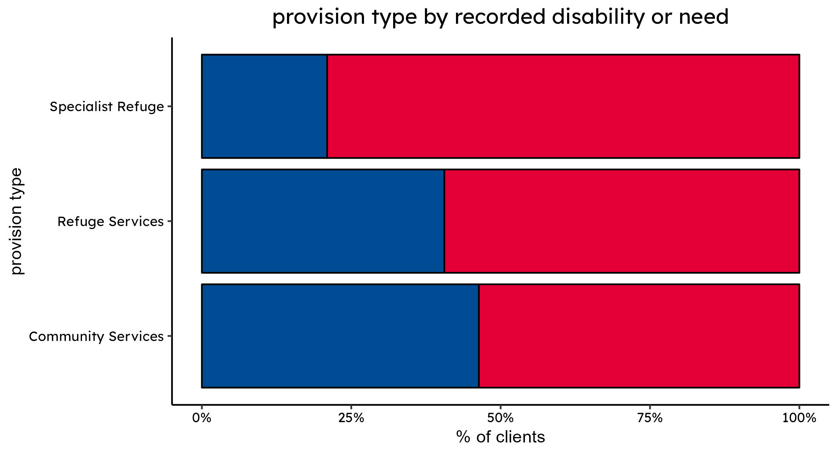
At least 12% to 13% of victims have Physical Health Needs and Disabilities
  741 victims within provider services had a recorded physical disability, making up 13% of supported victims. The proportion of disabled victims was higher within Specialist Refuge at 23% and in Refuge, at 16%.
  154 district supported victims had a physical disability, making up 12% of all district supported victims. Please note that for 56% of district cases, physical health needs have not been recorded.
INTERVIEWED SURVIVORS WITH DISABILITIES MENTIONED RELUCTANCE TO LEAVE THEIR HOME WHICH MEETS THEIR ACCESSIBLITY NEEDS, TO GO INTO REFUGE.
HOW CAN THIS COHORT BE BETTER SUPPORTED WITH THE ADJUSTMENT?

Slide 74
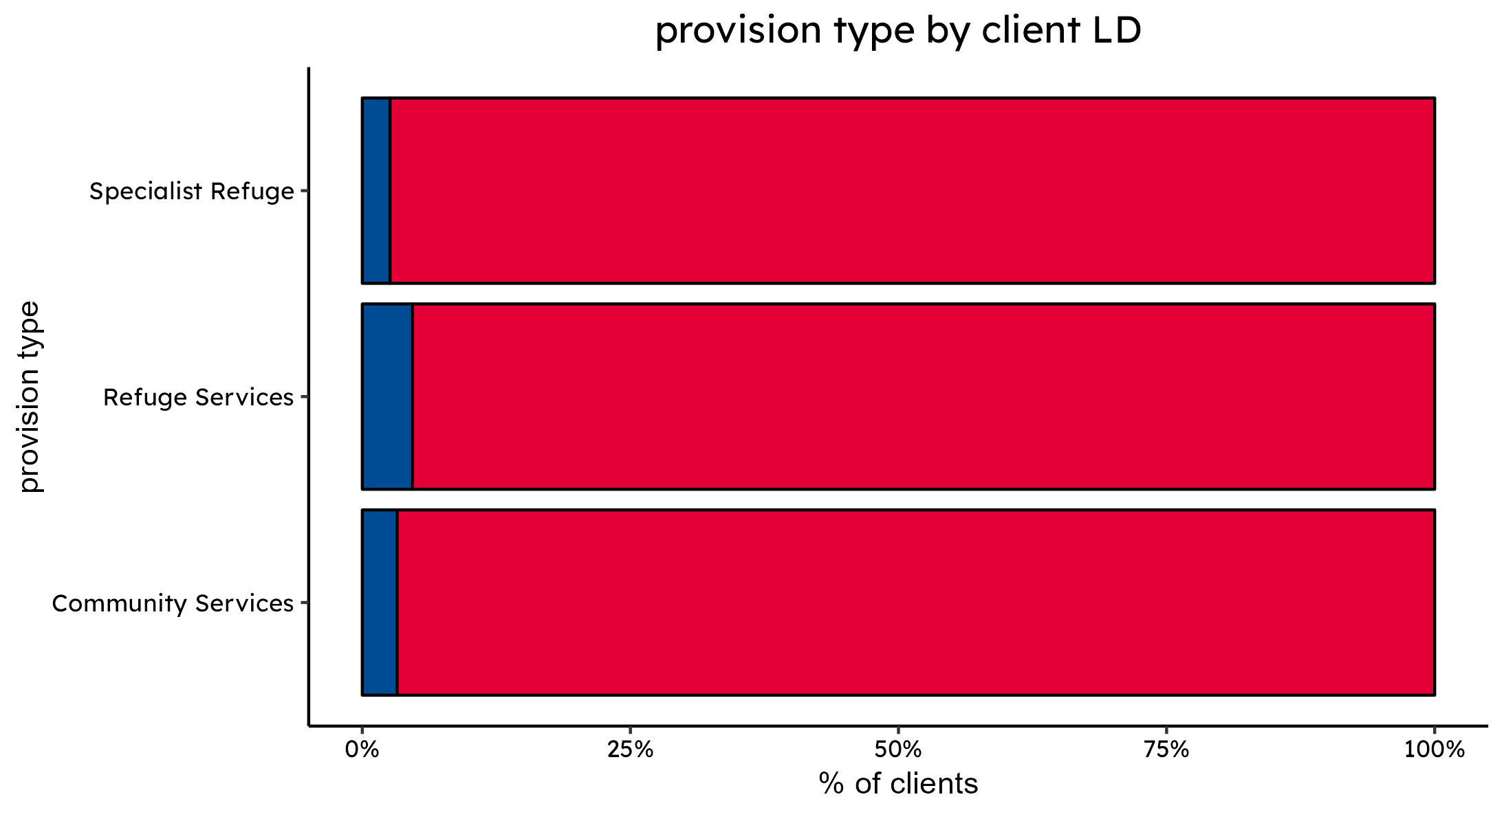
At least 6% of district supported victims and 3% of provider supported victims have a Learning Disability
  201 of domestic abuse victims supported by DA providers had a Learning Disability. Refuge had the largest proportion of victims with a Learning Disability, 5%.
  Across districts, at least 6% of supported victims are affected by a Learning Disability.
  For Colchester, this figure was double the districts average, at 12%.
  Please note that for 59% of district cases, Learning Disability needs have not been recorded.

Slide 75
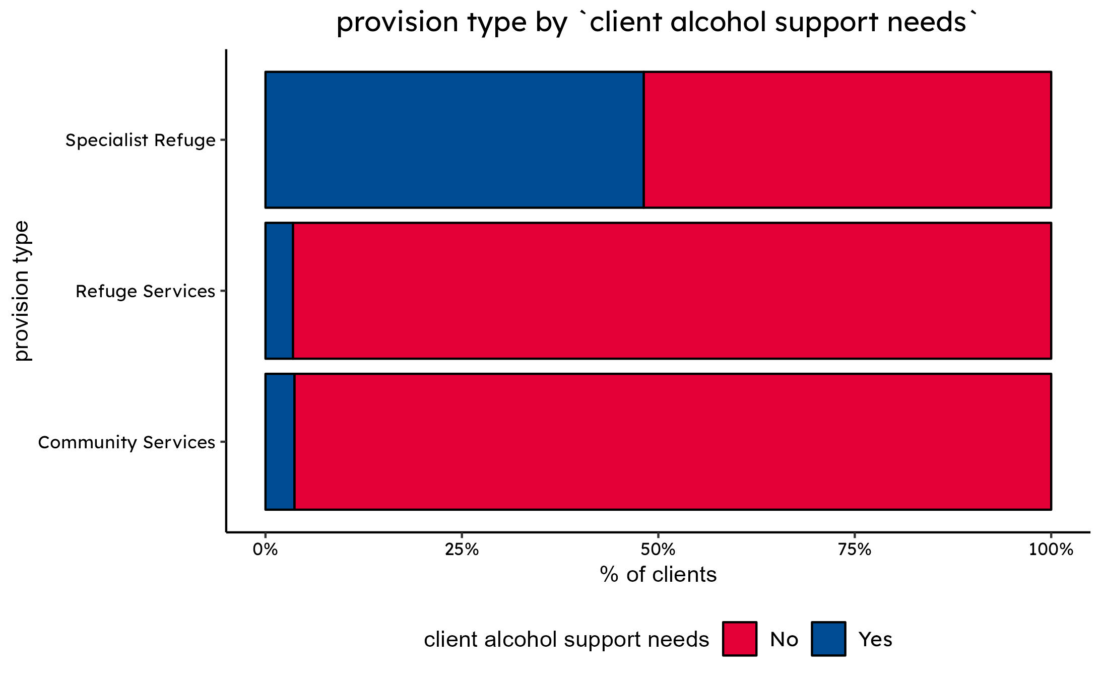
1 in 2 victims within Specialist Refuge had alcohol support needs, whilst 1 in 4 victims supported by Drug & Alcohol Services had experienced DA
  287 victims supported by providers had alcohol dependency needs, of which 120 (49%) were supported within Specialist Refuge.
  Across the districts capturing this field, at least 3% of district supported victims have alcohol dependency needs.
  A significant proportion* of the 287 individuals supported by ECC commissioned Drug and Alcohol Services in financial year 2022/2023 for Alcohol Dependency had either experienced Domestic Abuse or were experiencing it at the time of the service.
*Low figure was removed to avoid risk of identification.

Slide 76
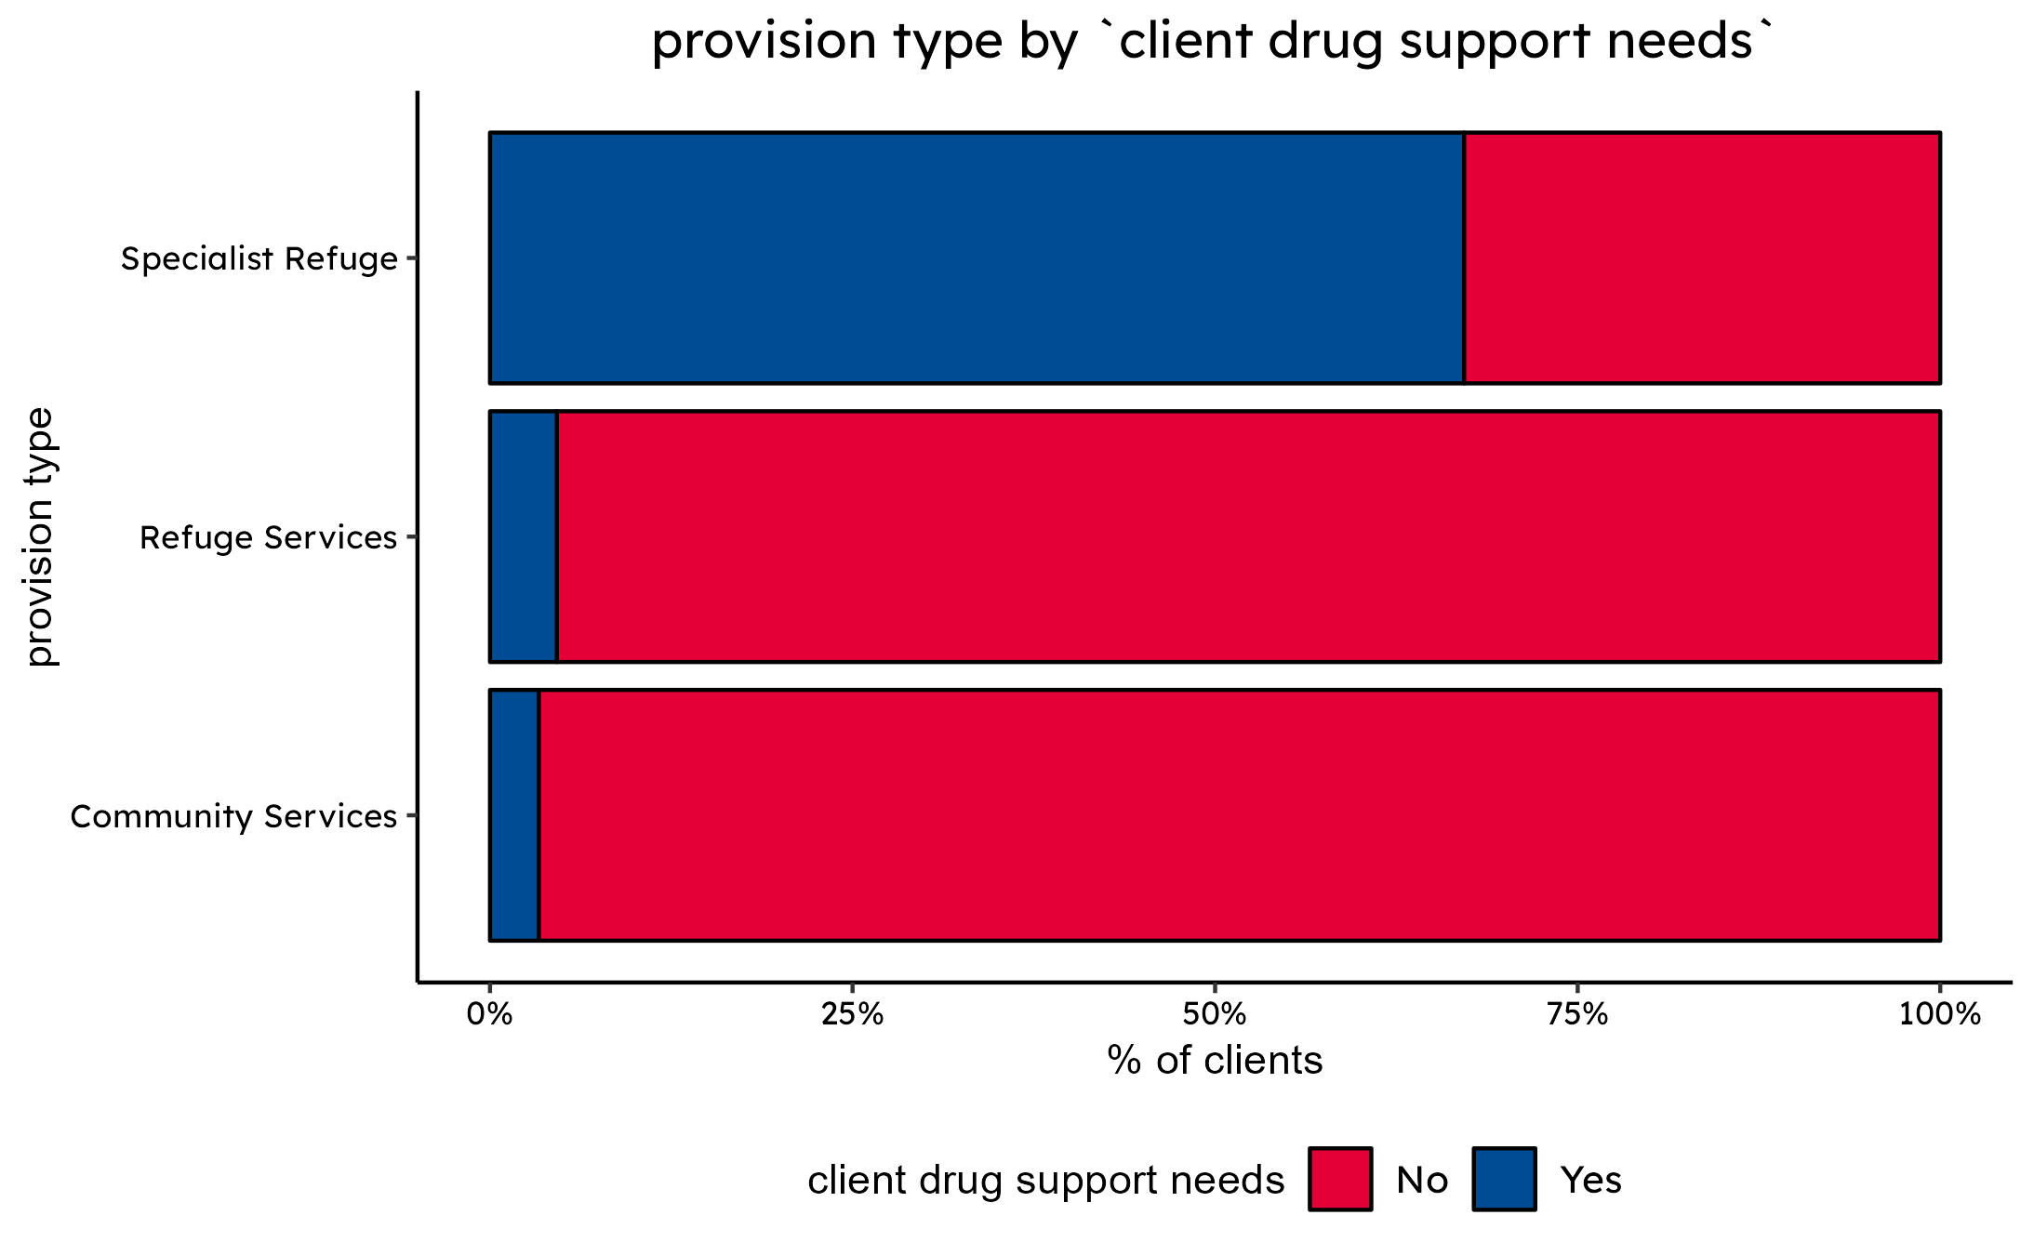
Over two thirds of victims in Specialist Refuge have Drug Dependency Needs, whilst 22% of Drug Support service clients have experienced DA
  6% (318) of victims supported by domestic abuse providers have Drug Dependency needs. Most of these victims were supported within Specialist Refuge (68%, 167).
  Across districts which capture this information, 3% of supported victims are presenting Drug Dependency needs. Please note however that for 62% of cases supported by all districts, Drug Dependency has not been recorded.
  107 of the 489 individuals supported by ECC commissioned Drug and Alcohol Services between in financial year 2022/2023 for Drug Dependency had either experienced Domestic Abuse or were experiencing it at the time of the service, making up 22% of the cohort.

Slide 77
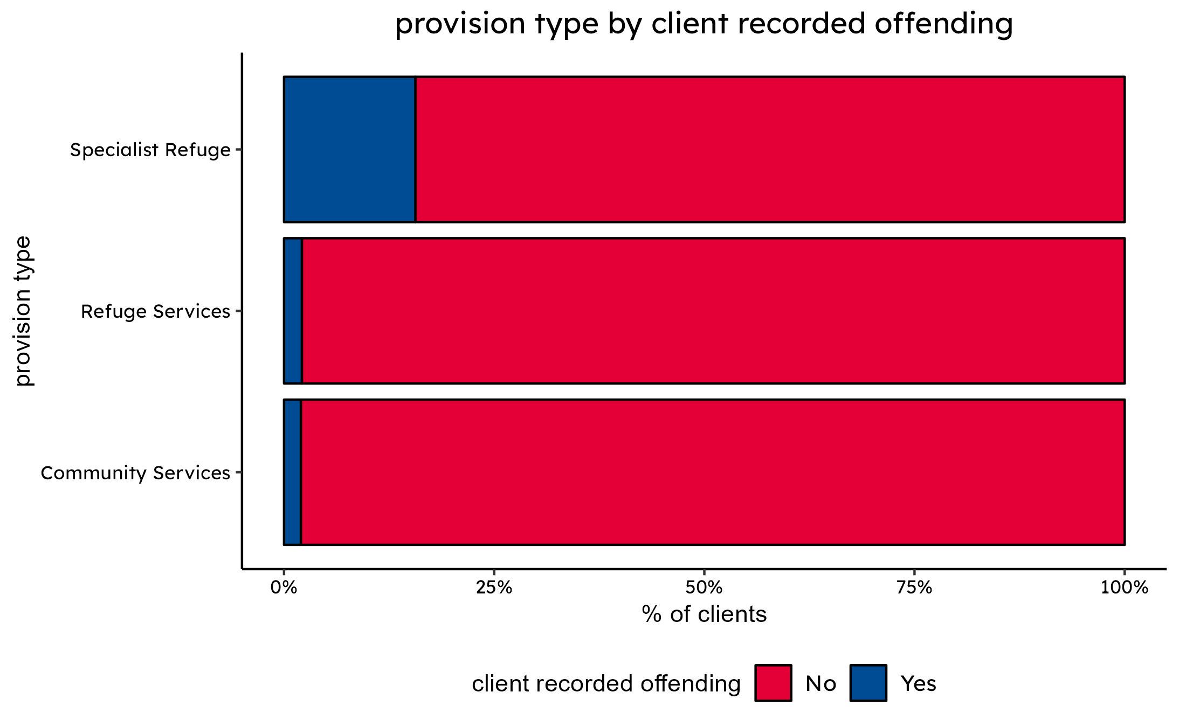
7% of victims in Refuge have No Recourse to Public Funds, and 15% of victims in Specialist Refuge have an Offending History
  4% (221) of victims supported by providers have No Recourse to Public Funds. This proportion is higher for victims in Refuge, of which 7% (41) have No Recourse to Public Funds.
  Across victims supported by domestic abuse providers, 2% (128) of victims have an Offending History.

Slide 78
13% of victims in Refuge and 4% of district supported victims have experienced sexual abuse
  Across all provider services, 7% (386) of supported victims have been recorded as having experienced sexual abuse. The proportion of refuge supported victims who had experienced sexual abuse is higher, at 13%.
  381 female victims experienced sexual abuse, making up 7% of all women supported by providers.
  Please note these figures are estimated to be much higher due to the sensitive nature and high level of non-disclosure.

Slide 79
Are any of the Characteristics or Needs of Victims preventing them from accessing services or leading to Complexity in Relation to their Needed Support?

Slide 80
Key Findings
Male victims and older adults appear to be under-represented in Domestic Abuse services. Based on comparisons to external data, and according to literature, these cohorts may be less likely to engage with domestic abuse services due to a variety of factors.
Particularly, men have been found in qualitative analysis to feel like services are not aimed at them, pointing to one of the potential dynamics behind lower representation of men among provider clients.
A higher proportion of male provider victims were ages 66 and over than for female provider victims.
11% (121) of victims from a global majority* ethnic group are in the UK on a visa, as a Refugee or Asylum Seeker, or with an Insecure Status. 31% (344) do not have English as their first language. When it comes to the services they access, most global majority* victims went on to be supported by community services or outreach, but at the service level, the proportion of each group differed by service type.
** Global Majority is a collective term which refers to people who are Black, Asian, Brown, dual-heritage, indigenous to the global south, and or have been racialised as 'ethnic minorities’ (Campbell-Stephens 2020). The term also refers to clients who are Irish, Gypsy or Irish Traveller, Roma or from other White Groups.

Slide 81
Cont.
When trying to better understand the needs of victims in refuge who are parents, it was found that 49% (206) of parents in refuge had mental health needs and at least 48% (203) were unemployed.
Goodman Project supported male children were mostly ages 13 to 15, and a third had a disability. Sisters in Strength supported female victims were also mostly aged 13 to 15.
Qualitative research found that building trust was perceived to be important by children and young people who received support from professionals in service settings.
The proportion of male victims who are LGBTQ+ was significantly larger than that of female LGBTQ+ victims. 70% (131) of LGBTQ+ victims have mental health needs.
Wider literature suggests that the proportion of Black, Asian and minority ethnic LGBTQ+ people facing domestic abuse is higher than that of White LGBTQ+. A significant difference could not be identified on this however in the provider data.
Developing further understanding of male, LGBTQ+ and older victims can help with supporting these groups which may be encountering additional barriers to services.

Slide 82
Older victims may be under-accessing Domestic Abuse services
  The limited research on older adults experiencing domestic abuse suggests that this cohort is consistently under-represented in Domestic Abuse services.
  Essex Police recorded 2,886 victims ages 66+ of DA assessed crimes, making up 4% of victims of DA assessed crimes ages 16 and above*.
  In provider client data, only 2.5% (143) of all supported victims are ages 66 and over, with even fewer accessing support via Tier 2 local authorities.
  In MARAC data as well, only 1% of all cases heard between April 2021 and March 2023 were ages 65 and over.
  Essex County Council Adult Social Care data, where the majority of clients are of older age, may provide additional insight into the needs of older domestic abuse victims.
  Between April 2021 and March 2023, 437 individuals ages 66 and above had a Domestic Abuse Safeguarding Concern and/or Domestic Abuse Safeguarding Enquiry raised in Adult Social Care services in Essex.
  23% of the concerns became an Enquiry, slightly less than the countywide conversion rate to Enquiry, which was 27%, but more than the overall conversion rate to Enquiry for DA Safeguarding concerns in Essex, which was 15%.
  The volume of Domestic Abuse Safeguarding Enquiries made up 2% of all enquiries raised in Adult Social Care Services in Essex.
4
* Between April 2021 and September 2023.

Slide 83
Almost a third of Safeguarding Concerns were male
  32% of the 437 individuals ages 66 and above with a domestic abuse safeguarding concern or enquiry were male.
  While women remain the predominant gender in this cohort as well, the proportion of men is larger than seen in domestic abuse provider data, where 24% of victims ages 66 and over were male.
  For 78%, the risk of domestic abuse was a relative/family carer (partners included).
  Over half of the 437 individuals were receiving social care at the time due to Physical Support Needs.
  A detailed breakdown of the main support needs for the remaining individuals was removed to minimise the risk of identification. This can be made available upon request.

Slide 84
Older victims are more likely to have physical support needs
  43% of provider supported victims ages 66 and over have physical support needs, a significantly larger proportion than in other age groups.
  This proportion is close to that of adults receiving Physical Support among older adult safeguarding concerns related to domestic abuse (as seen on previous slide).
  Research on the barriers to accessing domestic abuse support for older adults has found health conditions to be a key barrier for this group, as they become more dependent on their partner or family members, and in time, more isolated due to the need for care, reduced mobility, etc.
4
  As mentioned on slide 65, interviewed victims who have a physical disability highlighted their reluctance to leave their home which
  can meet their accessibility needs.
COULD ELDERLY VICTIMS OF DOMESTIC ABUSE WITH HEALTH SUPPORT NEEDS BE MORE CHALLENGING TO IDENTIFY & ENGAGE DUE TO OVERLAP OF NEEDS?

Slide 85
Over a quarter of victims recorded by the Police are men, but less than 10% of victims supported across DA services are male
  27% of the Domestic Abuse crimes assessed by Essex Police between April 2021 and September 2023 were recorded as having been against male victims, the equivalent of 18,753 male victims.
  By contrast, between April 2021 and March 2023, 435 men were referred via Compass, and 126 men approached a local authority for housing due to DA.
  A small number* of men received housing support following the approach, and 249 received support from domestic abuse providers.
  While societal factors can be one of the factors behind men not accessing support, interviews with male victims of domestic abuse found that men did not feel like support services were aimed at them.
  “There needs to be public awareness about how people are supported, frameworks need to be public knowledge, so people are aware of the process, it’s not gender.” [Male, 35- 44, Chelmsford]
  “There is no support group [for you]. You are a man and could traumatise the women.” [Male, 35-44, Colchester]
5
HOW CAN MALE VICTIMS BE ENCOURAGED TO APPROACH DA SERVICES?
*Low figure was removed to avoid risk of identification.

Slide 86
Nearly 1 in 2 men who did not progress to a service after being referred to South and West Essex DA providers, did not engage or want support
  The number of referrals to South and West Essex DA providers which did not progress to a service and where the victim was male was 137. This was higher than the number of referrals to these providers which progressed to a service and male.
  30% of male victims who did not progress to a service did not want support. A further 18% were not contactable, meaning nearly half did not engage with services.
  Please note that this information is only based on South and West Essex provider data due to data availability. As such, findings represent only a sub-group of male victims.
*A detailed breakdown of reasons behind lack of service progression can be provided upon request, figures have been removed to minimise identification risk.

Slide 87
Case study: Blockers to support for me
“DA is [seen as] a women’s issue. Need a greater awareness of male survivors.” “Men are the villains, [we are seen as] unreasonable because of our gender. Need the same as girls, equal service.”
Brian was in an abusive relationship for around two years, where he experienced emotional abuse. He endured being screamed at by his partner and put down, resulting in trying to please her all time. Brian’s partner would also accuse him of stalking her to her friends.
Brian ended the relationship some time ago. He now has trust issues and is wary about dating new people. “It’s always the man [blamed] and my sanity started to deteriorate…you are indoctrinated, men are violent [so] you [men] don’t stand up for yourself.” “I know you are sort of judged.” “If the shoe was on the other foot, I would be [seen as] a monster.”
The couple attended counselling, but Brian felt the counsellor took his partner's side. He also had individual counselling, but this did not help. Eventually he rang a service (he was not sure which) and told “if you’re not in immediate physical danger we can’t help you, go to your GP.” (Brian said this was because they were not living together.) He was also told there is “No support group [for you]…you are a man and could traumatise the women”.
Brian subsequently contacted Mankind Initiative (charity in Kent), but this was during Covid and they were unable help him. The GP said Brian could have suffered PTSD, referred him to mental health services for CBT, but there was a years’ wait for 6 sessions. “Nobody along the way signposted me to support and then did not bother looking for support groups”. Brian has taken up volunteering opportunities and has become actively involved in local male DA support networks. Brian said there needs to be greater awareness of male victims.
[Brian, 35-44, male,
no dependants]

Slide 88
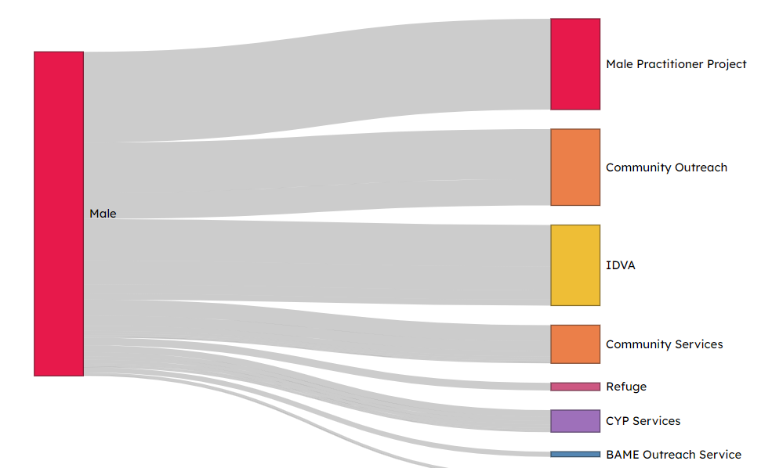
Most male clients are progressed on to community provision, as opposed to safe accommodation such as Refuge
  Within the male minority, the most common type of provision that male clients received were community-based services including the ‘Male Practitioner Project’ and ‘Community Outreach’.
  A large proportion* of male clients accessed IDVA services.
  A small proportion* of male clients was referred to Children and Young People services (CYP) or to safe accommodation services such as refuge.
Source: Safer Places, Changing Pathways, The Next Chapter
*Low figures were removed to avoid risk of identification.

Slide 89
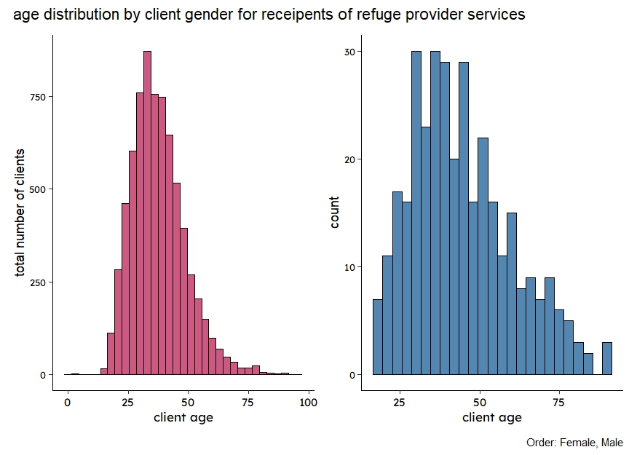

Male victims are more likely to be age 66 and older than women
  While the number of male victims ages 66 and above is low, the proportion* it makes up of all provider supported men is 8 times higher than the proportion of provider supported women who fall in this age bracket.
DO ELDERLY FEMALE VICTIMS FIND IT MORE CHALLENGING TO ENGAGE, OR IS THE INCREASED % OF ELDERLY MALE VICTIMS OWED TO YOUNGER MEN BEING LESS LIKELY TO ENGAGE WITH SUPPORT?
client age
*Low figure was removed to avoid risk of identification.

Slide 90
Older victims are less likely to be from a global majority or Irish, Roma, Irish Traveller or other White ethnic group
  Older victims supported by providers are less likely to be from a global majority or Irish, Roma, Irish Traveller or other White ethnic group than those under the age of 66.
  When looking at the age split within ethnic groups, 90% of victims from a global majority or Irish, Roma, Irish Traveller or other White ethnic group are ages 26 to 65, compared to White British victims, where 84% are ages 26 to 65.
ARE GLOBAL MAJORITY* OLDER VICTIMS POTENTIALLY MORE CHALLENGING TO IDENTIFY AND ENGAGE?
Global Majority*
* Global Majority is a collective term which refers to people who are Black, Asian, Brown, dual-heritage, indigenous to the global south, and or have been racialised as 'ethnic minorities’ (Campbell-Stephens 2020). In this document, the term also refers to clients who are Irish, Gypsy or Irish Traveller, Roma or from other White Groups.

Slide 91
11% of victims from a global majority ethnic group* are in the UK on a visa, or as a Refugee
  121 of the provider supported victims from a global majority ethnic group* are in the UK on a visa, or as a Refugee.
  344 do not have English as their first Language, making up 31% of all global majority* provider supported victims.
IMMIGRATION STATUS AND INTERPRETER NEEDS CAN RESULT IN HIGHER COMPLEXITY AMONG GLOBAL MAJORITY* VICTIMS.
* Global Majority is a collective term which refers to people who are Black, Asian, Brown, dual-heritage, indigenous to the global south, and or have been racialised as 'ethnic minorities’ (Campbell-Stephens 2020). In this document, the term also refers to clients who are Irish, Gypsy or Irish Traveller, Roma or from other White Groups.
**Please note that figures for victims from a global majority ethnic group grouped by immigration status were removed to avoid identification. These can be made available upon request.

Slide 92
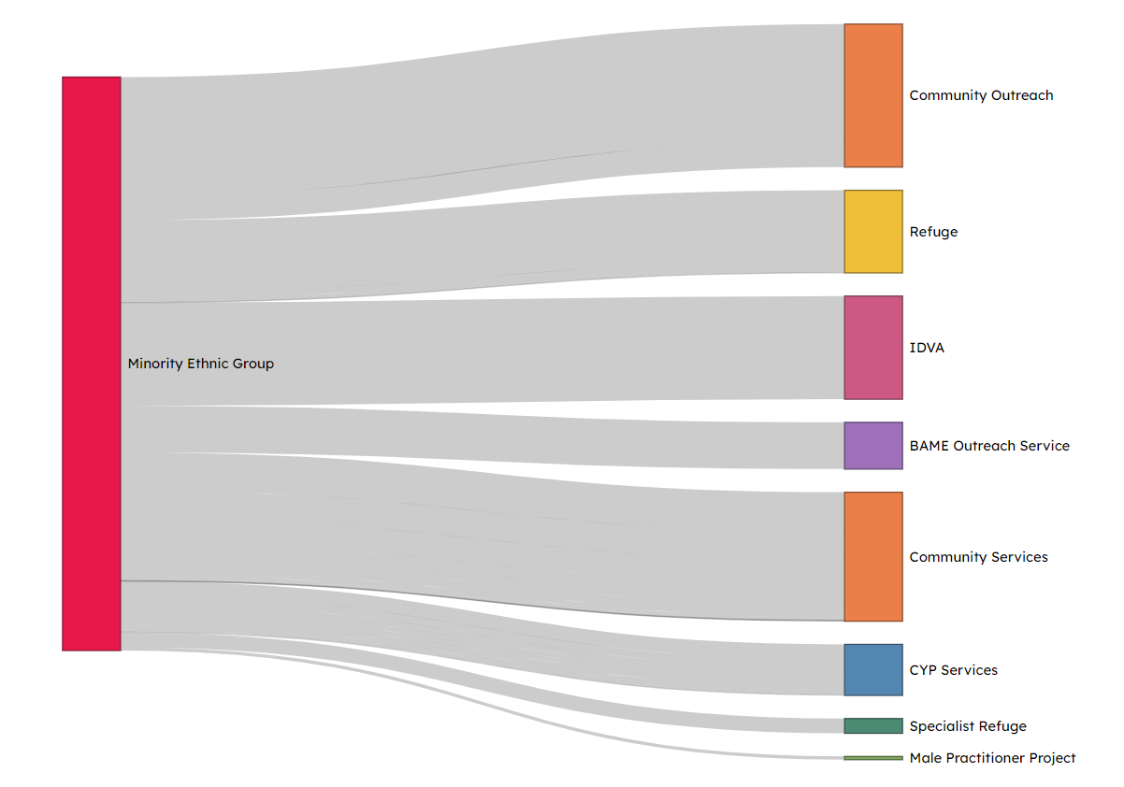
23% (359) of global majority* provider supported victims went on to Community Services** and 25% (398) to Community Outreach, with these being the most common provisions for global majority* clients, followed by IDVA (18%, 287)
Global Majority or Irish, Roma, Gypsy or Irish Traveller or from other White Groups
Source: Safer Places, Changing Pathways, The Next Chapter
*Or Irish, Gypsy or Irish Traveller, Roma or from other White Groups
** Where Community Services includes multiple provisions that are offered by Domestic Abuse Providers based within the community.

Slide 93
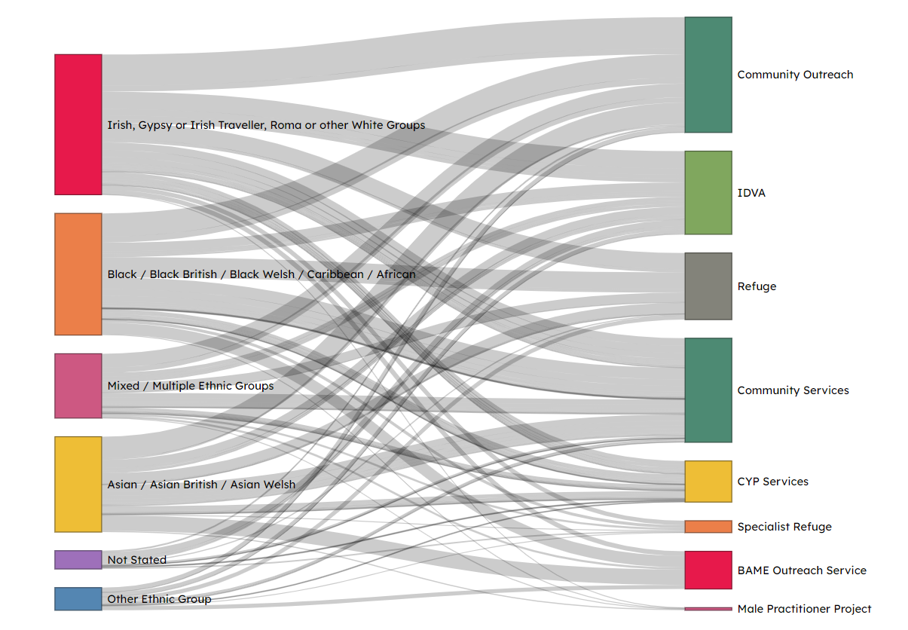
The proportion of global majority* clients who accessed services differed by each service type
Most of the global majority* clients who accessed the BAME Outreach Service (41%) and Male Practitioner Project (44%) were Asian/Asian British/Asian Welsh clients.
Community Outreach (31%, 128), CYP services (33%) and Specialist Refuge (37%) were accessed the most out of non-White British groups by Irish, Gypsy, Irish Traveller, Roma or White Other groups.
Black/Black British/Black Welsh/ Caribbean/African were the largest global majority* group within Refuge, accounting for over a third of minority clients (30%).
* Or Irish, Gypsy or Irish Traveller, Roma or from other White Groups
Source: Safer Places, Changing Pathways, The Next Chapter
** Please note low figures have been removed to avoid risk of identification.

Slide 94
70% of LGBTQ+ victims and 58% of transgender victims are presenting mental health needs
  A significantly higher proportion of LGBTQ+ provider supported victims are presenting mental health needs, compared to 51% (2,802) of heterosexual victims.
  In total, 131 LGBTQ+ provider supported individuals have mental health needs.
  The proportion of transgender victims* supported by providers who are presenting mental health needs is also slightly larger than that of cisgender victims with mental health support needs.
*Low figure was removed to avoid risk of identification.

Slide 95
The proportions of LGBTQ+ female victims and of LGBTQ+ ethnic minority victims are smaller than their counterparts
  The proportion* of provider supported male victims who are LGBTQ+ is significantly higher than the proportion of female victims who are LGBTQ+.
  The proportion* of LGBTQ+ provider supported victims from a global majority ethnic group is smaller than the proportion for heterosexual victims.
  While this difference has not been found to be statistically significant, research suggests that the proportion of Black, Asian and minority ethnic LGBTQ+ people facing domestic abuse is higher than that of White LGBTQ+.
2
ARE FEMALE LGBTQ+ AND ETHNIC MINORITY LGBTQ+ VICTIMS POTENTIALLY MORE CHALLENGING TO IDENTIFY & ENGAGE?
*Low figures have been removed to avoid risk of identification.

Slide 96
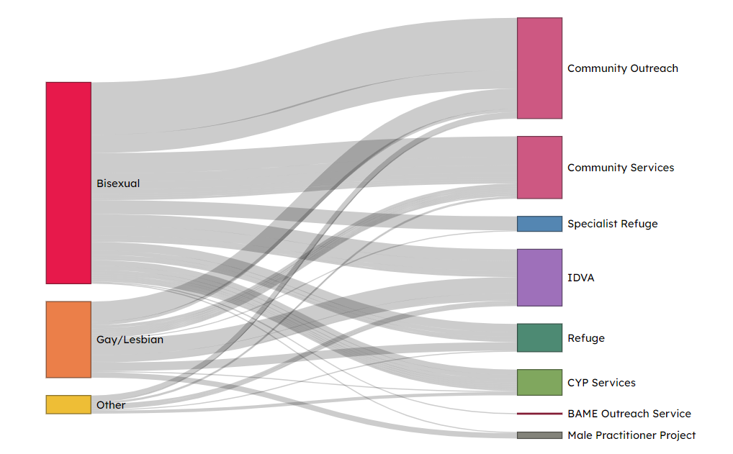
Community Services and Outreach accounted for over half of the provision received by LGBTQ+ clients, with fewer LGBTQ+ victims accessing refuge.
Source: Safer Places, Changing Pathways, The Next Chapter

Slide 97

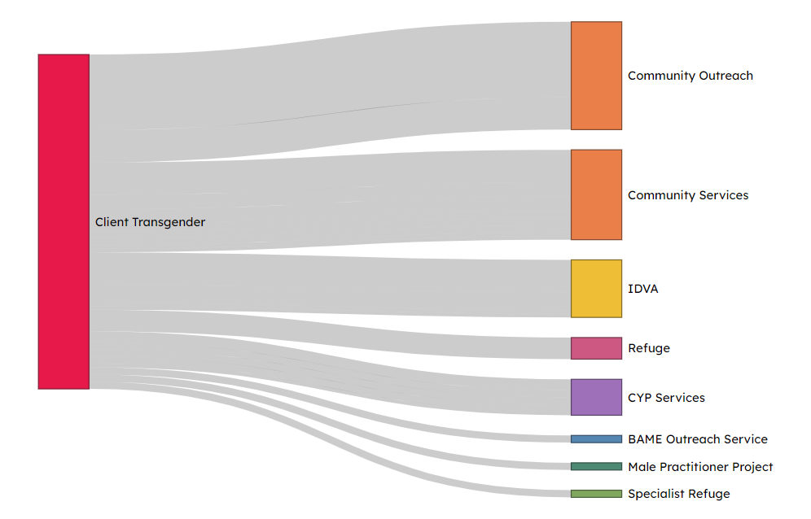
Similarly, most Transgender clients were referred to Community Services and Outreach, and few accessed refuge services.
Source: Safer Places, Changing Pathways, The Next Chapter

Slide 98
Support for children was a key theme in interviews with victims
With 67% (422) of victims who were accommodated in Refuge and over half of district supported victims having children, a focus on improving support for children whose parents access domestic abuse services can benefit a large proportion of victims.
Interviews with survivors of domestic abuse highlighted the lack of support available for their children concerning mental health, schooling and childcare.
“Because my son witnessed it, I was more concerned about his mental health than mine…I had to chase children’s services then through school…he kept being turned down because of his age (6), they kept saying he’s not old enough…what happens to kids that are younger than him?...School nurse got play therapy for school he’s at now – he loves it, it’s the best thing he’s ever done.”
[Female, 35-44, Epping]
“I asked what happens with school etc, and she [DV lead at district council] said ‘well most women [in refuge] don’t really send their kids to school’…I said I’m not not sending him to school.” [Female, 35-44]
HOW CAN SUPPORT FOR CHILDREN BE IMPROVED TO ENSURE THEY RECEIVE THE MENTAL HEALTH SUPPORT THEY NEED AND MANAGE TO CONTINUE THEIR SCHOOLING?

Slide 99
48% of parents have mental health needs and 48% of parents in Refuge are unemployed
Parents, in addition to requiring support for their children, are also presenting other needs.
At least 48% (203) of parents in refuge are also unemployed*. This proportion is much larger than the overall proportion of provider supported unemployed victims with children, which stands at 14%.
“Because things like addiction impact education and stuff, I think classes for things like maths and English, or like computing would be good. Also, things to do with your CV like how to write one or what a good one is would be helpful to benefit people for their future.” [Female, 25-34, Colchester]
Overall, 48% (1,821) of parents supported by providers have experienced a need for mental health support.
“No mention of childcare support. Had to leave my whole support network of friends who would
look after my son when I was at work, so I didn’t have anything.” [Female, 35-44, Epping]
The need for employability classes has been highlighted during interviews, as well as that for childcare.
CHILDCARE AND EMPLOYABILITY CLASSES COULD HELP PARENTS MANAGE OTHER NEEDS AS WELL
*Where the term ‘unemployed’ also includes those relying on financial support, long term ill or disabled, on maternity leave, or students. Please note that for 47% of parents in refuge, employment status was not recorded, indicating the unemployment proportion may be higher.

Slide 100
30% to 39% of victims with a drug or alcohol dependency are parents
2.5% of victims in provider support who are parents are presenting a drug dependency, and 3% are recorded as having an alcohol dependency.
When looking only at the group of provider supported victims who have a substance abuse support need however, it is found that the 111 parent victims make up 39% of all victims with an alcohol dependency.
Parent victims with a drug dependency make up 30% of all provider supported victims with a drug dependence related support need.
As parents make up 66% of all provider supported victims, they appear to be under-represented in these cohorts. However, parents who are struggling with drug or alcohol dependency may require more tailored support to also aid them with
childcare duties as they spend time with the service.
HOW CAN PARENTS WITH SUBSTANCE USE SUPPORT NEEDS POTENTIALLY BE FURTHER SUPPORTED?

Slide 101
Over a third of children from domestic abuse flagged households are under the age of 5
  While provider data does not record information on children of victims, ECC Children & Families Assessment data can provide a glimpse into the characteristics of children in households where domestic violence has been flagged.
  Over a third of the 2,857 children who had domestic abuse flagged in an assessment between April 2021 and March 2023 were under the age of 5 at the time of the assessment.
  The gender split for this cohort is 51% female, and 49% male, and a further split of gender by age shows very similar ages across both female and male children.
  74% of children overall are White British, Welsh, Scottish or Northern Irish.
  When looking at ethnicity by gender, 8% of male children are from the ethnic group ‘Black, Black British, Black Welsh, Caribbean or African’, as opposed to 6% of girls.

Slide 102


Understanding Young People further – The Goodman and Sisters in Strength Projects
  While Children’s Social Care data allows us insight into children in whose households domestic abuse was identified, the Goodman and Sisters in Strength Projects provide information on young people at risk of entering abusive relationships, or who already are in an abusive relationships.
  494 young men and male children accessed the Goodman Project between April 2022 and September 2023.
  70% were ages 13 to 15.
  33% had a disability.
  Figures on ethnicity and a detailed age breakdown have been removed to minimise the risk of identification and can be made available upon request.
  451 young women and female children accessed the Sisters in Strength Project between April 2022 and September 2023.
  80% were ages 13 to 15.
  Figures on disability and a detailed age breakdown have been removed to minimise the risk of identification and can be made available upon request.
  Ethnicity was not recorded for the Sisters in Strength project.

Slide 103

Conversations with children and young people highlighted trust in professionals
Key themes around what’s important to young people and aspects of good relationships included:
Emotional support and comfort
“I feel safe when I am with my mum as she gives me hugs and kisses and makes sure the house is safe and secure.” [8-12 years]
“They give me a hug when I am feeling sad.” [8-12 years]
“When they show that they care and don’t shout.” [8-12 years]
Being there when you need them
“Be there when you need them.” [Male, 13+]
Having time away from problems
“By spending time away from the problem.” (e.g. playing sport) [13+ years]
Having somewhere to go after school
People to talk to and listen to them (e.g. counsellor/youth worker)
“ When they listen to me and offer to help me with any worries I have.” [8-12 years]
“Not looking anywhere else or talking to other people whilst talking to me.” [Male, Year 9]
Support network
“ I feel happy when I spend time with my family: my mum, auntie and cousins.” [8-12 years]
“ I feel safe because my mum gets help from my school and social care to make sure she has support, and we are both happy and healthy.” [8-12 years]
Doing as they say
“When professionals do what they say they are going to do.” [8-12 years]

Slide 104
  Experiences with
  Current Support

Slide 105
What are the Experiences of Victims with the Support they have received?

Slide 106
Key Findings
During times of vulnerability, supportive professionals made a big difference to how some victims felt – those of the victims who participated in qualitative research praised staff within the police and local authority district housing teams for their supportive approach.
The additional services provided to victims within refuge had a positive impact on their overall lived experience. Services for children such as TRIBE were cited by victims, alongside services aimed at adult victims particularly with regards to legal aid and confidence building initiatives.
Having to retell traumatic experiences to multiple agencies was mentioned by victims as a challenging aspect of accessing and receiving support. Some victims also cited a general lack of coordination and communication between services. Coordination between services including referrals and a general lack of sign posting presented a challenge to some victims who accessed support.
Victims also felt that some professionals within certain services such as the Police were not supportive and could be more informed and aware of domestic abuse – some victims cited what they perceived to be insufficient training as the cause of this problem.
Some victims in safe accommodation (refuge and housing) disclosed negative lived experiences including feeling unsafe due to the behaviour of other tenants, the lack of building security and poor living conditions inside the accommodation.

Slide 107

Experiences of good support include professionals and peers
Key themes around what was good about the support received included:
Housing support (e.g. from housing leads within local authorities)
"She [DV Lead at district council] changed my life." [Female, 36-45, Harlow]
Support from younger police officers (felt to be more understanding than older officers)
“Old policeman [had] old values/morals…25-year-old [Police Officer] was on it like a car bonnet.”
[Female, 45-54, Colchester]
Domestic Abuse support providers – survivors experienced immediate action and support
Peer support (often self-directed)
“Since going through it I support people...the lived experience” [Female, 35-44, Chelmsford]
“Friends of friends have reached out for help, and I have signposted many including women.” [Male, 35-44, Chelmsford]

Slide 108

The additional services which support victims in Refuge were highlighted
Positive experiences within refuges highlighted in interviews included:
  Drug and alcohol support (within specialist refuge)
  Various classes and sessions such as arts and crafts, farming ‘wellies on’, support with finances, counselling
  “You have to be up for breakfast by a certain time, go to classes for finances/budgeting,
  domestic abuse or arts and crafts, and stuff like counselling.” [Female 25-34, Colchester]
  Timetable of activities for children in family refuge such as arts and crafts and TRIBE – “TRIBE is fun.” [Child]
  Help securing legal aid
  One survivor said the refuge helped her in securing legal aid both for family court and criminal court for her ongoing sexual assault investigation. [Female, 25-24, Colchester]
  Referral for counselling
  Help with rebuilding confidence
  A survivor commented that she suffered with “severe social anxiety” prior to coming to the refuge but engaging with the support they offered has helped her to develop her self-confidence. [Female, 25-34, Colchester]
  Support getting a job, providing a reference
  Help with sorting access to foodbank

Slide 109
Challenges experienced by victims
Key themes around challenges with support and negative experiences included:
Having to repeat story multiple times (sometimes in front of children) – caused by lack of join up between services
“Having to keep repeating it was frustrating. I kept saying I can’t really talk because my son’s here…constantly reliving it over and over again…it was a constant reminder, and I couldn’t move on really...different organisations weren’t really talking to each other. I think they just need to communicate with each other and find out what’s going on.” [Female, 35-44, Epping]
Lack of signposting and referrals between services e.g. mental health services not signposting DA services - survivors felt the onus was on them to reach out to services
Lack of available local support (e.g. support groups) and limited knowledge of what’s available
Police support – e.g. lack of understanding for male victims, and not understanding coercive control
Lack of discrete disclosure routes
Lack of support for children
Insufficient training and knowledge about domestic abuse among professionals, including Police, housing services and health

Slide 110

Negative experiences with housing
Safety in refuge has been highlighted in qualitative findings. Among the negative experiences were:
Other residents breaking rules by getting drunk, bringing men back and smashing windows
Other residents behaving in a rude, aggressive and bullying manner
As seen in the case study on slide 47, negative experiences with local authority provided accommodation have also been highlighted, with one case study mentioning:
Lack of Domestic Abuse focused support once placed in temporary accommodation
Concerns around potential easy accessing of the housing by perpetrator
Costliness of improving offered housing
“ I had a very poor experience at the first refuge I stayed in in Essex […] it was wild. Other residents broke the rules by getting drunk, bringing men back and smashing windows […] during my time there I really feared for my safety, but nobody believed me, it felt like being back with my abuser”
[Female, 25-34]

Slide 111
What does the Typical Journey to Accessing Support and Throughout the Service look like?

Slide 112
Key Findings
For many victims of domestic abuse, the Police is the first channel through which domestic abuse services are accessed, as identified in both qualitative and quantitative data.
In contrast, victims cited negative experiences within medical settings, particularly with regards to the lack of support and signposting when presenting with physical injuries from violence.
Because of this, victims may be using other channels to access support such as Compass, where most victims appear to self-refer to services.
It is currently unclear how many victims actually self-refer to provider services and are then triaged by inhouse duty teams, as self-referral was inconsistently recorded within the data.
Lack of join-up between services was also found to impact victims’ journeys, with victims feeling like they were not supported in reaching out to additional services.

Slide 113
What prompts domestic abuse victims to approach support services?
Common triggers for seeking support identified in quantitative analysis included:
Police intervention following a particularly violent incident – more ‘extreme’ than previous abuse
Child witnessing an abusive incident – concern for their safety, mental health, and future
“I couldn’t have him growing up thinking that’s how men are and that’s what's normal.”
[Female, 35-44, Epping]
This aligns with research which finds that, at the point when victims try to approach support, the abuse is likely to have escalated in frequency, severity or both.
6

Slide 114
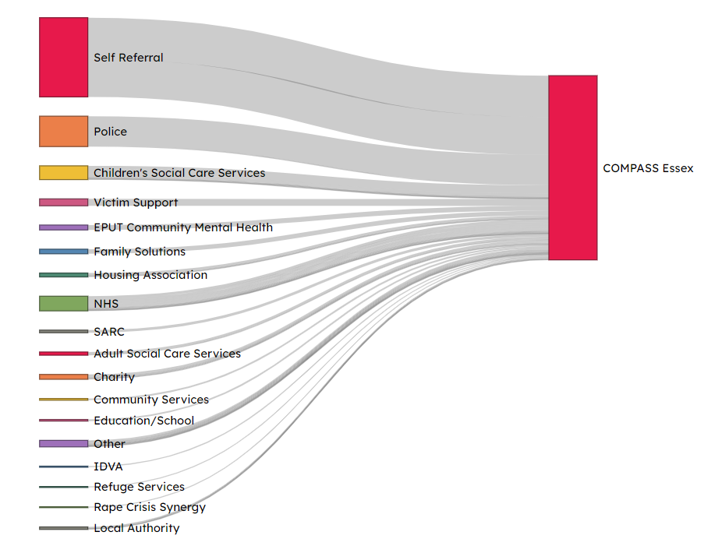
Many victims’ service journeys start through the Police or direct contact with Compass
Qualitative analysis found that typical journeys into accessing domestic abuse support and safe accommodation included:
Call to Police who then advised they seek support/move elsewhere for their safety
Signposting to DA support services following contact with local authority housing teams and disclosing situation
Direct contact with DA support providers
This is also reflected in Compass source referral data, where:
  Most clients (43%, 3,097) self-referred to COMPASS either via telephone or online
  Police services (Essex and out of county) were the second most common referral route (16%, 1,189)
Source of Referrals to Compass*
*Please note graph shows the main sources of referral to COMPASS due to the level of recording within the data. A version including uncommon routes can be made available upon request.

Slide 115
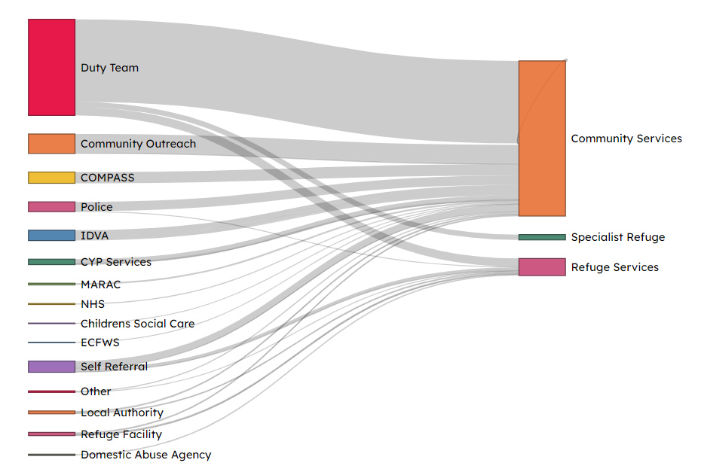
Many provider referrals are initially picked up by Duty Teams and then referred further
Source of Referrals to Services within Providers’ Provision
  Most referrals to providers are initially picked up by provider In-House Duty Teams, which may provide initial support, followed by progressing the referral internally as and when needed
  COMPASS, Self-Referrals and the Police are the main external sources of referrals to services
  Childrens and Young Person’s Services (CYP), MARAC, NHS services, Childrens Social Care and Local Authorities also refer victims directly to services
  The main channel for referrals reaching Specialist Refuge is through the In-House Duty Teams
*Please note graph shows the main sources of referral to domestic abuse providers due to the level of recording within the data. A version including uncommon routes can be made available upon request.
Source: Safer Places, Changing Pathways, The Next Chapter

Slide 116
Further training of professionals has been emphasized in interviews with victims
Previous missed opportunities for professionals to identify interviewed survivors as a victim of domestic abuse and signpost them appropriately were mentioned by interviewees.
“Been to the social prescriber at the surgery and although good about some things they did not offer DA support or signposting” [Female, 35-44, Chelmsford]
“I know there’s safeguarding lead at the hospital, but I went in with injuries once and I just got pushed through the queue and spat out the other side.” [Female, 35-44, Epping]
This can result in victims’ journeys with services starting later and them living with domestic abuse for longer, with research finding that on average, families with domestic abuse experience it for 2.6 years, but that it can be ongoing for significantly longer6.
Overall improved training for professionals, including within local authorities, Police and health services has been highlighted in the qualitative analysis, and can help support victims in their navigating of support services.
ADDITIONAL ENGAGEMENT WITH REFERRAL AGENCIES AND WITH EXTERNAL SUPORT SERVICES ON HOW TO IDENTIFY AND HELP DA VICTIMS

Slide 117
Lack of join-up between services can generate difficulties throughout victims’ service journeys
Lack of communication between services was highlighted in interviews with victims with regard to case information.
“Having to keep repeating it was frustrating. I kept saying I can’t really talk because my son’s here…constantly reliving it over and over again…it was a constant reminder, and I couldn’t move on really...different organisations weren’t really talking to each other. I think they just need to communicate with each other and find out what’s going on.” [Female, 35-44, Epping]
Lack of signposting and referring between services was also emphasized, with survivors feeling like the onus was on them to reach out to services.
IMPROVING CURRENT CHANNELS OF SHARING INFORMATION ON DA CASES COULD HELP VICTIMS DURING THEIR JOURNEY THROUGH SERVICES

Slide 118
Outcomes following Support

Slide 119
What Outcomes do Victims experience following Services?

Slide 120
96% of clients who received provision went on to complete their allocated service
  Of those clients who received provision and had an outcome recorded by the provider, the majority (96%) went on to complete their allocated service.
  **Please be aware that Domestic Abuse Providers are developing a new way of recording client outcomes and as such the figures provided are not reflective of the data currently being collated.
  **Not all clients who received a service had a recorded outcome. The figures in the table are reflective of those who had a progress referral, started a service and had a recorded outcome.
Recorded Outcome | Total Number of Clients | %
Client Received Service/Support | 6034 | 96.5
Improvement/Completed Support | 137 | 2.2
Other | 84 | 1.3
Source: Safer Places, Changing Pathways, The Next Chapter

Slide 121
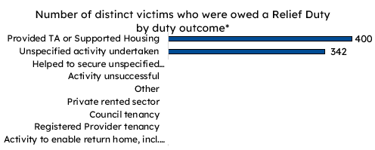
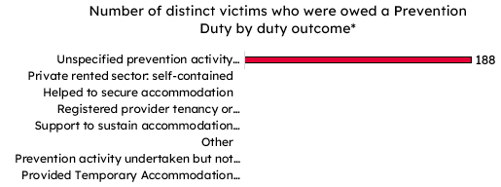
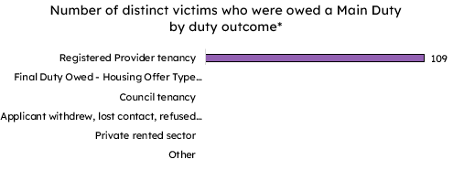
Housing was secured in at least 973 instances through Local Authorities
A variety of housing was secured or offered for to victims of domestic abuse as part of the housing duties owed by local authorities.
266 of the 973 were council tenancies or tenancies with local authority registered providers.
407 of the provided accommodation was temporary accommodation or supported housing.
Please note that for 43% of victims supported through a Relief Duty and for 29% of those supported through a Main Duty, the final housing type in which victims resided was not specified/recorded.
* Please note that detailed breakdowns were removed to minimise identifications risks. This can be made available upon request.
Source: Local Authority Housing Data

Slide 122
Safe housing for moving on has been identified through interviews as requiring improvement
Interviews with victims highlighted the suitability of moving on housing for victims. One such example was included in Jenny’s case study on slide 47, where the council property to which Jenny was moved at the end of her support from a local authority generated difficulties.
With at least 32% (421) of victims supported by local authorities being unemployed*, and council tenancies or tenancies with local authority registered provider having been provided at least 266 times for victims, moving on in housing which requires improvements can result in new challenges for a large number of victims.
“The house was in terrible state…had to borrow money left right and centre to do the house up. Got given a £60 decorating card but paint alone cost £300. Had to get new flooring...can’t have my 6-year-old walking on floorboards with nails sticking out…not just aesthetic it was damage to the property…another stress to add when we’re trying to start our life again.”
[Jenny, 35-44, 6-year-old son]
HOW CAN LOCAL AUTHORITIES BE SUPPORTED WITH REGARD TO THE FINAL HOUSING PROVIDED TO VICTIMS?
*Where the term ‘unemployed’ also includes those relying on financial support, long term ill or disabled, on maternity leave or students.

Slide 123
Service follow-on support was also identified through interviews as requiring improvement
    Support quality and frequency following services was highlighted in the qualitative analysis, with one interviewee saying:
“Support just dropped. [DA provider] basically ceased contact with me…haven’t heard from a single person since [court date]. There’s not even been a yearly call to see if we need anything.” [Female, 35-44, Epping]

Slide 124
How many go on to need Support again?

Slide 125
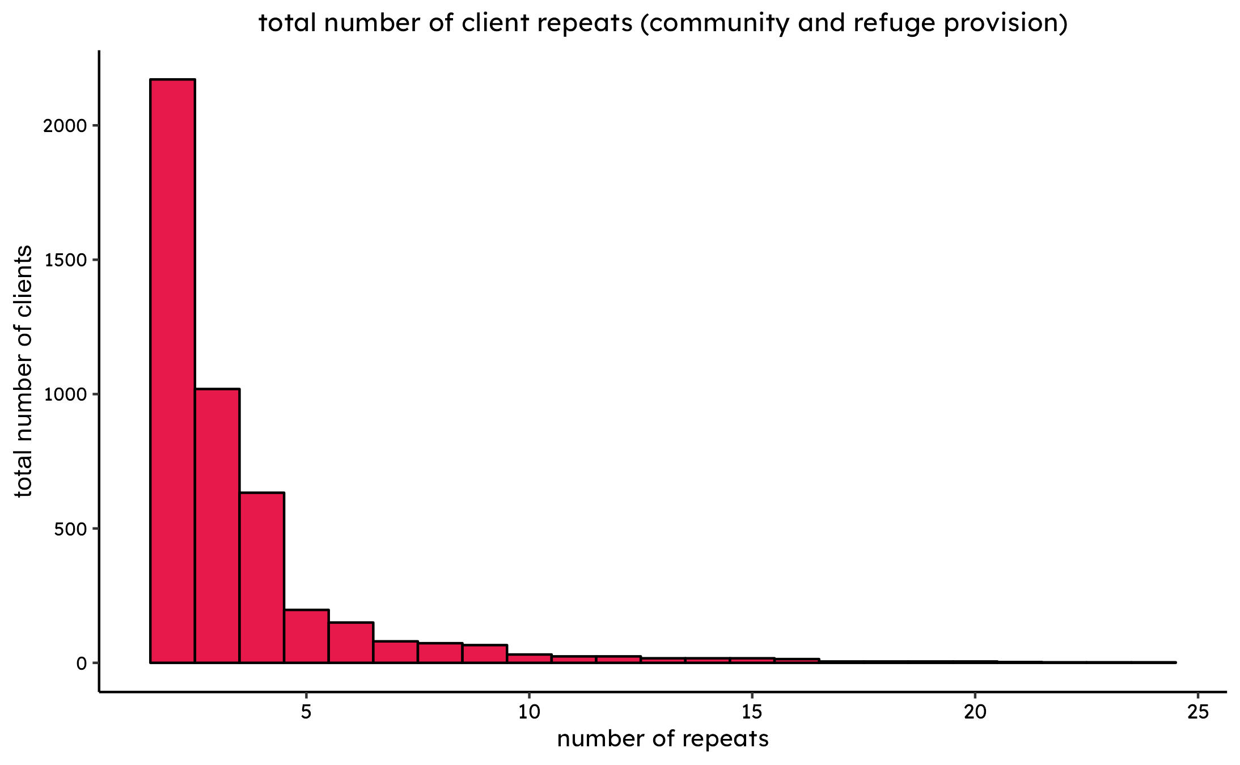
Whilst most clients don’t repeat in services, those who did mostly returned a second time
  Within the population of clients who went on to need support again, the majority only returned for a second time (2,223).
  Less than a quarter of clients went on to receive services for a third time (1,715).
  The most repeats recorded with regards to an individual client was 23 returns to service.
  ** Please note that most clients did not have any repeats (61% of all clients who received a service including community, refuge and specialist refuge).
  ** The number of repeats was unavailable for both COMPASS and Local Authority Housing Services.
Source: Safer Places, Changing Pathways, The Next Chapter

Slide 126
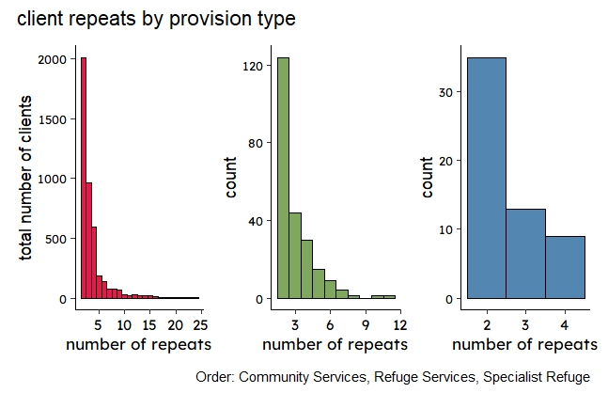
Community Services had the greatest volume and range of repeats, whilst Specialist Refuge had the least repeats
Client repeats by provision type
Across all provision types, the majority of clients didn’t repeat within services – but those who did mostly returned to services for a second time.
The highest number of repeats recorded within Refuge Services was 12, whilst within Specialist Refuge the maximum was 4.
number of repeats
Source: Safer Places, Changing Pathways, The Next Chapter

Slide 127
How can Current Support be Improved?

Slide 128

How well are needs being met?
“I did try to access peer support groups and go to a meeting but the only meetings they had were in the evening and I thought well I can’t take my son to a DA meeting. I didn’t have anyone to look after him so I couldn’t go to any support groups, and they didn’t do any during the day. Thought it was bloody stupid, most people going through it have kids.”
Interviews identified multiple areas where it appeared survivors’ needs were not being met. This included:
Lack of services for male survivors with limited support available - services are still female-focused
Survivor with disabilities reluctant to go into refuge and give up home that meets their accessibility needs
Insufficient mental health support – particularly lack of ongoing support once out of ‘danger’
      Some paid for private therapy sessions and found this helpful - intermittent trauma therapy.
Lack of local support groups or groups being held at inconvenient times meaning survivors cannot attend
[Female, 35-44]

Slide 129
How can support be improved?
The following areas were identified for improvement through qualitative analysis of interviews and conversations with victims:
More joined-up approach between services
Increased access to services for male survivors
Explore additional routes to discretely disclose abuse – suggestion for a ‘middle channel’ before contacting the Police (wider promotion of DA support such as Compass could be beneficial)
Improved training for professionals, including within local authorities, Police and health services
Explore ways for survivors to safely stay in their own home, and ensure survivors have choice and control over safe accommodation options available to them
Accessibility of support (e.g. local groups available, suitable time of sessions, childcare availability, virtual options)
Wider promotion of who to contact and where to go for support
More personal feel to services
Improved follow-on support after survivor is out of immediate danger and beyond
“Just having someone there to listen to you…You get a call and it’s tick box, you answer the questions they need then its ‘okay bye have a good day’…needs more of a personal feel.”
“There should be safe places to go at hospitals to go and report things. If you’re in an abusive relationship and being monitored where you’re going…if you go to doctors and it’s a safe environment, I think a lot more would be reported.”
“Maybe the focus needs to be on education for agencies…with the end goal of never leaving a victim of abuse feeling that they have no support or have wasted people’s time. Especially when they are told to go and call somebody else. Having to repeat their abusive situation over and over leaving that victim feeling misunderstood, and that they are making a fuss over nothing.”

Slide 130
Appendix

Slide 131
Data & Analysis

Slide 132
Analytical Approach
Qualitative and quantitative analysis was undertaken as part of the Needs Assessment to enable the answering of the research questions.
Quantitative Analysis
Qualitative Analysis
Collection of client level and aggregate level data from 23 external partner organisations and internal services who have engaged with and/or supported domestic abuse victims between April 2021 and March 2023 (and up to September 2023 where available)
Descriptive analysis followed by significance testing of relationships between variables of interest was conducted
Visits to refuges (including a complex needs refuge) were made, followed by in-depth interviews with 13 victims of domestic abuse
Engagement with young people was conducted which included young men participating in the Goodman Project and Care Leavers
Focus group with male survivors living in safe accommodation

Slide 133

Quantitative Data Sources
Data on domestic abuse from the following 23 external and Essex County Council services was collected and analysed:
Person Level Data
Aggregate Data
Domestic Abuse Providers (The Next Chapter, Changing Pathways and Safer Places)
Compass (provided by Safe Steps)
Essex Tier 2 Local Authorities (Basildon, Braintree, Brentwood, Castle Point, Chelmsford, Colchester, Epping Forest, Harlow, Maldon, Rochford, Tendring and Uttlesford)
Essex County Council Children’s Social Care
Essex County Council Adults’ Social Care Safeguarding
Essex Police
Drug and Alcohol Support Services (Phoenix Futures and Essex Young People’s Drug and Alcohol Service)
Sanctuary Scheme Data provided by Basildon, Braintree, Castle Point, Epping Forest, Tendring and Maldon
Essex County Council Youth Service on two projects - Sisters in Strength and The Goodman Project)
Essex Multi-Agency Risk Assessment Conference (MARAC)

Slide 134

Qualitative Data
Insight was gathered through engagement with:
56 people (via refuge visits, in-depth interviews & focus groups)
12 x female survivors
6 x male survivors
38 x children and young people
33 x young men (via Goodman Project)
2 x young women
1 x BAME
3 x gender undisclosed
3 x with disabilities
4 x out of county (3 in specialist refuge,
1 in family refuge)
27 x aged 13-15
2 x aged 8-12
2 x aged 16-25 (care leavers)
Of the survivors with whom engagement was conducted, the majority came from families where domestic abuse was present in early life. The vast majority experienced abuse within romantic relationships, with one survivor experiencing abuse as an adult from their parent.
Engagement with children and young people was carried out via the Goodman Project and focus groups with Year 9 males. A small focus group with care leavers was led by the Involvement Team, and conversations with children via Social Workers.

Slide 135



Quantitative Data – Limitations
Local Authorities Homelessness Applications Data
Unavailable data The type of information recorded by Local Authorities varies across Essex, with each district recording different levels of detail on the received Homelessness Applications, and on the supported applicants as a result. The recording differences resulted in data being unavailable for certain metrics for all domestic abuse victims.
Incomplete data exports Technical difficulties with Case Management Systems, manual recording of information, and recent system changes across Local Authorities has resulted in limitations on the data which could be exported and shared. As a result, some homelessness applications and supported victims could not be captured in this analysis, and therefore, Local Authority figures in this needs assessment may be slightly lower than the actual demand seen by the district housing teams.
Domestic Abuse Providers Data
Recording inconsistency Differing levels of information being captured across providers resulted in challenges when attempting to combine data for the purposes of analysing all provider supported cases in a consistent manner.

Slide 136

References
  The Crime Survey for England and Wales, March 2023. https://www.ons.gov.uk/peoplepopulationandcommunity/crimeandjustice/bulletins/domesticabuseinenglandandwalesoverview/november2023
  LGBTQT in Britain. Home and Communities. 2018. Chaka L. Bachmann, Stonewall. Becca Gooch, YouGov. https://www.stonewall.org.uk/sites/default/files/LGBTQt_in_britain_home_and_communities.pdf
  Intimate partner violence as a predictor of substance use outcomes among women: A systematic review. Shannon. N. Ogden, Melissa E. Dichter, Angela R. Bazzi. https://www.sciencedirect.com/science/article/pii/S0306460321003993
  Safe Later Lives: Older people and domestic abuse.Safe Lives. 2016. https://safelives.org.uk/sites/default/files/resources/Safe%20Later%20Lives%20-%20Older%20people%20and%20domestic%20abuse.pdf
  Domestic Abuse Commissioner. https://domesticabusecommissioner.uk/blogs/our-support-for-male-victims/#:~:text=We%20know%20that%20men%20face,and%20can%20impact%20on%20reporting.
  Getting it right first time. Safe Lives. https://safelives.org.uk/sites/default/files/resources/Getting%20it%20right%20first%20time%20-%20complete%20report.pdf
  Male victims of domestic abuse and partner abuse: 70 key facts. ManKind Initiative.2023. https://mankind.org.uk/wp-content/uploads/2024/02/4-Key-Facts-on-Male-Victims-of-Domestic-Abuse-2023-final-June-2023-revised.pdf
  Global Majority; Decolonising the language and Reframing the Conversation about Race. Campbell-Stephens (2020). final-leeds-beckett-1102-global-majority.pdf (leedsbeckett.ac.uk)

Slide 137


This information is issued by: Essex County Council
Essex County Council
County Hall, Chelmsford,
Essex, CM1 1QH
Essex_CC
facebook.com/essexcountycouncil
The information contained in this document can be translated, and/or made available in alternative formats, on request. Please contact DomesticAbuse.data@essex.gov.uk
Published July 2024

