Slide 1
VOLUNTEERING support through Ews
COVID 19 and BEYOND
DATA & ANALYTICS
JUNE 2020

Slide 2
HEADLINES
New benefits claimants and volunteer rates are not closely linked
VOLUNTEERS IN THE MOST DEPRIVED Areas are supporting more people and travelling further for each job
LARGE NUMBERS OF VOLUNTEERS ARE at a high risk of reducing their volunteering
There is most pressure on volunteers in the most deprived areas. They are working to support more people per volunteer and traveling furthest – at their own expense. We need to look to retain these volunteers and ensure sustainability.
Profiles of volunteers that are likely to reduce or stop volunteering based on risk factors have been explored. The most risky 11 profiles make up a quarter of volunteers.
It was suggested that those who had found themselves out of work due to closure of workplaces may have volunteered. The data indicates that this is probably not the case.

Slide 3
Volunteering aND new Benefits claimants
There is not a clear link between benefits claimants and volunteering rates. We can see a difference across the districts, with Basildon and Tendring having the highest rates of new benefit claimants across the county.
EWS volunteers per 1000 population
New benefits claimants per 1000 population
Essex

Slide 4
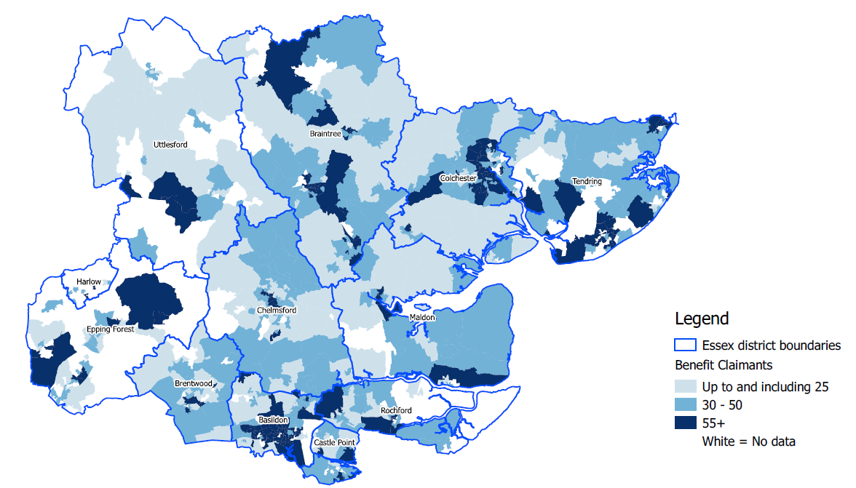
New benefits claimants
The new benefits claimants since April shows high levels in areas where the population are employed in retail, typically close to retail parks and high streets.
We also see costal areas and areas where employment in manufacturing is high (North Braintree) and near Stansted Airport (Uttlesford)

Slide 5
Volunteers by LSOA
Highest concentrations of volunteers can be seen in North East Essex, and central Essex. Lower volumes in West Essex, and Rochford.
Table below shows LSOAs with highest volunteer volumes:
District | LSOA | # Volunteers
Colchester | Rowhedge | 32
Maldon | Wickham Bishops | 18
Colchester | Dedham | 17
Colchester | Colchester Garrison | 13
Tendring | Bradfield & Wix | 13

Slide 6
CURRENT POSITION

Slide 7
VOLUNTEERS MOSAIC OVERVIEW
Across all areas there are a higher percentage of Volunteers in the following groups than in the total Essex Population.
B - Prestige prosperity
D – Domestic Success
H – Aspiring
J – Rental Hubs
Higher % of volunteers from domestic success and prestige positions - groups that are more affluent
Lower % from family basics, suburban stability and senior security groups. - likely to be low to middle income families.

Slide 8
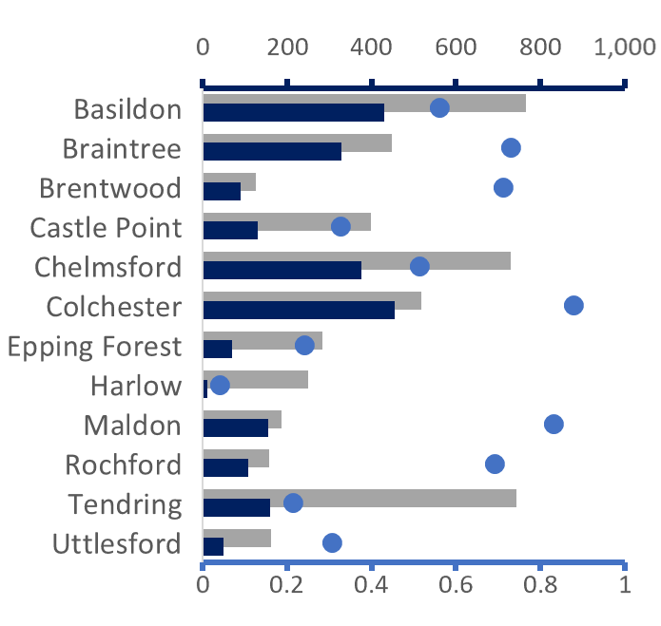
EWS DEMAND and volunteer availability
We have the highest volumes of people registered with EWS in Basildon, Chelmsford and Tendring. These districts do have large populations, but also the rate of registrations as a % of the population are high too.
The blue dots show the rate of volunteers to customers (those registered for EWS support). Colchester has the highest rate at 0.88 volunteers for every 1 customer, while Harlow has the lowest at only 0.04 volunteers per customer. A closer look into deprivation may help explain some of these differences.

Slide 9
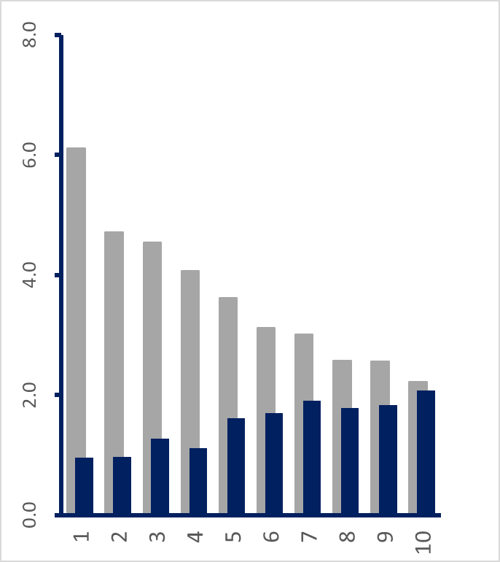
EWS DEMAND and volunteering - DEPRIVATION
The chart shows a very clear relationship between deprivation and EWS interaction. Those in the most deprived areas are most likely to use the service, and those in the least deprived are most likely to be a volunteer. It is worth noting that the EWS volunteers are not reimbursed for expenses such as petrol, and volunteers are sometimes required to pay for shopping and await reimbursement. This would be a barrier for those in more deprived areas.
The images on the right illustrate the rate of volunteers per customer. In the most deprived decile there is one volunteer for 6.3 customers, whereas in the least deprived decile There is one volunteer per customer. The additional workload for volunteers in the lower deciles is concerning due to the financial cost to the volunteer of carrying out these tasks.
Deprivation Deciles (1 is most deprived)
EWS Customers per 1,000 pop.
Volunteers per 1,000 pop.
Decile 1
Decile 10

Slide 10
VOLUNTEER DISTANCE TRAVELLED
Distance travelled by district
LSOA distance and rate of volunteers to customers
Distance travelled is measured from the volunteers home address to the customer.
The variation between the districts can be partially explained by looking at LSOA level - areas with a higher volunteer to customer ratio tend to travel less.
This adds further pressure to volunteers in low ratio areas, as they are spending more travel time and money on volunteering.
Rate of volunteers to customers
Average distance (miles)
Average distance (miles)

Slide 11
VOLUNTEER DISTANCE TRAVELLED and capacity
Looking at the distance travelled by deprivation decile, we are seeing that the most deprived areas are travelling further per job.
The volunteers in decile 1 (most deprived) are covering more patients each, are travelling further to each customer and are likely to be under financial pressure.
It is important to ensure that continuing to volunteer is sustainable for these people.
Distance (miles)
Most deprived
Deprivation Decile
Least deprived

Slide 12
VOLUNTEERING STABILITY AFTER LOCKDOWN

Slide 13
WHAT MAY CHANGE and how will this affect volunteers
Workplaces reopening. People returning to work from furlough may no longer be able to volunteer. People who were working at home may have less time to volunteer if they are now commuting.
Schools and nurseries reopening. People who are volunteering may now have additional time to help if their children are attending school.
Lockdown relaxation. There may be less desire to help as the situation moves from helping out in a crisis. Additional time outside during lockdown is no longer a benefit of volunteering.
Former volunteering commitments resume. People may go back to their old volunteering roles.
Normal lifestyles, social, leisure and travel resume, volunteers may start to take holidays and have less free time available to volunteer.

Slide 14
WHICH volunteer groups might we see a change
7%
The last slide described how things might change and how people’s attitudes towards volunteering or their availability may be affected.
We can use market segmentation to create profiles of those who are currently volunteering, and this could help identify which people are more likely to continue volunteering and which are at risk of stopping or reducing capacity.
These 5 Mosaic Types make up over a quarter of the EWS volunteers countywide.
6%
5%
5%
4%

Slide 15
VOLUNTEERS - WHAT IF?
We can see what might happen if certain groups became less likely to volunteer in the future. The light blue cells in the table are our speculations of what might happen because of the changes. We can apply this to the current volunteering cohort and see which Mosaic types are most likely to reduce their volunteering, and which areas will be most at risk.
We can change how much impact we think each change will have on specific types of people to test how this changes in different scenarios.
Notes:
So for example – in the top row, a person who volunteers in a Mosaic type who are 3x more likely to be in employment full time are at the highest risk of stopping volunteering (-100%). A person who is half as likely to be in full time employment would be at a lower risk (-25%).

Slide 16
WHAT IF? - Results
Number of current volunteers
Based on the scenario – these groups are the 11 (top quintile) most likely to stop or reduce their volunteering.
These groups account for around a quarter of the current EWS volunteering workforce. (587 people).
B06 – Bank of Mum and Dad, and D17 Thriving Independence are both high risk and high volume Mosaic Types and the impact of these groups stopping volunteering would be greatest in terms of numbers.
Exploring some of the volunteer research to see if these groups are showing any signs of reducing, engaging with these groups to see what might enable them to continue and developing a volunteer retention strategy accordingly may help reduce the impact.
Highest risk
reducing risk
Notes:
Opportunity here for a joined up piece of work across SIE.

Slide 17
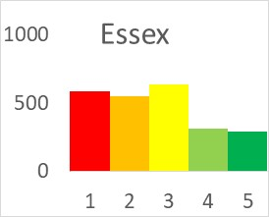
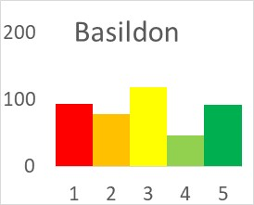
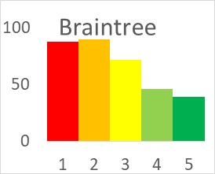
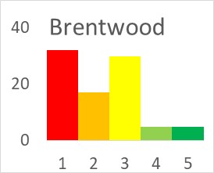
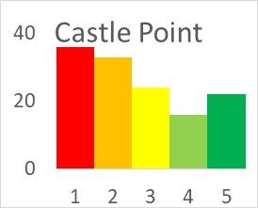
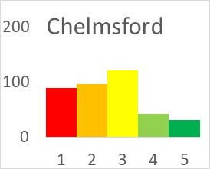
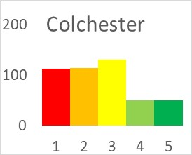
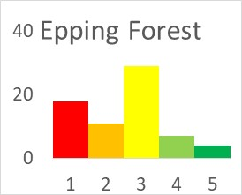
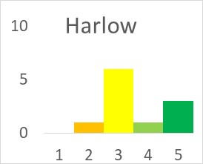
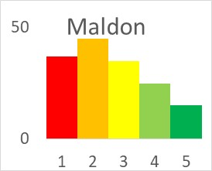
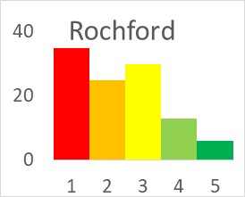
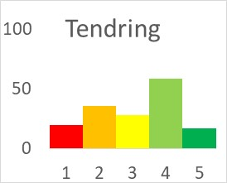
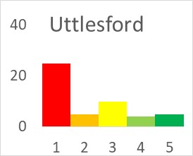
WHAT IF? RESULTS – DISTRICT LEVEL
The Mosaic Types have been split into risk quintiles (11 types in each quintile). Quintile 1 (red) is most likely to stop volunteering.
These charts show the volunteering workforce distribution in each quintile. Those districts with higher proportions of volunteers in the highest risk quintiles are likely to see the greatest impact on volunteer numbers.
High risk
Moderate risk
Lower risk

Slide 18
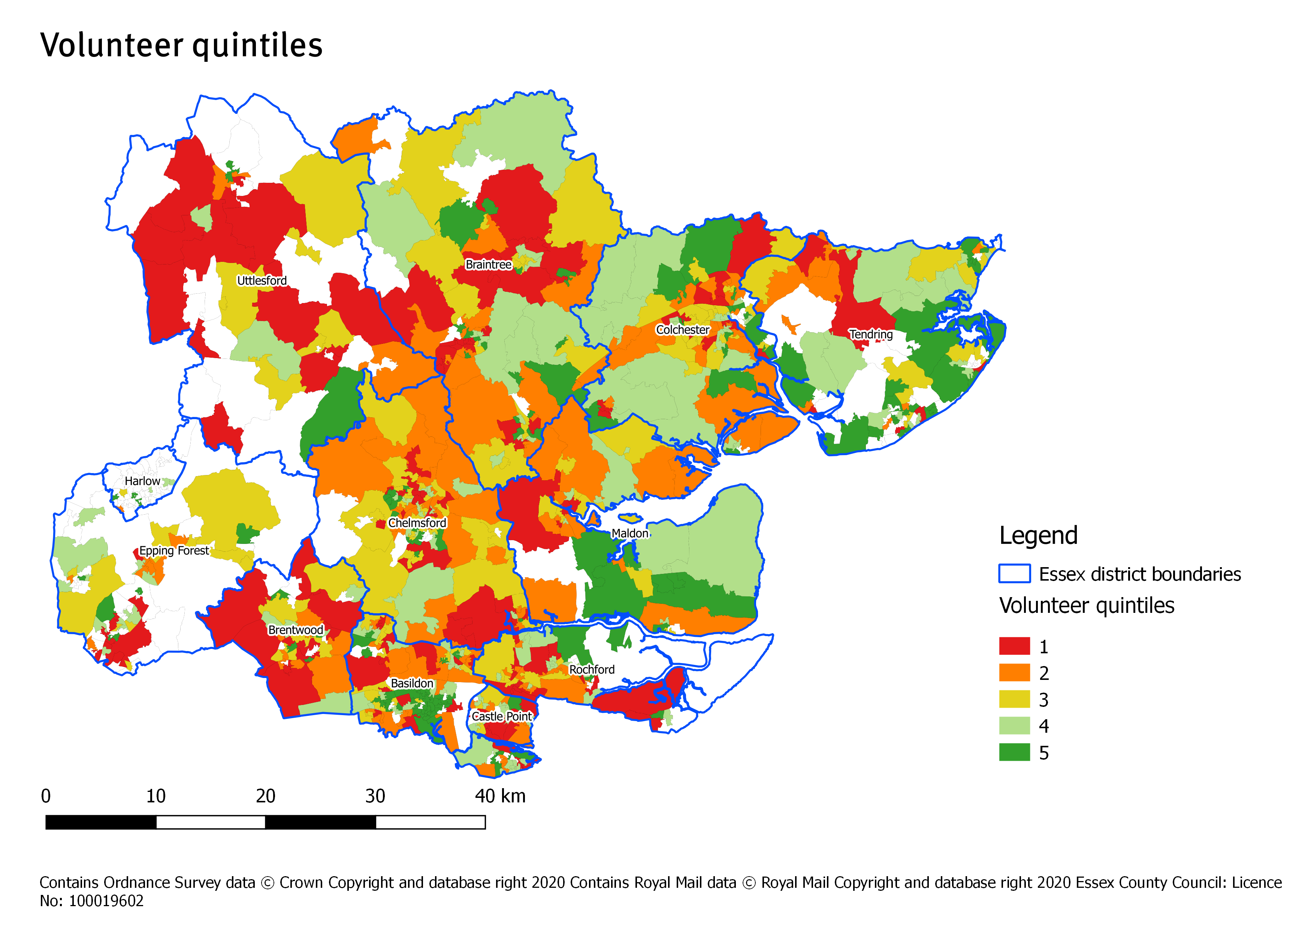
WHAT IF? RISK AT LSOA LEVEL
This map shows at LSOA level the overall risk quintile. The red areas are the highest risk of volunteer numbers reducing, and the dark green are areas with the lowest risk.
This shows that even in the districts where a high risk has been identified, there are still areas with low risk. Looking at increasing capacity within these areas and ensuring that traveling to a wider area is feasible would be recommended.

