Slide 1

Understanding our population
Equalities insights from Census 2021
Policy Unit
January 2024

Slide 2
Our population is growing at a rate of over 200 people per week...
…at 1.5m, our population is larger than at any point in recorded history.
c.20% of this is to ‘natural change’
c.55% is due to migration within the UK
c.25% is due to migration from other countries
Sources: ONS Mid-year population estimates (2011 - 2021) & components of population change
Notes:
Key message: population growth was expected and has been seen across Essex to varying degrees, driven by natural change but also migration into the county, primarily from within the UK.
This is expected to continue over the next few years, but as the population ages migration will likely be the primary cause.
Population growth is faster than that of England as a whole
(0.76% vs. 0.64% respectively).
Components of population change:
Uplift of migration into Essex:
Majority of migration into Essex comes from within the UK.
6% of new residents (in the last year from 21st March 2021), came from outside of the UK.
Natural change in population; greater number of births vs. deaths.
Leading to an increase in population density across Essex. Harlow, Castle Point and Basildon are seeing the greatest impacts of increased population density.
~1.52 million in 2022
~1.58 million in 2032
ONS projections suggest the Essex population could continue growing by ~0.4% -0.6% per year over the next 10 years.
Natural increase is projected to slow as the population ages.
The main driver of growth will come from NET migration into the county, largely from within the UK.

Slide 3
Our population is changing and becoming more diverse
Ethnicity
Disability
Religion
224,000
residents identify as members of an ethnic minority group (an ethnic group other than “White British”).
This is equivalent to 14.9% of the overall population.
250,500
residents in Essex report that they have a disability under the equalities act.
This is equivalent to 16.7% of the overall population.
785,090
of residents are members of a religious faith. This is c.52.2% of residents
The majority identify as Christian (720,752 – 92% of the figure above). The largest faiths other than Christianity were Islam (c.24,500) and Hinduism (c.15,300).
Sexuality
Gender identity
27,000
residents (aged 16+) identified as LGB+.(lesbian, gay, bisexual, or other sexualities).
This is equivalent to 2.5% of the 16+ population.
1,400
residents (aged 16+) identified as having a gender different to the sex assigned at birth.
This is equivalent to 0.3% of the 16+ population.
Notes:
Areas of population change to consider in future planning – changes are fairly consistent with national picture but at slightly varying rates:
Essex has an aging population – slightly higher than UK average - impacting certain districts more – Maldon, Tendring, Rochford and Castle Point – this will continue until eventually we see a shift of balance between births and deaths.
35% dependency ratio as of 2021 – this is expected to increase as the population ages. Dependency ratios calculated using mid year estimates for 2021 (ONS) – projections use 2020 interim projections – available for England level only.
Household types – number has increased as expected with the increase in population, we seen consistent proportions over the last 10 years and across England.
Ethnic diversity – while at a lesser rate vs. England Essex is becoming more diverse, particularly in West Essex.
Resulting in an increase in language diversity, while proficiency of English is still high, there are pockets of low proficiency which could impact engagement and access to services.

Slide 4

Essex has become significantly more diverse over the past 10 years (albeit from a relatively low level compared with England as a whole).
This trend will continue.
Ethnic minority populations in Essex are generally younger than the population as a whole.
Because of this, headline data often suggests that they enjoy better outcomes. For example, they are more likely to be in good health and free of disability, to hold qualifications, or to be successful in the labour market.
But when we control for the effects of age, some ethnic minority groups experience consistently poorer outcomes than the population average.
There is a relatively weak link between poor outcomes for these groups and deprivation. Deprivation cannot be the only factor at play.
Ethnicity
Notes:
Key message: population growth was expected and has been seen across Essex to varying degrees, driven by natural change but also migration into the county, primarily from within the UK.
This is expected to continue over the next few years, but as the population ages migration will likely be the primary cause.
Population growth is faster than that of England as a whole
(0.76% vs. 0.64% respectively).
Components of population change:
Uplift of migration into Essex:
Majority of migration into Essex comes from within the UK.
6% of new residents (in the last year from 21st March 2021), came from outside of the UK.
Natural change in population; greater number of births vs. deaths.
Leading to an increase in population density across Essex. Harlow, Castle Point and Basildon are seeing the greatest impacts of increased population density.
~1.52 million in 2022
~1.58 million in 2032
ONS projections suggest the Essex population could continue growing by ~0.4% -0.6% per year over the next 10 years.
Natural increase is projected to slow as the population ages.
The main driver of growth will come from NET migration into the county, largely from within the UK.

Slide 5
Essex is less ethnically diverse than England…
Percentage of the population by ethnic group, 2021
Minority ethnic groups (ethnic groups other than “White British”) account for 14.9% of the Essex population. This is less than across England as a whole (24.5%).
Essex’s most ethnically diverse district is Harlow – but the level of diversity seen in this area is in line with the average for England as a whole.
The largest minority ethnic grouping in Essex is the “Other White Group”, including Irish, Gypsy and Irish Traveller, Roma, and other white groups. In this respect Essex contrasts with England as a whole, where “Asian, Asian British or Asian Welsh” is the second largest ethnic group.

Slide 6
Growth in minority ethic groups in Essex 2011 - 2021
…but it has become significantly more diverse over the past decade
In 2011 ethnic groups other than White British accounted for 9.2% of residents, compared to the 14.9% recorded in 2021.
The scale of this increase is similar to that seen nationally.
With the exception of the gypsy or Irish traveller group, every other ethnic group in Essex grew at a faster rate than the white British group in the 2011-2021 period.

Slide 7
The minority ethnic groups tend to be younger than the population average

Slide 8
The minority ethnic groups tend to be younger than the population average
This will be a driver of increasing diversity
This risks distorting our understating of the outcomes enjoyed by minority ethnic groups
There are significant concentrations of Asian, black, other white, and other ethnic groups in the ages 25-40. This is the age range most associated with having children.
The effects of this over the past fifteen years can be seen in the mixed ethnic group population period.
Headline comparisons often suggests that minority ethnic groups fare better than the wider population with respect to key educational, economic and health outcomes.
But in many cases this reflets the fact that younger people are more likely to be in good health, free of disability, to hold qualifications, and to be successful in the labour market.

Slide 9
When we remove the effect of age, some ethnic minority groups experience consistently poorer outcomes than the wider population
Residents with no qualifications by ethnic group
(age standardised rate)
Residents in professional occupations by ethnic group
(age standardised rate)
Gypsy/ Irish Traveller (54.7%)
Gypsy/ Irish Traveller (1.9%)
Roma (27.8%)
Roma (4.3%)
Bangladeshi (25.6%)
Bangladeshi (9.2%)
Other Ethnic Group (18.6%)
White & Black Caribbean (9.6%)
Chinese (17.8%)
Black Caribbean (9.6%)
Whole population average
White British (16.3%)
Other Black (10.5%)
15.4%
White & Black African (10.7%)
White & Black Caribbean (15.0%)
White British (10.8%)
Other White (14.0%)
11%
Arab (13.3%)
Other White (11.2%)
White & Black African (13.2%)
Black African (11.4%)
Irish (13.0%)
Other ethnic group (11.4%)
Other Asian (12.8%)
Other Asian (11.7%)
Pakistani (12.4%)
Other Mixed (12.2%)
Other mixed (11.3%)
Irish (14%)
Black Caribbean (11.2%)
Chinese (14.1%)
White & Asian (9.8%)
White & Asian (14.7%)
Other Black (9.3%)
Pakistani (18.2%)
Indian (8.4%)
Arab (21.3%)
Black African (7.4%)
Indian (22.2%)

Slide 10
When we remove the effect of age, some ethnic minority groups experience consistently poorer outcomes than the wider population
Residents who are in poor health
(age standardised rate)
Residents in who have a disability
(age standardised rate)
Gypsy/ Irish Traveller (15.4%)
Gypsy/ Irish Traveller (32.2%)
Bangladeshi (7.5%)
White & Black Caribbean (21.7%)
White & Black African (6.4%)
Other Mixed (19.5%)
White & Black Caribbean (6.1%)
Bangladeshi (17.6%)
Roma (5.8%)
White British (17.3%)
Arab (5.6%)
White & Black African (17.2%)
Irish (5.5%)
Irish (17%)
Other Mixed (5.5%)
16.7%
Pakistani (5.5%)
Black Caribbean (4.9%)
White & Asian (16.4%)
Other Black (4.6%)
Black Caribbean (15.6%)
Whole population average
White British (4.7%)
Pakistani (14.6%)
4.7%
Roma (14.1%)
Arab (13.6%)
Other Black (4.6%)
Other Black (13.4%)
White & Asian (4.5%)
Other Ethnic Group (13.1%)
Other White (3.2%)
Other White (11.6%)
Indian (2.6%)
Other Asian (10.1%)
Other Asian (2.6%)
Black African (9.9%)
Chinese (2.4%)
Indian (9.8%)
Black African (2.2%)
Chinese (8.0%)

Slide 11
Ethnic groups with the poorest outcomes across our four thematic areas
Ethnic Group | Population in Essex | Qualifications | Professional Jobs | Health | Disability
Gypsy/ Irish Traveller |  | ● | ● | ● | ●
Bangladeshi |  | ● | ● | ● | ●
White British |  | ● | ● | ● | ●
Roma |  | ● | ● | ●
White & Black Caribbean |  |  | ● | ● | ●
White & Black African |  |  | ● | ● | ●
Black Caribbean |  |  | ● | ●
Other Black |  |  | ● | ●
Irish |  |  |  | ● | ●
Other mixed |  |  |  | ● | ●
Other ethnic group |  | ●
Chinese |  | ●
Arab |  |  |  | ●
Pakistani |  |  |  | ●

Slide 12
Deprivation may influence poor outcomes, but it is not the only factor
Percentage of the population by deprivation decile, 2021
Gypsy or Irish Traveller vs the Essex population
The ethnic minority group that experiences the poorest outcomes (Gypsy or Irish Traveller) is not disproportionately represented in Essex’s most deprived communities. Factors other than deprivation are likely to be significant in shaping the distribution of outcomes.
The Bangladeshi ethnic group is more clearly represented in Essex’s deprived neighbourhoods, and this may be more of a factor in explaining poor outcomes.
Deprivation may be a more powerful factor in explaining poor outcomes for some ethnic groups than for others. It is likely that the factors influencing poor outcomes will be different for different groups – we should therefore be suspicious of simple explanations!
Percentage of the population by deprivation decile, 2021
Bangladeshi vs the Essex population
Percentage of the population by deprivation decile, 2021
Overall ethnic minority population vs the Essex population

Slide 13

There are 250,500 disabled people in Essex. This 16.7% of the population and is online with the England average (16.9%).
Levels of disability within the population vary substantially across districts. Coastal areas have the highest levels of disability within their resident populations.
There is a strong link between disability and age. One third of the disabled population is aged 70+. Above the age of 50, more women live with a disability than without. The equivalent age for men is 60.
At the Essex level, the characteristics of the disabled population are largely a reflection of demography. They are less likely to have no / low level qualifications; to have access to a vehicle. They are more likely to have served in the armed forces and to provide unpaid care.
When we control for the effects of age, the census suggests that disabled people are significantly more likely to have never worked or to be long-term unemployed compared to working-age residents. Disabled people are also:
  less likely to hold occupations managerial, administrative and professional roles than the wider working population; and
  More likely to be in ‘routine occupations and semi-routine occupations’
  less likely to be full time students.
Disability
Notes:
Key message: population growth was expected and has been seen across Essex to varying degrees, driven by natural change but also migration into the county, primarily from within the UK.
This is expected to continue over the next few years, but as the population ages migration will likely be the primary cause.
Population growth is faster than that of England as a whole
(0.76% vs. 0.64% respectively).
Components of population change:
Uplift of migration into Essex:
Majority of migration into Essex comes from within the UK.
6% of new residents (in the last year from 21st March 2021), came from outside of the UK.
Natural change in population; greater number of births vs. deaths.
Leading to an increase in population density across Essex. Harlow, Castle Point and Basildon are seeing the greatest impacts of increased population density.
~1.52 million in 2022
~1.58 million in 2032
ONS projections suggest the Essex population could continue growing by ~0.4% -0.6% per year over the next 10 years.
Natural increase is projected to slow as the population ages.
The main driver of growth will come from NET migration into the county, largely from within the UK.

Slide 14
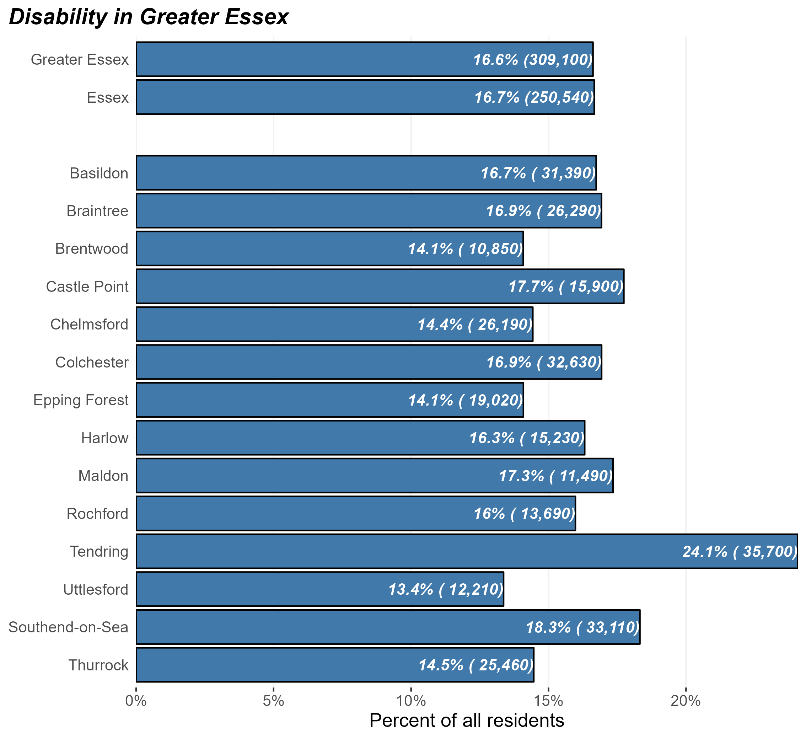
The disabled population
At the time of Census 2021, there were some 250,500 disabled people in Essex and 309,000 in Greater Essex (including the areas of Southend and Thurrock).
This equates to 16.7% of Essex residents – broadly in line with the average of England as a whole (16.9%).
But the prevalence of disability within the population varies substantially across different districts. Coastal areas – Tendring, Southend, and Castle Point – have the highest levels of disability within their resident populations.
Number and percentage of residents identifying as disabled in Greater Essex and Essex Districts, Census 2021

Slide 15
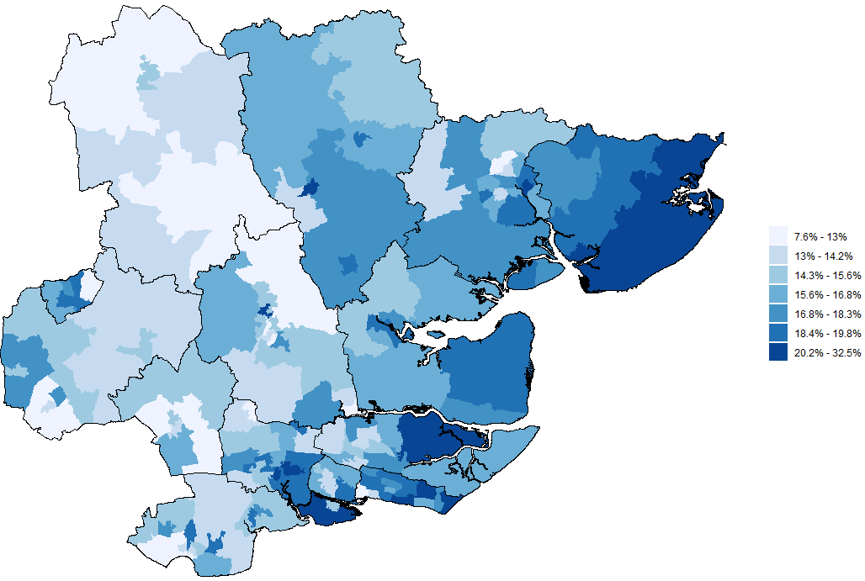
Disability across Greater Essex
The map opposite shows the proportion of residents in each middle-level super outputs area (MSOA) who identify as disabled
This shows that the proportion of the population who identify as disabled is generally higher in coastal areas – Tendring, parts of Rochford, Maldon, Castle Point, and Southend.
These areas tend to have an older average age, which may explain some of the patterns
There are also significant concentrations of disabled people in neighbourhoods in Essex’s larger towns – Basildon, Harlow, Braintree, Colchester and Chelmsford. These concentrations tend to be found in more deprived areas within these urban centres.
Prevalence of disability by MSOA, Greater Essex, Census 2021

Slide 16
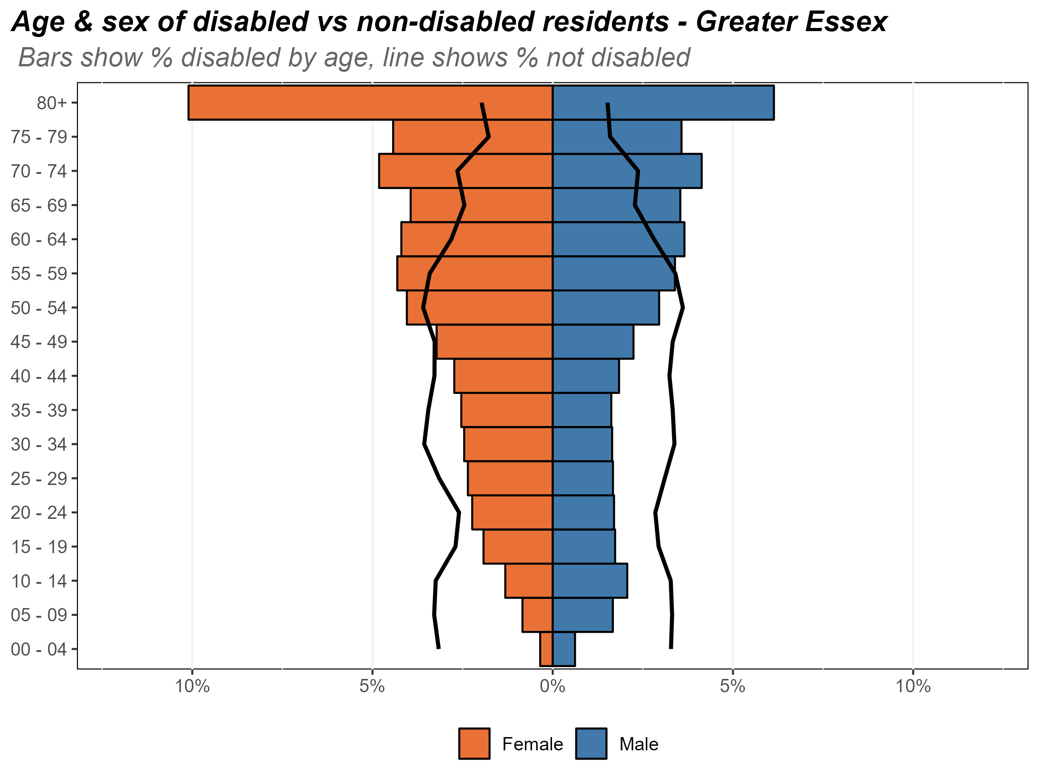
Age and sex of the disabled population
The chart opposite shows the composition of Essex’s disabled population by age and by sex. The age/sex profile for Essex’s non-disabled residents is shown by the black lines.
This analysis reveals that:
the disabled population is, in large part, made up of residents who are older – a third of Essex’s disabled population are over 70;
a significant minority are aged 40 (some 73.3%);
the majority of the disabled population are female (134,000 compared to 108,000 men). This is likely to reflect the fact that women live longer on average.
women who are over 50 are more likely to live with disabilities then without.
men who are over 55 are more likely to live with disabilities then without.
Composition of the disabled population by age and sex, Essex, 2021

Slide 17
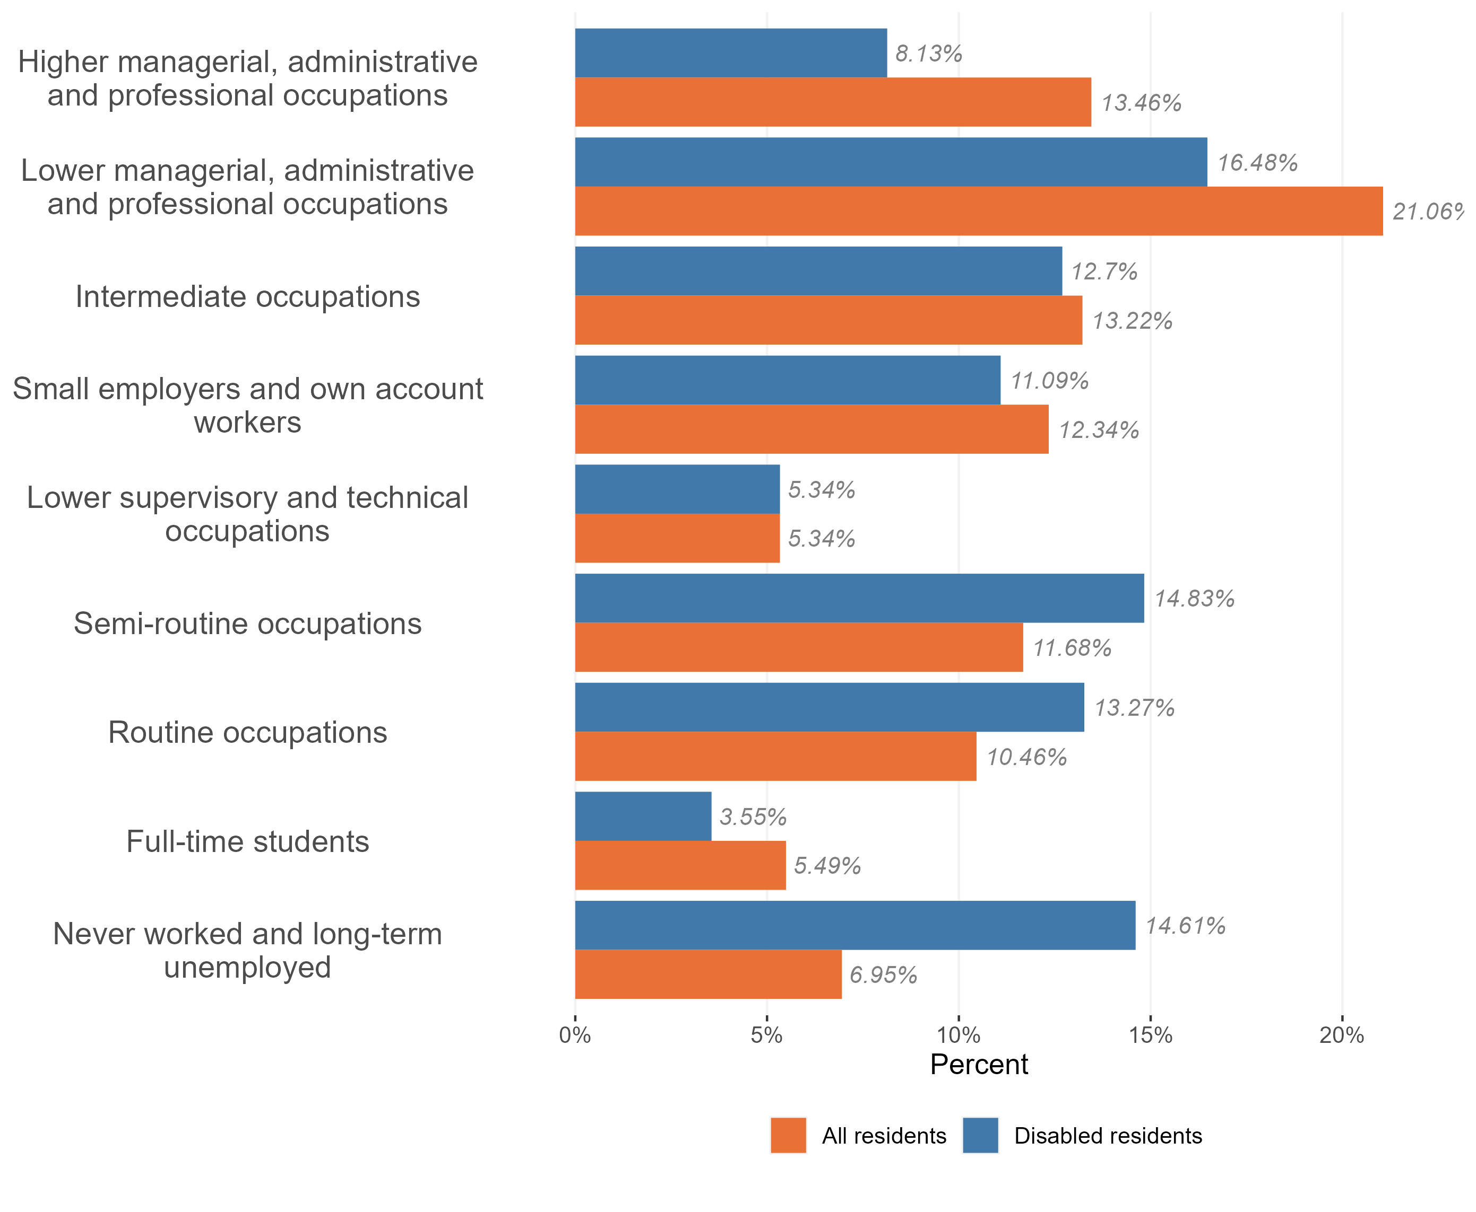
Employment and occupation type
Disabled people in Essex are significantly more likely to have never worked or to be long-term unemployed compared to working-age residents.
Those disabled people who are in work are:
less likely to hold occupations managerial, administrative and professional roles than the wider working population; and
More likely to be in ‘routine occupations’ and semi-routine occupations’
Disabled people are also less likely to be full time students.
Employment and occupation type, disabled and non-disabled population, Essex 2021

Slide 18

Around 785,000 people in Essex identify as members of a faith or religion (52.2% compared to 57.3 nationally).
There is a strong link between faith/religion and age. More than half of those who identify as members of a faith are aged 50+.
While the vast majority of those who identify as members of a faith are white British, there is a strong link between religion and ethnic group. Around 90% of residents from Asian, Asian British and Black, Black British groups identify as members of a religion.
Members of religious groups are generally less likely to identify as members of the LGBTQ+ community.
There is not obvious link between health, educational or economic outcomes and religious observance.
Religion
Notes:
Key message: population growth was expected and has been seen across Essex to varying degrees, driven by natural change but also migration into the county, primarily from within the UK.
This is expected to continue over the next few years, but as the population ages migration will likely be the primary cause.
Population growth is faster than that of England as a whole
(0.76% vs. 0.64% respectively).
Components of population change:
Uplift of migration into Essex:
Majority of migration into Essex comes from within the UK.
6% of new residents (in the last year from 21st March 2021), came from outside of the UK.
Natural change in population; greater number of births vs. deaths.
Leading to an increase in population density across Essex. Harlow, Castle Point and Basildon are seeing the greatest impacts of increased population density.
~1.52 million in 2022
~1.58 million in 2032
ONS projections suggest the Essex population could continue growing by ~0.4% -0.6% per year over the next 10 years.
Natural increase is projected to slow as the population ages.
The main driver of growth will come from NET migration into the county, largely from within the UK.

Slide 19
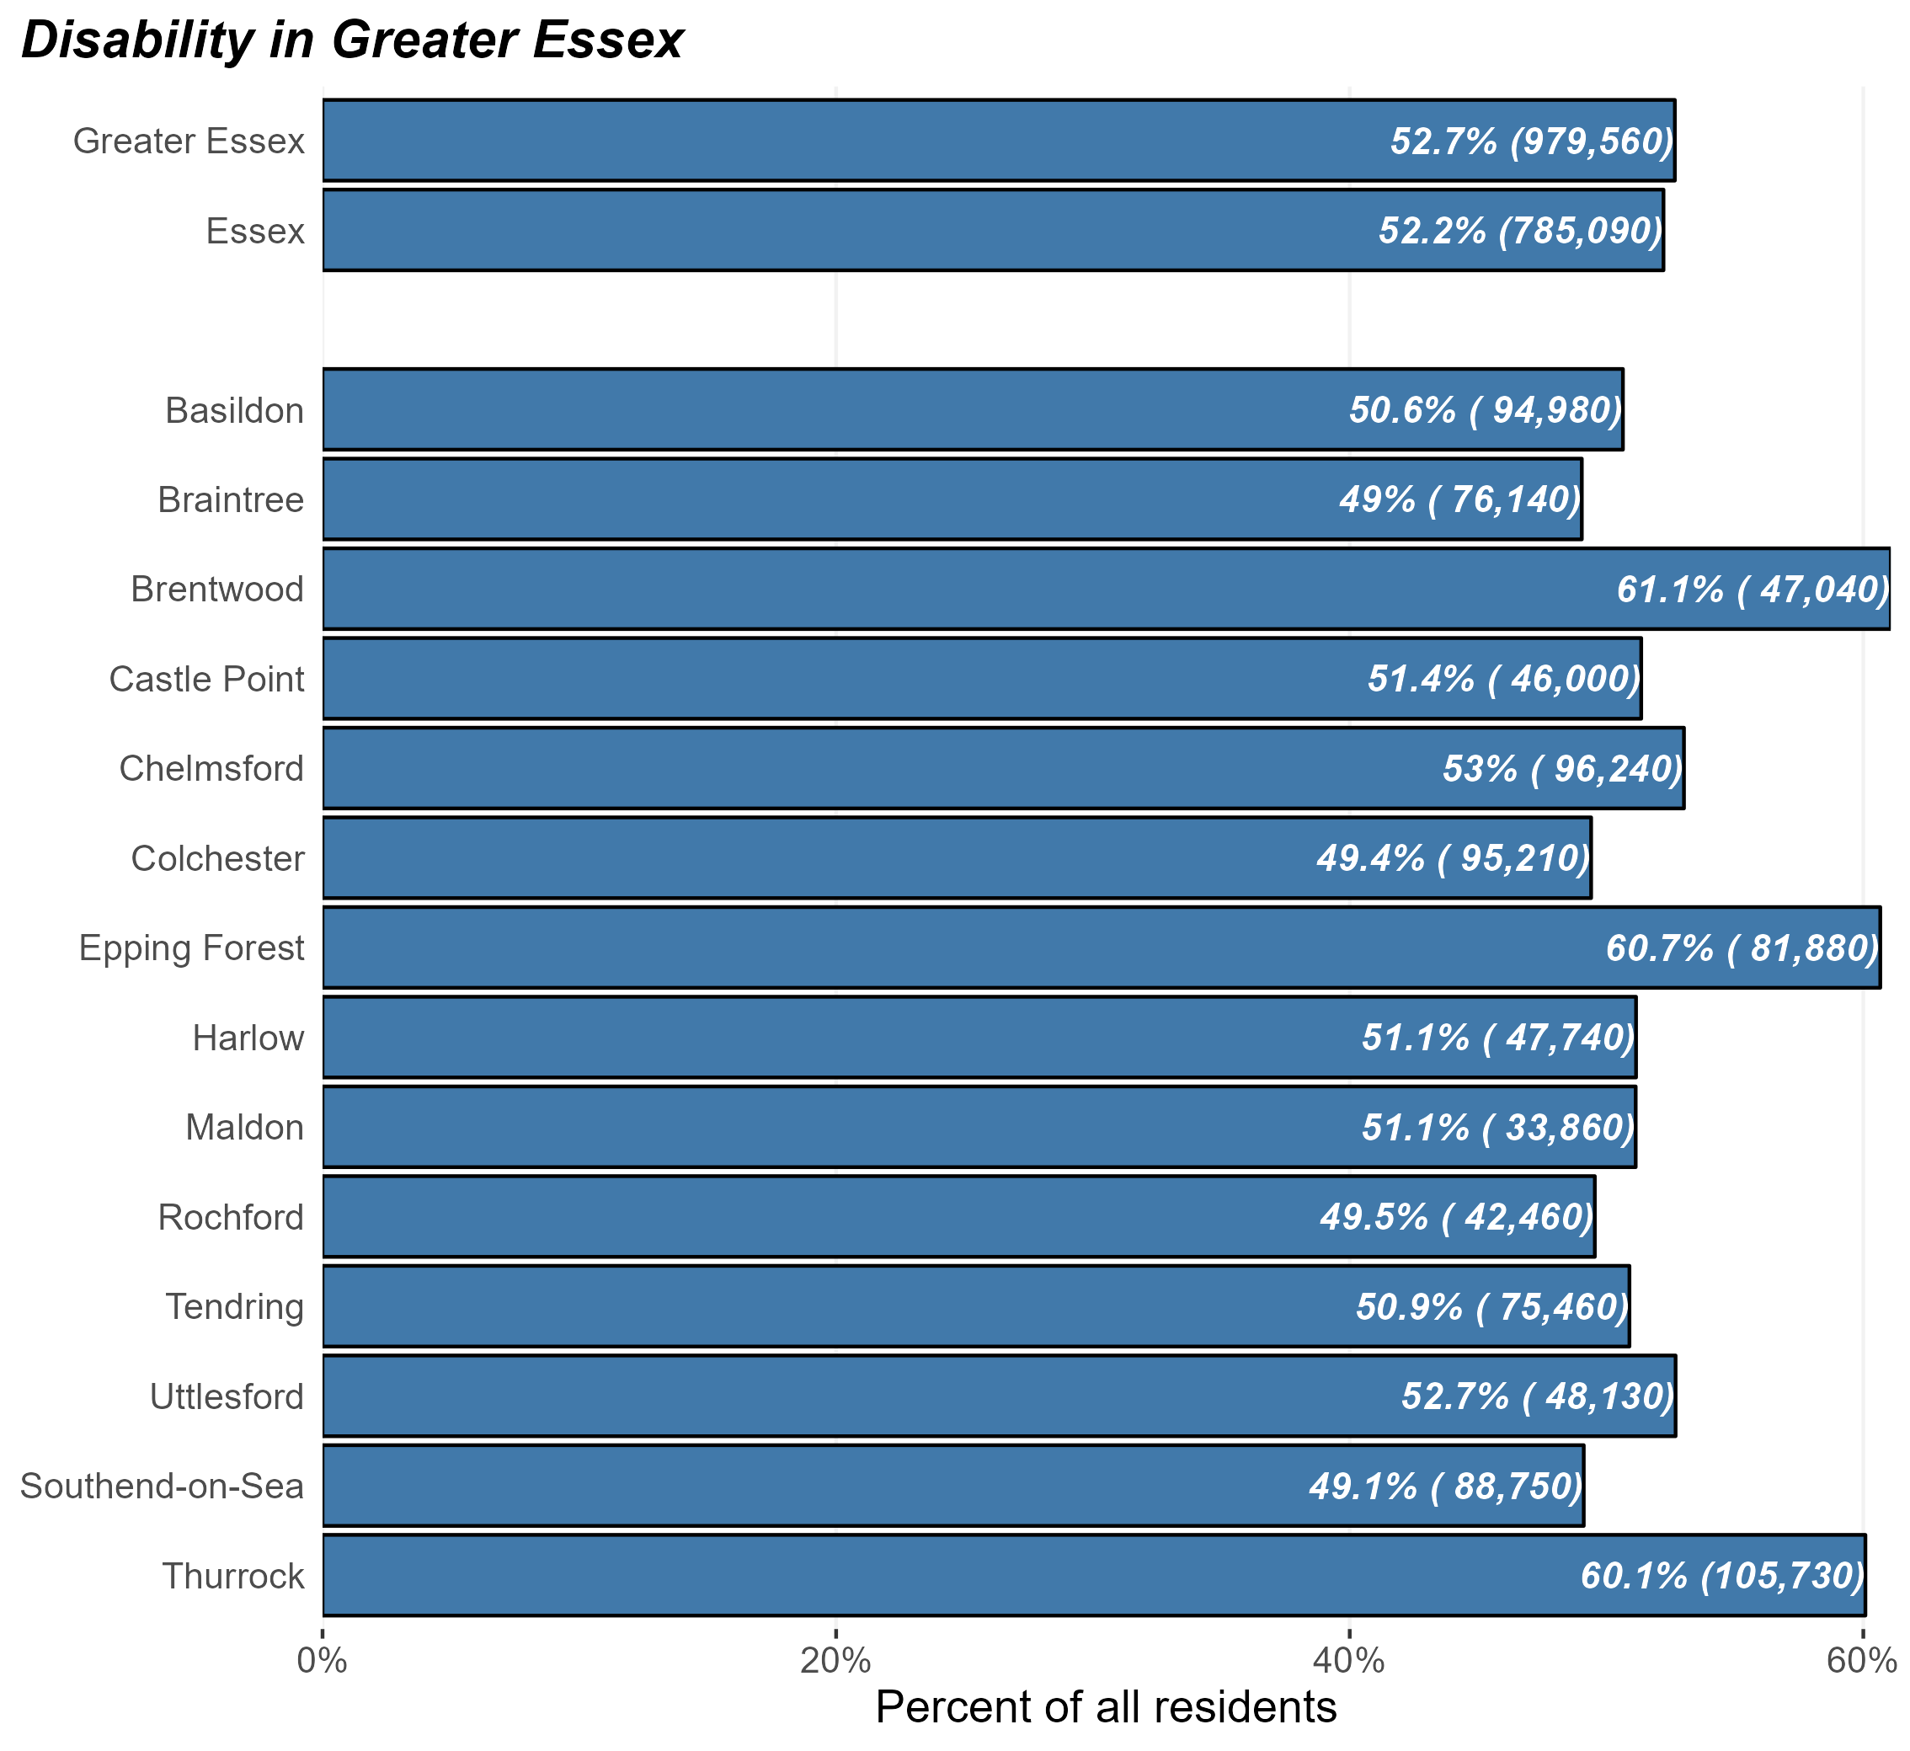
Faith in Essex population
At the time of Census 2021, there were some 785,090 religious people in Essex and 979,560 in Greater Essex (including the areas of Southend and Thurrock).
This equates to 52.2% of Essex residents – broadly in line with the average of England as a whole (57.3%).
But the prevalence of religion within the population varies substantially across different districts. Brentwood, Epping, and Thurrock have the highest levels of religious residents.
Residents identifying as members of a religion, Essex 2021

Slide 20
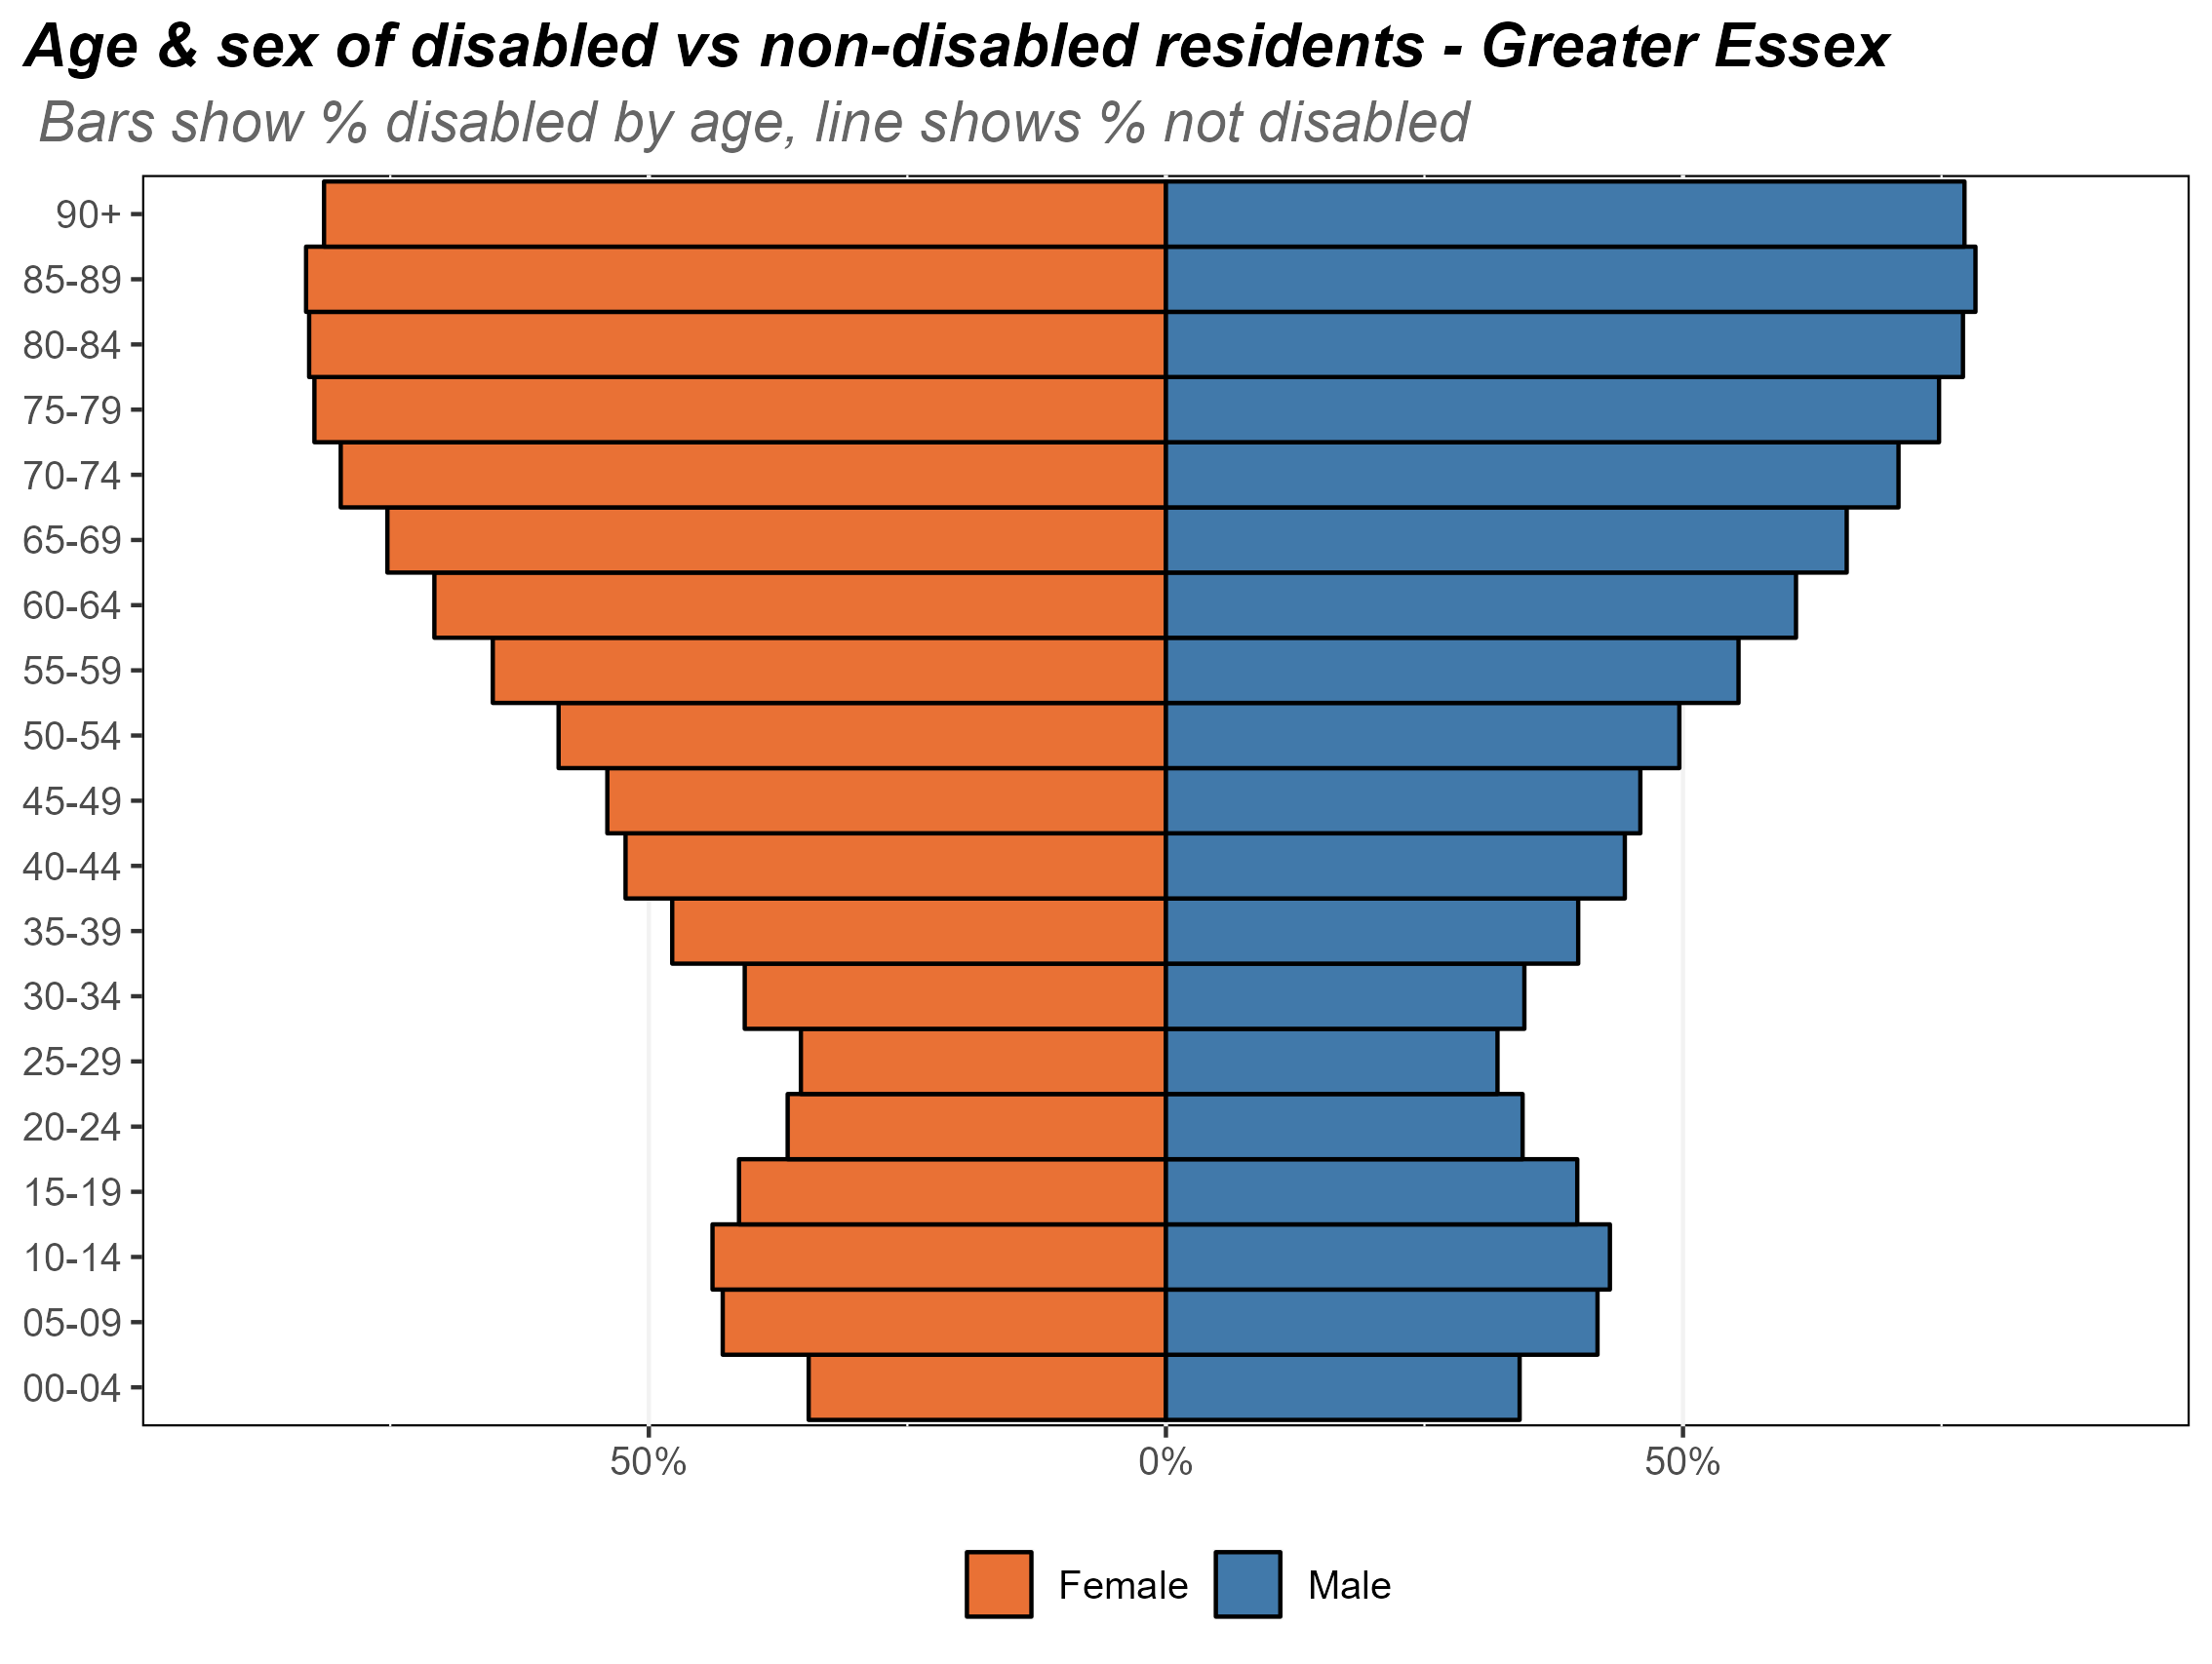
Faith by age in Essex
The chart opposite shows the composition of Essex’s religious population by age and by sex.
There is a strong link between age and religion – older Essex residents are far more likely to be religious compared to younger residents. More than half of the over 50s follow some religion.
Composition of the religious population by age and sex, Essex, 2021

Slide 21
Faith and ethnicity
While the vast majority of those who identify as members of a faith are white British, there is a strong link between religion and ethnic group. Around 80% of residents from Asian, Asian British and 90% of residents from Black, Black British groups identify as members of a religion.
This has implications for the mechanisms used by public bodies to engage with minority ethnic communities. It suggests that engagement through religious groups and institutions may be effective in reaching some communities but may be less effective in supporting engagement with others.

Slide 22

27,000 people identified as LGB+ in Essex at the time of the Census (2.2% of the 16+ population – lower than the average for England as a whole (3.4%)).
There is substantial variation across districts, with significantly greater numbers in Colchester (3.4%) and neighbouring Southend (3.2%).
Identifying as LGB+ is most common in the younger age groups (16-24), where circa 5.5% of residents identify as LGB+. This is slightly lower than England (6.9%). Less than 1% of Essex residents aged 75+ identifying as LGB+.
The vast majority of Essex’s LGB+ population identify as White British (83.5% - or 22,600 for the 27,070 LGB+ population).
Some 4,500 residents identify as members of ethnic minority groups (16.5% - compared to 13.6%). Members of the Essex LGB+ population are nearly twice as likely as the wider population to identify as Gypsy or Irish Traveller, Roma or Other white or mixed or multiple ethnic groups.
A reflection of the age profile of the LGB+ population in Essex, members some 15% are full-time students (compared to 5% of the population overall).
Sexuality
Notes:
Key message: population growth was expected and has been seen across Essex to varying degrees, driven by natural change but also migration into the county, primarily from within the UK.
This is expected to continue over the next few years, but as the population ages migration will likely be the primary cause.
Population growth is faster than that of England as a whole
(0.76% vs. 0.64% respectively).
Components of population change:
Uplift of migration into Essex:
Majority of migration into Essex comes from within the UK.
6% of new residents (in the last year from 21st March 2021), came from outside of the UK.
Natural change in population; greater number of births vs. deaths.
Leading to an increase in population density across Essex. Harlow, Castle Point and Basildon are seeing the greatest impacts of increased population density.
~1.52 million in 2022
~1.58 million in 2032
ONS projections suggest the Essex population could continue growing by ~0.4% -0.6% per year over the next 10 years.
Natural increase is projected to slow as the population ages.
The main driver of growth will come from NET migration into the county, largely from within the UK.

Slide 23

4,210 people in Essex (0.3% of the 16+ population) identified as Trans (i.e. the gender the identify with is not the same as the sex assigned at birth). This broadly in line with the England average (0.5%).
The majority are White British but a significant minority (35%) identify as members of minority ethnic groups.
Those aged under 24 are significantly more likely to identify as trans than any other age group.
The vast majority of Essex’s trans residents are not disabled but the trans population is more likely to be disabled than the population as a whole ((28.9% - compared to 18.9%)
30% identify as Lesbian, Gay or Bisexual compared to 2.2% of the population as a whole.
Outcomes for trans residents are a prima facie reflection of the age-profile for this group:
  they are significantly more likely to be full time students, to never have worked or be in lower skilled roles;
  they are more lily to work part-time time than the population as a whole;
  they are less likely to hold qualifications.
Gender identity
Notes:
Key message: population growth was expected and has been seen across Essex to varying degrees, driven by natural change but also migration into the county, primarily from within the UK.
This is expected to continue over the next few years, but as the population ages migration will likely be the primary cause.
Population growth is faster than that of England as a whole
(0.76% vs. 0.64% respectively).
Components of population change:
Uplift of migration into Essex:
Majority of migration into Essex comes from within the UK.
6% of new residents (in the last year from 21st March 2021), came from outside of the UK.
Natural change in population; greater number of births vs. deaths.
Leading to an increase in population density across Essex. Harlow, Castle Point and Basildon are seeing the greatest impacts of increased population density.
~1.52 million in 2022
~1.58 million in 2032
ONS projections suggest the Essex population could continue growing by ~0.4% -0.6% per year over the next 10 years.
Natural increase is projected to slow as the population ages.
The main driver of growth will come from NET migration into the county, largely from within the UK.

