Slide 1
What is a logic model / theory of change?
Research & Citizen Insight

Slide 2
Who is this for?
Anyone who wants to understand what a logic model / theory of change is
If you want to try and create one
Please look at our guide on: ‘How to make a logic model / theory of change’
Write it down on one page
Have a project in mind to work through!

Slide 3
PHAB Major Grant Applications
Projects applying to the PHAB programme for £15,000 or more are classified as major grants.
It is required that such projects submit an evaluation plan and project logic model, also known as a theory of change, as part of their application.
This is not only to support the funding decision process, but also to support applicants in initially exploring and generating ideas about the evidence generation for their specific project and its’ goals.
This is a useful start, with major grant projects awarded funding then required to deliver an evaluation of their project (at suitable project timelines), as outlined in the evaluation specification documents.

Slide 4
This pack covers
What they are
Why do a logic model / theory of change
What they look like
Key steps in creating one
What is it like creating one

Slide 5
What they are
An explanation of how your project will create change or impact.
They help to illustrate how the project is expected to work and the relationships between its’ component elements, presenting the flow of activities and outputs proposed to lead to desired outcomes and ultimately contribute to achieving the project’s goals and impact.

Slide 6
They help to identify
The change or impact the project will make (objectives and outcomes) The reasons for why people cannot make those changes themselves
The activities and resources that will be offered that will help your project users make those changes to develop intended outcomes
What your project users will need to do to engage with and make use of your activities and resources
Who your project will work for, and who it might not work for
And if your project is about doing something ‘better’, it will help explain why your project methods are better than identified existing ones

Slide 7
They are helpful because they…
Enhance clarity for your projects’ goals, activities and expected outcomes
Are a useful communication tool to use with partners, funders and stakeholders for explaining and justifying your project
Help focus your work. Identifying key components required to achieve desired outcomes helps ensure efforts and resources are focused on impactful strategies
Encourage reflection and learning during project implementation to support continuous improvement
Helps identify appropriate measures to monitor and evaluate the projects process and success.
Provided a framework for evaluating the implementation and impact of your project

Slide 8
And doing one can be helpful because it…
Helps people reach an agreement on what they should be doing and how they should be doing it.
It helps all project stakeholders have a shared understanding of the project, facilitating collaboration and support.
Can lead to better ideas about how people should be doing things and so help to make your project more effective.
It can lead to a more accessible service. It can help you identify what you need to do to make your project more accessible and attractive to people from different groups.

Slide 9
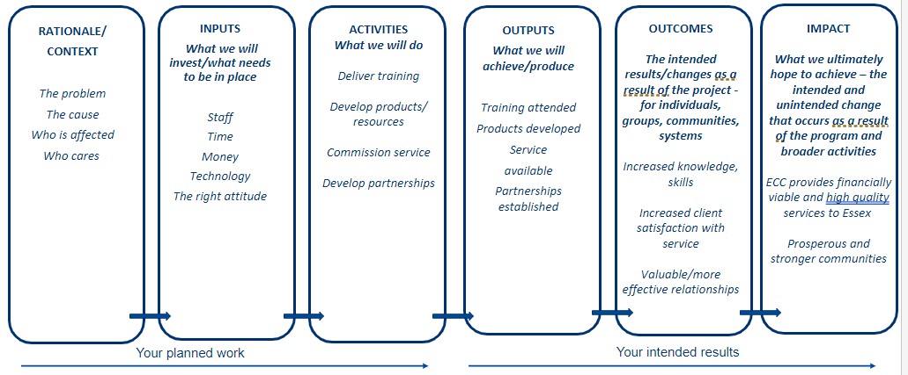
What form do they take?
Usually a diagram
But it’s good to have a written story too

Slide 10
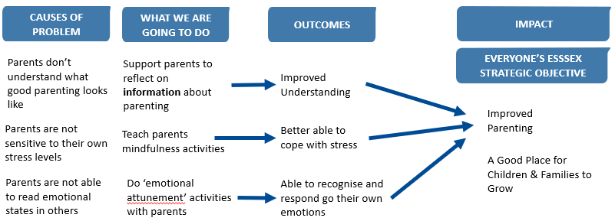
An Example – The Parenting Service
Keep it short and sweet! Use arrows to make clear links between the activities, outputs and outcomes, and think about how they all connect.​

Slide 11
Why are we providing ‘The Good Parenting Service’ and why do we think it will make a difference to parents?
Essex County Council are committed to making Essex a good place for children and families to grow up.
Sadly some parents find it hard to respond calmly to their children, when their children get upset, tired and angry. This is because they didn’t see parenting done well when they were young and don’t really understand what it looks like. Its also because they are unable to read emotional states in others and are not very sensitive to their own stress levels.
In Essex we’re committed to supporting parents, children and families, so our service works with parents to do three things.
First, we talk to parents about how to respond to children when the child is upset, and we spend time with them with their children, so we can model the behaviour.
Second we encourage parents to do mindfulness exercises, where they practice recognizing and talking about their stress levels, and start to think through what they can do when they are feeling stressed.
Third we work with parents to start to think about the different emotional states that their children can experience, and how this impacts on their child’s behaviour. We then encourage parents to explore how they can respond to their children when their child might be upset or tired.
We think that doing these activities will allow parents to have more empathy and sympathy for their children, when they are upset.
It will also give them techniques and tools for both understanding what is happening and what they can do to lower their own stress levels and support their children when the child is stressed.
In this way we think that our service contributed to Essex County Council’s goal of making Essex a good place for children and families to grow up.

Slide 12
Key steps in the creation of one
Think about the changes, outcomes and impacts you want the project to make, it can be helpful to start with what you are looking to achieve - What is the challenge you’re trying to solve?
Think about what your project will do, how your support, activities and resources will help achieve these. What is going into the project and what will be delivered? What needs to be in place? This could be staff, time, money, technology etc.
Identify who your project will work for, and who it won’t. Think about who the population is that is affected by the challenge that you are targeting
Find and show the evidence that backs up your theory. If the evidence contradicts your theory, change your theory and activities!

Slide 13
Test it against four types of evidence…
Professional expertise and judgment
Place based evidence from users, residents and professionals
Published research evidence
Organisational data
Bonus: if you are already delivering your service, do some small-scale research to critically assess your service
| 13

Slide 14
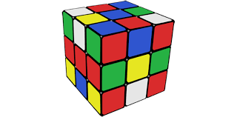
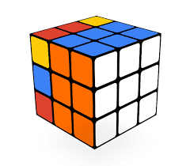
What is it like creating one?
Changes to thinking in one area can impact on others
The process can feel a bit messy, it can unearth differences of opinion
By the end we should feel happier with our thinking, plans and service

Slide 15
https://www.youtube.com/watch?v=6zRre_gB6A4
| 15

Slide 16
This information is issued by: Research & Citizen Insight, Essex County Council
Contact us: research@essex.gov.uk
Policy Unit Essex County Council County Hall, Harlow Essex, CM1 1QH
Essex_CC
facebook.com/essexcountycouncil
The information contained in this document can be translated, and/or made available in alternative formats, on request.
Published March 2024

