Slide 1
Project Evaluation A Beginner’s Guide
Research & Citizen Insight

Slide 2
Who is this for?
Anyone who wants a quick overview of planning and doing an evaluation
R&CI offer evaluation planning workshops, support and guidance Email research@essex.gov.uk for more info
Write it down on one page
Have a project in mind to work through!

Slide 3
PHAB Major Grant Applications
Projects applying to the PHAB programme for £15,000 or more are classified as major grants.
It is required that such projects submit an evaluation plan and project logic model, also known as a theory of change, as part of their application.
This is not only to support the funding decision process, but also to support applicants in initially exploring and generating ideas about the evidence generation for their specific project and its’ goals.
This is a useful start, with major grant projects awarded funding then required to deliver an evaluation of their project (at suitable project timelines), as outlined in the evaluation specification documents.
| 3

Slide 4
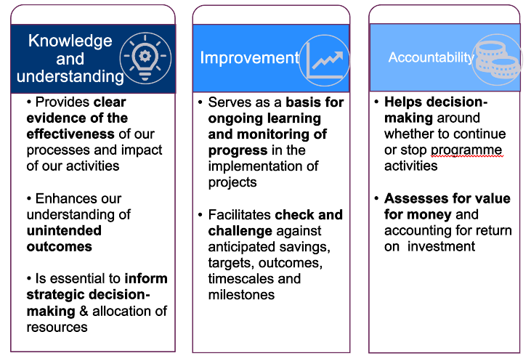
Benefits of evaluation
Evaluation
Key question: Will/ did the intervention succeed, and why?
Focusses on:
- Comparing selected metrics before and after an intervention takes place;
- Deciding whether change has occurred or not, and whether this is attributable to the intervention;
- Learning lessons to improve practice and decision-making
programme

Slide 5
The value of planning

Slide 6
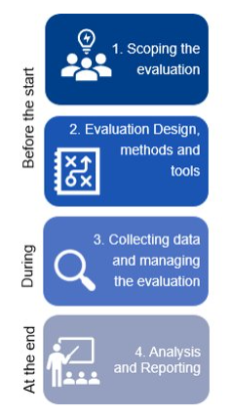
Project evaluation consists of 5 steps
Describe what your project will do and the difference it will make
Identify your evaluation questions
Work out how you are going to get answers your questions
Create an evaluation plan, get a budget and get ethical approval
Collect the data and present your findings

Slide 7
Step 1
Describe what your project will do and how it will make a difference
You may wish to read through our ‘logic model / theory of change’ resources

Slide 8
Starting off your evaluation
A good evaluation is usually based on a well-defined project.
Work with stakeholders to identify:
What your project will do
The change it will make
How it links to our strategic objectives
List the things that your project will do and offer, and the different project activities
Write it down on one page

Slide 9
Starting off your evaluation
A good evaluation is usually based on a well-defined project.
Work with stakeholders to identify:
What your project will do
The change it will make
How it links to our strategic objectives
List the things that your project will do and offer, and the different project activities
What will change for the project or service users, if they engage with your project activities?
For each difference:
Who will you make the difference to?
What will they be able to do that they weren’t able to do before?
For lean evaluation pick 1-3 priority differences
Write it down on one page

Slide 10
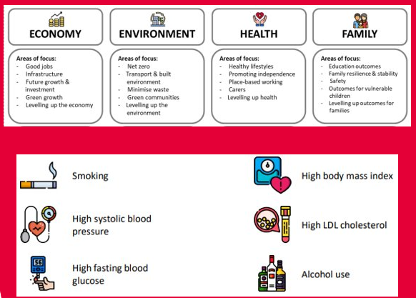
Starting off your evaluation
A good evaluation is usually based on a well-defined project.
Work with stakeholders to identify:
What your project will do
The change it will make
How it links to our strategic objectives
List the things that your project will do and offer, and the different project activities.
What will change for the project or service users, if they engage with your project activities?
For each difference:
Who will you make the difference to?
What will they be able to do that they weren’t able to do before?
For lean evaluation pick 1-3 priority differences.
Then link the changes to the Essex County Council’s public health strategic objectives. Read the plan here.
Write it down on one page

Slide 11
Your project on a page, logic model or theory of change
The Parenting Service
WHAT WE ARE GOING TO DO
WHAT WILL CHANGE FOR PARENTS
EVERYONE’S ESSSEX STRATEGIC OBJECTIVE
Support parents to reflect on information about parenting
Improved Understanding
Improved Parenting
A Good Place for Children & Families to Grow
Teach parents mindfulness activities
Better able to cope with stress
Do ‘emotional attunement’ activities with parents
Able to recognise and respond go their own emotions
Keep it short and sweet!

Slide 12
Make your outcomes 'concrete'
Parents, who shouted at their child, when their child had a tantrum, before the intervention, speak calmly to their child in response to a tantrum after the intervention.
Now take the notes which look at the differences made. Can you define the difference in a way that makes it more precise, concrete and measurable? Does the definition include a before and after state?
A child who does not talk at all before the programme, is able to speak at a level that is considered appropriate for his or her age, by the end of the programme.
A child, who is obese, and who does less than 30 minutes of physical activity, before the sports initiative, does 30 minutes of physical activity every week, for the six months after the initiative.

Slide 13
Link your outcomes to ECC public health priorities
For each outcome, the difference the project intends to make, group them under the ECC Public Health priorities & strategic objectives.​
You can find the new Essex Wellbeing, Public Health and Communities Plan here.​ ​

Slide 14
At the end of step 1
Now you’ve got a well-defined project, you can think carefully about which aspects of your project to focus your evaluation questions on
You should be able to:
Clearly communicate what you are doing, why you are doing it and who is going to benefit
Communicate why your project is going to help achieve ECC strategic objectives
In other words, you will have your very own project on a page, logic model or theory of change
You are now ready to identify your evaluation questions

Slide 15
Step 2
Identify your evaluation questions

Slide 16
At the end of step 2
You should be able to ..
Identify the key questions you are going to ask, categorise and prioritise those that are most important
Think about what kind of decisions will be taken about the project, and what kind of questions need to be asked, and the types of answer you need to take those decisions
And make sure you know what you are going to do with the evaluation. Focus on evaluation questions that can inform real choices going forward

Slide 17
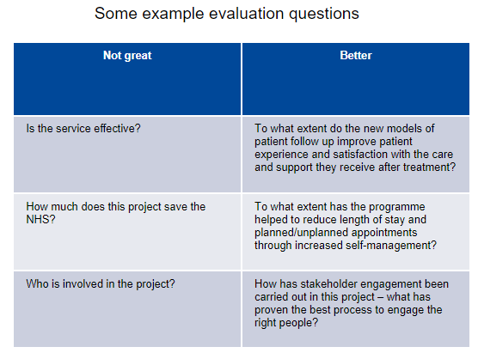
Developing evaluation questions
Develop some key questions which you want the evaluation to answer. Here are some top tips:​
​
Be specific and avoid closed questions​
Get the right balance between process, impact and value for money evaluation
Use your logic model to guide you​
Ask yourself:​
Will it provide information to make decisions or provide ​ valuable learning? ​
Can it be answered within the available resources and timeframes?

Slide 18
Your evaluation questions
Examples might include: ….
Implementation questions How much do your staff have the training and expertise required to deliver the project?
Engagement questions Do the people experiencing your project have the right level of need?
Impact or outcome questions What is it about the project that is helping? Are their unanticipated benefits? Are there other services or projects that could be contributing?
Keep focused on a few good questions!

Slide 19
Then group your questions into implementation, engagement and impact questions
Implementation questions
Engagement questions
Impact questions
These are about whether you can provide the project activities you set out to.
Are you able to provide the project in the way you planned?
Do your staff have the training and expertise required?
Do you have access to the resources you need?
Are your project costs within your budget?
Best for projects that have just got started.

Slide 20
Then group your questions into implementation, engagement and impact questions
Implementation questions
Engagement questions
Impact questions
These are about whether you can provide the project activities you set out to.
Are you able to provide the project in the way you planned?
Do your staff have the training and expertise required?
Do you have access to the resources you need?
Are your project costs within your budget?
These are about whether the right people are engaging with your project activities, and in the right number.
Are people using your project?
Do they have the right level of need?
What do they think of the project? Are they engaged in it fully?
Who isn’t being referred or engaging? Why aren’t they being referred or engaging?
Best for projects that have just got started.
Best for projects, which are running and doing what they are supposed to do.

Slide 21
Then group your questions into implementation, engagement and impact questions
Implementation questions
Engagement questions
Impact questions
These are about whether you can provide the project activities you set out to.
Are you able to provide the project in the way you planned?
Do your staff have the training and expertise required?
Do you have access to the resources you need?
Are your project costs within your budget?
These are about whether the right people are engaging with your project activities, and in the right number.
Are people using your project?
Do they have the right level of need?
What do they think of the project? Are they engaged in it fully?
Who isn’t being referred or engaging? Why aren’t they being referred or engaging?
These are about whether the people who access the project activities are benefiting.
Are the people experiencing the change or benefit your project is designed to deliver?
Are they experiencing benefits that you had not anticipated?
What is it about the project that is helping? And does the project rely on other services or things to bring about this benefit?
If people are not benefiting why might this be?
And are certain types of people more likely to benefit from the project than others? Are certain groups not benefiting at all?
Best for projects that have just got started.
Best for projects, which are running and doing what they are supposed to do.
Best for 'full steam ahead' projects, being delivered as planned and which have the right type of people, with the right type of need using them.

Slide 22
Exercise: Evaluation Questions
On post it notes write down all the evaluation questions you’d like to ask
Now group those questions into implementation questions, engagement questions and effectiveness questions
Now consider where you are in your project: starting off, up and running or being delivered as planned
Now, being realistic, think about which questions you should prioritize, given where your project is

Slide 23
Exercise: Brainstorm your evaluation questions here. What do you want to know?

Slide 24
Implementation questions
Engagement questions
Impact questions

Slide 25
What will you do with the evaluation findings?
You may wish to work with stakeholders to identify:
What will you do with the evaluation findings?
What kind of decisions will you be making in the future?
How will the findings be used?
What will it feed into?
How will these findings be shared?
Who will these findings be shared with?
For each decision option …
Think about what kind of evidence would you need to take that option?
So, what kind of evaluation question do you need to ask?
What will these stakeholders wish to know?
What will help people make decisions or change what we do?
What are the realistic options?
For each decision option …
Think about what kind of evidence would you need to take that option?
So, what kind of evaluation question do you need to ask?

Slide 26
How will you respond to different types of finding?
What if the findings turn out to be disappointing?
What will you do if the findings are positive?
If the findings are not what you hoped for, will you …
Redesign the project?
Ask for more money or resources?
Do a bit more research with your users?
Or stop the project?
Be upfront, ask stakeholders what might happen if results are not as hoped for
Be honest and objective with your findings – tell both sides of the story
If the findings are positive, will you:
Seek more funding to continue or grow the project?
Look to do a big impact study?
Encourage other people to copy what you are doing?
Think about what kind of information would trigger the different decisions you might make

Slide 27
At the end of step 2
You should now be able to ..
Identify the key questions you are going to ask, categorise and prioritise those that are most important
Think about what kind of decisions will be taken about the project, and what kind of questions need to be asked, and the types of answer you need to take those decisions
And make sure you know what you are going to do with the evaluation. Focus on evaluation questions that can inform real choices going forward
You are now ready to work out how to get answers for your questions.

Slide 28
Step 3
Work out how you are going to get answers to your questions

Slide 29
At the end of step 3
You should be able to ..
Determine what methods are most suitable for collecting data for your evaluation
Write a data collection plan
Ensure that you keep your questions, methods and samples small and focused

Slide 30
Data collection methods
Now you know what your evaluation questions are, you are ready to select your data collection methods
If you are doing a lean evaluation, you should have a few choice evaluation questions to look at
If you want to know something about all your users, you can do a survey or a census. You can also use project data that you might collect on all users
If you want to explore people’s experiences of a particular aspect of the project, but you don’t need to know what everyone thinks, you can do an interview, focus group or a case study
So, take your evaluation questions, and for each one think about
What do we want to measure?
How will we collect data to help answer it?

Slide 31
Project data
This is the outputs from your project or intervention. It could include but is not limited to:
Referrals made
People supported
Staff trained
Staff performance
Risks and issues managed
Improvements made
Costs vs. budget

Slide 32
Surveys
Create a list of questions, no more than ten questions
Keep the list of questions focused
Decide if you're going to talk to everyone or a sample
If you're going to talk to a sample, select the sample at random or try to make the sample representative
Would online survey or paper-based be best for the audience?

Slide 33
Interviews, focus groups
These might be:
Informal chats
Interviews
Group discussions
Would online or face-to-face be best for the audience?
Create a list of exploratory questions – what do you want to know?
Try to get a small sample of people with different and contrasting experiences in relation to your evaluation questions
For a lean evaluation, you need to keep the data collection small and focused!
!

Slide 34
Case studies
Explore how the service or intervention is working for a small set of users – their perceptions, attitudes and behaviors
Talk to various people who are involved: professionals, residents, family or other people who interact or work with the resident
You can do observations
You can read case notes
You'll then need to spend time bringing the case study together
For a lean evaluation you'd want to be doing between three and five.

Slide 35
Post-it notes exercise: Data collection methods
So, take your evaluation questions, and for each one think about,
What will we measure?
How will we collect data to help answer it? (Project data, Interview, Focus Group, Case Study)
Will this be face-to-face, online, system or admin / project data?
Collecting this in a table will keep it neat and in one place!

Slide 36
So, take your evaluation questions, and for each one think about, how will we collect data to help answer it?
Evaluation Question | Collecting … Project data, Interview, Focus Group, Case Study | Format face-to-face, online, system or admin data | Who will collect

Slide 37
Lots of guidance and further reading available in our short modules on our Open Data Platform
Understanding research methods
Quantitative methods
Qualitative methods
Differences between qualitative and quantitative research
Choosing the right research method
Surveys
Questionnaire design
On street research
In-depth interviews
Focus groups
Traditional ethnography and digital ethnography.
Additional methods & approaches
Design and materials
Contact research@essex.gov.uk
For videos, audios and diaries; story-telling.
Behavioural insights
Ethical research data protection and safeguarding
Sampling and recruitment
Cognitive bias
https://data.essex.gov.uk/dataset/e5lmn/phab-resources-supporting-documents-2-a-beginners-guide-to-project-evaluation

Slide 38
At the end of step 3
You should now be able to ..
Determine what methods are most suitable for collecting data for your evaluation
Write a data collection plan
Ensure that you keep your questions, methods and samples small and focused
You are now ready to create an evaluation plan, get a budget and ethical approval

Slide 39
Step 4
Create an evaluation plan, get a budget and get ethical approval

Slide 40
At the end of step 4
You should be able to ..
Pull together an evaluation plan, a project plan, staff to do the work, a budget
Build in time for the analysis and checking in with stakeholders who will use the findings
And you’ll need to think through the ethical issues associated with your plan and get ethical approval

Slide 41
Create an evaluation plan and think through timings
When will data collection start and finish?
When will the analysis and writing up start and finish?
When will you feedback findings and how will you make sure the evaluation findings influence decisions?
For every day you spend on data collection, set aside a day for analysis. In some cases, you can start your analysis as you collect your data.
Analysis and writing up tends to take longer than you think!

Slide 42
Consider resourcing and budget
Who will do the work?
Who is going to pay for the work? How much budget is there?
Do you need to build the costs for the evaluation into the business case for your project?
Have you got the capacity to do all the work?
If you don’t, then prioritize evaluations questions and data collection.
Keep your analysis focused on the evaluation questions: cut everything else out!

Slide 43
Ethical review
If you are carrying out the evaluation data collection in house, please send the following things to R&CI on research@essex.gov.uk
Your evaluation plan
The section on 'ethics' in the research planning template
Data collection materials (questionnaires, topic guides)
Information sheets and consent forms
If you are commissioning a research organization to collect the data, you will need to ensure that they abide by a code of ethical research.
Ethical research data protection and safeguarding

Slide 44
Independence
The person collecting and analysing the evaluation data should not be the person delivering the project.
Try to find someone from another project, team or service to collect and analyze the data
Or get an evaluator or independent researcher to do the work
Provide alternate views, if present in your data
Cognitive bias.
Don’t present just one side of the story!

Slide 45
At the end of step 4
You should now be able to ..
Pull together an evaluation plan, a project plan, staff to do the work, a budget
Build in time for the analysis and checking in with stakeholders who will use the findings
And you’ll need to think through the ethical issues associated with your plan and get ethical approval
You are now ready for the delivery of your project!

Slide 46
Step 5
Collect your data, analyse it, draw conclusions and consider next steps.

Slide 47
At the end of step 5
You should be able to ..
Collect and analyse your data
Draw conclusions from your findings and consider next steps
Develop your report so that it tells the story
If you need guidance on how to analyse your insight contact research@essex.gov.uk

Slide 48
Now, the work really begins!
Firstly, be prepared to be flexible with your evaluation
Once the data is collected, a lean evaluation requires a super focused approach to analysis
Focus on answering the evaluation questions and cut out everything else
Draw out and headline your presentation with the implications and recommendations for decision-makers. They want to know what they need to next
And be balanced in your feedback. Talk about what worked and what didn’t work so well

Slide 49
Analysis: build in space and time for reflection
Be prepared to be flexible
Maintain a focus on your evaluation questions - cut everything else out!
Sometimes evaluations don’t go to plan
It can be difficult or impossible to collect certain types of data
Over time, it's clear that there are other more pressing evaluation questions that need to be answered
Reflection
Is the evaluation plan working?
Or do we need to do something differently?
Focus on your evaluation questions
Reflection
What is the data telling you about the answers to your questions?
Are there any other important findings that you think your audiences must know about?

Slide 50
Be balanced
Draw out the ‘so what’s’
Evaluation findings are usually a balance of things that worked well and things that could have worked better. Present both sides.
Reflection
What worked about the way the project was implemented and what didn’t?
Which people used your project, and which didn’t? What explains the difference?
Who has benefited from the project and who hasn’t? Again, what explains the difference?
Once you have answered your evaluation questions, think through the so-what’s.
Reflection
Who is the audience for this evaluation?
What do the findings suggest they should do?
Continue funding the project?
Stop the project?
Redesign or develop the project?
Encourage other people to do the same?

Slide 51
Presenting findings: get to the point quickly!
Your presentation needs to meet the needs or your audience
Wake your audience up! Start off by explaining to your audience which of their needs you are going to meet
Then give your audience the ‘so-what’s’ from your evaluation. Tell them what they need to do differently
Then provide a brief summary of the supporting evidence
Use quotes, case studies and key figures to illustrate the answers
Consider using audio, images and videos

Slide 52
For example, your audience might want to know
What should they do?
What are the headline findings?
What is the evidence supporting this?
Should they continue to fund the project, develop it, stop it or encourage others to copy it?
Tell them what they need to do, and then give them the headline findings that back up this recommendation. You might look at:
What worked well?
What was challenging?
What did stakeholders think of the project?
How much things cost, and could you keep within budget?
Make sure you can back each recommendation up with the evidence e.g., video, quote, case study
When presenting your findings lead with the implication. and recommendations.
You might want to provide an expanded report on the evidence
But remember, most audiences don’t want to know about the journey you’ve been on
And they don’t want all the data

Slide 53
Lots of guidance and further reading available in our short modules on our Open Data Platform
Analysis
Bringing insight together
Storytelling
Qualitative analysis
Quantitative analysis
Brainstorming: bringing insight together
Storytelling and delivering with impact
https://data.essex.gov.uk/dataset/e5lmn/phab-resources-supporting-documents-2-a-beginners-guide-to-project-evaluation

Slide 54
At the end of step 5
You should now be able to ..
Collect and analyse your data
Draw conclusions from your findings and consider next steps
Develop your report so that it tells the story.
Conduct your own ‘lean evaluation’

Slide 55
Research & Citizen Insight
We can provide free consultancy and act as a ‘critical friend’ at each stage of your evaluation
Theory of change/logic model
Research questions
Research methods & approach
Analysis
Writing up and plans for sharing findings
R&CI can quickly feedback on your evaluation work at any of the 5 steps (research@essex.gov.uk)

Slide 56
Research Advice Drop-in
Every Tuesday, 10-11 am, on Teams Contact research@essex.gov.uk

Slide 57
This information is issued by: Research & Citizen Insight, Essex County Council
Contact us: research@essex.gov.uk
Policy Unit Essex County Council County Hall, Harlow Essex, CM1 1QH
Essex_CC
facebook.com/essexcountycouncil
The information contained in this document can be translated, and/or made available in alternative formats, on request.
Published March 2024

