Slide 1
Mapping an Evaluation Journey for your Project or Service
Research & Citizen Insight

Slide 2
Who is this for?
Anyone who wants to know about how evaluation can be used at varying project stages, from design to implementation, and different evaluation methods that could be used for such
R&CI offer evaluation planning workshops, support and guidance Email research@essex.gov.uk for more info
Write it down on one page
Have a project in mind to work through!

Slide 3
PHAB Major Grant Applications
Projects applying to the PHAB programme for £15,000 or more are classified as major grants.
It is required that such projects submit an evaluation plan and project logic model, also known as a theory of change, as part of their application.
This is not only to support the funding decision process, but also to support applicants in initially exploring and generating ideas about the evidence generation for their specific project and its’ goals.
This is a useful start, with major grant projects awarded funding then required to deliver an evaluation of their project (at suitable project timelines), as outlined in the evaluation specification documents.
| 3

Slide 4
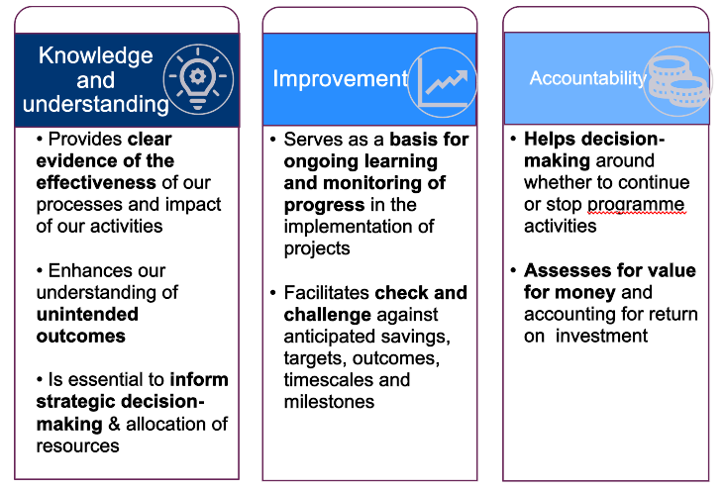
Benefits of evaluation
Evaluation
Key question: Will/ did the intervention succeed, and why?
Focusses on:
- Comparing selected metrics before and after an intervention takes place;
- Deciding whether change has occurred or not, and whether this is attributable to the intervention;
- Learning lessons to improve practice and decision-making
programme

Slide 5
The value of planning

Slide 6
Key Points
You may wish to read through our ‘introduction to project evaluation’ resources

Slide 7
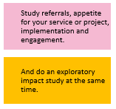
Four take-aways
What a quick short evaluation might look like for a small project
Its worth mapping out an evaluation and evidence journey for your specific project or service. You need to design the evaluation journey that will help achieve your project/service aims and objectives.
If in the design phase, study the problem, the potential solutions and from there clearly define the solution you want to try out.
If you have a small or quick project to deliver and you’re already delivering, you might want to do a quick short evaluation.
Once delivering your solution, evaluation could look at whether it was possible to provide as planned, and if so, what are the impacts.
If you’re scoping the problem, or your project has a 2+ year time-frame, or you’re delivering something medium/large, complex, ambitious, or expensive, you might want to consider a 3-step evidence journey….

Slide 8
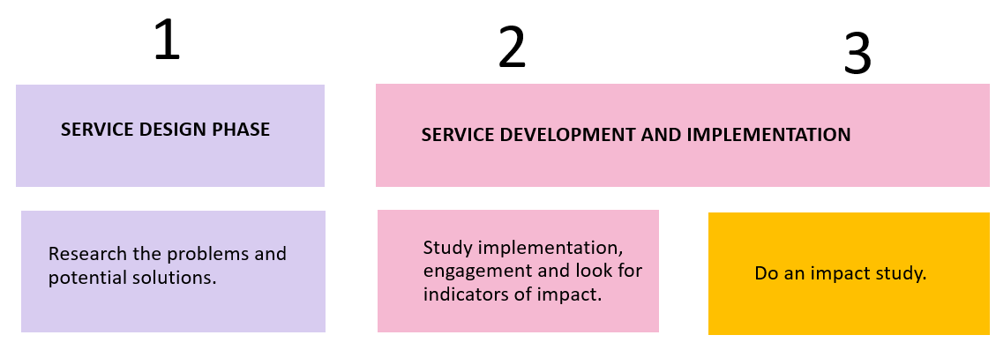
Three-step evidence journey
Useful for medium-large sized projects, longer-term, expensive or complex/ambitious projects, and any projects still in design phase
Clearly define your project / solution
Test & develop potential for adoption & scale-up through 1-3
Delivered as planned? Awareness, appetite and uptake?
These can be exploratory or a population study.
Test & develop capability to deliver an impact study in the design phase

Slide 9
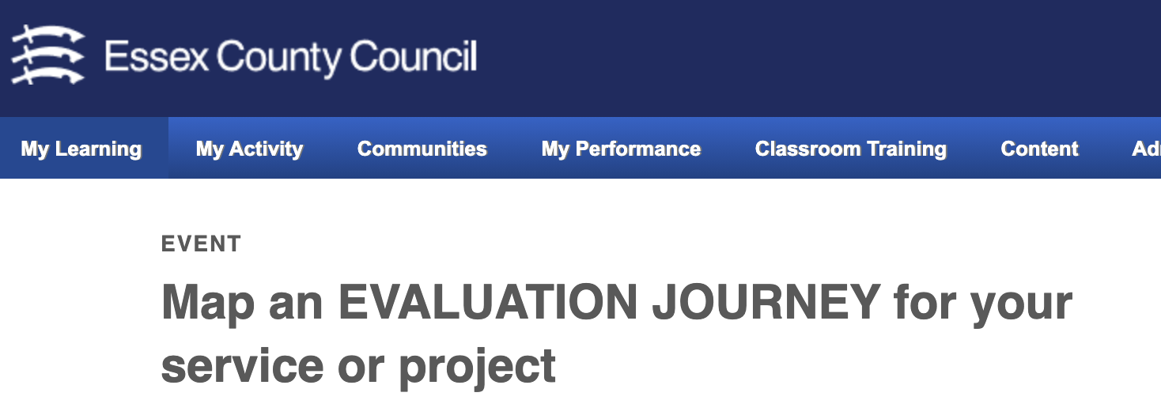
A reflective journey
Test & learn cycles should also be built in – asking after a round of evaluation, do we need to do more work on our project and test things out again? Or, can we move on?
However, the evaluation is design is really up to you. You might not want to do all these things, or you might want to do some of them together. It’s worth considering which things you’d want to do first, which second, and put some time frames to those activities.
This pack is part of a suite of resources intended to help you design your specific projects’ evaluation journey. You might also be interested in the My Learning session hosted by an experienced evaluator. Sign up here or email research@essex.gov.uk.

Slide 10
Different ways to evaluate impact

Slide 11
What do we mean by impact and how can we look at it?
‘Impact’ can mean many different things, but we’re referring to helping people achieve things or helping people in ways that make a positive difference.
One aspect you might want to think about when planning your evaluation, is how you want to look at impact. Roughly speaking, there are two overall different ways of looking at impact:
Exploratory Approach | Group or Population Level Study
The ‘good news’ approach | ‘My users benefit’ approach
The ‘how is this working?’ approach | ‘My service is better than yours’ approach
The ‘strengths and weaknesses’ approach | ‘if you replicate my service, your users will benefit’ approach

Slide 12
Exploratory approaches
The focus is on developing clues and insights into where the project or service might be benefiting users. It relies mostly on perceptions, experiences and stories, and can involve collecting case studies and surveys for example. It does not try to capture a picture that represents all user experiences.
Generally, there are three types:
‘Good news’ approach – gathering only positive stories and data
‘How is this working?’ approach - gather data and insight about who your project is working for, and how and why your project is working
‘Strengths and weaknesses’ approach - balanced exploration of ways in which your project is and is not working, and why this is
Generally, if you are running a small project with short time-scales (under 2 years), an exploratory impact study will work better.

Slide 13
Group or Population Studies
The focus is on trying to draw a conclusion on the overall benefit for users, or to estimate the scale and size of benefit were the project to be offered to a wider population. It involves quantifying people’s experiences and using statistical analysis. Often, there is longer set up time and its more expensive and challenging to do than an exploratory study.
Generally, there are three types:
‘People benefit when they use my service’ approach - show the average benefit to users, with data collected from a random or representative sample
‘My service is better than yours’ approach - as above, with a control or comparison group
‘If you replicate my service, your users will benefit’ approach - like the two above examples, but with statistical analysis applies to the results to estimate what the benefit would be for the wider population of eligible users. Useful for commissioners.
Generally, this approach is better if you are running a medium-large, long-term (2+ years), complex or expensive project, and you want to make claims about the overall benefits of your project.

Slide 14
Several things need to be in place before you can successfully do one of these
You need to be sure that staff are delivering the intervention according to the model
Users need to have the right level of need
There needs to be enough users completing the intervention, and also agreeing to complete your evaluation measures
You may also need to organize a comparison or control group
Staff need to be signed up to making the impact study a success – don’t assume this is the case
You need management and administrative support to make the impact study work
Its worth doing an exploratory study first to see if you find early signs and indicators of impact, before launching into a full-scale impact study

Slide 15
If it’s your ambition to do a group or population level impact study, you should build in time to:
Develop the capability, capacity and conditions for conducting an impact study Do an evaluation which looks at the feasibility of doing an impact study, taking into account all the factors on the previous slide
This therefore means that working evaluatively during the project design, development and implementation phases will likely be needed, to test the feasibility of doing a population or group level impact study...
An example: This evaluation found significant challenges to doing an impact study. There were big variations in the way staff were delivering the model; few users had the level of need that the intervention was designed to meet; few users completed the intervention; there were low consent rates to the evaluation; and staff questioned whether the intervention was really about the improving the key outcomes that the impact study would be focused on.

Slide 16
Other things worth evaluating before looking at impact Design Phase

Slide 17
Evaluation for designing and implementing a project
Effectiveness of projects take time to develop, and all kinds of things needs to be right first, such as venue, staff recruitment and training, and getting the right people engaged in your project.
As such, if you dive into an impact study too soon, your results may be disappointing. Impact studies are often time consuming and can be expensive, so it’s more cost effective to do an impact study after first evaluating whether things are up and running as they should.
If you use evaluation in your project/service design phase, this can improve service implementation and you also stand more chance of delivering and demonstrating impacts.
May be real benefits to doing this especially for medium-large sized projects, longer-term, complex/ambitious, or expensive projects, and any projects still in design phase

Slide 18
Three ways of working evaluatively during project design
Study the problem
Review potential solutions
Clearly define your project, so it can be evaluated

Slide 19
1 & 2: Studying the problem and solutions
Test claims about what actually is a problem and what the most important problems are; look at causes and possible solutions, within the context the problem is occurring; and assess likely take up and engagement with different solutions, and what would improve engagement.
We can do this by bringing together 4 different information sources:
Professional expertise and judgment
Place based evidence from users, residents and professionals
Published research evidence
Organisational data.
It can be difficult to do all of this, but a little is better than nothing. The more you do, the more reliable, valid and relevant the evidence, the better the decisions. In other words, if you invest in service design, you stand to improve your chance of impact.
https://www.youtube.com/watch?v=tSfo2XhEWkE

Slide 20
3: Provide a clear explanation of how your project will solve a particular problem
Develop a logic model, also known as a theory of change
In summary, this sets out what the problem is, what the project/service will do, and what the outcomes of doing this may be
Crucially, a logic model provides the basis for an evaluation and impact study later on
See our ‘logic model/theory of change’ resource packs for information and guidance on how to develop one for your project.

Slide 21
Other things worth evaluating before looking at impact Development & Implementation

Slide 22
Three ways to use evaluation to support project development and implementation
Monitor and improve user awareness, appetite and uptake
Study and develop model implementation
Study and improve user engagement with the model

Slide 23
4. Example evaluation questions
Awareness and referrals:
What is the level of awareness for the service?
How many users are being referred?
What do we need to do to boost uptake or referrals?
Are we getting referrals in equal numbers from across user groups? Or are certain groups under or over represented?
User appetite and need:
Are those referred in willing to give the service a go?
Do users have the level of need that the service is designed for?

Slide 24
Why does assessing user need matter?
Your project may be being funded to meet a particular level of need. If you want to do an impact study, you will want to later demonstrate that your service helps meet a particular need. You won’t be able to demonstrate that if your users don’t have that level of need.
At this stage, you can use needs assessment tools or outcome measures to establish the needs of your actual service users.
Example: service managers assumed that children in care had low resilience and well-being, so life story work would help; however, the study found 2/3rds were resilient and 90% had good wellbeing already!
https://tinyurl.com/FeasibilityStudyLSW

Slide 25
Struggling with take up? Evaluate the world of your users
How do they see the world?
What makes them tick?
What are their priorities and concerns?
What are their daily routines?
How does all of this influence their awareness and how they perceive your project?

Slide 26
5. Evaluating model implementation
This is about asking the question: are we able to provide what we said we would?
Example evaluation questions:
Do we have the full compliment of staff to deliver the project?
Have staff been trained effectively?
Do staff have time, materials & other resources they need to deliver the project?
Are staff motivated to deliver the project activities?
Are staff delivering the core elements and activities of the project to the standard required? Are they delivering these in the right amount?

Slide 27
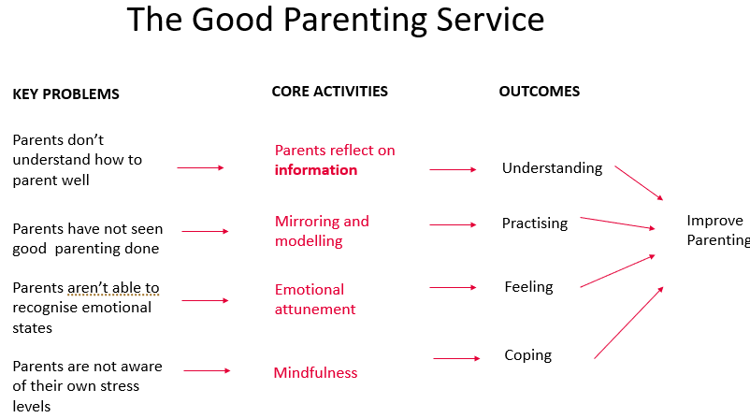
An example
Are they helping parents reflect on information about good parenting?
Are they mirroring and modelling in the parents’ home?
Are they coaching parents to recognize emotions in themselves and others?
And are they helping parents to monitor, be aware of and respond to their stress levels?

Slide 28
6. Evaluating user engagement
If the project is being delivered as intended, and the right type of people with the right level of need have been brought into it, then it's time to look at whether users are fully engaged with all project aspects. z
Example evaluation questions:
Are users completing the intervention in full? Are they engaging with all elements of it?
What is the minimum level of engagement a user would need to have, to get a benefit? How many users are engaging in this way?
Are some groups engaging more with the intervention than others? What helps explain this?
Are there any indicators that full engagement is leading to improved outcomes?

Slide 29
Here is a study which sought to look at user engagement
The service was designed to encourage children to come out of exploitative relationships.
But the study found children didn’t want to talk about exploitation for various reasons and would disengage.
So, the service approach was changed so that practitioners were encouraged to support children with the things that mattered to them.
https://tinyurl.com/nspcsereport

Slide 30
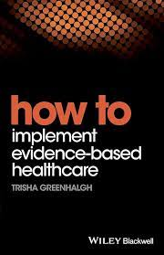
Using evaluation to improve the chances of scaling up a project or adopting it into BAU
Sometimes it’s thought that demonstrating impact will lead to further adoption or scale up of the project. However, research says that commissioners will also want to know about a whole range of other things too, for example:
Costs
Staff skills and capacity
Administrative and management support
Resources including materials required
Risks and side effects
Whether users enjoy and engage with it
Whether staff support it and deliver it well

Slide 31
Working evaluatively in project design, development & implementation can therefore help this!
In the service design stage, consult with potential commissioners, find out what would be feasible, and what they’d want to know about it, and design and test that.
Use the service development & implementation stage to develop insights into the issues that concern commissioners, as well as what impacts the service is having.
Keep asking, based on what we know, does adoption still look feasible and desirable, or would we need to change the model?
An example: The NSPCC wanted to develop and test a service to deliver life story work to children, demonstrate impact to then have local authorities (LAs) deliver it. The study found LAs didn’t need impact to be sold on it, just the money or capacity to deliver it. LAs suggested instead working with NSPCC to integrate the skills and techniques into everyday case-loads of social workers.

Slide 32
Want more help?

Slide 33
Research Advice Drop-in
Every Tuesday, 10-11 am, on Teams Contact research@essex.gov.uk

Slide 34
This information is issued by: Research & Citizen Insight, Essex County Council
Contact us: research@essex.gov.uk
Policy Unit Essex County Council County Hall, Harlow Essex, CM1 1QH
Essex_CC
facebook.com/essexcountycouncil
The information contained in this document can be translated, and/or made available in alternative formats, on request.
Published March 2024

