Slide 1
How to make a Logic Model/Theory of Change
Workshop Slide Deck Research & Citizen Insight

Slide 2
Who is this for?
Anyone who wants to do a logic model/theory of change.
You can use these slides to create one.
ECC R&CI offer workshops for staff who want to develop one. Email mike.williams@essex.gov.uk for more info.
You might want to read through the slide pack ‘What is a logic model/theory of change’ before working through these slides.

Slide 3
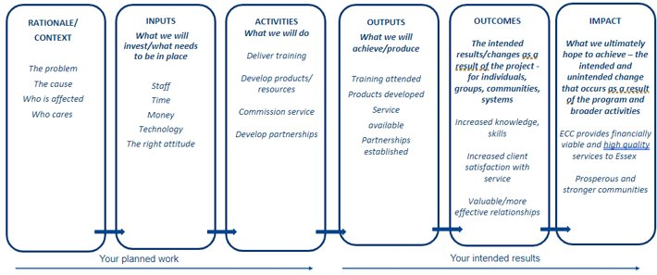

Slide 4
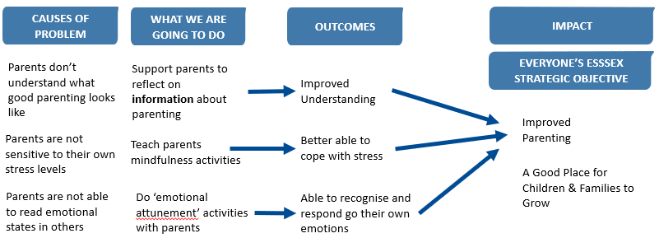
An Example – The Parenting Service
Keep it short and sweet! Use arrows to make clear links between the activities, outputs and outcomes, and think about how they all connect.​

Slide 5
Why are we providing ‘The Good Parenting Service’ and why do we think it will make a difference to parents?
Essex County Council are committed to making Essex a good place for children and families to grow up.
Sadly some parents find it hard to respond calmly to their children, when their children get upset, tired and angry. This is because they didn’t see parenting done well when they were young and don’t really understand what it looks like. Its also because they are unable to read emotional states in others and are not very sensitive to their own stress levels.
In Essex we’re committed to supporting parents, children and families, so our service works with parents to do three things.
First, we talk to parents about how to respond to children when the child is upset, and we spend time with them with their children, so we can model the behaviour.
Second we encourage parents to do mindfulness exercises, where they practice recognizing and talking about their stress levels, and start to think through what they can do when they are feeling stressed.
Third we work with parents to start to think about the different emotional states that their children can experience, and how this impacts on their child’s behaviour. We then encourage parents to explore how they can respond to their children when their child might be upset or tired.
We think that doing these activities will allow parents to have more empathy and sympathy for their children, when they are upset.
It will also give them techniques and tools for both understanding what is happening and what they can do to lower their own stress levels and support their children when the child is stressed.
In this way we think that our service contributed to Essex County Council’s goal of making Essex a good place for children and families to grow up.

Slide 6
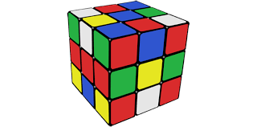
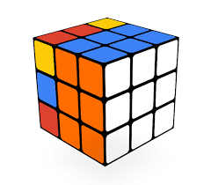
What is it like creating one?
Changes to thinking in one area can impact on others
The process can feel a bit messy, it can unearth differences of opinion
By the end we should feel happier with our thinking, plans and service

Slide 7
Seven steps in the creation of one
Describe what your project will do and how it will make a difference. Firm up your outcomes, make them precise, concrete and measurable. Select your priority outcomes. Explain why residents are sometimes unable to achieve the outcomes.
Explain how the support, activities and resources you will offer, will help residents achieve the outcomes. Put your logic model/theory of change together.
Then put your theory to the test.

Slide 8
Step 1
Describe what your project will do and how it will make a difference to people

Slide 9
Exercise: Separate out what you do from the difference you will make
On post it notes write down all the things your project does and all the differences your project will make to people’s lives.
For each difference describe a before state and an after state.
Then group the notes into things the project does, and the difference made to people’s lives.
Do you have any notes, which try to do both? Separate the project activity from the difference made on to two separate notes.
Think about who your project will work for, and who it won’t - who the population is that is affected by the challenge that you are targeting

Slide 10
Exercise: On each post it note, write down what your project will do and what types of change it intends to make to people’s lives.

Slide 11
Now sort out each post it note, into: 1) Things the project staff will provide or offer or do. 2) Objectives about reaching or engaging residents. 3) Outcomes or impact, which relate to the change you will make to residents’ lives.

Slide 12
Things your project is doing
Reach and Engagement
Outcomes or Impact

Slide 13
Step 2
Firm up your outcomes: make them precise, concrete and measurable

Slide 14
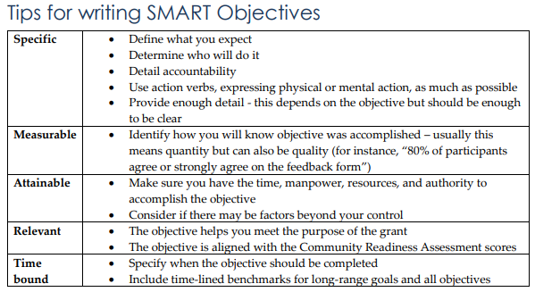
Make your outcomes precise, concrete and measurable
Parents, who shouted at their child, when their child had a tantrum, before the intervention, speak calmly to their child in response to a tantrum after the intervention.
A child who does not talk at all before the programme, is able to speak at a level that is considered appropriate for his or her age, by the end of the programme.
A child, who is obese, and who does less than 30 minutes of physical activity, before the sports initiative, does 30 minutes of physical activity every week, for the six months after the initiative.

Slide 15
Exercise For each outcome, create a new slide. On the left hand side see if you can redefine the outcome so it is precise, concrete and measurable.

Slide 16
Outcome expressed in a precise, concrete and measurable way
Outcome

Slide 17
Step 3
If you’ve identified more than 5 outcomes, prioritize

Slide 18
Exercise: List all your outcomes. Is it a must have or nice to have?
Must have
Must have
Nice to have
Nice to have
Must have
Must have
Nice to have
Nice to have
Must have
Must have
Nice to have
Nice to have

Slide 19
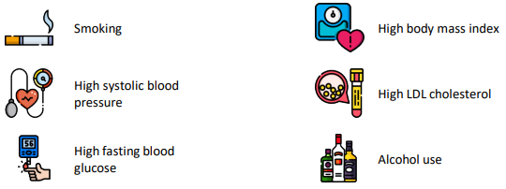
Link your outcomes to public health priorities
Copy the slide above Now for each outcome, indicate which of the ECC Public Health priorities, your outcome supports.
You can find the new Essex Wellbeing, Public Health and Communities Plan here

Slide 20
Prioritization
Focus your logic model/theory of change around the most important outcomes.
Select those outcomes, which are must haves and which clearly support the ECC Public Health priorities.
All PHAB funded projects must meet at least one of the priorities. Applications will be assessed on the outcomes the project will achieve rather than the number of priority areas they are working towards.

Slide 21
Step 4
Taking your most important outcomes, explain why residents are sometimes not able to achieve these outcomes

Slide 22
Start off by identifying why you think residents are not ordinarily able to achieve the outcomes

Slide 23
An Example – The Parenting Service
Keep it short and sweet! Use arrows to make clear links between the activities, outputs and outcomes, and think about how they all connect.​

Slide 24
Think about what stops residents from achieving the outcomes
Consider
Capabilities – what things do residents need to understand or be able to do.
Opportunities – what does the Council or state need to do to enable and empower residents to achieve the outcome.
Motivation – could it be that residents lack the desire to do the things that would help them achieve the outcomes.
For each outcome.
Consider why it is that residents or users are unable to achieve the outcomes.

Slide 25
Exercise: For each outcome, create a new slide. And on the left hand side identify all the reasons for why residents cannot achieve the outcome.
Desired outcome.
Capabilities: lack skills, know-how or understanding
Capabilities: lack skills, know-how or understanding
Capabilities: lack skills, know-how or understanding
Motivation: lack aspiration or vision
Motivation: lack aspiration or vision
Motivation: lack aspiration or vision
Opportunities: lack services, equipment or facilities
Opportunities: lack services, equipment or facilities
Opportunities: lack services, equipment or facilities

Slide 26
Step 5
Examine and explain how the support, activities and resources you will offer, will help residents overcome the things that sometimes stop them from achieving the outcome

Slide 27
An Example – The Parenting Service
Keep it short and sweet! Use arrows to make clear links between the activities, outputs and outcomes, and think about how they all connect.​

Slide 28
Exercise For each outcome, create a new slide. Put the outcome on the right hand side. Put the reasons for why residents sometimes find it difficult to achieve the outcome on the left. Then in the middle list the activities that will help residents overcome those reasons. Provide an explanation of how the activity will do this and any evidence you have that supports this idea.

Slide 29
CAUSES OF PROBLEM
ACTIVITIES, SUPPORT AND RESOURCES
OUTCOME
What is your activity, resource or form of support and how will it help residents to overcome the reasons for why they cannot achieve the outcomes
Capabilities: lack skills, know-how or understanding
Activity, resource or support
Motivation: lack aspiration or vision
Provide an explanation of how the activity, resource or support, will it enable the resident to overcome the reasons for why they ordinarily do not achieve the outcome.
Outcome
Opportunities: lack services, equipment or facilities

Slide 30
Step 6
Put your logic model / theory of change together!

Slide 31
You now have all the ingredients!
Outcomes
Activities
Explanation for why activities help achieve the outcomes
The first thing you can do is create a diagram

Slide 32
An Example – The Parenting Service
Keep it short and sweet! Use arrows to make clear links between the activities, outputs and outcomes, and think about how they all connect.​

Slide 33
And the second thing is create a one page story, explaining the theory

Slide 34
How to structure your story
Start by identifying the PHAB priority area that your service is contributing to.
Then explain why some residents are not able to achieve the outcomes that your service is supporting them to achieve.
Provide a brief summary of why residents, sometimes, are not able to achieve these outcomes.
Then explain the key activities and resources that your service offers to help residents overcome the challenges.
Explain that you think that doing these activities will help residents achieve a variety of outcomes.
And then link these outcomes to one or several of Essex County Council’s priority areas.
Keep it short and sweet!

Slide 35
Why are we providing ‘The Good Parenting Service’ and why do we think it will make a difference to parents?
Essex County Council are committed to making Essex a good place for children and families to grow up.
Sadly some parents find it hard to respond calmly to their children, when their children get upset, tired and angry. This is because they didn’t see parenting done well when they were young and don’t really understand what it looks like. Its also because they are unable to read emotional states in others and are not very sensitive to their own stress levels.
In Essex we’re committed to supporting parents, children and families, so our service works with parents to do three things.
First, we talk to parents about how to respond to children when the child is upset, and we spend time with them with their children, so we can model the behaviour.
Second we encourage parents to do mindfulness exercises, where they practice recognizing and talking about their stress levels, and start to think through what they can do when they are feeling stressed.
Third we work with parents to start to think about the different emotional states that their children can experience, and how this impacts on their child’s behaviour. We then encourage parents to explore how they can respond to their children when their child might be upset or tired.
We think that doing these activities will allow parents to have more empathy and sympathy for their children, when they are upset.
It will also give them techniques and tools for both understanding what is happening and what they can do to lower their own stress levels and support their children when the child is stressed.
In this way we think that our service contributed to Essex County Council’s goal of making Essex a good place for children and families to grow up.

Slide 36
Step 7
Put your theory to the test!

Slide 37
A strong theory is one which has been tested This means looking for evidence that contradicts your theory and assumptions

Slide 38
Five ways you can test your theory
Ask professionals working in the field to critically assess the theory.
Ask residents who your project is for to critically assess your theory.
Commission a review of the research evidence.
Ask someone to look at organizational data, which might challenge certain aspects of your theory.
If you are already delivering your service, do some small-scale research to critically assess your theory.
Write it down on one page

Slide 39
If you find evidence that contradicts your theory and the assumptions in it, you will need to rethink your theory and your project’s activities and support

Slide 40
Also, ask ‘will this work for everyone?’ Think about which groups of people your activities will work for, and which they won’t Will you need to do things differently for particular groups?

Slide 41
Want more help?

Slide 42
Research Advice Drop-in
Every Tuesday, 10-11 am, on Teams Contact research@essex.gov.uk

Slide 43
This information is issued by: Research & Citizen Insight, Essex County Council
Contact us: research@essex.gov.uk
Policy Unit Essex County Council County Hall, Harlow Essex, CM1 1QH
Essex_CC
facebook.com/essexcountycouncil
The information contained in this document can be translated, and/or made available in alternative formats, on request.
Published March 2024

