Slide 1
Understanding Gender in Essex
Analysis of data from Census 2021
September 2023

Slide 2
Introduction
This document presents an analysis of the trans population in Essex, based on data collected through Census 2021. It has been prepared as part of a series of analyses exploring the scale, distribution and characteristics of populations with ‘protected characteristics’ as defined by the Equality Act (2010).
The document is divided into three sections:
Section 1: considers the number of people across Essex, and Essex districts who are identified as trans in the most recent Census data. These are people who, at the time of Census 2021, report their gender identity as different to the gender assigned at birth
Section 2: examines the characteristics of the trans population, focusing on the extent to which the wider range of protected characteristics can be found within members of the trans population;
Section 3: examines the outcomes enjoyed by members of the trans population, focusing on employment outcomes, employment type, health outcomes, the likelihood of providing unpaid care, qualification levels and access to cars/vans.
This is part of a suite of similar analyses examining the protected characteristics defined by the equalities act. Similar analyses, and a series of interactive dashboards, exploring issues of ethnicity, age, sex, sexuality, disability, and gender identity can be found at data.essex.gov.uk.
ECC’s Research and Citizen Insight Team is leading the county council’s work to prepare examine and understand Census data. If you would like to ask questions, find out more, or get involved in this work please contact Alastair Gordon (Alastair.Gordon@essex.gov.uk) or Sean Maguire (Sean.Maguire@essex.gov.uk).
Research & Citizen Insight | Policy Unit | Essex County Council
2

Slide 3
Section 1: The trans population
Understanding the scale and distribution of Essex’s trans population

Slide 4
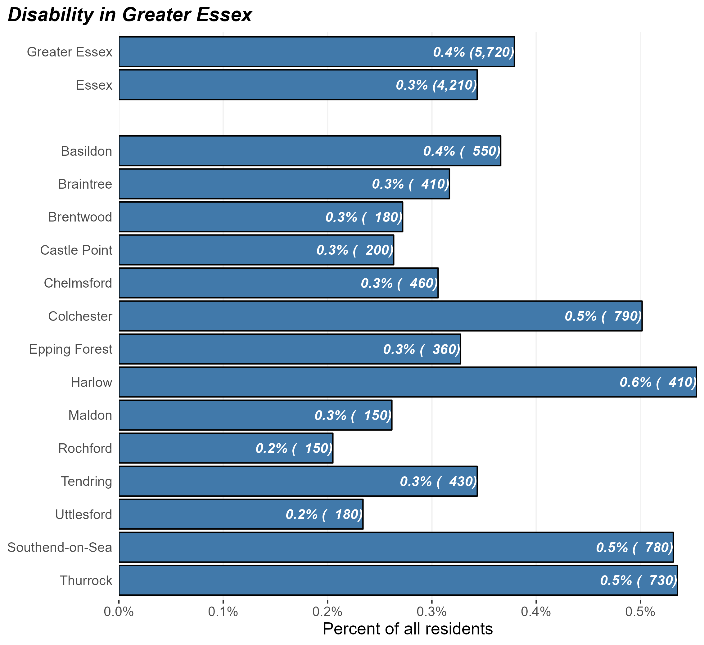
The trans population
Number and percentage of residents identifying as trans in Greater Essex and Essex Districts, Census 2021
The census 2021 question on gender identity was voluntary and asked those aged 16 years and over “ Is the gender you identify with the same as your sex registered at birth?”. The responses showed that:
At the time of Census 2021, there were some 4,210 trans people in Essex and 5,720 in Greater Essex (including the areas of Southend and Thurrock).
This equates to 0.3% of Essex residents (0.4% for Greater Essex) – broadly in line with the average of England as a whole (0.5%).
But the prevalence of disability within the population varies substantially across different districts. Harlow, Southend, and Thurrock have the highest levels of trans residents
Research & Citizen Insight | Policy Unit | Essex County Council
4

Slide 5
Section 2: Characteristics of the trans population
Exploring the prevalence of other protected characteristics within Essex’s trans population

Slide 6
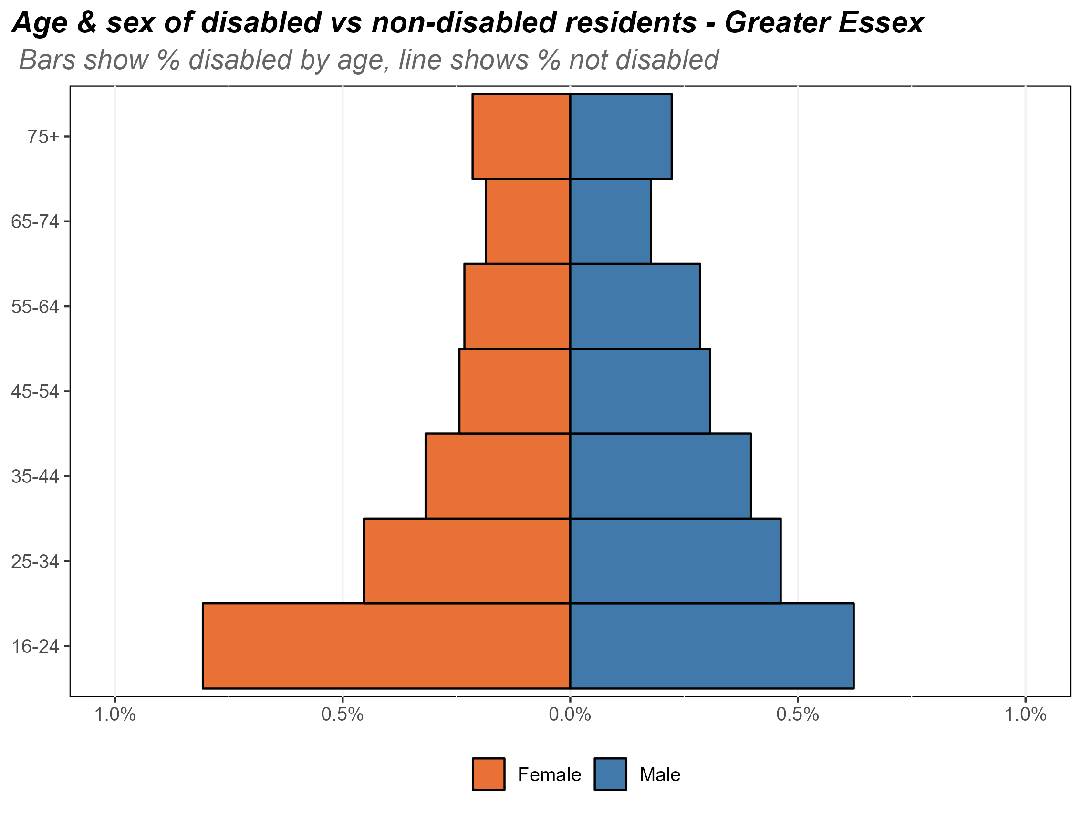
Age and sex of the disabled population
Composition of the trans population by age and sex, Essex, 2021
The chart opposite shows the composition of Essex’s trans population by age and by sex.
Trans residents make up a relatively small proportion of Essex’s population. in total 0.3% of Essex residents identify with a gender different to the one assigned at birth.
There is an almost even split of sex in the trans population, with the exception of the youngest 16-24 age group, where there is slightly more females who identify as trans compared to males. The census data does not make it possible to break down if these are people who were assigned female sex at birth and now identify as another gender, or if these are trans people who now identify as female
Research & Citizen Insight | Policy Unit | Essex County Council
6

Slide 7
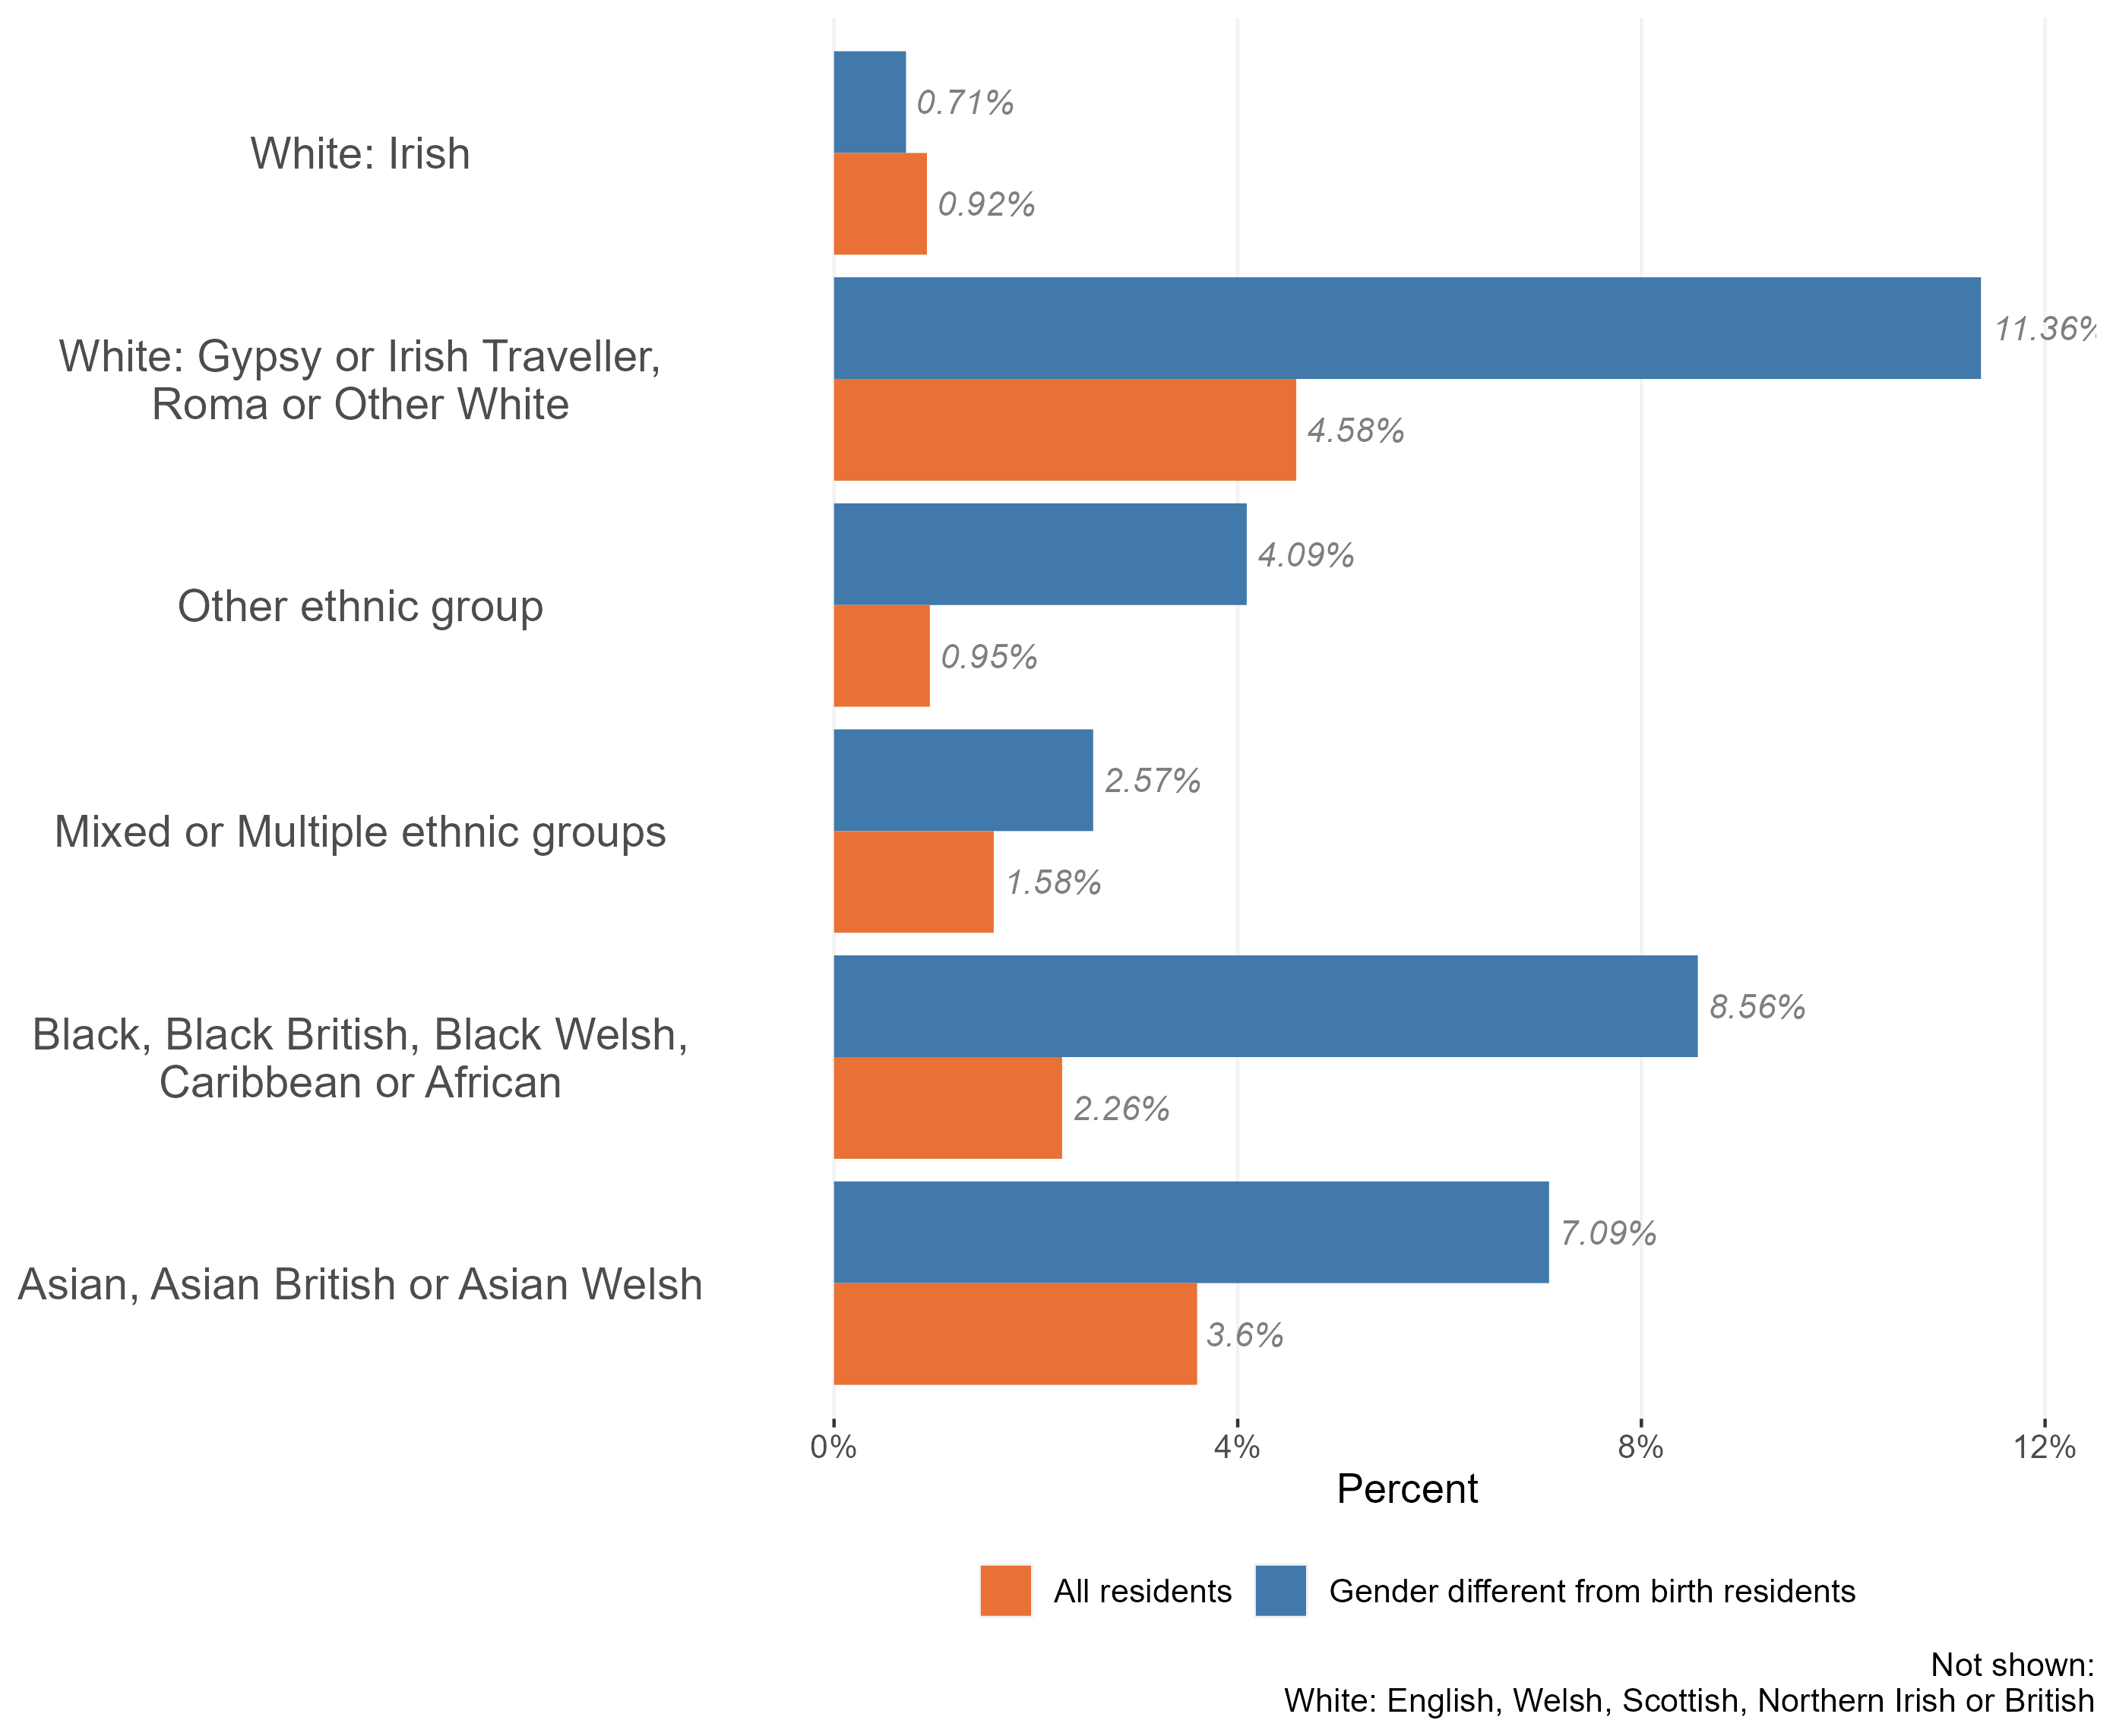
Ethnic diversity in the trans population
Composition of the trans and nontrans populations by ethnic group Essex, 2021
The vast majority of Essex’s trans population identify as White British (65.6% - or 2,760 for the 4,210 trans population).
1,450 identify as ethnic minorities* (34.6% - compared to 16.7% across the population as a whole).
In particular, the analysis reveals that members of the Essex Trans population are more than twice as likely as the wider population to identify as:
Gypsy or Irish Traveller, Roma or Other white;
Black, Black British, Caribbean or African;
Asian or Asian British;
Other ethnic group
* Defined as any ethnicity other than white British
Research & Citizen Insight | Policy Unit | Essex County Council
7

Slide 8
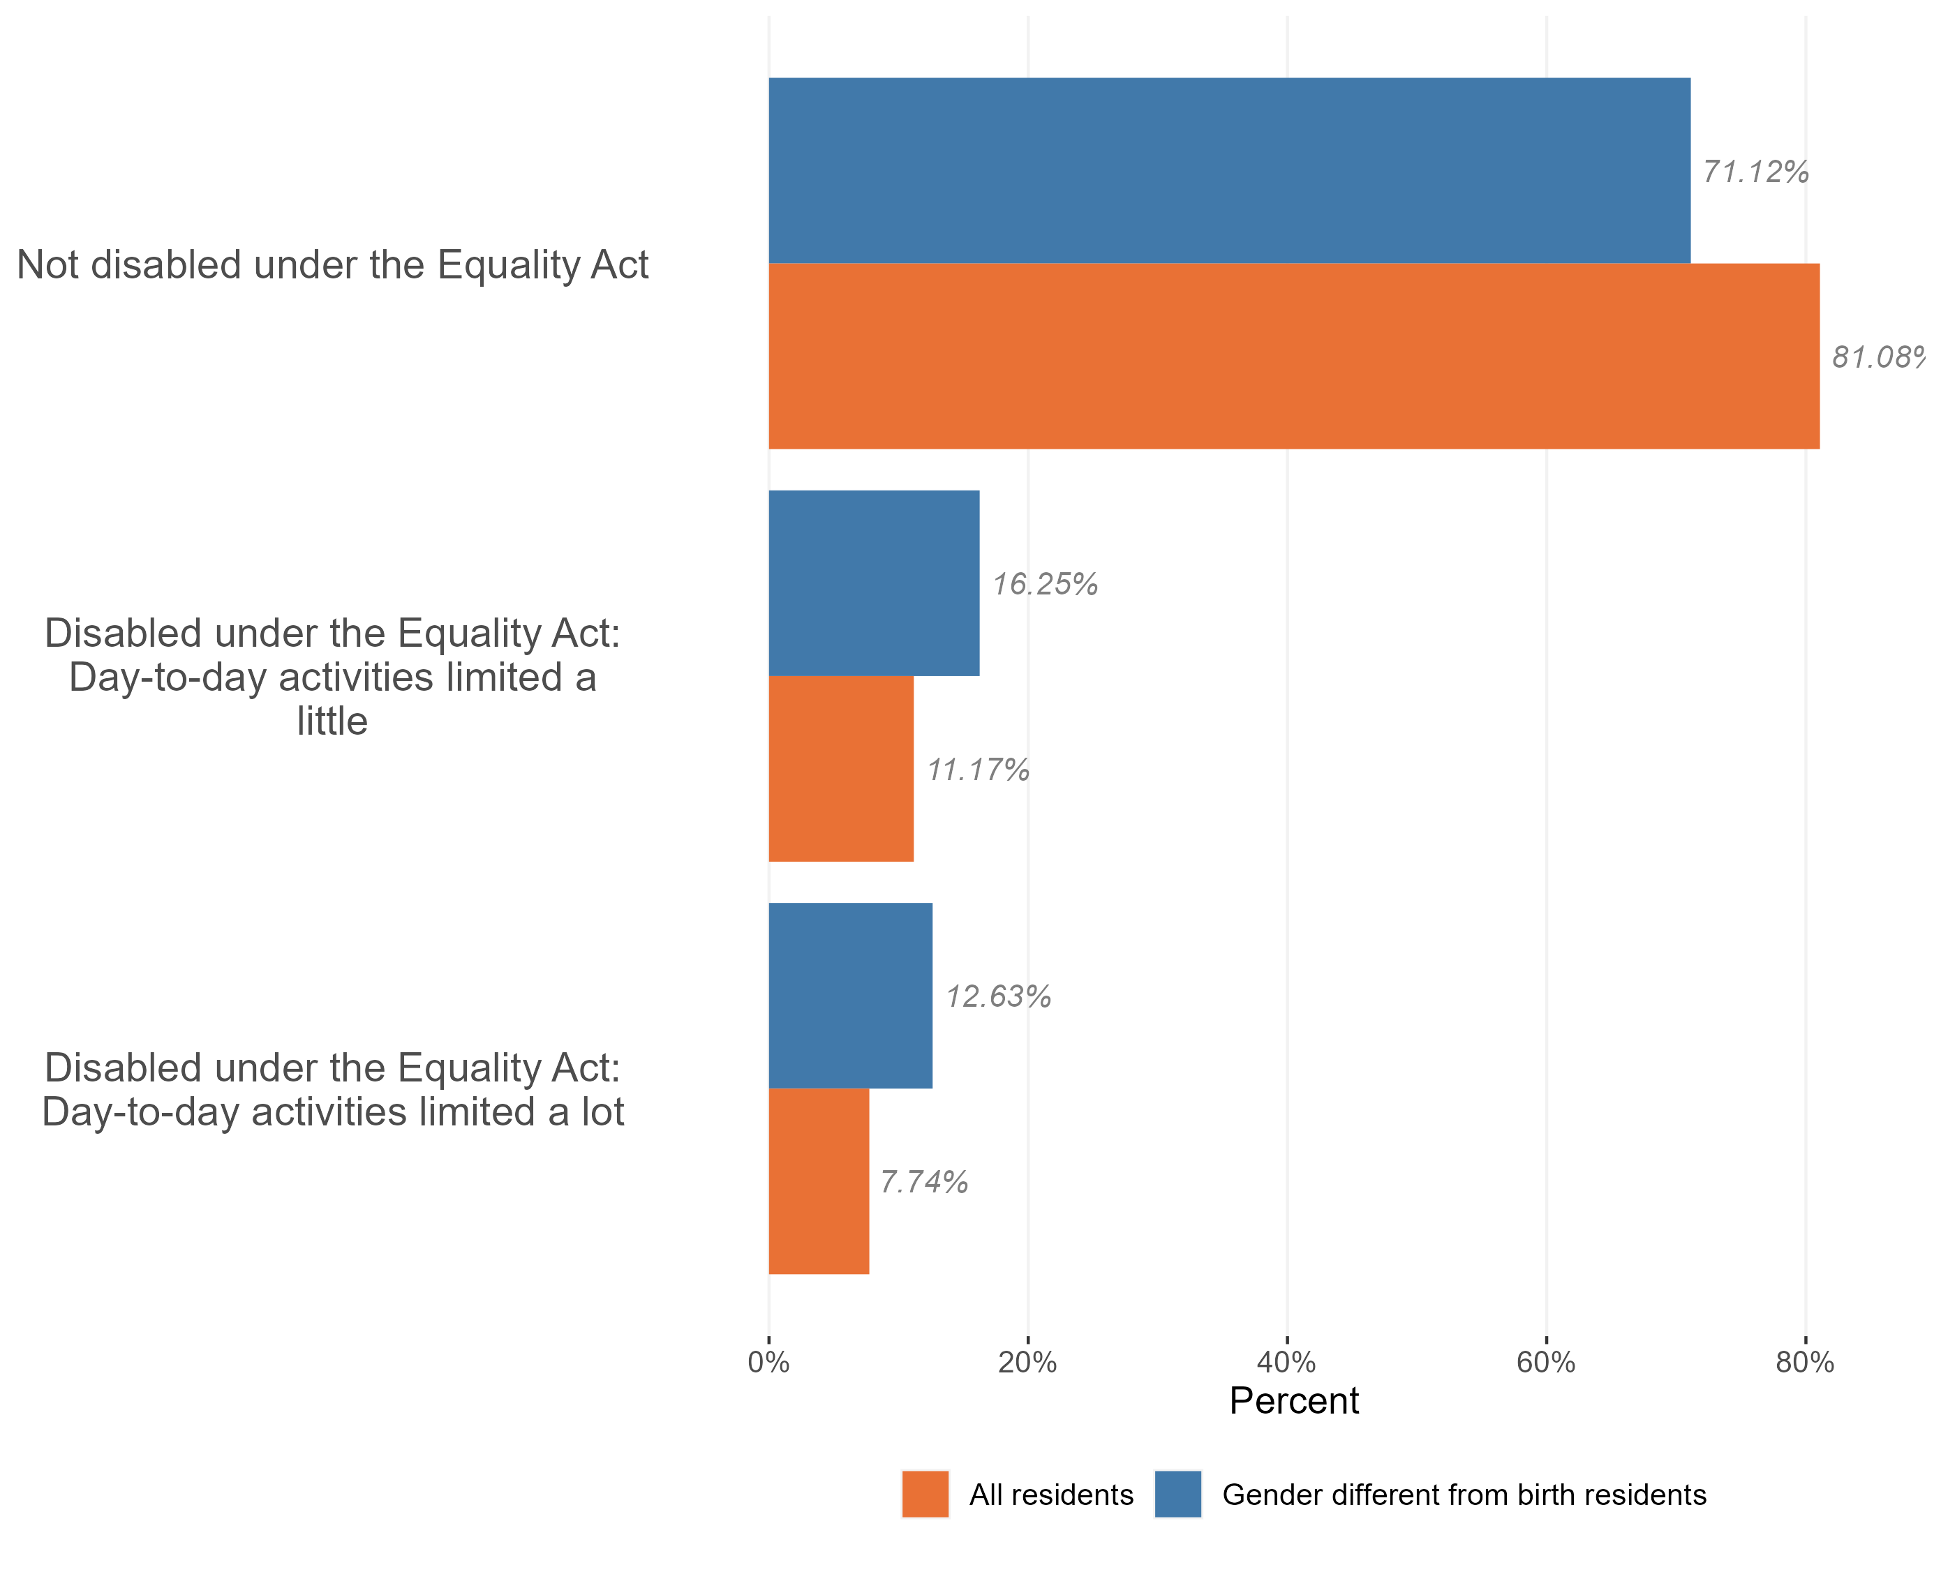
Disability in the trans population
Composition of the trans and nontrans populations by disability, Essex, 2021
The vast majority of Essex’s trans residents are not disabled under the equality act (71.1% - or 2,990 for the 4,210 trans population).
1,220 are disabled with their day-to-day activities limited in some way due to their disability (28.9% - compared to 18.9% across the population as a whole).
Essex’s trans residents are more likely to have their day-to-day activities limited a little due to their disability (16.3% of trans residents compared to 11.2% of all Essex residents). This gap increases for people who have their day-to-day activities limited a lot – 12.6% of trans residents compared to 7.7% of all residents.
Research & Citizen Insight | Policy Unit | Essex County Council
8

Slide 9
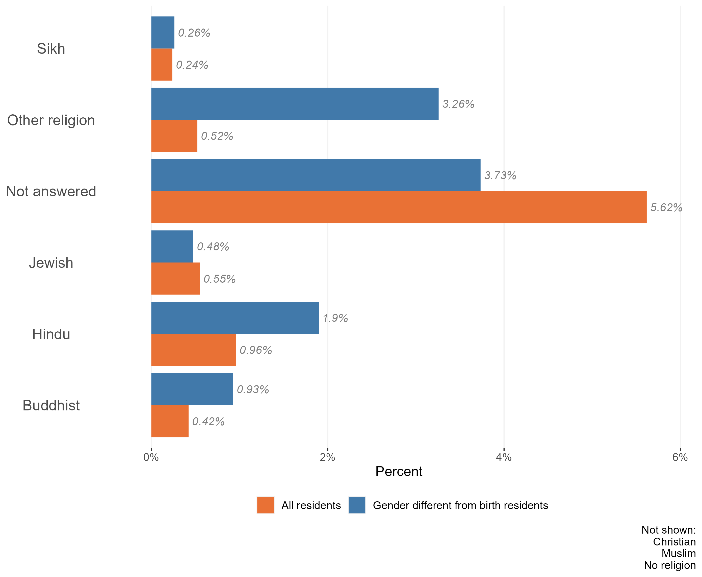
Religion in the trans population
Composition of the trans and non-trans populations by religion, Essex, 2021
The vast majority of the Essex trans population identify either as having ‘no religion’ (42.1%), followed by Christian (42.1%) and Muslim (5.3%). This is a slightly higher proportion of trans people with no religion, and a lower proportion of trans people who are Christian compared to the general Essex population.
Also, amongst the Essex trans population:
a higher percentage of residents identified as following ‘other ’, Hindu, and Buddhist religions compared with the Essex population as a whole
a similar composition of those following Sikh religion
a marginally lower percentage of residents identified as Jewish compared with the Essex population as a whole
More likely to state their religion compared with the Essex population as a whole
Research & Citizen Insight | Policy Unit | Essex County Council
9

Slide 10
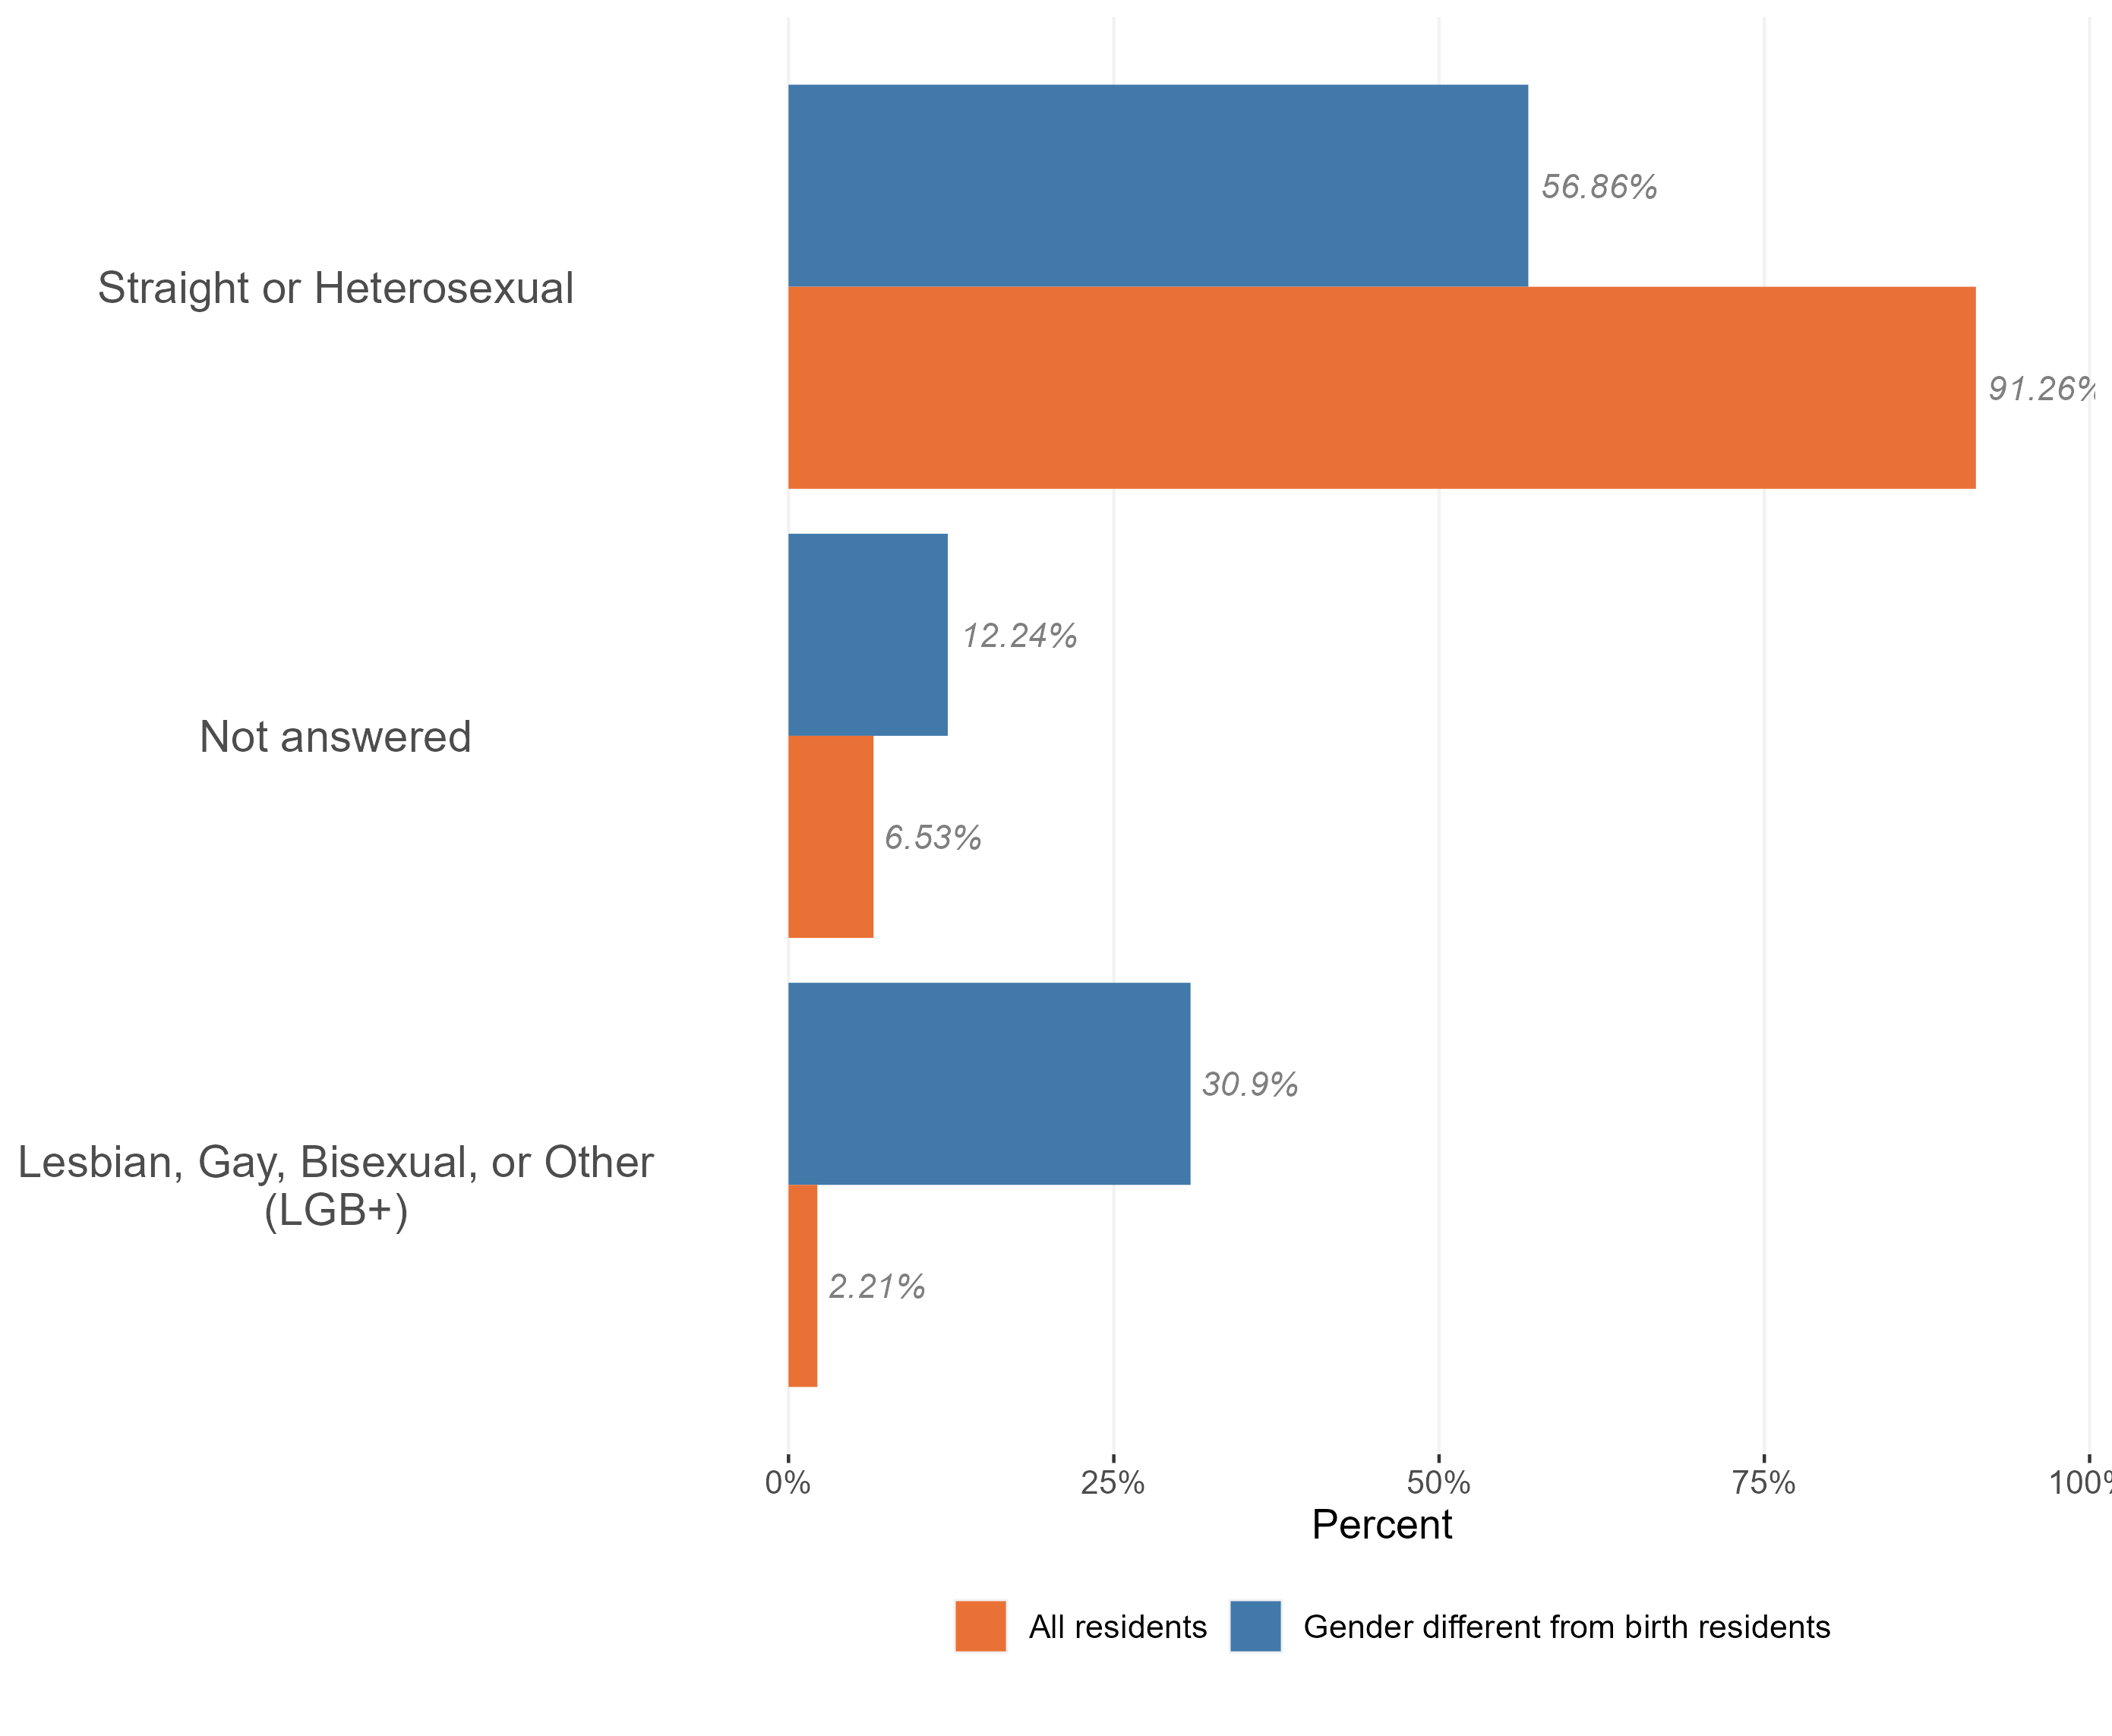
Sexuality and the trans population
Composition of the trans and non-trans populations by sexuality, Essex, 2021
The majority of the Essex trans population identify as ‘straight or heterosexual’ (56.9%). This is much lower than across the Essex population as a whole (91%).
Members of the Essex trans community are more likely to identify as gay or lesbian, bisexual, or ‘other sexual orientations’ than the Essex population as a whole.
Members of the Essex disabled population were also less likely to provide an answer to questions about their sexuality in census 2021 than the population as a whole. It is worth noting that 2021 was the first census which collected data on sexuality. Compared to other questions on the census, this topic has a relatively high proportion of ‘not answered’ responses – where the person has not provided any information on the topic.
Due to the sensitive nature of the topic, this ‘missing data’ will not be missing at random. Certain groups of the population, or people living in certain situations, may feel unable or unwilling to answer these questions.
Research & Citizen Insight | Policy Unit | Essex County Council
10

Slide 11
Section 3: Outcomes for the trans population
Exploring the extent to which the trans population enjoy positive outcomes

Slide 12
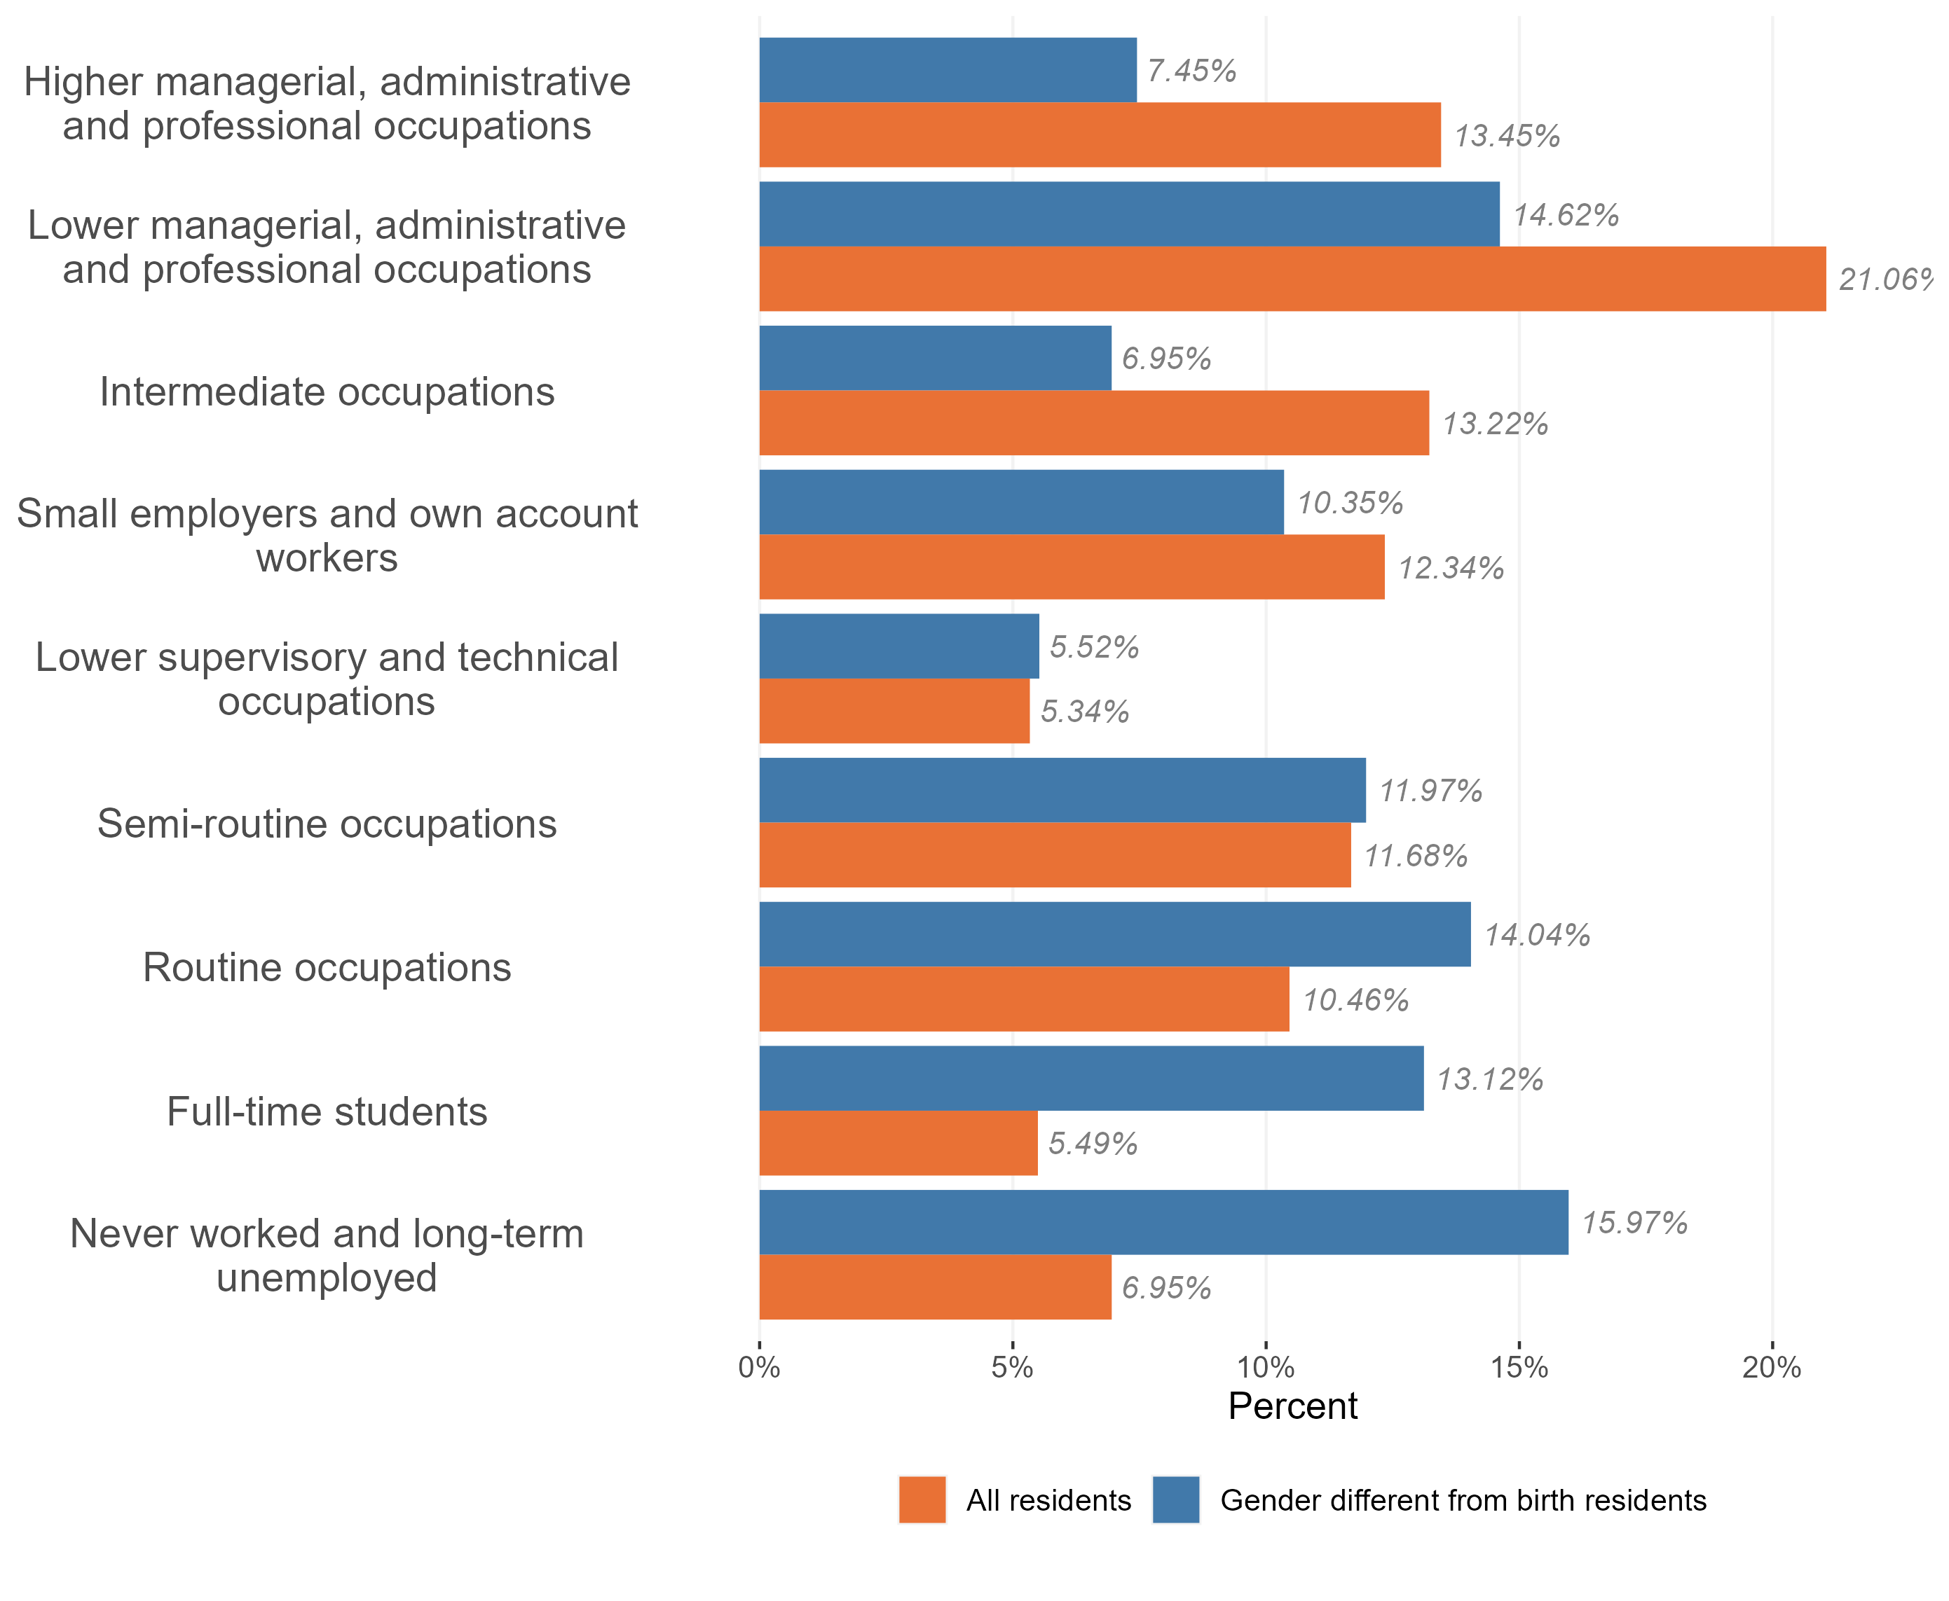
Employment and occupation type
Employment and occupation type, trans and non-trans population, Essex 2021
Compared to working-age residents, trans people in Essex are significantly more likely to have never worked or to be long-term unemployed, as well as being full-time students.
Of the trans residents who are in work, they are :
less likely to hold Higher managerial occupations, administrative and professional roles than the wider working population; and
more likely to be in ‘routine and semi-routine occupations’
Research & Citizen Insight | Policy Unit | Essex County Council
12

Slide 13
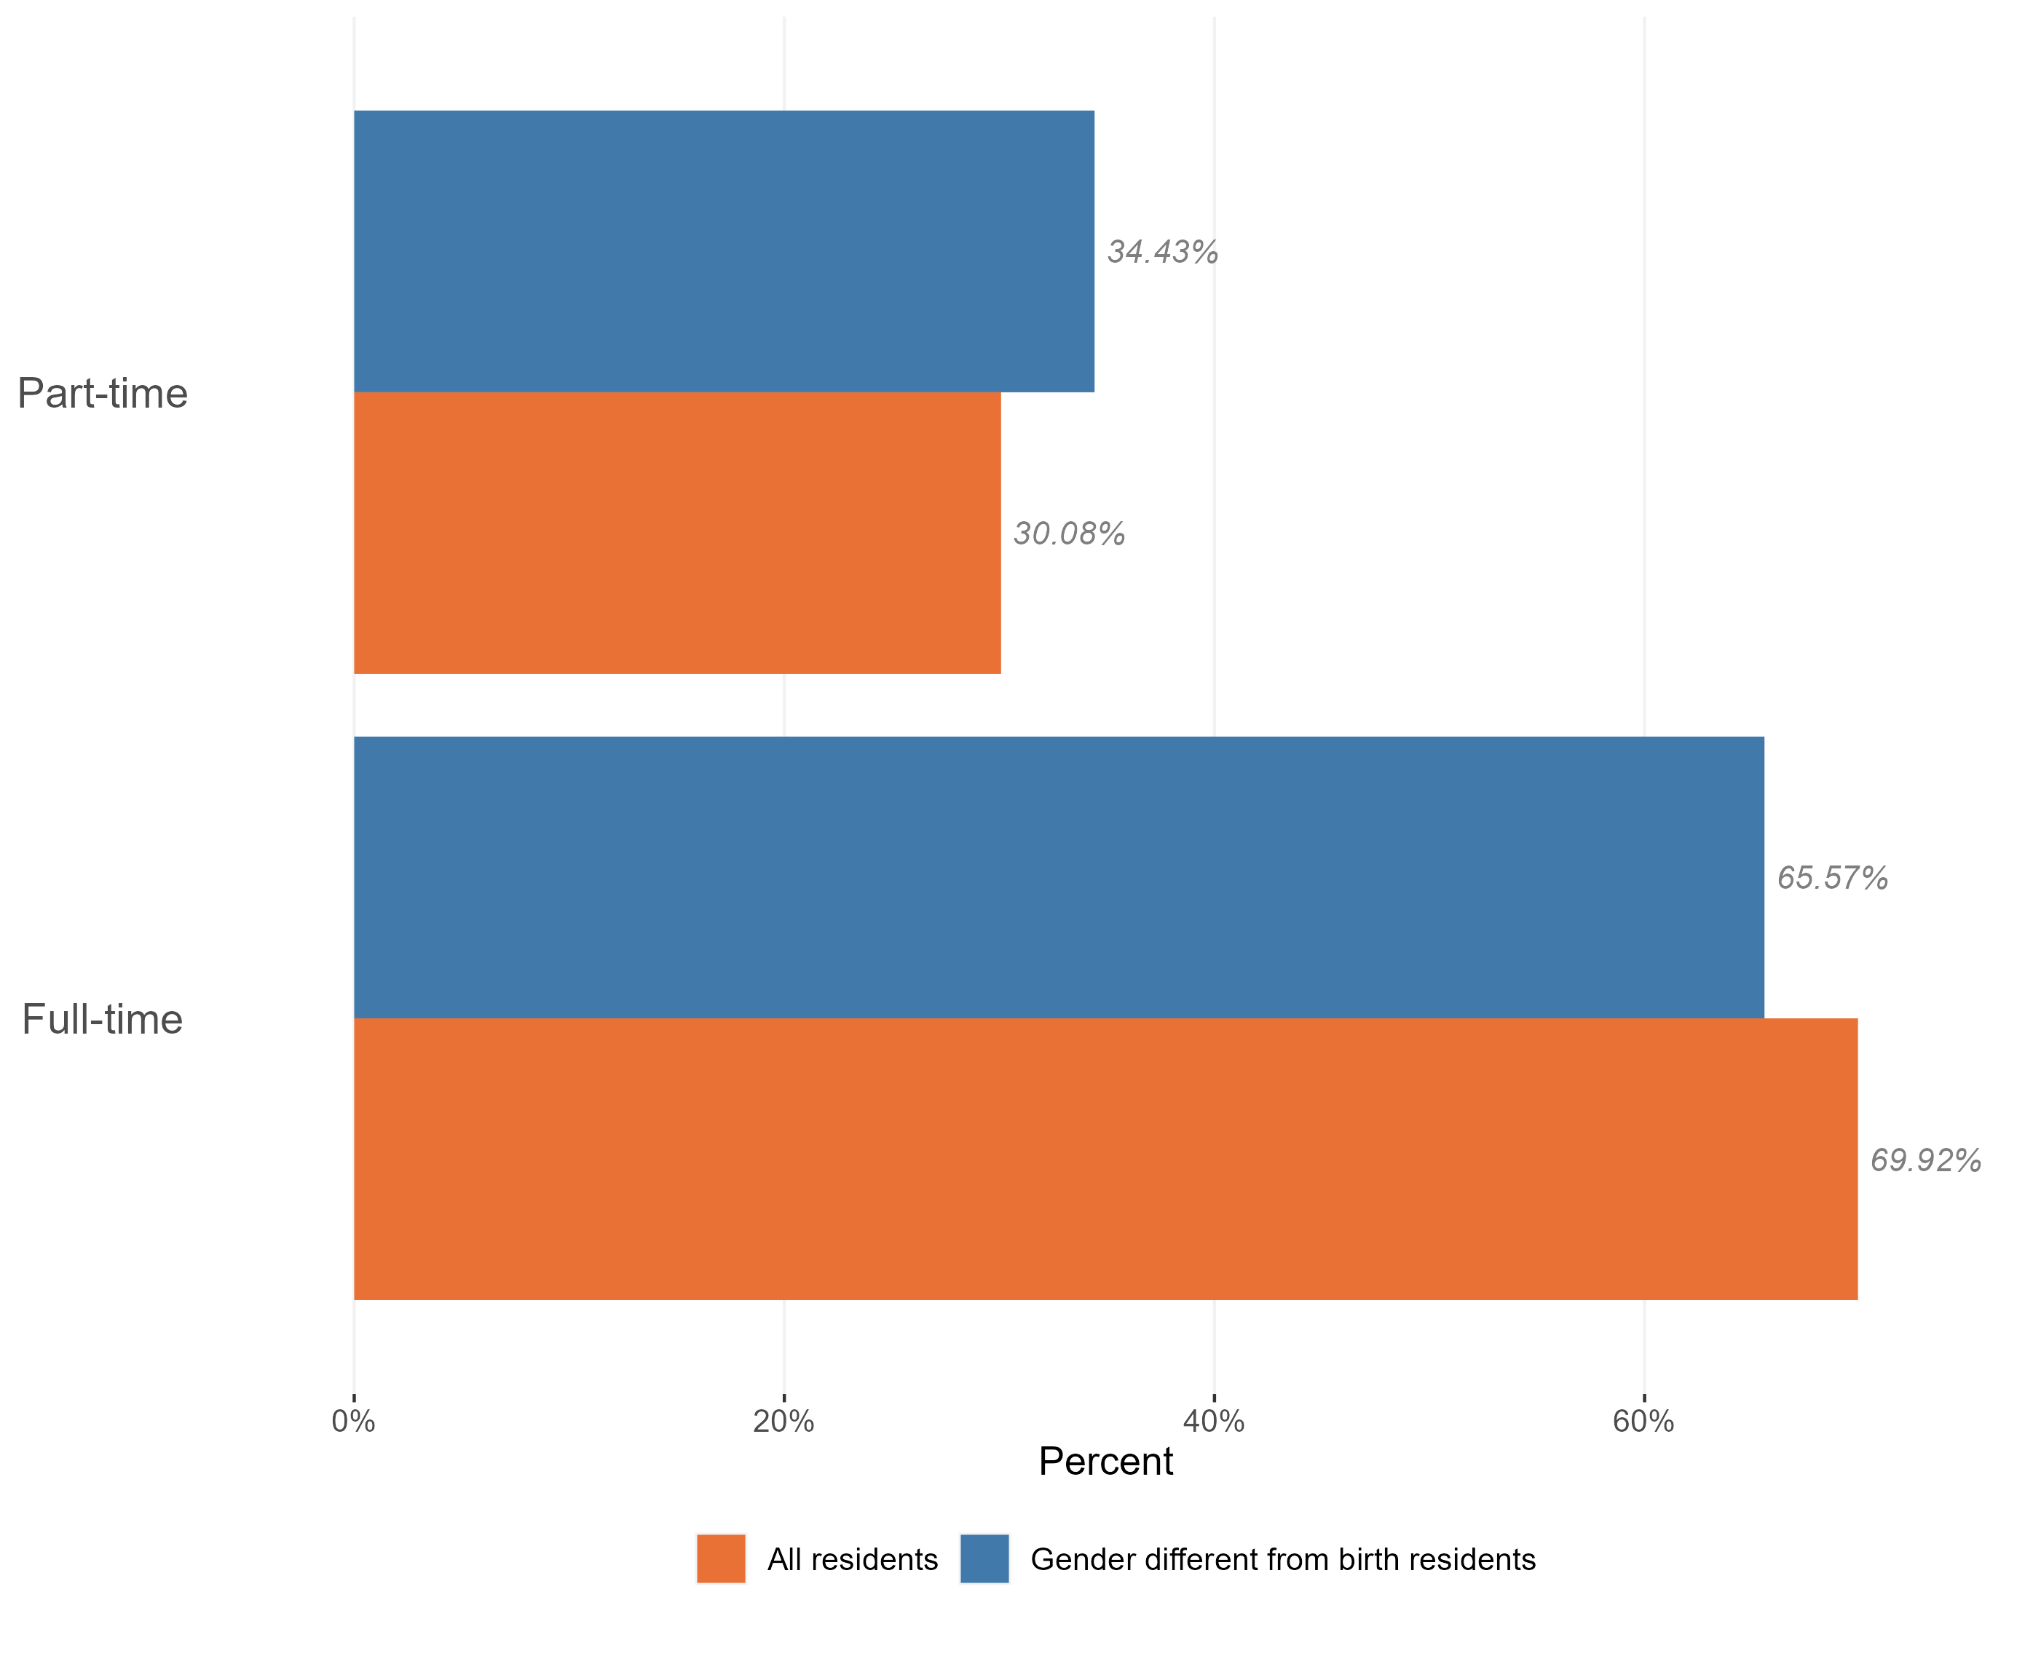
Employment and hours worked
Hours worked by gender status, Essex, 2021
Trans people in Essex are less likely to be in work than the working-age population as a whole. Those who do work are more likely to work part-time than members of the wider population.
*Within Census data full time roles are classified as 31+ hours per week and part-time roles are classed as 30 hrs or less per week.
Research & Citizen Insight | Policy Unit | Essex County Council
13

Slide 14
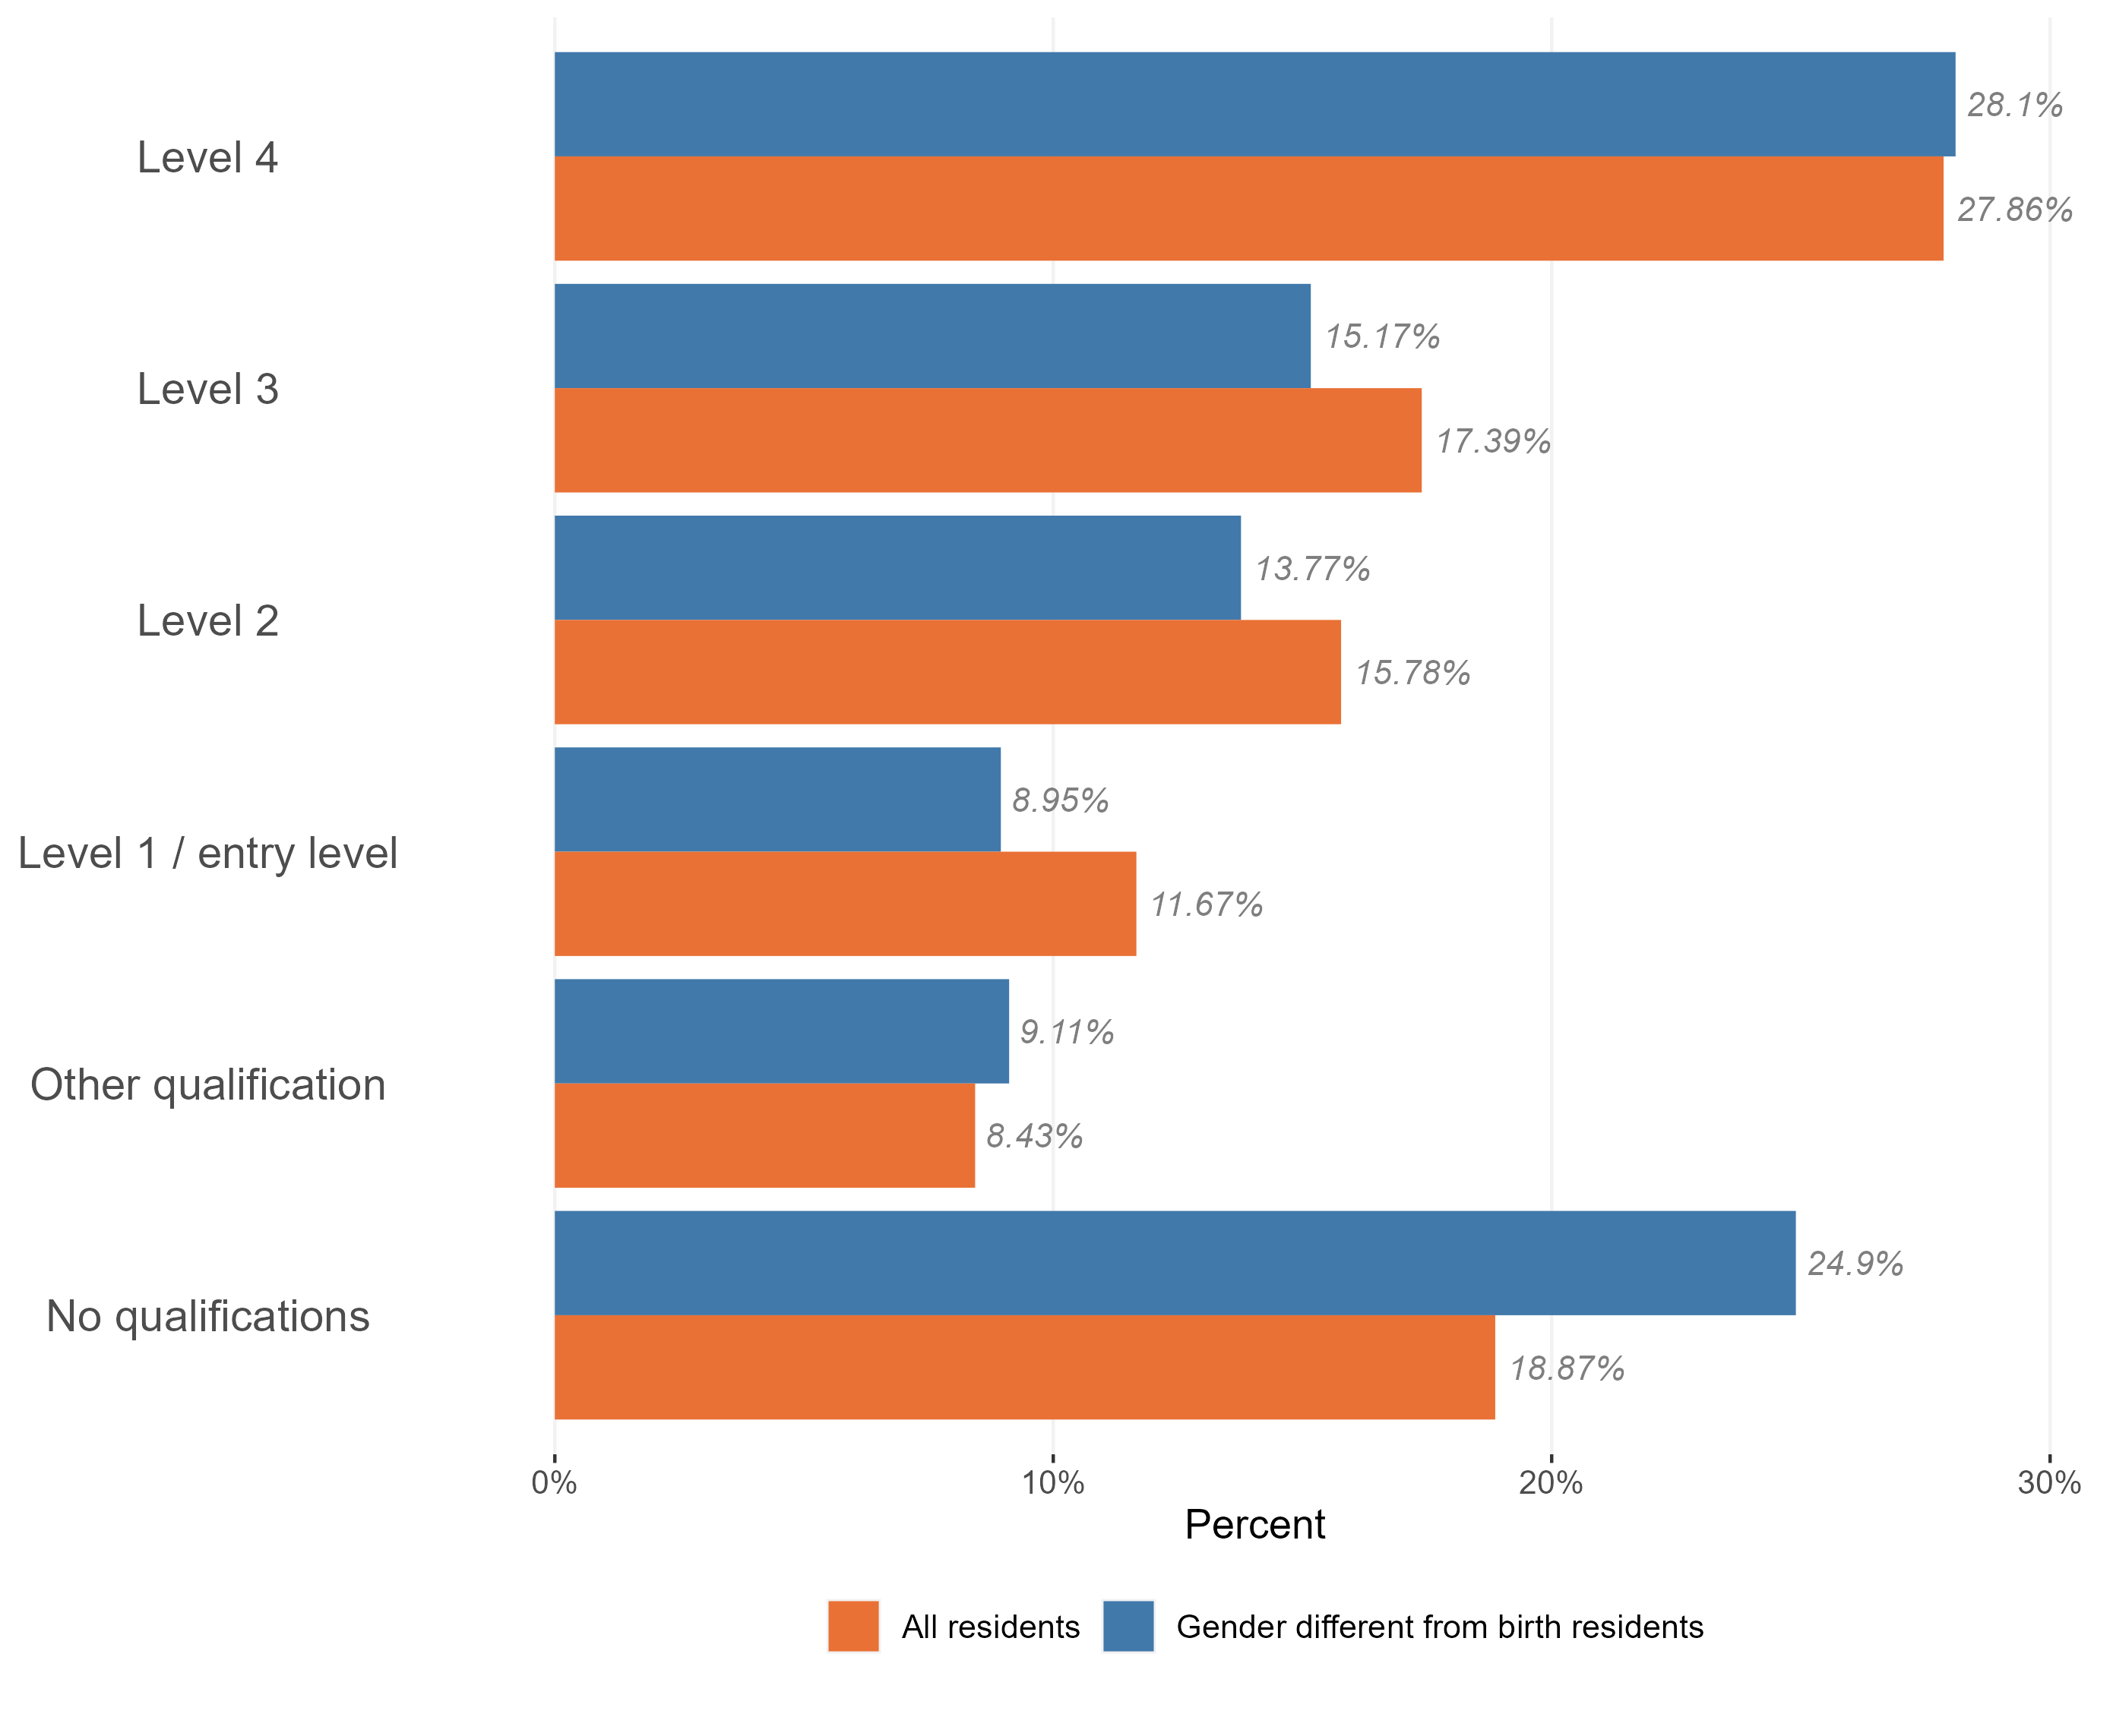
Highest qualification level
Level of qualifications held in the trans population, Essex, 2021
Trans people are more likely to have no qualifications compared to the general Essex population. Nearly a quarter of all trans residents have no formal qualifications, compared to 19% of the general population in Essex.
Of trans people who do have qualifications, there is a slightly higher proportion of other qualifications and level 4 (e.g. Masters and PhDs) in the trans population.
* Qualifications:
no qualifications: no formal qualifications
Level 1: one to four GCSE passes (grade A* to C or grade 4 and above) and any other GCSEs at other grades, or equivalent qualifications
Level 2: five or more GCSE passes (grade A* to C or grade 4 and above) or equivalent qualifications
apprenticeships
Level 3: two or more A Levels or equivalent qualifications
Level 4 or above: Higher National Certificate, Higher National Diploma, Bachelor's degree, or post-graduate qualifications
other qualifications, of unknown level
Research & Citizen Insight | Policy Unit | Essex County Council
14

Slide 15
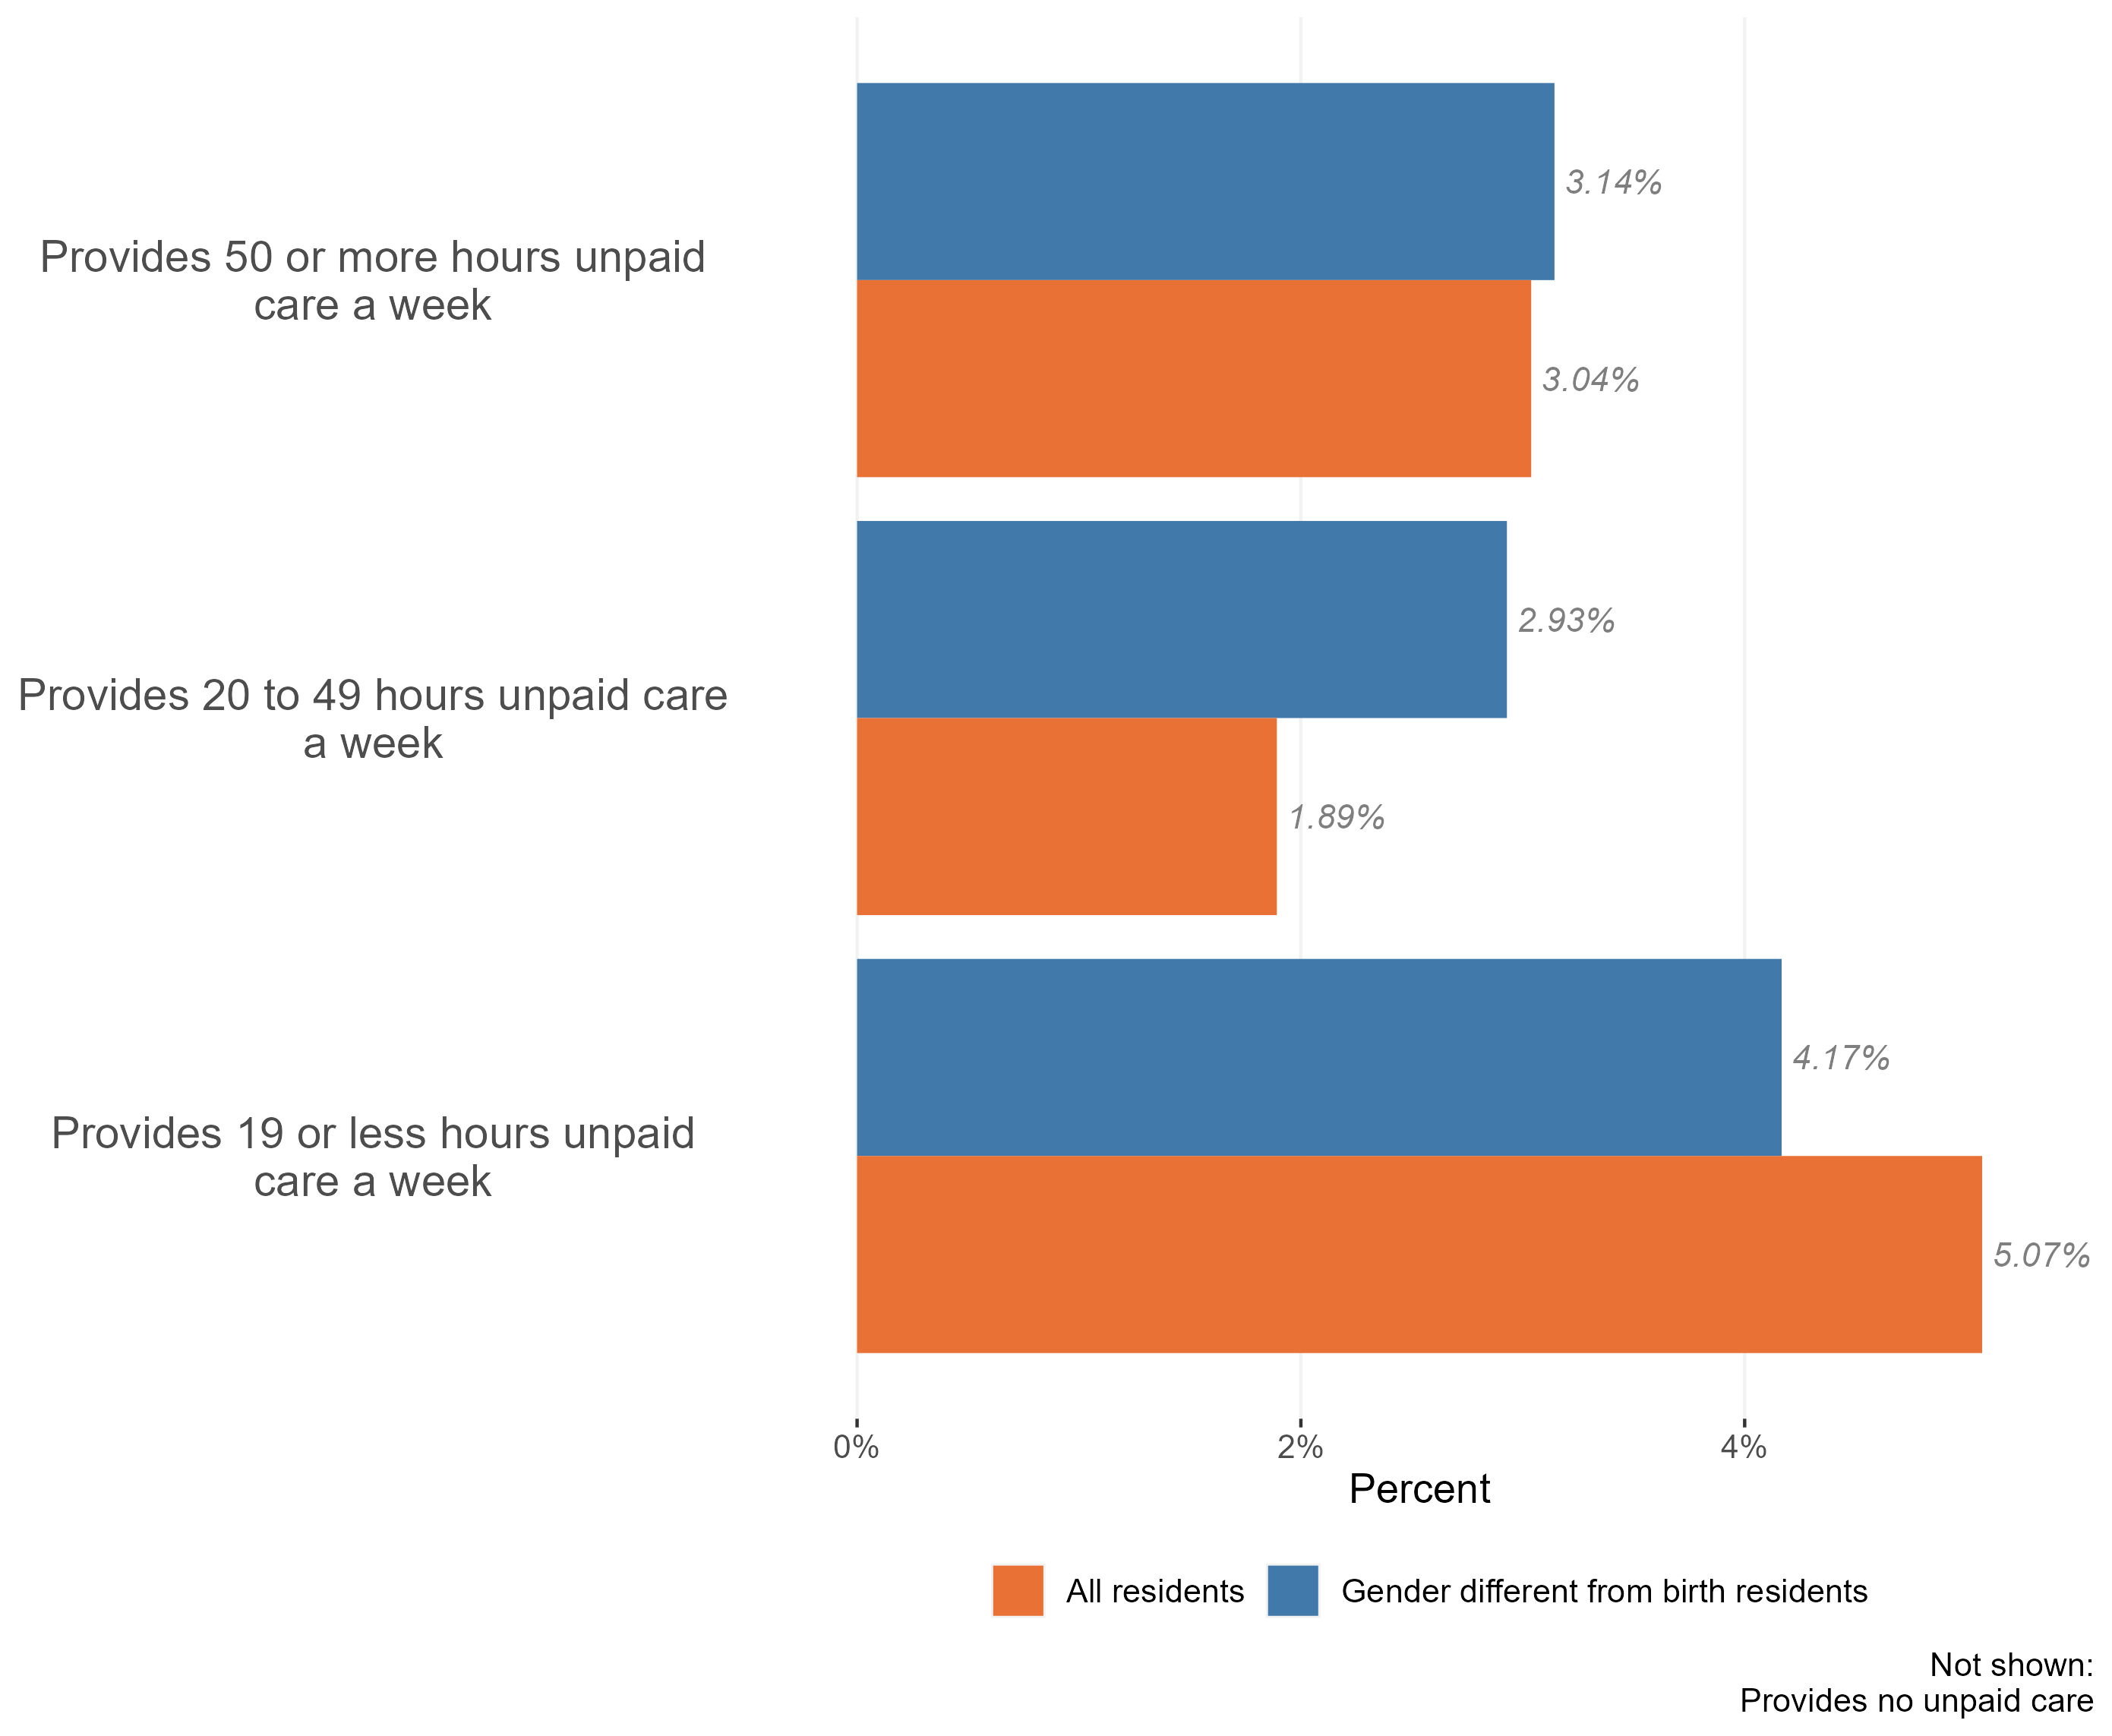
Gender status by unpaid care
Provision of unpaid care by the trans population, Essex, 2021
The vast majority of trans people in Essex do not provide unpaid care. Only 10.3% of the Trans population provide some form of unpaid care. This is similar to the general population in Essex, where c9% of residents identified themselves as unpaid carers in the 2021 census.
Our analysis also suggests that trans people are more likely to provide unpaid care for a more than 20 hours time each week.
Research & Citizen Insight | Policy Unit | Essex County Council
15

