Slide 1
Understanding veterans in Essex
Analysis of data from Census 2021
September 2023

Slide 2
Introduction
This document presents an analysis of the veteran population in Essex, based on data collected through Census 2021. It has been prepared as part of a series of analyses exploring the scale, distribution and characteristics of populations with ‘protected characteristics’ as defined by the Equality Act (2010).
The document is divided into three sections:
Section 1: considers the number of people across Essex, and Essex districts who are identified as veterans in the most recent Census data. In the 2021 census, veteran is defined as anyone who has previously served in the regular UK armed forces or the UK reverse forces
Section 2: examines the characteristics of the veteran population, focusing on the extent to which the wider range of protected characteristics can be found within members of veteran population;
Section 3: examines the outcomes enjoyed by members of the veteran population, focusing on employment outcomes, employment type, health outcomes, the likelihood of providing unpaid care, qualification levels and access to cars/vans.
This is part of a suite of similar analyses examining the protected characteristics defined by the equalities act. Similar analyses, and a series of interactive dashboards, exploring issues of disability, age, sex, sexuality, religion, and gender identity can be found at data.essex.gov.uk.
ECC’s Research and Citizen Insight Team is leading the county council’s work to prepare examine and understand Census data. If you would like to ask questions, find out more, or get involved in this work please contact Alastair Gordon (Alastair.Gordon@essex.gov.uk) or Sean Maguire (Sean.Maguire@essex.gov.uk).
Research & Citizen Insight | Policy Unit | Essex County Council
2

Slide 3
Section 1: The veteran population
Understanding the scale and distribution of Essex’s veteran population

Slide 4
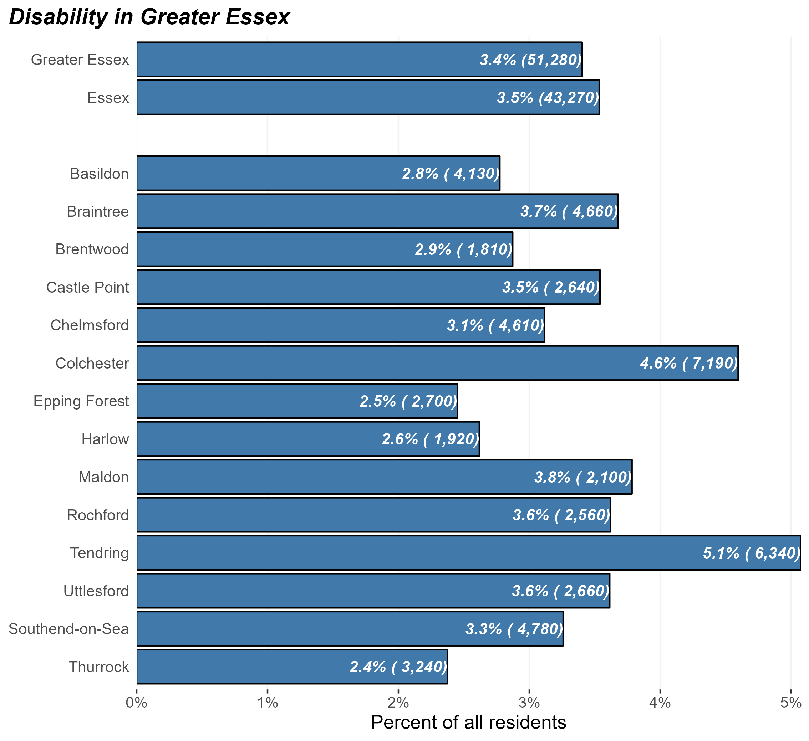
The veteran population
Number and percentage of residents identifying as veterans in Greater Essex and Essex Districts, Census 2021
At the time of Census 2021, there were some 43,000 veterans in Essex and 51,000 in Greater Essex (including the areas of Southend and Thurrock).
This equates to 3.4% of Greater Essex residents, slightly lower than England as a whole (3.8%).
There is some variation across the districts – Tendring and Colchester have the highest proportion of veteran residents, and Thurrock and Harlow have the lowest
Research & Citizen Insight | Policy Unit | Essex County Council
4

Slide 5
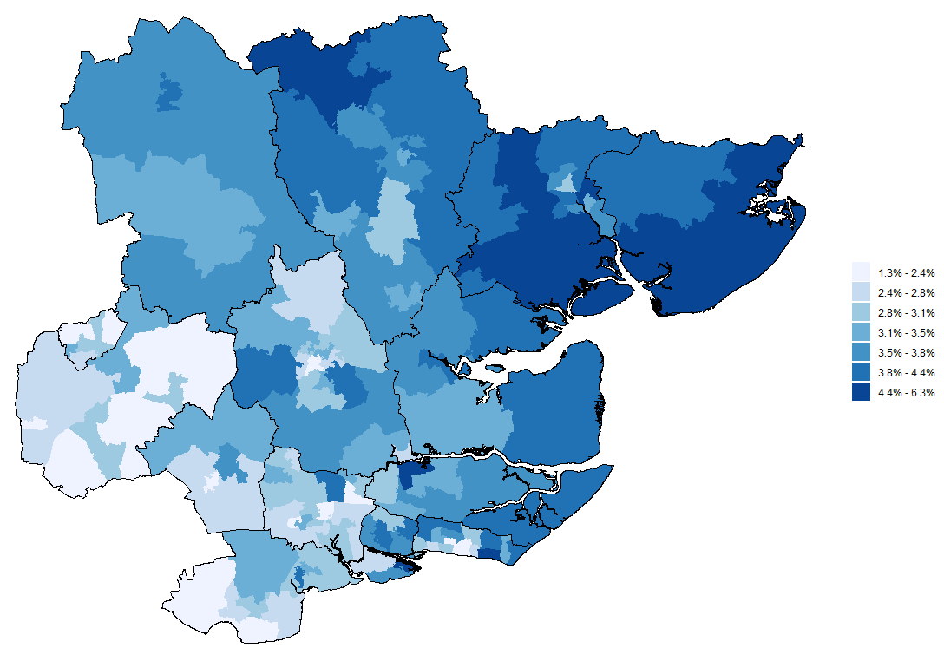
Veterans across Greater Essex
Proportion of veterans by MSOA, Greater Essex, Census 2021
The map opposite shows the proportion of residents in each middle-level super outputs area (MSOA) who are veterans
This shows that the proportion of the population who identify as disabled is generally highest in Tendring and Colchester, most likely due to the military barracks
There are also some areas across Greater Essex with high levels of veterans – Newland in Canvey Island, Hullbridge in Rochford, and Steeple Bumpstead & Great Yeldham in Braintree
Research & Citizen Insight | Policy Unit | Essex County Council
5

Slide 6
Section 2: Characteristics of the veteran population
Exploring the prevalence of other protected characteristics within Essex’s veteran population

Slide 7
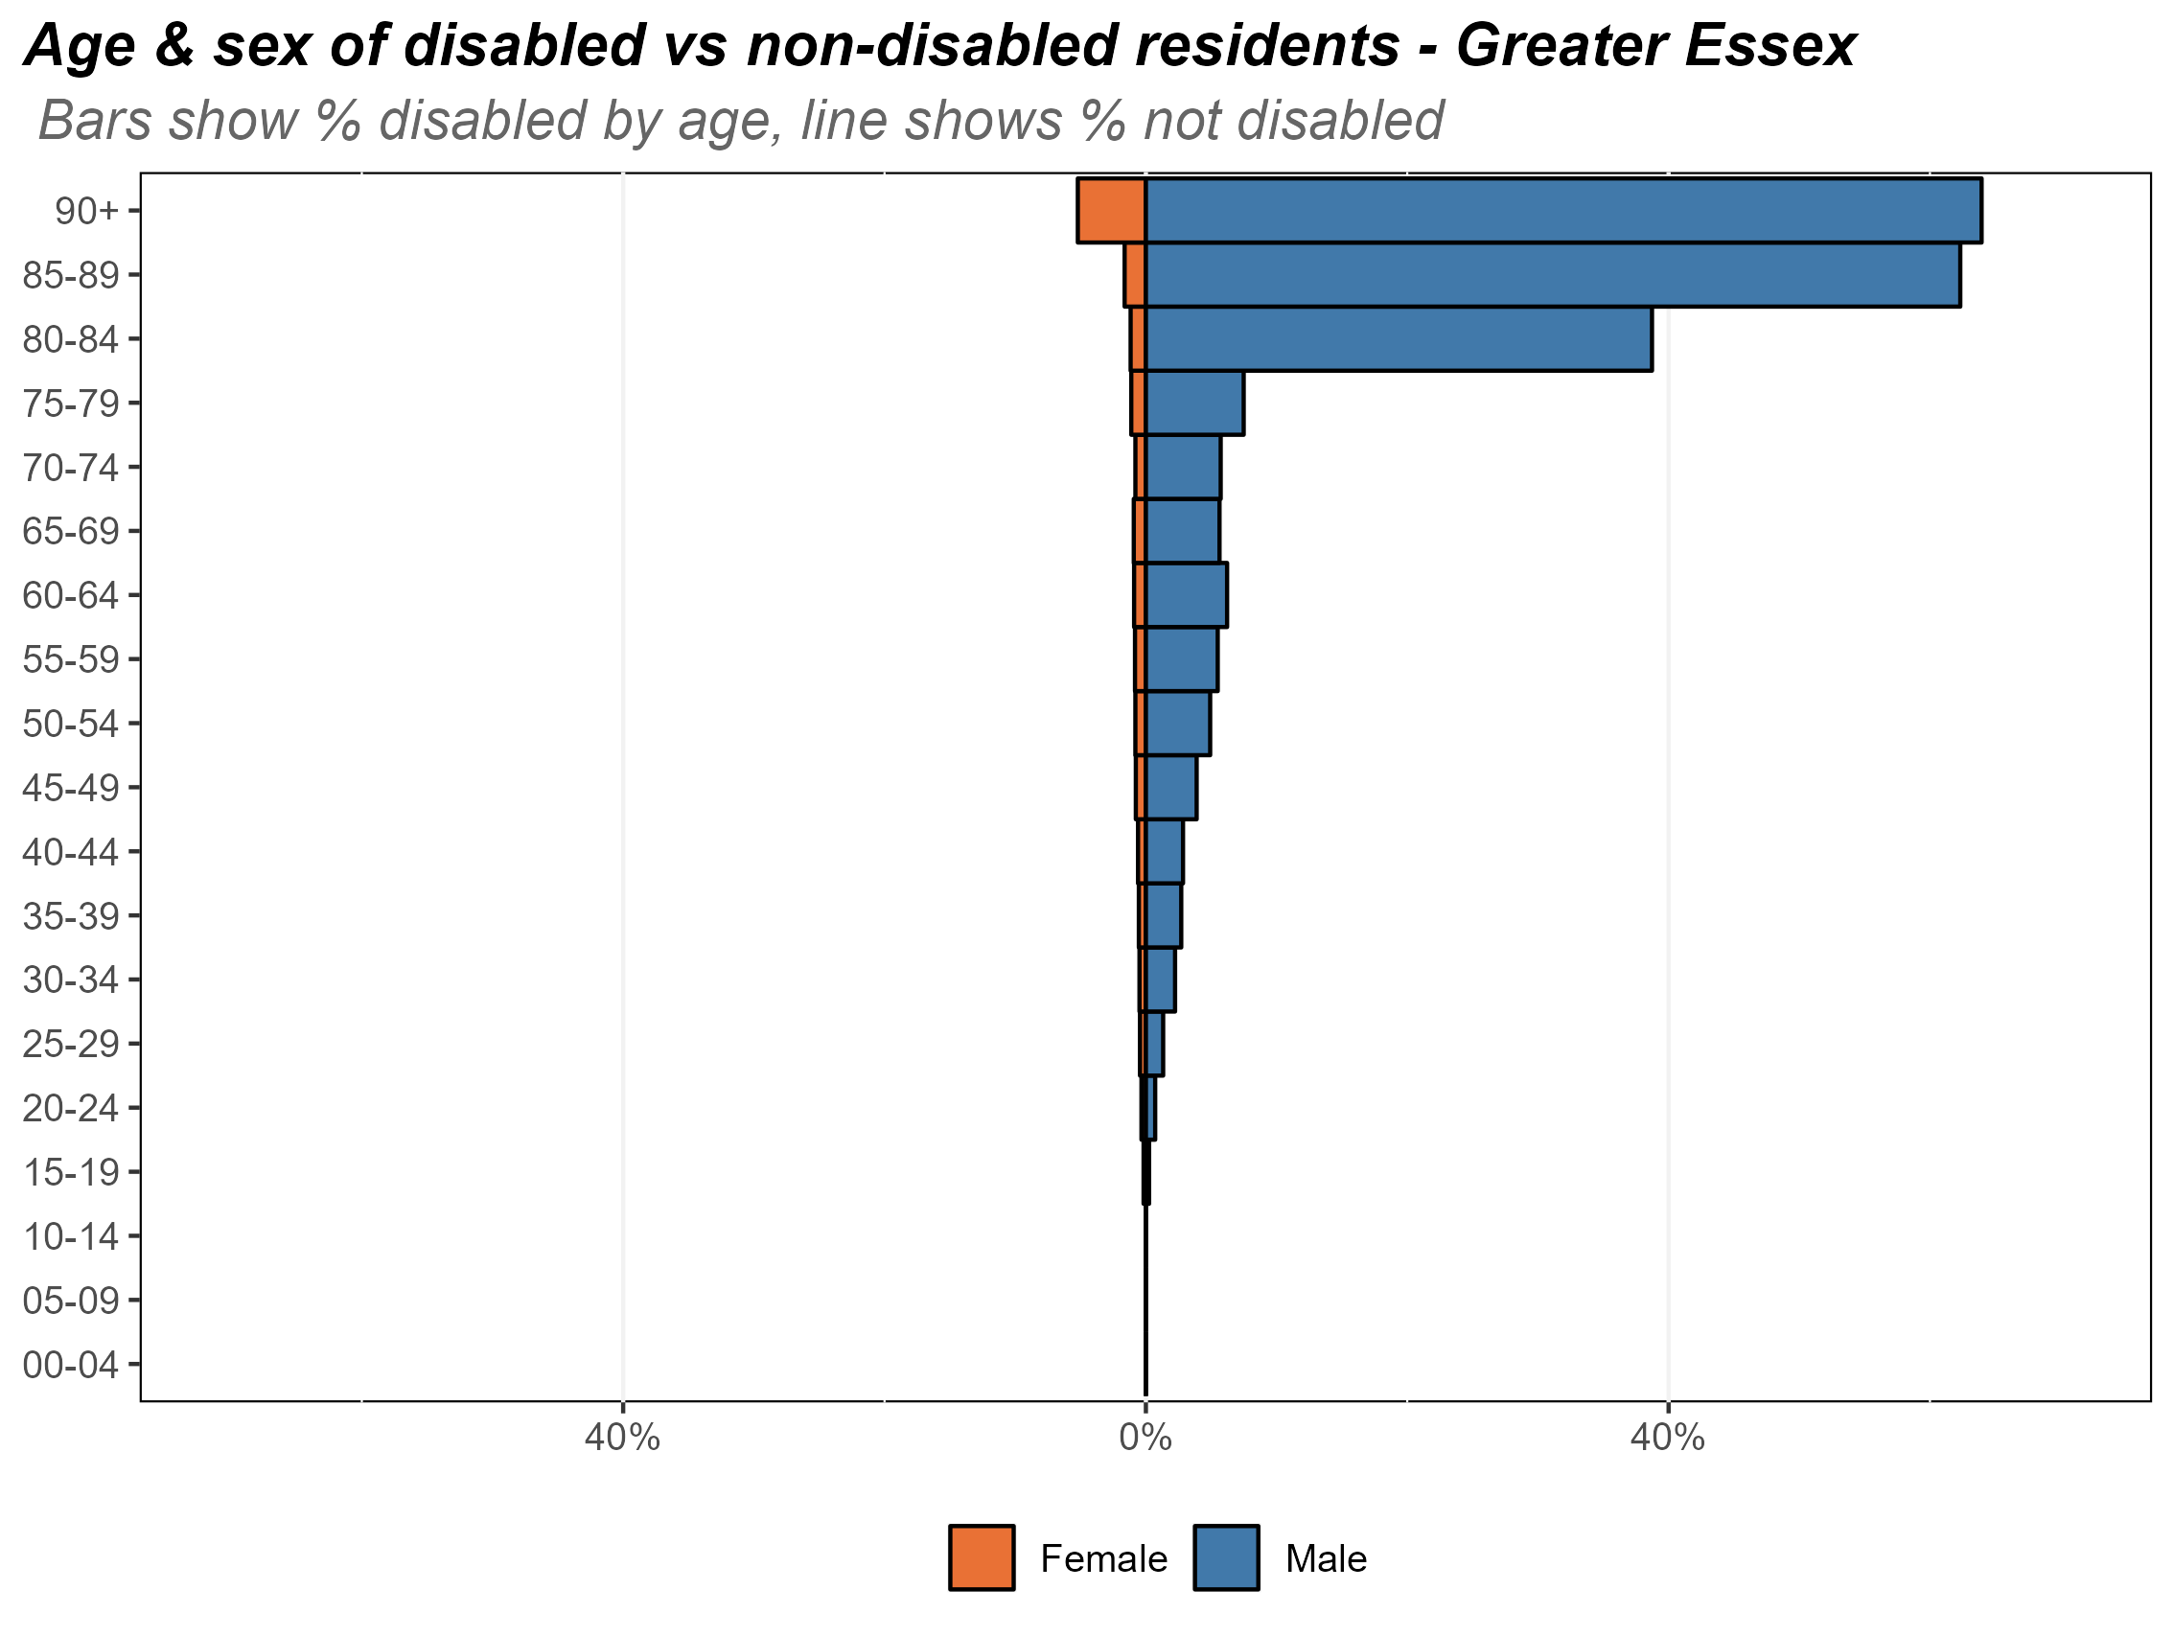
Age and sex of the veteran population
Composition of the veteran population by age and sex, Essex, 2021
The chart opposite shows the composition of Essex’s veteran population by age and by sex.
Most veterans in Essex are male (88.7%). Veterans are typically much older than the general population, with over 40% of Essex veteran residents being aged 80+. The demographics of veterans in Essex is similar to the national veteran picture.
The large number of older veterans is likely due to national service. As the veteran population is much older that the general population, this will result in higher levels of poor health and disability
Research & Citizen Insight | Policy Unit | Essex County Council
7

Slide 8
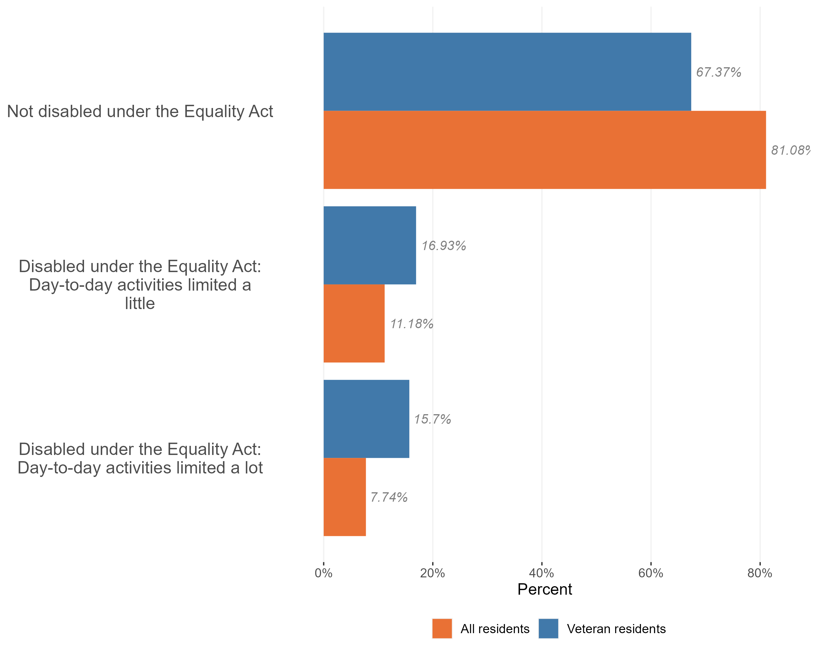
Disability in the veteran population
Composition of the disabled and nondisabled populations by veteran status Essex, 2021
The majority of Essex’s veteran population are not disabled (67.4% - or 29,100 of the 43,000 veteran population).
However, the prevalence of disability is much higher in the veteran population compared to the general Essex population. 19.1% of the general Essex population are classed as disabled by the equality act, in veterans this increases to 32.6%.
Veterans have higher proportion of residents who have their day-to-day activities limited a little (16.9% of veterans compared to 11.2% in Essex), and the proportion of veterans who have their day-to-day activities limited a lot by their disability is more than twice as high compared to the general population (15.7% in veterans compared to 7.7% in the general population).
Research & Citizen Insight | Policy Unit | Essex County Council
8

Slide 9
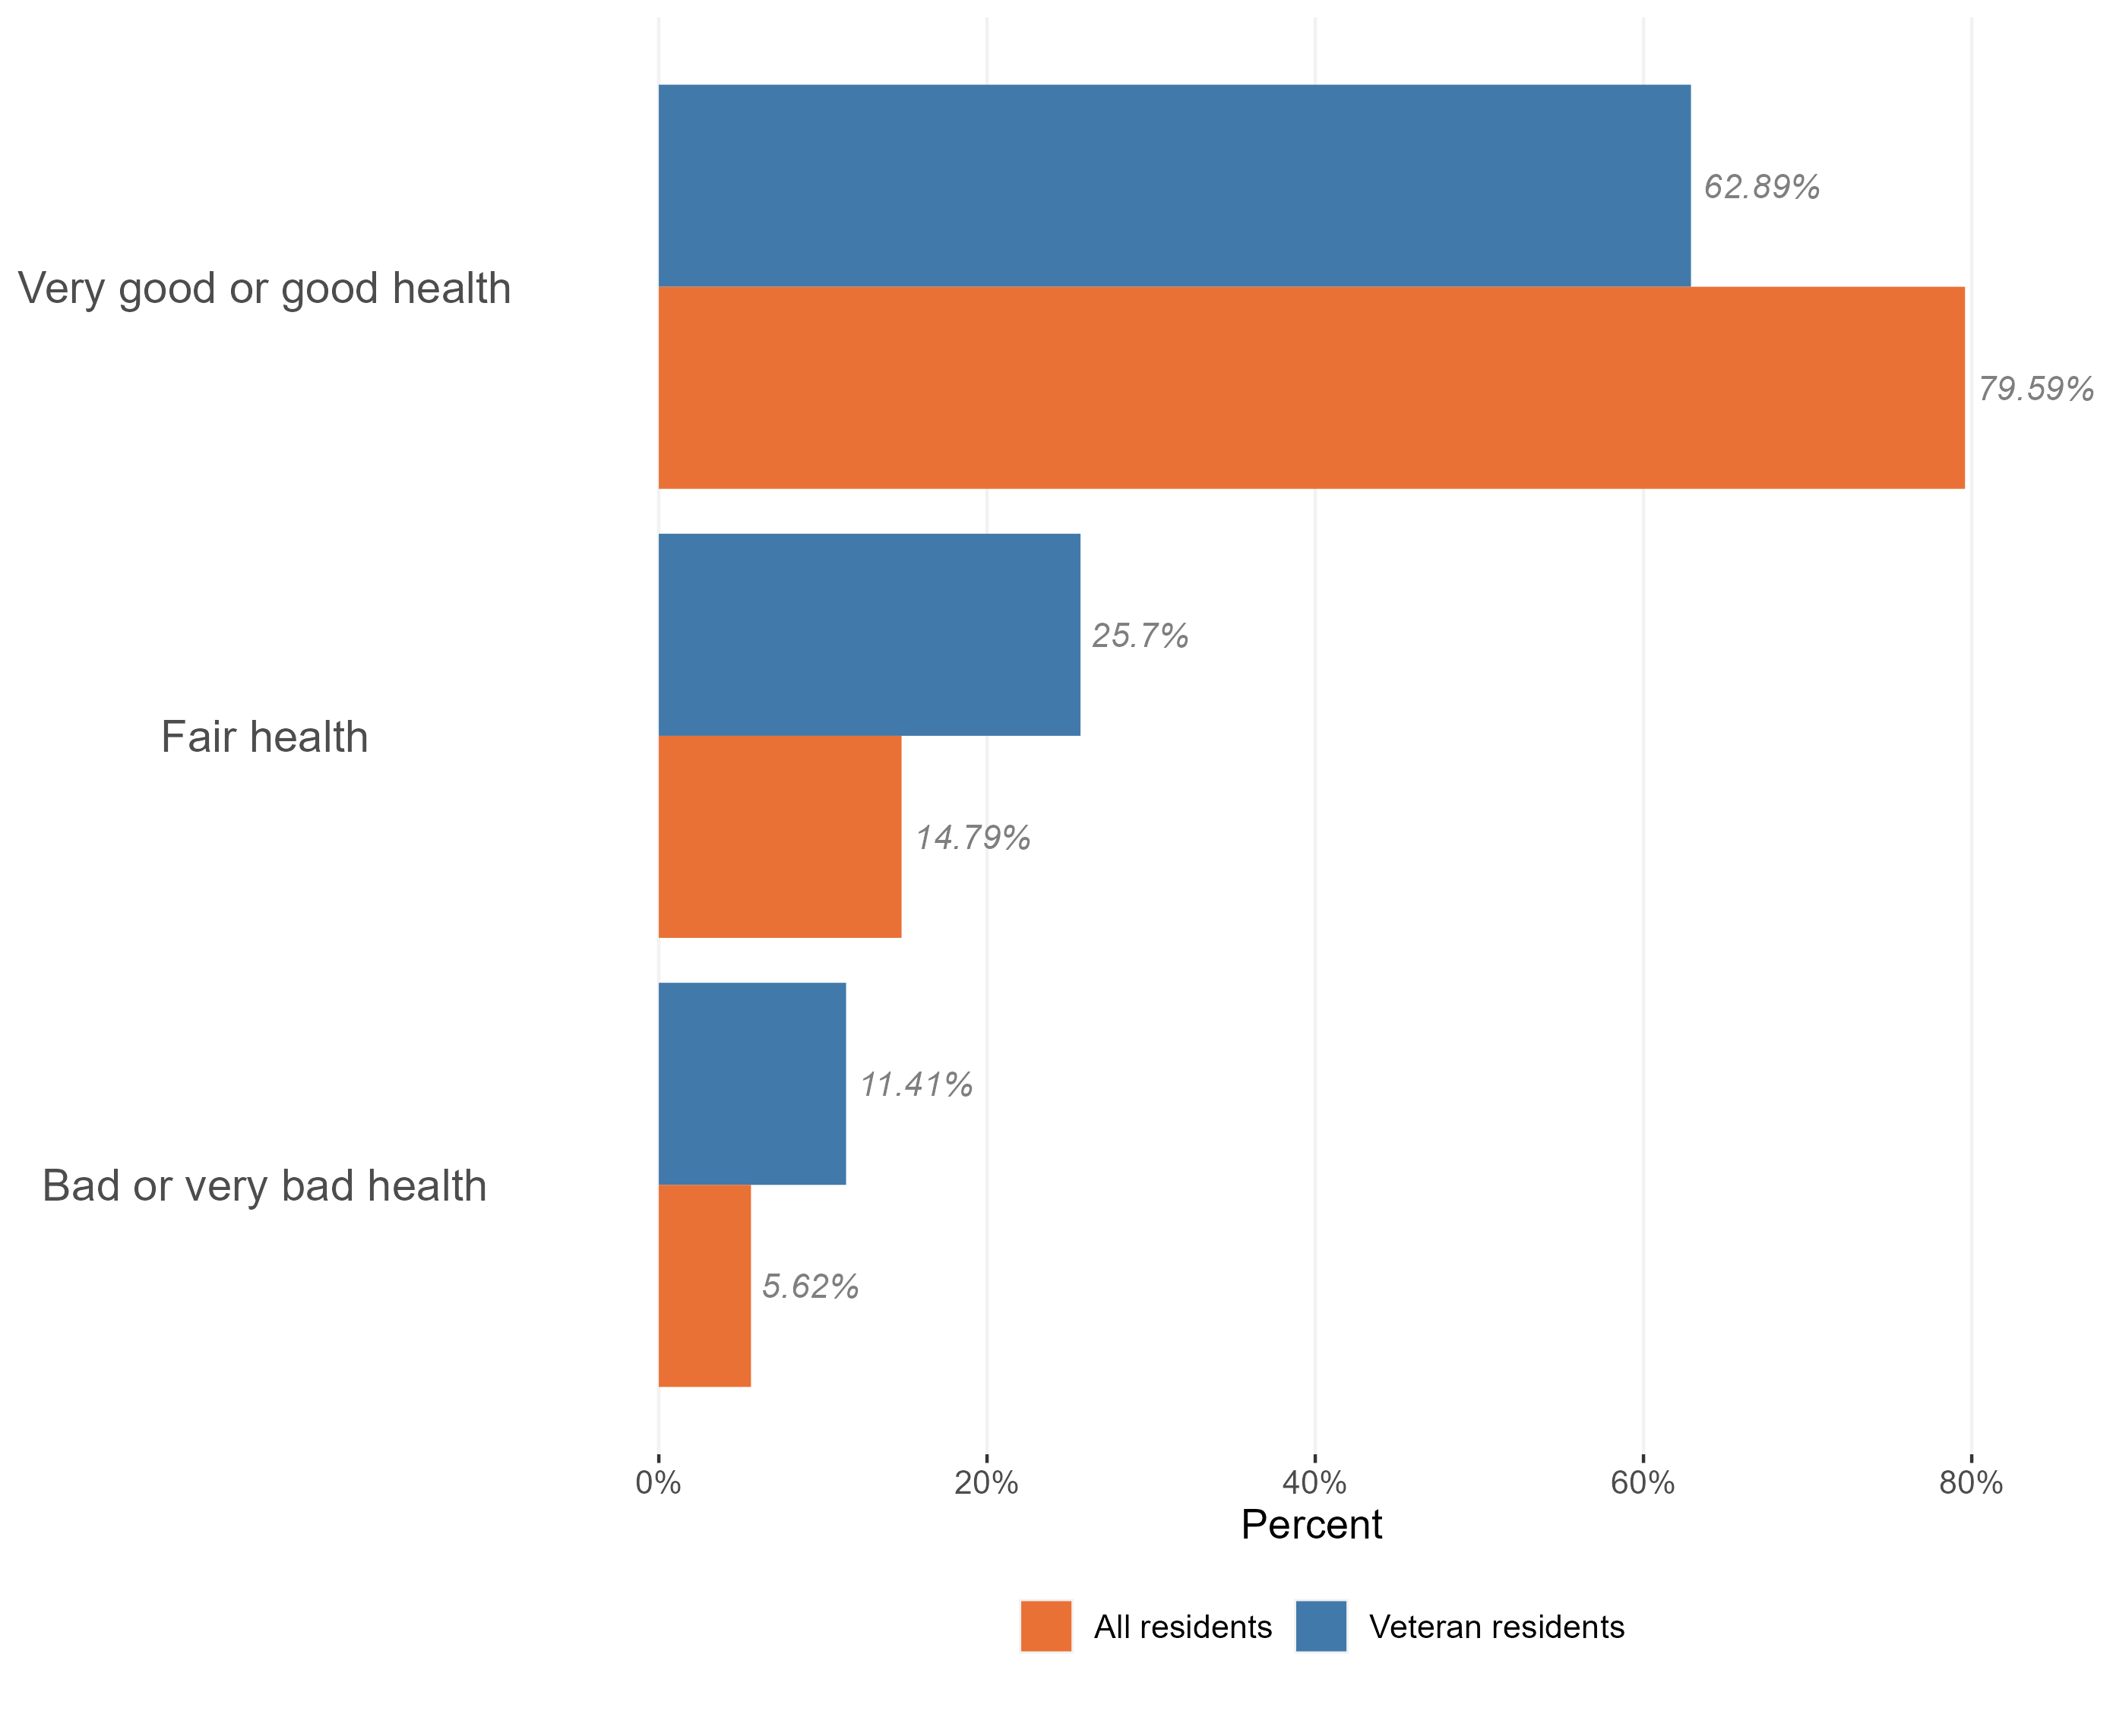
Health in the veteran population
Health status of veterans compared to the general population, Essex, 2021
Veterans are more likely to report bad or very bad health compared to the general Essex population. 11.4% of Essex veterans have bad or very bad health compared to 5.6% of the general population.
The veteran population is, on average, older than the general population in Essex. This may partly explain the patterns seen here
Research & Citizen Insight | Policy Unit | Essex County Council
9

Slide 10
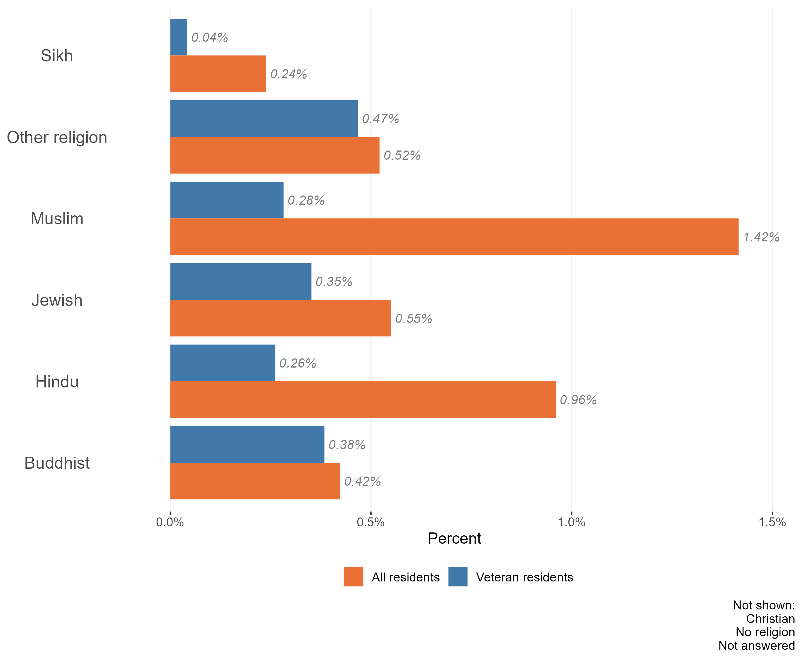
Religion in the veteran population
Composition of the white British and veteran populations by religion, Essex, 2021
The vast majority of the Essex veteran population identify either as Christian (65.4%) or ‘no religion’ (27.7%). There is an over-representation of Christian religion in the veteran population compared to all Essex residents (65.4% in veteran residents compared to 50.8% in all residents).
Following Christian and no religion, the most common faiths among the veteran population are other religions (0.47%) and Buddhist (0.38%). 5.2% of veterans chose not to answer religion questions in the census, slightly lower than all Essex residents (5.6%)
Research & Citizen Insight | Policy Unit | Essex County Council
10

Slide 11
Section 3: Outcomes for veteran residents
Exploring the extent to which veteran residents enjoy positive outcomes

Slide 12
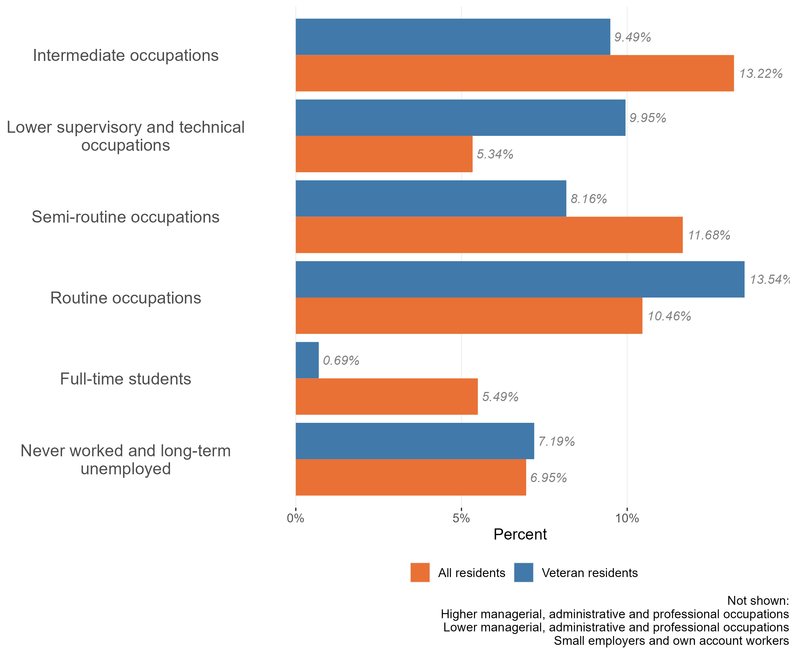
Employment and occupation type
Employment and occupation type, ethnic minorities and all residents, Essex 2021
The majority of Essex’s veteran residents work in higher managerial (23.2%), lower managerial (29.9%), or small employers (22.4%). Together these roles account for c59% of all employments in veteran residents.
Compared to the general Essex population, veterans in Essex are less likely to be full time students or work in intermediate / semi-routine occupations. They are slightly more likely to have never worked or be long term unemployed compared to the general population, and more likely to work in routine of lower supervisory / technical roles
Research & Citizen Insight | Policy Unit | Essex County Council
12

Slide 13
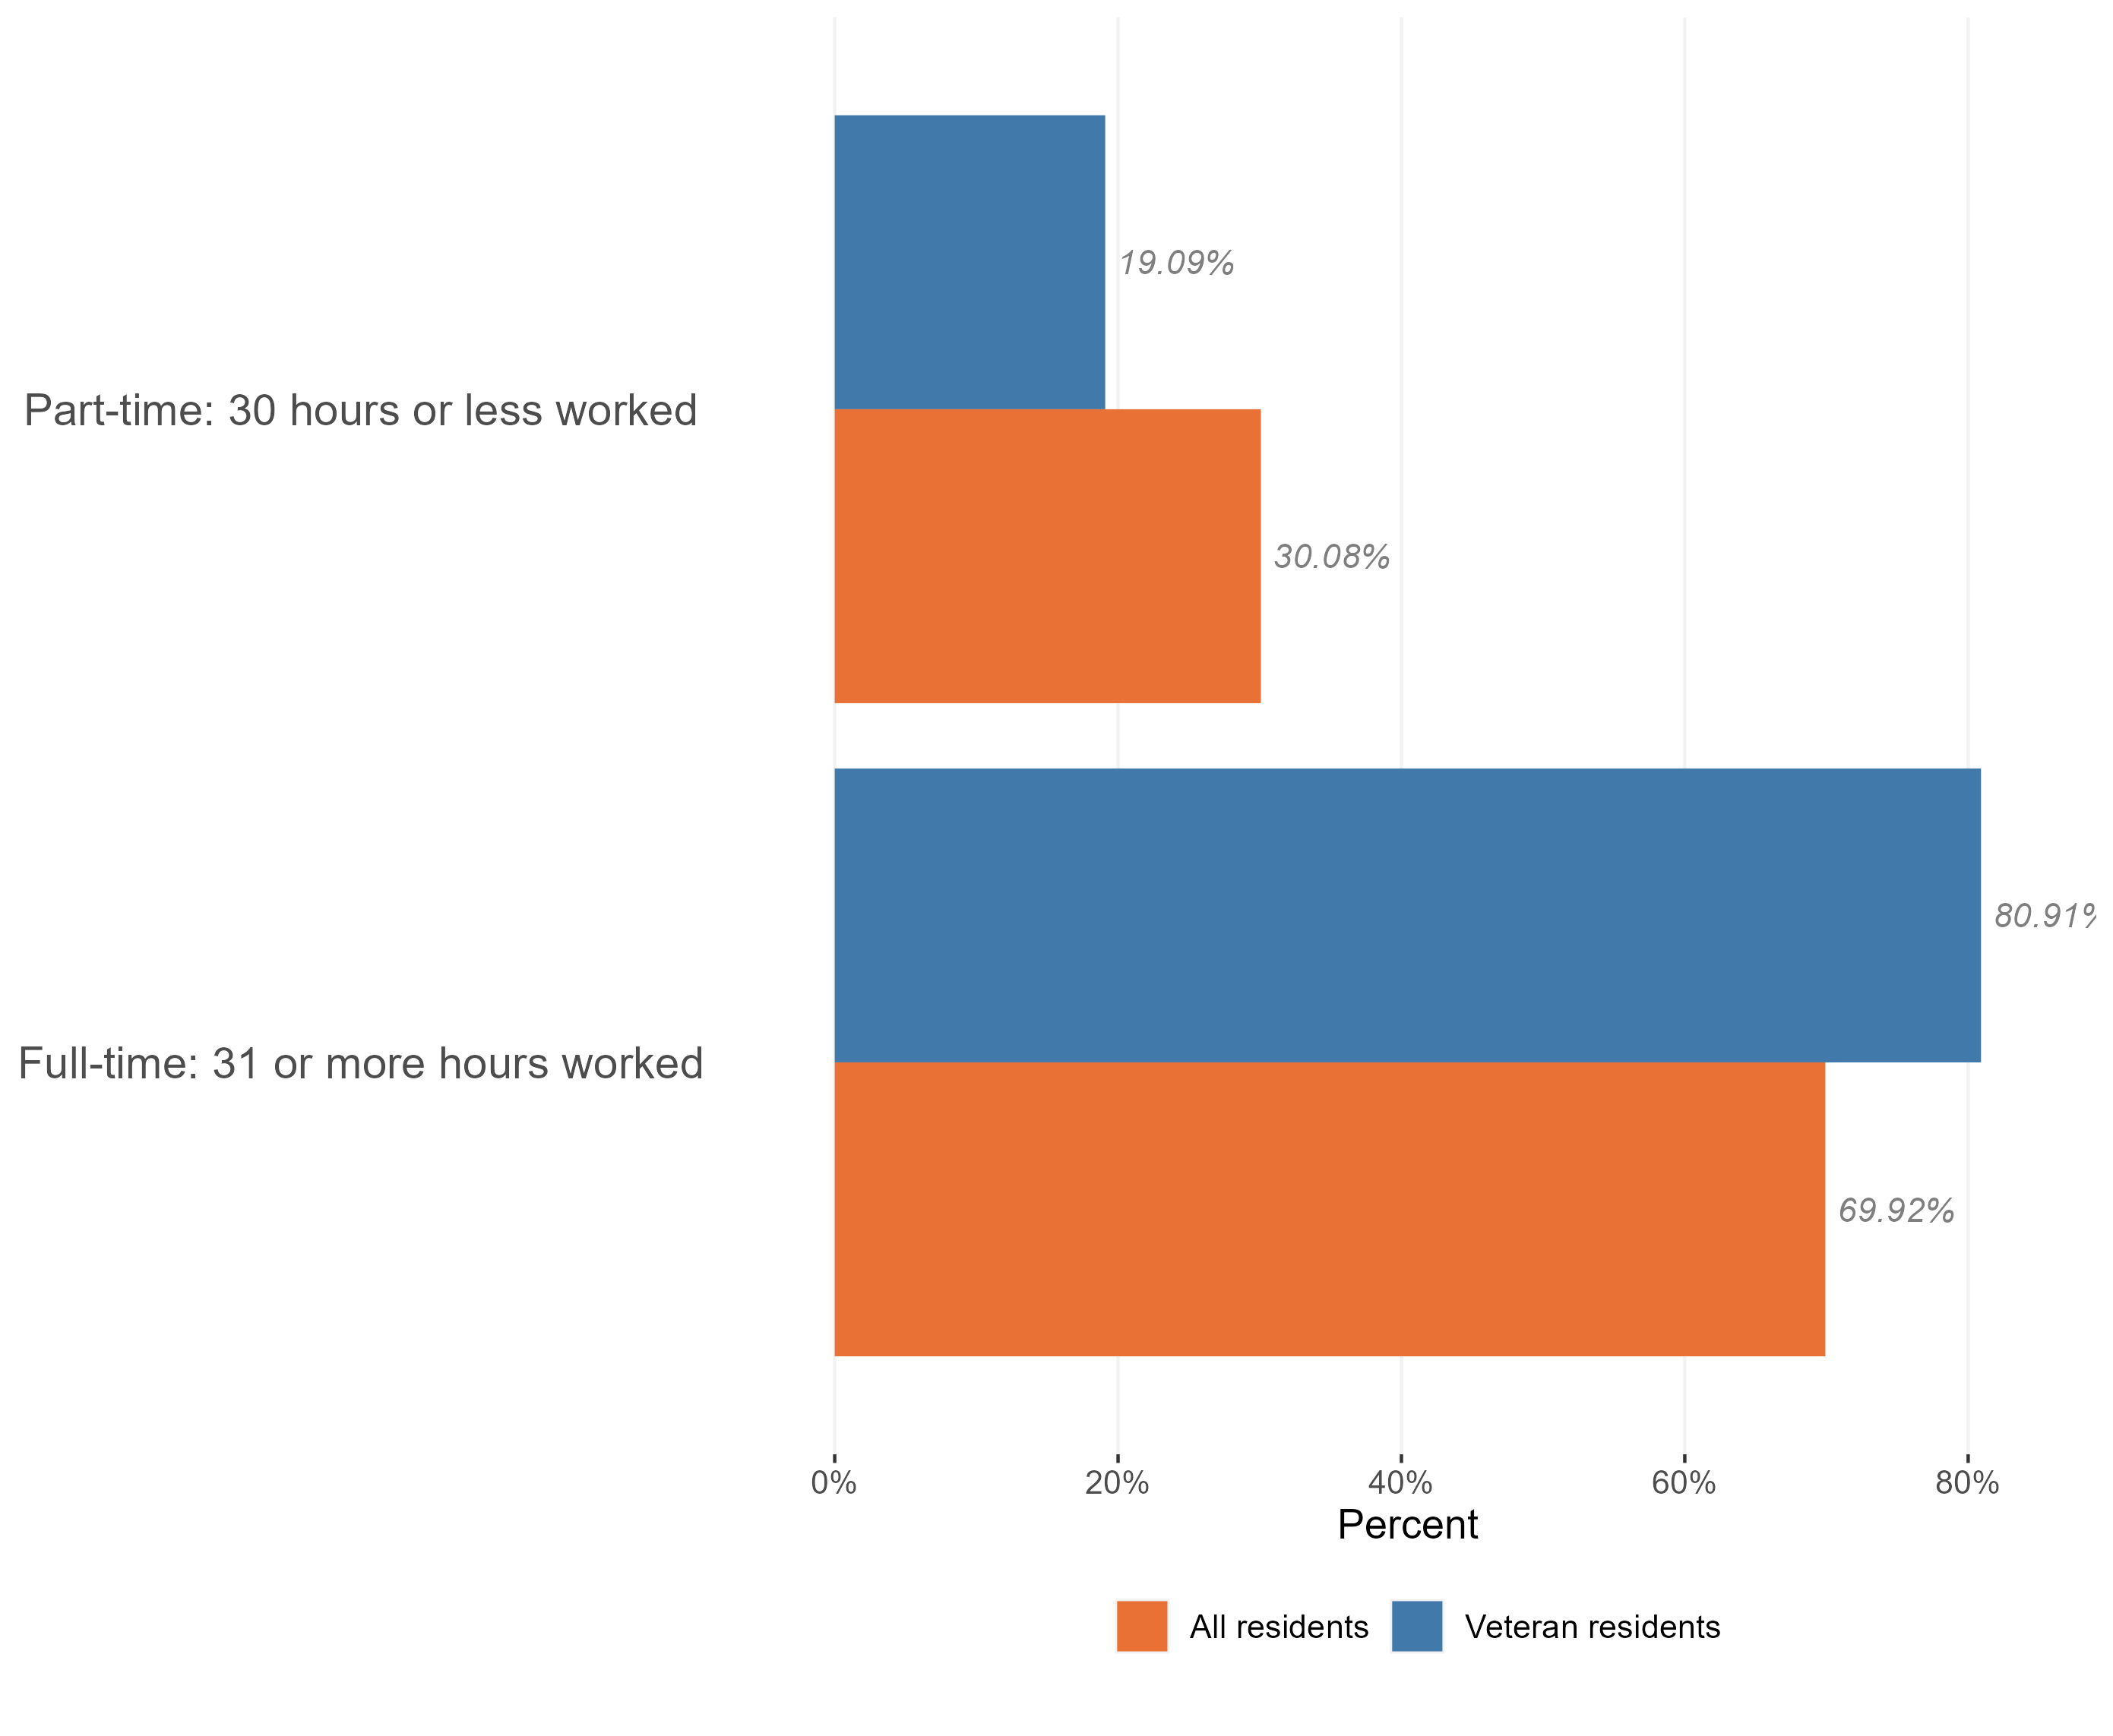
Employment and hours worked
Hours worked, veterans and all residents, Essex, 2021
Of the 43,000 people who make up the Essex veteran population, 18,000 are working-age adults. Of this group 88.9% were in work at the time of Census 2021.
This is higher proportion than we see across the working-age population as a whole (78.1%).
The majority of the Essex veteran population who are in work are in full-time roles (81% hold full-time roles compared to 19% working part-time)*, a higher proportion are in full-time work than across the Essex working-age population as a whole.
*Within Census data full time roles are classified as 31+ hours per week and part-time roles are classed as 30 hrs or less per week.
Research & Citizen Insight | Policy Unit | Essex County Council
13

Slide 14
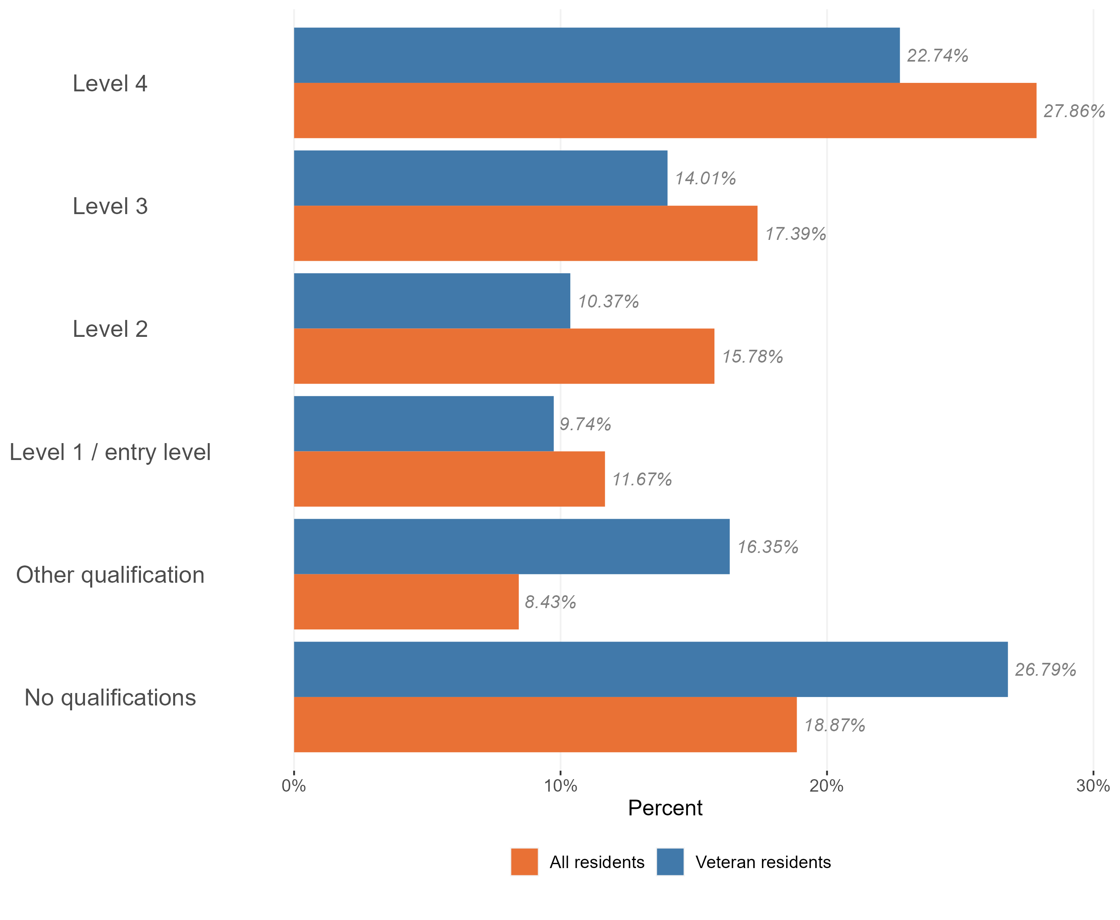
Highest qualification level
Level of qualifications held in the veteran population, Essex, 2021
Veteran Essex residents are more likely to have no level qualifications compared to the general Essex population. A larger proportion of the veteran population have other qualifications (vocational or work-related qualifications) compared to the general population.
They are less likely to have higher qualifications, with the gap in attainment increasing with level of qualification
Research & Citizen Insight | Policy Unit | Essex County Council
14

Slide 15
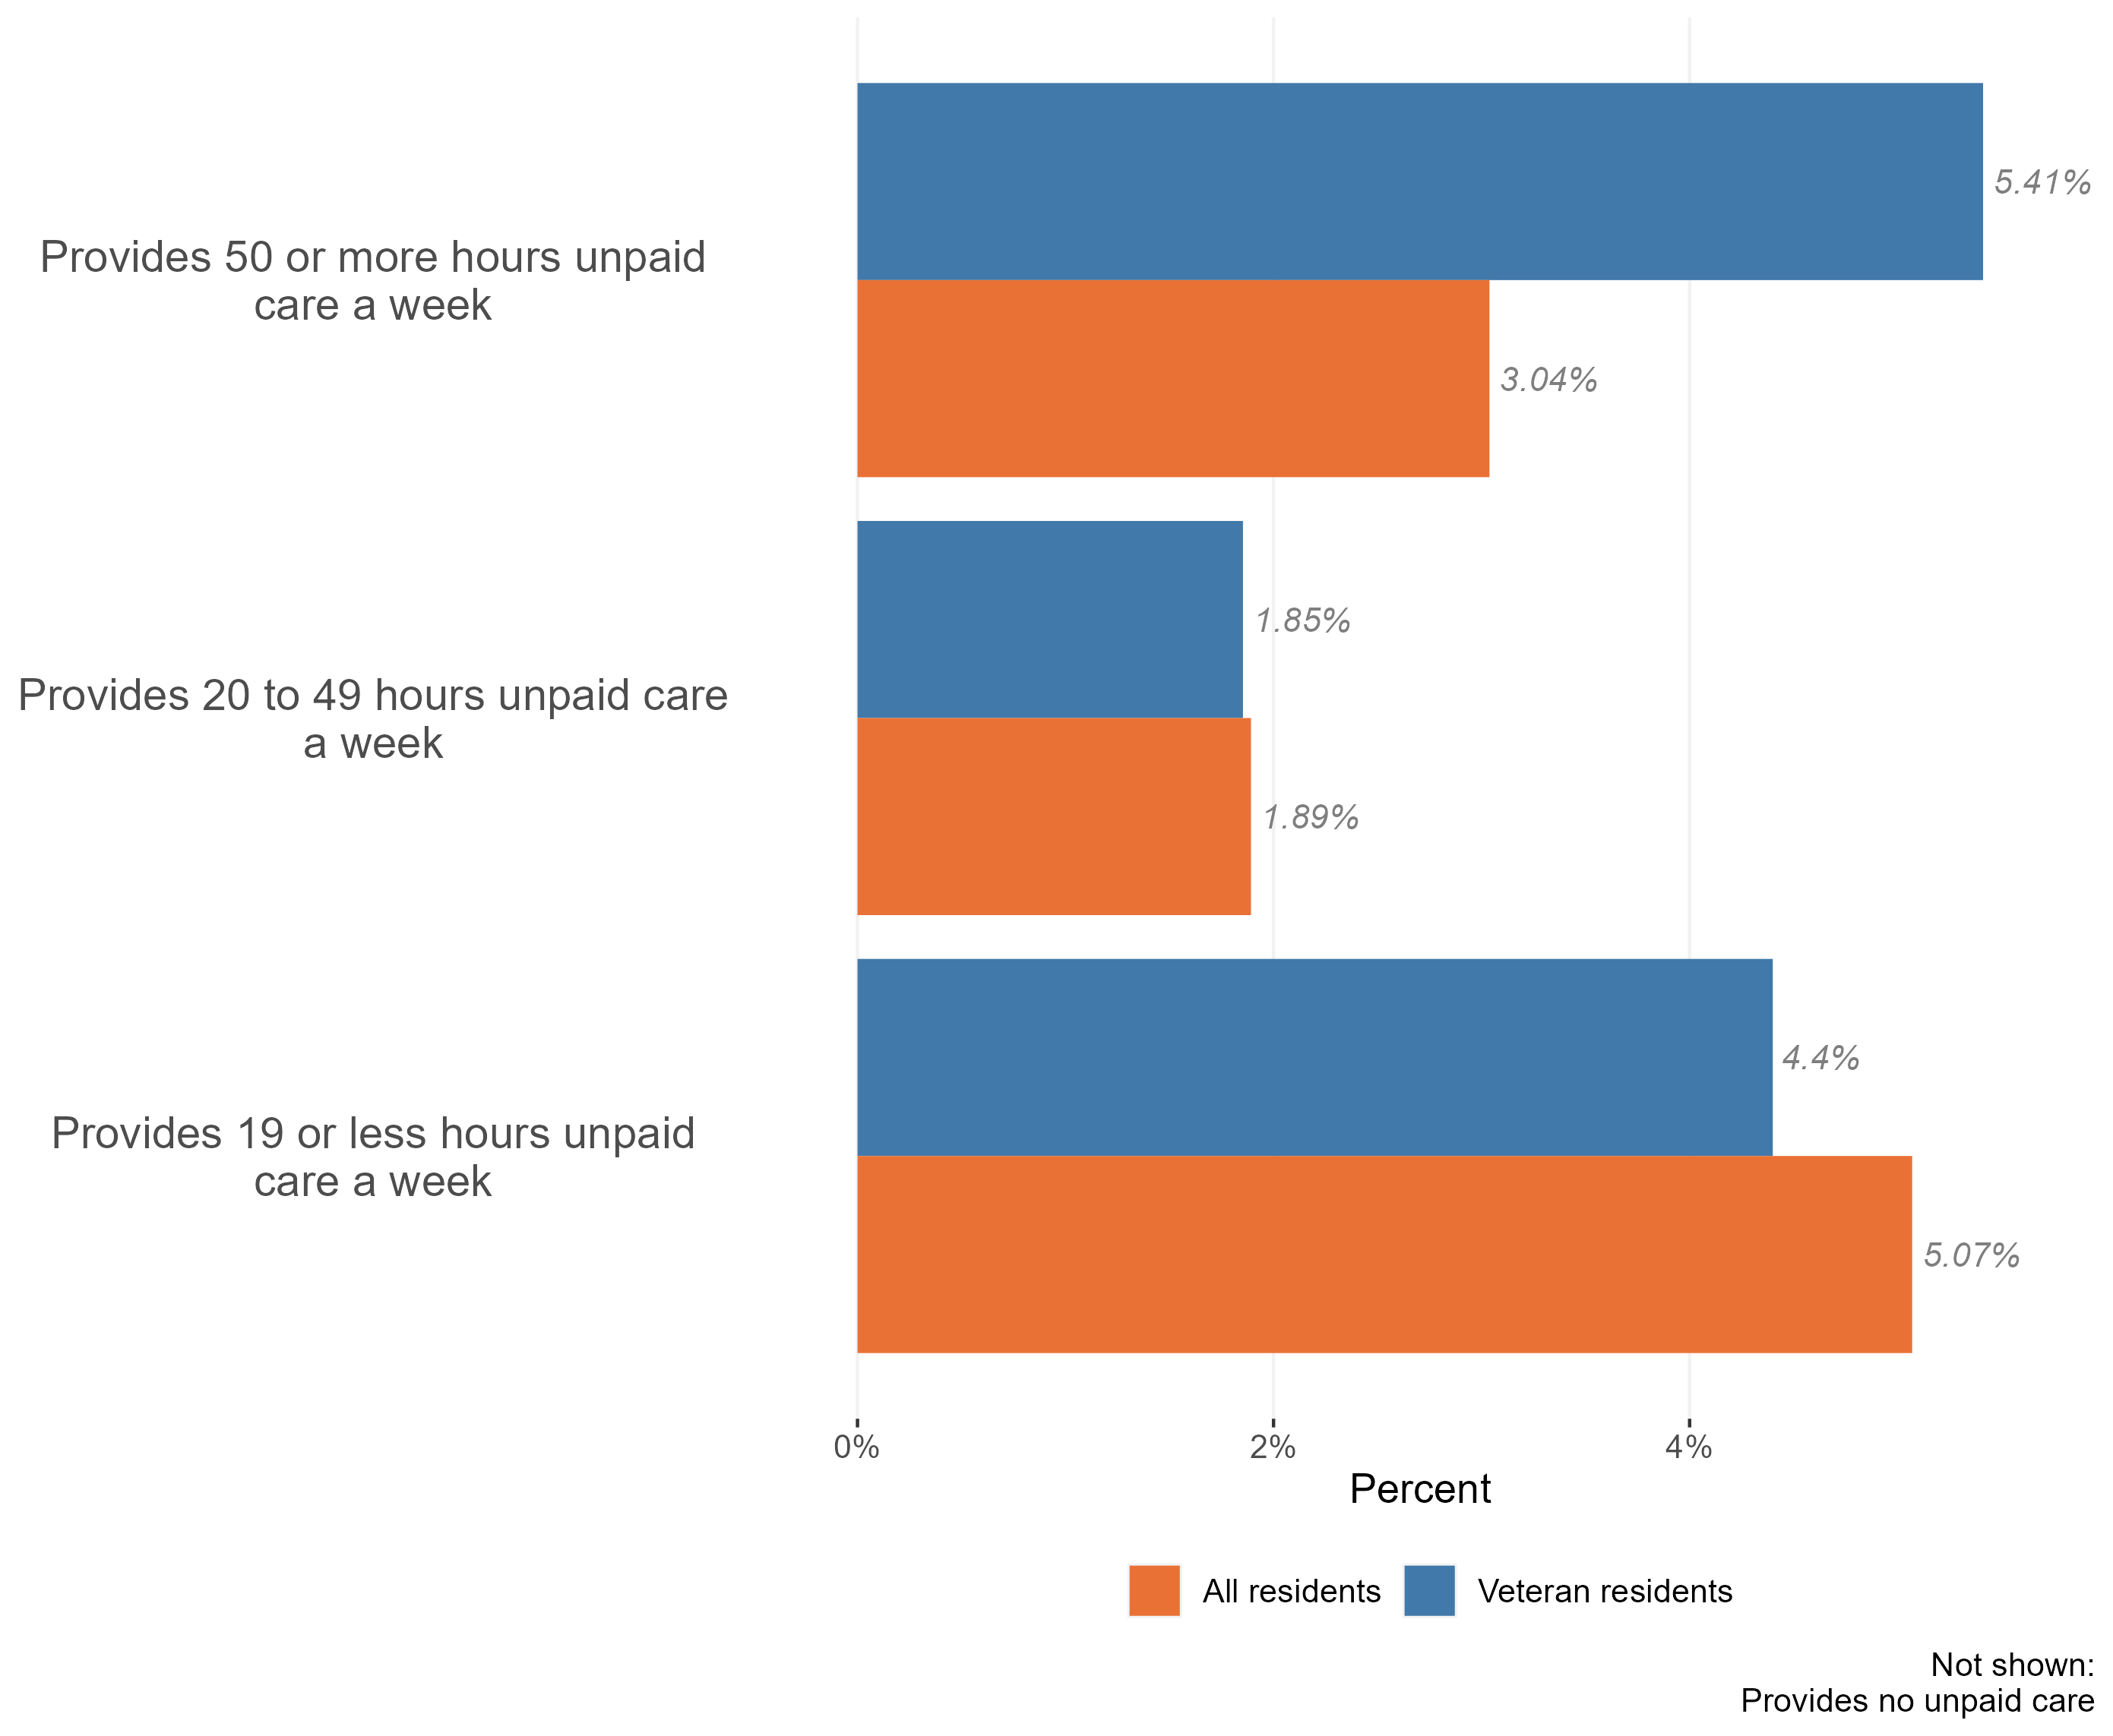
Provision of unpaid care by veterans
Provision of unpaid care by veteran residents, Essex, 2021
11.7% of Essex veteran residents provide some form of unpaid care. This is higher than the general population, where 9% of the general population identified themselves as carers in the Census 2021.
Veterans are more likely to provide 50+ hours of unpaid care, and less likely to provide lower amounts of unpaid care, compared to the general population. This suggests that the burden of unpaid care in the veteran population is large – if a veteran provides unpaid care, they are much more likely to be providing very high levels of care compared to the general population. It is likely that part of this pattern can be explained by age – veterans tend to be older than the general public.
Research & Citizen Insight | Policy Unit | Essex County Council
15

Slide 16
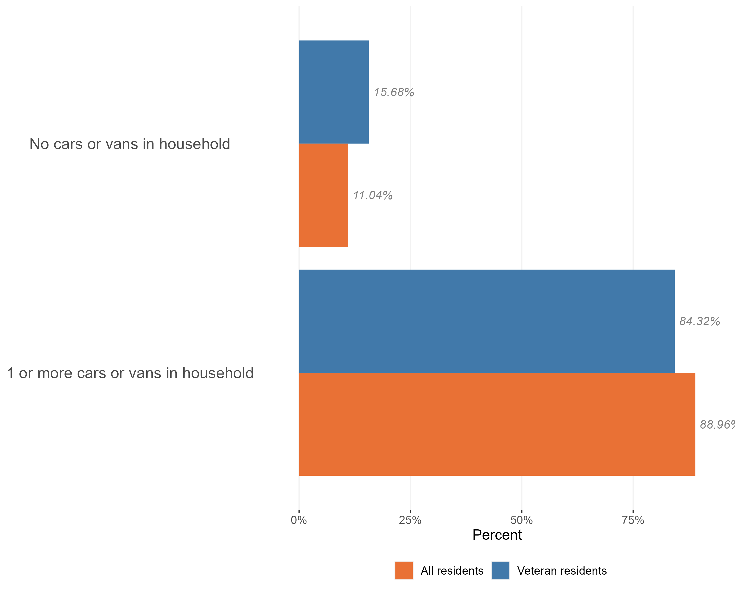
Access to cars
Access to a car or van in the veteran population, Essex, 2021
Veterans are less likely to have access to a car or van compared to the general Essex population (16% of veterans have no access compared to 11% of the general population). This may have an impact on access to services in the veteran community
Research & Citizen Insight | Policy Unit | Essex County Council
16

