Slide 1
Understanding disability in Essex
Analysis of data from Census 2021
September 2023

Slide 2
Introduction
This document presents an analysis of the disabled population in Essex, based on data collected through Census 2021. It has been prepared as part of a series of analyses exploring the scale, distribution and characteristics of populations with ‘protected characteristics’ as defined by the Equality Act (2010).
The document is divided into three sections:
Section 1: considers the number of people across Essex, and Essex districts who are identified as disabled in the most recent Census data. These are people who, at the time of Census 2021, assessed their day-to-day activities as limited by long-term physical or mental health conditions or illnesses. This definition of a disabled person meets the harmonised standard for measuring disability and is in line with the Equality Act (2010).
Section 2: examines the characteristics of the disabled population, focusing on the extent to which the wider range of protected characteristics can be found within members of the disabled population;
Section 3: examines the outcomes enjoyed by members of the disabled population, focusing on employment outcomes, employment type, health outcomes, the likelihood of providing unpaid care, qualification levels and access to cars/vans.
This is part of a suite of similar analyses examining the protected characteristics defined by the equalities act. Similar analyses, and a series of interactive dashboards, exploring issues of ethnicity, age, sex, sexuality, religion, and gender identity can be found at data.essex.gov.uk.
ECC’s Research and Citizen Insight Team is leading the county council’s work to prepare examine and understand Census data. If you would like to ask questions, find out more, or get involved in this work please contact Alastair Gordon (Alastair.Gordon@essex.gov.uk) or Sean Maguire (Sean.Maguire@essex.gov.uk).
Research & Citizen Insight | Policy Unit | Essex County Council
2

Slide 3
Section 1: The disabled population
Understanding the scale and distribution of Essex’s disabled population

Slide 4
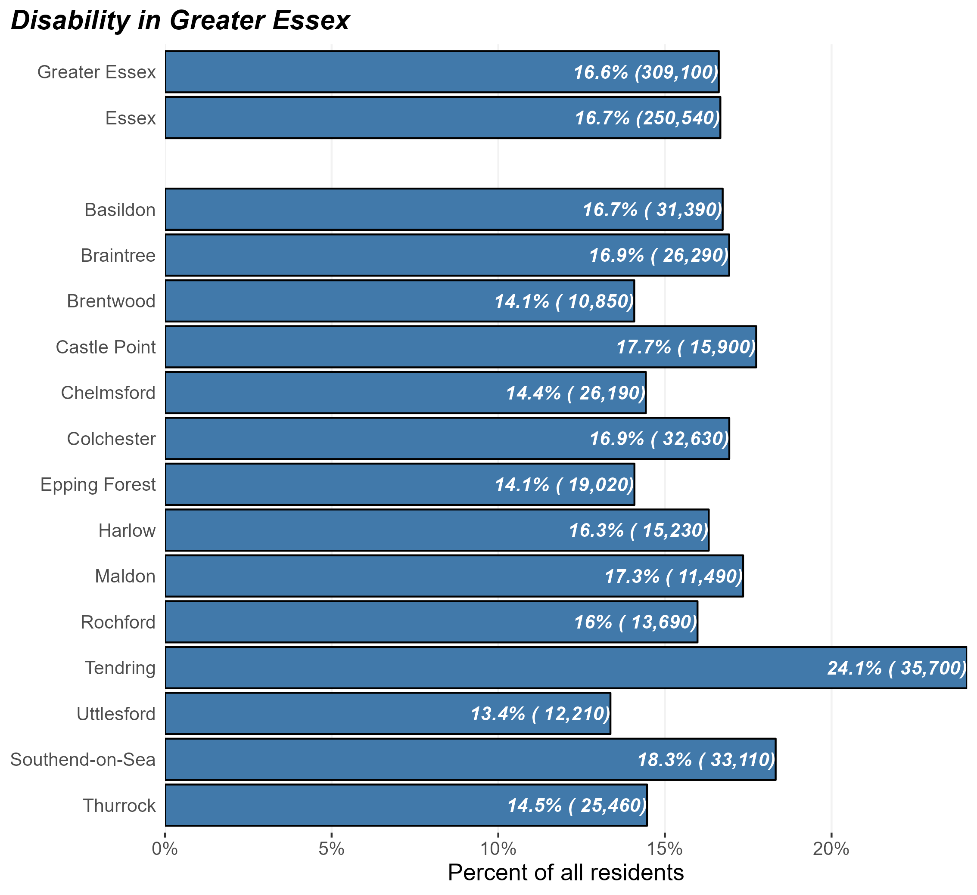
The disabled population
Number and percentage of residents identifying as disabled in Greater Essex and Essex Districts, Census 2021
At the time of Census 2021, there were some 250,500 disabled people in Essex and 309,000 in Greater Essex (including the areas of Southend and Thurrock).
This equates to 16.7% of Essex residents – broadly in line with the average of England as a whole (16.9%).
But the prevalence of disability within the population varies substantially across different districts. Coastal areas – Tendring, Southend, and Castle Point – have the highest levels of disability within their resident populations.
Research & Citizen Insight | Policy Unit | Essex County Council
4

Slide 5
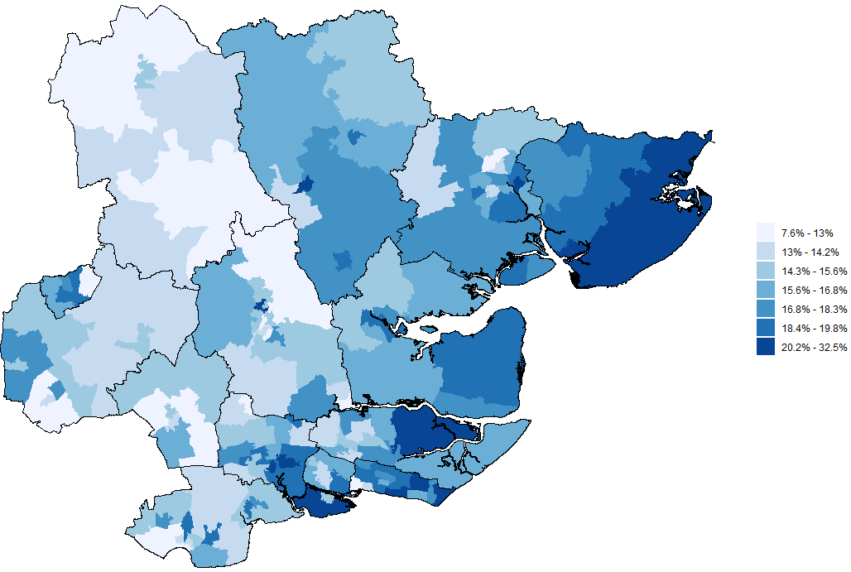
Disability across Greater Essex
Prevalence of disability by MSOA, Greater Essex, Census 2021
The map opposite shows the proportion of residents in each middle-level super outputs area (MSOA) who identify as disabled
This shows that the proportion of the population who identify as disabled is generally higher in coastal areas – Tendring, parts of Rochford, Maldon, Castle Point, and Southend.
These areas tend to have an older average age, which may explain some of the patterns
There are also significant concentrations of disabled people in neighbourhoods in Essex’s larger towns – Basildon, Harlow, Braintree, Colchester and Chelmsford. These concentrations tend to be found in more deprived areas within these urban centres.
Research & Citizen Insight | Policy Unit | Essex County Council
5

Slide 6
Section 2: Characteristics of the disabled population
Exploring the prevalence of other protected characteristics within Essex’s disabled population

Slide 7
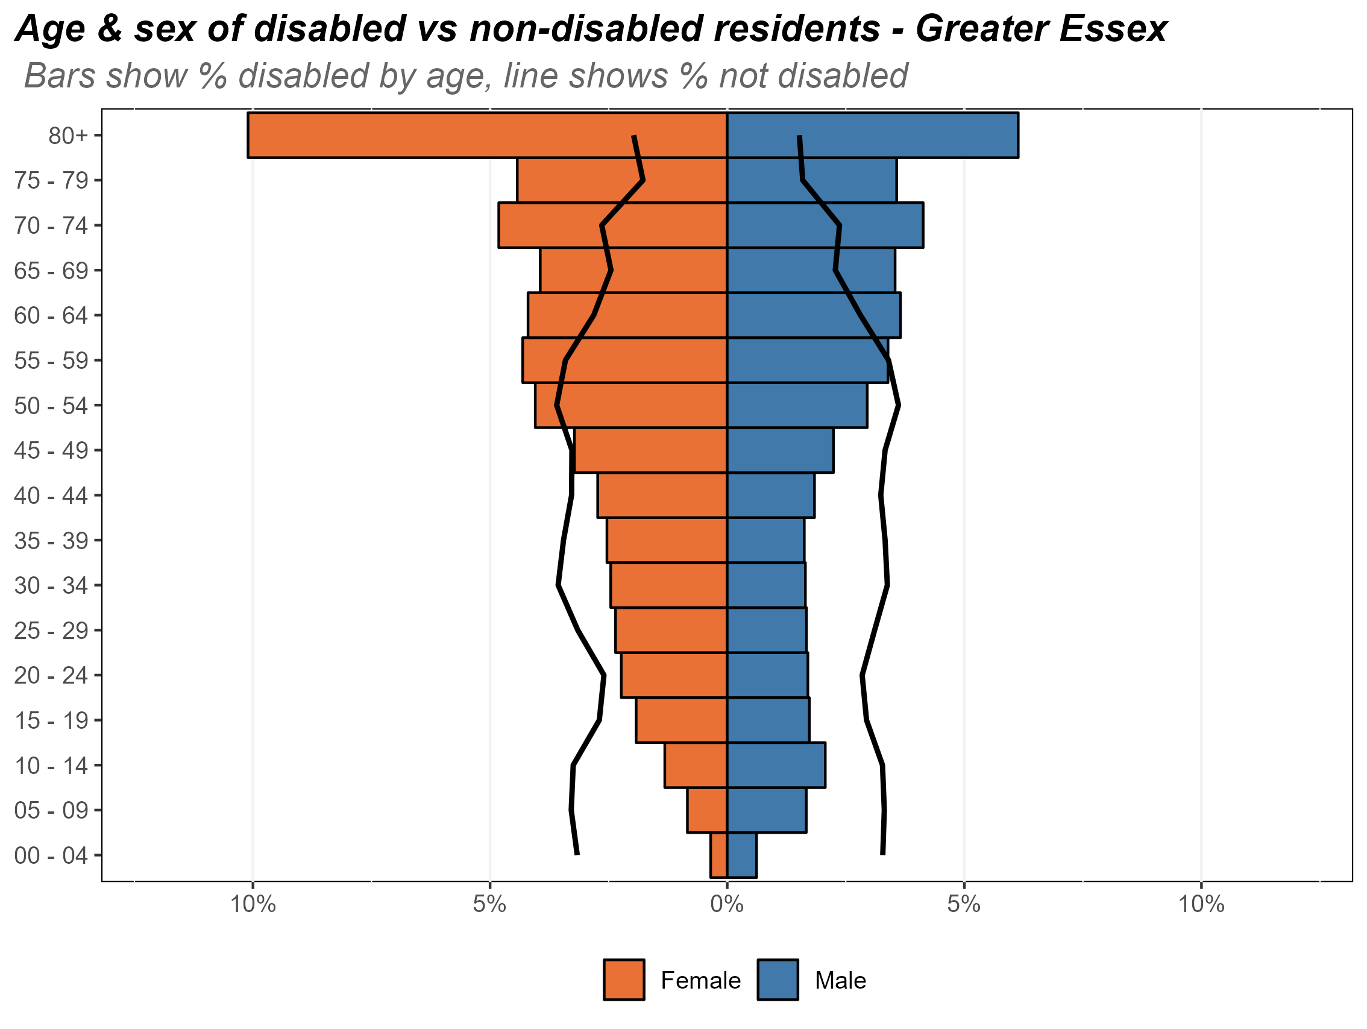
Age and sex of the disabled population
Composition of the disabled population by age and sex, Essex, 2021
The chart opposite shows the composition of Essex’s disabled population by age and by sex. The age/sex profile for Essex’s non-disabled residents is shown by the black lines.
This analysis reveals that:
the disabled population is, in large part, made up of residents who are older – a third of Essex’s disabled population are over 70;
a significant minority are aged 40 (some 73.3%);
the majority of the disabled population are female (134,000 compared to 108,000 men). This is likely to reflect the fact that women live longer on average.
women who are over 50 are more likely to live with disabilities then without.
men who are over 55 are more likely to live with disabilities then without.
Research & Citizen Insight | Policy Unit | Essex County Council
7

Slide 8
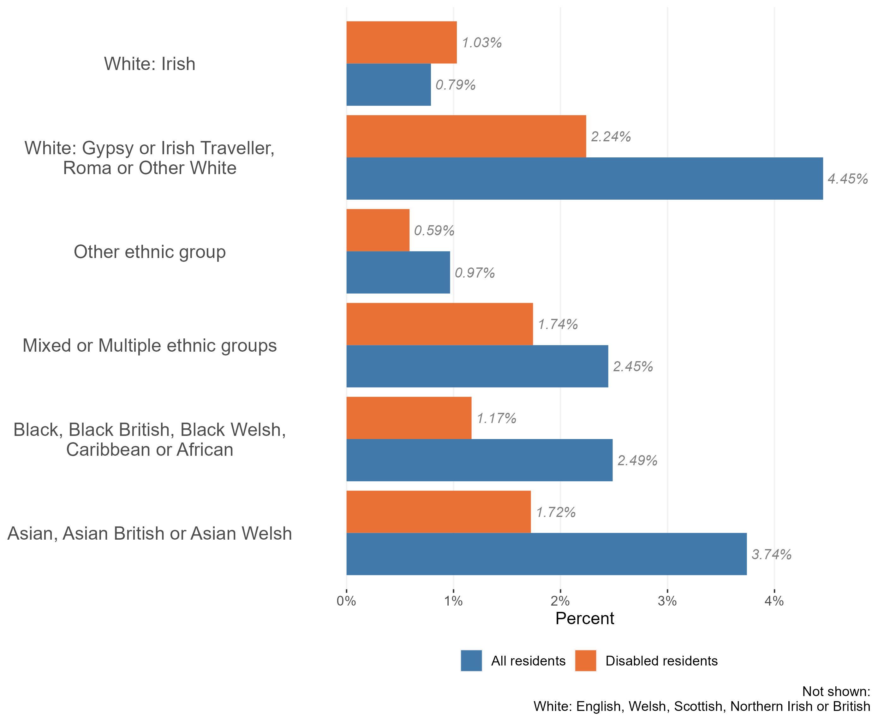
Ethnic diversity in the disabled population
Composition of the disabled and nondisabled populations by ethnic group Essex, 2021
The vast majority of Essex’s disabled population identify as White British (91.5% - or 229,300 for the 250,600 disabled population).
Only 21,300 identify as members of other ethnic groups (8.5% - compared to 16.7% across the population as a whole).
In particular, the analysis reveals that members of the Essex disabled population are half as likely as the wider population to identify as:
Gypsy or Irish Traveller, Roma or Other white;
Black, Black British, Caribbean or African;
Asian or Asian British.
Members of the disabled population are more likely to identify as White Irish than the population as a whole.
The ethnic composition of the disabled population is likely to be a reflection of its age profile. Those who are disabled are more likely to be in older groups, and those in older age groups are more likely to identify as White British.
Research & Citizen Insight | Policy Unit | Essex County Council
8

Slide 9
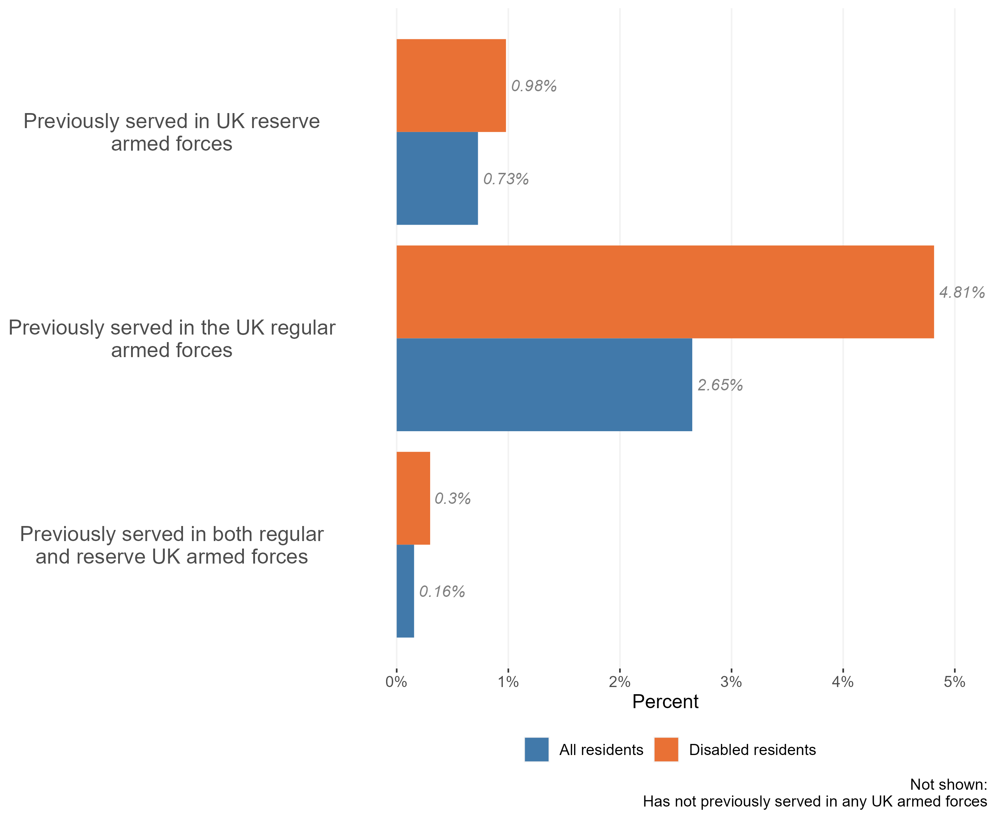
Veterans in the disabled population
Composition of the disabled and non-disabled populations by veteran status, Essex, 2021
The vast majority of the Essex disabled population (c.94%) have not previously served in the UK armed forces in any capacity.
Nevertheless, our analysis suggests that veterans are over-represented in the Essex disabled population. There are around 14,100 members of the disabled population who have previously served, either as members of the UK reserve or regular armed forces.
Previous service in the armed forces has the strongest link with disability, followed by service in the reserve forces. There is a slight increase in disability for people who served in both the reserves and the regular armed forces
Veteran status is strongly related to age (due to for example national service), which may explain some of this association.
Research & Citizen Insight | Policy Unit | Essex County Council
9

Slide 10
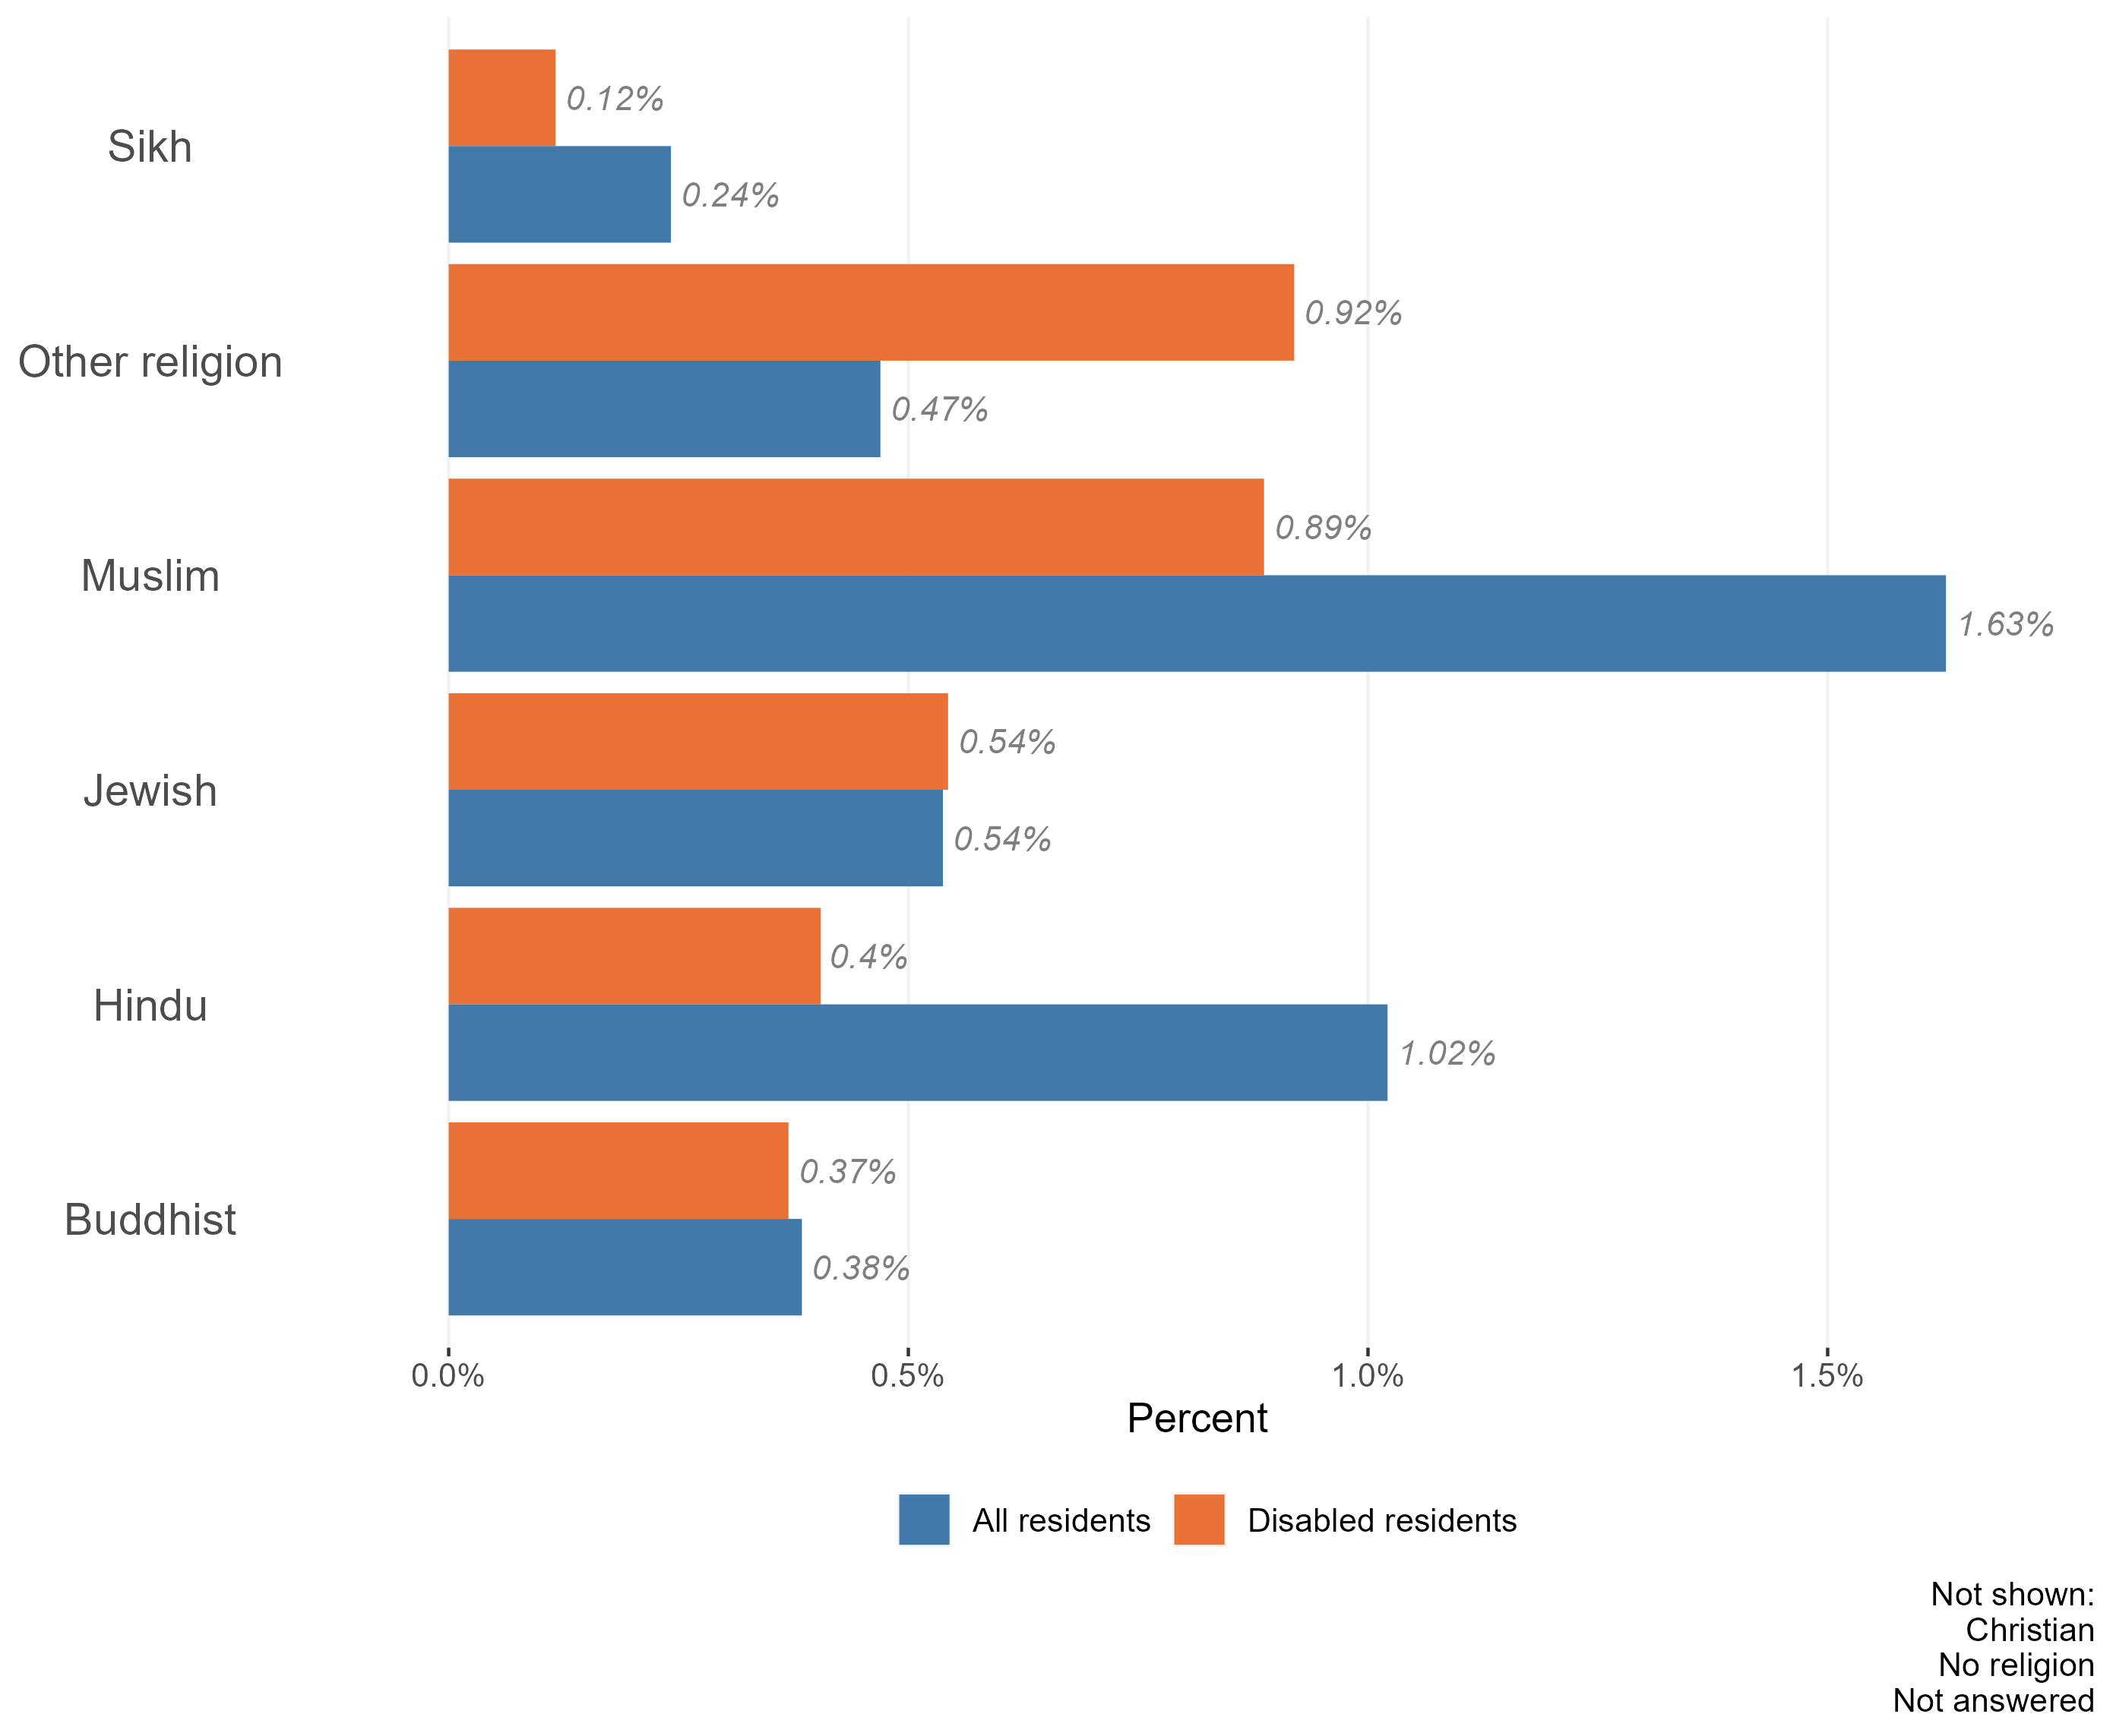
Religion in the disabled population
Composition of the disabled and non-disabled populations by religion, Essex, 2021
The vast majority of the Essex disabled population identify either as having either ‘no religion’ (37.1%) or as Christian (53.7%). This is broadly in line with the religious make-up of the Essex population as a whole.
But amongst the Essex disabled population:
a higher percentage of residents identified as following ‘other religions’ than the Essex population as a whole.
a lower percentage of residents identified as Muslim, Sikh, Hindu or Buddhist than the Essex population as a whole.
Again, the religious profile of the disabled population is likely to be a reflection of its age profile. Those who are disabled are more likely to be in older groups, and those in older age groups are more likely to identify as Christian / no religion. Those who identify as Sikh, Muslim, Hindu or Buddhist tend to be in younger age groups.
Research & Citizen Insight | Policy Unit | Essex County Council
10

Slide 11
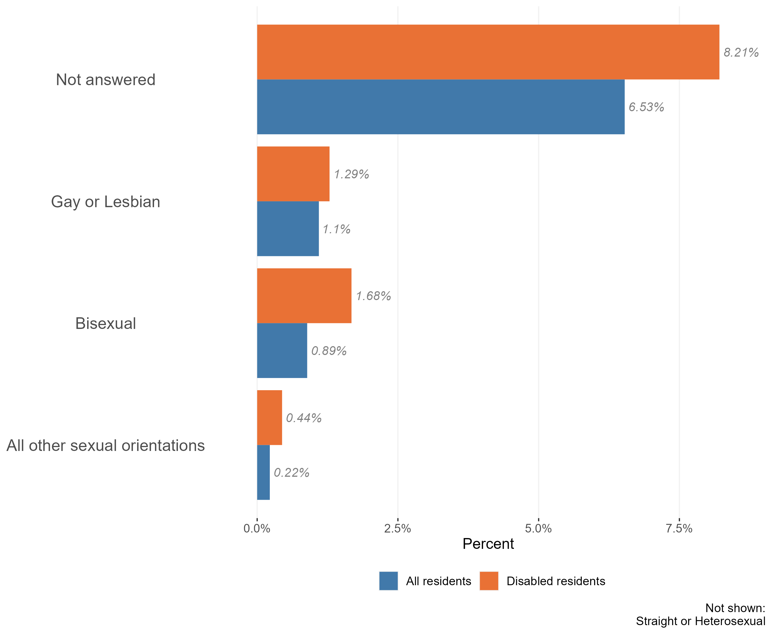
Sexuality and the disabled population
Composition of the disabled and non-disabled populations by sexuality, Essex, 2021
The majority of the Essex disabled population identify as ‘straight or heterosexual’ (88%). This is slightly lower than across the Essex population as a whole (91%).
Members of the Essex disabled community are more likely to identify as gay or lesbian, bisexual, or ‘other sexual orientations’ than the Essex population as a whole.
Members of the Essex disabled population were also less likely to provide an answer to questions about their sexuality in census 2021 than the population as a whole. It is worth noting that 2021 was the first census which collected data on sexuality. Compared to other questions on the census, this topic has a relatively high proportion of ‘not answered’ responses – where the person has not provided any information on the topic.
Due to the sensitive nature of the topic, this ‘missing data’ will not be missing at random. Certain groups of the population, or people living in certain situations, may feel unable or unwilling to answer these questions.
Research & Citizen Insight | Policy Unit | Essex County Council
11

Slide 12
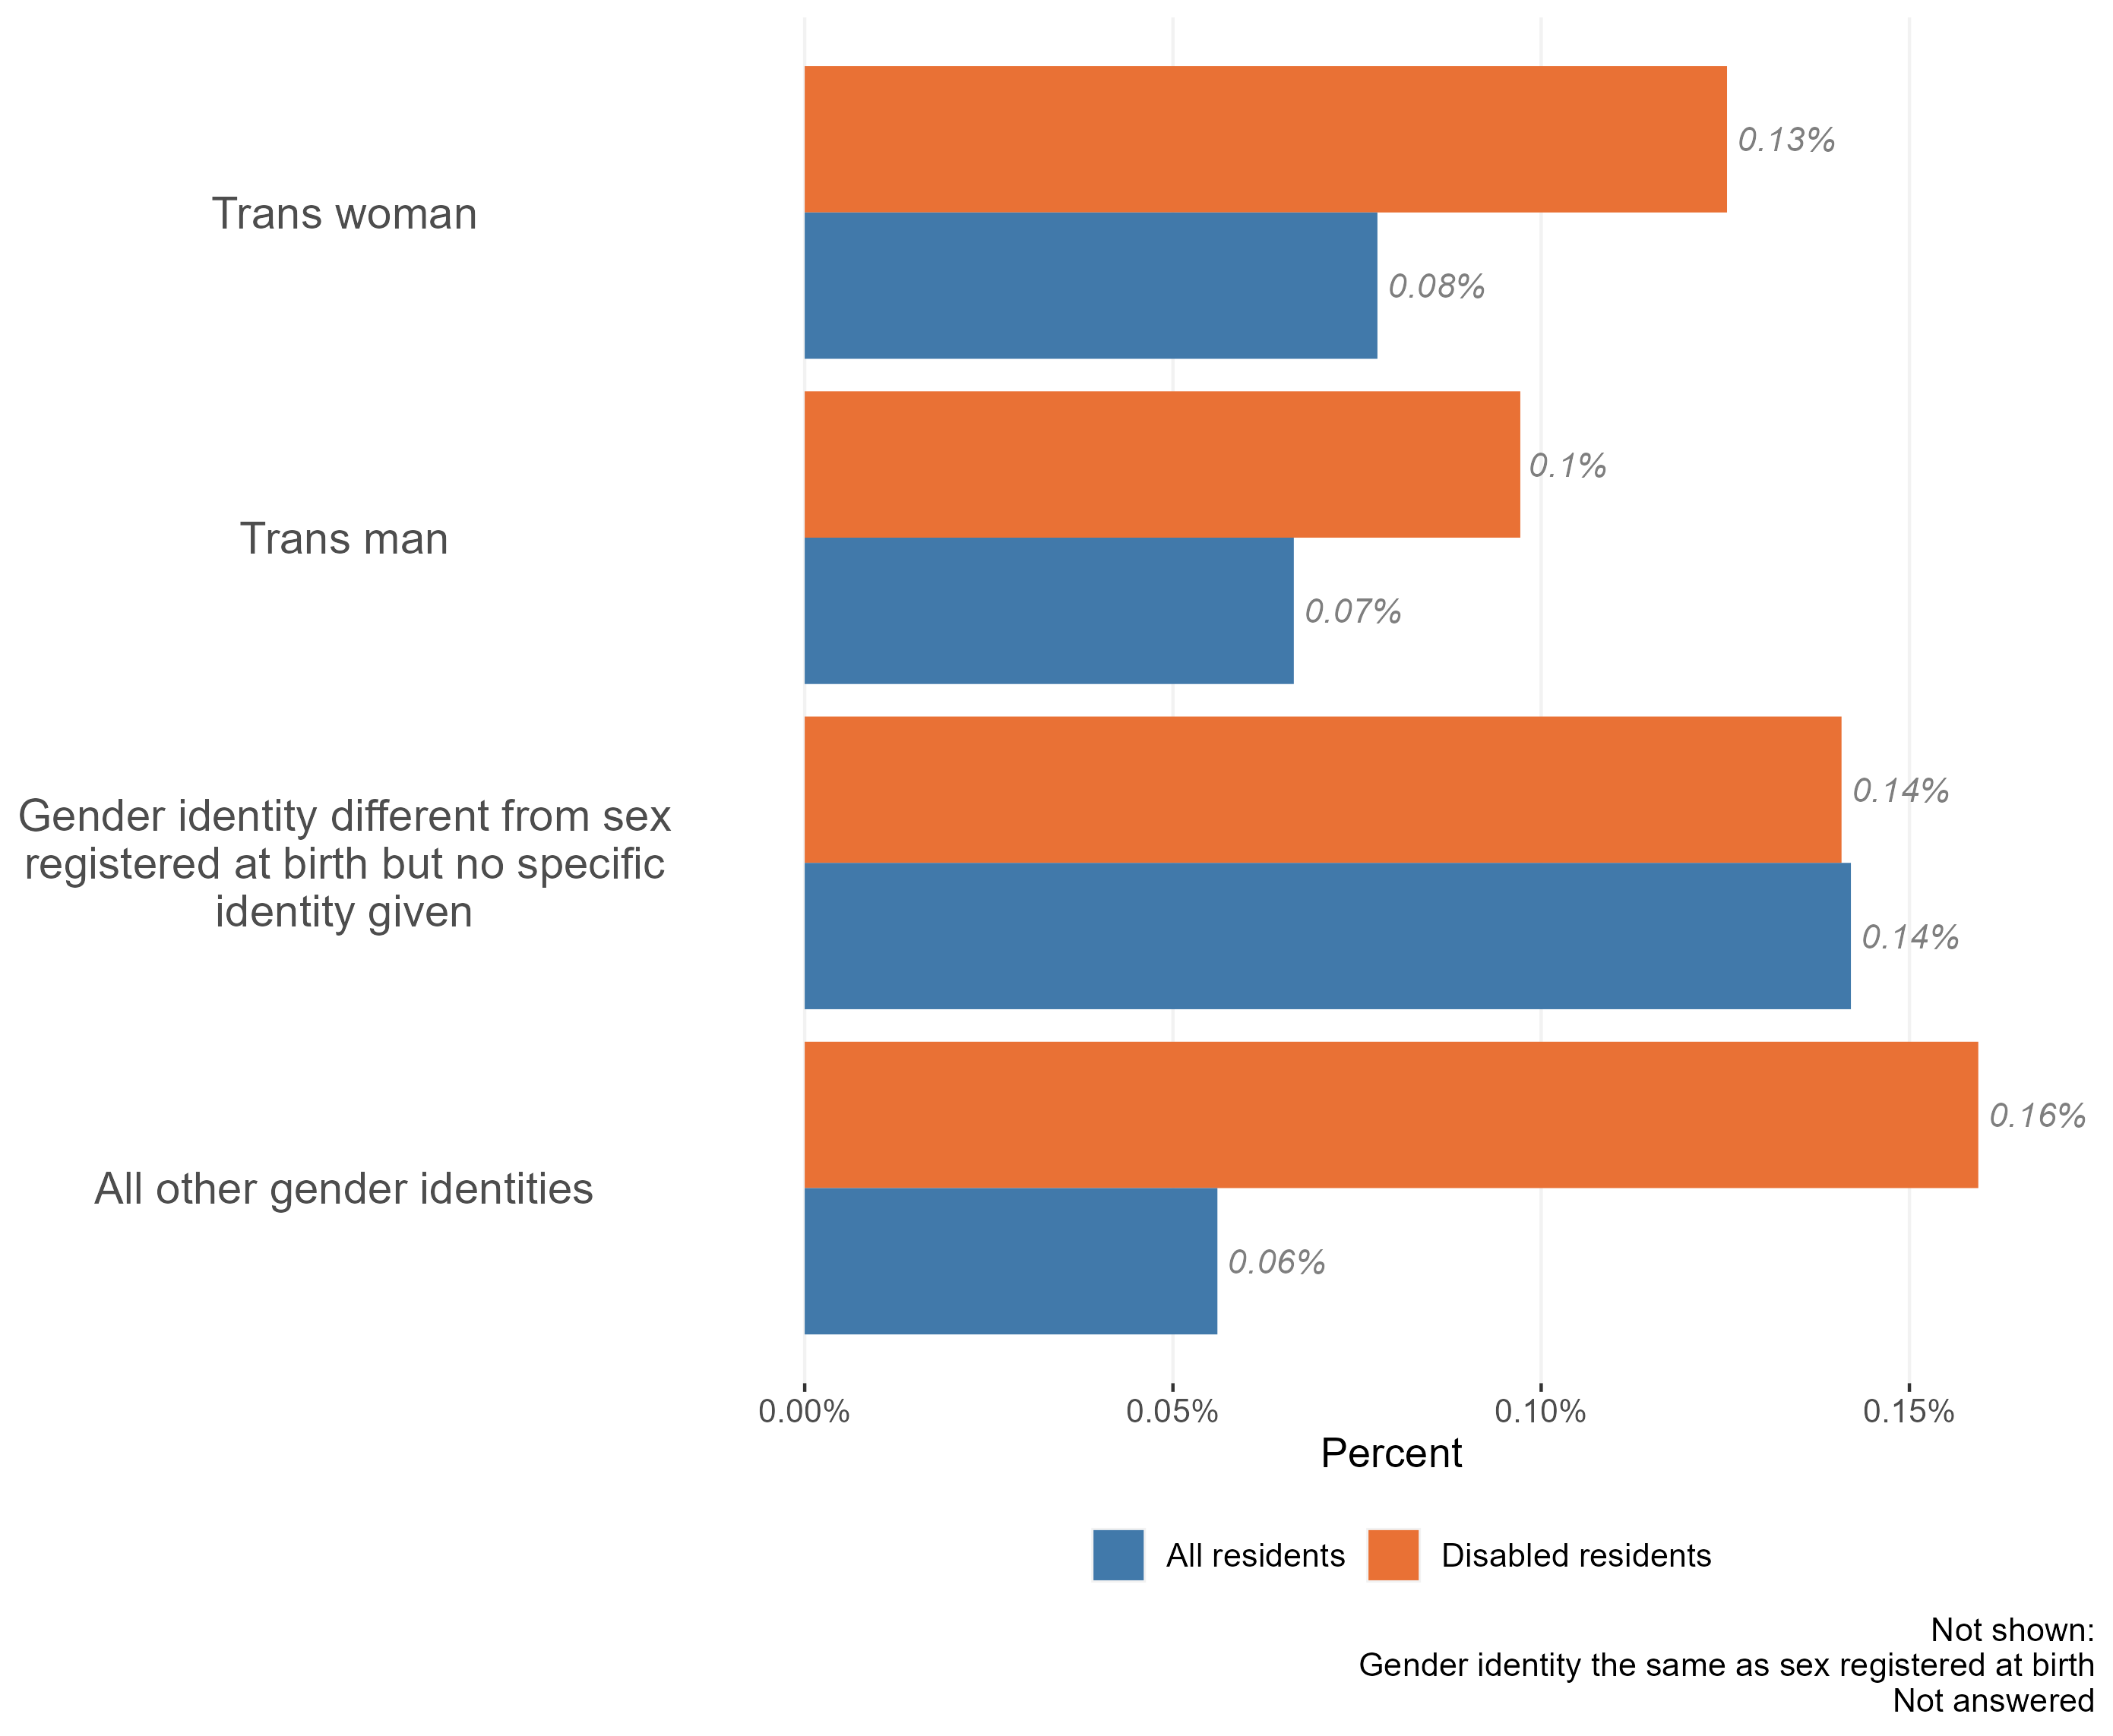
Gender identity in the disabled population
Composition of the disabled and non-disabled populations by gender identity, Essex, 2021
The vast majority of the Essex disabled population have a gender identity which the same as their sex registered at birth. Only around 1,200 people in the Essex disabled population identify as having a different gender identity.
Nevertheless, this is a slightly higher proportion than across the Essex population as a whole. Within the Essex disabled population:
a higher percentage of residents identified as trans men and trans women than across the population as a whole;
a higher percentage of residents identified as having ‘other gender identities.’
Research & Citizen Insight | Policy Unit | Essex County Council
12

Slide 13
Section 3: Outcomes for the disabled population
Exploring the extent to which the disabled population enjoy positive outcomes

Slide 14
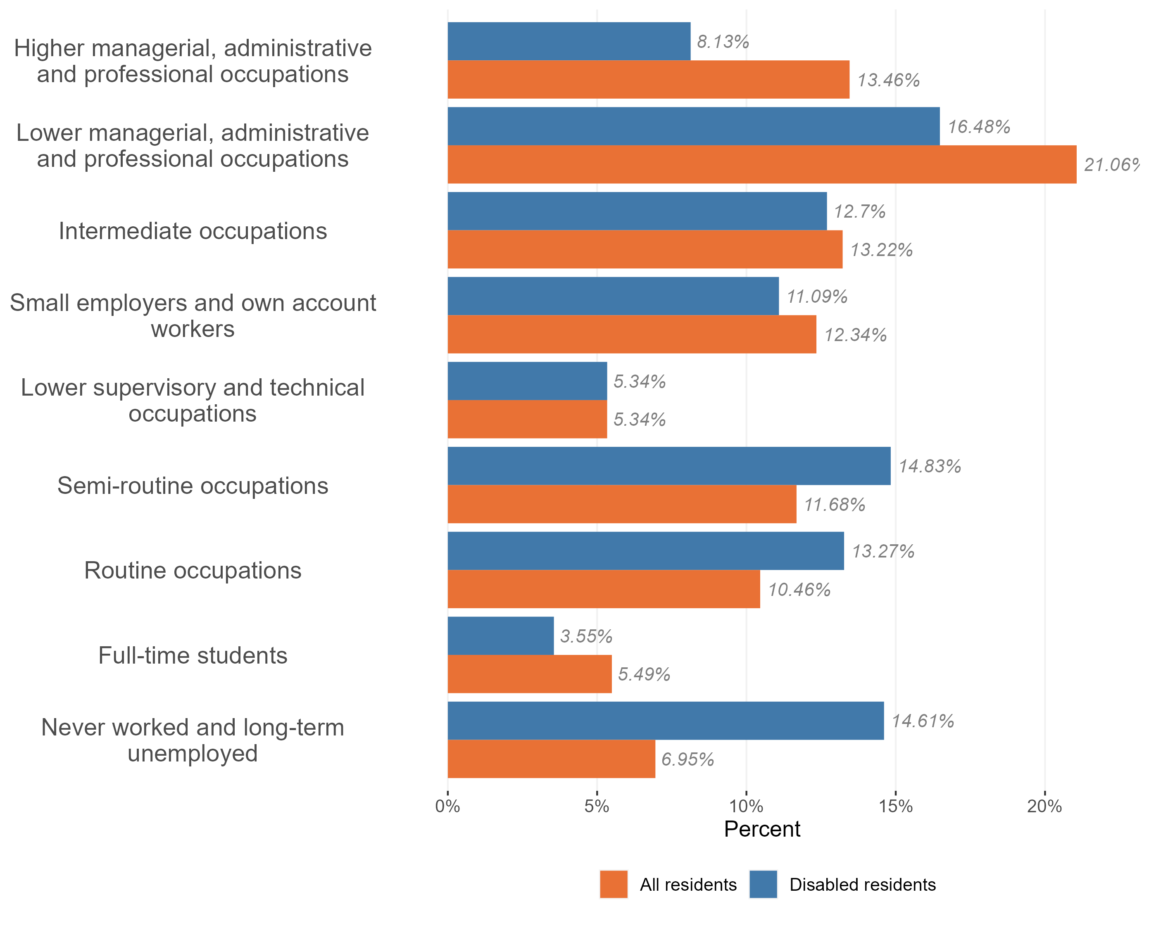
Employment and occupation type
Employment and occupation type, disabled and non-disabled population, Essex 2021
Disabled people in Essex are significantly more likely to have never worked or to be long-term unemployed compared to working-age residents.
Those disabled people who are in work are:
less likely to hold occupations managerial, administrative and professional roles than the wider working population; and
More likely to be in ‘routine occupations’ and semi-routine occupations’
Disabled people are also less likely to be full time students.
Research & Citizen Insight | Policy Unit | Essex County Council
14

Slide 15
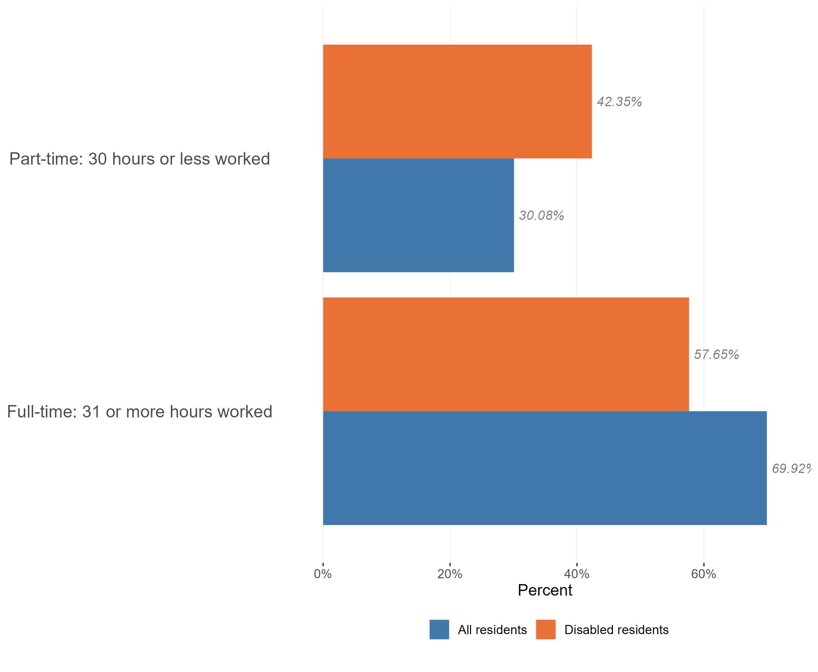
Employment and hours worked
Hours worked by disability status, Essex, 2021
Disabled people in Essex are less likely to be in work than the working-age population as a whole. Those who do work are more likely to work part-time than members of the wider population.
Of the 205,600 people who make up the Essex disabled population, 131,500 are working-age adults. Of this group 48.8% were in work at the time of Census 2021.
This is a lower proportion than we see across the working-age population as a whole suggesting that disabled people are less likely to be in work than the average for the population as a whole.
The majority of the Essex disabled population who are in work are in full-time roles (58% hold full-time roles compared to 42% working part-time)*, a higher proportion are in part-time work than across the Essex working-age population as a whole.
*Within Census data full time roles are classified as 31+ hours per week and part-time roles are classed as 30 hrs or less per week.
Research & Citizen Insight | Policy Unit | Essex County Council
15

Slide 16
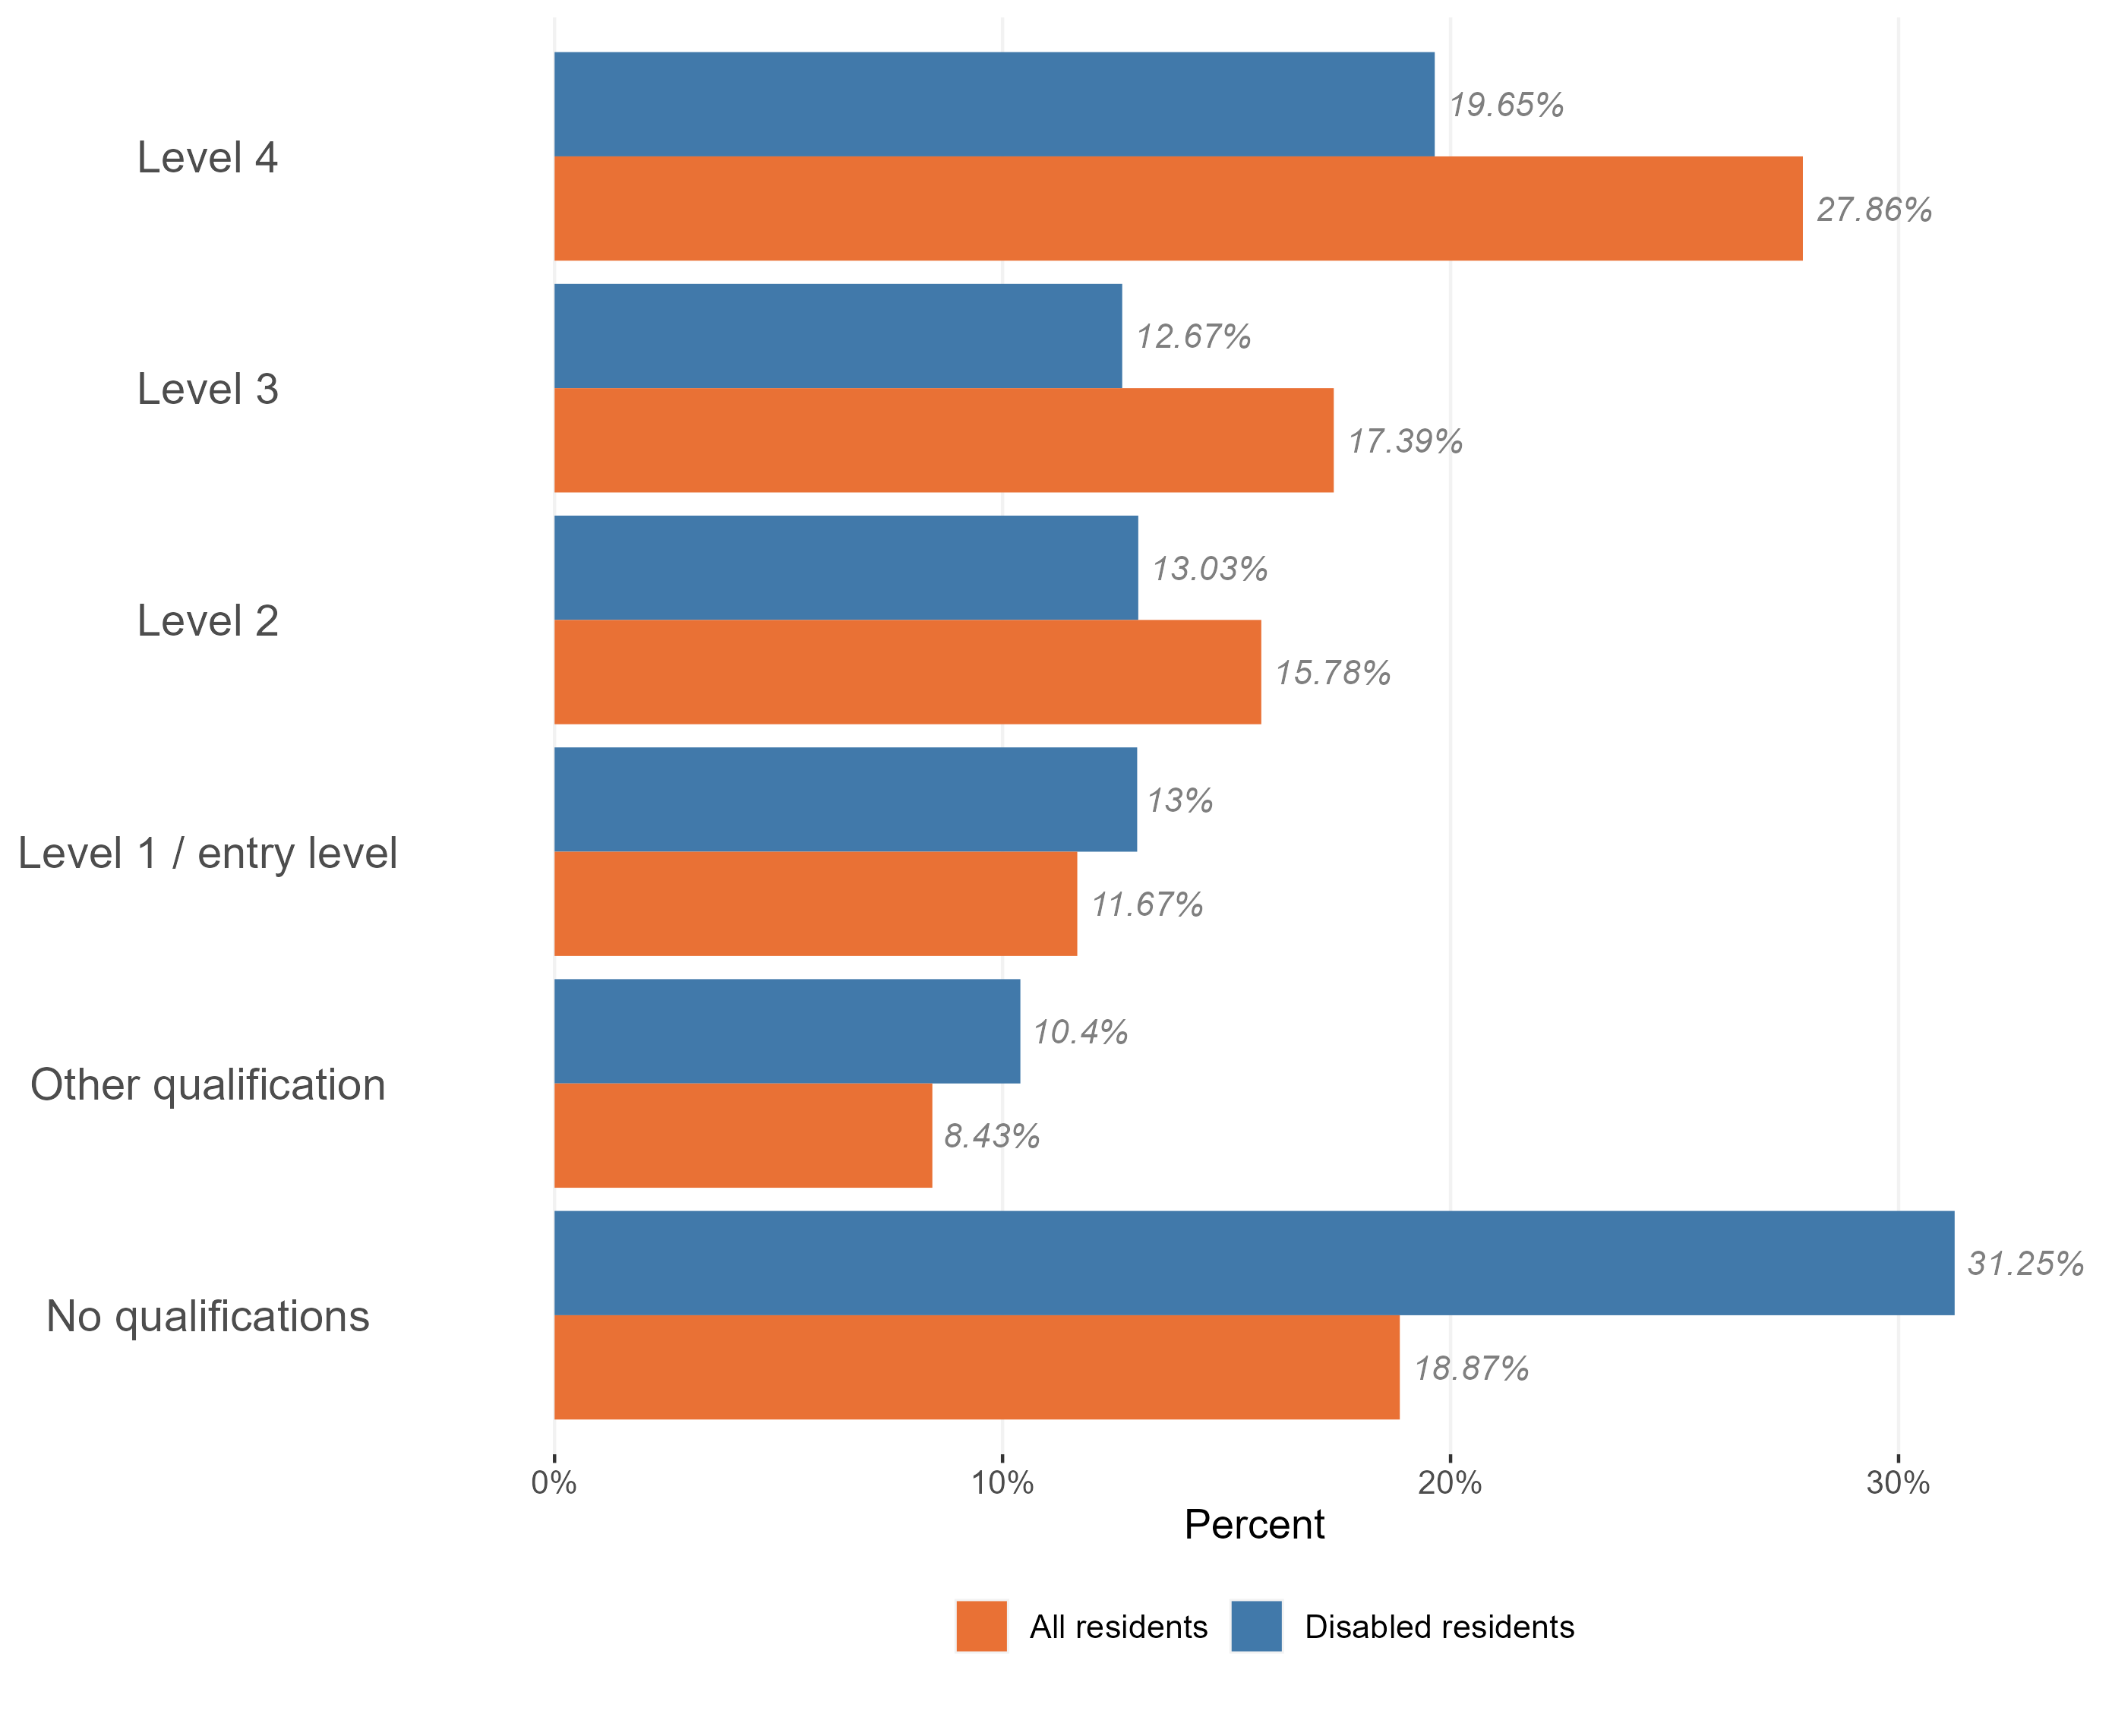
Highest qualification level
Level of qualifications held in the disabled population, Essex, 2021
Disabled people in Essex are significantly less likely to hold higher level qualifications than the population as a whole.
They are also significantly more likely to hold no formal qualifications or to hold only entry level qualifications than the wider population of working-age residents.
Our analysis suggests that the scale of the inequality between disabled residents and on-disabled residents increase with level of qualification – there are fewer than expected disabled people in Essex with the highest levels of qualifications (level 4 – e.g. Masters degrees or PhDs).
Research & Citizen Insight | Policy Unit | Essex County Council
16

Slide 17
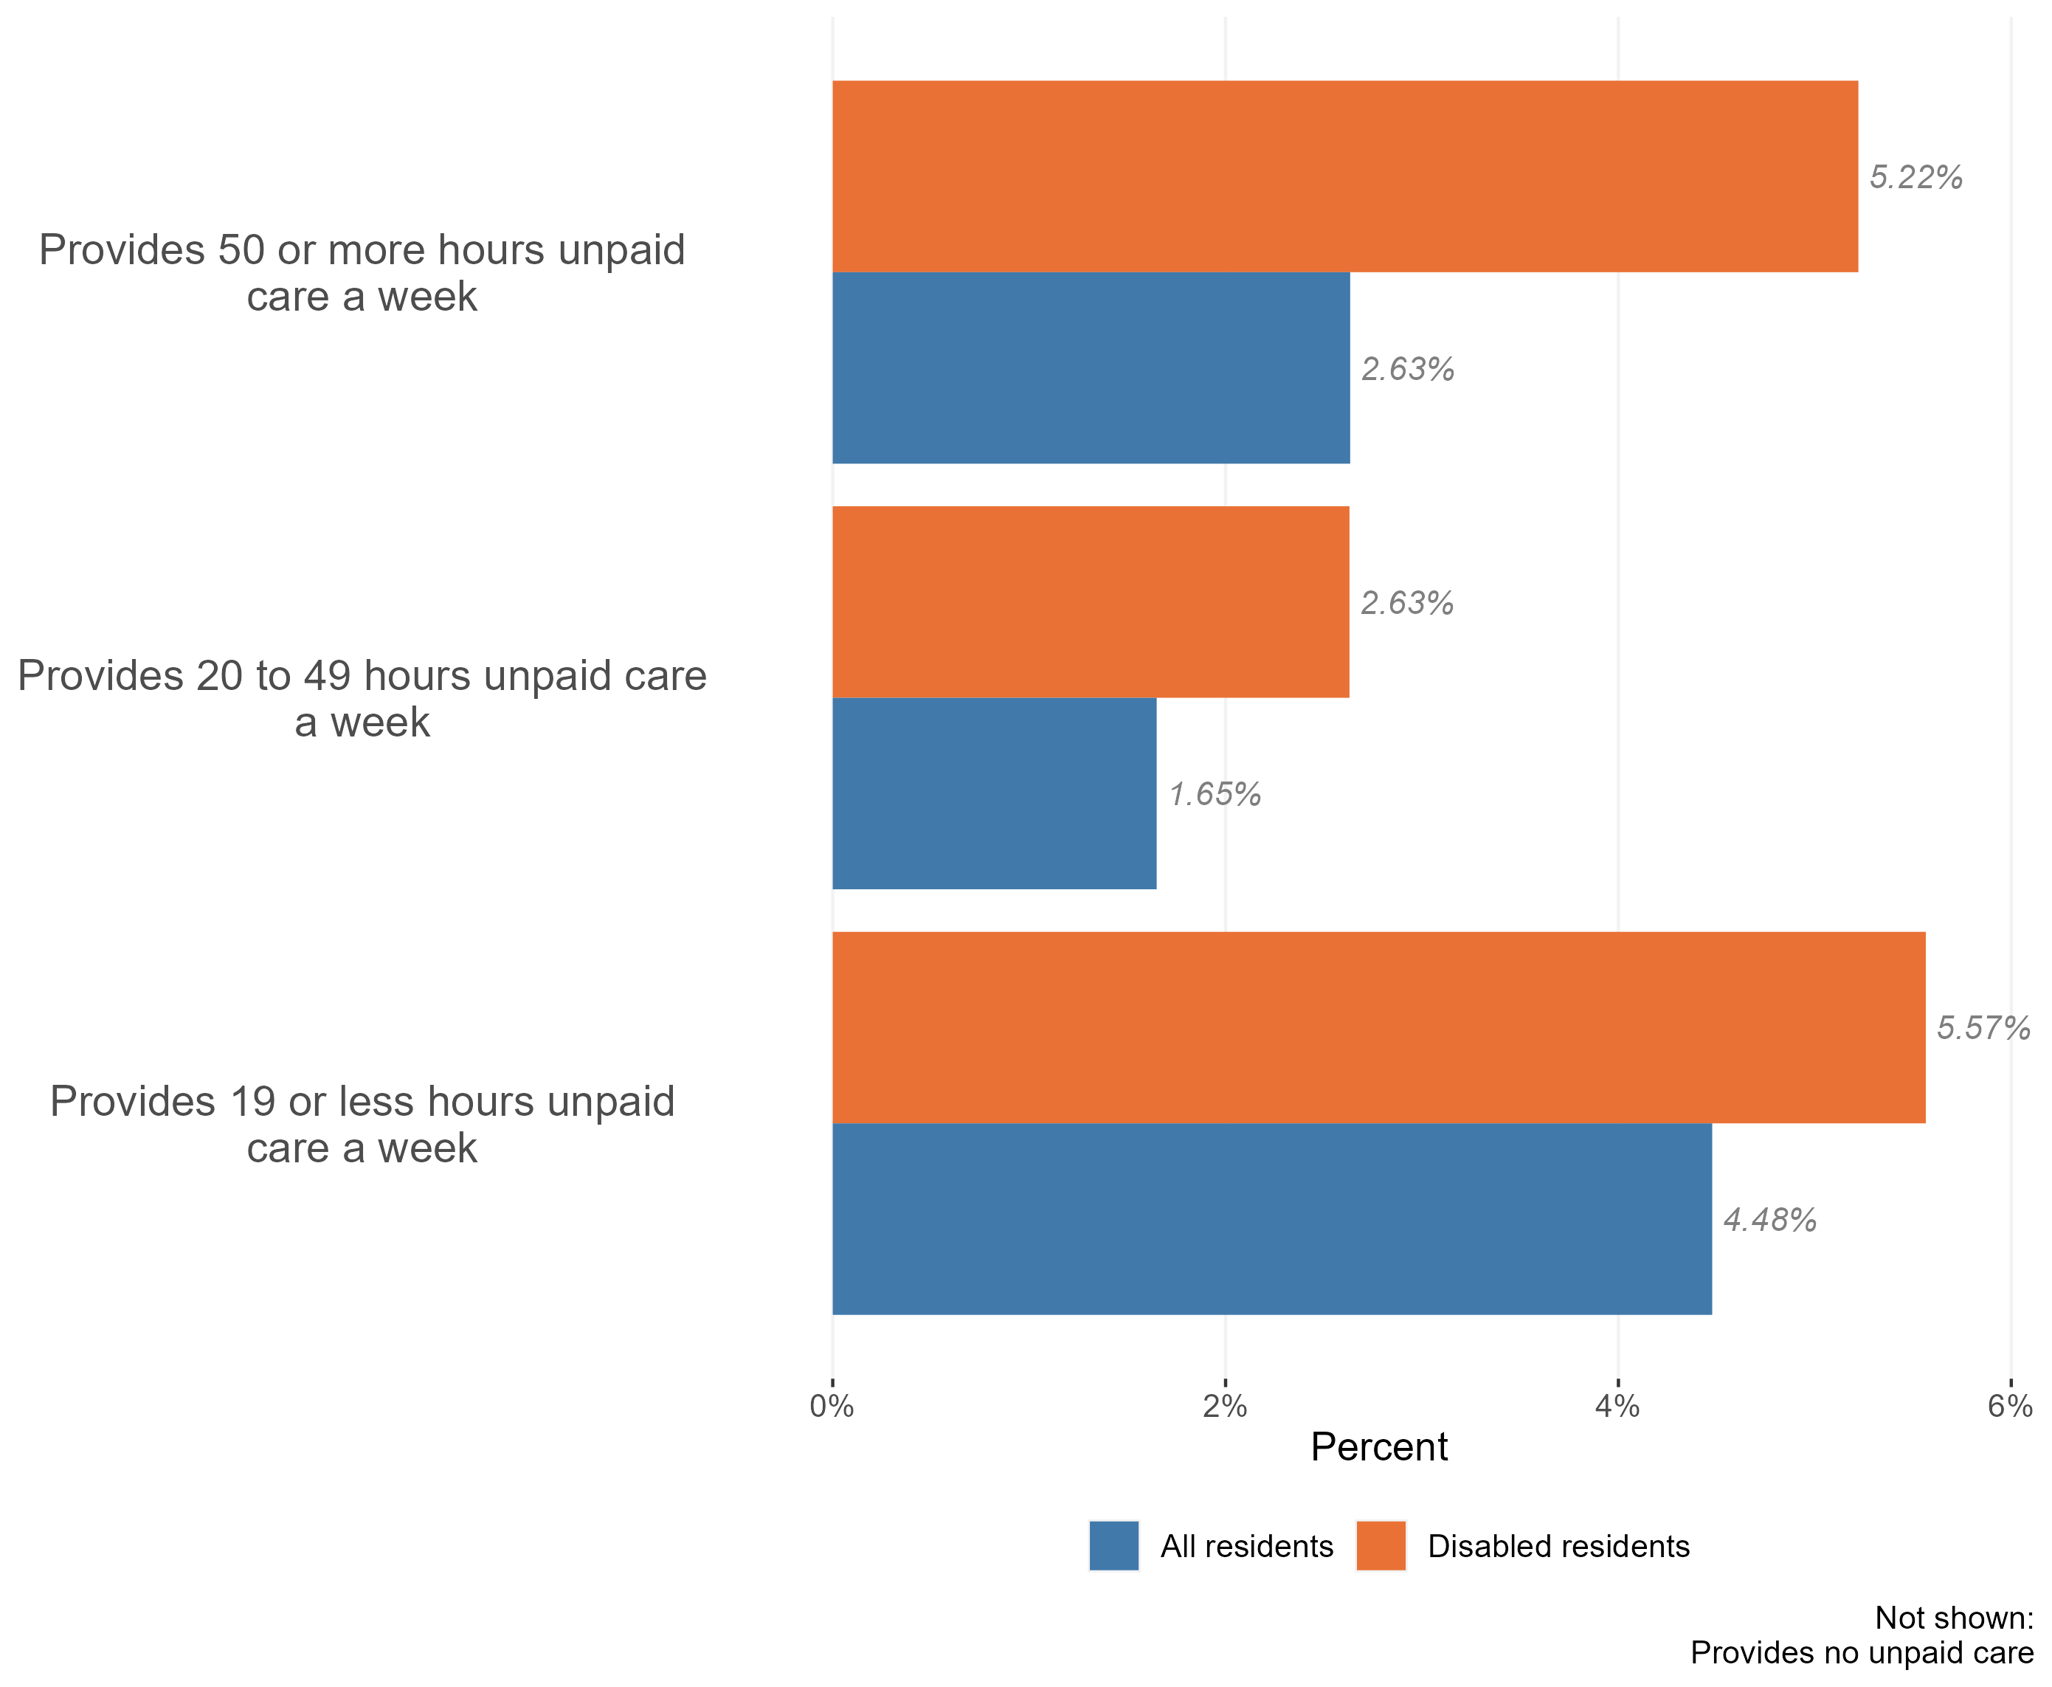
Disability by unpaid care
Provision of unpaid care by the disabled population, Essex, 2021
The vast majority of disabled people in Essex do not provide unpaid care. Only 13% of the disabled population provide some form of unpaid care.
However, disabled people are more likely to be providers of unpaid care than the Essex population as a whole. Only 9% of the general population identified themselves as carers in the Census 2021.
Our analysis also suggests that disabled people are significantly more likely to provide unpaid care for a more time each week. For example, members of Essex’s disabled population are twice as likely as members of the wider population to provide more than 50 hours of unpaid care per week.
Research & Citizen Insight | Policy Unit | Essex County Council
17

Slide 18
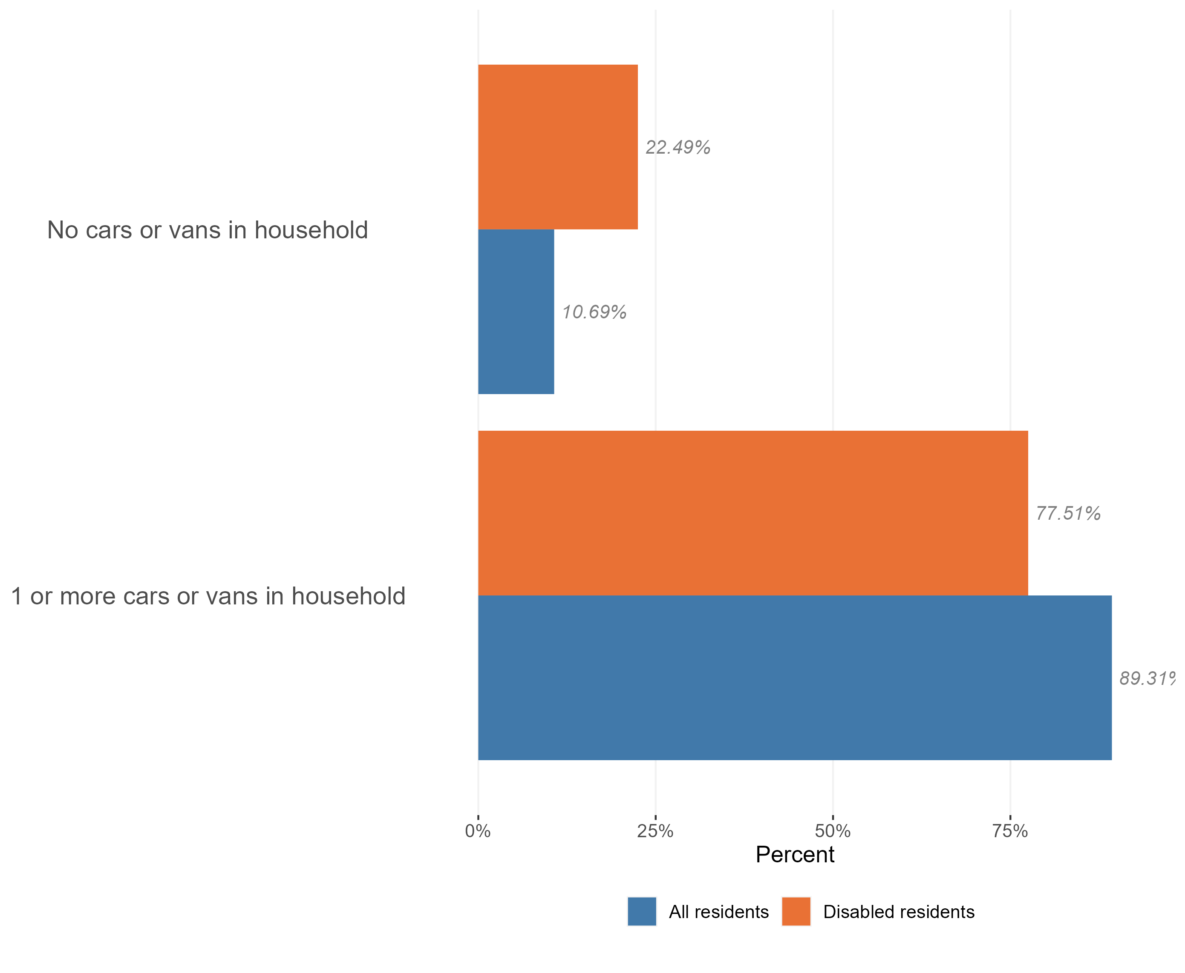
Access to cars
Access to a car or van in the disabled population, Essex, 2021
The vast majority of disabled residents in Essex live have access to one or more cars in their household (78%), although disabled people are less likely to have access to a car than the population as a whole (89%).
Research & Citizen Insight | Policy Unit | Essex County Council
18

