Slide 1
Understanding ethnicity in Essex
Analysis of data from Census 2021
September 2023

Slide 2
Introduction
This document presents an analysis of the ethnic minority population in Essex, based on data collected through Census 2021. It has been prepared as part of a series of analyses exploring the scale, distribution and characteristics of populations with ‘protected characteristics’ as defined by the Equality Act (2010).
The document is divided into three sections:
Section 1: considers the number of people across Essex, and Essex districts who identify as any ethnic group other than white British in the most recent Census data.
Section 2: examines the characteristics of the ethnic minority population, focusing on the extent to which the wider range of protected characteristics can be found within members of the ethnic minority population;
Section 3: examines the outcomes enjoyed by members of the ethnic minority population, focusing on employment outcomes, employment type, health outcomes, the likelihood of providing unpaid care, qualification levels and access to cars/vans.
This is part of a suite of similar analyses examining the protected characteristics defined by the equalities act. Similar analyses, and a series of interactive dashboards, exploring issues of disability, age, sex, sexuality, religion, and gender identity can be found at data.essex.gov.uk.
ECC’s Research and Citizen Insight Team is leading the county council’s work to prepare examine and understand Census data. If you would like to ask questions, find out more, or get involved in this work please contact Alastair Gordon (Alastair.Gordon@essex.gov.uk) or Sean Maguire (Sean.Maguire@essex.gov.uk).
Research & Citizen Insight | Policy Unit | Essex County Council
2

Slide 3
Section 1: The ethnic minority population
Understanding the scale and distribution of Essex’s ethnic minority population

Slide 4
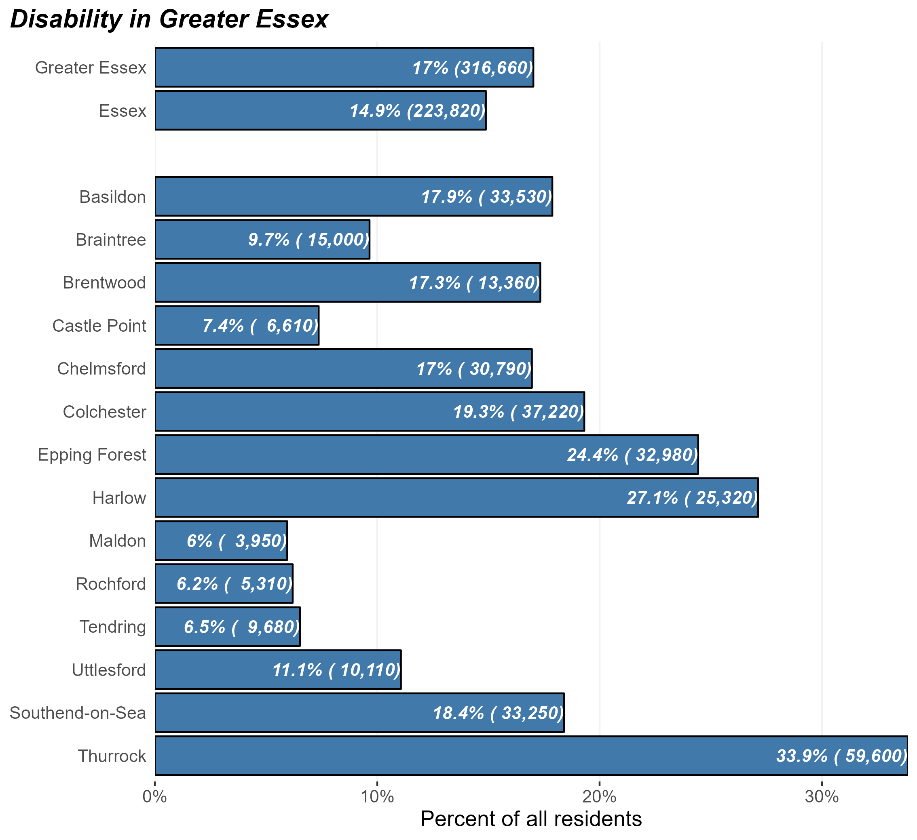
The ethnic minority population
Number and percentage of ethnic minority residents in Greater Essex and Essex Districts, Census 2021
At the time of Census 2021, there were some 224,000 ethnic minority people in Essex and 316,000 in Greater Essex (including the areas of Southend and Thurrock).
This equates to 17.0% of Greater Essex residents – lower than the average of England as a whole (26.4%).
this varies substantially across different districts. Thurrock, Harlow, and Epping have the highest levels of ethnic minority residents within their resident populations.
Research & Citizen Insight | Policy Unit | Essex County Council
4

Slide 5
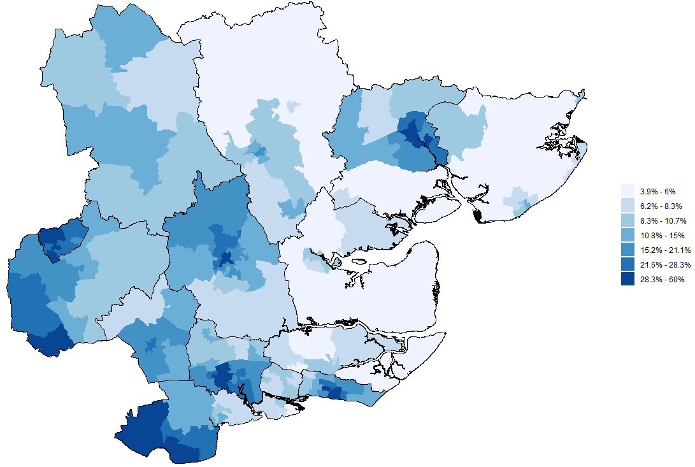
Ethnic minority across Greater Essex
Proportion of ethnic minority residents by MSOA, Greater Essex, Census 2021
The map opposite shows the proportion of residents in each middle-level super outputs area (MSOA) who identify as any ethnicity other than white British
This shows built up areas and the major towns & cities tend to have the higher proportion of ethnic minority residents, as well as areas neighbouring London in Epping Forest and Thurrock
Research & Citizen Insight | Policy Unit | Essex County Council
5

Slide 6
Section 2: Characteristics of the ethnic minority population
Exploring the prevalence of other protected characteristics within Essex’s ethnic minority population

Slide 7
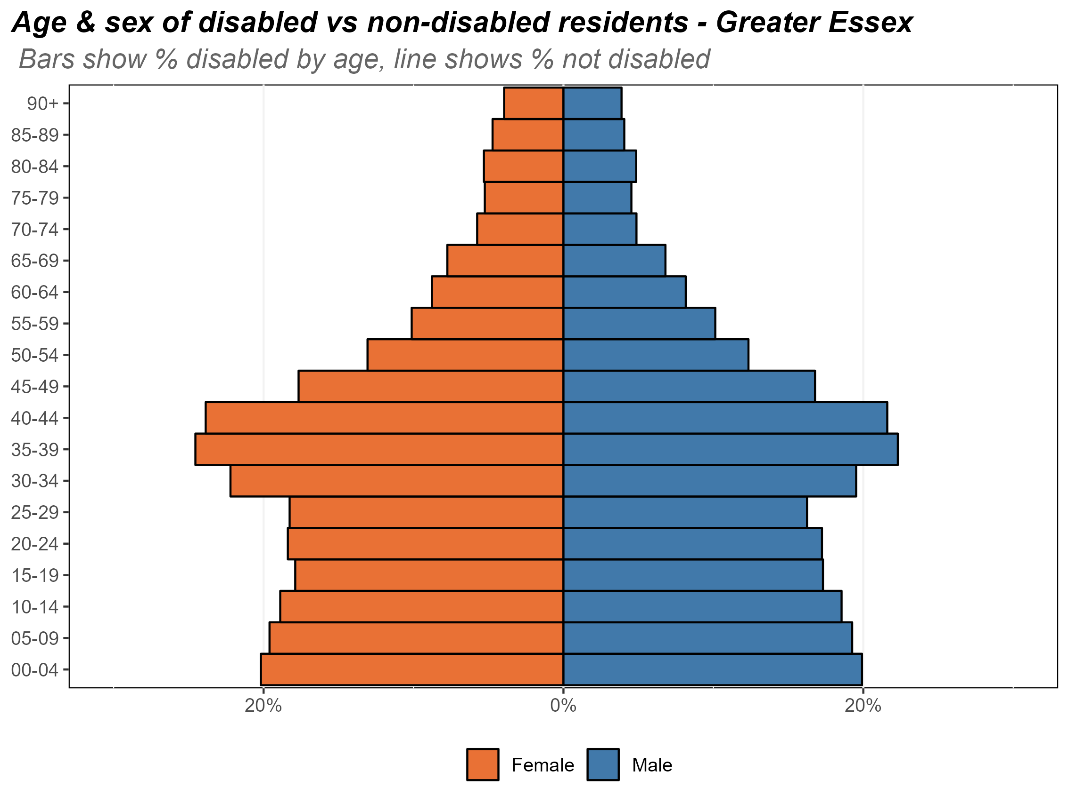
Age and sex of the ethnic minority population
Composition of the ethnic minority population by age and sex, Essex, 2021
The chart opposite shows the composition of Essex’s ethnic minority population by age and by sex.
The ages with the highest proportion of ethnic minority residents are the 30-49 age bands. There is also relatively high proportions of ethnic minority residents in the youngest (0-9) age bands.
This is most likely due to the middle aged ethnic minority residents starting families in Essex.
The proportion of ethnic minority residents then begins to fall as age increases. In the oldest ages, the most common ethnic minority is Irish.
Research & Citizen Insight | Policy Unit | Essex County Council
7

Slide 8
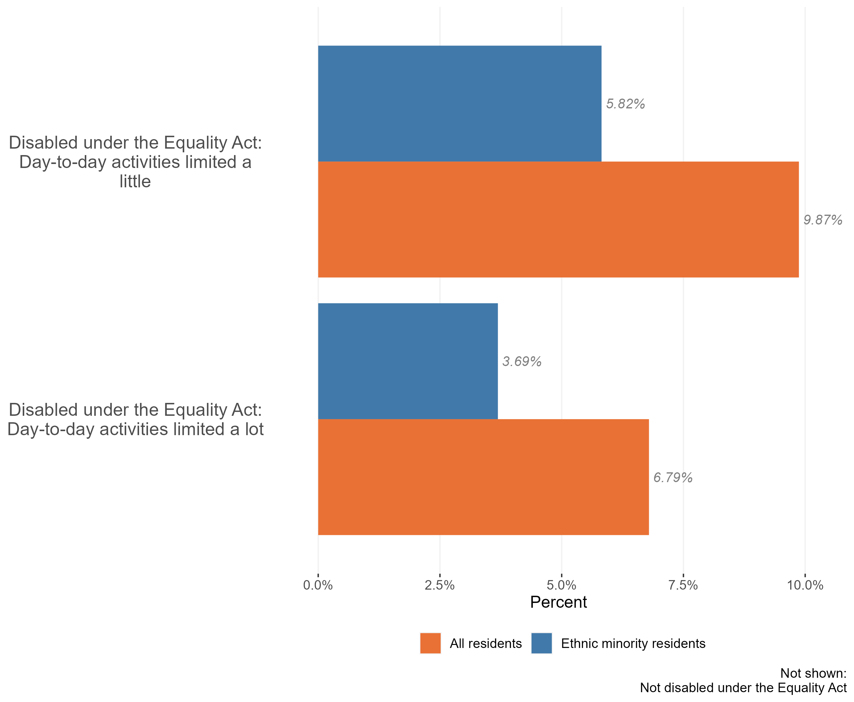
Disability in the ethnic minority population
Disability in the ethnic minority and general populations, Essex, 2021
The prevalence of disability is much lower in Essex ethnic minority residents compared to the general Essex population – 9.5% of ethnic minority residents class themselves as disabled under the equality act, compared to 16.7% of Essex residents.
Essex has a slightly lower prevalence of disability compared to England as whole (17.3% of England residents are disabled), and we see a similar gap when looking at ethnic minority residents. In England 10.7% of ethnic minority residents class themselves as disabled, in Essex this figure drops to 9.5%.
Disability is strongly related to age, and Essex ethnic minority residents are on average younger than the general Essex population. This may explain part of these disability patterns
Research & Citizen Insight | Policy Unit | Essex County Council
8

Slide 9
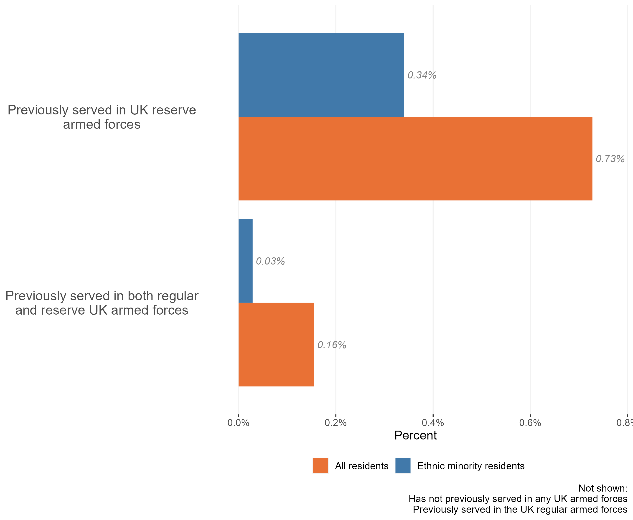
Veterans in the ethnic minority population
Veteran status in the ethnic minority and general populations, Essex, 2021
The vast majority of the Essex ethnic minority population (c.98%) have not previously served in the UK armed forces in any capacity. 1,900 ethnic minority residents have served in the UK armed forces in some capacity.
Circa 1,300 ethnic minority residents have previously served in the regular armed forces (0.7%), lower than the 2.9% of all Essex residents.
Compared to all Essex residents, ethnic minority residents also had lower proportions of previous service in the reserve armed forces or in both the reserves and regular armed forces.
Research & Citizen Insight | Policy Unit | Essex County Council
9

Slide 10
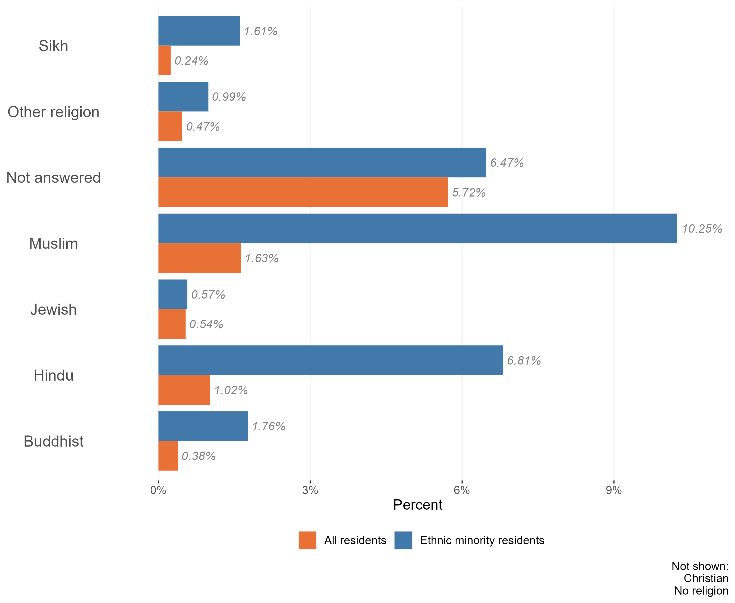
Religion in the ethnic minority population
Composition of general population and ethnic minority populations by religion, Essex, 2021
The vast majority of the Essex ethnic minority population identify as either Christian (50.4%) or ‘no religion’ (21.1%). This is broadly in line with the religious make-up of the Essex population as a whole.
But amongst the Essex ethnic minority population there is a higher percentage of residents identified as Muslin, Hindu, Sikh, and choosing not to answer than the Essex population as a whole.
Research & Citizen Insight | Policy Unit | Essex County Council
10

Slide 11
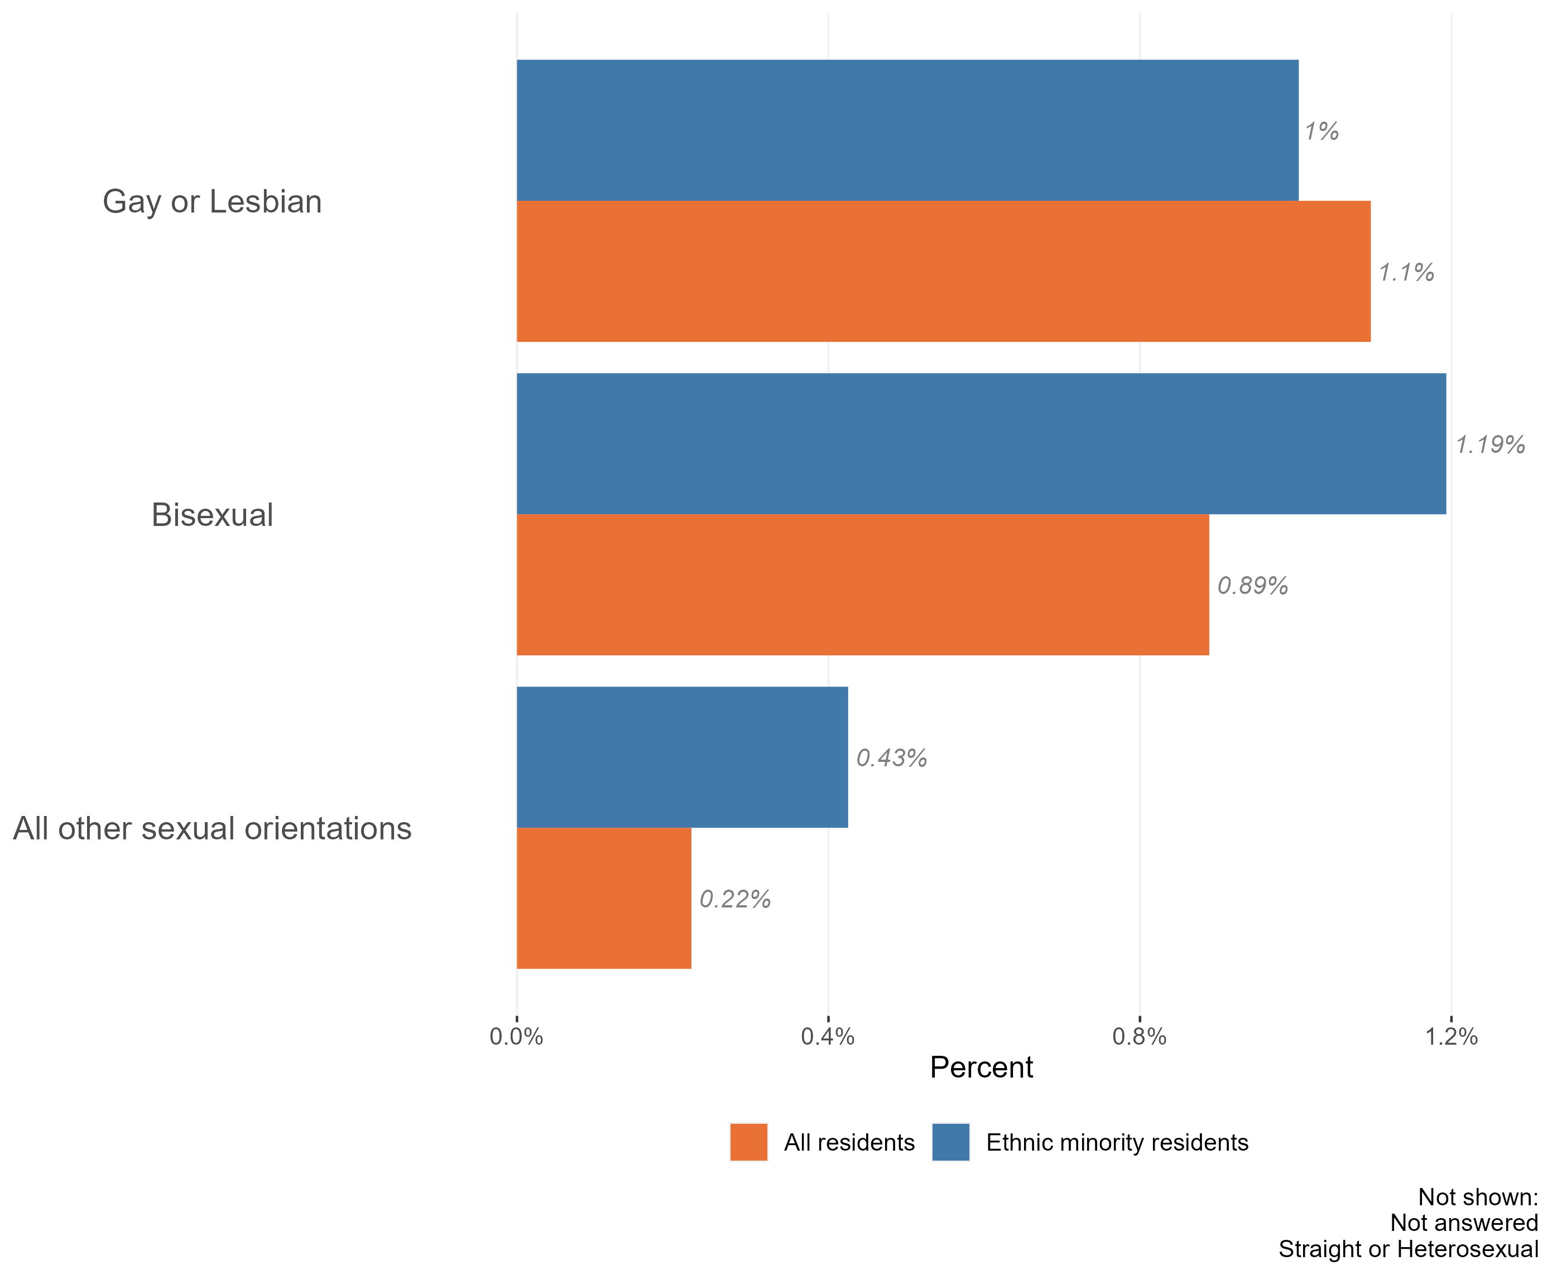
Sexuality and the ethnic minority population
Composition of the general population and ethnic minority populations by sexuality, Essex, 2021
The majority of the Essex ethnic minority population identify as ‘straight or heterosexual’ (89%). This is slightly lower than across the Essex population as a whole (91%).
Ethnic minority residents of Essex are more likely to identify as gay or lesbian, bisexual, or ‘other sexual orientations’ than the Essex population as a whole.
Ethnic minority residents were also less likely to provide an answer to questions about their sexuality in census 2021 than the population as a whole. 8.8% of non-white Residents did not answer census questions regarding sexuality, compared to 6.5% of all Essex residents.
It is worth noting that 2021 was the first census which collected data on sexuality. Compared to other questions on the census, this topic has a relatively high proportion of ‘not answered’ responses – where the person has not provided any information on the topic. Due to the sensitive nature of the topic, this ‘missing data’ will not be missing at random. Certain groups of the population, or people living in certain situations, may feel unable or unwilling to answer these questions.
Research & Citizen Insight | Policy Unit | Essex County Council
11

Slide 12
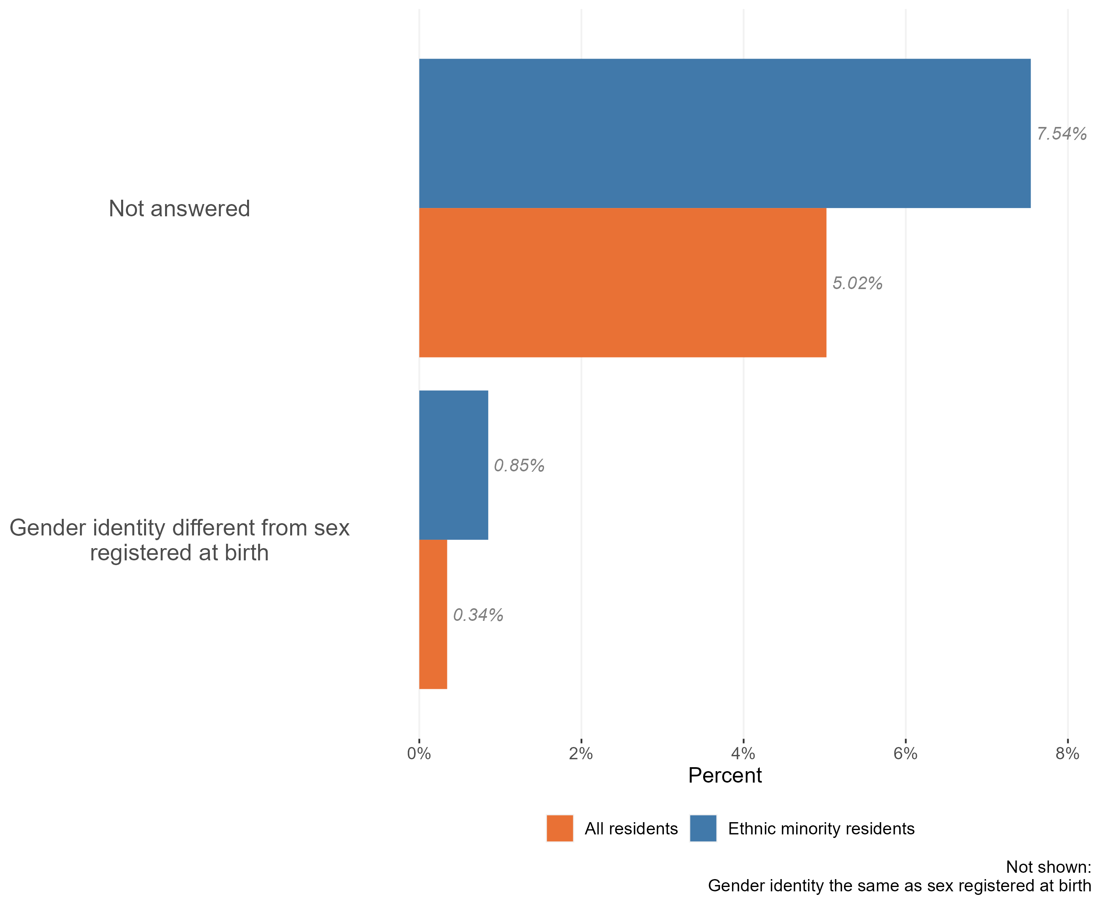
Gender identity in the ethnic minority population
Composition of white British and ethnic minority populations by gender identity, Essex, 2021
The vast majority of the Essex ethnic minority population have a gender identity which the same as their sex registered at birth. Only around 4,200 ethnic minority residents of Essex identify as having a different gender identity.
Nevertheless, this is a slightly higher proportion than across the Essex population as a whole. There is also a higher proportion of residents choosing not to answer questions related to gender compared to the general population of Essex
Research & Citizen Insight | Policy Unit | Essex County Council
12

Slide 13
Section 3: Outcomes for ethnic minority residents
Exploring the extent to which ethnic minority residents enjoy positive outcomes

Slide 14
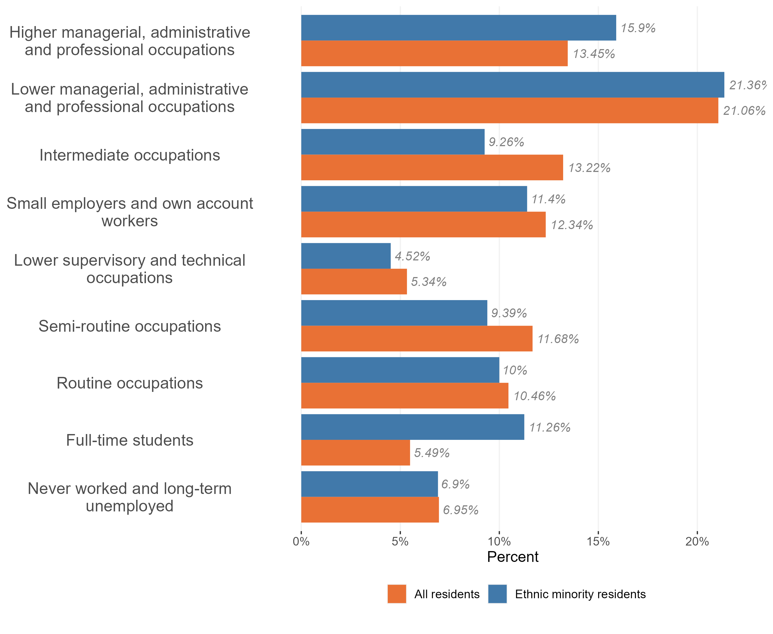
Employment and occupation type
Employment and occupation type, ethnic minorities and all residents, Essex 2021
A higher proportion of ethnic minority Essex residents work in higher managerial roles (15.9% in ethnic minority residents compared to 13.5% in all Essex residents).
There is also a higher proportion who are full time students (11.3%, more than double the 5.5% in the general population), most likely because there are people who come from outside Essex to study for university.
The proportion of ethnic minority residents who have never worked or are long-term unemployed is similar to the general population – 6.9% of ethnic minority residents are in this category, compared to 6.95% in the general population.
Research & Citizen Insight | Policy Unit | Essex County Council
14

Slide 15
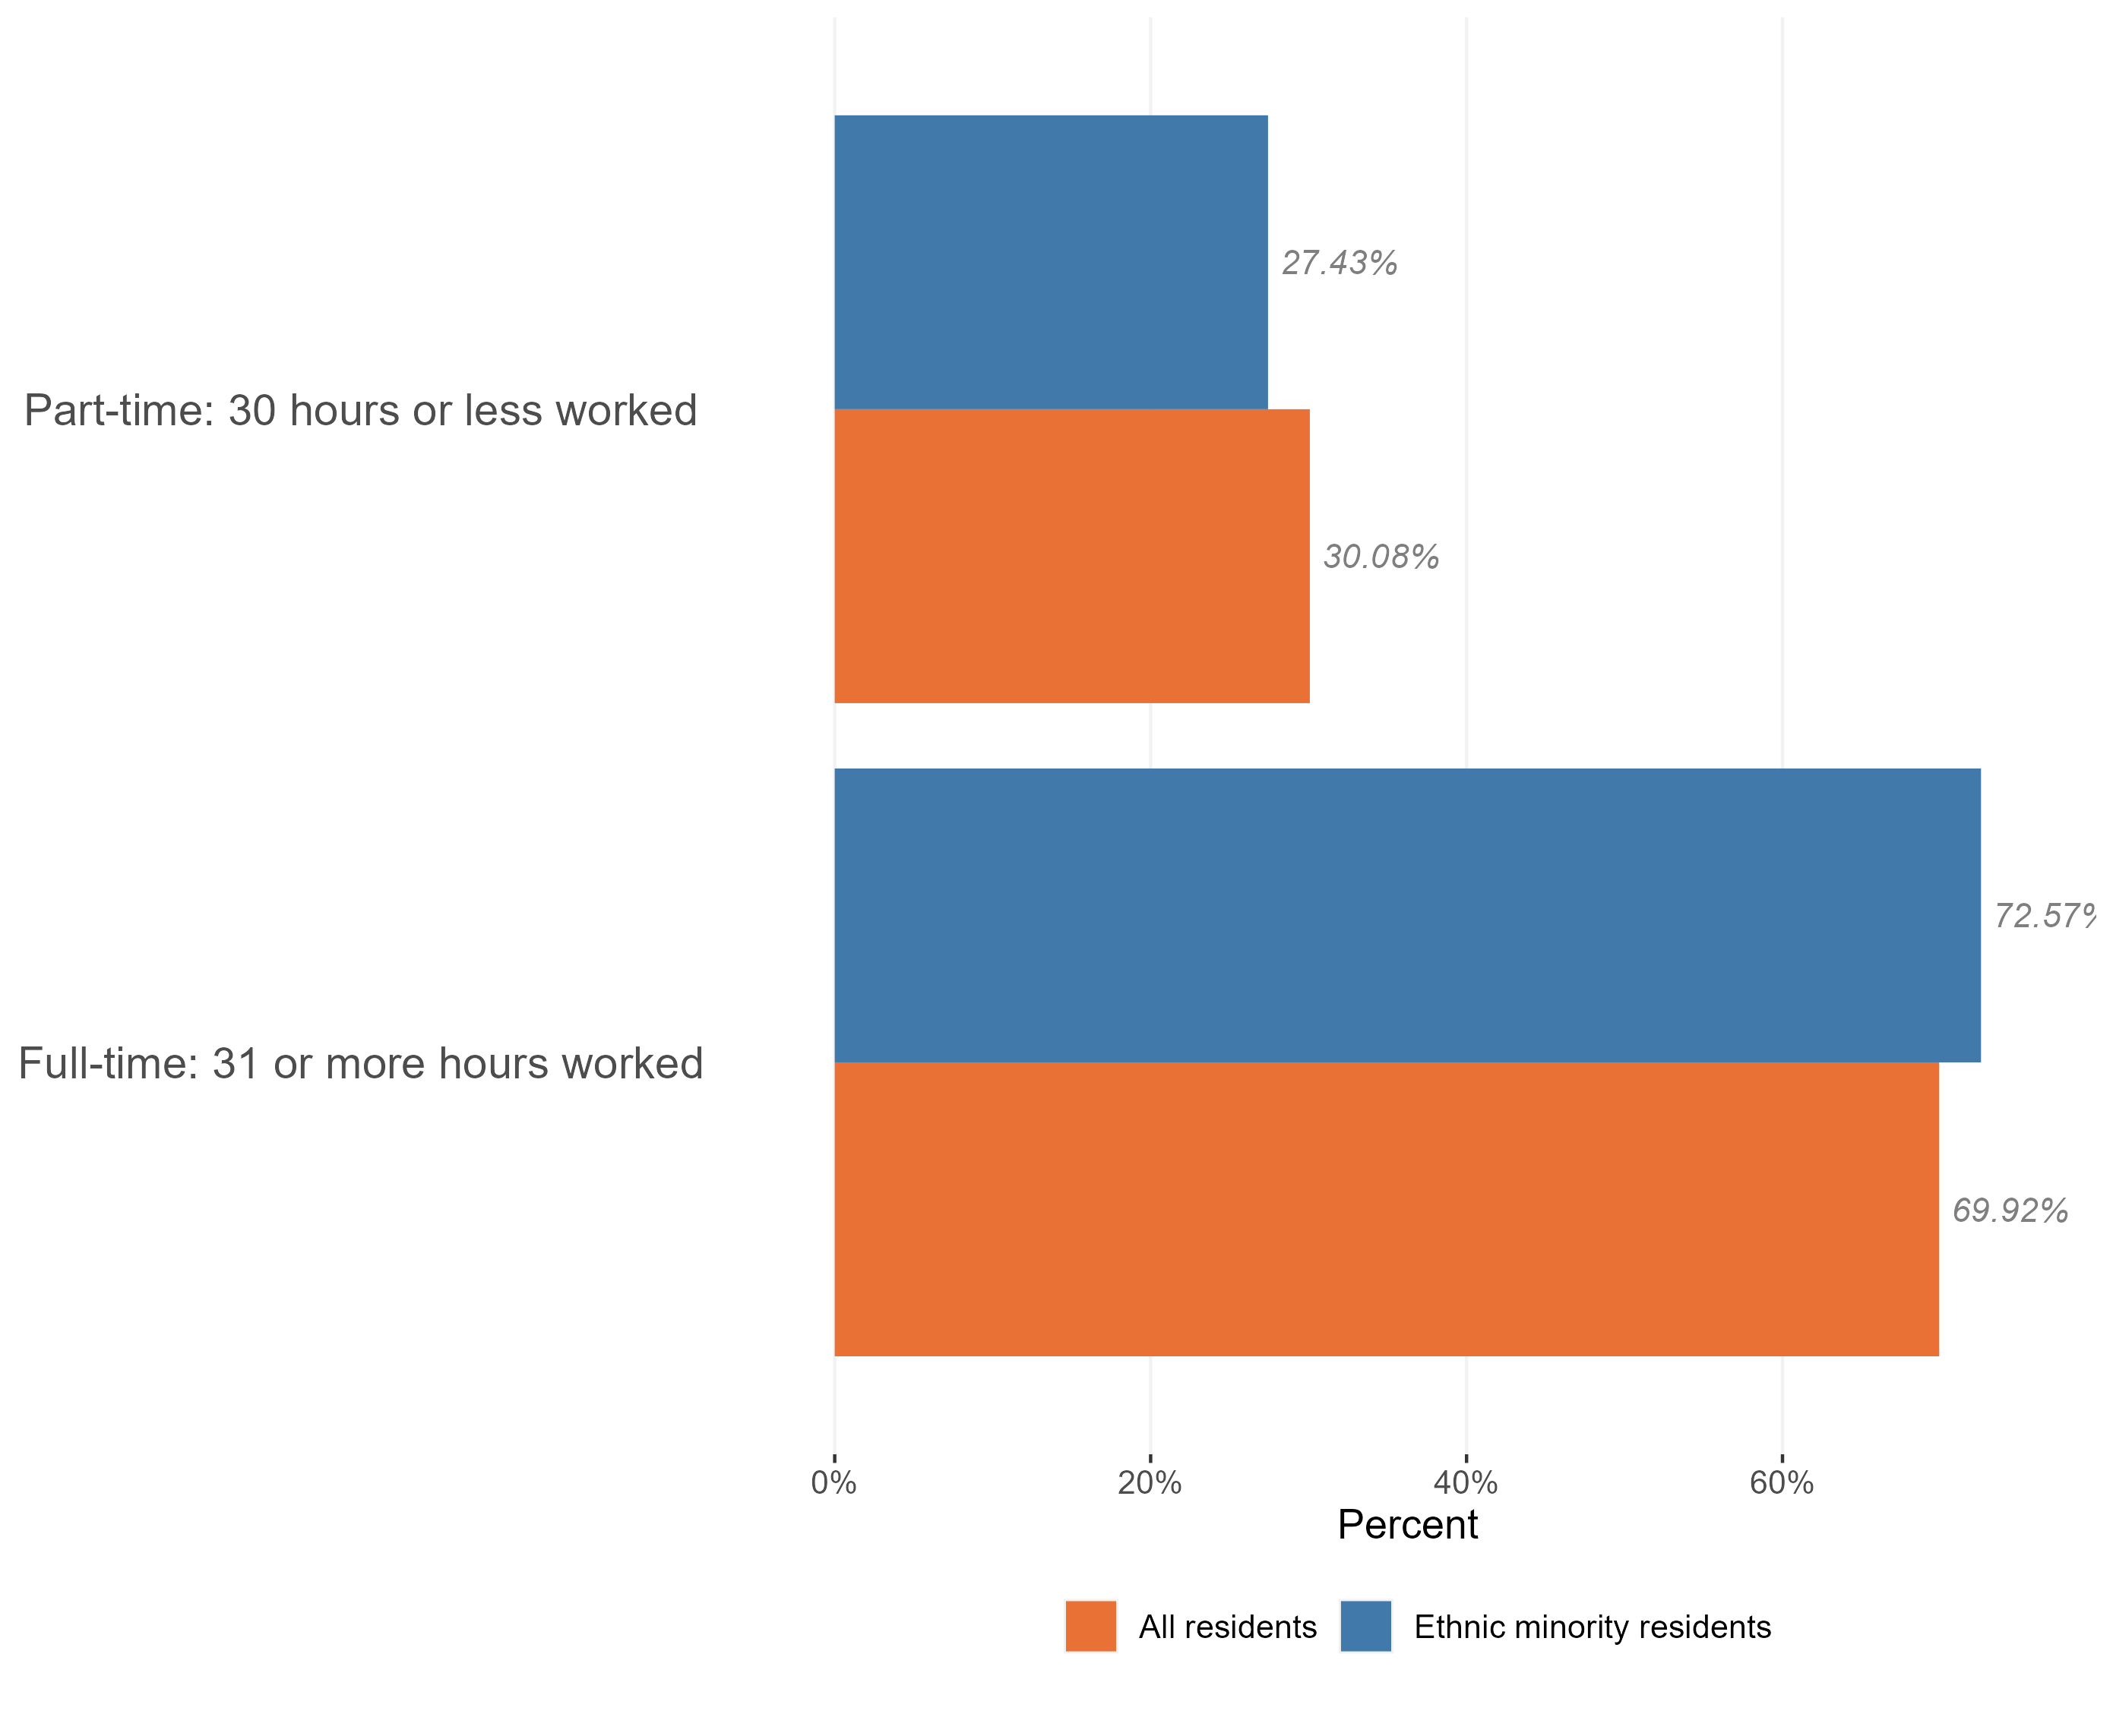
Employment and hours worked
Hours worked, ethnic minorities and all residents, Essex, 2021
Of the 224,000 people who make up the Essex ethnic minority population, 153,000 are working-age adults. Of this group 74.5% were in work at the time of Census 2021.
This is slightly lower proportion than we see across the working-age population as a whole (78.1%).
The majority of the Essex ethnic minority population who are in work are in full-time roles (72.6% hold full-time roles compared to 27.4% working part-time)*.
*Within Census data full time roles are classified as 31+ hours per week and part-time roles are classed as 30 hrs or less per week.
Research & Citizen Insight | Policy Unit | Essex County Council
15

Slide 16
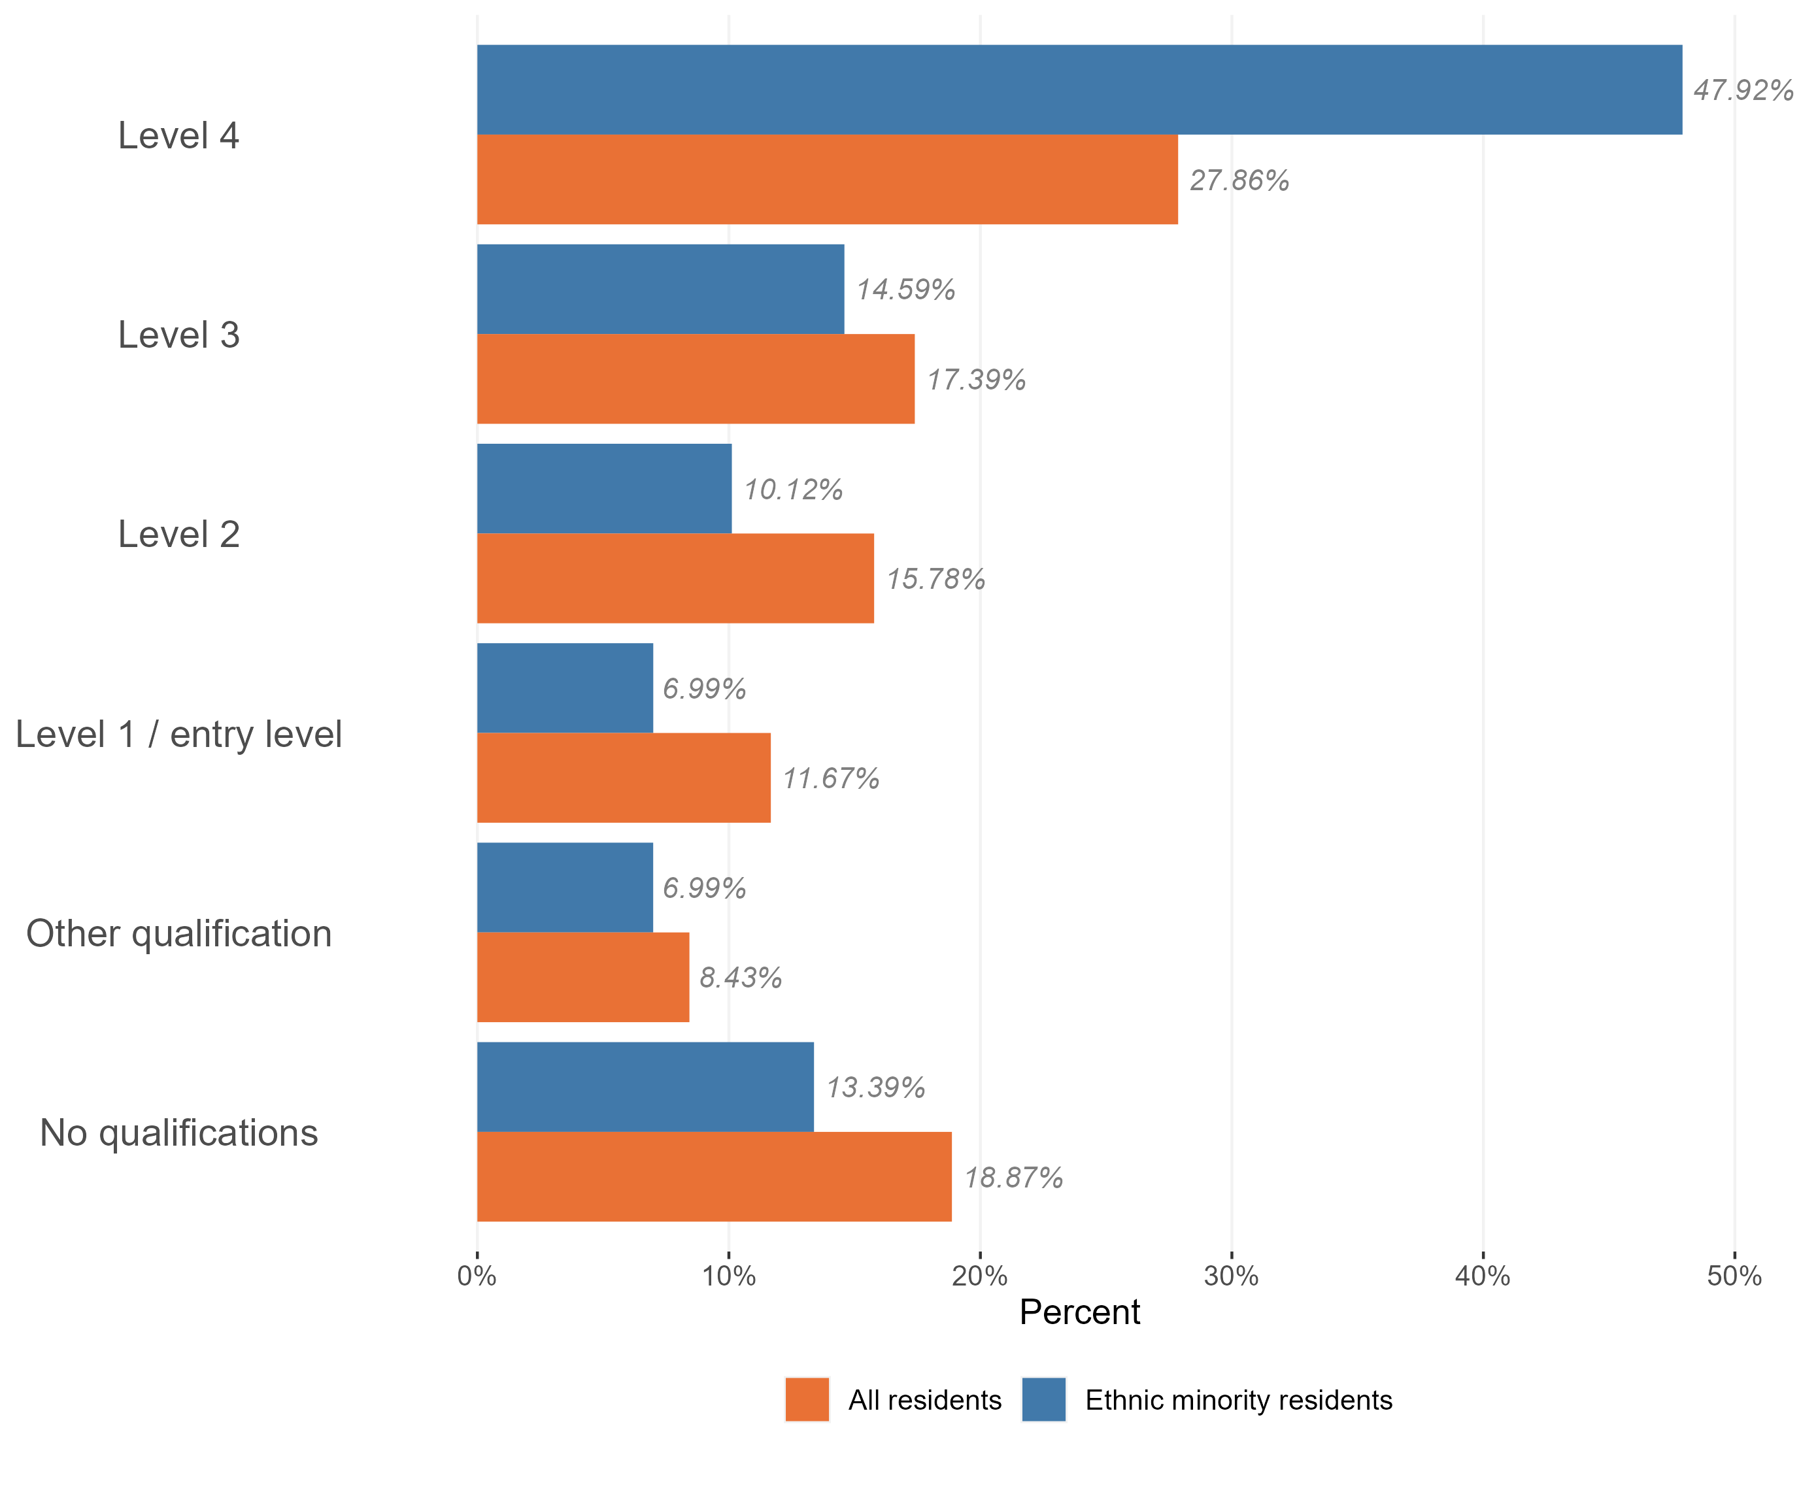
Highest qualification level
Level of qualifications held in the ethnic minority population, Essex, 2021
Ethnic minority Essex residents are more likely to have higher level qualifications compared to the general Essex population. A much larger proportion of the ethnic minority population have level 4 qualifications (such as Masters degrees or PhDs) compared to the general population, and are less likely to have no qualifications.
Aside from level 4 qualifications, the ethnic minority population have a relatively lower proportion of people with all other qualification types.
Research & Citizen Insight | Policy Unit | Essex County Council
16

Slide 17
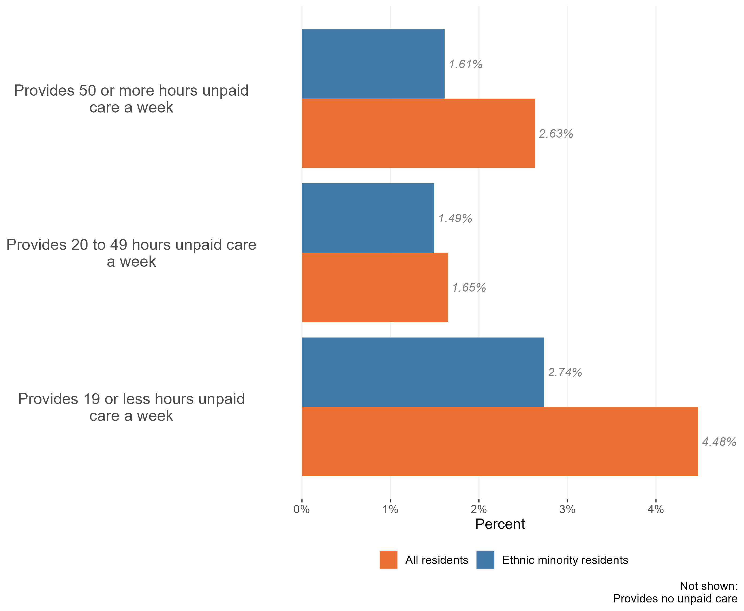
Ethnic minority and unpaid care
Provision of unpaid care by ethnic minority residents, Essex, 2021
The vast majority of Essex ethnic minority residents do not provide unpaid care. Only 6% provide some form of unpaid care.
This is lower than the general population, where 9% of the general population identified themselves as carers in the Census 2021.
Of the ethnic minority residents who do provide unpaid care, providing between 1 – 19 hours of care is the most common
Research & Citizen Insight | Policy Unit | Essex County Council
17

Slide 18
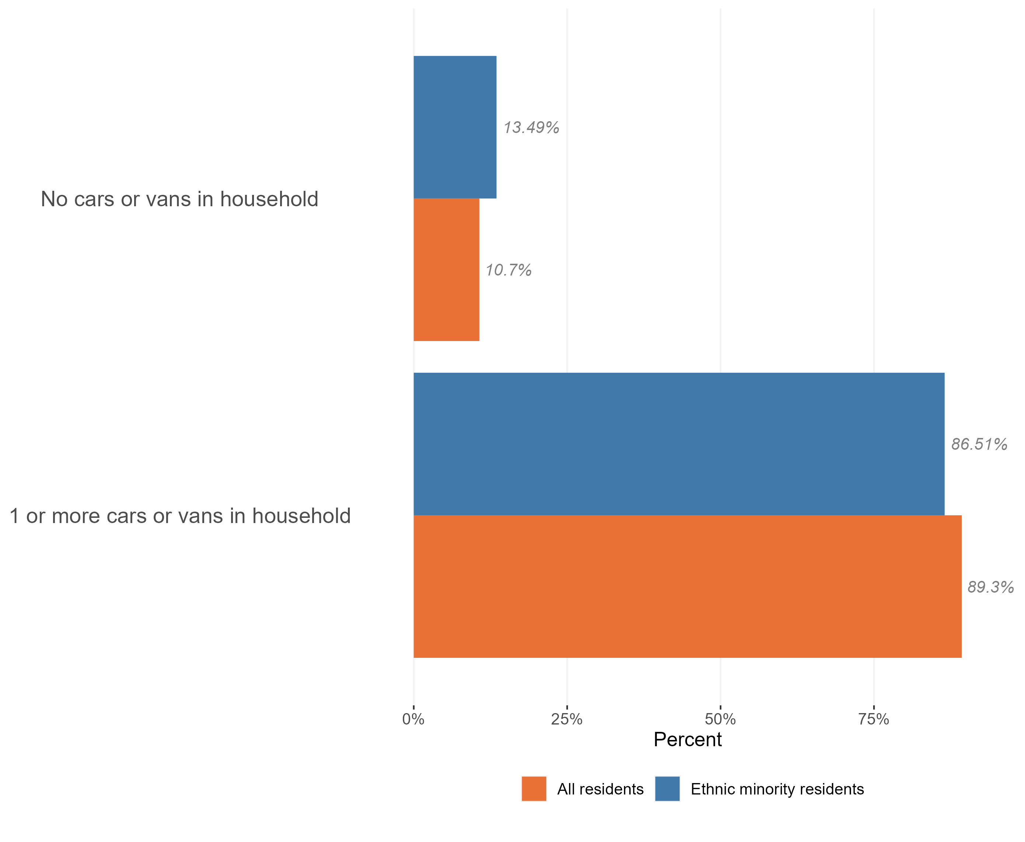
Access to cars
Access to a car or van in the minority ethnic population, Essex, 2021
The vast majority of ethnic minority residents in Essex live have access to one or more cars in their household (87%), although ethnic minority residents are less likely to have access to a car than the population as a whole (13.5%).
Research & Citizen Insight | Policy Unit | Essex County Council
18

