Slide 1
Understanding marriage & civil partnership in Essex
Analysis of data from Census 2021
September 2023

Slide 2
Introduction
This document presents an analysis of the married & civil partnership population in Essex, based on data collected through Census 2021. It has been prepared as part of a series of analyses exploring the scale, distribution and characteristics of populations with ‘protected characteristics’ as defined by the Equality Act (2010).
The document is divided into three sections:
Section 1: considers the number of people across Essex, and Essex districts who are identified as currently being in a marriage or civil partnership in the most recent Census data.
Section 2: examines the characteristics of the married & civil partnered population, focusing on the extent to which the wider range of protected characteristics can be found within members of the married & civil partnered population;
Section 3: examines the outcomes enjoyed by members of the married & civil partnered population, focusing on employment outcomes, employment type, health outcomes, the likelihood of providing unpaid care, qualification levels and access to cars/vans.
This is part of a suite of similar analyses examining the protected characteristics defined by the equalities act. Similar analyses, and a series of interactive dashboards, exploring issues of disability, age, sex, sexuality, religion, and gender identity can be found at data.essex.gov.uk.
ECC’s Research and Citizen Insight Team is leading the county council’s work to prepare examine and understand Census data. If you would like to ask questions, find out more, or get involved in this work please contact Alastair Gordon (Alastair.Gordon@essex.gov.uk) or Sean Maguire (Sean.Maguire@essex.gov.uk).
Research & Citizen Insight | Policy Unit | Essex County Council
2

Slide 3
Section 1: The married & civil partnered population
Understanding the scale and distribution of Essex’s married & civil partnered population

Slide 4
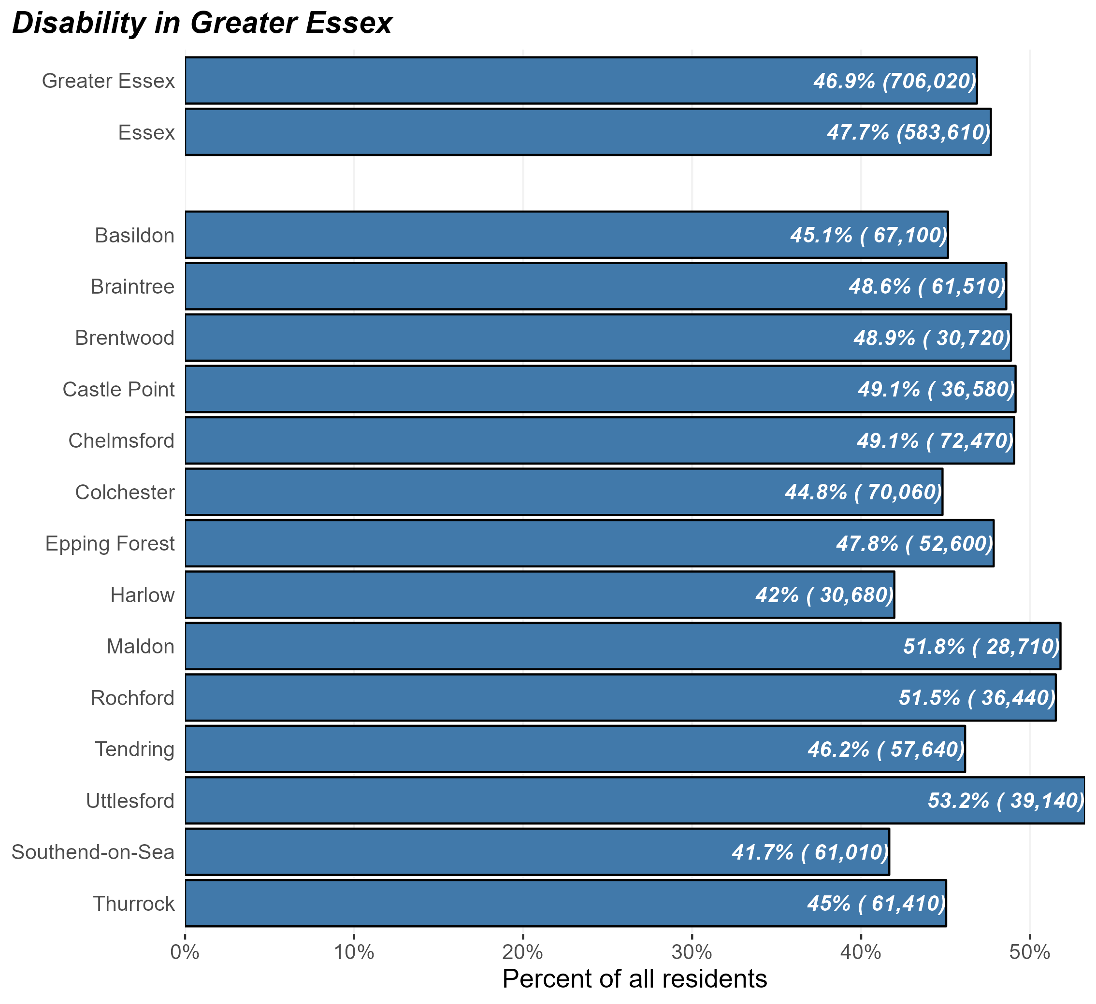
The married & civil partnered population
Number and percentage of residents identifying as married or civil partnered in Greater Essex and Essex Districts, Census 2021
At the time of Census 2021, there were some 584,000 married & civil partnered people in Essex and 706,000 in Greater Essex (including the areas of Southend and Thurrock).
This equates to 47.7% of Essex residents slightly higher than England as a whole (44.7%).
There is some variation across the districts – Uttlesford and Maldon have the highest proportion of residents who are married or in a civil partnership, and Harlow and Southend have the lowest
Marriage and civil partnership is strongly related to age, so part of the patterns seen in this pack will be due to the effect of age rather than being in a marriage or civil partnership
Research & Citizen Insight | Policy Unit | Essex County Council
4

Slide 5
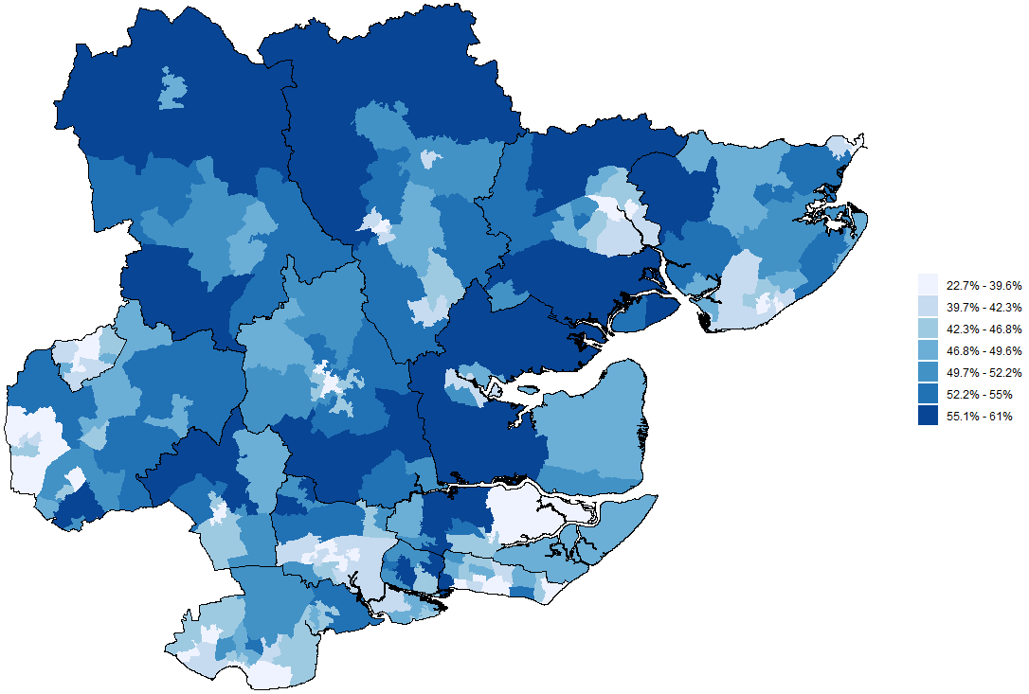
Marriage and civil partnership across Greater Essex
Prevalence of marriage and civil partnership by MSOA, Greater Essex, Census 2021
The map opposite shows the proportion of residents in each middle-level super outputs area (MSOA) who are married or in a civil partnership
Marriage and civil partnership is highest in North Essex (Uttlesford and Braintree), as well as parts of Colchester and Maldon
Marriage and civil partnership is generally lower in towns and cities – Chelmsford, Colchester Town, Harlow, and Basildon Town have some of the lower proportions of marriage and civil partnership across Greater Essex
Marriage and civil partnership is strongly related to age, which may explain some of these patterns
Research & Citizen Insight | Policy Unit | Essex County Council
5

Slide 6
Section 2: Characteristics of the married & civil partnered population
Exploring the prevalence of other protected characteristics within Essex’s married & civil partnered population

Slide 7
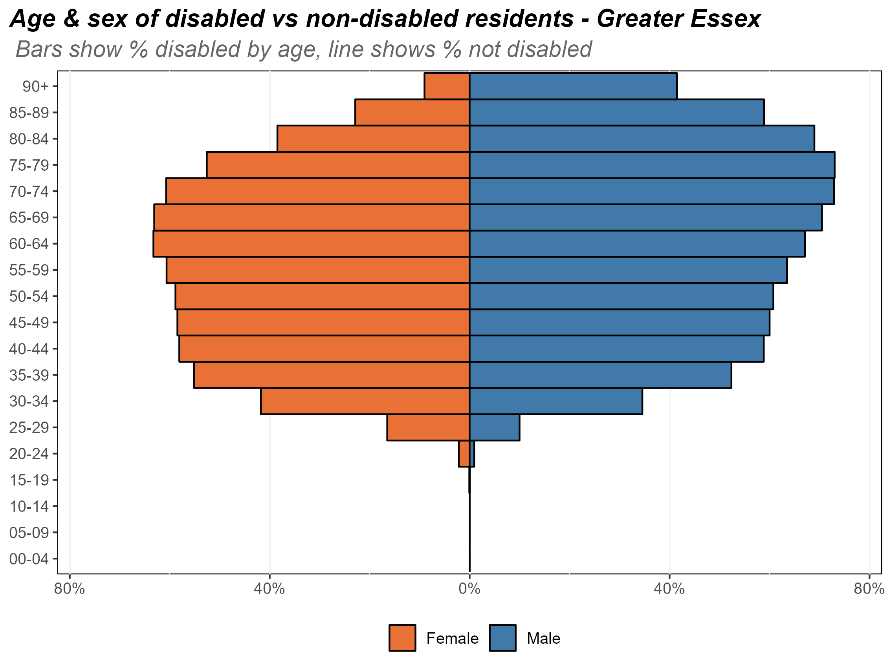
Age and sex of the married or civil partnered population
Composition of the married or civil partnered population by age and sex, Essex, 2021
The chart opposite shows the composition of Essex’s married or civil partnered population by age and by sex.
There is very low levels of marriage or civil partnership until the late 20’s 25-29 age band. Only 0.9% of Essex residents aged 24 and younger are in a marriage or civil partnership.
From 25 onwards the proportion of residents in a marriage or civil partnership steadily rises. Two thirds of Essex residents in their 60’s are currently in a marriage of civil partnership, the highest proportion in all age bands.
The proportion of residents in marriages or civil partnerships begins to fall from ages 70 and over, with a more rapid fall in female residents compared to males. This is most likely due to married or civil partners dying and people becoming widows.
Research & Citizen Insight | Policy Unit | Essex County Council
7

Slide 8
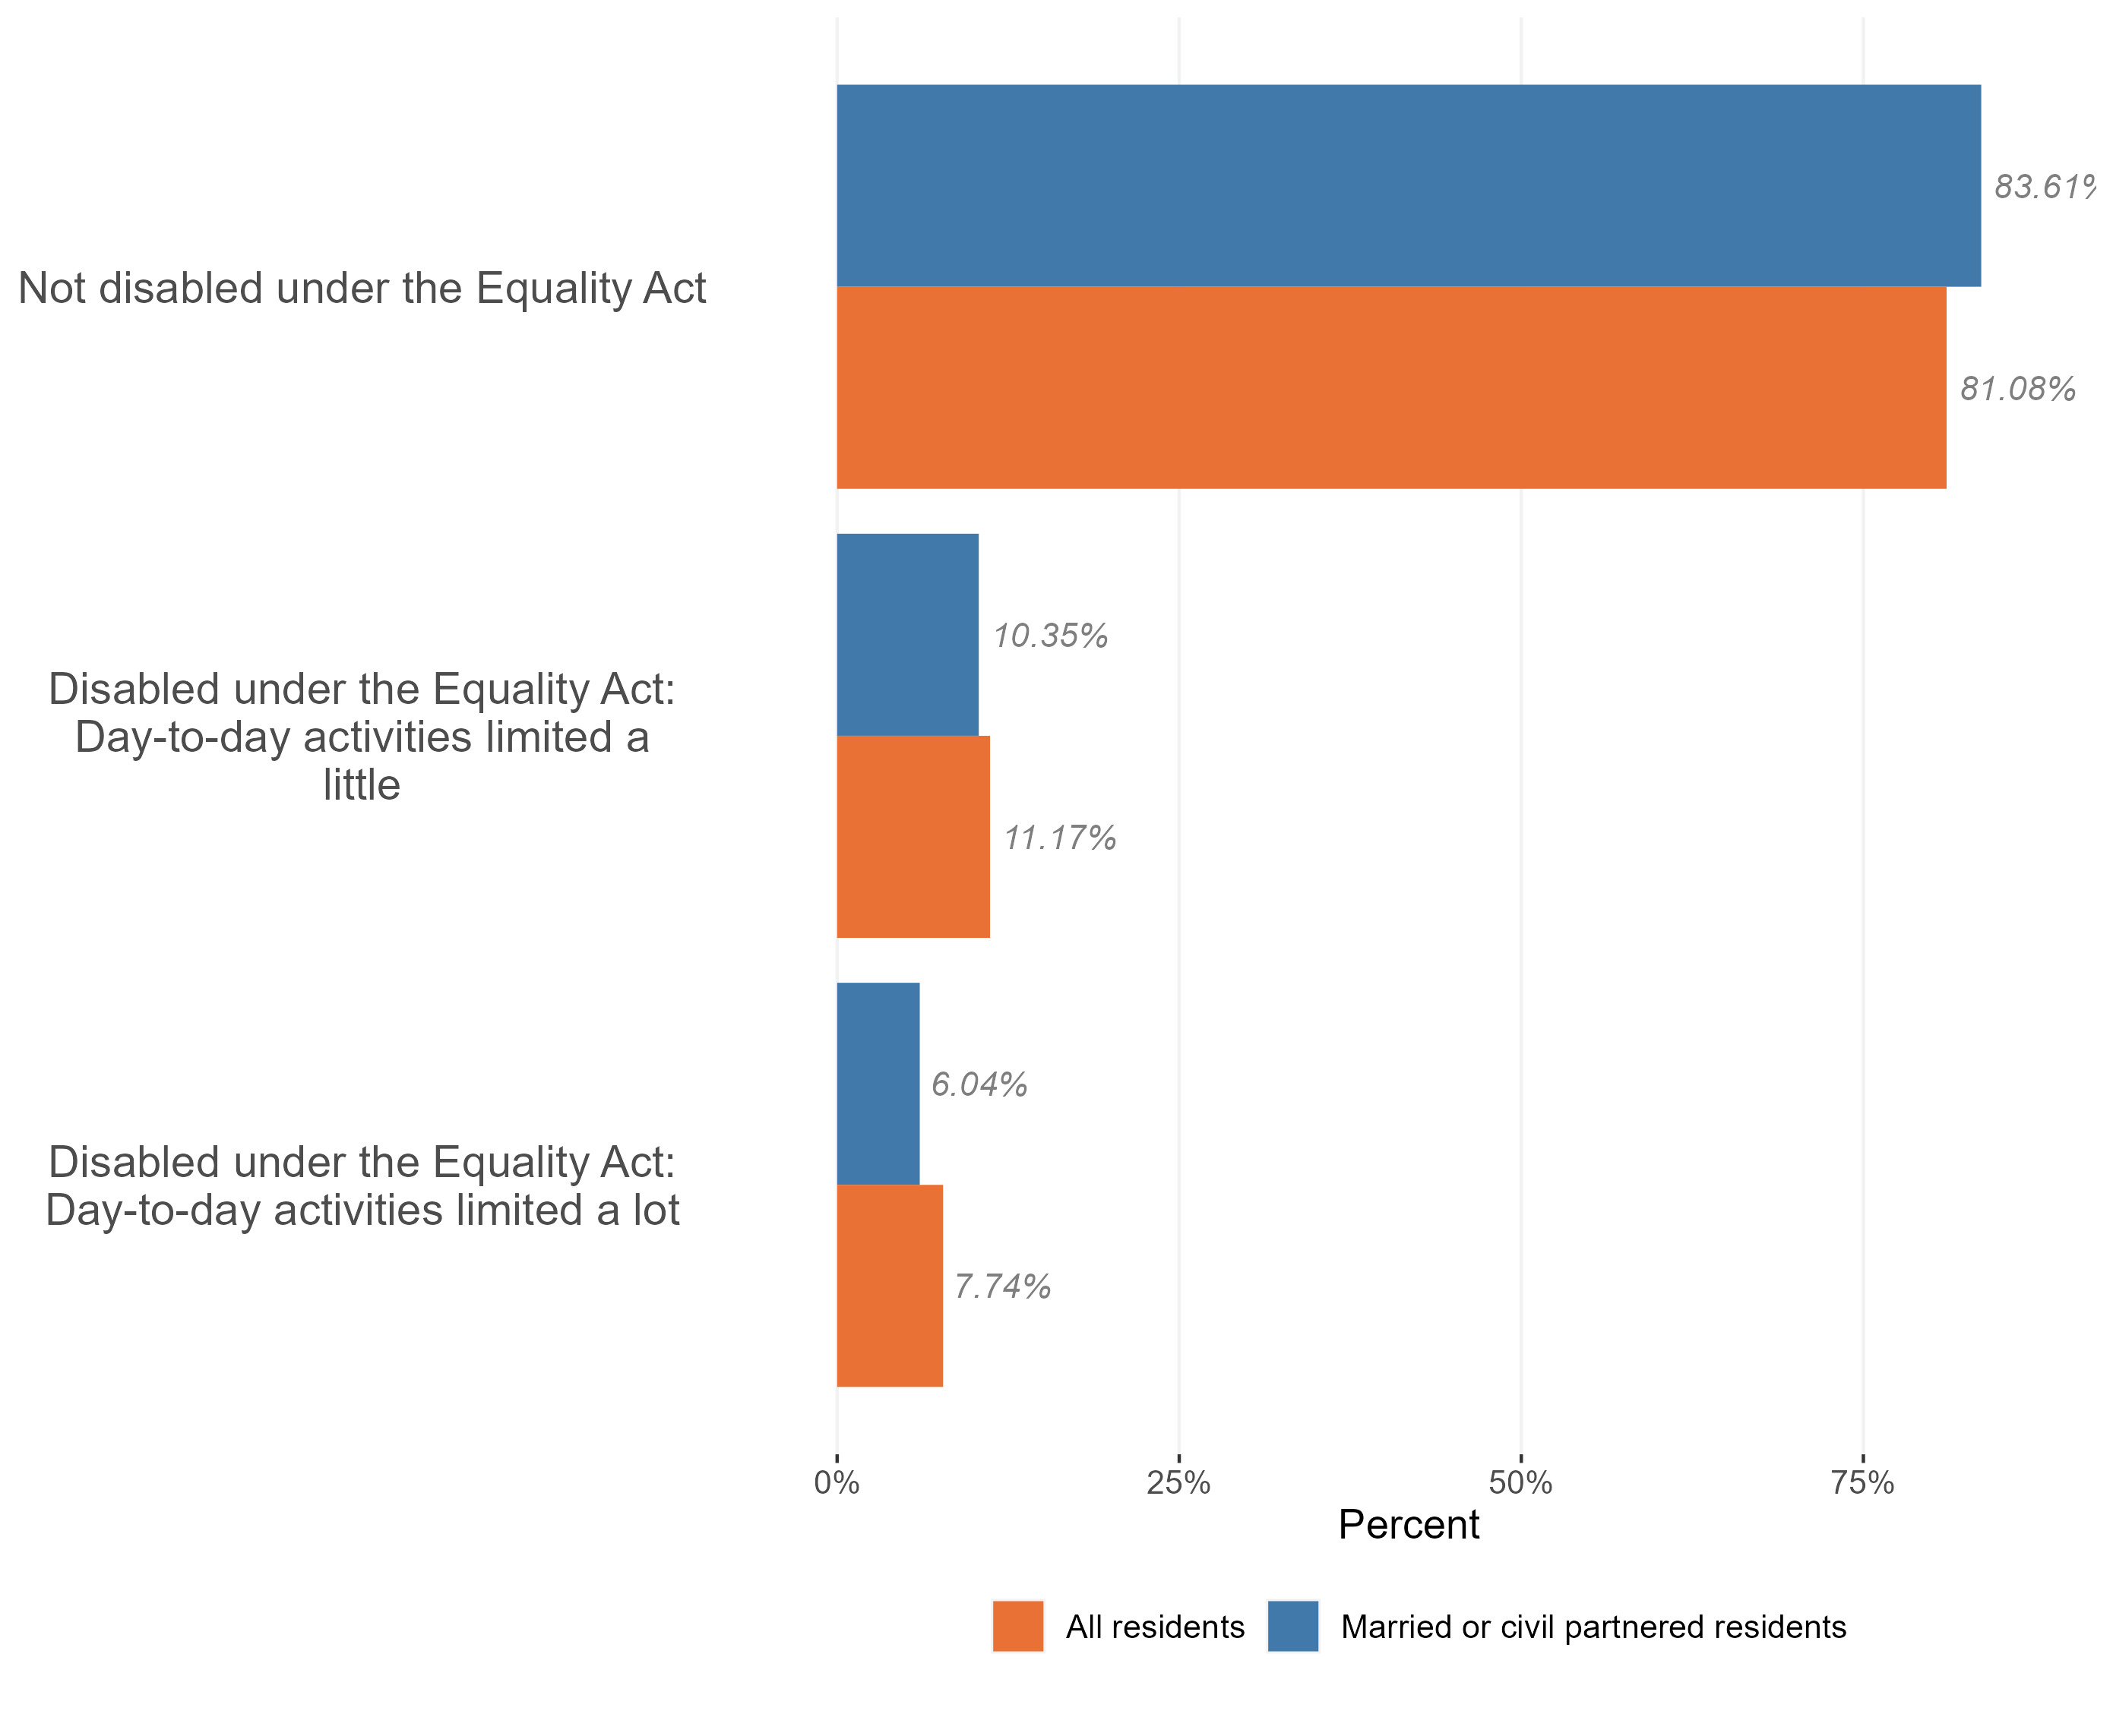
Disability in the married & civil partnered population
Comparison of disability in the married & civil partnered population & general population, Essex, 2021
Essex residents who are married or in a civil partnership have a slightly lower prevalence of disability compared to the general Essex population. 16.4% of the married and civil partnered population are disabled, compared to 18.9% of all Essex residents.
The largest difference is in the severely disabled – people who’s day-to-day activities are limited a lot. 7.7% of all Essex residents have their day to day activities limited a lot, compared to 6% of married or civil partnered residents.
Research & Citizen Insight | Policy Unit | Essex County Council
8

Slide 9
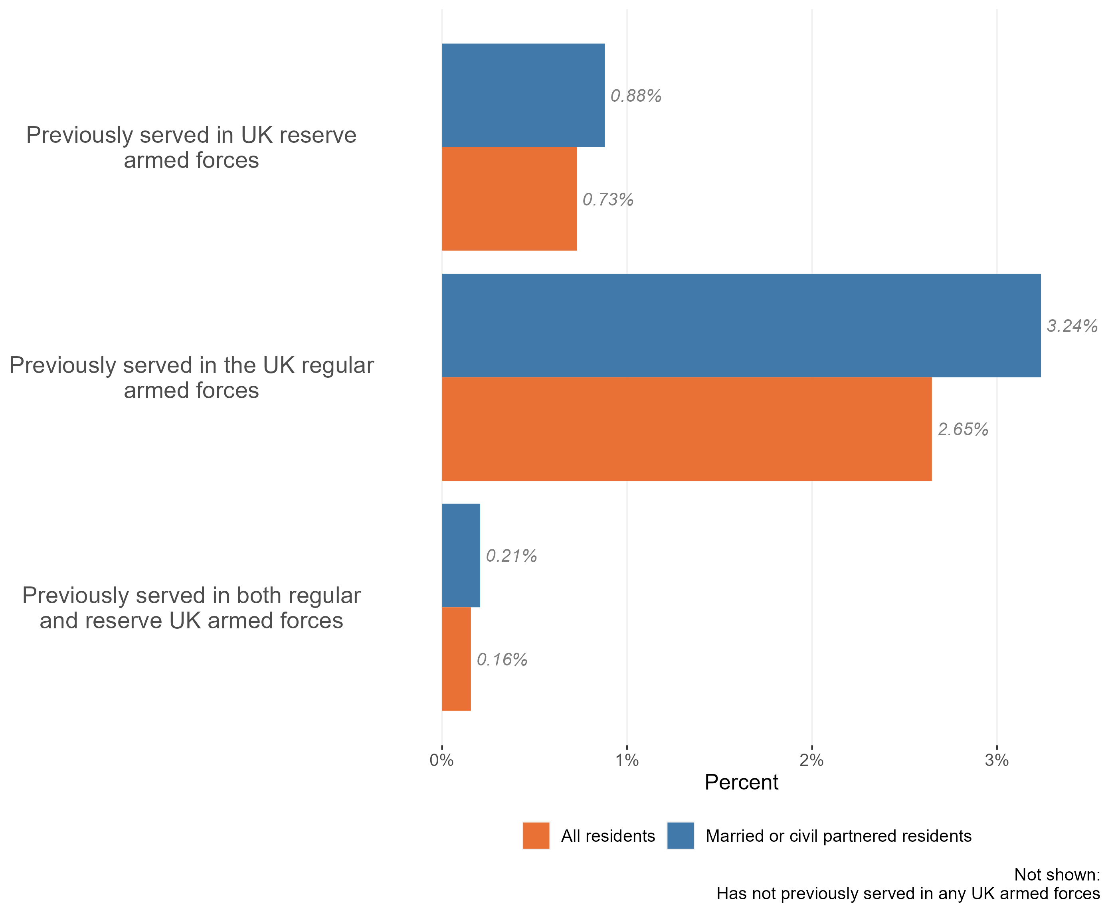
Veterans in the married & civil partnered population
Composition of the married and civil partnered populations by veteran status, Essex, 2021
The vast majority of the Essex married & civil partnered population (95.7%) have not previously served in the UK armed forces in any capacity. 25,000 married & civil partnered residents have served in the UK armed forces in some capacity. There is a higher proportion of married or civil partnered Essex residents who have previously served in the UK armed forces compared to the general population – 4.3% of married and civil partnered Essex residents are veterans, compared to 3.5% of the general Essex population.
The most common service type in the married or civil partnered population is previous service in the UK regular armed forces (3.24%)
Research & Citizen Insight | Policy Unit | Essex County Council
9

Slide 10
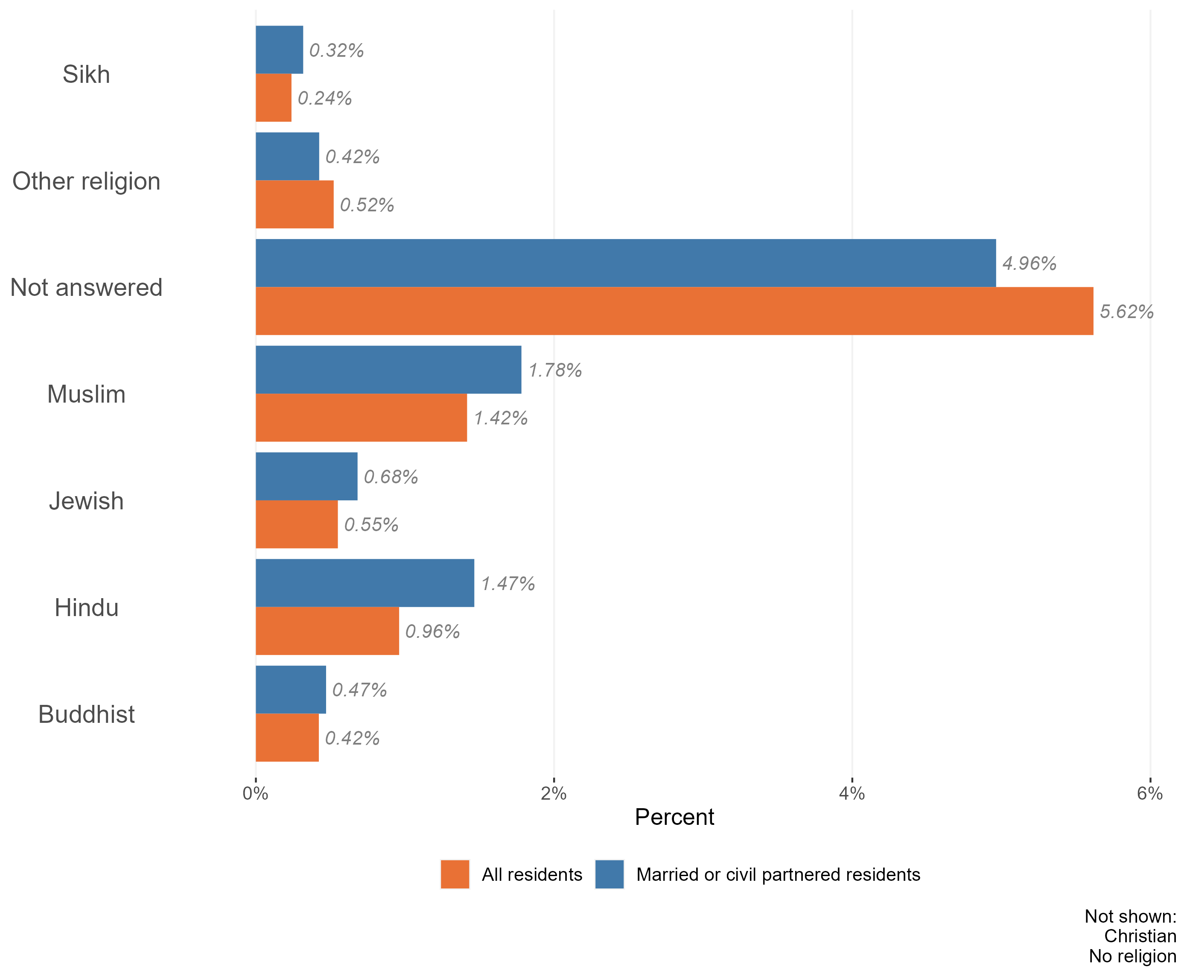
Religion in the married & civil partnered population
Composition of the married & civil partnered and general populations by religion, Essex, 2021
The vast majority of the Essex married & civil partnered population identify either as Christian (58.3%) or ‘no religion’ (31.5%). There is a slight over-representation of Christian religion in the married or civil partnership compared to all Essex residents (58.3% in married or civil partnered residents compared to 50.8% in all residents).
Following Christian an no religion, the most common faiths among the married or civil partnered population are Muslim (1.78%) and Hindu (1.47%). 4.98% of married residents chose not to answer religion questions in the census, slightly lower than all Essex residents (5.62%)
Research & Citizen Insight | Policy Unit | Essex County Council
10

Slide 11
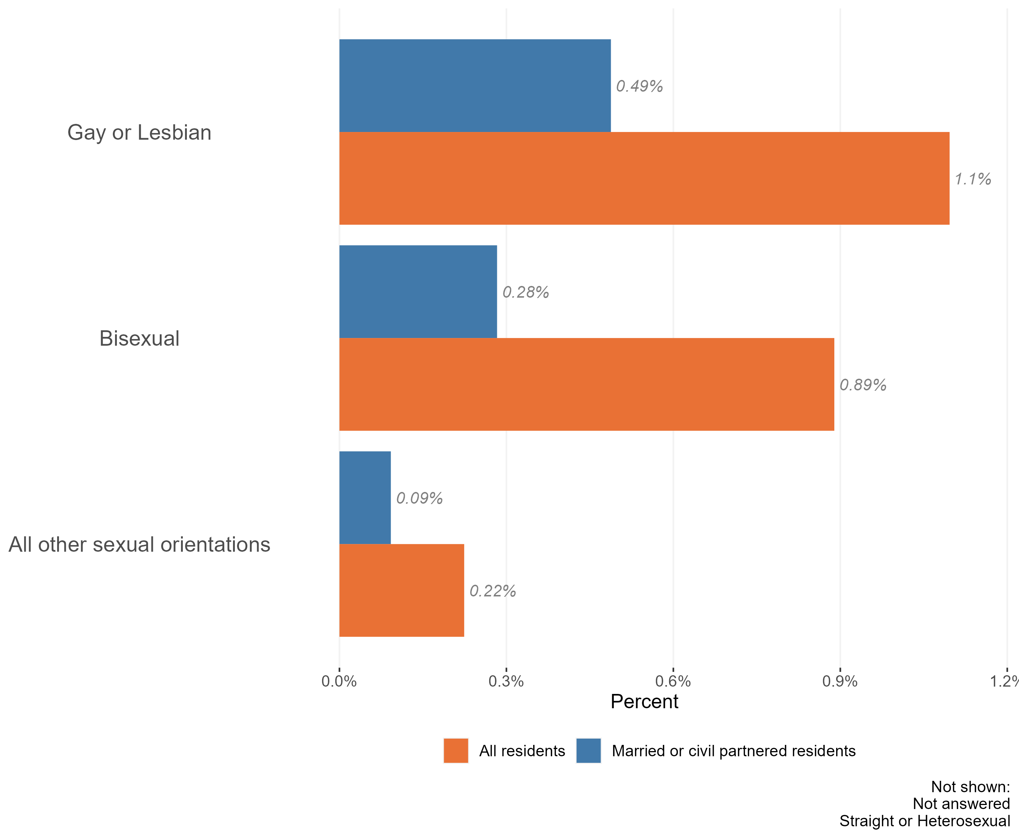
Sexuality and the married & civil partnered population
Composition of the married & civil partnered and general populations by sexuality, Essex, 2021
The majority of the Essex married & civil partnered population identify as ‘straight or heterosexual’ (99.1%). This is slightly higher than across the Essex population as a whole (97.8%).
Essex residents who are married or in a civil partnership are significantly less likely to be LGB+ compared to the general Essex population.
Married or civil partnered residents were more likely to provide an answer to questions about their sexuality in census 2021 than the population as a whole. 5.2% of married or civil partnered residents did not answer census questions regarding sexuality, compared to 6.5% of all Essex residents.
It is worth noting that 2021 was the first census which collected data on sexuality. Compared to other questions on the census, this topic has a relatively high proportion of ‘not answered’ responses – where the person has not provided any information on the topic. Due to the sensitive nature of the topic, this ‘missing data’ will not be missing at random. Certain groups of the population, or people living in certain situations, may feel unable or unwilling to answer these questions.
Research & Citizen Insight | Policy Unit | Essex County Council
11

Slide 12
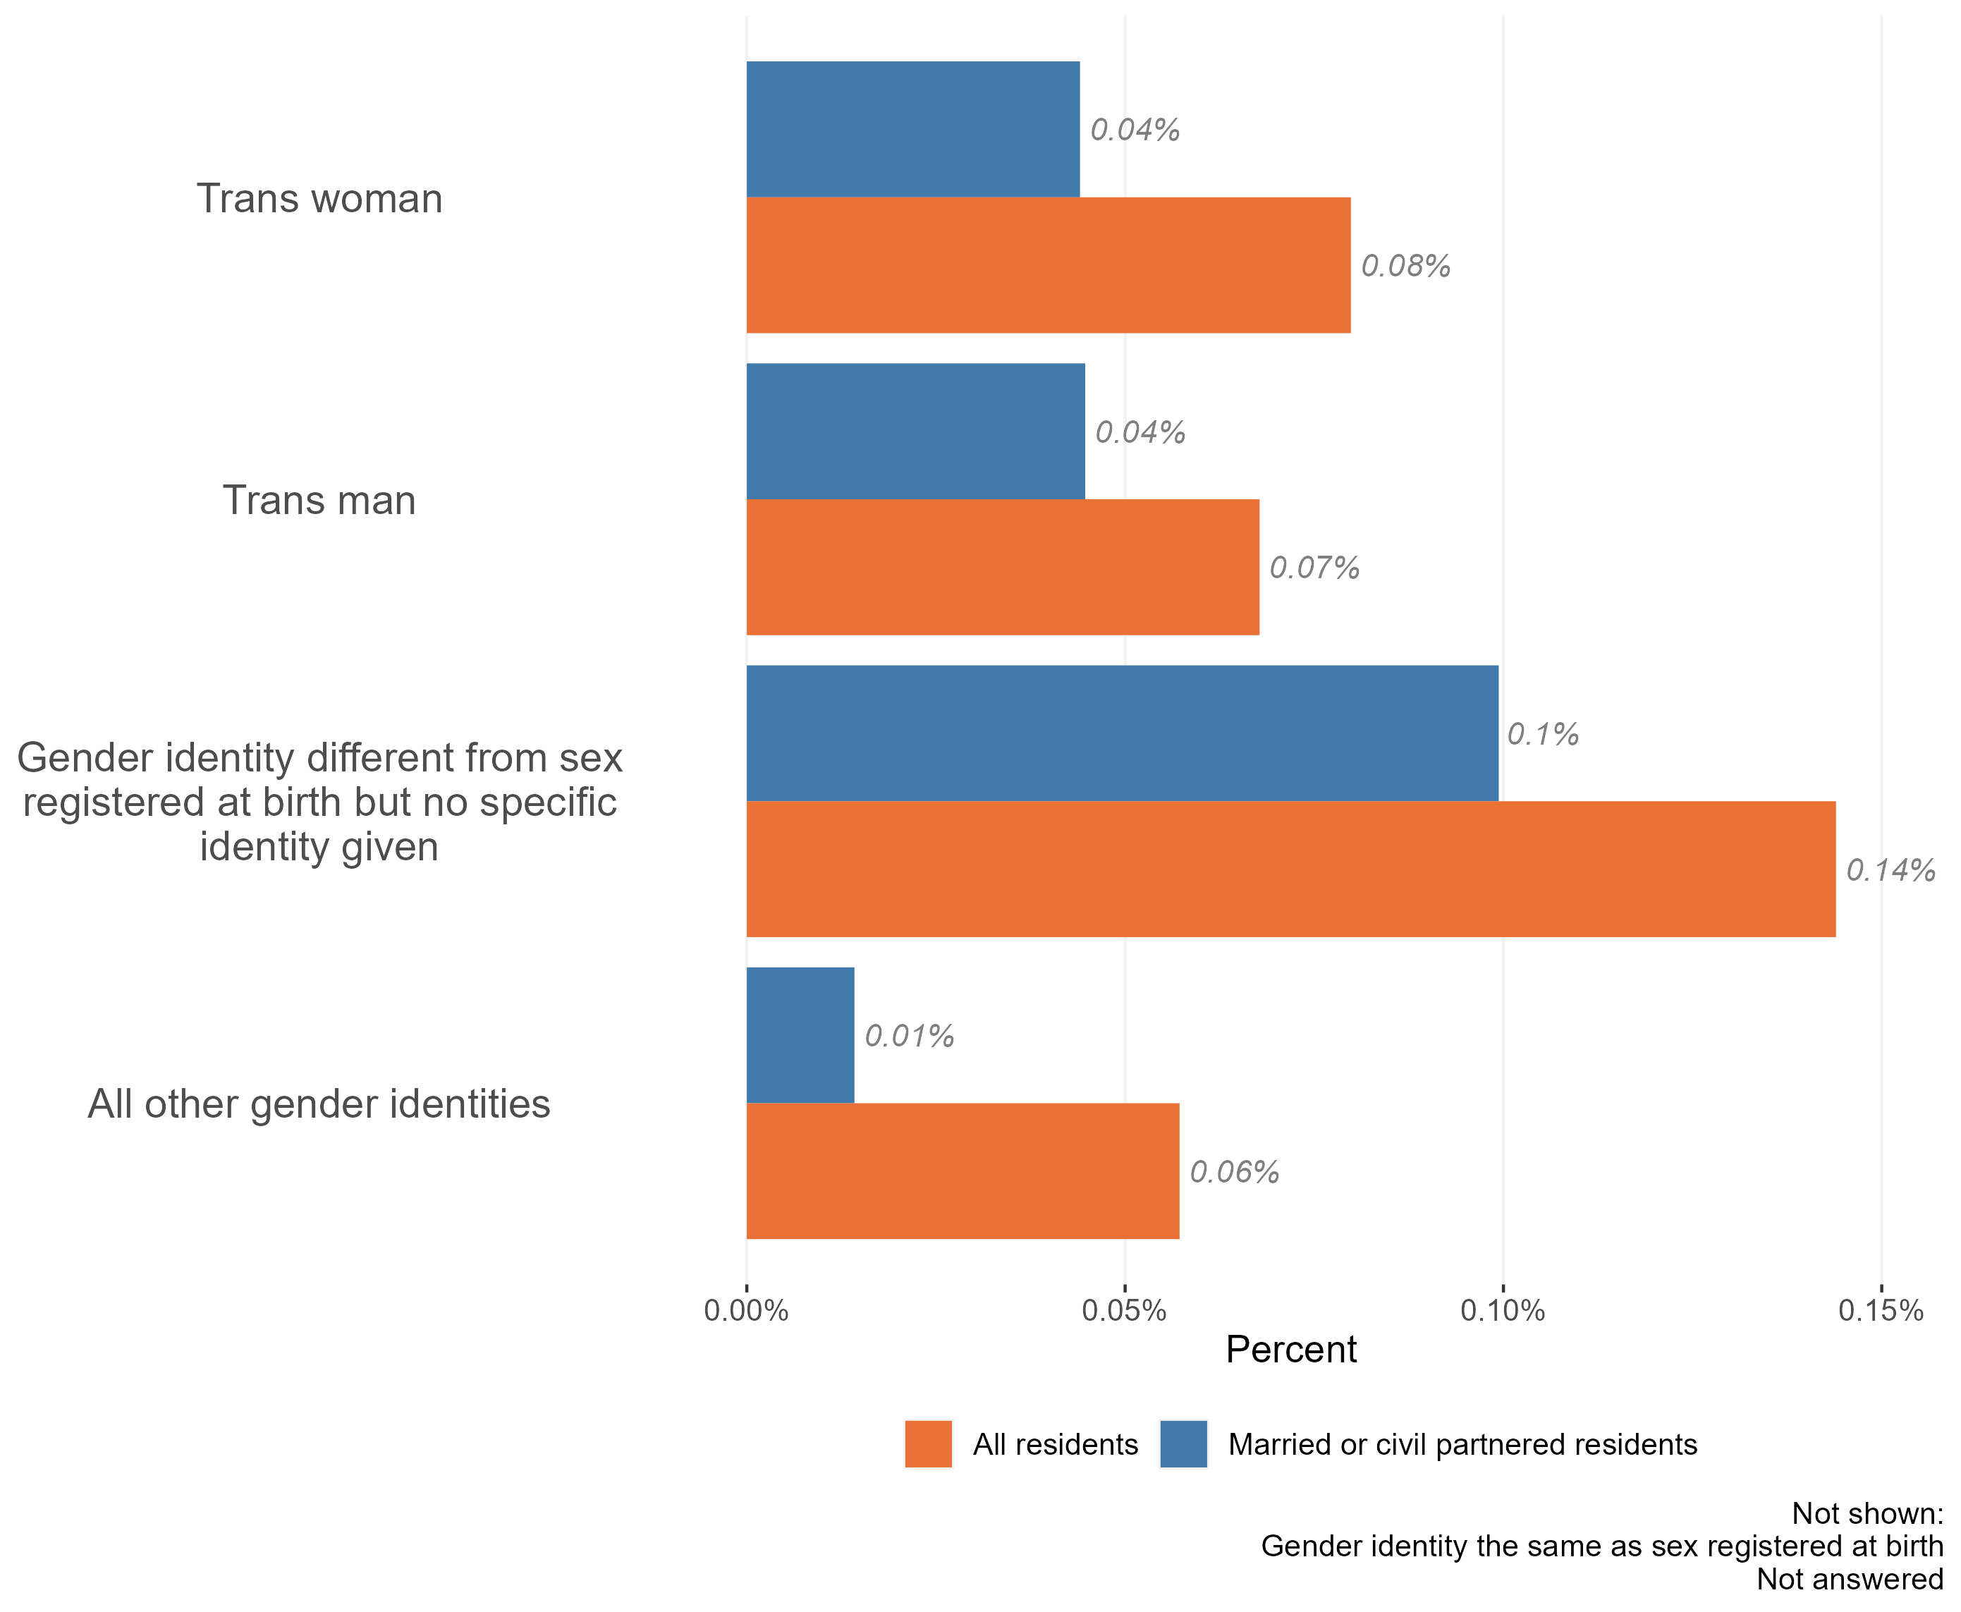
Gender identity in the married & civil partnered population
Composition of married & civil partnered and general populations by gender identity, Essex, 2021
The vast majority of the Essex married & civil partnered population have a gender identity which the same as their sex registered at birth. Only around 1,200 married & civil partnered residents of Essex identify as having a different gender identity.
All gender identities which differ to the sex registered at birth had lower levels of marriage or civil partnership compared to the general public.
Research & Citizen Insight | Policy Unit | Essex County Council
12

Slide 13
Section 3: Outcomes for married & civil partnered residents
Exploring the extent to which married & civil partnered residents enjoy positive outcomes

Slide 14
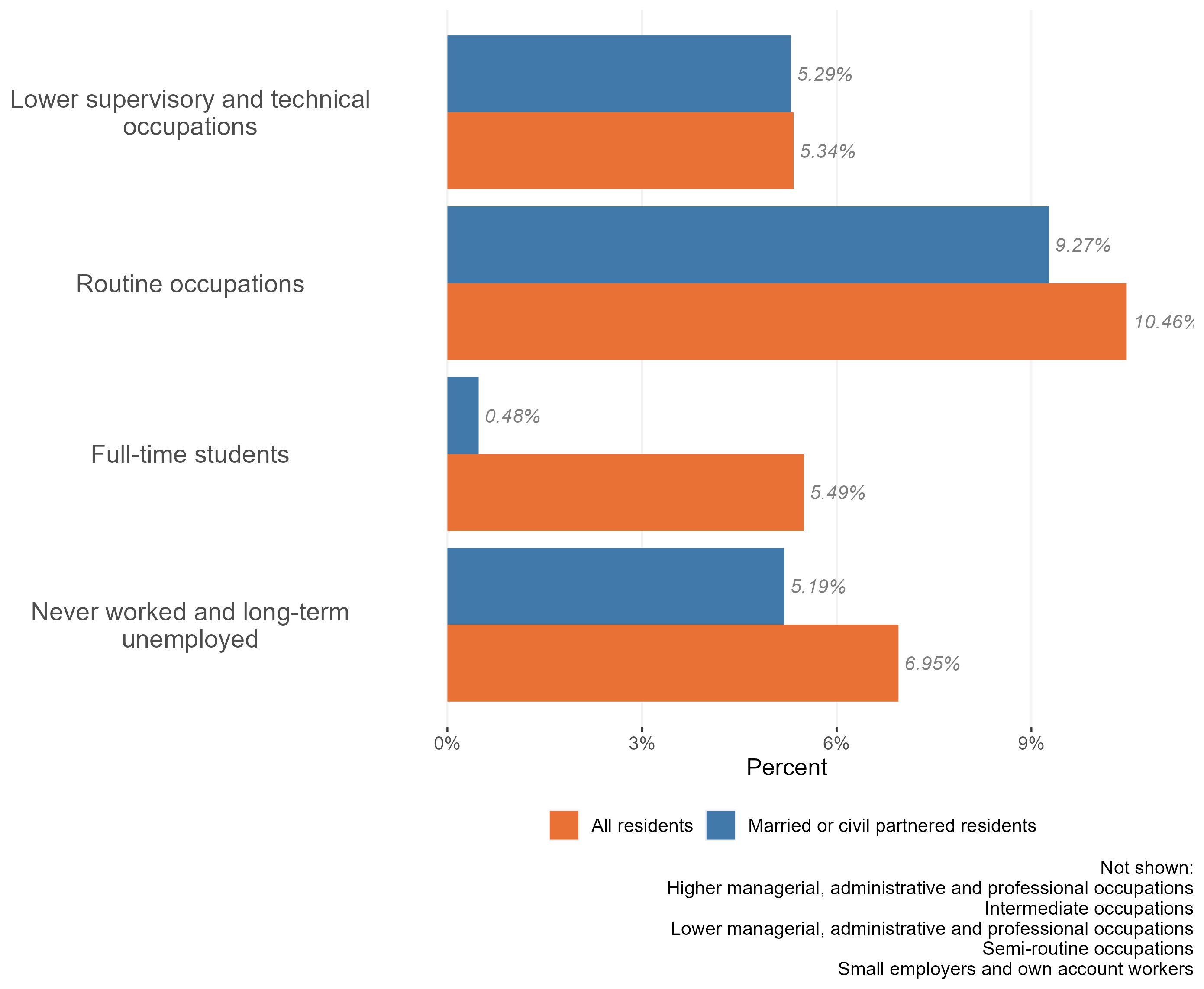
Employment and occupation type
Employment and occupation type, married and civil partnered and general populations, Essex 2021
The vast majority of Essex married and civil partnered residents work in higher managerial (17.4%), intermediate occupations (13.8%), lower managerial (23.9%), semi-routine occupations (10.6%), or self-employed roles (14.0%). Together these roles account for c80% of all employments in married and civil partnered residents.
Compared to the general Essex population, married or civil partnered residents are less likely to be full time students, work in routine occupations, or be unemployed or never worked
Research & Citizen Insight | Policy Unit | Essex County Council
14

Slide 15
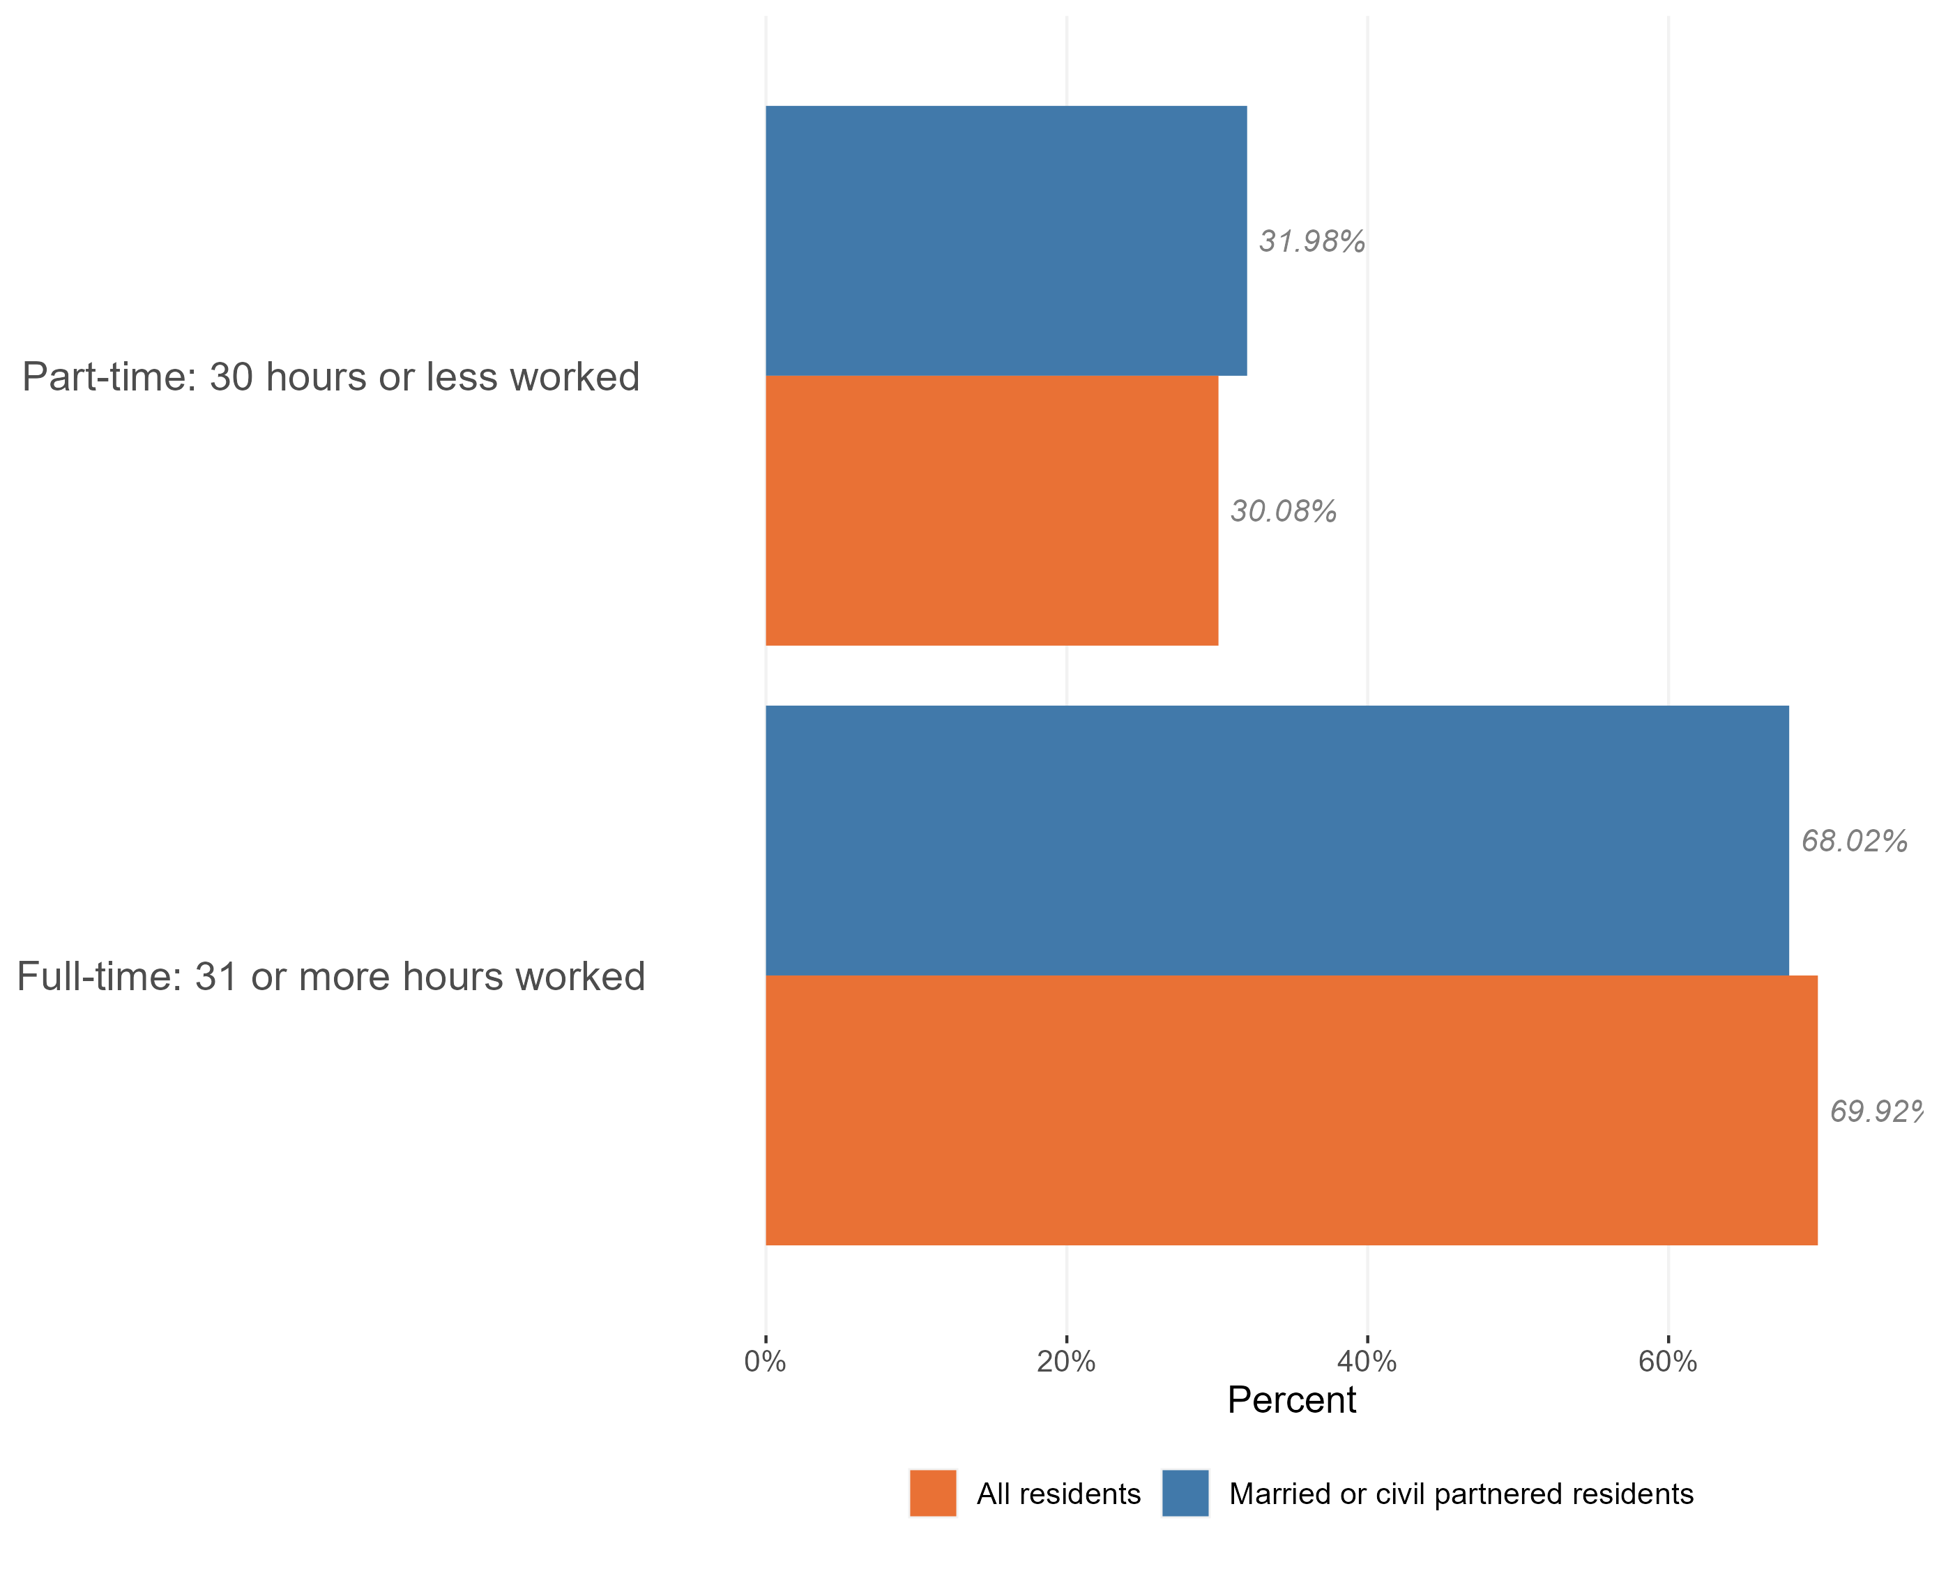
Employment and hours worked
Hours worked, married and civil partnered and general populations, Essex, 2021
Of the 584,000 people who make up the Essex married and civil partnered population, 412,000 are working-age adults. Of this group 86.1% were in work at the time of Census 2021.
This is higher proportion than we see across the working-age population as a whole in Essex (78.1%).
The majority of the Essex married & civil partnered population who are in work are in full-time roles (68% hold full-time roles compared to 32% working part-time)*, a higher proportion are in part-time work than across the Essex working-age population as a whole.
*Within Census data full time roles are classified as 31+ hours per week and part-time roles are classed as 30 hrs or less per week.
Research & Citizen Insight | Policy Unit | Essex County Council
15

Slide 16
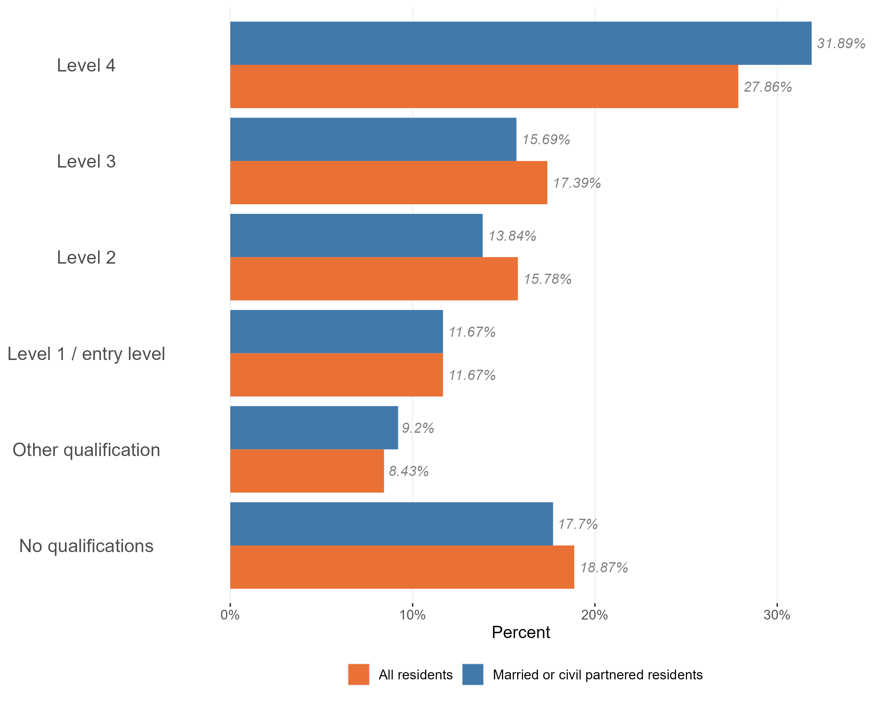
Highest qualification level
Level of qualifications held in the married and civil partnered and general populations, Essex, 2021
married & civil partnered Essex residents are more likely to have higher level qualifications compared to the general Essex population.
A larger proportion of the married & civil partnered population have level 4 qualifications (such as Masters degrees or PhDs) compared to the general population, and are slightly less likely to have no qualifications.
Research & Citizen Insight | Policy Unit | Essex County Council
16

Slide 17
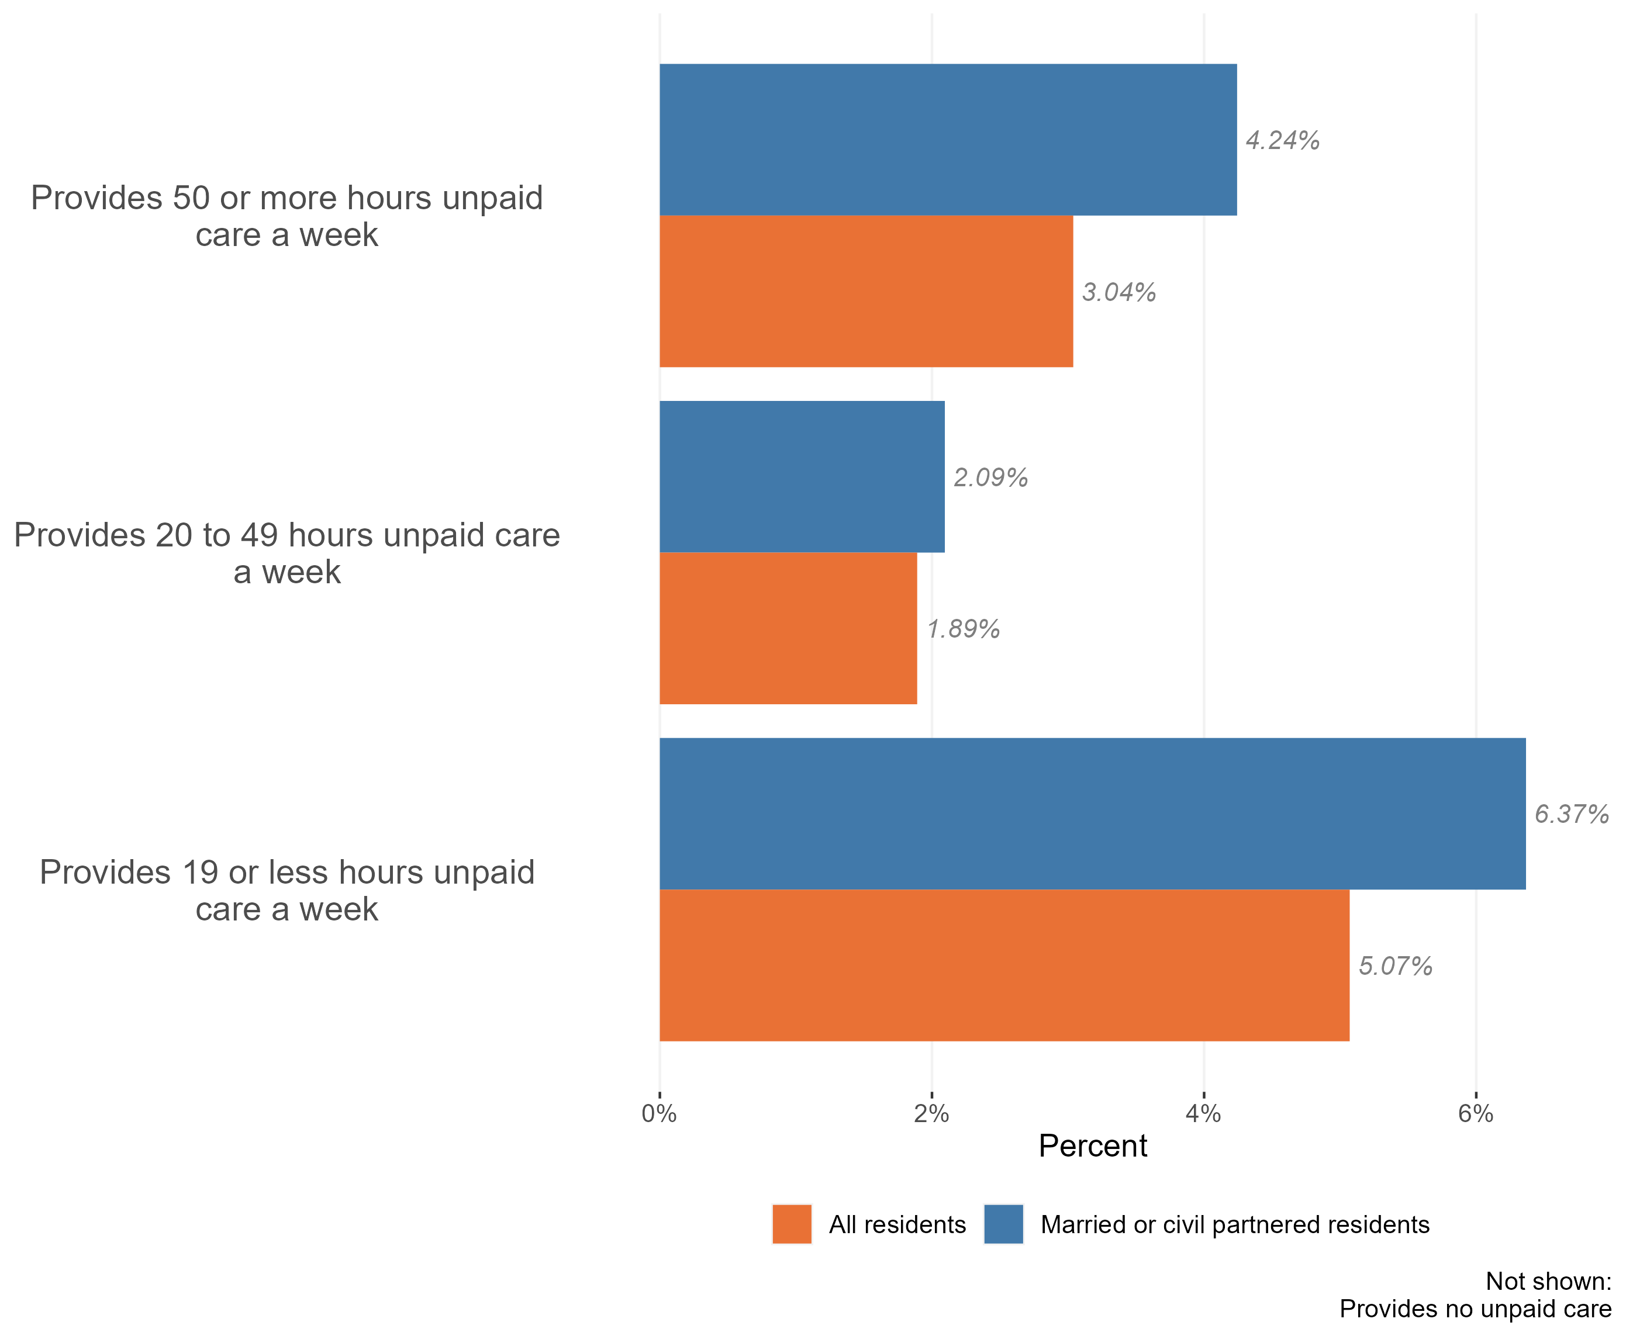
Provision of unpaid care by married or civil partnered residents
Provision of unpaid care by married & civil partnered residents, Essex, 2021
12.7% of Essex married or civil partnered residents provide some form of unpaid care. This is higher than the general Essex population, where 9% of the general population identified themselves as carers in the Census 2021.
Married and civil partnered residents are more likely to provide up to 19 or 50+ hours of unpaid care compared to the general Essex population. It is likely that part of this pattern can be explained by age – married and civil partnered residents tend to be older than the general public.
Research & Citizen Insight | Policy Unit | Essex County Council
17

Slide 18
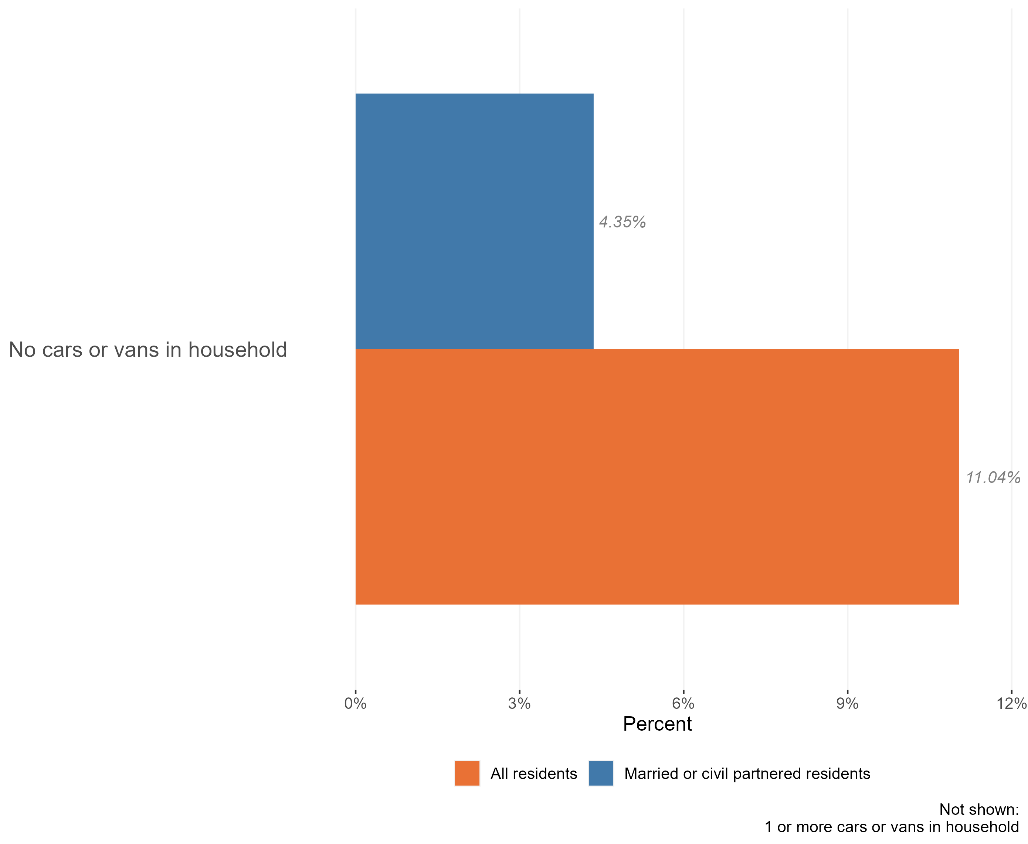
Access to cars
Access to a car or van in the married or civil partnered population, Essex, 2021
The vast majority of married & civil partnered residents in Essex live have access to one or more cars in their household (96%), higher than the Essex population as a whole (89%)
Research & Citizen Insight | Policy Unit | Essex County Council
18

