Slide 1
Understanding sexual orientation in Essex
Analysis of data from Census 2021
September 2023

Slide 2
Introduction
This document presents an analysis of the LGB+ population in Essex, based on data collected through Census 2021. It has been prepared as part of a series of analyses exploring the scale, distribution and characteristics of populations with ‘protected characteristics’ as defined by the Equality Act (2010).
The document is divided into three sections:
Section 1: considers the number of people aged 16+ across Essex, and Essex districts who are identified as LGB+ in the most recent Census data. These are people who, at the time of Census 2021, report their sexual orientation as Lesbian, Gay, Bisexual, or Other
Section 2: examines the characteristics of the LGB+ population, focusing on the extent to which the wider range of protected characteristics can be found within members of the LGB+ population;
Section 3: examines the outcomes enjoyed by members of the LGB+ population, focusing on employment outcomes, employment type, health outcomes, the likelihood of providing unpaid care, qualification levels and access to cars/vans.
This is part of a suite of similar analyses examining the protected characteristics defined by the equalities act. Similar analyses, and a series of interactive dashboards, exploring issues of ethnicity, age, sex, sexuality, disability, and gender identity can be found at data.essex.gov.uk.
ECC’s Research and Citizen Insight Team is leading the county council’s work to prepare examine and understand Census data. If you would like to ask questions, find out more, or get involved in this work please contact Alastair Gordon (Alastair.Gordon@essex.gov.uk) or Sean Maguire (Sean.Maguire@essex.gov.uk).
Research & Citizen Insight | Policy Unit | Essex County Council
2

Slide 3
Section 1: The LGB+ population
Understanding the scale and distribution of Essex’s LGB+ population

Slide 4
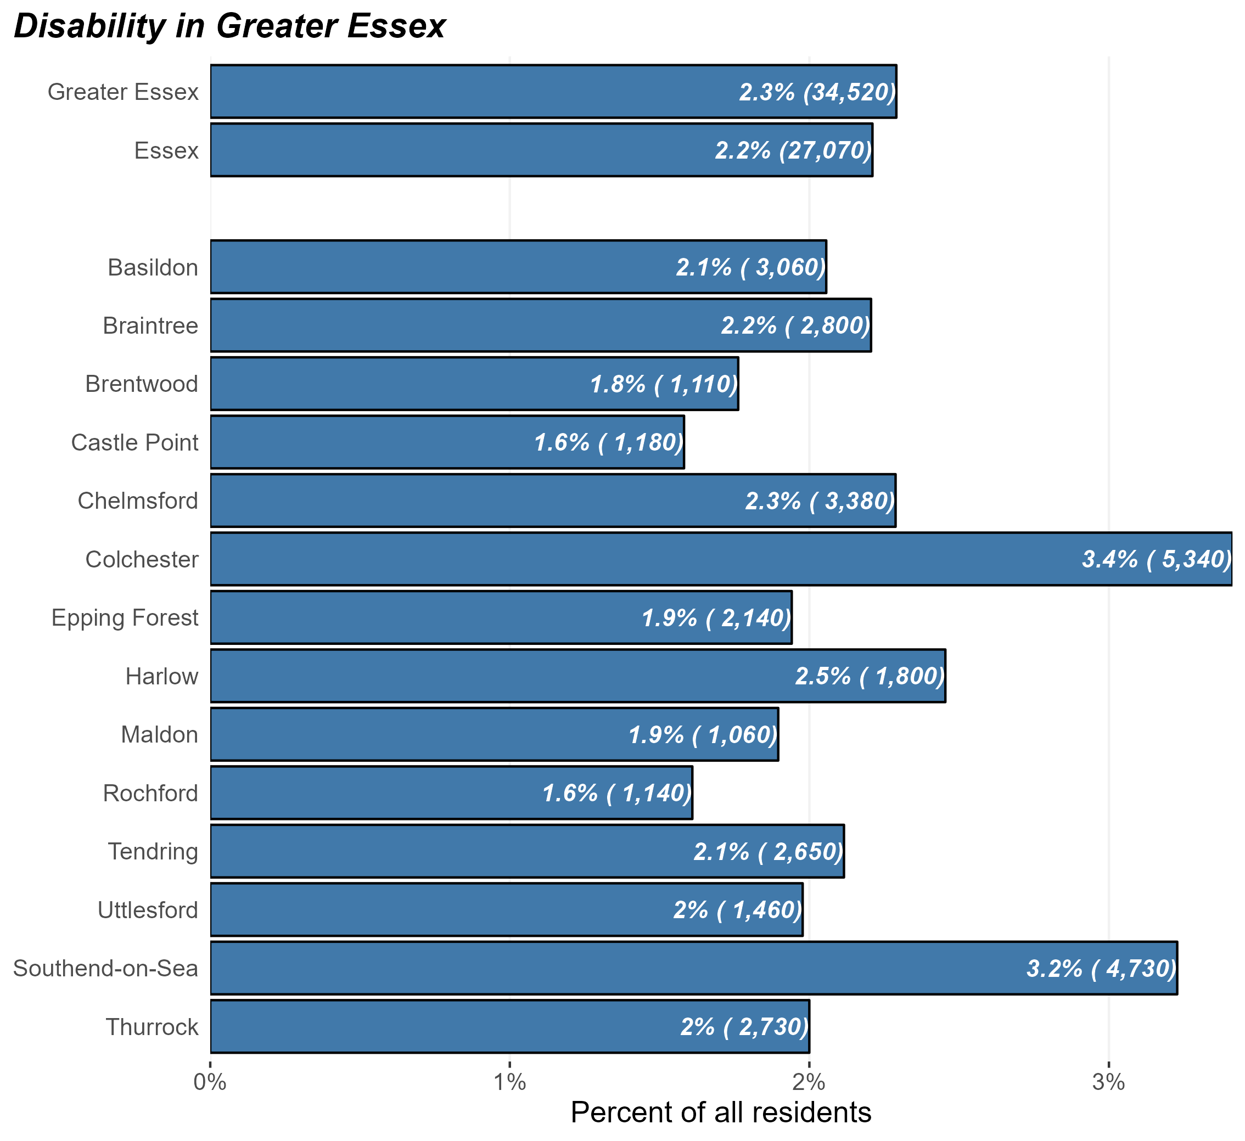
The LGB+ population
Number and percentage of residents identifying as LGB+ in Greater Essex and Essex Districts, Census 2021
At the time of Census 2021, there were some 27,000 LGB+ people in Essex and 34,500 in Greater Essex (including the areas of Southend and Thurrock).
This equates to 2.3% of Greater Essex residents aged 16+ – lower than the average of England as a whole (3.4%).
But the prevalence of LGB+ residents within the population varies substantially across different districts. Colchester and Southend have the highest levels of LGB+ residents
Research & Citizen Insight | Policy Unit | Essex County Council
4

Slide 5
Section 2: Characteristics of the LGB+ population
Exploring the prevalence of other protected characteristics within Essex’s LGB+ population

Slide 6
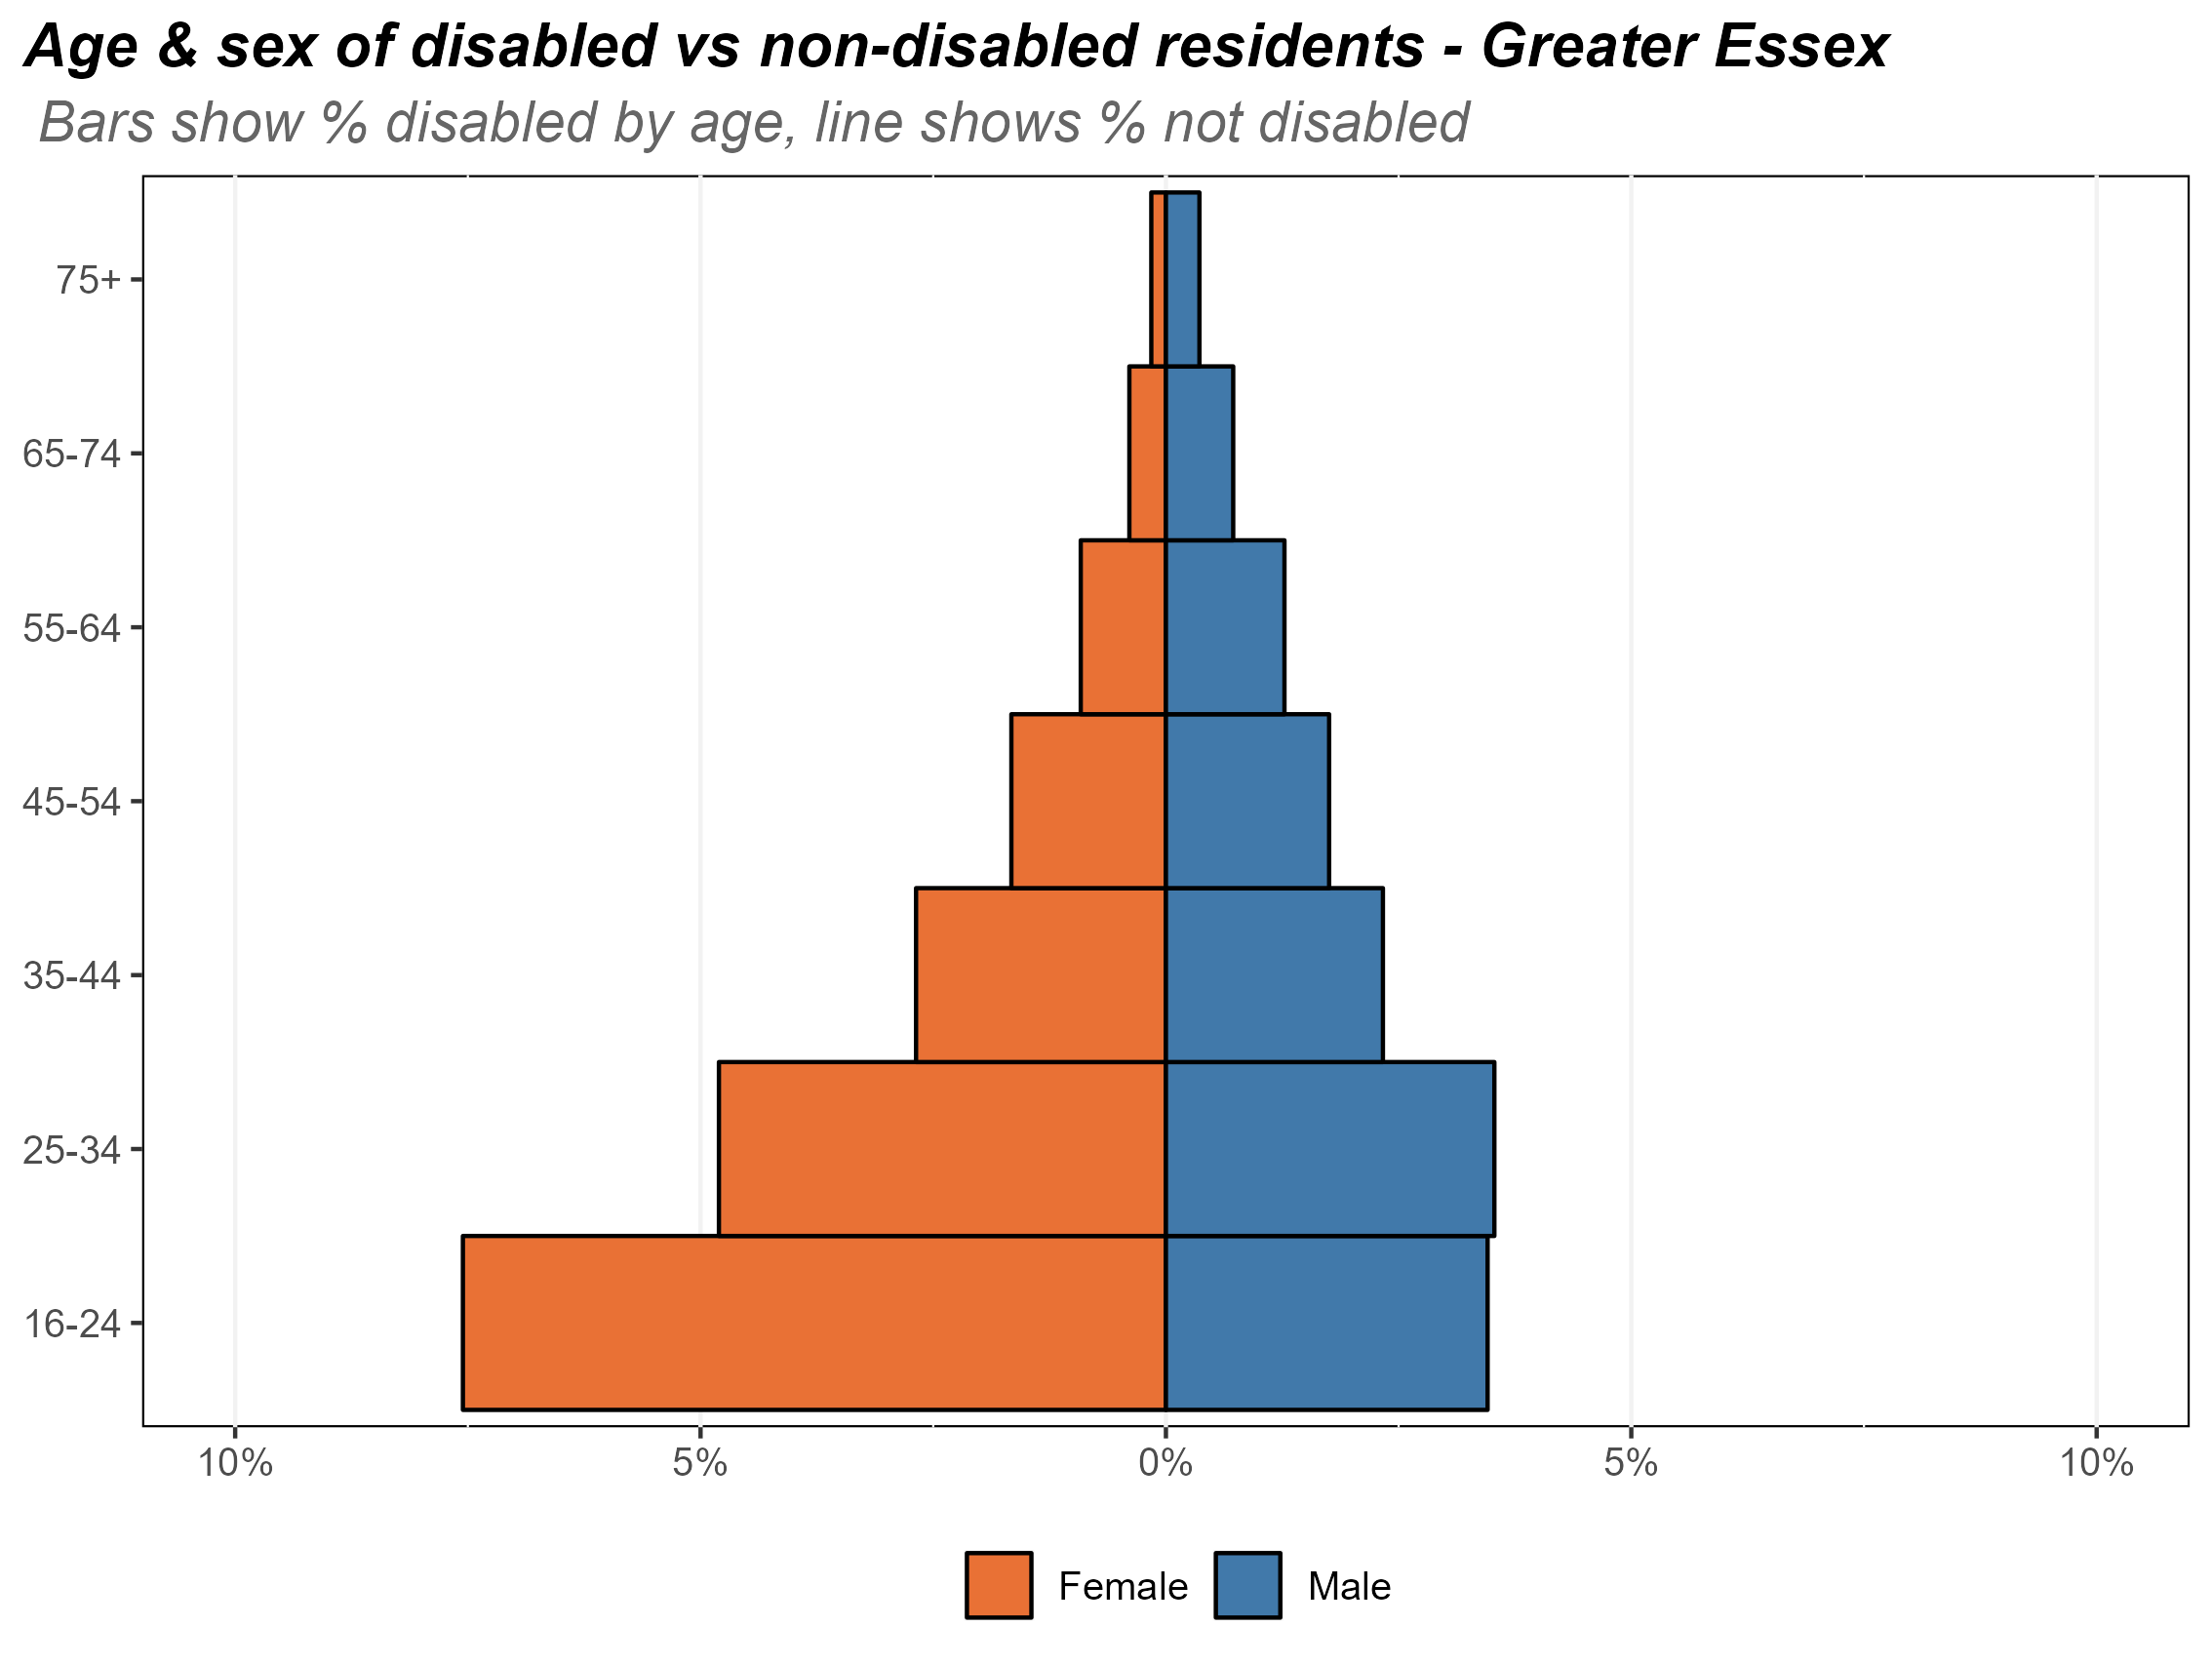
Age and sex of the LGB+ population
Composition of the LGB+ population by age and sex, Essex, 2021
The chart opposite shows the composition of Essex’s LGB+ population by age and by sex.
Identifying as LGB+ is most common in the youngest (16-24) age band, where circa 5.5% of residents identify as LGB+. This is slightly lower than England (6.9%).
The proportion of residents in each age band identifying as LGB+ falls off with age, with less than 1% of Essex residents aged 75+ identifying as LGB.
There is a higher proportion of females identifying as LGB+ in the younger age bands. Females have a higher proportion of LGB+ compared to males up to age 45-54, at which point the pattern flips and there are higher proportion of males identifying as LGB+ compared to females.
Research & Citizen Insight | Policy Unit | Essex County Council
6

Slide 7
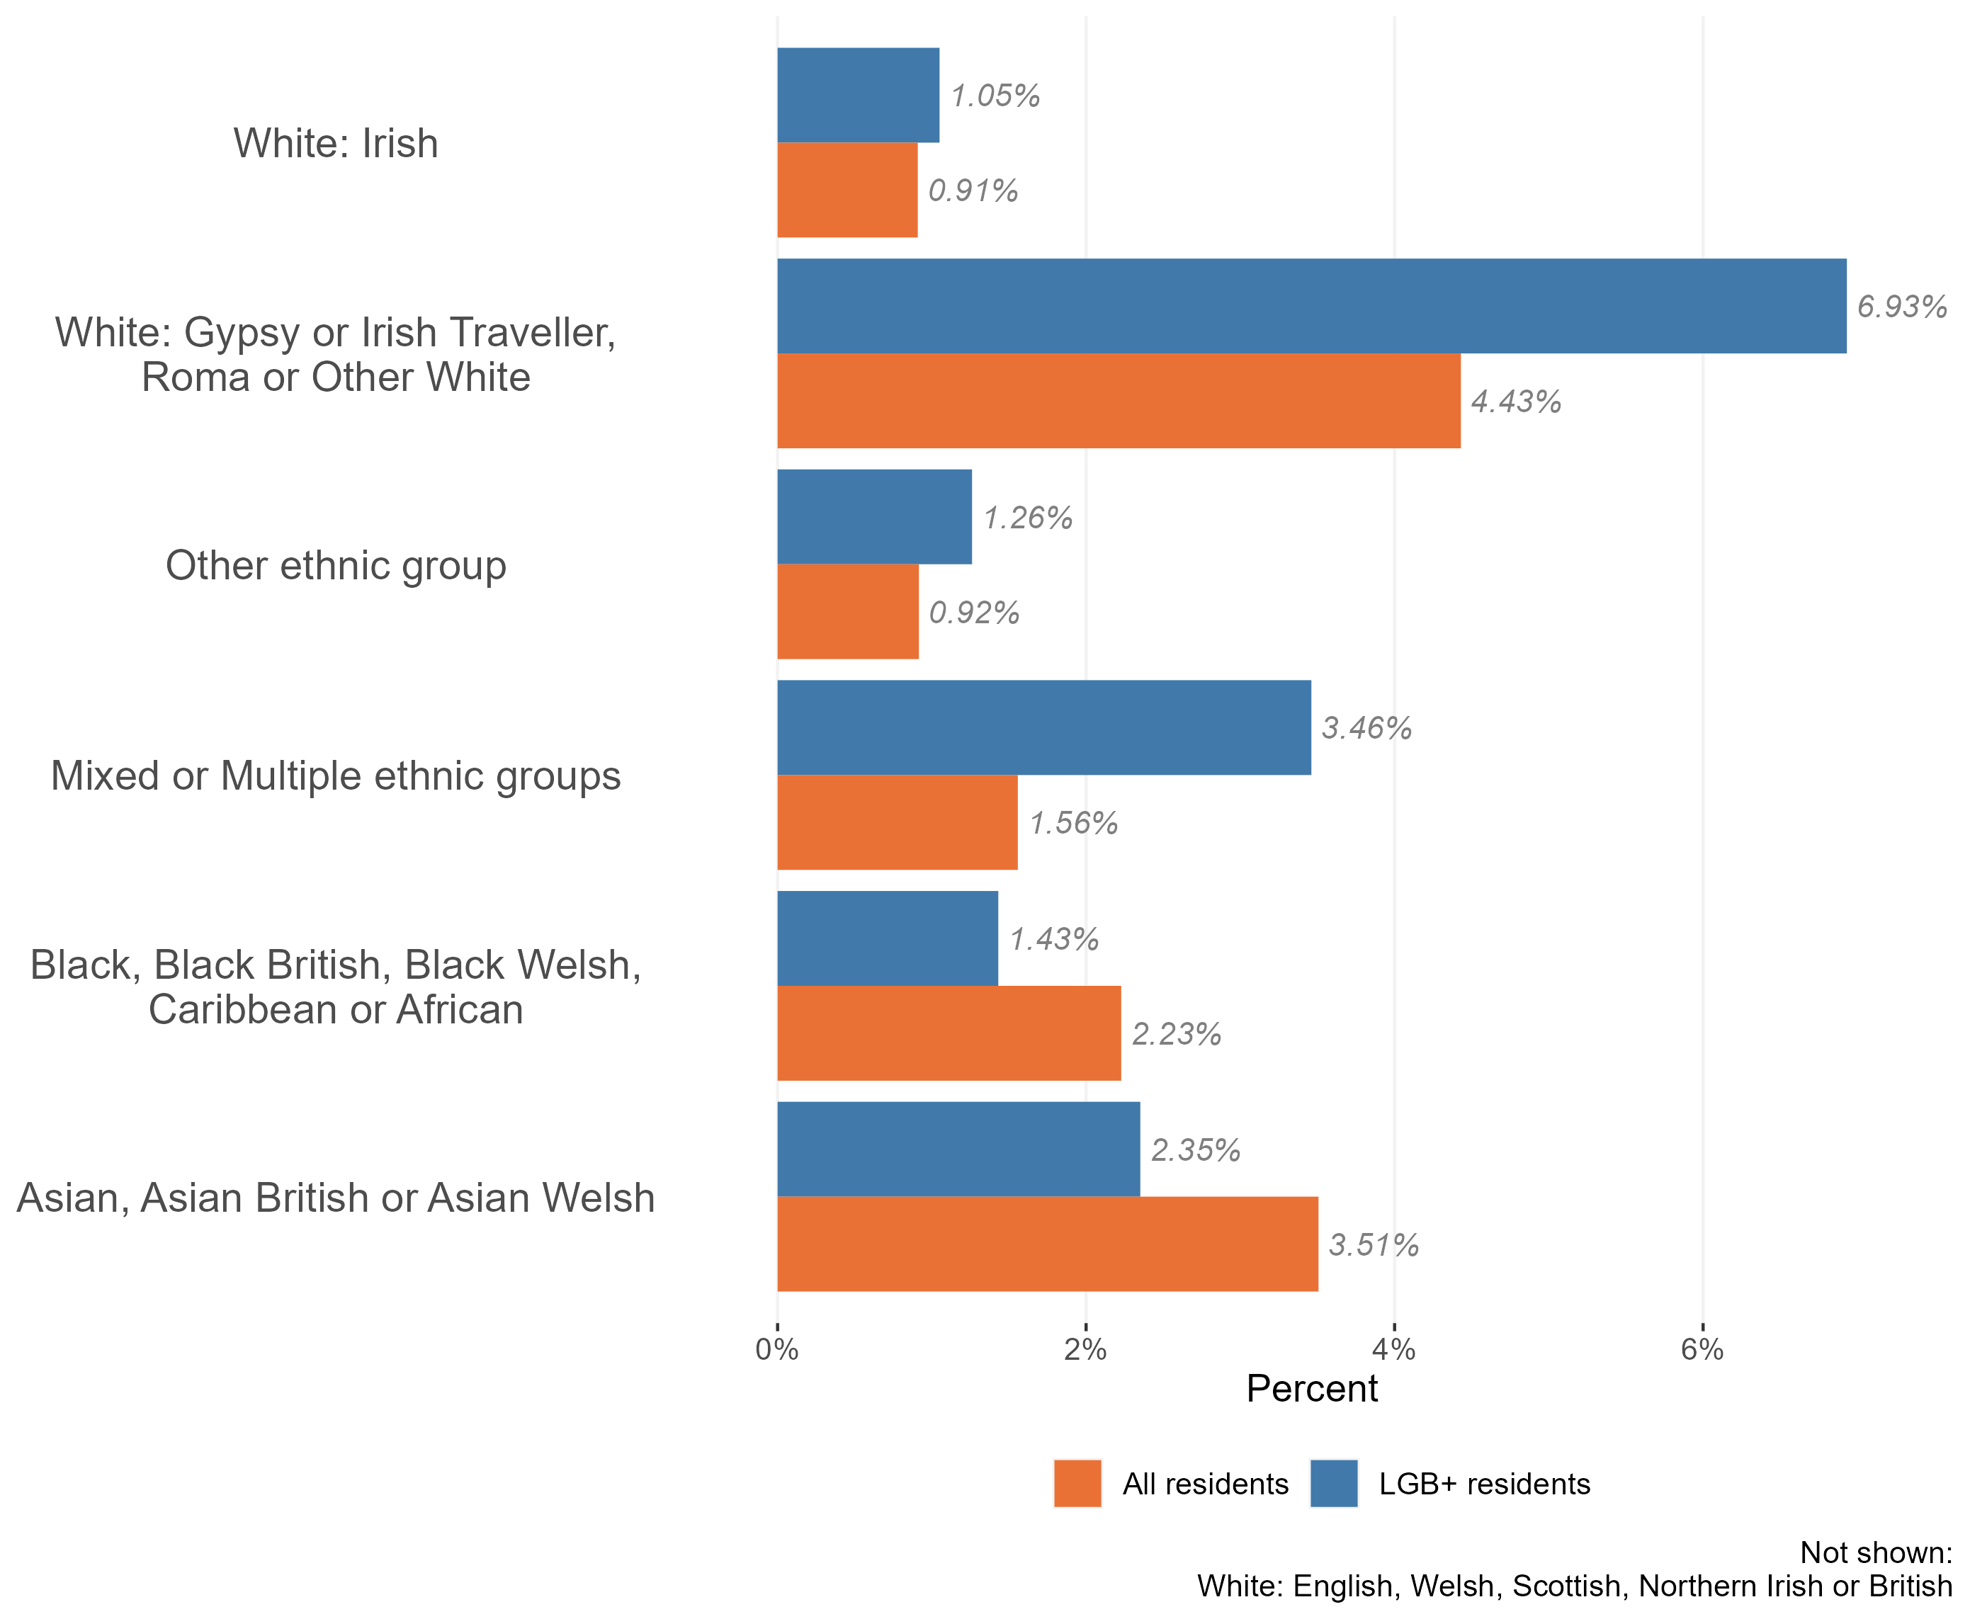
Ethnic diversity in the LGB+ population
Composition of the LGB+ population by ethnic group Essex, 2021
The vast majority of Essex’s LGB+ population identify as White British (83.5% - or 22,600 for the 27,070 LGB+ population).
4,470 identify as members of other ethnic groups (16.5% - compared to 13.6% across the population as a whole).
In particular, the analysis reveals that members of the Essex LGB+ population are nearly twice as likely as the wider population to identify as:
Gypsy or Irish Traveller, Roma or Other white;
Mixed or multiple ethnic group;
Members of the LGB+ population are less likely to identify as Black, Black British, Black Welsh, Caribbean or African and Asian, Asian British or Asian Welsh
It is interesting to note that the highest proportion of LGB+ residents in Essex are Gypsy, Irish traveller, or Roma. More needs to be done to support this community as they can be doubly discriminated due to their sexuality and their traveller status [1]
[1] Racism and Ethnic inequality in a time of crisis: Chapter 4 (Racism and racial discrimination)
Research & Citizen Insight | Policy Unit | Essex County Council
7

Slide 8
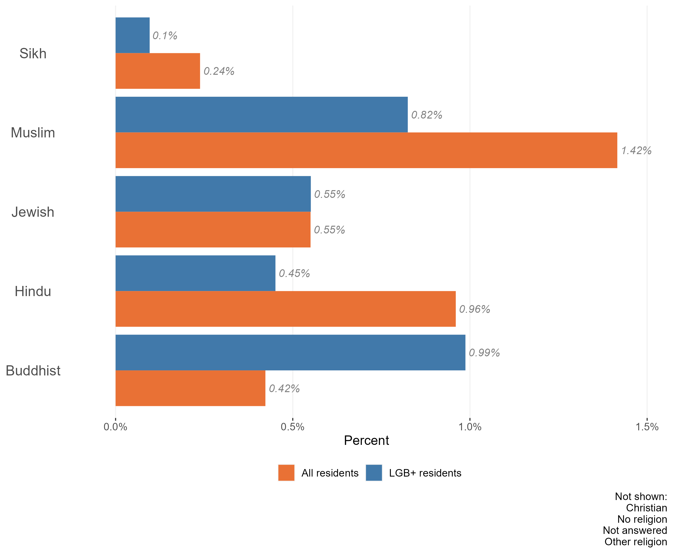
Religion in the LGB+ population
The vast majority of the Essex LGB+ population identify as having ‘no religion’ (64.3%), followed by Christian (26.6%). This is slightly different to the general population of Essex, where nearly half of the population are Christian.
Also, amongst the Essex LGB+ population:
a higher percentage of residents identified as following Buddhist religion 2.3x higher than the Essex population as a whole.
Those identifying as Jewish was equal to all residents in the Essex population
a lower percentage of residents identified as Muslim, Sikh or Hindu than the Essex population as a whole.
The Essex population is reflective of national trends, as a vast majority of LGB+ population in England identify as having no religion. According to national LGBT survey, half of LGBT+ members who experienced conversion therapy, experienced it in faith groups. This can likely be indicative of dissatisfaction with faith groups [1]
Composition of the LGB+ population by religion, Essex, 2021
[1] National LGBT Survey 2018
Research & Citizen Insight | Policy Unit | Essex County Council
8

Slide 9
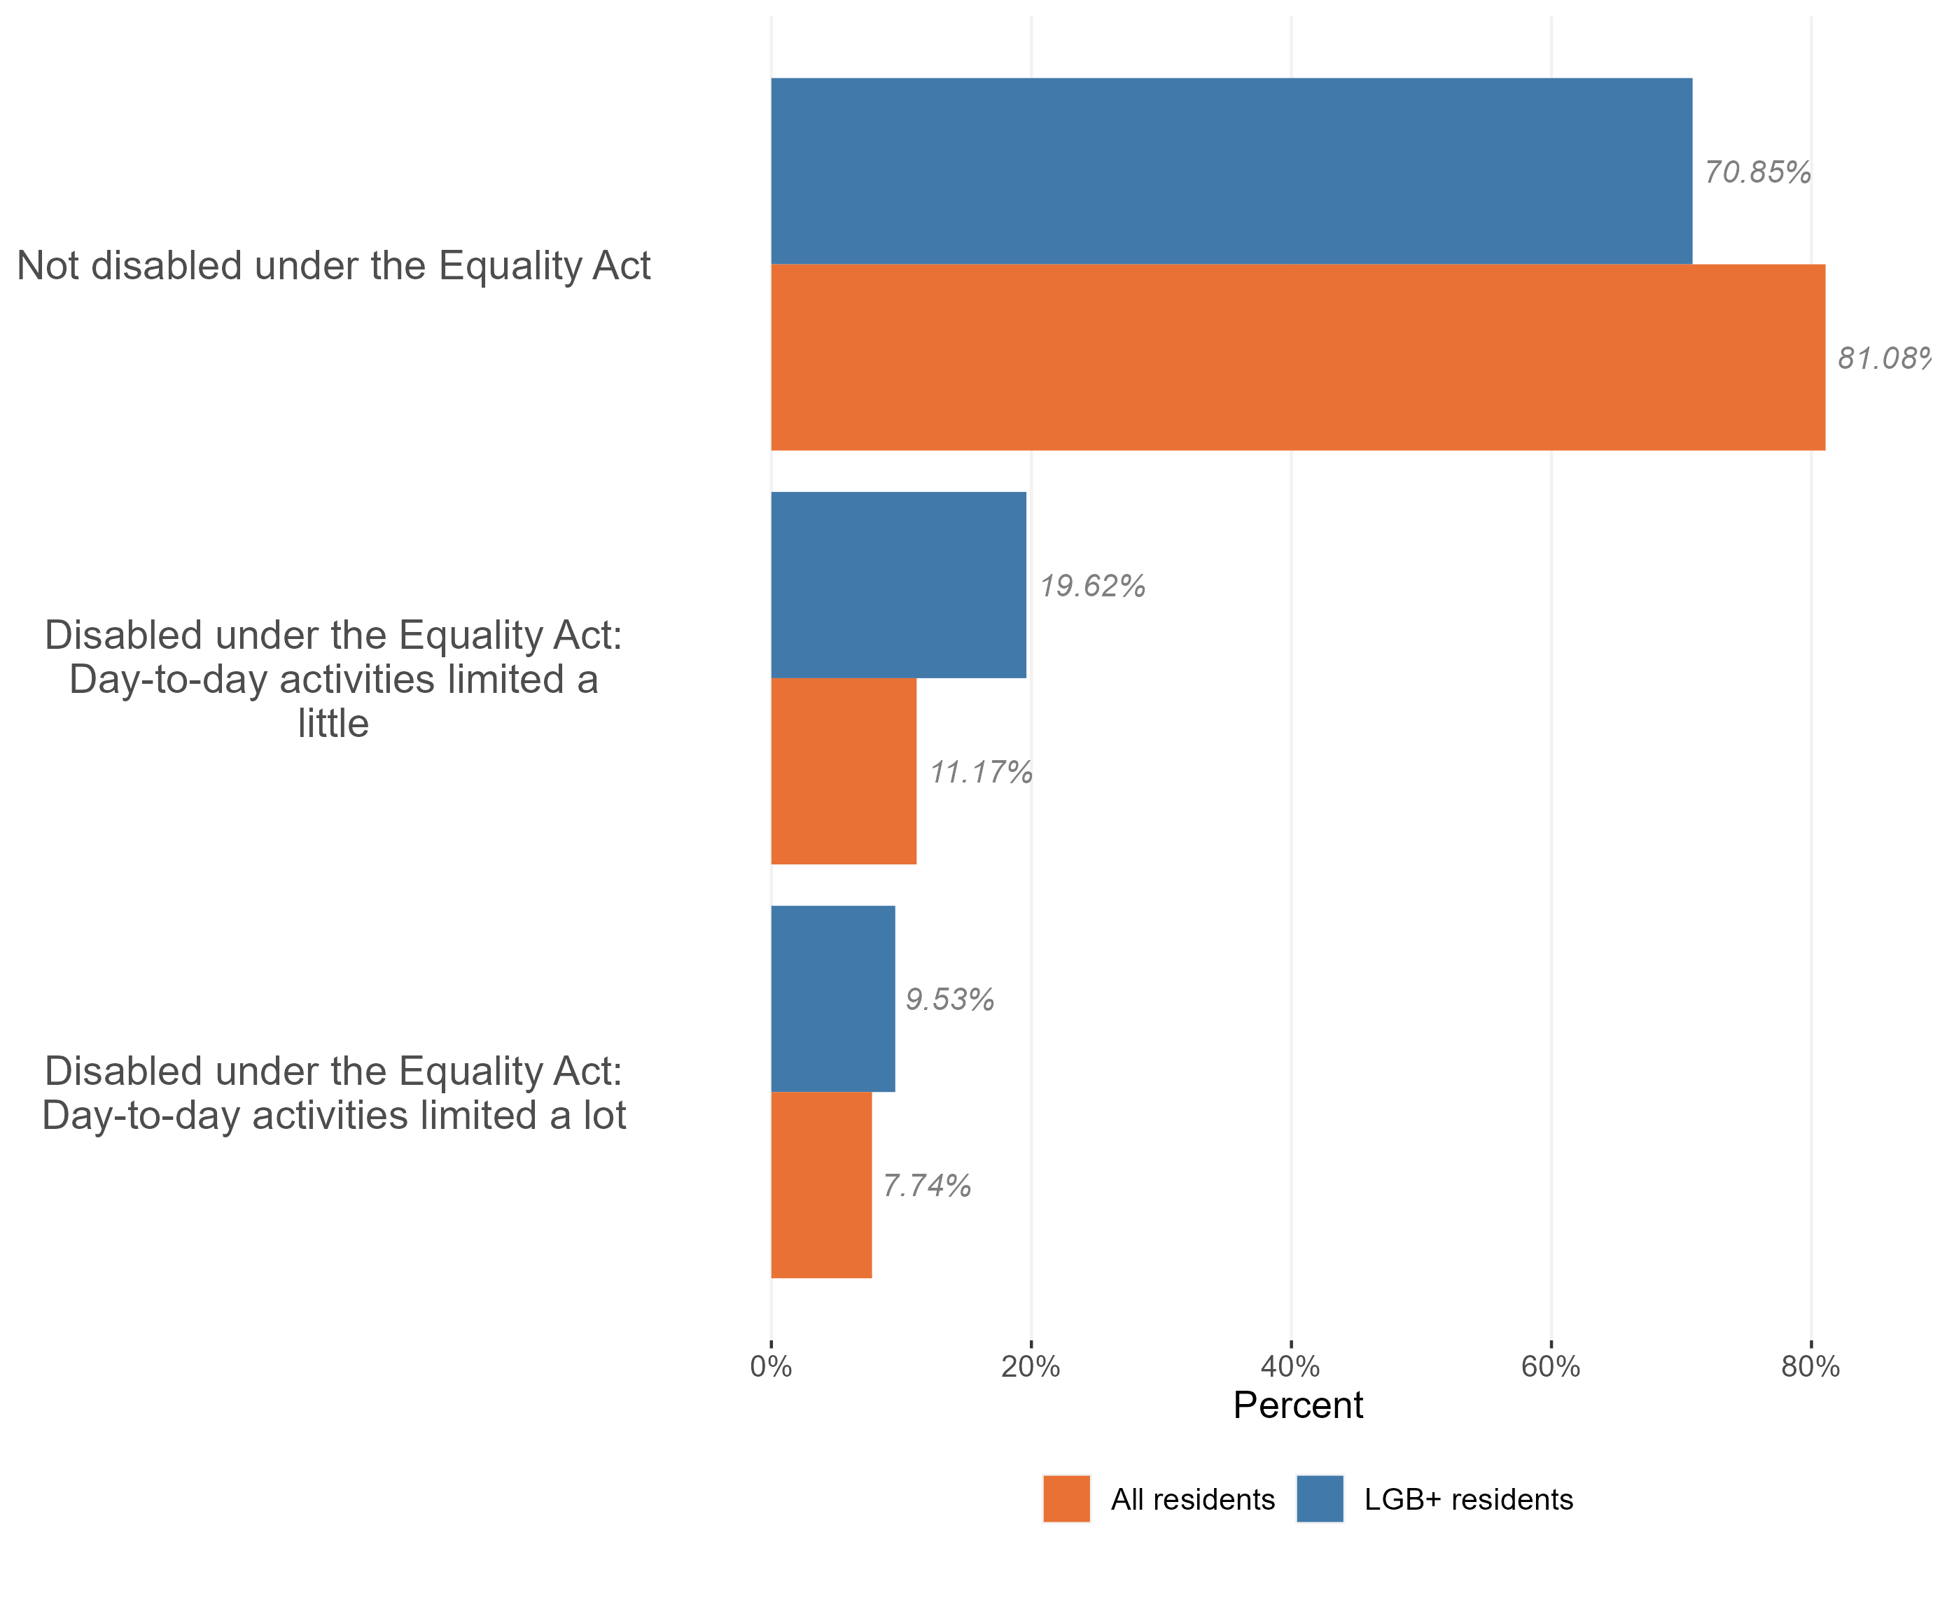
Disability in the LGB+ population
The prevalence of disability is higher in the LGB+ population – roughly 3 in every 10 LGB+ Essex residents are disabled, compared to 2 in every 10 residents in the general Essex population.
A higher proportion of the LGB+ population are disabled and have their day-to-day activities limited a little. 20% of Essex’s LGB+ residents have their day to day activities limited a little by their disability, almost twice as high as the general Essex population.
LGB+ residents also have a slightly higher proportion who are disabled and have their day-to-day activities limited a lot (9.5% compared to 7.7% in the general population)
Composition of the LGB+ population by disability, Essex, 2021
Research & Citizen Insight | Policy Unit | Essex County Council
9

Slide 10
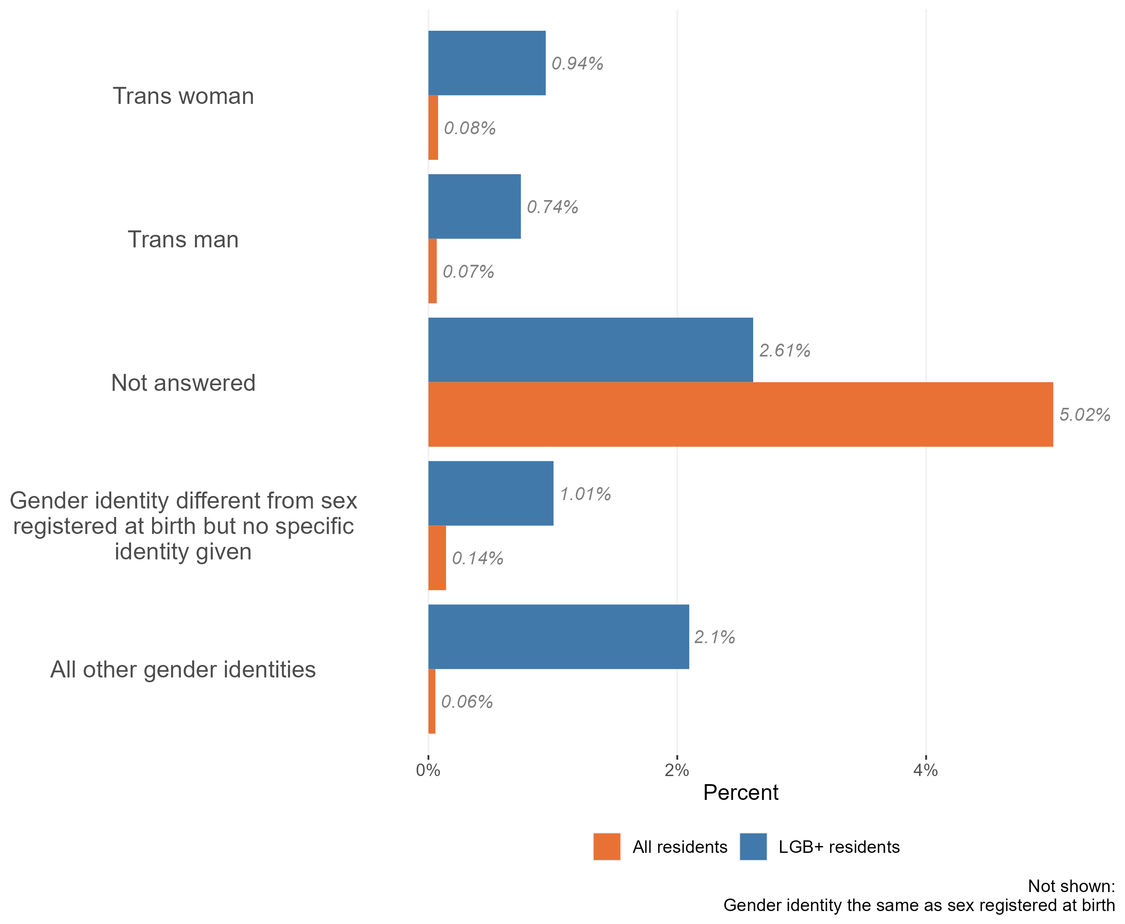
Gender and the LGB+ population
Composition of the LGB+ population by sexuality, Essex, 2021
The vast majority of the Essex LGB+ population have a gender identity which the same as their sex registered at birth (92.6%, 25,000). Only around 1,300 people in the Essex LGB+ population identify as having a different gender identity.
Nevertheless, this is a slightly higher proportion than across the Essex population as a whole. Within the Essex LGB+ population:
A higher percentage of residents identified as having ‘other gender identities.’
A higher percentage of residents identified as trans men and trans women than across the population as a whole, and
A lower proportion of LGB+ residents chose not to answer the gender question compared to the general population, possibly due to differences in talking about gender identity in the LGB+ population compared to the general population
Research & Citizen Insight | Policy Unit | Essex County Council
10

Slide 11
Section 3: Outcomes for the LGB+ population
Exploring the extent to which the LGB+ population enjoy positive outcomes

Slide 12
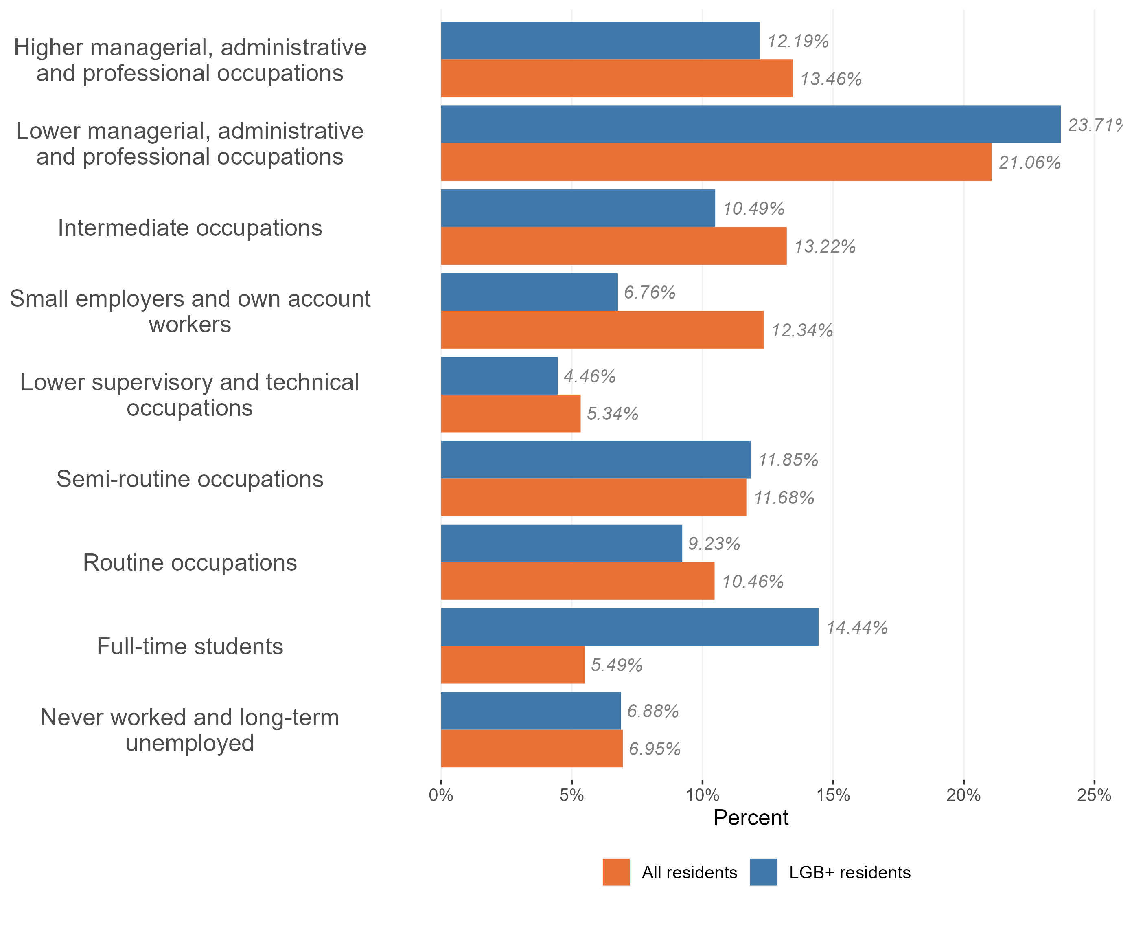
Employment and occupation type
Employment and occupation type, LGB+ and general population, Essex 2021
LGB+ people in Essex are significantly more likely to be full time students compared to all Essex residents.
Those LGB+ people who are in work are:
More likely to be in lower managerial, administrative and professional occupations than the wider working population; and
less likely to be working in routine, lower supervisory and technical occupations, and intermediate occupations
This is reflective of the age of the LGB+ population in Essex, more than half are aged 16 to 34 years, and therefore more likely to be full time students
Research & Citizen Insight | Policy Unit | Essex County Council
12

Slide 13
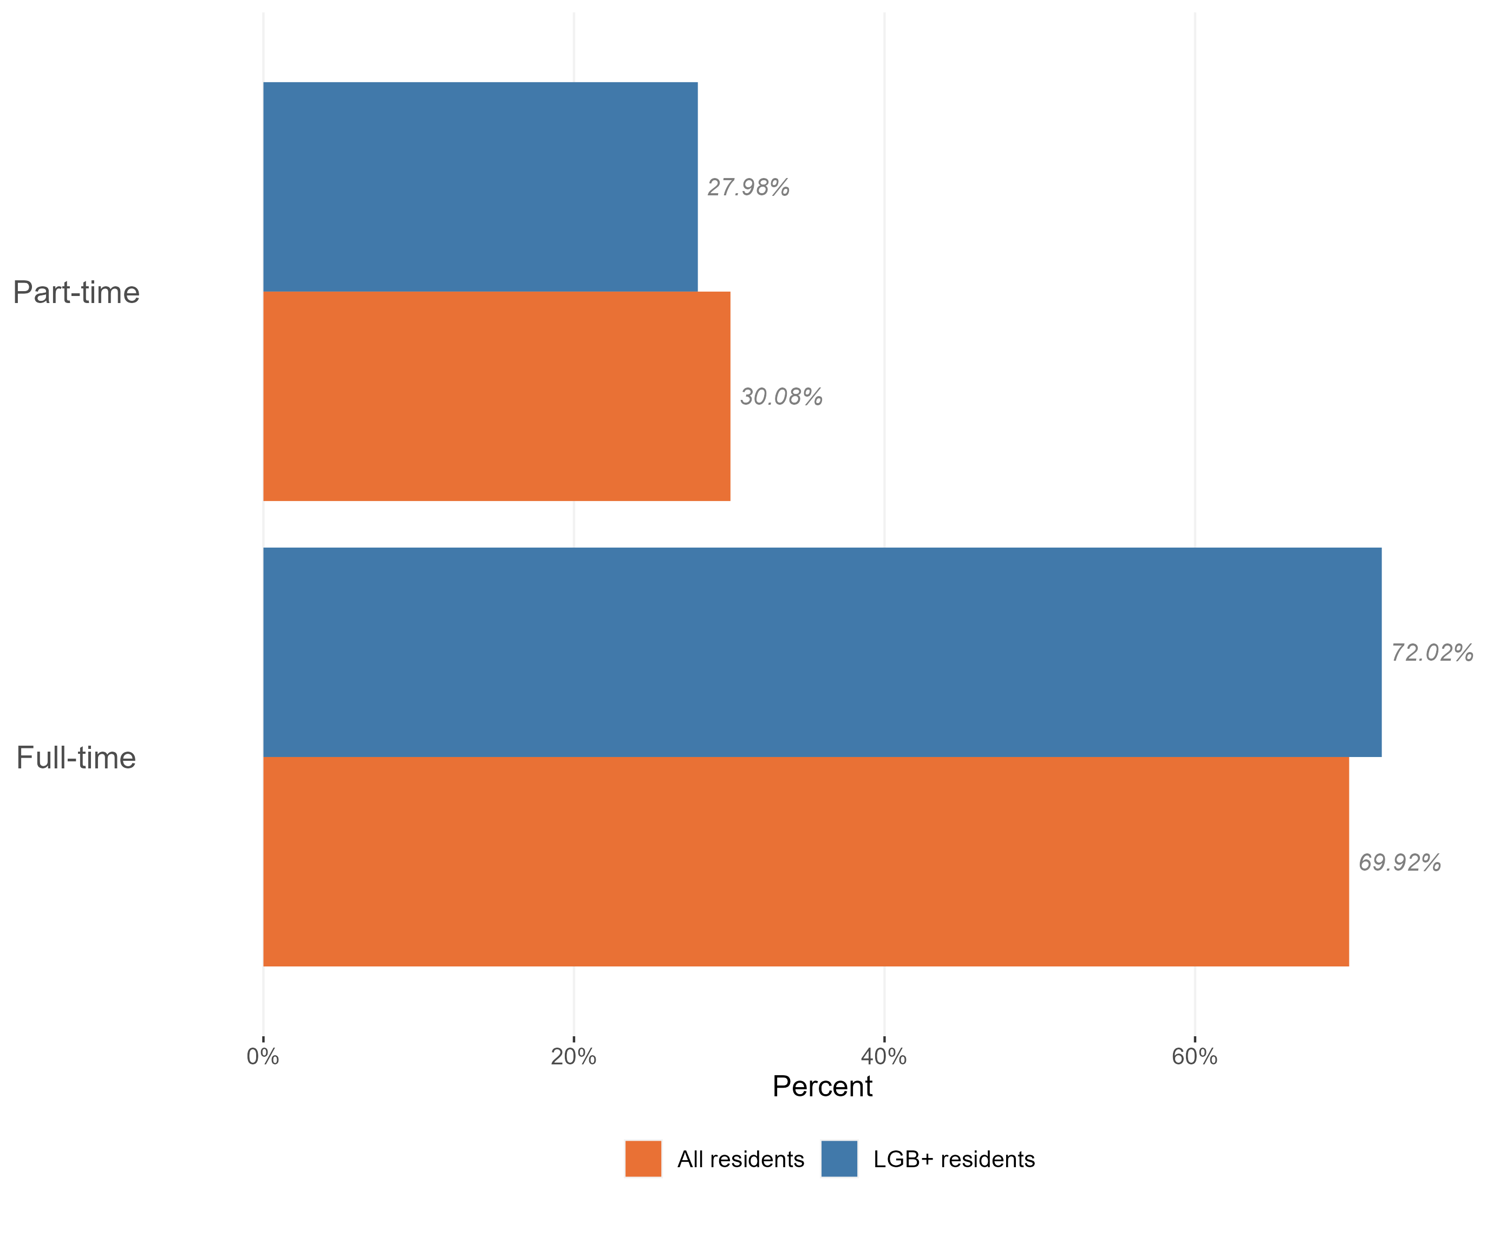
Employment and hours worked
Hours worked, LGB+ and general population, Essex, 2021
LGB+ people in Essex are more likely to be in work than the working-age population as a whole. Those who do work are slightly more likely to work full-time than members of the wider population.
There are 25,806 LGB+ people in Essex aged 16-64 of which 17,729 are in employment (full time or part time) This means around 2/3rd of the group is in employment at time of census 2021
This is a higher proportion than we see across the working-age population as a whole suggesting that LGB+ people are more likely to be in work than the average for the population.
The majority of the LGB+ population in Essex who are in work are in full-time roles (72% hold full-time roles compared to 27% working part-time)*, a higher proportion are in full-time work than across the Essex working-age population as a whole.
*Within Census data full time roles are classified as 31+ hours per week and part-time roles are classed as 30 hrs or less per week.
Research & Citizen Insight | Policy Unit | Essex County Council
13

Slide 14
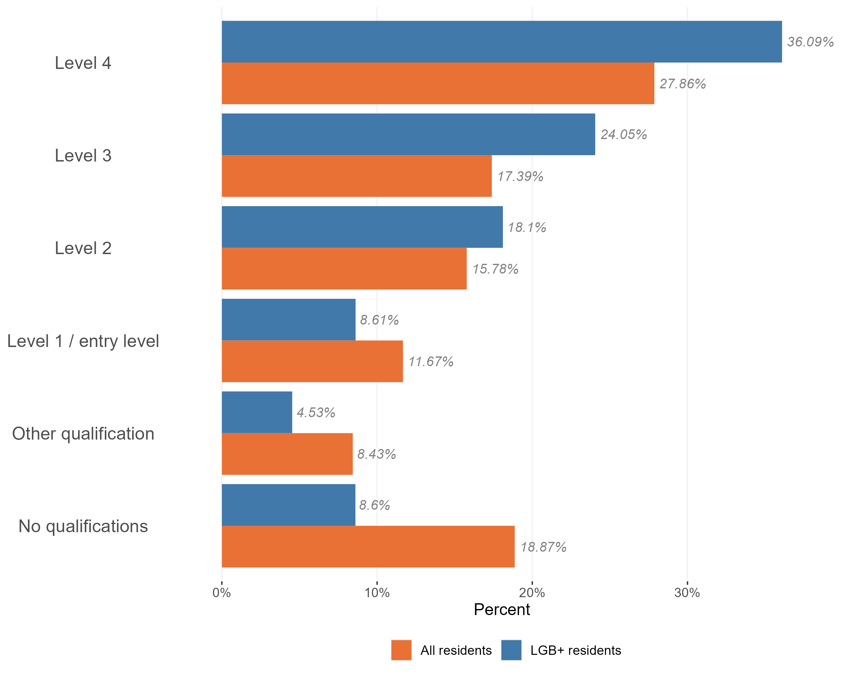
Highest qualification level
Level of qualifications held in the LGB+ and general population, Essex, 2021
LGB+ people in Essex are significantly more likely to hold higher level qualifications than the population as a whole.
They are also significantly less likely to hold no formal qualifications or to hold only entry level qualifications than the wider population of working-age residents. In fact, LGB+ residents are half as likely as the Essex general population to hold no qualifications.
There are more LGB+ people with higher levels of qualification (level 4 – e.g. Masters degrees or PhDs) than Essex general population
Research & Citizen Insight | Policy Unit | Essex County Council
14

Slide 15
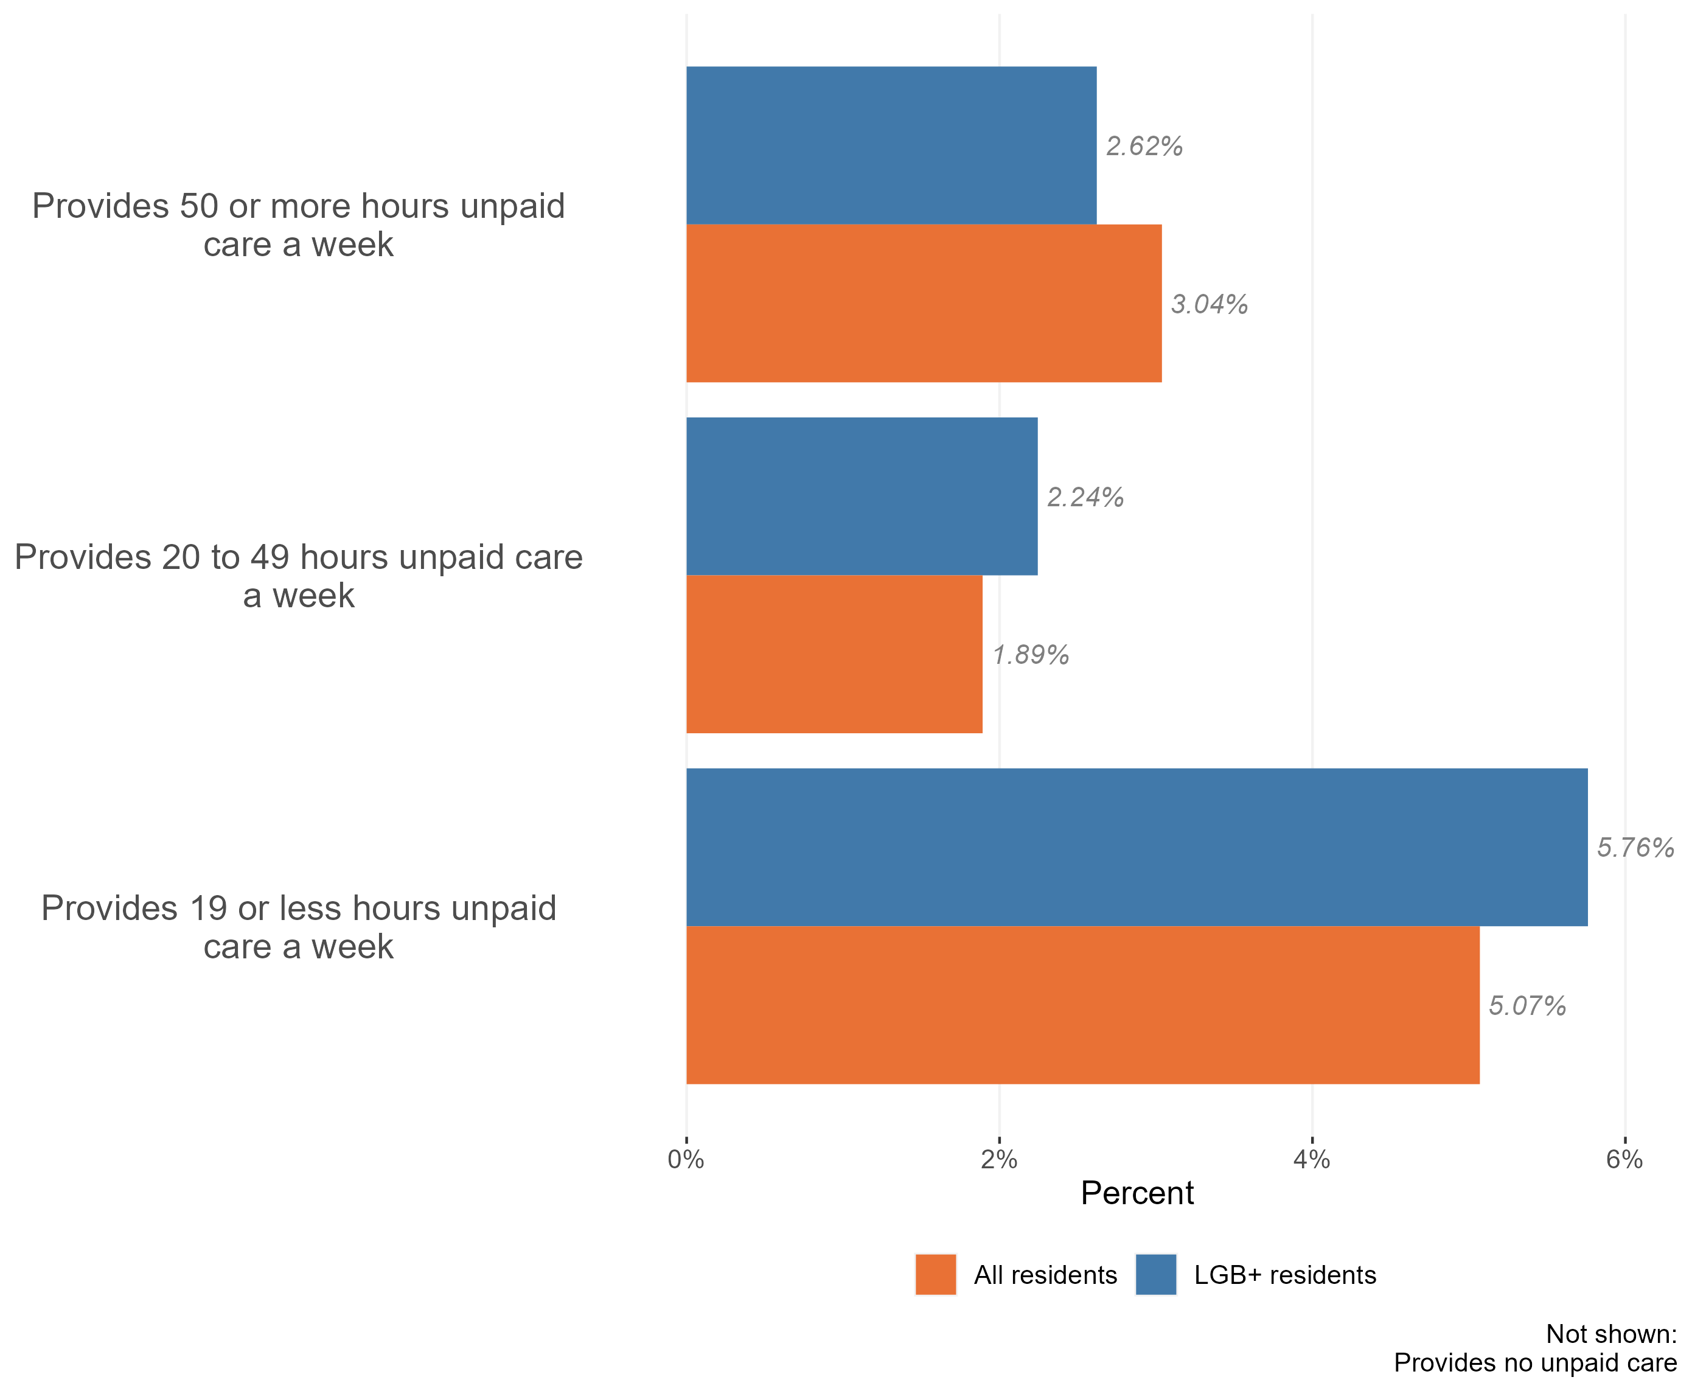
Sexuality by unpaid care
Provision of unpaid care by the LGB+ population, Essex, 2021
The vast majority of LGB+ people in Essex do not provide unpaid care. Only 10% of the LGB+ population provide some form of unpaid care. This is similar to the general Essex population, where c9% of residents provide some level of unpaid care.
LGB+ residents are more likely to provide 0-19 and 20-49 hours of unpaid care compared to the general population in Essex
Research & Citizen Insight | Policy Unit | Essex County Council
15

