Slide 1
Understanding religion in Essex
Analysis of data from Census 2021
September 2023

Slide 2
Introduction
This document presents an analysis of the religious population in Essex, based on data collected through Census 2021. It has been prepared as part of a series of analyses exploring the scale, distribution and characteristics of populations with ‘protected characteristics’ as defined by the Equality Act (2010).
The document is divided into three sections:
Section 1: considers the number of people across Essex, and Essex districts who are identified as religious in the most recent Census data. These are people who, at the time of Census 2021, report their religion as any option other than ‘no religion’ or ‘not answered’
Section 2: examines the characteristics of the religious population, focusing on the extent to which the wider range of protected characteristics can be found within members of the religious population;
Section 3: examines the outcomes enjoyed by members of the religious population, focusing on employment outcomes, employment type, health outcomes, the likelihood of providing unpaid care, qualification levels and access to cars/vans.
This is part of a suite of similar analyses examining the protected characteristics defined by the equalities act. Similar analyses, and a series of interactive dashboards, exploring issues of ethnicity, age, sex, sexuality, disability, and gender identity can be found at data.essex.gov.uk.
ECC’s Research and Citizen Insight Team is leading the county council’s work to prepare examine and understand Census data. If you would like to ask questions, find out more, or get involved in this work please contact Alastair Gordon (Alastair.Gordon@essex.gov.uk) or Sean Maguire (Sean.Maguire@essex.gov.uk).
Research & Citizen Insight | Policy Unit | Essex County Council
2

Slide 3
Section 1: The religious population
Understanding the scale and distribution of Essex’s religious population

Slide 4
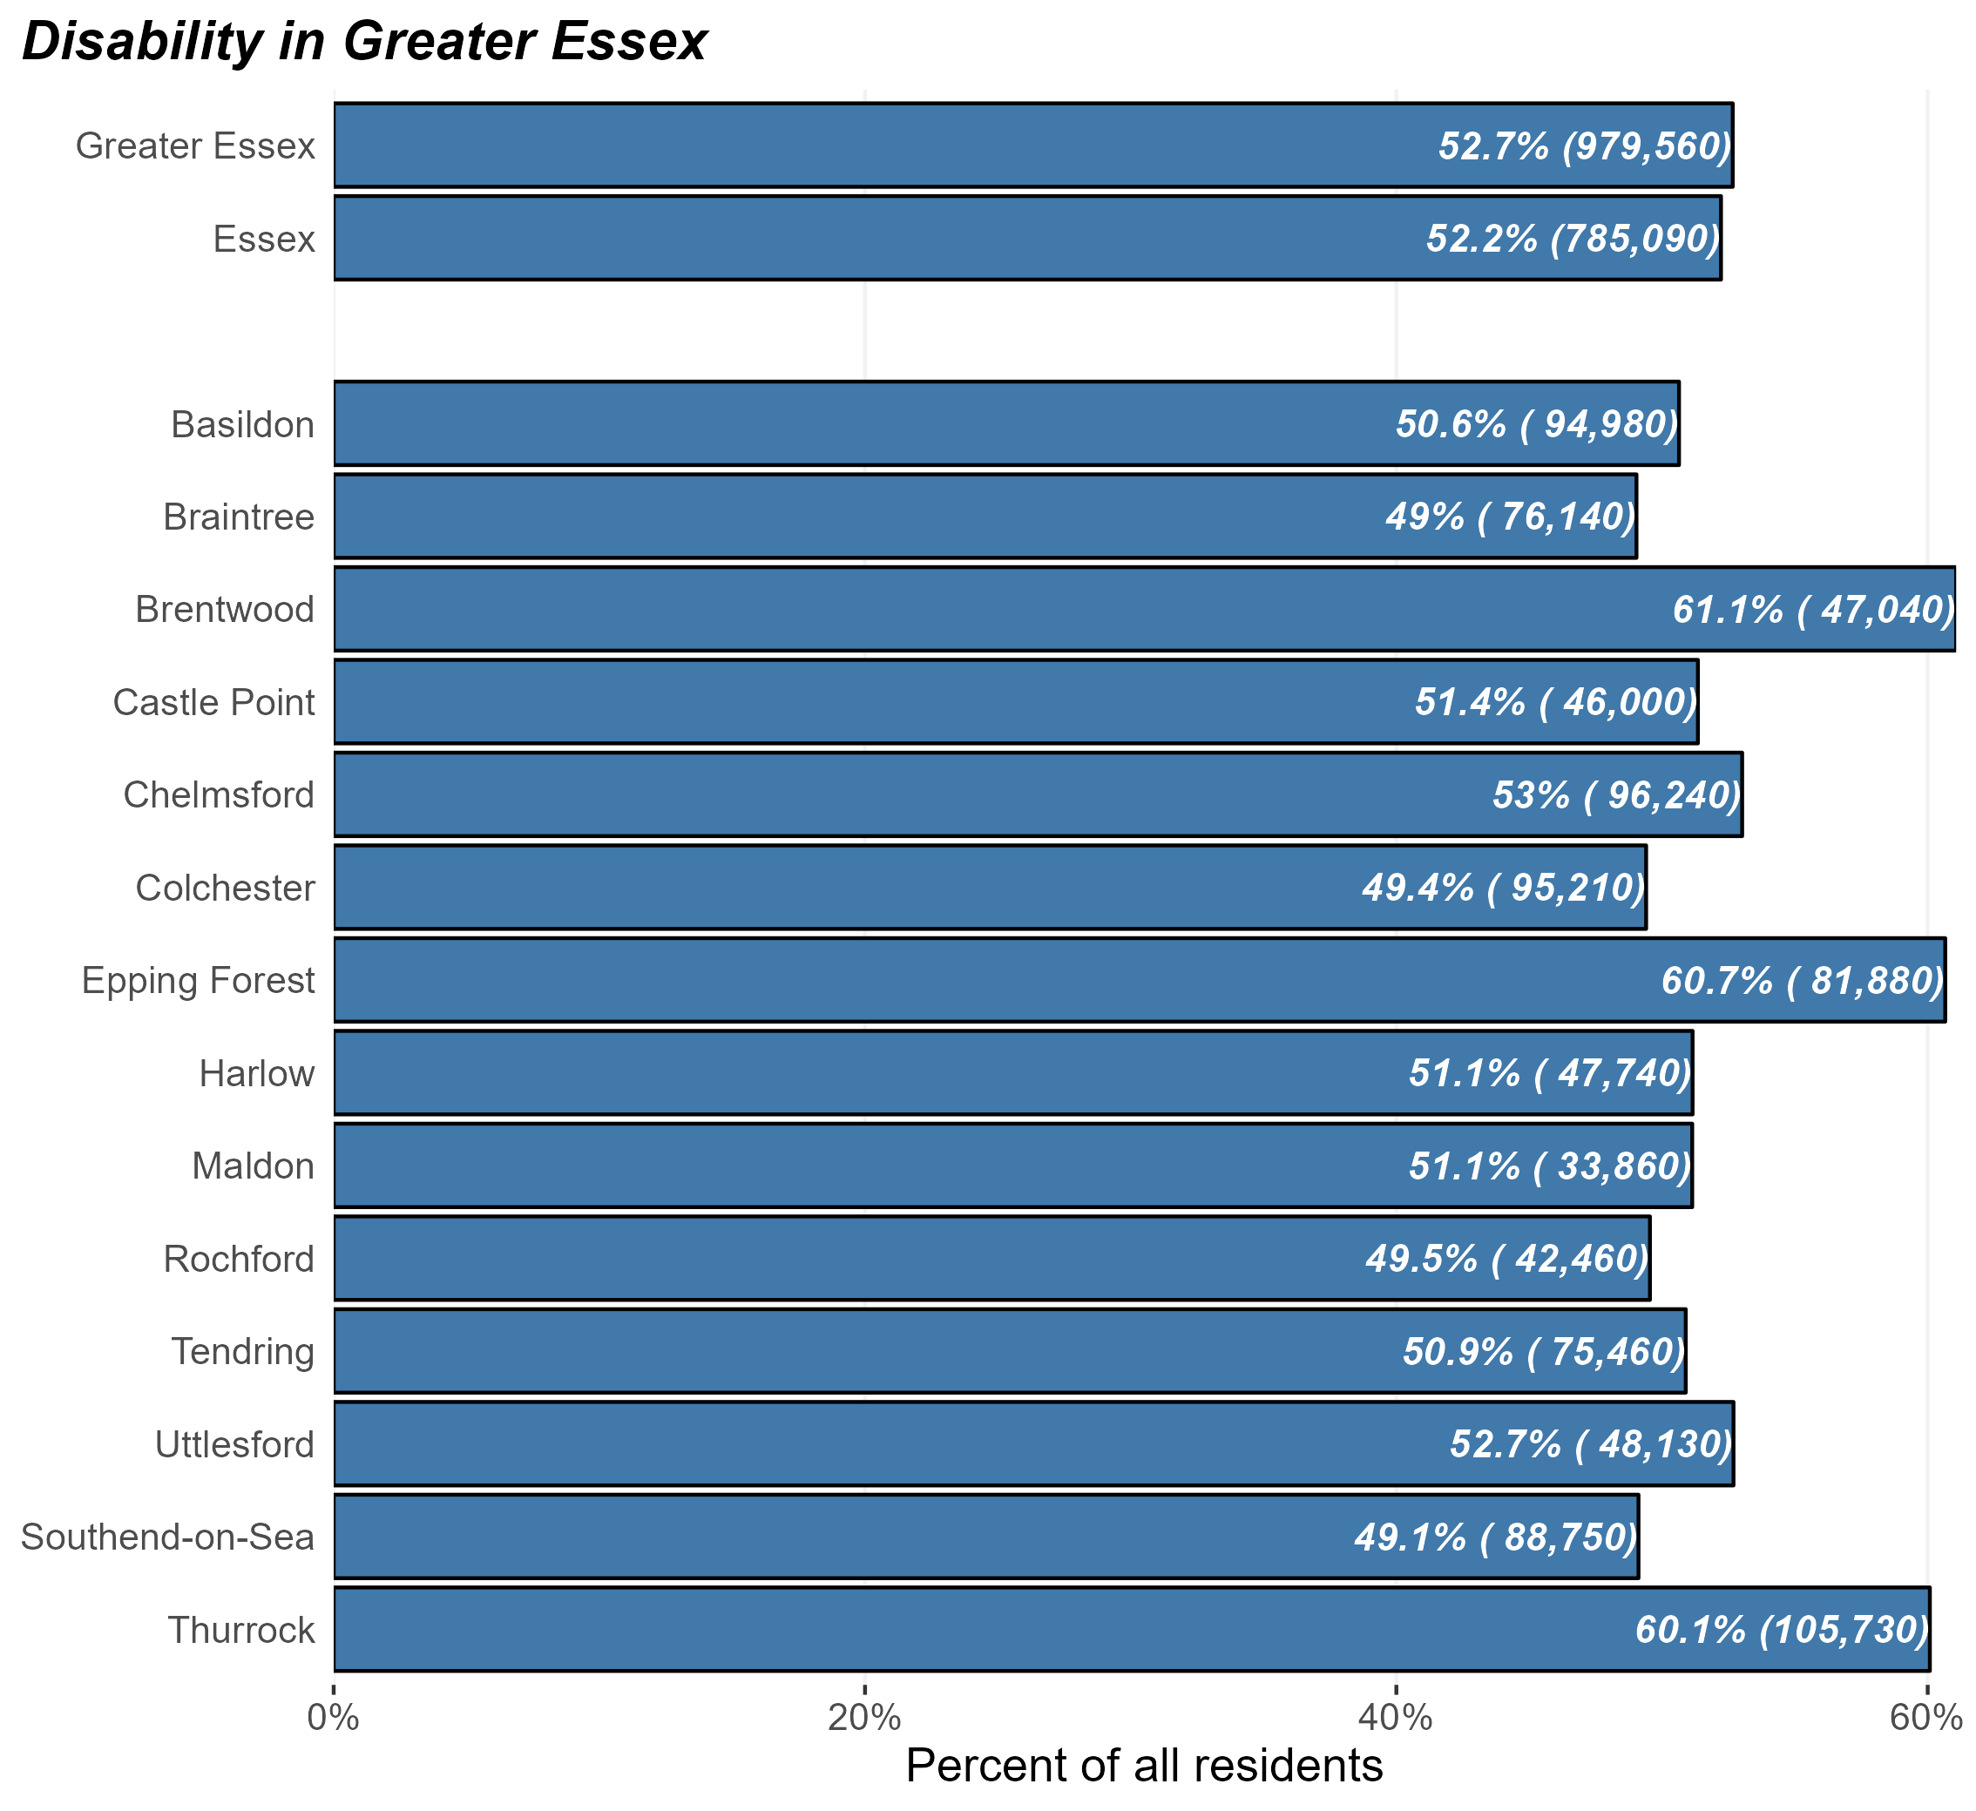
The religious population
Number and percentage of residents identifying as religious in Greater Essex and Essex Districts, Census 2021
At the time of Census 2021, there were some 785,090 religious people in Essex and 979,560 in Greater Essex (including the areas of Southend and Thurrock).
This equates to 52.2% of Essex residents – broadly in line with the average of England as a whole (57.3%).
But the prevalence of religion within the population varies substantially across different districts. Brentwood, Epping, and Thurrock have the highest levels of religious residents
Research & Citizen Insight | Policy Unit | Essex County Council
4

Slide 5
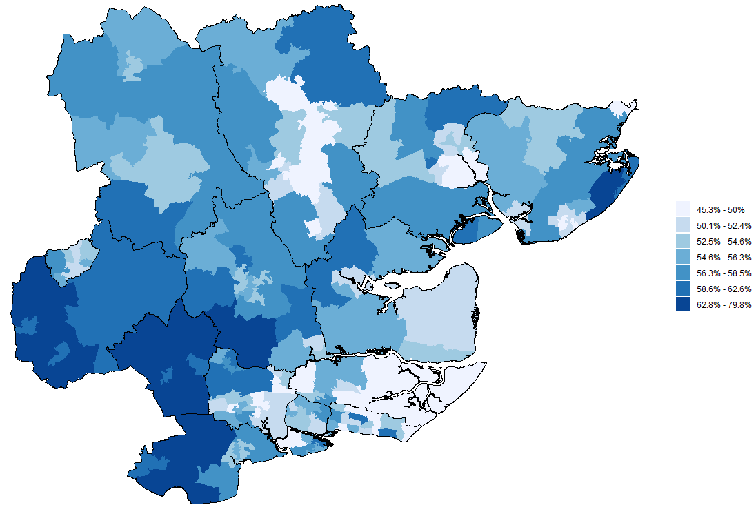
Religion across Greater Essex
Prevalence of religion by MSOA, Greater Essex, Census 2021
The map opposite shows the proportion of residents in each middle-level super outputs area (MSOA) who identify as religious
This shows that the proportion of the population who identify as disabled is generally higher in areas neighbouring London – Epping Forest, Brentwood, and Thurrock.
There are also significant concentrations of religious people in parts of South Chelmsford (Margaretting, Stock & Ramsden) and Coastal Tendring (Holland-on-Sea)
Research & Citizen Insight | Policy Unit | Essex County Council
5

Slide 6
Section 2: Characteristics of the religious population
Exploring the prevalence of other protected characteristics within Essex’s religious population

Slide 7
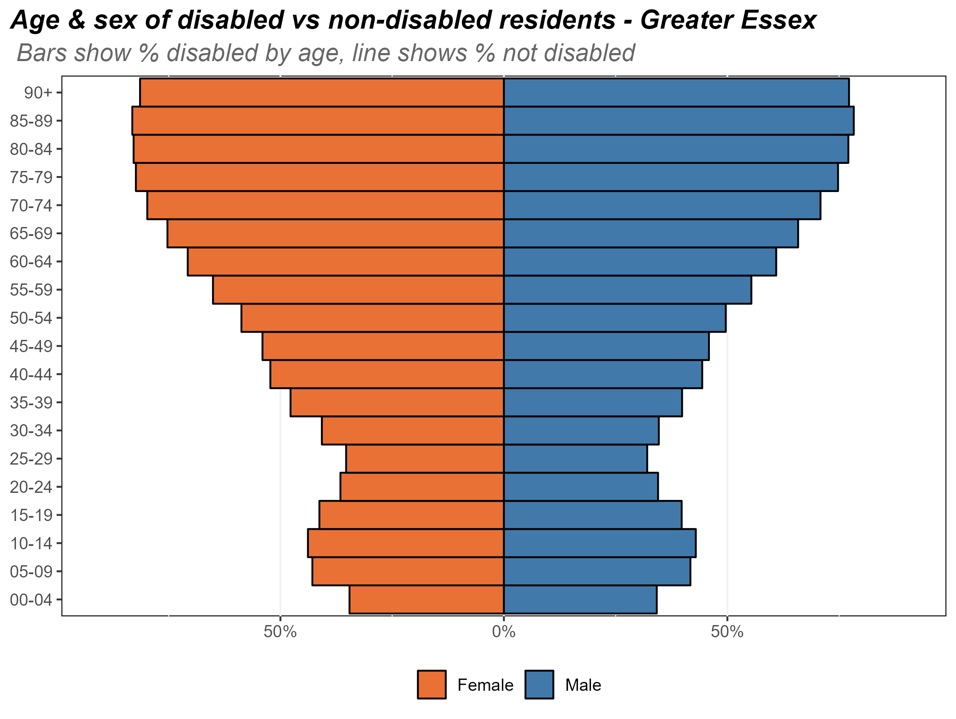
Age and sex of the religious population
Composition of the religious population by age and sex, Essex, 2021
The chart opposite shows the composition of Essex’s religious population by age and by sex.
There is a strong link between age and religion – older Essex residents are far more likely to be religious compared to younger residents. More than half of the over 50s follow some religion.
Research & Citizen Insight | Policy Unit | Essex County Council
7

Slide 8
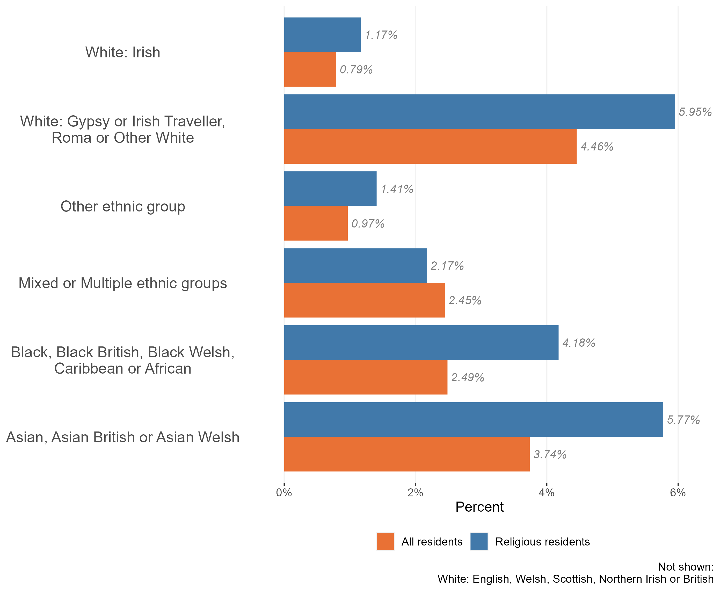
Ethnic diversity in the disabled population
Composition of the religious and nonreligious populations by ethnic group Essex, 2021
The vast majority of Essex’s religious population identify as White British (79.4% - or 623,000 for the 785,090 disabled population).
Only 162,090 identify as members of other ethic groups (20.6% - compared to 16.7% across the population as a whole).
There is higher levels of religiousness in the Gypsy or Irish Traveller, Roma or Other White, Other ethnic group, Black & Black British, and Asian & Asian British ethnicities.
Research & Citizen Insight | Policy Unit | Essex County Council
8

Slide 9
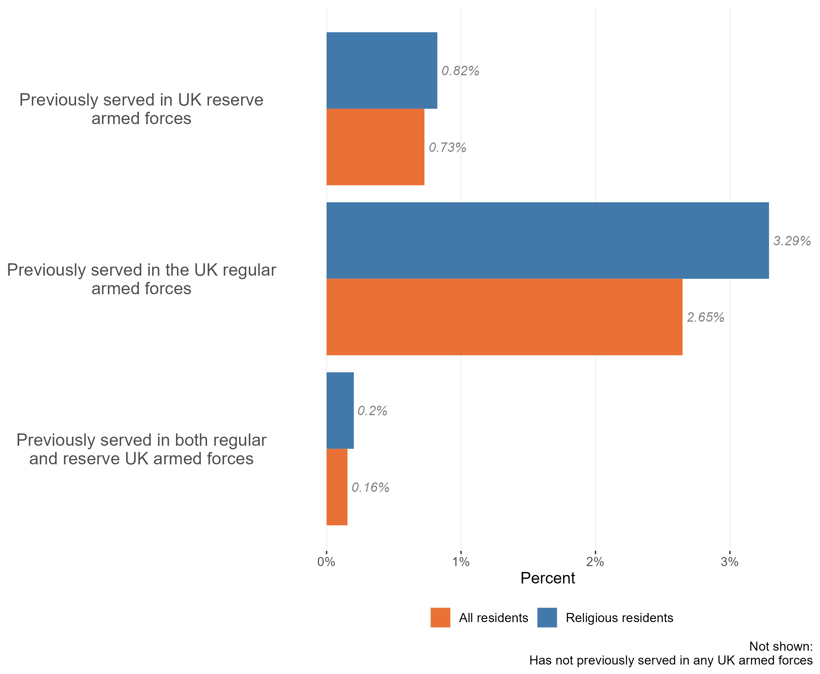
Veterans in the religious population
Composition of the religious and non-religious populations by veteran status, Essex, 2021
The vast majority of the Essex religious population (c.82%) have not previously served in the UK armed forces in any capacity.
Nevertheless, our analysis suggests that veterans are over-represented in the Essex religious population. There are around 14,200 members of the religious population who have previously served, either as members of the UK reserve or regular armed forces.
Veteran status is strongly related to age (due to for example national service), which may explain some of this association.
Research & Citizen Insight | Policy Unit | Essex County Council
9

Slide 10
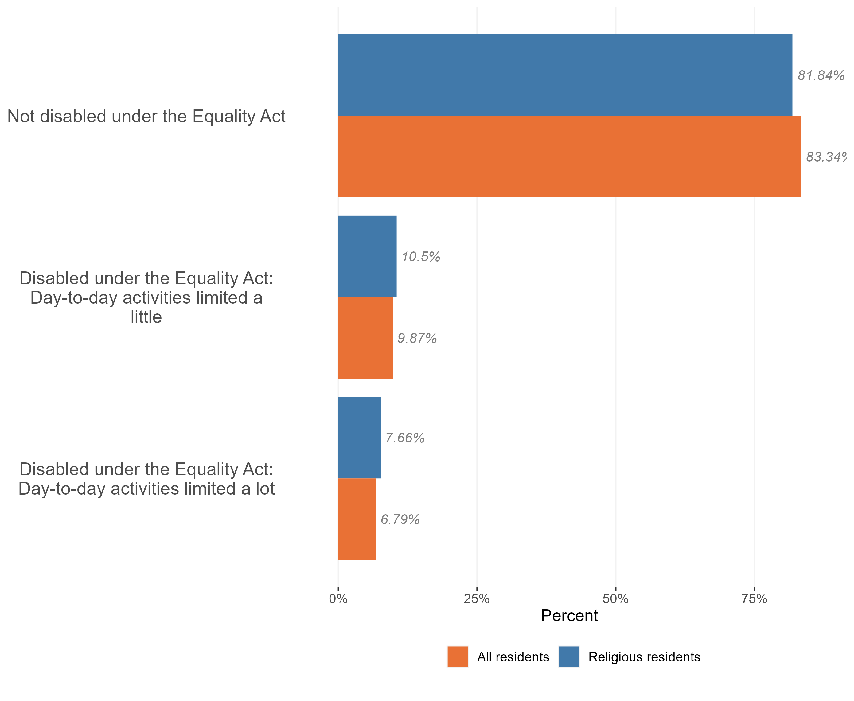
Disability in the religious population
Composition of the disabled and non-disabled populations by religion, Essex, 2021
The vast majority (82%) of religious residents in Essex are not disabled.
Of the c18% of religious residents who are disabled, there is a similar proportion of residents who have their day-to-day activities limited a little in the religious population as there are in the general Essex population
Research & Citizen Insight | Policy Unit | Essex County Council
10

Slide 11
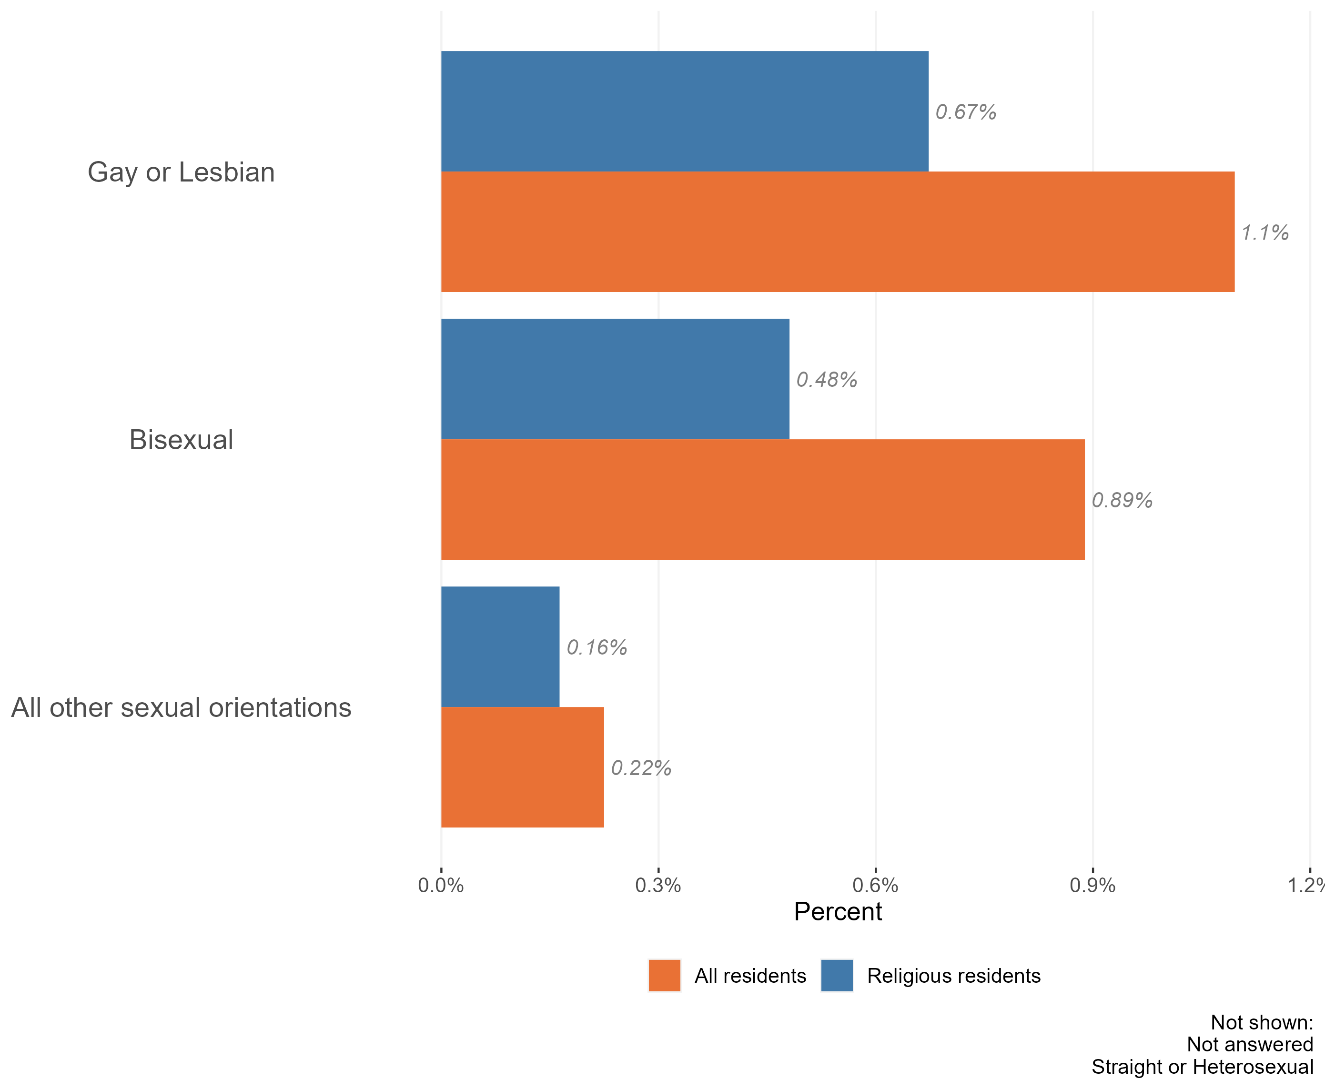
Sexuality and the religious population
Composition of the religious and non-religious populations by sexuality, Essex, 2021
The majority of the Essex religious population identify as ‘straight or heterosexual’ (94%). This is slightly higher than across the Essex population as a whole (91%).
Religious Essex residents have a lower proportion of people identifying as LGB+. The largest gaps are in religious people identifying as Gay or Lesbian, or Bisexual.
Members of the Essex disabled population were also less likely to provide an answer to questions about their sexuality in census 2021 than the population as a whole. It is worth noting that 2021 was the first census which collected data on sexuality. Compared to other questions on the census, this topic has a relatively high proportion of ‘not answered’ responses – where the person has not provided any information on the topic.
Due to the sensitive nature of the topic, this ‘missing data’ will not be missing at random. Certain groups of the population, or people living in certain situations, may feel unable or unwilling to answer these questions.
Research & Citizen Insight | Policy Unit | Essex County Council
11

Slide 12
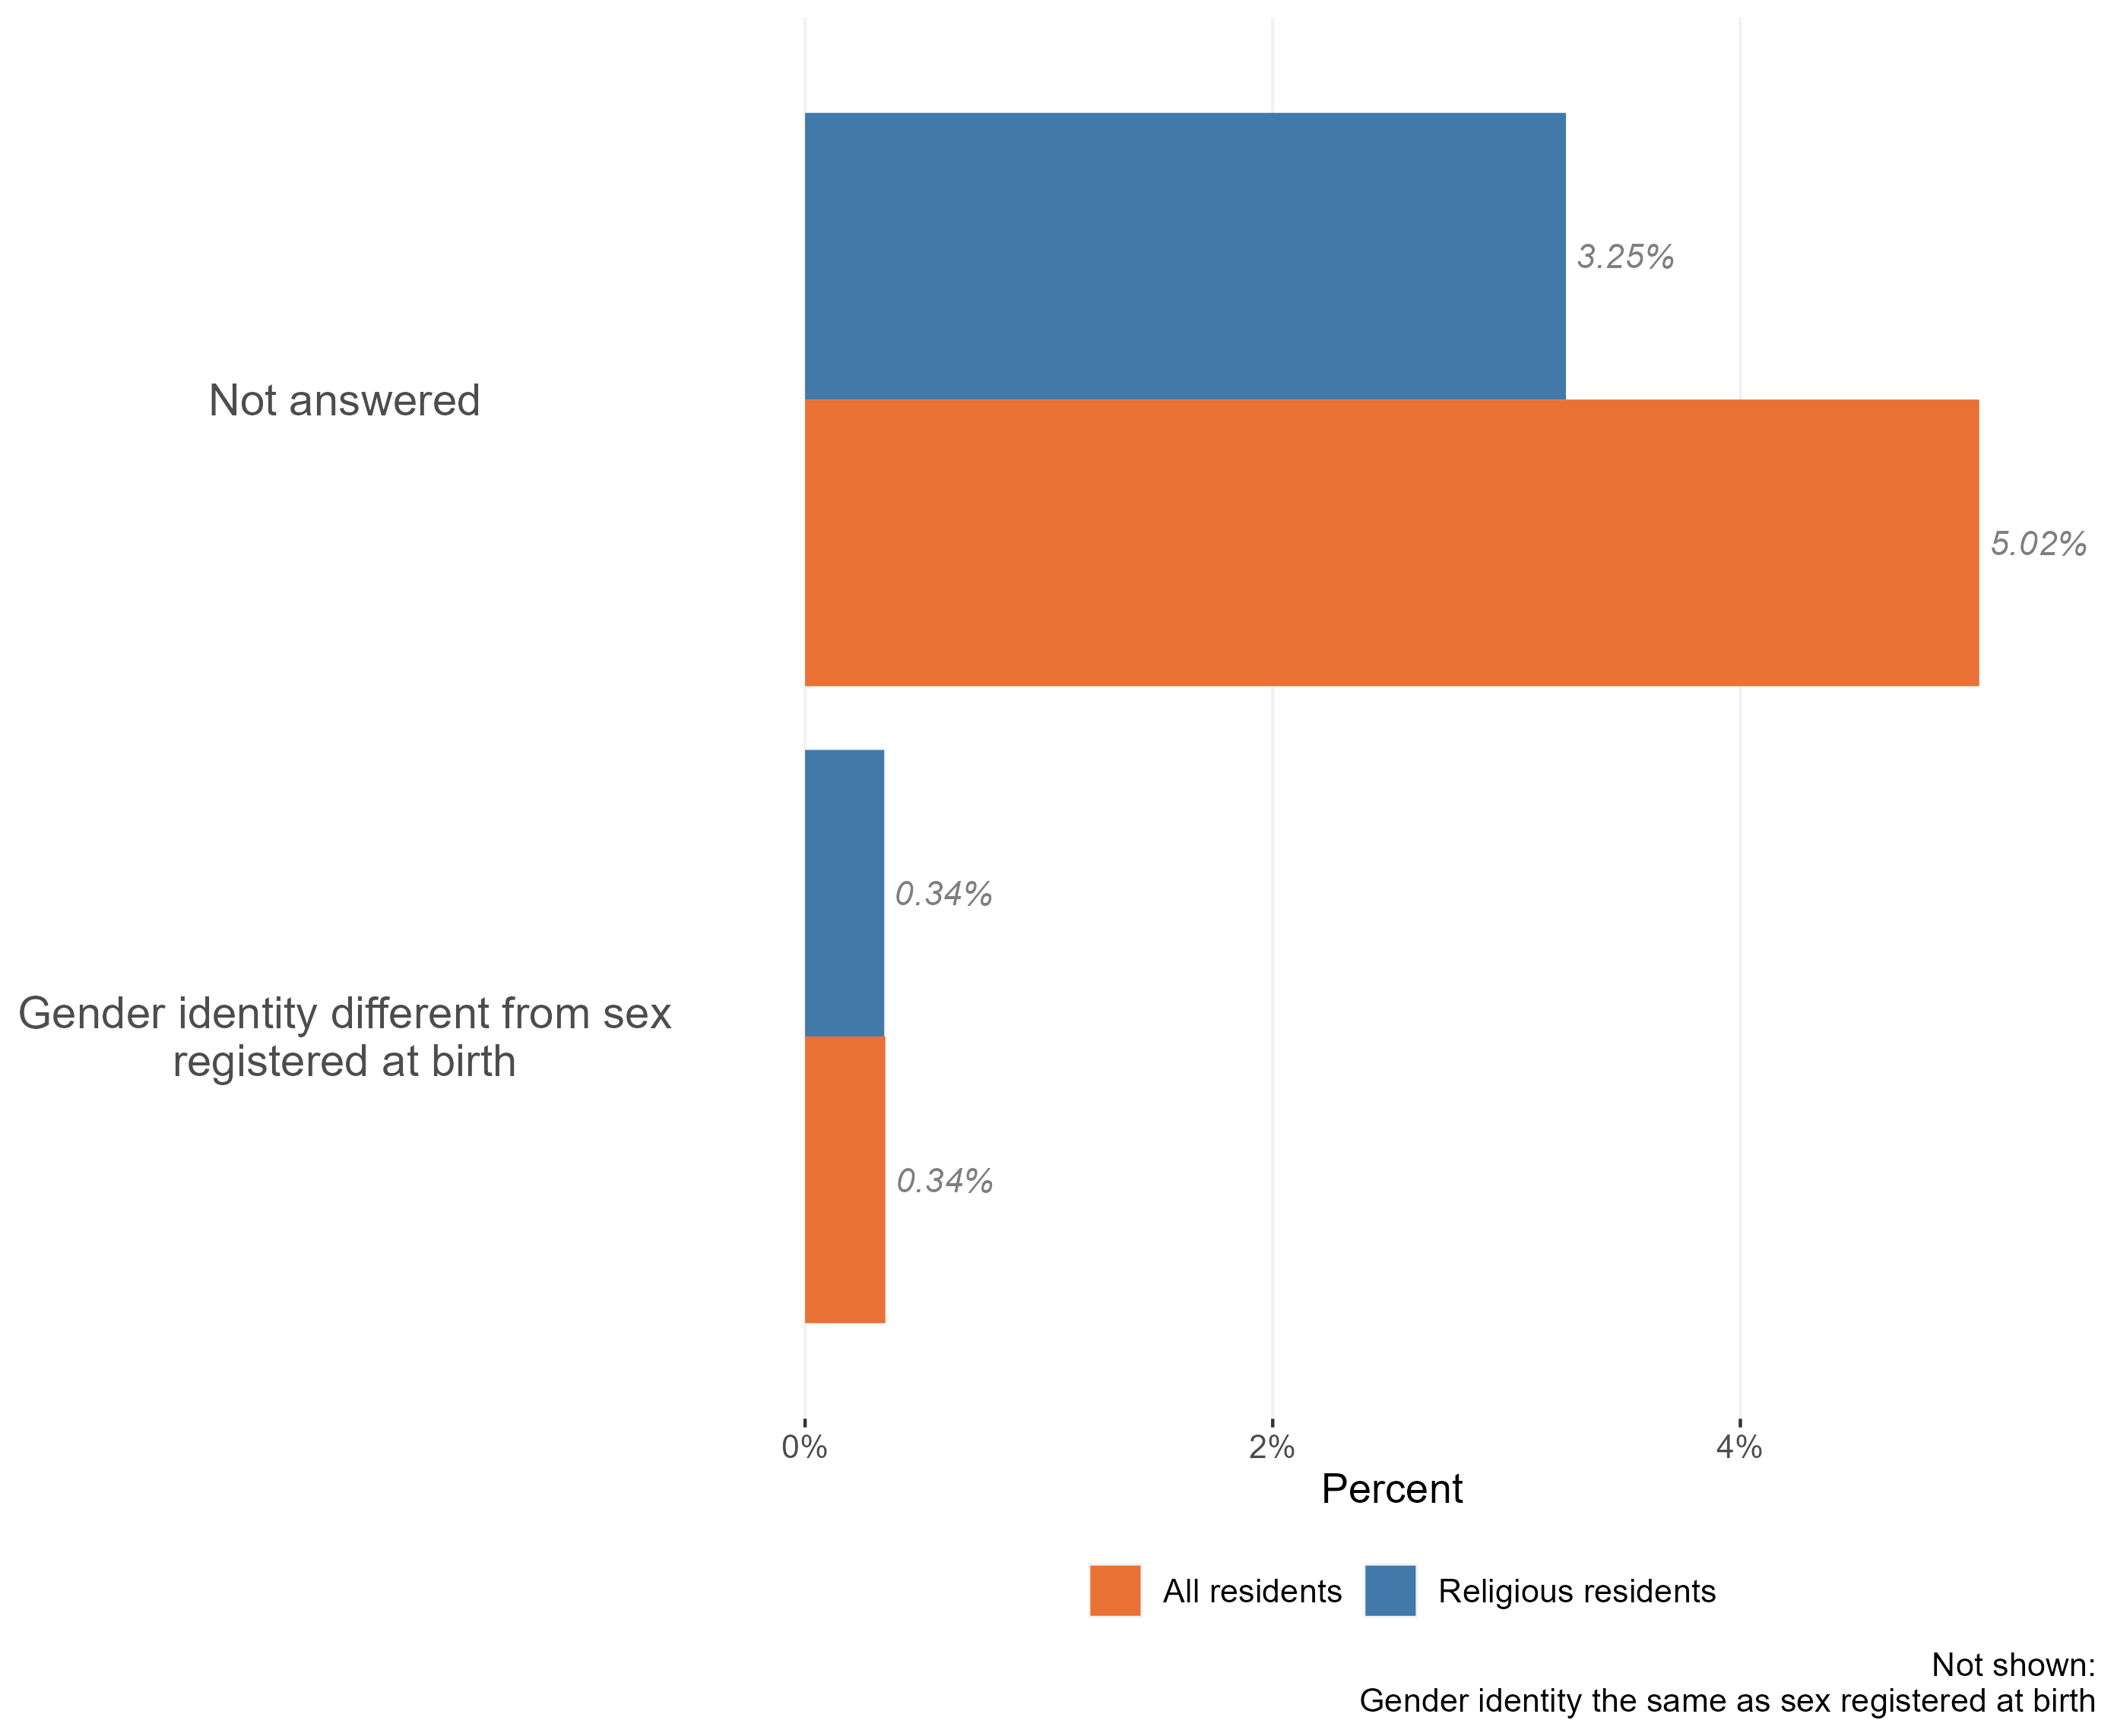
Gender identity in the religious population
Composition of the religious and non-religious populations by gender identity, Essex, 2021
The vast majority of the Essex disabled population have a gender identity which is the same as their sex registered at birth. There is a similar proportion of religious residents who identify as trans compared to the general population.
There is a much lower proportions of religious residents who chose not to answer the gender questions in the 2021 census
Research & Citizen Insight | Policy Unit | Essex County Council
12

Slide 13
Section 3: Outcomes for the religious population
Exploring the extent to which the religious population enjoy positive outcomes

Slide 14
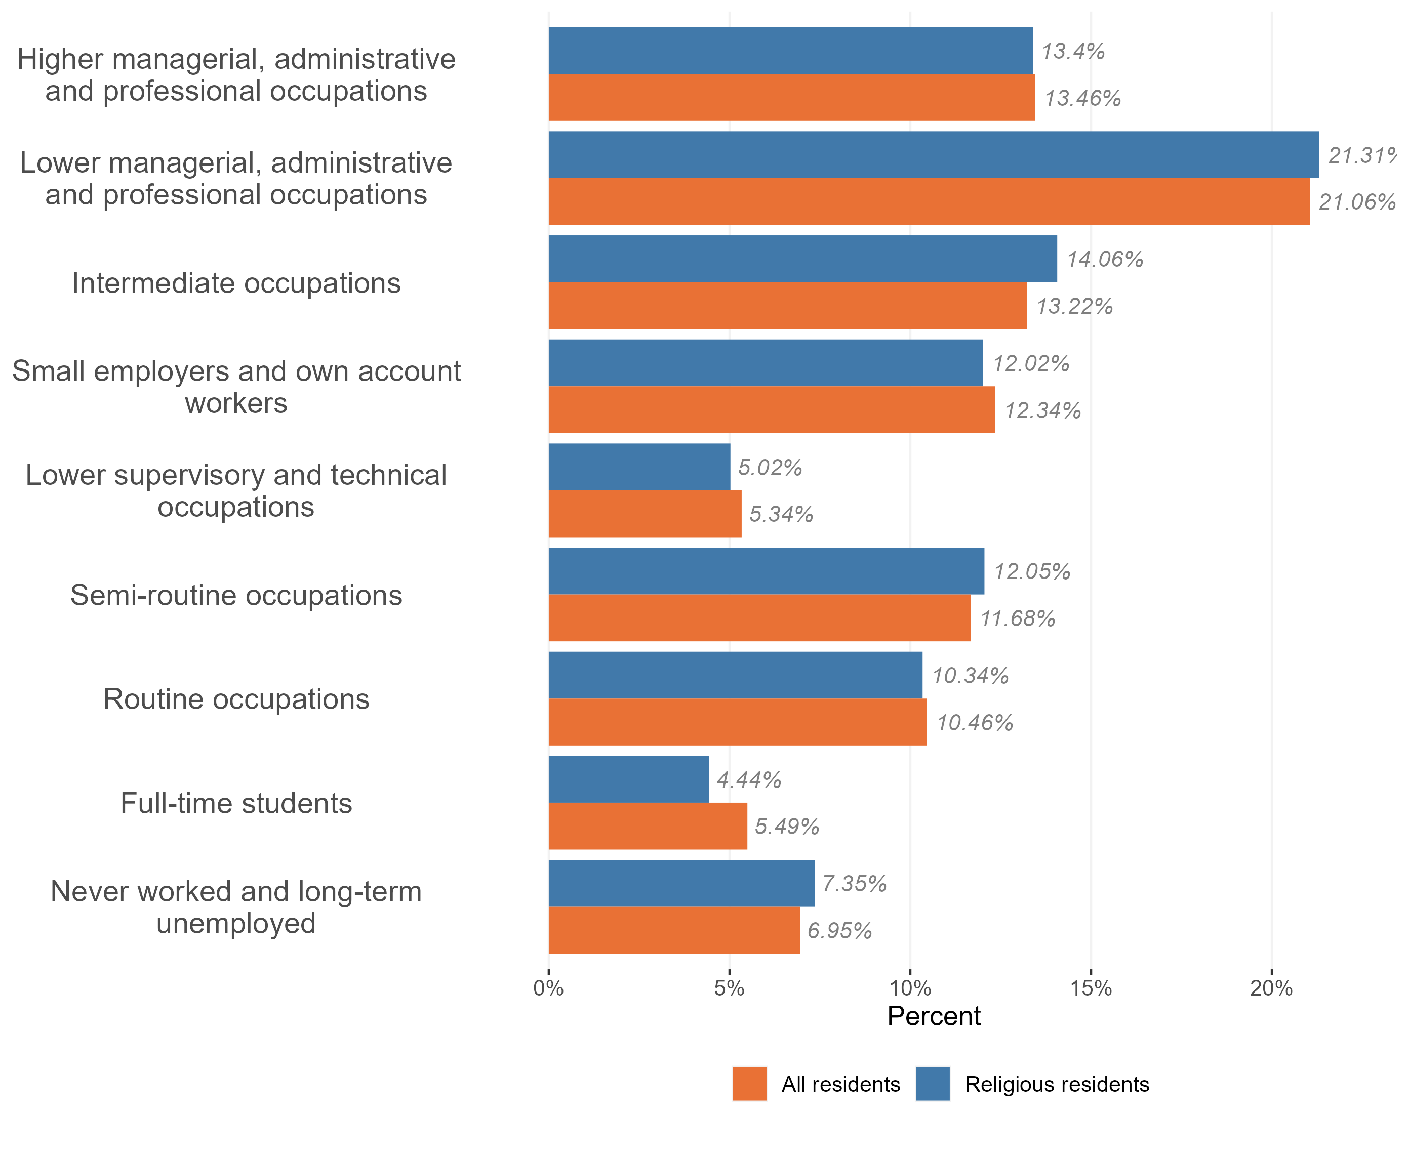
Employment and occupation type
Employment and occupation type, religious and non-religious population, Essex 2021
religious people in Essex are more likely to have never worked or to be long-term unemployed compared to working-age residents.
Religious Essex residents are also:
slightly more likely to work in lower managerial, administrative and professional occupations, intermediate occupations, and semi-routine occupations compared to the general Essex population
less likely to be full time students – possibly because religious residents tend to be older on average than general Essex residents
Research & Citizen Insight | Policy Unit | Essex County Council
14

Slide 15
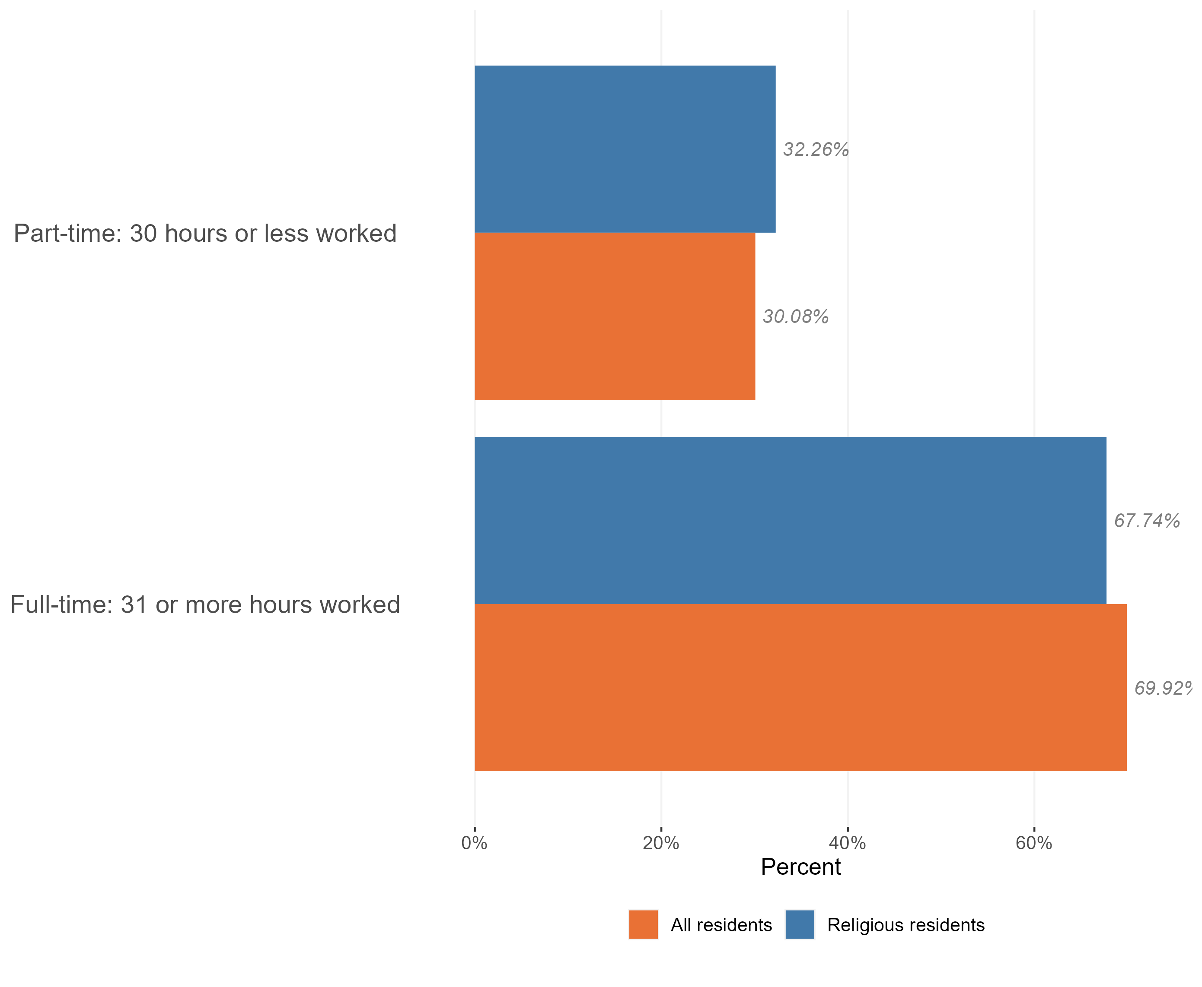
Employment and hours worked
Hours worked by religion, Essex, 2021
Of the 784,000 religious residents in Essex, 436,000 are working age. Of the 436,000 working age religious residents, 348,000 (79.8%) were working at the time of the 2021 census. This is higher than the 74.3% of working age residents who were in work across England.
A slightly higher proportion of religious residents are in part-time employment compared to the general Essex population, though the majority (c70%) of the religious population in Essex is in full-time work.
*Within Census data full time roles are classified as 31+ hours per week and part-time roles are classed as 30 hrs or less per week.
Research & Citizen Insight | Policy Unit | Essex County Council
15

Slide 16
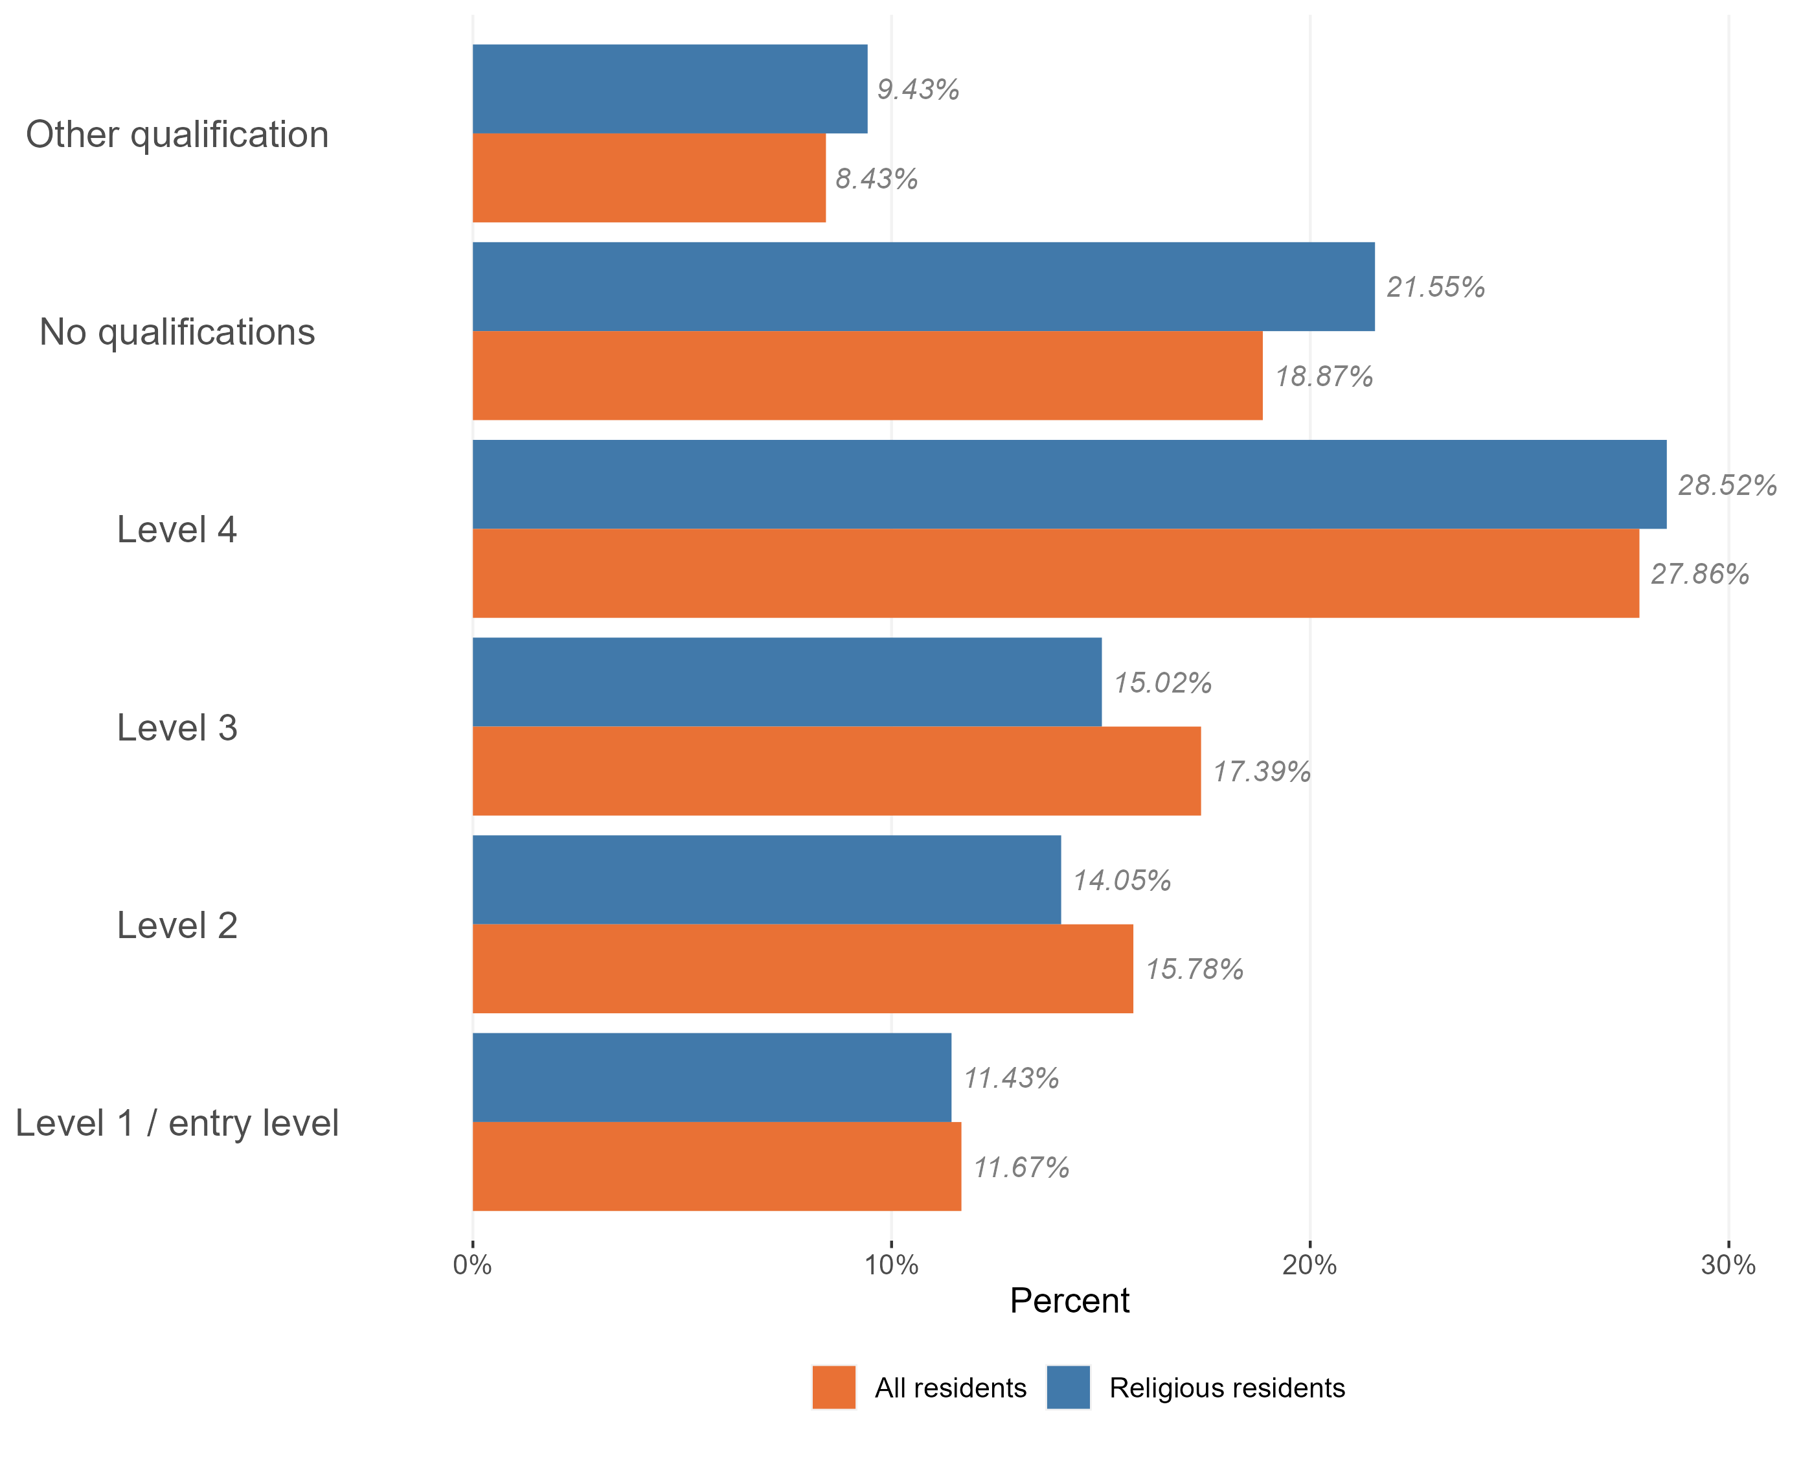
Highest qualification level
Level of qualifications held in the religious population, Essex, 2021
Religious residents in Essex are more likely to have no qualifications compared to the general Essex population.
Of those religious residents who do have a qualification, there is a slightly higher proportion with other qualifications and level 4 qualifications compared to the general Essex population
Research & Citizen Insight | Policy Unit | Essex County Council
16

Slide 17
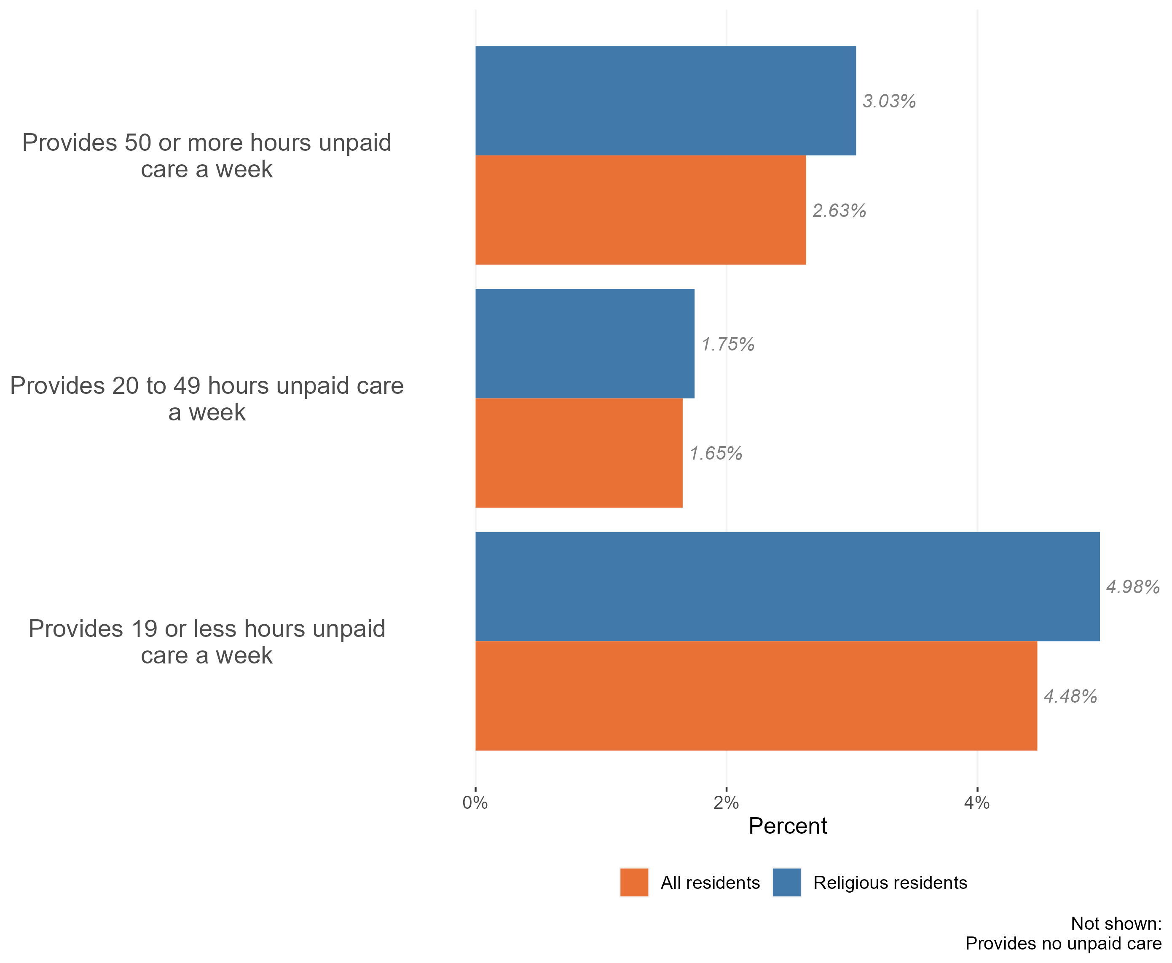
Provision of unpaid care & religion
Provision of unpaid care by the religious population, Essex, 2021
10% of religious Essex residents provide unpaid care, slightly higher than the 9% of residents in the general Essex population.
Of the Essex residents who do provide unpaid care, religious residents provide slightly higher proportions across all levels of unpaid care (0-19, 20-49, and 50+ hours per week). The largest difference is in the 0-19 hours of care.
Research & Citizen Insight | Policy Unit | Essex County Council
17

Slide 18
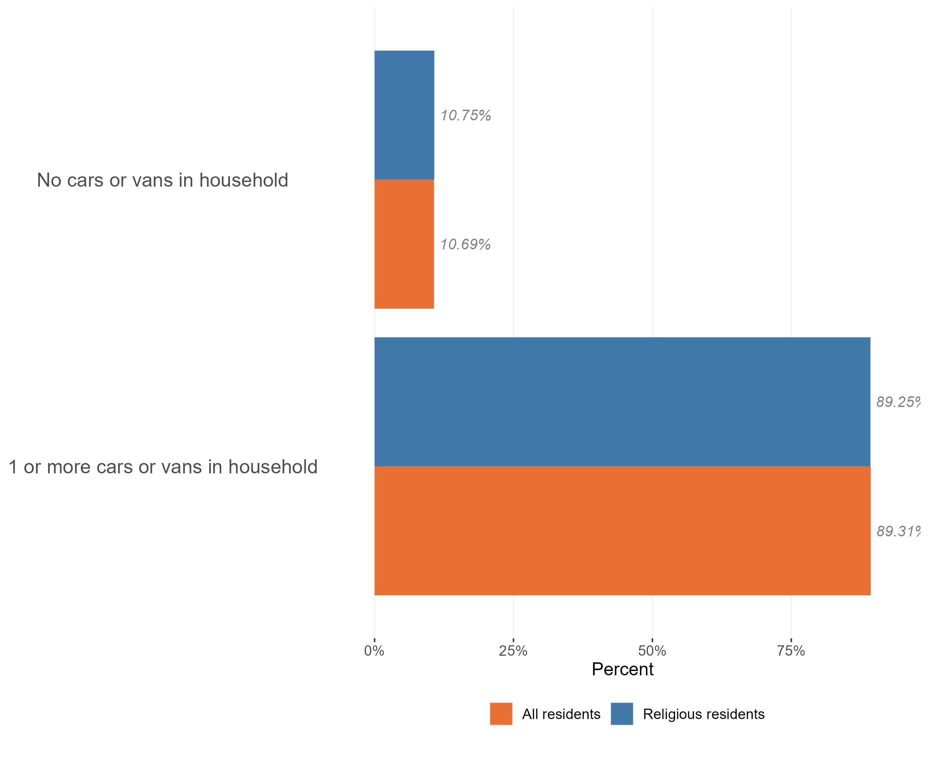
Access to cars
Access to a car or van in the religious population, Essex, 2021
The vast majority of religious residents live in a household with access to a car or van (89.3%). This is in line with the proportion of general Essex residents who have access to a car or van
Research & Citizen Insight | Policy Unit | Essex County Council
18

