Slide 1

Corporate Performance Report
February 2024
PART TWO: OPERATING CONTEXT

Slide 2
Contents: Part Two
PART TWO: Operating Context
Operating Context
    Operating context for Everyone’s Essex
    Climate
    Equalities
    Society
Strategic Risk
    Strategic Risk: Inflation
    Strategic Risk: Children in Care
    Strategic Risk: ASC Safeguarding
    Strategic Risk: C&F Safeguarding
Drivers for public perception of health
    Public Perception of Health

Slide 3




THE ECONOMY
Health & wellbeing
Children & families
Levelling up
The UK inflation rate was 4% in January.
The latest OBR forecasts that the 2% target wouldn’t be hit until the first half of 2025. In November inflation figures were better than expected and some forecasters have recently predicted that the 2% target could be reached as early as April 2024.
Falling inflation will alleviate some of the cost of living/operating pressures that have been facing both residents and businesses, although it won’t negate the impacts of price rises that have already happened and are now built in. It could also mean that during 2024 the Bank of England will be able to start reducing interest rates, which currently stand at 5.25%, although the Bank has maintained a cautious stance on the timing of rate reductions, which will have an impact on residents and the cost of financing ECC’s capital programme.
Annual growth in earnings was 7.3% in August to October 2023. Wage growth combined with falling prices, means that real wages are now rising materially faster than inflation, which should continue in 2024.
The Essex health and care system has continued to face demand pressures. The social care market has continued to operate well, and Essex has continued to perform well in terms of low delays on discharges from hospital. ECC has been working with NHS partners on the implementation of transfer of care hubs.
The Essex Care Technology service continues to grow and outperform its targets and is now supporting over 9,000 adults to maintain their independence. The inclusive employment service for adults with learning disabilities and autism delivered by the Council’s trading vehicle (ECL) has continued to grow and successfully supported its 350th adult to access paid employment this Quarter.
Adult Social Care is progressing work to reduce the time people wait for the Council to complete an activity, and the longest waits for a Review have been almost eliminated. Cases are prioritised according to an agreed matrix to ensure those with the highest priority get an appropriate response.
The people waiting measures have been highlighted as an on-going pressure for the service, and this information now forms part of the strategic performance measures, broken down by category.
The rate per 10,000 of children known to social care has been published by the DFE and shows the rate in Essex has increased by 4 (191.7 to 195.7). This remains notably lower than our comparators, and while following a similar trend, is increasing at a slower rate. In comparison, the rate across England as a whole fell by 1 per 10,000, now sitting at 342.7, indicating that Essex and its neighbours are not seeing the same movement as the country as a whole.​
​
The number of children attending a Good or Outstanding school in Essex has reached its highest percentage in just over a year with 88% - which is a significant achievement across the county. More so as there are some Districts which have 95-100% of children residing there attending a Good or outstanding school.​
The current focus for the Levelling Up Essex agenda is mobilisation of delivery for the 4 priority cohorts (All age MD/LD/SEND; Children accessing free school meals; working families and NEETs). Interventions for NEETs are now being delivered following approval in 2023, and proposals for the remaining cohorts are in the process of being finalised and expected to be launched by the end of Q4. Cohorts' delivery will take place across all districts and boroughs, building on the existing work underway across services and partners to support these cohorts.
Work continues on the Levelling Up Essex priority places. The large-scale community engagement project in Rural Braintree, and '100 days 100 families' project in Canvey Island have both concluded the initial stage, and work is underway to develop plans with partners based on the outputs of those exercises. The Levelling Up Essex 2 Years On report has also been drafted and will be published in March 2024.
Operating Context: Everyone’s Essex

Slide 4








Average number of litres used daily per person
Proportions of Components in Essex
A
Essex: 152.3
(litres per head, per day)
ECC has achieved an overall A rating for the second year in a row against tightening criteria: 27 UK LAs achieve an A rating, ECC are the only County Council.
316,973
Trees planted by Essex Forest Initiative since 2020
73,600
Trees planted YTD
New woodland contributes to delivering net zero carbon, nature recovery, reduces flooding, cooling city centres and provides protection against airborne pollution.
Adaptations
UK average: 142.0
(litres per head, per day)
A
2050 ambition to reduce: 134.6
(litres per head, per day)
Mitigations
Essex GHG Emissions
Operating Context: Everyone’s Essex, Climate
 | AFOLU |  | IPPU |  | Stationary Energy |  | Transportation |  | Waste
Year | Actual | Projection | Actual | Projection | Actual | Projection | Actual | Projection | Actual | Projection
2018 | 0.18 | 0.18 | 0.35 | 0.35 | 3.67 | 3.67 | 3.07 | 3.07 | 0.94 | 0.97
2019 | 0.16 | 0.16 | 0.36 | 0.35 | 2.95 | 3.67 | 3.25 | 3.07 | 0.94 | 0.97
2020 | 0.17 | 0.16 | 0.58 | 0.33 | 3.79 | 3.50 | 2.64 | 2.98 | 0.91 | 0.97
61.7 Hectares
Planted (from 2021/22 – 22/23)
13.8km
Hedgerows planted
(2022/23)
ECC Emissions – 2020/21 vs 2021/22 - Tonnes of Carbon Dioxide Equivalent (tCO2e)
8.09 MtCO2e
Actual (2020)
0.81 MtCO2e
Projection 2050
Percentage of land that is now green infrastructure
WWF Science based target 3.19 MtCO2e by 2030
Scope 1 & 2:
energy in buildings and fuel used
14%
30%
2040 target
Notes:
UPDATED 19/01/2024

Slide 5


Embedding Equalities
Organisational Health
Measure​ | Target​ | Q4 (22/23)​ | Q1 (23/24)​ | Q2 (23/24)​ | Q3 (23/24) | Direction of Travel​
 |  | Mar 23​ | Jun 23​ | Aug 23​ | Dec 23
% of employees who have completed the Equality and Diversity e-learning modules​ | 75-80%​ | 83.3%​ | 82.1%​ | 82.7% | 84.8% | ↑
Adult Social Care​ | 75-80%​ | 88.0%​ | 88.3%​ | 89.1% | 90.5% | ↑
Chief Executive's Office​ | 75-80%​ | 93.7%​ | 94.3%​ | 92.6% | 93.5% | ↑
Children & Families​ | 75-80%​ | 84.2%​ | 84.3%​ | 83.7% | 83.6% | ↓
Corporate Services​ | 75-80%​ | 97.4%​ | 96.9%​ | 97.1% | 98.5% | ↑
Education​ | 75-80%​ | 56.7%​ | 59.4%​ | 60.2% | 60.6% | ↑
People and Transformation​ | 75-80%​ | 94.9%​ | 95.4%​ | 96.0% | 96.0% | ↔
Climate, Environment & Customer Services​ | 75-80%​ | 76.6%​ | 69.5%​ | 70.6% | 77.5% | ↑
Economy, Investment & Public Health​ | 75-80%​ | 91.7%​ | 92.7%​ | 93.7% | 94.2% | ↑
Essex Councillors | - |  |  |  | 7.8%
Everyone’s Essex places great emphasis on addressing inequalities and improving life chances of our most vulnerable. We are building on our Year 1 equality objectives progress review report which we published in June 2023.
We are now developing and delivering an equalities insight plan that will deepen our understanding of communities across Essex and improve both the quality and coverage of the data we hold on those who use our services. We have drawn together a multi-disciplinary team to:
better understand, for each ECC function, the data that is collected by ECC and in commissioned services, and to improve the information we collect;
analyse available data to understand if groups experience differential impacts in terms of access to services or outcomes;
assess the relationship between particular protected characteristics and key outcomes across the Essex population, irrespective of whether individuals are in touch with ECC services; and
explore what further insights are needed to better understand the lived experience of different populations and groups within Essex, including of accessing and using public services.
EDI training by function
Strategic Priorities: Equalities
ECIAs by function
Function | 2022/23 | 2022/23 | 2023/24
 | # | % | # | %
Adult Social Care | 55 | 21% | 33 | 19%
Chief Executive | 7 | 3% | 5 | 3%
Children, families & education | 43 | 16% | 28 | 16%
Climate, Environment & customer services | 61 | 23% | 48 | 27%
Corporate Services | 36 | 13% | 10 | 6%
Economy, Investment & Public Health | 56 | 21% | 43 | 25%
Organisation Development & People | 10 | 4% | 8 | 5%
Total | 268 |  | 175
Workforce representation:
Notes:
Community: we are committed to addressing inequalities and levelling up life change for our residents and advancing equality of opportunity for our communities.
Workforce: We are committed to being an employer that values difference and attracts, recruits and retains talented individuals from a diverse range of backgrounds. We will support and encourage our employees to be the best they can be at work and provide them with an employment deal that is fair and inclusive.

Slide 6


Crime and feeling safe
Employment
Over a third of crime in Essex is categorised as Violent Crime, which is down 2.5% compared to the same period last year.
Unemployment rates have fallen to pre-coronavirus pandemic levels, following a rise during the pandemic.
Breakdown:
Number of people unemployed by Age Group:
4.9K
aged between 16-24
15.7K
aged between 25-49
6.1K
aged 50+
Operating Context: Society
Essex continues to perform strongly in employment performance compared with the national picture. High employment rates will contribute to reduced demand and enhance council tax yield. However, the impact of the cost of living will still impact in-work families.
Crime and fear of crime is a contributing factor to people’s satisfaction with place, and with their own wellbeing.
Economic factors could have a negative impact on crime
61.4%
In September 2023 (latest available data), around 6 in 10 adults in Great Britain said they tend to be satisfied with the police in the UK.
Notes:
Crime and feeling safe:
https://www.ons.gov.uk/peoplepopulationandcommunity/wellbeing/articles/ukmeasuresofnationalwellbeing/dashboard
Participation & satisfaction:
https://www.ons.gov.uk/peoplepopulationandcommunity/wellbeing/articles/ukmeasuresofnationalwellbeing/dashboard
Participation in, satisfaction with, and balance between work and leisure activities represent people’s lifestyle choices. Measures in this domain cover subjective and objective measures related to work, leisure and volunteering.
Employment rate 16-64
: is down 1.1 % from last quarter (Nomis) Economically Active
https://www.ons.gov.uk/employmentandlabourmarket/peopleinwork/employmentandemployeetypes/timeseries/lf24/lms
Claimant rate 16+ up 0.2% from last quarter (Nomis) Claimant Count

Slide 7








Strategic Risk: Inflation
Inflation: 4.0% & Interest Rates: remain at 5.25
5.25%
Interest rates remain unchanged.
Higher rates aim to reduce inflation
ECC Strategic Risk (SRR0092): Inflation
Inflation reached 40-year highs of 11.1% in 2022, however during 2023 it has begun to reduce, with it reaching 4.0% in the latest update.
The current rate is in-line with the Bank of England’s forecast reduction out to 2024, which is used for inflation assumptions driving the MTRS in the short-term. If the inflation rate does not reduce in-line with this forecast, this may create significant pressure on the ECC Revenue and Capital budgets, impacting on the financial sustainability of the organisation.
Inflation has reduced and expected to fall further this year
Operating Context: Risk, Inflation
12
(4, 3)
Current risk score
No change since Q2
Probability
8
(4, 2)
Bank of England’s inflation target is 2%
Target score
Impact
National
Essex
Around 6 in 10 adults are spending less on non-essentials because of the cost-of-living increases.
Around 4 in 10 adults reported having to spend more than usual when food shopping to what they normally purchase.
Retail sales decreased by 2.3% in December.
Average house prices are estimated to have fallen 1.2%.
The average UK house price was £288,00 (October), which is £3k less than the same month a year ago.
A third (33%) of adults in Great Britain paying rent or mortgage said they were finding the payments very or somewhat difficult to afford.
Private rent prices increased 6.1% in England.
Mortgage and Landlord possession claims remain high, Essex remains in the lower quartile with the highest claims in the East of England.
Colchester, Basildon and Tendring have the highest rate of combined claims.
Brentwood, had the highest rate for private landlord claims (290.5 per 100,00 households); followed by Tendring and Basildon.
Average property rents in Essex are £1,730 pcm.
Notes:
Inflation was 3.9% in Jan, and now 4.0% in Feb. Interest rates remain unchanged.
Inflation: population survey:
*according to those asked in October 2023
Rent and Mortgage insight:
Source: https://www.ons.gov.uk/economy/inflationandpriceindices/articles/costoflivinginsights/housing
Source: https://homelet.co.uk/-/media/project/barbon/homelet/homelet-documents/homelet-rental-index/2023-21-september-homelet_dataloft_rental-report_300.pdf

Slide 8
Strategic Risk: Children in Care
For non-SMC children, the last 2 years has shown an increase in in-house and kinship fostering to meet rising demand, as well as smaller rises in residential care. SMC increases in demand have largely been met through semi-independent accommodation.
ECC Strategic Risk (SRR0046):
Placement sufficiency for Children in Care:
There is a shortage of placement choice and significant increasing costs nationally. This is compounded by; increasing Children in Care numbers nationally, Ofsted inspection outcomes, pressure of health, education and criminal justice beds, workforce recruitment and retention issues and the current economic situation.
The consequences are two potential risks arise; insufficient
placements resulting in a failure to meet our statutory duty to provide lawful placements for children requiring care, and increased pressure on budgets due to rising costs. The
number of unregistered placements is not reducing, thus
creating reputational risk for the Local Authority.
Placement Type: Comparison between placement types December 2021 to current (Jan 2024) profile.
Operating Context: Risk,
Placement sufficiency for CiC
Current risk score
16
(4, 4)
January 2024
Probability
9
(3, 3)
Target score
Impact
In progress:
Residential Strategy: development of local in-house and commissioned residential provision.
Joint Protocol
Lobbying
Monitoring: Prevention of entry into care and re-unification
Control Measures:
Notes:
TO INCLUDE THE P8 PERFORMANCE INFO

Slide 9

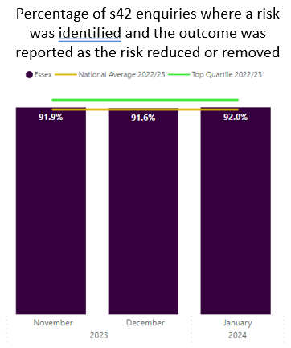
Strategic Risk: ASC Safeguarding
Control Measures: ongoing
Strong relationships
Essex Safeguarding Adults Board (ESAB)
Ongoing relationship with the Care Quality Commission (CQC)
Serious Concerns Review Group (SCRG)
Robust relationships in place
Continuous Professional Development (CPD)
Care Sector Hubs
ECC Strategic Risk (SRR0055):
ASC Safeguarding: Risk of potential death or serious injury of a vulnerable adult or child as a result of market failure or poor practices. This would have a significant impact on service delivery, officer morale and the reputation of the Council .
ASC track a number of measures that help the service understand the performance of safeguarding processes and services. This includes:
Volumes
Timeliness
Outcomes
Shown (right) is a measure that is tracked nationally that looks at removal and reduction of risk, where ECC performs above national averages.
Percentage of s42 enquiries where a risk was identified, and the outcome was reported as the risk reduced or removed
Operating Context: Risk,
ASC Safeguarding
Current risk score
12
(3, 4)
January 2024
Probability
8
(2, 4)
Target score
Impact
Notes:
SRR0055 Treat
ASC Safeguarding: Risk of potential death or serious injury of
a vulnerable adult or child as a result of market failure or poor
practices. This would have a significant impact on service
delivery, officer morale and the reputation of the Council .

Slide 10
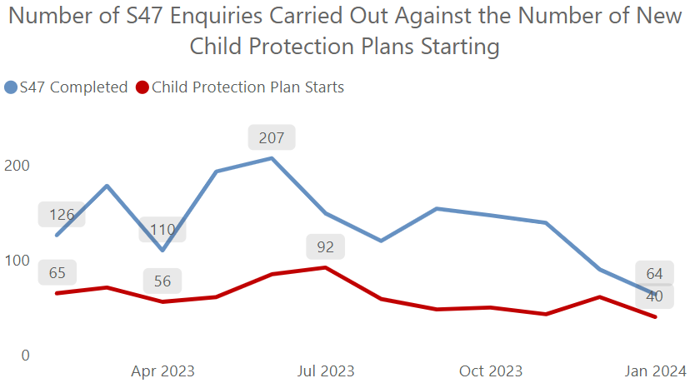
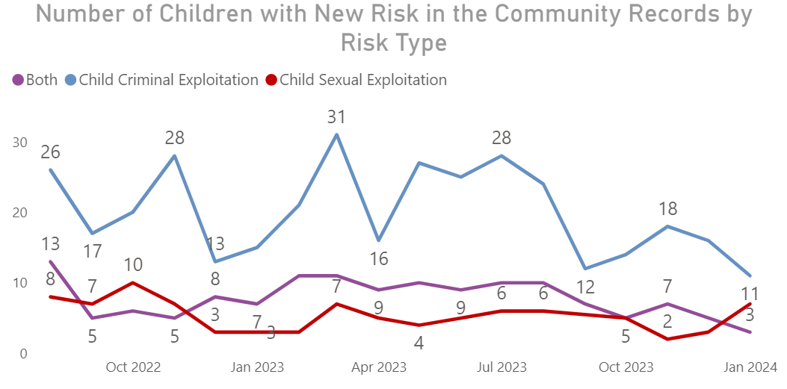
Strategic Risk: C&F Safeguarding
Control Measures: ongoing
Projecting future demand
Prevent and Channel meetings
Child Sexual Exploitation Strategy (CSE)
Independent Inquiry into Child Sexual Abuse (IICSA)
Quality checks
Serious Case Review
Online wellbeing service
ECC Strategic Risk (SRR0056):
C&F Safeguarding: Due to stretched capacity internally and
externally; social worker caseloads increasing in complexity
and volume; and an increasing number of families living in
poverty, there is an increased risk of child abuse, long-term
psychological damage, serious injury, or death of a child. This may result in significant negative impact on officer wellbeing and morale, and the reputation of the Council.
Child protection and CSE / CCE cases and performance are monitored closely by the service to understand demand and to manage this risk
Operating Context: Risk,
C&F Safeguarding
Current risk score
12
(3, 4)
January 2024
Probability
8
(2, 4)
Target score
Impact
Notes:
Updated on 08/02/24

Slide 11
Public perception of health

Slide 12
Drivers of public perception of health: Overview
From ECC’s recent Pulse Survey, healthcare/NHS was identified as the most important issue for residents in Essex today.
The survey results show that people in Essex are significantly more concerned about healthcare compared to the UK average.
To help understand why this might be, two virtual focus groups with residents were carried out to explore themes in more depth.
Focus group participants were recruited from ECC’s Residents' Panel, selecting a sample of those who previously stated that healthcare/NHS was a top priority for them. Two 30-minute interviews with residents were also carried out.
A total of 11 participants across Essex took part in this engagement in the week commencing 12th February 2024.
The conversations focused on:
What’s important to residents regarding healthcare
What contributes to good healthcare
Views on quality of healthcare locally
Key challenges and barriers around healthcare
Factors influencing people’s health and wellbeing
Ideas for what actions ECC or other organisations could take
Key findings are presented within this summary report. The intention is to use the insights to inform ECC’s upcoming quarterly performance report, as well as aiding understanding of the issues and identifying areas of opportunity for ECC or partner organisations to influence this area.

Slide 13

Key findings
Key themes arising from the engagement can be summarised into the following:
What’s important
Key challenges
Opportunities for intervention
Feeling listened to and being taken seriously
Professionals taking time to understand the problem
Clear communication around the process and what to expect
Skilled staff and trust in professionals’ expertise
Increased focus on prevention rather than cure
Access to the right services at the right time and for care to be there when you need it
Faster diagnosis
Receiving care at home where possible with appropriate adaptations and support
Difficulty in accessing appointments – demand too high and services are strained, appointment process inaccessible (particularly for working people), and lack of transport links
Being offered services inappropriate for needs
Disjointed services with lack of join up between departments/organisations/systems (including apps) – leads to communication breakdown and inefficient record keeping
Long wait times (including several years on waiting lists for some)
Inconsistency in service experienced (e.g. different doctors) and across the county
Onus is always on the individual to chase/follow up/keep track of process
Made to feel you are a nuisance/wasting time
Increased education and awareness raising to support healthy lifestyles (e.g. vaping, diet, physical activity – particularly for children and young people)
Support with transport to GPs/hospitals, particularly in rural communities
Increased join up between services e.g. social care and health
Consider infrastructure support around services e.g. parking at GPs/pharmacies
More considered planning when developing housing to ensure adequate access to services, as well as quality homes
Better utilise and promote pharmacies
Support unemployed into entry-level healthcare roles and utilise volunteers and voluntary sector

Slide 14
Referral to Treatment
(Provider Level Analysis)
In 2022/23, Accident & Emergency services nationally saw the biggest year to year increase in dissatisfaction, according to the analysis published in the Nuffield Trust and The King’s Fund.
Two thirds of respondents (69%) chose long waiting times for GP and hospital appointments as one of the top reasons for dissatisfaction
There were also falls in public satisfaction across all other individual NHS services, including general practice, dentistry and in-patient hospital services, with all services reaching record lows.
Satisfaction with the NHS decreased to a record low of just 29% amid intense public frustration with long waiting times for care, and resourcing issues, this is the lowest it’s been in 40 years.
Dissatisfaction has more than doubled in just two years, from 25% in 2020 to 51% in 2022, noting a range of key services including GP care (42%), dentistry (42%) and A&E (40%).
Referral to Treatment, waiting times
Notes:
https://www.england.nhs.uk/statistics/statistical-work-areas/rtt-waiting-times/rtt-data-2023-24/#Dec23
https://www.nuffieldtrust.org.uk/qualitywatch/indicators

Slide 15




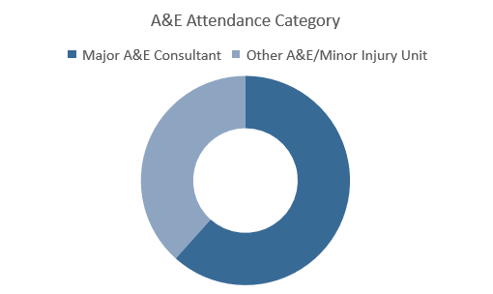
Hospital Accident & Emergency Activity 2022/23
(Provider Level Analysis)
In 2022/23 there were over 25.3m unplanned visits to A&E departments
This is a 4% increase from 2021/22
70.8% of patient attendees spent 4 hours or less in A&E departments
This is a decrease from 2021/22
% NHS standard is 95%
Accident & Emergency wait times
In 2022/23 patients aged under 35 years of age accounted for 47.4% of all A&E attendances
This is an increase from 47.1% in 2021/22
47.1%
(2021/22)
In 2022/23, approximately 51% of A&E attendees in England were women
An increase in the past 10 years
A&E attendances in deprived areas
There were around twice as many attendances to A&E departments in England for the 10% of the population living in the most deprived areas (3.1 million), compared with the least deprived 10% (1.6 million)
Notes:
https://digital.nhs.uk/data-and-information/publications/statistical/hospital-accident--emergency-activity/2022-23

Slide 16


This information is issued by: Essex County Council
Contact the team directly:
Duncan.Taylor@essex.gov.uk; Louisa.Thomas@essex.gov.uk;
Performance & Business Intelligence, Corporate Team
Policy Unit
Essex County Council
County Hall, Chelmsford
Essex, CM1 1QH
facebook.com/essexcountycouncil
Essex_CC
The information contained in this document can be translated, and/or made available in alternative formats, on request.
Due to be published February 2024

