Slide 1

Corporate Performance Report
February 2024
PART THREE: ATTAINMENT IN ESSEX

Slide 2
Contents: Part Three
PART THREE:
Spotlight: Education, Attainment
    Attainment in Essex
    Disadvantage Gap
    Free School Meals and Higher Education
    SEN and EHCP – changing cohorts
    Key messages
    Appendix

Slide 3





What does attainment look like in Essex?
87%
Aged 18: Key Stage Five
Achieving 2+ A Levels
Better than England and Statistical Neighbour
Lower than Eastern Region
Aged 16: Key Stage Four
% 9-4 in English & Maths
Lower than England, Eastern Region and Statistical Neighbours
63.4%
Spotlight: Attainment in Essex
61.1%
Aged 11: Key Stage Two
% achieving RWM
Better than England, Eastern Region and Statistical Neighbours
57.9%
Aged 8: Key Stage One
% achieving RWM
Better than England, Eastern Region and Statistical Neighbours
Aged 5: Early Years Foundation Stage
% Good Level of Development
Better than England and Eastern Region
Lower than Statistical Neighbours
68.9%
Notes:
RWM = Reading, Writing, Maths.

Slide 4
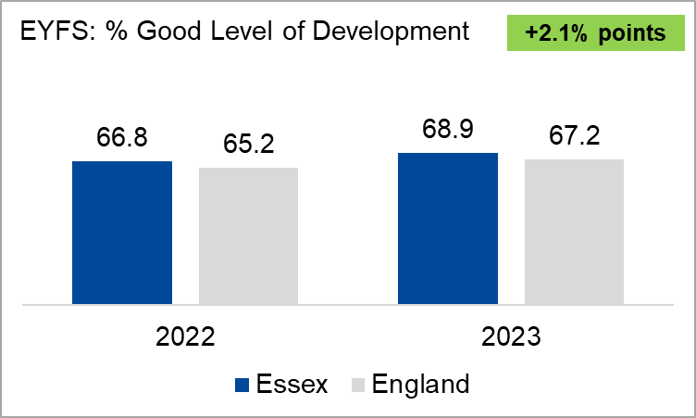
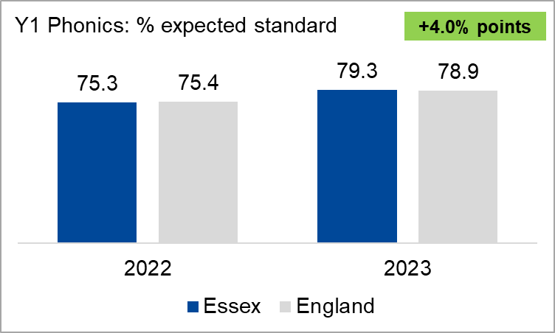
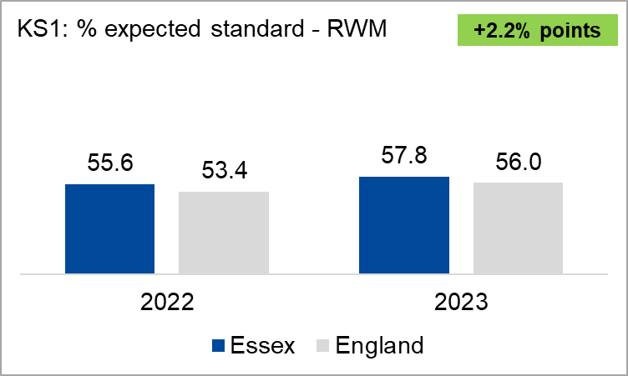
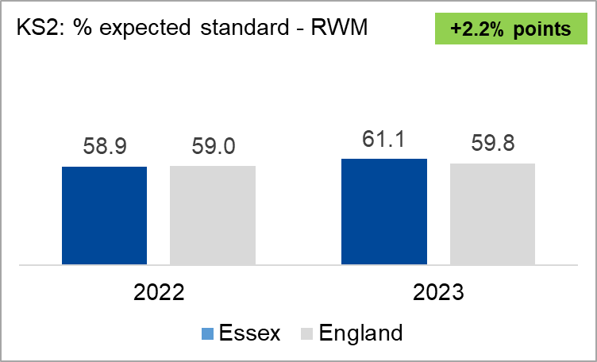
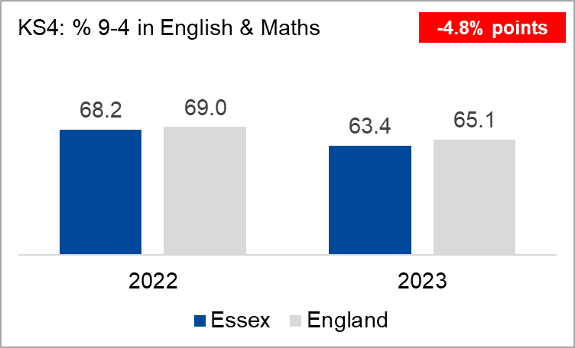
Changes since the 2022 baseline
(National change = +2%)
(National change = +3.5%)
(National change = +2.6%)
Spotlight: Attainment in Essex
Whilst attainment journeys differ amongst the various cohorts and characteristics – the largest and most significant impact to Attainment is Disadvantaged and Special Educational Needs
(National change = +0.8%)
KS4 performance was expected to fall in 2023 as DfE reverted back to pre-COVID marking.
(National change = -3.9%)

Slide 5



Mind the Disadvantage Gap
Dis./non-dis. gap |  | Difference
Essex | 21.5 | +3.6
England | 17.9
EYFS
Gaps increase through the key stages with those in Essex consistently being higher than England.
Dis./non-dis. gap |  | Difference
Essex | 25.0 | +2.6
England | 22.4
KS2
Spotlight: Attainment in Essex
Dis./non-dis. gap |  | Difference
Essex | 33.6 | +4.2
England | 29.4
Essex disadvantaged pupils lower than national peers across all key stages.
KS4
Were Essex performance for Disadvantaged pupils to match the England average this would mean that, 37 more pupils to achieve GLD 72 more pupils to achieve at KS2 69 more pupils to achieve at KS4

Slide 6
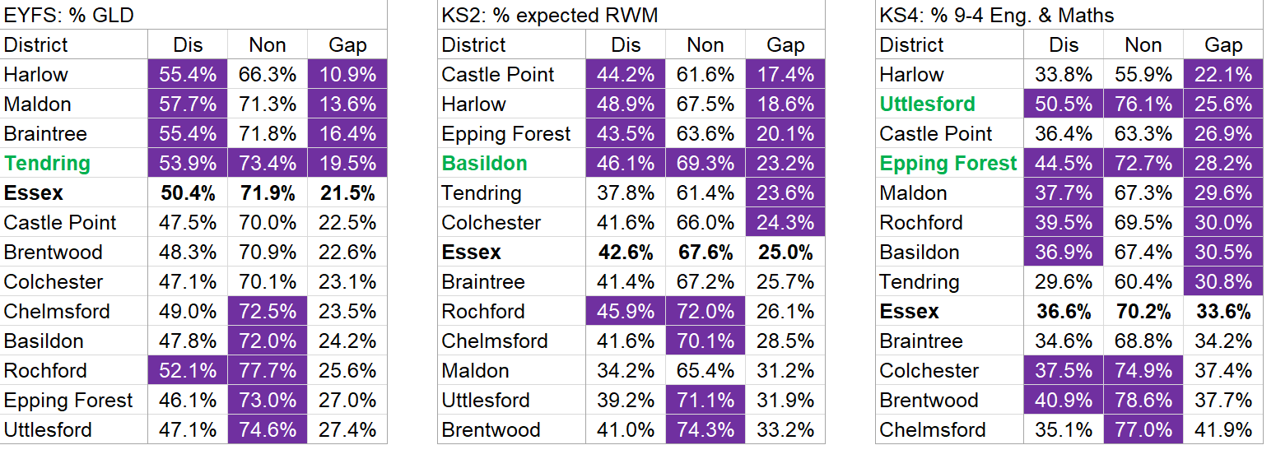
District level disadvantaged attainment
Spotlight: Attainment in Essex
We want to ensure that progress is made in both Disadvantaged and Non-disadvantaged pupils (i.e. that both see improvements in performance, but at a faster rate for our disadvantaged pupils). The tables above show where districts have higher attainment and lower gaps (compared to the Essex averages) highlighted in purple. Any districts where both are achieved are named in green.

Slide 7
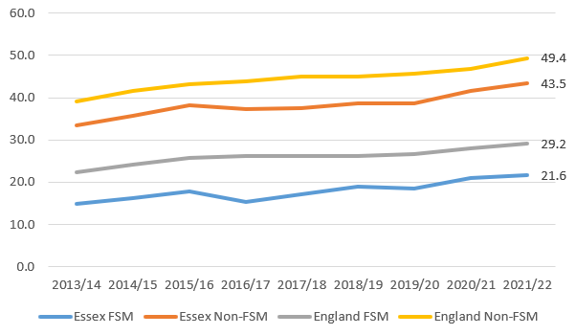


Pupils receiving Free School Meals and Higher Education
% 15-year-olds from State Funded schools entered Higher Education by age 19 – Essex vs. England FSM & Non-FSM
The percentage of Essex FSM pupils entering higher education has been increasing, albeit inconsistently, throughout the years. However, only 21% of those do go on to HE. This is almost 8% lower than the England FSM percentage
Spotlight: Attainment in Essex
There is a 22% gap between Essex FSM children and Essex Non-FSM children attending University.
Essex Non-FSM students are 7% lower than the England non-FSM average in attending Higher Education.
In 2021/22 there were 1,185 Essex FSM children within the cohort. Of those 256 went on to Higher Education, but 929 did not. If ECC children attended HE at a similar level to those seen nationally, an additional 94 children would go to university in that year

Slide 8
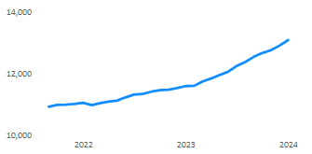
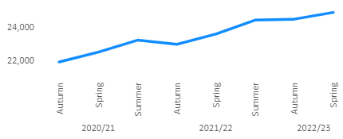
Focus on SEN and EHCP – Changing cohort sizes
Number of EHCPs for whom Essex is responsible
Number of SEN Support pupils
13,084
12,906
Previous Month
24,862
Spotlight: Attainment in Essex
The number of new EHCPs nationally has increased each year since their introduction in 2014. This is also apparent in Essex as shown by the trend above.
There are 389,171 EHCP plans currently in England, which is an increase of 9.5% from academic year 2022/23
There are 1,183,384 pupils in England receiving SEN Support – which is an increase of 4.7% when compared to the previous academic year of 2022/23.
Essex has experienced a similar increase in the number of pupils receiving SEN Support.

Slide 9
Focus on SEN and EHCP - % achieving expected standard at each Key Stage
EYFS: % GLD | KS2: % expected RWM | KS4: % 9-4 Eng. & Maths | Comments
 |  |  | Essex pupils with no SEN compare favourably in the primary phase.
 |  |  | Across all key stages, pupils with SEN Support have lower performance in Essex than nationally.
 |  |  | The cohort sizes are much smaller among EHCP so percentages can easily vary. Essex is broadly similar to England.
No SEN |  | Difference
Essex | 74.6 | +0.6
England | 74.0
No SEN |  | Difference
Essex | 70.7 | +0.4
England | 70.3
No SEN |  | Difference
Essex | 69.7 | -2.5
England | 72.2
SEN Support |  | Difference
Essex | 18.9 | -5.4
England | 24.3
SEN Support |  | Difference
Essex | 22.1 | -1.5
England | 23.6
SEN Support |  | Difference
Essex | 33.5 | -3.1
England | 36.6
Spotlight: Attainment in Essex
EHCP |  | Difference
Essex | 4.5 | +0.7
England | 3.8
EHCP |  | Difference
Essex | 7.7 | -0.5
England | 8.2
EHCP |  | Difference
Essex | 12.3 | -0.6
England | 12.9

Slide 10
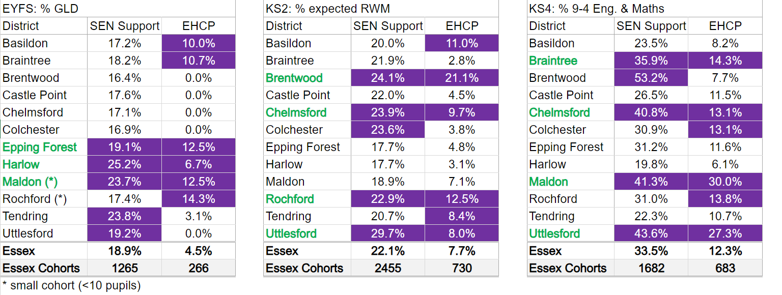
District level Special Educational Needs
Spotlight: Attainment in Essex
The tables above show where districts have higher attainment (compared to the Essex averages) highlighted in purple. Any districts where the performance for both SEN groups are named in green.

Slide 11



Key messages
 | Essex attainment outcomes are higher than England throughout the primary phase.
 | The span between highest and lowest performing districts has reduced since the 2022 baseline.
 | Essex performance up by 2%+ points across primary phase.
 | Most disadvantaged v non-disadvantaged gaps have reduced in Essex since 2022.
 | Whilst disadvantaged performance has improved among younger pupils, for those aged 7 and above, still only around 4 in 10 pupils are achieving the expected standard.
 | Disadvantaged gaps and district spans increase through the key stages.
 | Essex pupils with SEN Support continue to have lower outcomes than their national peers.
 | Over 5,000 more KS2 pupils needing to achieve for Essex to reach Government 90% target by 2030.
Spotlight: Attainment in Essex
Supporting appendix slides: 43 - 47

Slide 12
Attainment in Essex: Appendix
PBI: Education

Slide 13
HOW DOES ESSEX COMPARE IN 2023?
Shows highest performance
Of 153 LAs
Key Stage | Measure | Essex | ER | SN | England | Rank | Quartile
EYFS | % Good Level of Development | 68.9 | 67.2 | 69.4 | 67.2 | 45th | 2nd
Year 1 Phonics | % expected standard | 79.3 | 78.0 | 79.2 | 78.9 | 71st | 2nd
Key Stage 1 | % expected standard – Reading | 70.4 | 67.5 | 70.1 | 68.2 | 38th | 2nd
 | % expected standard – Writing | 62.5 | 58.5 | 61.6 | 60.1 | 41st | 2nd
 | % expected standard - Maths | 72.6 | 69.5 | 71.9 | 70.4 | 38th | 2nd
Key Stage 2 | % expected standard - RWM | 61.1 | 58.0 | 58.6 | 59.8 | 66th | 2nd
 | % expected standard – Reading | 74.0 | 72.7 | 73.3 | 73.3 | 64th | 2nd
 | % expected standard – Writing | 73.4 | 69.8 | 71.3 | 71.7 | 58th | 2nd
 | % expected standard - Maths | 74.4 | 72.1 | 72.0 | 73.3 | 63rd | 2nd
 | Progress score – Reading | -0.1 | -0.1 | -0.4 | 0.0 | 94th | 3rd
 | Progress score – Writing | 0.4 | -0.3 | -0.6 | 0.0 | 55th | 2nd
 | Progress score - Maths | 0.0 | -0.2 | -0.7 | 0.0 | 82nd | 3rd
ER = Eastern Region. SN = Statistical neighbours (CIPFA)

Slide 14
HOW DOES ESSEX COMPARE IN 2023?
Shows highest performance
Of 153 LAs
Key Stage | Measure | Essex | ER | SN | England | Rank | Quartile
Key Stage 4 (provisional) | % 9-4 in English & Maths | 63.4 | 66.1 | 65.5 | 65.1 | 89th | 3rd
 | Attainment 8 score | 45.2 | 46.5 | 45.9 | 46.3 | 85th | 3rd
 | Progress 8 score | -0.18 | 0.01 | -0.06 | -0.03 | 114th | Bottom
Key Stage 5 (provisional) – college data not included | Average APS per A level entry | 34.5 | 34.1 | 32.9 | 34.5 | 57th | 2nd
 | % achieving 2+ A levels | 87.0 | 87.2 | 84.3 | 86.6 | 73rd | 2nd
 | % achieving AAB or better in A levels | 23.2 | 22.5 | 20.2 | 23.3 | 48th | 2nd
ER = Eastern Region. SN = Statistical neighbours (CIPFA)

Slide 15
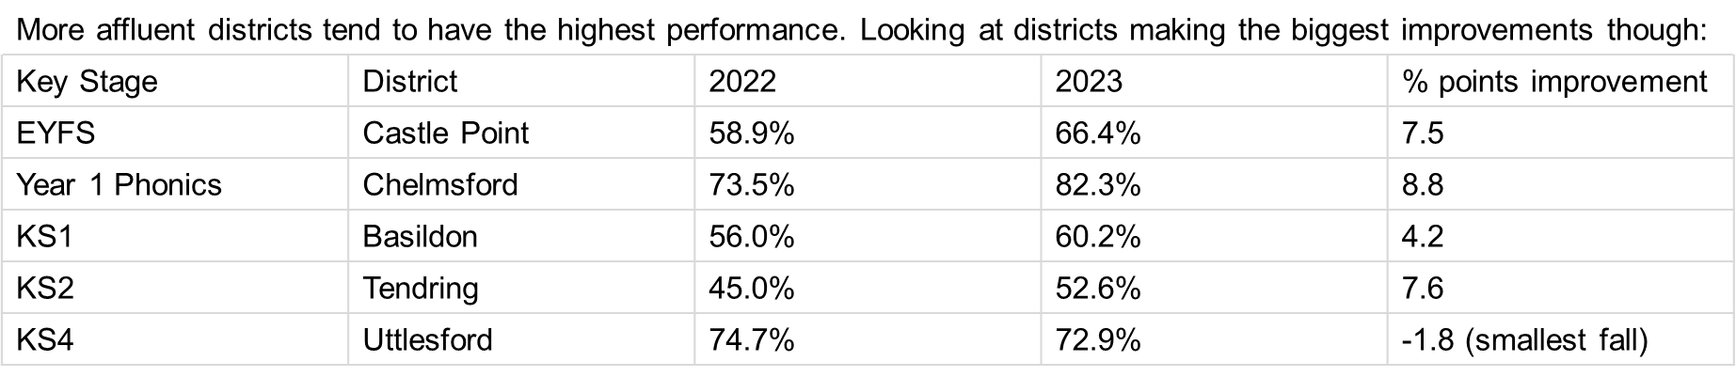
DATA ANNEX – DISTRICT PERFORMANCE (2023)

Slide 16
FOCUS ON DISADVANTAGED PUPILS IN 2023
EYFS: % GLD | KS2: % expected RWM | KS4: % 9-4 Eng. & Maths | Comments
 |  |  | Essex disadvantaged pupils lower than national peers across all key stages.
 |  |  | In the primary phase Essex non-disadvantaged pupils above England averages.
 |  |  | Gaps increase through the key stages with those in Essex consistently being higher than England.
Service Children (national comparative data not published) ▪ EYFS: % GLD – 62.0% of the 92 cohort achieved compared to 69.0% of non-service children. ▪ KS2: % expected RWM – 67.7% of the 127 cohort achieved compared to 60.7% of non-service children. ▪ KS4: % 9-4 Eng. & Maths – 65.9% of the 91 cohort achieved compared to 63.4% of non-service children.
Disadvantaged |  | Difference
Essex | 50.4 | -1.6
England | 52.0
Disadvantaged |  | Difference
Essex | 42.6 | -1.6
England | 44.2
Disadvantaged |  | Difference
Essex | 36.6 | -6.8
England | 43.4
Non-Dis. |  | Difference
Essex | 71.9 | +2.0
England | 69.9
Non-Dis. |  | Difference
Essex | 67.6 | +1.0
England | 66.6
Non-Dis. |  | Difference
Essex | 70.2 | -2.6
England | 72.8
Dis./non-dis. gap |  | Difference
Essex | 21.5 | +3.6
England | 17.9
Dis./non-dis. gap |  | Difference
Essex | 25.0 | +2.6
England | 22.4
Dis./non-dis. gap |  | Difference
Essex | 33.6 | +5.8
England | 39.4

Slide 17


This information is issued by: Essex County Council
Contact the team directly:
Duncan.Taylor@essex.gov.uk; Louisa.Thomas@essex.gov.uk;
Performance & Business Intelligence, Corporate Team
Policy Unit
Essex County Council
County Hall, Chelmsford
Essex, CM1 1QH
facebook.com/essexcountycouncil
Essex_CC
The information contained in this document can be translated, and/or made available in alternative formats, on request.
Due to be published March 2024

