Slide 1


Corporate Performance Report
April – June 2023-24
Performance and Business Intelligence,
Corporate Team
Policy Unit

Slide 2
Contents
The Essex Story
    Purpose of the report
    Key points for consideration
  Operating Context
    Ongoing context for Everyone’s Essex
    Society: Operating context 1
    Risks: Operating context 2
  Strategic Priorities
    Levelling Up Mission: updates
    Climate
    Equalities
    100 Deliverables
  Strategic Indicators
    Everyone’s Essex Strategic Indicators: Key Points
    Everyone’s Essex: Achievements
    Measures to watch
    Financial Wellbeing: developing a future framework
    Performance Report annex

Slide 3




To agree organisational performance issues – including those that are:
Council agreed EE targets that are at risk;
challenges to the financial well-being of the Council;
wider issues relating to the Council’s performance; and
contextual factors that have the potential to impact on demand and budget.
operational issues within a function won’t generally be flagged as requiring CLT discussion unless there is a need to escalate above FLT/Portfolio consideration.
Agree an appropriate response to those issues. This might include:
seeking assurance as a leadership team that appropriate remedial action is being taken to address performance risks;
noting actions being taken where these are sufficient to provide assurance;
confirming advice to PLT/Members in cases where CLT considers that remedial action is unlikely to correct deviations in performance in order to meet published targets within the time or resources available.
Purpose of this report
Sign off the report for:
Onward transmission to PLT and the Scrutiny Committee
Identification of any issues that require particular handling with PLT or Scrutiny Committee ahead of those discussions, or with the media/public.
Review progress
Check that agreed CLT/PLT performance actions have been completed;
Consider whether this provides CLT with assurance that actions are feeding through into delivery and therefore improved performance.

Slide 4




Key Points
In this quarter, the report identifies key areas of ECC performance that are below target (strategically or functionally), and represent a risk to the Council. CLT are asked to consider:
What is driving the performance in these areas
What are the wider implications of current levels of performance in this area: financially, reputationally, politically
What are the actions we are looking to pursue organisationally to improve the position
What support is required from other parts of the organisation to address the issues
What level of assurance can we provide to PLT/Members about our ability to remediate or address the position in a reasonable timeframe
Environment – ECC and County-wide emissions
Increases in emissions against planned reduction (detail outlined on slides 10 and 12).
Adult social care - People waiting
Ongoing challenges in meeting demand for assessment, reviews and deprivation of liberty safeguards (detail outlined on slides 5 and 12)
Housing affordability and impact of inflation (cost of living)
Essex residents are more exposed to increasing housing costs than other areas, which could have an impact on the financial wellbeing of residents. Essex residents will be continuing to feel the ongoing impact of inflation, increasing cost of living and reducing (slide 7)

Slide 5




THE ECONOMY
Health & wellbeing
Children & families
Levelling up
Changes in the macro-economy and their impacts on Essex households present a significant risk to the medium-term sustainability of services and the work necessary to deliver the commitments set out in Everyone’s Essex.
The Consumer Prices Index (CPI) rose by 6.8% in the 12 months to July 2023, down from 7.9% in June, and down from a recent peak of 11.1% in October 2022. High inflation rates drive increasing costs for ECC and increase pressure on ECC budgets.
High inflation rates also reflect rising living costs for residents – we project that by Feb 2023, some 15,000 households in Essex may have incomes below the level necessary to pay for food and essential bills. This creates considerable risk around future demand pressures and considerable uncertainty around future council tax and business rate revenues.
The Bank of England has raised interest rates on twelve consecutive occasions. The base rate reached 5.25% in august driving up the cost of borrowing with direct implications for the cost of financing ECC’s capital programme.
The Essex health system remains under pressure. Mental Health and Safeguarding have both experienced significant demand pressure over the past 12 months, which is continuing. These are demand-led services, and this is having an impact across the system. This is a national picture, but how this demand is being met varies across the country
While still a ‘live risk’ some progress has been made:
The number of adults waiting for an assessment of need more than 28 days have reduced by 28% and the number waiting for a safeguarding enquiry to start down 21%.
12 initiatives have been identified to reduce the number of adults waiting and manage the demand into ASC on a longer term basis.
ASC continue to look at all areas of prevention to reduce demand and promote independence. Care Technology continues to prevent, reduce, and delay demand coming into ASC for a higher proportion of residents.
Demand continues to rise in children's social care, with rates of children and young people known to the service increasing. (detail is provided in the Cost Driver section), however ECC continues to benchmark well.
The quality of the care provided to Essex families was assessed by OFSTED in June 2023 (just outside of this reporting period), and it found further improvements to the quality of provision from the last full inspection with ECC given a rating of Outstanding against all domains.
In education, there is a mixed picture on accessing early years (pre-school) subsidised placements, with successes noted in the pre-school demographic (aged 3&4), but a reduction in eligible 2 year olds accessing settings (this element is means tested and targets those on some benefits). Accessing good quality early years provision can support children to have structure and have improved outcomes in primary school and beyond.
Excess pressures such as the inflation and cost-of-living are likely to be felt worse in areas that are already falling behind, as seen through the disparities across districts using national Levelling Up mission outcomes data.
£516,000 has just been approved from the Everyone’s Essex reserve to support the priority cohort of 16- to 25-year-olds across Essex who are not in education, employment, or training (NEETs). To build on the existing work which the council already does in this area, we have identified three key priority areas of: 1) early intervention; 2) reducing barriers to apprenticeships; and 3) enhancing employment opportunities to support NEETs and those who are at risk of becoming NEET. By supporting young people earlier on, it is less likely that they will become NEET in the future. But, in order to fully support them we need to ensure we are trying to remove the barriers there are to accessing opportunities and to ensure there are opportunities for these young people. We will do this by continuing to develop stronger relationships with businesses to ensure there are good, local opportunities for young people.
Operating Context for Everyone’s Essex

Slide 6


Crime and feeling safe
Employment
Unemployment rates have fallen to pre-coronavirus pandemic levels, following a rise during the pandemic.
Essex continues to perform strongly in employment performance compared with the national picture, as has been the case since Q3 of 2021. High employment rates will contribute to reduced demand and enhance council tax yield. However, the impact of the cost of living will still impact in-work families
Operating Context for Everyone’s Essex 2: Society
Over a third of crime in Essex is categorised as Violent Crime, which is down 11.5% since last year.
Crime and fear of crime is a contributing factor to people’s satisfaction with place, and with their own wellbeing.
Economic factors could have a negative impact on crime
63.5%
Just under two-thirds of adults in Great Britain tend to be satisfied with the police in the UK. (May to June 2023)
Notes:
Crime and feeling safe:
https://www.ons.gov.uk/peoplepopulationandcommunity/wellbeing/articles/ukmeasuresofnationalwellbeing/dashboard
Participation & satisfaction:
https://www.ons.gov.uk/peoplepopulationandcommunity/wellbeing/articles/ukmeasuresofnationalwellbeing/dashboard
Participation in, satisfaction with, and balance between work and leisure activities represent people’s lifestyle choices. Measures in this domain cover subjective and objective measures related to work, leisure and volunteering.
Employment rate 16-64: is down 1.1 % from last quarter (Nomis) Economically Active
https://www.ons.gov.uk/employmentandlabourmarket/peopleinwork/employmentandemployeetypes/timeseries/lf24/lms
Claimant rate 16+ up 0.2% from last quarter (Nomis) Claimant Count

Slide 7




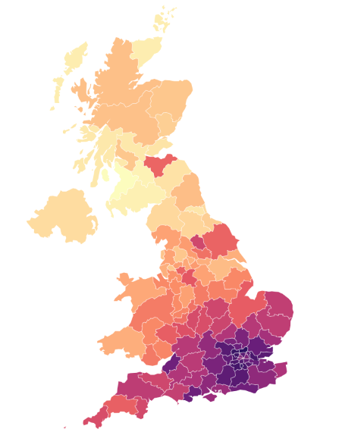

Strategic Risk
Probability
ECC Strategic Risk: Inflation
Strategic risk: SRR0092 (updated June 2023)
Inflation is at it’s highest level for 40 years, and may continue at a high level over the medium-term, which will create significant pressure on ECC revenue and capital budgets, drive up demand for services and impact upon the financial sustainability of the council. Interest rates are increasing to tackle inflationary pressures but will increase borrowing and capital financing costs, impacting ECC’s capital programme.
Impact
12
(4, 3)
8
(4, 2)
Current risk score
Target risk score
Mortgage risk in Essex
Mortgage and landlord possession claims
Operating Context for Everyone’s Essex: Risk
In Q4 there was a 39.7% increase in combined mortgage and landlord possession claims
High loan-to-income ratios (LTIs) are one of the most important indicators of risk in a period of rising mortgage rates. Households with a high LTI ratios are among those most likely to struggle to make mortgage payments at all. L enders typically consider a LTI ratio of 4+ to be high risk.
Essex has a relatively high proportion of homes, purchased with a LTI ratio of 4+ (c.39,000 – 7% of home owning households). Around 52% of these households have dependent children, with a quarter having a child below school age (0-4).
Only half of those households on Greater Essex with an outstanding mortgage have already experienced an increase in mortgage payments (c.152,000). The remainder will experience these impacts buy the end of 2026 (c.305,000 in total).
The impact on household finances could drive a significant increase in demand for public services whilst reducing rates of council tax collection.
Mortgage and Landlord possession claims rates have risen across all regions.
Harlow had the highest rate for private landlord claims (429 per 100,000 households owned by a private landlord). 39% of the households in Harlow were privately rented.
Regional Private landlord repossessions: Tendring were in the top three highest LAs with 187 per 100,000 households owned by the landlord.
Regional repossessions (by County Court bailiffs): Social landlord repossessions were highest in Castle Point with 146 per 100,000 households owned by a social landlord.
In England, private rental demand has increased as well as the rental prices increasing by 4.6% (12 months to March 23)
Percentage of mortgaged home purchases (2021) with a loan to income ratio >= 4

Slide 8




Quarter 1: updates to the LEVELLING UP MISSIONS:
Over the last quarter, new data has become available on:
  Gross Value Add (GVA) per hour worked (a measure of local labour productivity);
  Employment rate for people aged 16-64; and
  Percentage of children achieving the expected levels in reading, writing and maths by the end of Key Stage 2
This data allows for an updated assessment of the position of Essex and Essex districts on the government’s Levelling-up Mission One: Pay Productivity and Employment and Mission 5: School Achievement.
Key Strategic Priorities: Levelling Up
Levels of local productivity at 2021 remained broadly consistent with estimates for previous years.
However, the greatest shifts were:
a decline in local productivity in Harlow of c.3%; and
improvements in local productivity of 3% in Rochford and c.4% in both Colchester and Tendring.
None of these shifts were of a scale sufficient to alter the quartile position of these districts when benchmarked against LAs across England.
Employment rates fell for most districts between September & December 2022
The greatest shifts were in Braintree, Chelmsford, Epping Forest and Maldon and Uttlesford. Only Colchester and Harlow saw increasing rates of employment in this period.
These changes have led to a decline in Essex districts position relative to other local authority benchmarks:
Braintree, Epping and Uttlesford have slipped from the top quartile of LAs to the second quartile;
Chelmsford and Maldon have slipped from the 2nd quartile to the 3rd quartile. Employment rates in these districts are now below the median for all districts in England.
KS2 achievement rates increased in all but one district, but remain below pre-pandemic levels across Essex.
All districts, with the exception of Castle Point, saw increases in the percentage achieving the expected level in reading, writing and maths. The decline in Castle Point was from 58% to 57%.
Across the country, the proportion of key stage 2 pupils reaching the expected standard in all three areas of reading, writing and maths is unchanged from last year, showing no recovery to pre-Covid levels.
More detailed benchmarking is not possible at this stage as we do not yet have data for all LAs across England.

Slide 9
LEVELLING-UP TRENDS:
Improving trend | Stable trend | Declining trend
Trend position is determined by comparing the latest available data point with the range defined by the previous three data points.
Current position compared to historic trends for each place
Updated
Levelling up benchmarks
Key Strategic Priorities - Levelling up 2

Slide 10




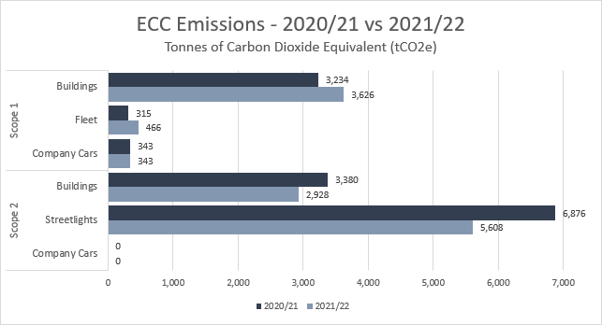
Improving resilience towards climate change (Q1)
162.0M
(Q1) Total Solar Energy Produced by ECC Sites (Wh)
£11M
The total amount of income/funding generated by the programme (2021/current) consequently helping to reduce surface water flooding
1,800+
Residential properties have benefited from reduced surface water flooding across Essex since 2021
ECC rating for Carbon Disclosure Project
A
100,624 (2022/23)
Trees planted by Essex Forest Initiative
New woodland contributes to delivering net zero carbon, nature recovery, reduces flooding, cooling city centres and provides protection against airborne pollution
48.1%
(Q1) Total consumption Solar Energy Produced by ECC Sites Fed to Grid (Wh)
Number of National Flood Management Schemes
Progress towards Everyone's Essex: Climate
8.42 MtCO2e
Actual (2019)
0.45 MtCO2e
Projection 2050
21.1 Hectares
Planted (22/23), on track to meet our target of 40 Hectares in 23/24
WWF Science based target 3.19 MtCO2e by 2030
13.8km
Hedgerows planted
(2022/23)
Percentage of land that is now green infrastructure
Year | Domestic Actual | Projections | I&C Actual | Projections | Industrial Actual | Projections | Transport Actual | Projections | Waste Actuals | Projections
2018 | 2.16 | 2.16 | 1.51 | 1.51 | 0.35 | 0.35 | 3.07 | 3.07 | 0.97 | 0.97
2019 | 2.17 | 2.09 | 1.54 | 1.41 | 0.36 | 0.33 | 3.25 | 2.98 | 0.89 | 0.89
14%
30%
2040 target
Notes:
CDP to be updated in October
£25.66M damages avoided.

Slide 11
EMBEDDING EQUALITIES
ORGANISATIONAL HEALTH
EDI training by function
Everyone’s Essex places great emphasis on addressing inequalities and improving life chances of our most vulnerable. We are building on our Year 1 equality objectives progress review report which we published in June this year.
We are now developing and delivering an equalities insight plan that will deepen our understanding of communities across Essex and improve both the quality and coverage of the data we hold on those who use our services. We have drawn together a multi-disciplinary team to:
better understand, for each ECC function, the data that is collected by ECC and in commissioned services, and to improve the information we collect;
analyse available data to understand if groups experience differential impacts in terms of access to services or outcomes;
assess the relationship between particular protected characteristics and key outcomes across the Essex population, irrespective of whether individuals are in touch with ECC services; and
explore what further insights are needed to better understand the lived experience of different populations and groups within Essex, including of accessing and using public services.
Measure​ | Target​ | Q2 (22/23)​ | Q3 (22/23)​ | Q4 (22/23)​ | Q1 (22/23)​ | Direction of Travel​
 |  | Sep 22​ | Dec 22​ | Mar 23​ | Jun 23​
% of employees who have completed the Equality and Diversity e-learning modules​ | 75-80%​ | 76.9%​ | 79.6%​ | 83.3%​ | 82.1%​ | ↓​
Adult Social Care​ | 75-80%​ | 84.2%​ | 85.9%​ | 88.0%​ | 88.3%​ | ↑​
Chief Executive's Office​ | 75-80%​ | 93.1%​ | 94.8%​ | 93.7%​ | 94.3%​ | ↑​
Children & Families​ | 75-80%​ | 71.1%​ | 75.9%​ | 84.2%​ | 84.3%​ | ↑​
Corporate Services​ | 75-80%​ | 97.0%​ | 97.4%​ | 97.4%​ | 96.9%​ | ↓​
Education​ | 75-80%​ | 53.2%​ | 56.1%​ | 56.7%​ | 59.4%​ | ↑​
People and Transformation​ | 75-80%​ | 94.8%​ | 94.8%​ | 94.9%​ | 95.4%​ | ↑​
Climate, Environment & Customer Services​ | 75-80%​ | 67.1%​ | 70.1%​ | 76.6%​ | 69.5%​ | ↓​
Economy, Investment & Public Health​ | 75-80%​ | 86.0%​ | 89.1%​ | 91.7%​ | 92.7%​ | ↑​
Key Strategic Priorities: Equalities
ECIAs by function
Function | 2022/23 | 2022/23 | 2023/24
 | # | % | # | %
Adult Social Care | 55 | 21 | 11 | 22
Chief Executive | 7 | 3 | 3 | 6
Children, families & education | 43 | 16 | 13 | 26
Climate, Environment & customer services | 61 | 23 | 11 | 22
Corporate Services | 36 | 13 | 2 | 4
Economy, Investment & Public Health | 56 | 21 | 8 | 16
Organisation Development & People | 10 | 4 | 2 | 4
Total | 268 |  | 50
Workforce representation:
Notes:
Community: we are committed to addressing inequalities and levelling up life change for our residents and advancing equality of opportunity for our communities.
Workforce: We are committed to being an employer that values difference and attracts, recruits and retains talented individuals from a diverse range of backgrounds. We will support and encourage our employees to be the best they can be at work and provide them with an employment deal that is fair and inclusive.

Slide 12

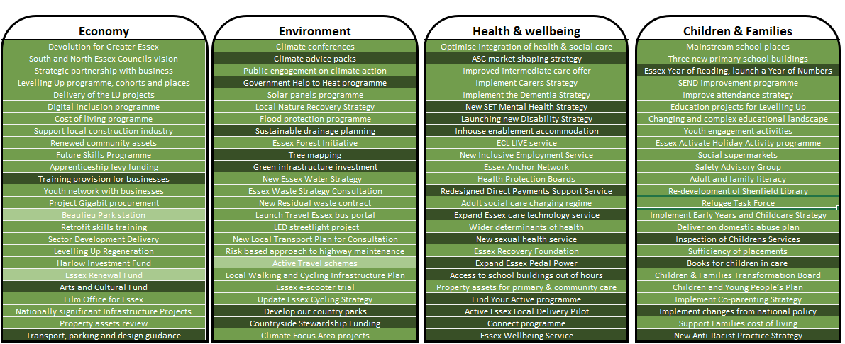
Key Strategic Priorities: 100 Deliverables
The 100 deliverables are commitments made in our annual plan for 2023/24. Reporting on progress against projects and outcomes will be included from Q1 of the 23/24 financial year

Slide 13


Key points to note
Climate:
Essex GHG emissions need to be on a downward trend in order to meet our ambitions to be Net Zero, locally and at a national level (ECC core estate by 2030, and nationally by 2050)
This is a high-level measure that provides an indicator on progress towards environmental outcomes mitigating the predicted rise in temperature by 1.5 degrees Celsius.
Latest reporting (2020) shows an increase in emissions across the County (all sources, not just ECC), and puts these targets at significant risk without further action. For ECC-controllable emissions, improvements in CO2e from streetlighting and green energy tariffs have been offset by increased car use (fleet and company). Some of the increases are a result of post-pandemic increases in activity (such as travel).
Adult Social Care:
Adult social care “people waiting” – there continues to be high numbers of people waiting for interventions from ASC. This includes people waiting for an assessment, review or a Deprivation of Liberty safeguards assessment. The services are prioritising based on risk. There are several initiatives underway in ASC to address the backlogs across these interventions, and these are starting to have some impact.
Risks to ECC:
Care needs and risks are only known as presented at the ‘front door’, including safeguarding.
Changing needs or new risks are not identified. An annual review is also requirement of the Care Act.
The proper tests for depriving people of their liberty (when they lack capacity) may not have been met.
Questions for consideration
Are wider community services (including VCS) and health aligned with prevention and IAG regarding ASC.
Risks to ECC:
Reputational in meeting our objectives, and ‘leading from the front’ with partners
Financial, resulted from ongoing high energy use
Questions for consideration:
Are the actions we are looking to pursue organisationally sufficient to improve the position
Are our partner institutions also committed to carbon reductions and on track?

Slide 14
The Everyone’s Essex Story
Q4 2022/23
100,624
Trees planted from Forest initiative
800
£6m savings
A
New primary and secondary school places created
from 5,987 service users receiving care technology
rating for Carbon Disclosure Project
7.4%
£3.4m
80% schools
£38m
Of adults known to secondary Mental Health services in paid employment
received for new homes on brownfields sites
Invested in social value has been delivered
Fully engaged in trauma perceptive practice
Everyone’s Essex Strategic Indicators: Achievements
Quarter 1 progress 2023/24
47% people achieving their health weight outcomes
Successful Family Solutions an increase on Q4 (77.5%) to 79.7% for Q1 2023-24
215
1,117 jobs directly created by ECC programmes
properties benefiting from reduced surface water flood risk
12,760
NHS Health Checks delivered in Q1 2023-24; this is above the target uptake of 12,000.
Replacement LED streetlight work continues, saving 6,500 tonnes of carbon per year
3–4-year-old Childcare Funding; Essex is ranked third highest against statistical neighbours at 95.2%
7.9%
of adults known to secondary mental health services in paid employment
Q2 2022/23

Slide 15

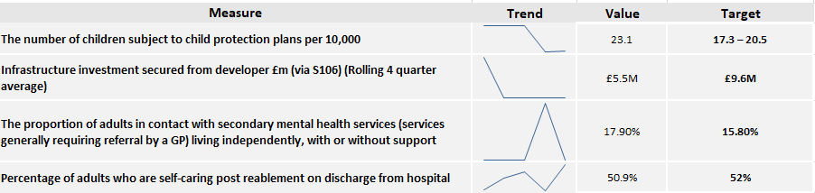
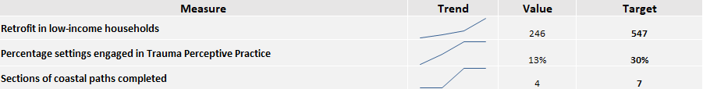

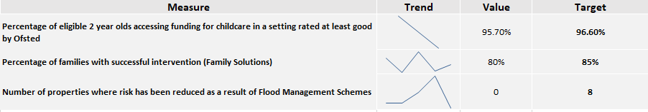
Everyone’s Essex Strategic Indicators: Measures to watch
Off Target and Worsening
Off Target but Stable or Improving
Ones to watch - Amber (<5% off Target) but Worsening

Slide 16









Everyone’s Essex Strategic Indicators: Financial Well-being Developing a future framework
Following the performance reporting work undertaken by IMPOWER, over the coming weeks, CLT will be considering options for a small suite of ‘ambition’ targets that look to give ECC a number of measures with opportunities for cross-council working, that link closely with the business plan, financial sustainability and resident priorities. Below is an initial list considered with finance*. All [targets] and [timescales] are illustrative.
Support [20%] more children with EHCPs in mainstream schools [by 2028]
Reduce ECC mileage by [20%] [by 2026]
Reduce the proportion of spot-purchased Domiciliary Care by [20%] [by 2025]
Reduce energy use in ECC building by [20%] [by 2027]
Reduce urgent repairs to highways
Maintain the balance of support for children, young people and families
Reduce residual waste by [15%] [by 2026]
Reduce the demand for home to school transport by [10%] [by 2028]
Continue to reduce people supported in residential settings by [5%] per year
Increase reablement where no ECC support required to [60%] [by 2025]
Reduce the proportion of CIC supported in residential settings
*noted that a gap in these proposals is on the economy, where discussions noted that there needs to be a measure identified where ECC can take direct action to affect an outcome, and that outcome be linked with ECC sustainability

Slide 17
Strong, Inclusive & Sustainable Economy
Skills, employability and jobs:
The current target was originally set at 1,720 due to budgetary unknowns. Sufficient funding has been acquired to provide more opportunities for people to gain additional qualifications supporting their aspirations and ability to get better jobs. We are now around three quarters into the academic year with good progress for ACL qualifications. While the aim is to increase the number of people with level 3, 4 and 5 qualifications, attaining level 2 may be a pre-requisite for that outcome.
Jobs created directly:
The combined total for jobs directly created through ECC programmes is 1,304. This significant over achievement was due to additional funding becoming available, which provided more opportunity to increase service provision. The number of jobs created and safeguarded via the Business Support contracts increased by 171 during the last 3 months, with a final total of 1,100 against target of 550. In addition to this, ECC has provided 187 entry level roles against a target of 210 in the 2022 calendar year, with a further 17 against a target of 265 in Q1 of the 2023 calendar year. Additionally, ECC engaged or supported 3293 businesses, and 175 businesses gained access to finance via the Backing Essex Business programme.
Measure | RAG | Value | Target
Number of people benefitting from ECC skills and employability programmes | Ç | 4,100 | 1,720
Jobs created directly through ECC programmes | Ç | 1,117 | 815
Infrastructure investment secured from developer £m (via S106) (Rolling 4 quarter average) | È | £5.5M | £9.6M
Funding and investment:
S106 receipts depend upon the wider economic climate and the progress of housing developments across the County, payable only at certain trigger points, and therefore vary significantly across the year and between years. This report now shows a rolling average, rather than ‘year to date’ as this reduces the impact of cyclical variations on performance outturns. Castle Point is the only district that did not receive any funding for 22/23. Compared with 21/22, contributions for the Strategic Development receipt category is up by around £2.6m.
Measures reported annually are included on rotation where there are updated figures.

Slide 18
High Quality Environment
Streetlights:
This is the third and final year of Phase 4 of the LED Replacement Programme. This year should see ECC finalise converting all of our remaining old-style street lighting stock from lamps into LED’s. Last year the upgrade programme was significantly impacted by the global shortage of components for the ‘Telecells’ that are used to control the streetlights. While we were able to recover a lot of lost ground in the final quarter of 22/23, this leaves the final year with a stretching target of 32,476 replacements. It should be noted that this is over 10% larger than the programmes delivered in Year 1 and Year 2 (27,131 and 28,439 replacements respectively). In Q1 we have seen Essex Highways delivery to be in line with the profile and, assuming no unforeseen issues, are currently on track to complete the programme by March 2024 as planned.
Measure | RAG | Value | Target
Retrofit in low-income households | Ç | 246 | 547
Replacing streetlights (mainly residential roads) in Essex with new LED lights | Ç | 7,582 | 32,476
Sections of coastal paths completed | Ç | 4 | 7
Retrofit in low-income households:
ECC Led Projects The SHDF (Sustainable Housing Decarbonisation Fund) completed 93 properties by the end of Q4. This is lower than the predicted figure of 547, but the nature of the work requires that significant efforts are put into the analysis and administration tasks at the outset of the programmes, with the actual installations occurring toward the end. The completion rate will therefore continue at pace during the first quarter of 2023/24.
External Partner Projects - Delivered by the Southeast Energy Hub The figures reported in Feb 2023 show 298 homes completed across Essex - 232 under the Green Homes Grant Local Authority Delivery (GHG LAD) Phase 3, and 66 under phase 1 of the Home Upgrade Grant (HUG1). In both instances, the highest number of completed homes were in Tendring.
Coastal Paths:
It is now possible for members of the public to walk along four of the nine Essex coastal paths; an unbroken stretch of 142 miles from Tilbury to Salcott. Approval has been granted in full for a further 88 miles, covering the two stretches from Salcott to Harwich, and work is underway to establish the routes for public use. The Jaywick to Harwich stretch is expected to complete in March 2025. Volunteers continue to maintain signage along the open stretches and the first maintenance grants have been offered for the open stretches.
Measures reported annually are included on rotation where there are updated figures.

Slide 19
Health, Wellbeing & Independence for all Ages 1
Note: updated public health measures are being considered, and will be provided once approved
Weight management:
We are in the first two years of the Essex Wellbeing Service (EWS) and are still seeing infrastructure development, such as increasing recruitment routes to meet necessary numbers - as such, not all weight management pathways are established or are fulling working yet. From year 3 onwards (2024/25), there remains a contractual expectation that EWS considerably increase the numbers supported to lose weight, and also monitor the number who actually lose weight sustainably over a period of 3 years.
Measure | RAG | Value | Target
Percentage of People booking who were supported to achieve their weight loss outcomes | Ç | 47% | TBC
Measures reported annually are included on rotation where there are updated figures.

Slide 20
Health, Wellbeing & Independence for all Ages 2
NHS Health Checks:
There were 12,760 health checks delivered in Q1 of 23/24. This is 106% of the target for this period (12,000) and is a large increase on Q1 of last year, which saw 7,523 health checks delivered. This means we are currently on track to meet the target of 48,000 health checks delivered in 2023/24.In terms of health checks offered, the cumulative total is 33,234 against our target of 24,000. This represents 138% of the target for Q1.
Mental Health services & paid employment:
This is the third consecutive quarter of seeing increases in this measure. This is mainly a result of a data quality project EPUT have launched and we expect to see the position continue to improve over the next 12 months as the data is made more reflective of the true position. Essex consistently performs in the top quartile nationally on this measure. Supporting people to find and maintain meaningful employment helps them to develop friendships and increase their confidence as well as supporting independence.
Number of adults with Learning Disabilities known to social services who secure new employment:
The ECL Live service continues to outperform it's targets. We are close to 300 adults with disabilities having been supported to find meaningful employment. This is having positive impacts on people's lives, helping them to develop friendships and increase their confidence as well as supporting independence.
Measure | RAG | Value | Target
Number of adult social care users in receipt of care technology | Ç | 6,945 | 4,195
Percentage of adults known to secondary mental health services in paid employment | Ç | 7.9% | Increase
Number of adults with Learning Disabilities known to social services who secure new employment | Ç | 279 | 115
Percentage of adults known to secondary mental health services in paid employment | Ç | 7.9% | 7.0%
The proportion of adults in contact with secondary mental health services (services generally requiring referral by a GP) living independently, with or without support | È | 17.9% | Increase
Percentage of adults who are self-caring post reablement on discharge from hospital | Ç | 50.9% | 52%
Number of total population aged 40-74 receiving an NHS Health Check | Ç | 12,760 | 46,000
Reablement:
Essex provides reablement services to a relatively high number of adults. While this measure is slightly below target, the service (provided by ECL) other effectiveness targets (reduction in hours of ongoing care required for adults who have been through reablement) are showing positive outcomes.
We have seen an increase in the levels of need of adults coming out of hospital. Thus, whilst the reduction in hours of ongoing need continues to be above target, this has made it less likely that adults will exit reablement fully self-caring.
Reablement and the entire intermediate care pathway is under review by adult social care.
MH accommodation
The proportion of people supported in Essex with MH needs who are in settled accommodation is decreasing, when the target was to increase against baseline. Active work with the provider (EPUT) to address and improve is underway

Slide 21
A Good Place for Children and Families to Grow 1
Measure | RAG | Value | Target
Percentage of eligible 2 year olds accessing funding for childcare in a setting rated at least good by Ofsted | È | 95.7% | 96.6%
Percentage of all 3 and 4 year olds, accessing funding for childcare in a setting rated at least good by Ofsted | È | 95.2% | 95.2%
% schools engaged in Trauma Perceptive Practice | Ç | 80.0% | 60%
% settings engaged in Trauma Perceptive Practice | Ç | 13.0% | 30%
Percentage of families with successful intervention (Family Solutions) | È | 79.7% | 85%
Eligible 2 year olds;
Essex performance fell by 1.5% points to 95.7% in 2022/23. This is the lowest it has been since the 2017/18 academic year. The Statistical Neighbours average also fell by the same margin although Essex remains 1.6% points above this. However, this is largely due to the very low performance of Central Bedfordshire. Nationally the decrease since 2021/22 was a drop of just 0.4% points. This brings the England average in line with Essex performance. This data is collected in the Early Years Census each January (next collection January 2024). This is submitted to DfE by all LAs for collation with the performance published late June.
Family Solution interventions: The proportion of successful intervention for Family Solutions is currently 2.2% points above Q4 22/23 (77.5%) successful interventions. Family Solutions closed 441 families in the last quarter, 232 of these cases were closed after an extended intervention, the remaining cases were closed as ‘Decision not to proceed’ or ‘Family Solutions not required’.
The overall rate of positive outcomes for sustained Family Solutions interventions remaining very stable over the reporting period around 81% but quadrants have a higher level of variation.
3 & 4 Year old funding;
Essex performance fell by 0.2% points in 2022/23 but continues to maintain the status levels of performance seen over the last four years. Performance is favourable when compared to the Statistical Neighbours and England averages - Essex being 1.7% points and 1.3% points higher respectively. Among the Statistical Neighbours group Essex is ranked third highest.
This data is collected in the Early Years Census each January. This is submitted to DfE by all LAs for collation with the performance published late June. Thus next update will be in the Q1 2024/25 report.
Trauma perceptive practice (school):
As at the end of the first academic year (2021/22), the target of 42% was exceeded with end of year performance being 65%. The target for the current academic year was set at 60% but performance by the end of the financial year (Q4) had already reached 80%. By the end of the academic year (Q1) performance had reached 85%. A target of 80% relates to the end of the 2023/24 academic year (by August 2024). This target has been met ahead of schedule. Currently 12% of schools have fully completed the training (against an end of 2022/23 target of 30% and 2023/24 being 50%).
Trauma perceptive practice (setting):
As at the end of the first academic year (2021/22), the target of 7% was achieved with end of year performance being 7.5%. The target for the current academic year was set at 30%. Performance by the end of the academic year (Q1) has reached 14%. A target of 50% relates to the end of the 2023/24 academic year (by August 2024). Based on current performance the number of settings needed to engage with ECC needs to increase by nearly four-fold. Currently 0.5% of settings have fully completed the training (against an end of 2022/23 target of 20% and 2023/24 being 40%).

Slide 22
A Good Place for Children and Families to Grow 2
Measure | RAG | Value | Target
The number of children known to social care per 10,000 | Ç | 191.7 | 190 – 210 (Target range)
The number of children subject to Children in Need plans per 10,000 | È | 48.7 | 47.3 - 63.1 (Target range)
The number of children subject to child protection plans per 10,000 | Ç | 23.1 | 17.3 - 20.5 (Target range)
Number of looked after children per 10,000 | È | 36.6 | 34.7 - 39.4 (Target range)
Review representation of Ethnically Diverse CYP across the statutory social care system: Open to social care | N/A | 23.2% | N/A
Review representation of Ethnically Diverse CYP across the statutory social care system: Children in Care | N/A | 26.2% | N/A
Review representation of Ethnically Diverse CYP across the statutory social care system: Child protection | N/A | 13.4% | N/A
Children in Need (CIN) and Child Protection plans:
The number of children on child in need plans in Essex has fluctuated over the last 12 months, with a peak of 1639 in March, dropping to 1544 by June, in line with levels seen last August. The main cause of this movement are changes within the mainstream CIN volumes, with CWD and case managed CIN plans remaining relatively stable. The rate of children in need was relatively stable during 2022, between 46 and 47 per 10,000 at any one time, with 2023 seeing rates between 50.2 and 48.7. Although higher, they are still within the expected range. North continues to have the highest rate (56.3), although West has seen a steady rise in CIN Since June'22 - from 37.7 to 46.4.
Looked After Children:
The number of children in care rose during 2022 and continues to see higher numbers. Following a peak in November, volumes have been more consistent, fluctuating between 1150 and 1170, currently sitting at 1160 in June. Despite the increases that have been seen over time, the number of children looked after by the council remains in our expected range. At a quadrant level, North continues to see significantly higher rates of children in care per 10,000 but has seen rates fall from 50.6 in June 2022 to 46.6 by June 2023. West has also seen rates rise, heavily impacted by the rising number of SMC during qu4 of 2022/23.
Social Care per 10,000:
The number of children open to Social Care has seen a continued rise during the last 2 years, with rates increasing from 174.8 per 10,000 to 191.7 by the end of June'23. We have also included the numbers of children open to social care for additional context.
Child Protection Plans:
The number of children subject to Child Protection plans was relatively stable during Q4 of last year, with numbers between 680 and 690. However, numbers have risen since March 2023, reaching 733 in June. This measure is rated as red as the rate of children on child protection plans continues to be slightly above the threshold range, however as noted previously – Essex continues to have a lower proportions of children on child protection plans than similar authorities.
At a quadrant level, the rate per 10,000 varies significantly, with notably more children on a child protection plan in North than the other three quadrants. Rates have risen from 32.8 to 36.6, while the other quadrants generally see rates between 15 and 22.
Children from an ethnically diverse group:
The proportion of children open to social care from an ethnically diverse group has grown gradually over time, and currently sits at 23.2%, slightly more than last quarter (21.9%). The increase is mainly reflected in the children in care numbers, where a higher number of separated migrant children is seen; 68.5% of SMC in care being of other ethnic groups for example. The proportion of children in care from Global Majority backgrounds falls from 26.2% to 15.6% when SMC are excluded, which is much closer to the Essex school census rate of 14.3%.

Slide 23
Service Excellence
Council Tax collection:
The 2023/24 Q1 forecast for the in-year collection rate is 97.04%, which is more or less equal to the Q4 position at the end of 2022/23, but is almost 1% lower than both the budgeted collection rate and the target collection rate.
However, total council tax income collected in relation to prior year is forecast to be £14.5m for 2023/24. This is almost equal to a 1.5% increase in income collected, so overall performance is similar to budget assumptions and total forecast council tax income is actually greater than was forecast by the districts at budget setting, when we consider the impact of prior year collection.
Measure | RAG | Value | Target
Collection rate of Council Tax achieved for the year. | È | 97.0% | 96%
Deliver social value through procurement and practice to increase availability of entry level jobs | Ç | - | N/A
Measures reported annually are included on rotation where there are updated figures.

Slide 24


This information is issued by: Essex County Council
Contact the team directly:
Duncan.Taylor@essex.gov.uk; Louisa.Thomas@essex.gov.uk;
Performance & Business Intelligence, Corporate Team
Essex County Council
County Hall, Chelmsford
Essex, CM1 1QH
facebook.com/essexcountycouncil
Essex_CC
The information contained in this document can be translated, and/or made available in alternative formats, on request.
Published July 2023

