Slide 1


Corporate Performance Report
2023-24: Quarter 4: December – March
Policy Unit

Slide 2
In this report pack
Corporate performance report. Quarter 4
The Essex story
  Suggested areas of focus
Strategic Performance
  Everyone’s Essex: Achievements
  Measures to watch / Year End position
  Strategic Performance Measures: Quarter 4 outturns
Accountability and governance
  Strategic Risks
Contents

Slide 3
Achievements – outlined on Slide 5, derived from areas performing well. Raising for awareness / promotion.​
Measures off target – noted on Slide 6 and 7. Measures highlighted in this section for the last four quarters: coastal paths, % of 16-18 NEET and Jobs created directly from ECC programmes.
The Essex Story: Suggested areas for focus

Slide 4
Strategic Performance
RAG ratings are generated from the outturn for this quarter, projections for end of year outturns, and professional judgement based on knowledge of service delivery.

Slide 5




4,908
People benefitting from ECC skills and employability programmes
The Sustainable Housing (Decarbonisation Fund) has now retrofitted 258 homes to an EPC rating of 'C'
The Everyone’s Essex Story
Q4 2023/24
48,004
NHS Health Checks completed YTD
83%
Social Value delivered against 30% target
9,982
Adult social care users in receipt of care technology
Waste per household reduced by 10.5%.
Strategic Perfomance: EE Achievements
Adults known to secondary Mental Health services in paid employment: 18%
Significantly above the last reported national average
ECC rating for Carbon Disclosure Project
Adaptation: A
Mitigation: A
173,688
Number of trees YTD planted from Essex Forest Initiative
249
Properties where risk has been reduced as a result of Flood Management Schemes
26
New homes delivered (via Essex Housing and ECC Independent Living programme)
Q1 2024/25

Slide 6

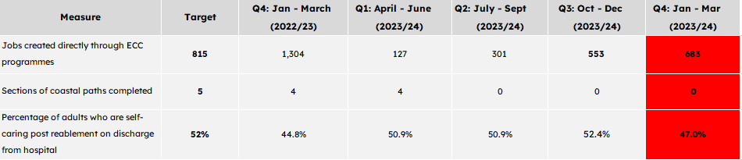
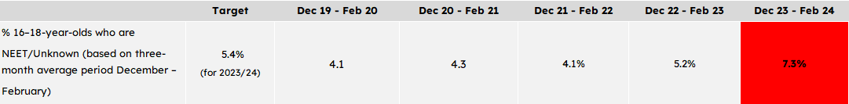
Measures Off Target, Out of Range, and Worsening
Strategic Performance: Measures to watch for Quarter 4

Slide 7
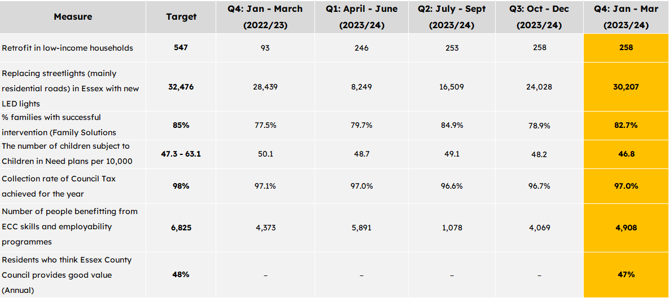
Measures Off Target but Stable or Improving
Strategic Performance: Measures to watch for Quarter 4
Measures available annually:

Slide 8
Strategic Performance Measures
2023/24 outturns
RAG ratings are generated from the outturn for this quarter, projections for end of year outturns, and professional judgement based on knowledge of service delivery.

Slide 9
New homes delivered: A 26-unit specialist and affordable development at Shernbroke in Waltham Abbey was successfully completed on 6th March 2024, and residents confirmed by 13th March. All homes scheduled for completion on this measure were delivered in 2023/24.
Measure | Q4: 22/23 | Q1: 23/24 | Q2: 23/24 | Q3: 23/24 | Q4: 23/24 | Target
New homes delivered (via Essex Housing and ECC Independent Living programme) | 0 | 0 | 0 | 0 | 26 Ç | 26
Number of people benefitting from ECC skills and employability programmes (Academic year) | 4,373 | 5,891 | 1,078 | 4,069 | 4,908 Ç | 6,825 Academic year
Jobs created directly through ECC programmes | 1,304 | 127 | 301 | 553 | 683 Ç | 815
Infrastructure investment secured from developers £m (via S106) (rolling 4 quarter average) | £5.6m | £5.5m | £4.5m | £5.2m | £5.0m | -
The number of people benefitting from ECC skills, employability programmes: There are 4,908 people accessing programmes against the academic year against a target of 6,825. A 15.7% increase on Q3. The schemes include Multiply, Apprenticeships and Entry Level up to Level 5 Qualifications.
Strong, Inclusive & Sustainable Economy
Jobs created directly through ECC programmes:
There has been an increase of 130 jobs in Q4 to a total 683 against a target of 815. This total includes:
107 jobs created and safeguarded by the Business Support contract. A total of 407 against a target of 550.
Entry Level roles remain at 276 against a target of 265.
23 jobs have been created in 2024 within ECC as part of the Entry to Work programme. The Team are currently waiting for further funding to be agreed before targets for the 2024 calendar year can be agreed.
The Business Support Contract concludes in June, with a new contract being procured. While performance for 2023/24 is lower than the annual target, overperformance in previous years means that the contract target of 1,550 was met.
​
Infrastructure investment secured from developers £m (via S106): The total s106 monies for 23/24 was £20.2m.
Arrows indicate direction of travel from the previous quarter.
Measures reported annually are included on rotation where there are updated figures.

Slide 10
Measure | Q4: 22/23 | Q1: 23/24 | Q2: 23/24 | Q3: 23/24 | Q4: 23/24 | Target
Number of properties where risk has been reduced as a result of Flood Management Schemes | 0 | N/A | 21 | 30 | 249 Ç | 215 properties
Replacing streetlights (mainly residential roads) in Essex with new LED lights | 28,439 | 8,249 | 16,509 | 24,028 | 30,207 Ç | 32,476
Retrofit in low-income households | 93 | 246 | 253 | 258 | 258  | 547
Flood Management Schemes:
There were 8 Priority Projects scheduled for 2023/24, providing a reduced surface water flood risk to at least 215 properties.
We were able to capitalise on in-year opportunities to increase the number of projects and the properties benefitting to 249.
It is estimated that the delivered schemes avoid damages of approx. £6m.
Replacing streetlights:
2023/24 was planned as the third and final year of Phase 4 of the LED Replacement Programme, where we finalised converting all of our remaining old-style street lighting stock from lamps into LED’s.
Due to the global shortage of components affecting delivery in year 2, this year’s programme was already over 10% larger than those in years 1 and 2 to ensure completion stays on track. Impacted earlier this year leading to only 93% of the planned programme completed. It should be noted that we have surpassed the delivery of 27,131 in year 1 and 28,439 in year 2, with a final outturn that is 11% and 6% larger than years 1 and 2 respectively.
The remaining c.2000 units will be upgraded by the end of Q1 in 2024/25.
Retrofit in low-income households:
The SHDF (Social Housing Decarbonisation Fund) has now retrofitted 258 homes (48% of the 547 target) to an EPC rating of ‘C’ with a £1.6m grant funding and a total project cost of £2.4m. Due to installer issues outside of ECC control, the government have agreed the 258 target.
High Quality Environment
Arrows indicate direction of travel from the previous quarter.
Measures reported annually are included on rotation where there are updated figures.

Slide 11
Measure | Q4: 22/23 | Q1: 23/24 | Q2: 23/24 | Q3: 23/24 | Q4: 23/24 | Target
ECC rating for CDP ( Carbon Disclosure Project) | A | A | A | Adaptation A Mitigation A | Adaptation A Mitigation A | B
Number of trees planted from Essex Forest Initiative | 100,624 | 0 | 0 | 73,600 | 173,688 Ç | 100,000
Sections of coastal paths completed | 4 | 4 | 0 | 0 | 0  | 5
ECC rating for CDP (Carbon Disclosure Project):
The ratings are awarded annually. There is no change to our current position of an A rating overall. (A for both Adaptation and Mitigation). Essex scores have improved year-on-year and have demonstrated best practice standards across adaptations and mitigations at a leadership level.
Trees:
The 2023/24 outturn has significantly exceeded the target of 100,000, with an estimated total of 173,688 trees being planted throughout Essex. This means that the 5-year target of 375,000 plantings has already been exceeded after four years. (The 4-year combined total stands at 417,061 trees)
High Quality Environment
Coastal Paths:
No additional sections have been completed this year with 5 sections outstanding. The Wallasea Island to Burnham-on-Crouch section has now been approved in full, enabling grant applications to begin by Essex Highways, who lead this project.
Agreement of the grant funding for Jaywick to Harwich is in process with Natural England.
This is a National programme of work to create a new long-distance trail that once completed will enable people to walk around the whole English Coast. The progress has been slower than anticipated with over half of the 67 sections across England to still be fully completed.
Arrows indicate direction of travel from the previous quarter.
Measures reported annually are included on rotation where there are updated figures.

Slide 12
Care technology:
By the time this report is published Essex will have past 10,000 adults supported to maintain their independence with the help of Care Technology. This is enabling adults to stay in their own homes for longer, reducing ambulance call outs and preventing, reducing and delaying need for further social services intervention in the adult's life.
Measure | Q4: 22/23 | Q1: 23/24 | Q2: 23/24 | Q3: 23/24 | Q4: 23/24 | Target
Number of adult social care users in receipt of care technology | 5,987 | 6,945 | 8,049 | 9,022 | 9,982 Ç | 4,195
Percentage of adults known to secondary mental health services in paid employment | 7.4% | 7.9% | 8.2% | 17.4% | 18% Ç | 7.0% (Baseline)
NEW MEASURE: Number of older adults (65+) admitted to permanent residential care following an assessment or review (per 100,000 population) (past 12 months) | 513.8 | 515.4 | 506.8 | 462.2 | 418.9 Ç | Below 538.5
NEW MEASURE: Number of working age adults (18-64) admitted to permanent residential care following an assessment or review (per 100,000 population) (past 12 months) | 10.9 | 12.2 | 14.0 | 13.1 | 13.1  | Below 13.9
Mental Health services & paid employment:
Essex is one of the top authorities in the country on this measure. Supporting adults to find and maintain employment helps to promote independence, prevent social isolation and overall prevent, reduce and delay the need for further social service intervention in the adult's life.
Number of older adults (65+) admitted to permanent residential care following an assessment or review (per 100,000 population) (past 12 months):
Essex continues to outperform the national average. Essex provides an extensive reablement offer. Combined with Care Technology and other Early Help initiatives, the Essex 'home first' approach is successful at preventing, reducing and delaying the need for residential care.
Number of working age adults (18-64) admitted to permanent residential care following an assessment or review (per 100,000 population) (past 12 months): The Essex Disability Strategy and the Meaningful Lives Matters programme has always focused on the importance of people having their own homes and being supported to live effectively in the community wherever possible. The initiatives to make this possible include clearly communicating with the provider market about the types of accommodation that we need, commissioning specific schemes for people with complex needs and supporting our operational staff to have effective Supporting Independence discussions with individuals. This work has been successful but over the last year we have improved it further with the development of an Accommodation Hub with specialist staff to support people to move home where that is the outcome everyone wants.
Health, Wellbeing & Independence for all Ages
Arrows indicate direction of travel (DoT) from the previous quarter. Where ‘good is low’, a reduction in outturn is shown as a positive DoT
Measures reported annually are included on rotation where there are updated figures.

Slide 13
Measure | Q4: 22/23 | Q1: 23/24 | Q2: 23/24 | Q3: 23/24 | Q4: 23/24 | Target
The proportion of adults in contact with secondary mental health services (services generally requiring referral by a GP) living independently, with or without support | 18.5 | 17.90% | 17.70% | 28.0% | 26.8% È | 15.8% (Baseline)
Number of total population aged 40-74 receiving an NHS Health Check | 12,919 22/23 outturn 40,548 | 12,686 | 13,055 | 12,291 | 9,972 È 23/24 outturn 48,004 | 48,000
Percentage of adults who are self-caring post reablement on discharge from hospital | 44.80% | 50.90% | 50.90% | 52.4% | 47% È | 52%
The proportion of adults in contact with secondary mental health services (services generally requiring referral by a GP) living independently, with or without support:
Data cleansing work by EPUT has provided a figure which is closer to the real performance. Essex is now shown as outperforming national averages when these were last published. EPUT are planning a further deep dive with their Mobius case management system over the coming months which could see further improvement in the outturn.
NHS Health Checks:
There were 9,972 health checks completed in Q4, and the annual checks completed at 48,004 during the 2023/24, which exceeds the target of 48,000.
The service also monitors the number of health check invites sent to people registered with an Essex GP, which was 102,964, against the target of 96,000.
ECC commission “Provide” to deliver this service. These free health checks are to look at overall health and help to identify whether individuals are at higher risk of getting certain health problems such as: diabetes, stroke, heart disease and kidney disease. The aim is to help improve health and promote better lifestyle choices and to lower the risk of getting conditions, by picking these up early.
Health, Wellbeing & Independence for all Ages
Reablement:
Essex offers reablement to adults with a much broader range of needs than other local authorities (5% of adults aged 65+ provided reablement on discharge from hospital vs 2.8% nationally). Essex's rate of admission to residential and nursing care is below national averages, which suggests that reablement to be successful. The service report that greater levels of need are being supported for adults entering reablement which could have an impact on those that are self-caring on exit from reablement.​
Arrows indicate direction of travel from the previous quarter.
Measures reported annually are included on rotation where there are updated figures.

Slide 14
Measure | Q4: End Mar 22/23 | Q1: End Jun 23/24 | Q2: End Sep 23/24 | Q3: End Dec 23/24 | Q4: End Mar 23/24
People Waiting: Care Act Assessment | 2,257 | 1,796 | 1,878 | 1,973 | 1,954 Ç
People Waiting: Safeguarding Enquiry | 338 | 282 | 259 | 448 | 428 Ç
People Waiting: Deprivation of Liberty Safeguards | 3,201 | 3,042 | 2,942 | 2,453 | 2,184 Ç
People Waiting: Review of Support Plan | 3,965 | 4,245 | 4,650 | 4,631 | 4,623 Ç
People Waiting measures:
Adult social care have identified people waiting as a priority for the service, and metrics are therefore included in this report to give srutiny the opportunity to be sighted on progress.
ASC services are subject to changes in demand, which has an impact on the number of people waiting. Essex benchmarks favourably with other authorities in the Eastern region for the size of the population. However, the service have an ambition to reduce the number of Essex residents waiting, and the length of time that they wait.
A prioritisation matrix is in place to ensure that urgent cases get seen without delay and people's immediate need is met whilst they wait. A workstream has been structured around people waiting and 12 initiatives are being implemented to impact performance.
This table highlights quarterly outturns on four waiting categories. For routine (including monthly reporting) additional information on OT waits and reassessment are also included, so information presented here varies slightly with our 'total waiting' (Slide 28).
There are no targets set for these measures at a system level, but this quarter saw small improvements to all the people waiting measures.
Health, Wellbeing & Independence for all Ages
Arrows indicate direction of travel (DoT) from the previous quarter. Where ‘good is low’, a reduction in outturn is shown as a positive DoT
Arrows indicate direction of travel from the previous quarter.

Slide 15
Measure | Q4: 22/23 | Q1: 23/24 | Q2: 23/24 | Q3: 23/24 | Q4: 2023/24 | Target
NEW MEASURE: Percentage of children attending a school rated at least good by Ofsted Primary Secondary Special All (including. PRU) | 93.2% 80.3% 97.6% 87.7% | 92.9% 77.7% 97.6% 86.5% | 93.2% 77.3% 97.8% 86.5% | 94.1% 80.2% 97.8% 88.2% | 94.6% 82.3% 97.8% 89.6% | 90% 90% 95% 90%
Ofsted:
Quarterly performance improves to its highest level during the financial year to 89.6%. This equates to 194,438 out of 217,057 who attend a school that has been inspected (18,206 pupils are in a Requires Improvement school and a further 4,413 in an Inadequate school).
At a district level performance is highest in Brentwood where ALL schools are graded good or outstanding. The lowest performance is seen in Tendring where around seven in ten (70.6%) pupils attend a school graded good or outstanding.
In terms of the number of schools, of 550 that have been inspected, 504 (91.6%) are graded good or outstanding (35 Requires Improvement and 11 Inadequate).
A Good Place for Children and Families to Grow
Measure | Dec 2019 – Feb 2020 | Dec 2020 – Feb 2021 | Dec 2021 - Feb 2022 | Dec 2022 - Feb 2023 | Dec 2023 - Feb 2024 | Target
% 16–18-year-olds who are NEET/Unknown (based on three-month average period December – February) | 4.1% | 4.3% | 4.1% | 5.2% | 7.3% È | 5.4% (for 2023/24)
NEET/Unknown rate: In 2021/22 and 2022/23, the Essex rate was at or below the England rate. However, a significant rise in the number of young people whose destination is unknown in 2023/24, sees the NEET/Unknown rate rise from 5.2% to 7.3% (England average 5.4%).
At district level, rates vary across the districts ranging from 4.7% in Brentwood to 11.7% in Tendring.
Arrows indicate direction of travel (DoT) from the previous quarter. Where ‘good is low’, a reduction in outturn is shown as a positive DoT
Measures reported annually are included on rotation where there are updated figures.

Slide 16
Family Solutions Interventions:
363 families concluded their Family Solutions interventions in the last quarter, 196 of these cases were closed after an extended intervention, the remaining cases were closed as ‘Decision not to proceed’ or ‘Family Solutions not required’.
The volume of successful interventions for Family Solutions between January 1st, 2024, and March 31st, 2024, is 82.7% this is 3.8% points above the previous outturn.
Of the families closed with Shared Family Assessment (SFA) 54 families (13.9%) identified as having one or more family members with Black, Asian, Mixed, or other ethnic backgrounds, there were 27 families (7.0%) where one member had ethnicity recording as blank, not disclosed or refused by families.
The DfE Supporting Families programme requirements changed 3 criteria part-way through 2023/24 which will have an impact on Payment by Results funding. The Early help data and insights team estimate that this will reduce the available cohort to 1,206 families (from the target of 2,805). Opportunities to maximise PBR funding is being explored by the service. ECC secured 100% of the reward grant as a result of this work.
This was an internally set target to measure the effectiveness of the service's work in achieving positive outcomes. Historically Family Solutions was the main contributor to central government's Troubled Families and Supporting Families Payment by Results framework, thus lower volumes of positive outcomes would have significantly impacted revenue generation. Family Solutions in 2024/25 are now one of many contributors to the programme. Financial impact and loss of revenue generation from 2.5 points is a small factor, though not one expected to be one of concern this quarter due to other sources providing evidence to generate revenue. It is something that should be monitored though as continuing declining successful outcomes could indicate a potential for service delivery challenges.
Measure | Q4: 22/23 | Q1: 23/24 | Q2: 23/24 | Q3: 23/24 | Q4: 2023/24 | Target
Percentage of families with successful intervention (Family Solutions) | 77.5% | 79.7% | 84.90% | 78.9% | 82.7% Ç | 85%
A Good Place for Children and Families to Grow
Arrows indicate direction of travel from the previous quarter.
Measures reported annually are included on rotation where there are updated figures.

Slide 17

Measure | Q4: 22/23 | Q1: 23/24 | Q2: 23/24 | Q3: 23/24 | Q4: 23/24 | Targets 2024/25
NEW MEASURE: Number of children being Electively Home Educated (EHE) (year groups R-11) | 2,902 | 3,169 | 2,816 | 3,103 | 3,578 È | -
NEW MEASURE: Number of children currently Missing Education (CME) (year groups R-11) | 469 | 464 | 536 | 478 | 463 Ç | 0
Electively Home Educated: Numbers of EHE rise throughout the academic year. They are now at their highest level with 3,578 at 31.03.24 - a 23% increase since 31.03.23. There is a natural dip in numbers over the Summer holidays due to pupil turnover. There is no target for this measure as parents have a right to home educate their children at any point in the year. This measure is therefore used to track the trajectory and what impact that might have on the wider school network. The service also record if EHE children have an EHCP, and this is growing at the same rate as for children who do not.
Children Missing Education: There have been little change in numbers over the course of the last year – these typically remaining in the 450-500 range. Supporting insights have also identified that most children return to education within two months.
NEW MEASURE: Absence rates (Academic Year) | 2020/21 | 2021/22 | 2022/23 | 2023/24 (Autumn) | Targets 2024/25
% overall absence | 4.4% | 7.7% | 7.2% | 6.6% Ç | 4%
% Persistent Absence | 11% | 22.7% | 20.2% | 18.8% È | 19.5%
% Severe Absence | 1.1% | 1.6% | 1.9% | 1.9%  | 2.0%
Absence rates: The latest available data comes from the January 2024 School Census that reports on absence during the Autumn term (Sep23-Dec 23).
Essex performance continues to mirror that seen nationally (latest Autumn term data for England shows 6.7% overall absence, 19.5% persistent absence, 2.0% severe absence).
Across districts, overall absence rates are relatively compact after one term – ranging from Brentwood 5.7% to Tending 8.1%.
Arrows indicate direction of travel (DoT) from the previous quarter. Where ‘good is low’, a reduction in outturn is shown as a positive DoT
Measures reported annually are included on rotation where there are updated figures.

Slide 18
NEW MEASURE: New school places created | Q1: 23/24 | Q2: 23/24 | Q3: 23/24 | Q4: 2023/24 | Targets 2024/25
Primary Secondary Special | - - - | 305 (21/22) 900 (21/22) - | 350 (22/23) 450 (22/23) - | 340 (23/24) 0 (23/24) - | 1,485 1,170 -
New school places: Creation of new places is to meet demand, and the required places varies to ensure that excess places are not created, according to adjusted forecasts.
As a result of these adjustments, a 900-place secondary school initially planned for 2023/24 has been delayed for a year.
A Good Place for Children and Families to Grow
NEW MEASURE: Early Years Forecasts | Q1: 23/24 | Q2: 23/24 | Q3: 23/24 | Q4: 2023/24 | Targets 2024/25
Demand in hours Additional places needed | 273,921 (Baseline) - | 291,674 (Apr 24) 226 (Apr 24) | 300,700 (Sep 24) 473 (Sep 24) | 365,467 (Sep 25) 2730 (Sep 25) | - -
Early Years Placements and Funding:
All data shown is taken from the latest available data pack shared by DfE. Based on the wave of changes to EY funding over the coming two years, the pack forecasts the likely shortfall in hours and equates these to the number of additional places needed to meet anticipated demand.
Demand is variable across the county with some wards/districts expected to have a surplus of places whereas others have a significant shortfall.
Arrows indicate direction of travel from the previous quarter.
Measures reported annually are included on rotation where there are updated figures.

Slide 19
Children known to Social Care: included in this quarter is the DFE annually published figures for the number of children known to social care. It shows that the rate per 10,000 in Essex has increased by 4. The rate in Essex remains notably lower than our comparators, and while following a similar trend, is not increasing at the same rate as our statistical neighbours (+11) or the East of England (+7). In comparison, the rate across England as a whole fell by 1 per 10,000, indicating that Essex and its neighbours are not seeing the same movement as the country as a whole.
Child Protection Plans: The number of children subject to child protection plans has dropped to 638 in Q4. This puts the child protection plan rate in the expected range for the first time in over a year at 20.1 children per 10,000. Since peaking in August at 796 plans, the number of children subject to child protection plans has been falling month on month. As noted previously – Essex continues to have a lower proportion of children on child protection plans than similar authorities. North continues to have the highest proportion of children subject to child protection plans and represents 31.5% of CP plans (201).
Looked After Children: The number of looked after children has dropped slightly to 1,155 from 1,183 in Q3. This lowers the rate per 10,000 in Q4 to 36.5. The Looked after children figures remain in the expected range and have done all year. Non-SMC Looked after children are at a 12-month high at 1,010 in March whilst SMC Looked after children have dropped to 145 from 177 in December. West remains as the quadrant with the highest number of Looked after children at 356, with this quadrant overseeing the majority of the SMC population.
Measure | Q4: 22/23 | Q1: 23/24 | Q2: 23/24 | Q3: 23/24 | Q4: 23/24 | Range
The number of children known to social care per 10,000 | 189.6 | 191.7 | 183.3 | 195.7 | 195.7  | 190 – 210
Number of Looked After Children per 10,000 | 36.7 | 36.6 | 36.5 | 37.4 | 36.5  | 34.7 - 39.4
The number of children subject to child protection plans per 10,000 | 21.7 | 23.1 | 24.6 | 21.8 | 20.1 Ç | 17.3 - 20.5
The number of children subject to Children in Need plans per 10,000 | 50.1 | 48.7 | 49.1 | 48.2 | 46.8 È | 47.3 - 63.1
A Good Place for Children and Families to Grow
Children in Need (CIN): The number of open children in need plans have dropped to 1,477 from 1,569 in Q3. This lowers the rate per 10,000 to 46.8 and outside of the expected range for CIN Plans. This is due to open mainstream plans dropping by 100 to 727 since Q3. Open CYPWD plans have continued to rise slightly in Q4 to 487 (+17). Looking at entries and exits for February and March, there have been 81 more exits then entries. Currently Mid has the highest number of open CIN plans (413).
Arrows indicate direction of travel from the previous quarter.
Measures reported annually are included on rotation where there are updated figures.

Slide 20
Measure | Q4: 22/23 | Q1: 23/24 | Q2: 23/24 | Q3: 23/24 | Q4: 23/24 | Target
Review representation of Ethnically Diverse CYP across the statutory social care system: Open to social care | 21.9% | 23.2% | 23.3% | 24.1% | 24.6% | N/A
Review representation of Ethnically Diverse CYP across the statutory social care system: Children in Care | 27.0% | 26.2% | 26.9% | 29.1% | 28.6% | N/A
Review representation of Ethnically Diverse CYP across the statutory social care system: Child protection | 12.5% | 13.4% | 14.3% | 13.6% | 16.5% | N/A
Children from an ethnically diverse group:
The proportion of children open to social care from an ethnically diverse group continues to grow gradually over time, and currently sits at 24.6%, slightly more than last quarter (24.1%).
Whilst the proportion of Children in Care from an ethnically diverse background has fallen slightly (down 0.5%), the proportion of children from ethnically diverse backgrounds with child protection plans has increased to 16.5%.
The proportion of children from ethnically diverse backgrounds with child protection plans has increased by 21%. This is a result of children from mixed backgrounds with child protection plans increasing by 9% and children from Asian backgrounds with child protection plans increasing to 6 from 0.
A Good Place for Children and Families to Grow
Arrows indicate direction of travel from the previous quarter.
Measures reported annually are included on rotation where there are updated figures.

Slide 21
Measure | Q4: 22/23 | Q1: 23/24 | Q2: 23/24 | Q3: 23/24 | Q4: 23/24 | Target
Deliver social value through procurement and practice SV % Delivered SV Committed (£) SV Delivered (£) | - | - | 38.0% £97.5m £36.9m | 41.0% £99m £40.5 | 83% £111m £92.7m Ç | 30% N/A N/A
Collection rate of Council Tax achieved for the year | 97.1% | 97.0% | 96.60% | 96.7% | 97.0% Ç | 98%
Social Value: The latest delivery survey data is from October - December 2023.
The delivery survey for 2023/24 Quarter 3 saw a large increase in the amount of delivered social value. The majority of this was through one contract. The Live at Home framework delivered a large over delivery, the committed value for Older People was £35.9m with £53.9m being delivered.
Council Tax: The quarter 4 in-year collection rate is an improvement on quarter 3 by 0.28% (on average across all district councils), and the overall income collected during 2023/24 was £2.6m greater than the Quarter 3 forecast. Overall, a positive movement in the position. This is the latest forecast from the districts and will remain a forecast until the official submission of this data to central government in May 2024. While any movements are usually insignificant, we will monitor them and keep CLT informed if it has a material impact on the above position.
Service Excellence (Everyone’s Essex measures)
Arrows indicate direction of travel from the previous quarter.
Measures reported annually are included on rotation where there are updated figures.

Slide 22
Corporate Performance Report
March 2024
STRATEGIC RISK

Slide 23


Performance and risk management:
ECC has effective performance management to monitor current and future performance; as well as robust and comprehensive processes to help identify, monitor, and understand, current and future risks. We are proactively tracking and monitoring any movement within strategic risks, which could impact on the council services.
Performance and Risk are assessed and monitored individually; and where possible we work together to strengthen key messages, highlight areas that require action or attention and pull together business intelligence to help provide understanding and guidance.
‘High scoring’ Strategic Risks:
SRR0088
SRR0046
Almost Certain (4)
Strategic Risks | Current Risk Score | Target Risk Score
Children in Care Placements SRR0046 | 16 (4, 4) | 9 (3, 3)
Supply Chains SRR0087 | 16 (4, 4) | 8 (2, 4)
ASC safeguarding SRR0055 | 12 (3, 4) | 8 (2, 4)
C&F safeguarding SRR0056 | 12 (3, 4) | 8 (2, 4)
Recruitment and Retention SRR0088 | 12 (4, 3) | 4 (2, 2)
SRR0087
4
8
12
16
Strategic Risk: introduction
SRR0055
Likely (3)
SRR0056
Probability
3
6
9
12
Possible (2)
2
4
6
8
Unlikely (1)
1
2
3
4
Minor (1)
Moderate (2)
Major (3)
Critical (4)
Information collected on 18/04/2024
Impact

Slide 24
ECC Strategic Risk (SRR0046):
Placement sufficiency for Children in Care:
There is a shortage of placement choice and significant increasing costs nationally. This is compounded by;
Increasing Children in Care numbers nationally,
Ofsted inspection outcomes,
Pressure of health, education and criminal justice beds,
Workforce recruitment and retention issues; and
Current economic climate.
The consequences are the potential risks;
Insufficient placements resulting in a failure to meet our statutory duty to provide lawful placements for children requiring care;
Increased pressure on budgets due to rising costs.
The number of unregistered placements is not reducing, creating reputational risk for the Local Authority.
For non-SMC children, the increase in the number of children in care continues to be mainly met by in-house fostering placements, with kinship fostering and residential care seeing increases over the last two years. SMC increases in demand continue to be mainly met through semi-independent accommodation, although overall SMC numbers have recently fallen slightly.
Placement Type: Comparison between placement types December 2021 to current (March 2024) profile.
Current risk score
16
(4, 4)
April 2024
Strategic Risk: Placement sufficiency for CiC
Probability
Target score
9
(3, 3)
9
(3, 3)
Impact
In progress:
Residential Strategy: development of local in-house and commissioned residential provision.
Joint Protocol
Lobbying
Monitoring
Ongoing:
Prevention of entry into care and re-unification
Transformation board work on fostering
Joint Protocol in place
Children and Young People’s Placement Service (CYPPS)
Children and Young People with Disabilities (CYPWD)
Control Measures:

Slide 25



ECC Strategic Risk (SRR0087):
Supply Chains: Due to global volatility and UK policy positions on e.g. immigration, there is a risk of supply chain disruption and escalating cost. This could be due to:
Continued high inflation particularly in relation to
volatility in the cost of Energy, leading to concerns over
viability of suppliers with high energy consumption e.g.
residential care and construction.
An emerging issue in relation to reduced numbers of
bids being seen across a number of category areas resulting in failed tenders and a need to go back out to market.
Vacancies in key sectors e.g. Haulage, Construction
and Care potentially exacerbated by proposed stricter
immigration controls.
Wage inflation due to historically high levels of
inflation combined with a lack of labour availability leading to higher than usual pay settlements. This could impact on our ability to fulfil our statutory duties which results in escalating costs to the council and failure to deliver services.
Additionally, shortages in supply and labour could result in suppliers sourcing less ethical solutions, e.g. modern slavery.
Highlight
Current risk score
16
(4, 4)
Target score
8
(2, 4)
Strategic Risk: Supply Chains
In progress:
Business Impact Analysis
Supporting the Care sector
Ongoing:
Reviewing sourcing strategies to see how we can mitigate any potential cost pressures, potentially extending contracts where we can even if at a slightly increased price to avoid going to the market at such a volatile time.
Reviewing and updating specifications to allow more flexibility from bidders as, at times, we are too prescriptive, and this is causing additional cost and availability challenges.
In addition to this we are reviewing the complexity of our requirements to see how we can make bidding more straightforward for suppliers.

Slide 26
ECC Strategic Risk (SRR0055):
Risk of potential death or serious injury of a vulnerable
adult or child as a result of market failure or poor
practices. This would have a significant impact on service
delivery, officer morale and the reputation of the Council.
ASC track a number of measures that help the service understand the performance of safeguarding processes and services. This includes:
Volumes
Timeliness
Outcomes
Shown (right) is a measure that is tracked nationally that looks at removal and reduction of risk, where ECC performs above national averages.
Percentage of s42 enquiries where a risk was identified, and the outcome was reported as the risk reduced or removed
Strategic Risk: ASC Safeguarding
Current risk score
12
(3, 4)
Target score
8
(2, 4)
Ongoing:
Strong relationships
Essex Safeguarding Adults Board (ESAB)
Ongoing relationship with the CQC
Quality Assurance Framework
Serious Concerns Review Group (SCRG)
Robust relationships in place
Continuous Professional Development (CPD)
Care Sector Hubs

Slide 27
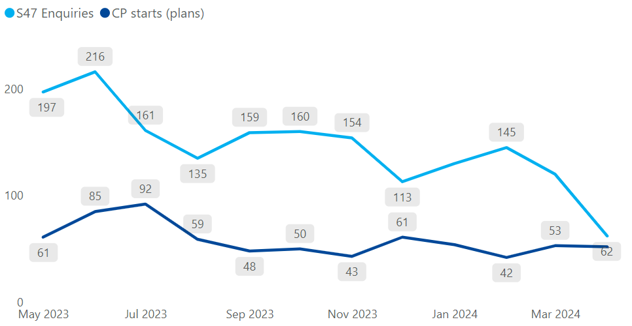
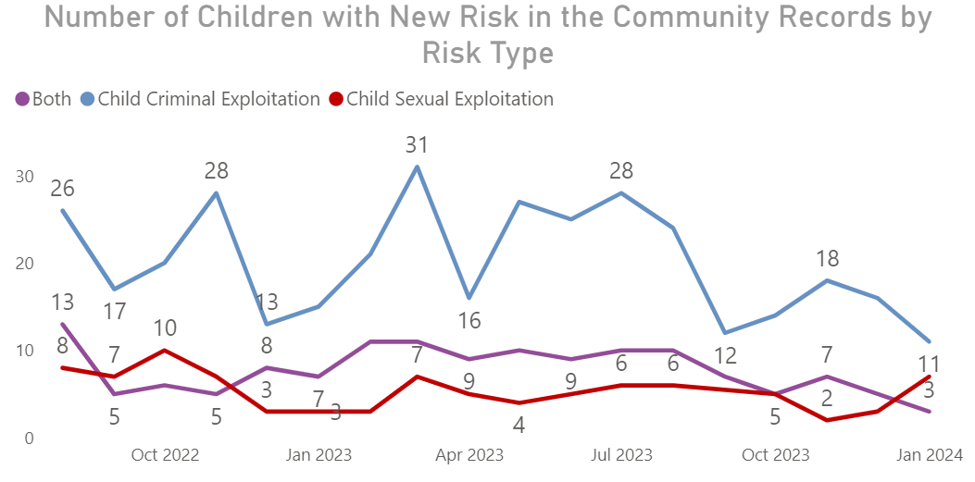
ECC Strategic Risk (SRR0056):
C&F Safeguarding:
Due to stretched capacity internally and externally; social
worker caseloads increasing in complexity and volume;
and an increasing number of families living in poverty, there
is an increased risk of child abuse, long-term psychological
damage, serious injury, or death of a child. This may result
in significant negative impact on officer wellbeing and
morale, and the reputation of the Council.
Number of S47 Enquiries Carried Out Against the Number of New Child Protection Plans Starting
Current risk score
12
(3, 4)
Strategic Risk: C&F Safeguarding
Target score
8
(2, 4)
Number of Children with New Risk in the Community Records by Risk Type
In progress:
Projecting future demand
Ongoing:
Projecting future demand
Prevent and Channel meetings
Child Sexual Exploitation Strategy (CSE)
Independent Inquiry into Child Sexual Abuse (IICSA)
Quality Checks
Child Safeguarding Practice Reviews
Early Help Offer

Slide 28
ECC Strategic Risk (SRR0088):
Recruitment and Retention:
ECC’s voluntary turnover rate has begun to stabilise over the
the last 12 months.
Whilst the rate of increase seen in previous years has improved and stabilised to below the target rate and industry comparators, the impact that has on the effective and efficient delivery of services in the Council is significant, especially roles which are considered hard-to-fill and critical to our services.
Failing to control or have measures in place to mitigate our voluntary turnover, will be financial, productivity loss and reputational.
This is monitored via the Excel MI Tool – and is open access for managers via the Workforce Breakdown
Strategic Risk: ECC Recruitment and Retention
Current risk score
12
(3, 4)
MI Tool headlines:
Target score
4
(2, 2)
Almost 10% of our workforce are on FTCs
19.4% of workforce have worked at ECC for 15+ years
68.3% of workforce are full time
31.7% are part-time
In progress:
Robust workforce planning
Talent identification, development and planning pilot
Report into FLTs and PBPs
Flexibility in organisation design
Pay and Reward

Slide 29


This information is issued by: Essex County Council
Contact the team directly:
Duncan.Taylor@essex.gov.uk; Louisa.Thomas@essex.gov.uk;
Policy Unit
Essex County Council
County Hall, Chelmsford
Essex, CM1 1QH
facebook.com/essexcountycouncil
Essex_CC
The information contained in this document can be translated, and/or made available in alternative formats, on request.
Due to be published June 2024

