Slide 1
Oral Health Needs Assessment
November 2022
Research & Citizen Insight
Policy Unit

Slide 2
Report Structure
1
Background
5
Prevalence of oral diseases in adults in Essex
2
Policy context
6
Treatment and access barriers and facilitators
3
Oral health inequalities, systemic health and the common risk factor approach
7
Recommendations
4
8
Appendix
Prevalence of oral diseases in children in Essex

Slide 3
About this report
This focussed Oral Health Needs Assessment (OHNA) report forms part of a wider Joint Strategic Needs Assessment (JSNA) suite of products that provide an overview of the key issues across Essex. The aims of this report are three-fold:
  1. To describe the oral health of the local population.
  2. To support the targeting of resources towards improving the oral health of those at specific risk or in underserved population subgroups.
  3. To identify new or alternative ways in which gaps can be addressed.
The report provides a foundation on which to scope a more comprehensive assessment of the required structures and support services for improved oral health outcomes, based on an understanding of oral health inequalities. Understanding the complexity of oral health needs in Essex can be viewed as an iterative approach, with this report being ‘phase 1’ to a possible ‘phase 2’ which would require further resources, input and collaboration from all partners within the health and care system of Greater Essex.
Out of Scope:
Internal organisation data
Workforce
Finance
Demographic details of the population as these are already on Essex Open Data.
In scope:
Publicly available data on:
Prevalence and incidence
Oral health inequalities
Services
Outcomes
Quality
Capacity of existing services to meet needs

Slide 4
Executive summary
NHS dental activity reduced significantly over the acute phase of the Covid-19 pandemic (2020/2021), but even before the pandemic, there were challenges in Essex. In 2020/21, there was a reduction of about 66% in NHS dental activity compared with the previous year.
The pandemic worsened the pre-existing challenges of accessing NHS dental health services. Prior to Covid, Essex had one of the highest percentages of the adult population who had not seen a dentist in the last two years, nearly double England's average, which created high levels of unmet treatment needs in the population.
Lack of access to NHS dental services is a significant concern to residents. Residents reported waiting lists to be registered with an NHS dentist for more than two years and treatment for over six months. Ability to access oral health services was influenced by cost, availability of NHS dentists and surgery opening times.
There is inequity of access as residents have to pay to access private dental health services if they are unable to register with an NHS dentist. This is not affordable for most residents and will likely increase oral health inequalities as these follow the socioeconomic gradient.
Without access to oral health services oral health outcomes will continue to decline in Essex for example:
  4 out of 10 adults in Essex have active decay which is nearly 1.5 times higher than the England and East of England average.
  Children in Brentwood and Basildon showed approximately 5 times higher substantial visible plaque compared with Essex and England averages.
  Among Essex districts, Colchester has one of the highest rates for children with decay involving the pulp, incisor caries, and extractions due to tooth decay, suggesting further attention is needed. There is need to increase oral health promotion services for adults in Essex.
Recommendations
There is definitive need for equitable access to oral health services for residents in order to improve oral health outcomes and reduce oral health inequalities. This requires the development of an oral health strategy, which integrates oral health improvement into existing public health efforts to address the modifiable risk factors that oral health diseases have in common with the main causes of morbidity and mortality across Essex.

Slide 5
1. Background

Slide 6
Overview
Oral health is a key indicator of overall health, wellbeing and quality of life. Oral diseases are largely preventable and affects nearly 3.5 billion people worldwide ^{[1]}.
It encompasses a range of diseases and conditions that include dental caries (tooth decay), periodontal (gum) disease, tooth loss, oral cancer, oro-dental trauma (injury to the teeth and/or other areas in and around the mouth), birth defects such as cleft lip and palate ^{[1]}
Oral health diseases can result in severe pain, infection, reduced quality of life, lost school days, disruption to family life and decreased work productivity ^{[1-2]}
Oral health diseases are associated with coronary heart disease ^{[3-4]}, poor diabetic control ^{[5-6]}, adverse pregnancy outcomes (premature births and low birth weight) ^{[7]}, pneumonia in older people ^{[2]} and obesity ^{[8]}
Poor oral health is a product of biological, social, economic, cultural and environmental factors and is influenced by the wider determinants of health. In the UK, deprivation, belonging to specific ethnic minority groups, social exclusion or isolation and low proficiency in English have been identified as risk factors for poor oral health outcomes in the UK ^{[1-2, 9]}
Treating oral diseases costs the NHS £3.4 billion per year and cost UK economy £105m every year in sick days (1.2mln) ^{[10-11]}
To address oral health inequalities, the National Institute for Health and Care Excellence (NICE) recommends that local authorities conduct oral health needs assessments to support the commissioning of dental health as part of the JSNA ^{[2]}
WHO (2022) Oral Health Factsheet Oral health (who.int)
NICE (2014) Oral health: Local authorities and partner Oral health: local authorities and partners (nice.org.uk)
Mathews D (2008) Is there a relationship between periodontal disease and coronary heart disease? Evidence-Based Dentistry 9: 8
Humphrey LL, Fu R, Buckley DI et al. (2008) Periodontal disease and coronary heart disease incidence: a systematic review and meta-analysis. Journal of General Internal Medicine 23: 2079–86
Grossi SG, Genco RJ (1998) Periodontal disease and diabetes mellitus: a two-way relationship. Annals of Periodontology 3: 51–61
Stewart JE, Wager KA, Friedlander AH et al. (2001) The effect of periodontal treatment on glycaemic control in patients with type 2 diabetes mellitus. Journal of Clinical Periodontology 28: 306–10
Xiong X, Buekens P, Fraser WD et al. (2006) Periodontal disease and adverse pregnancy outcomes: a systematic review. British Journal of Obstetrics and Gynaecology 113: 135–43
Public Health England (2015) The relationship between dental caries and obesity in children: an evidence summary Caries_obesity_Evidence_SummaryOCT2015FINAL.pdf (publishing.service.gov.uk)
de Abreu, M.H.N.G.; Cruz, A.J.S.; Borges-Oliveira, A.C.; Martins, R.d.C.; Mattos, F.d.F. (2021) Perspectives on Social and Environmental Determinants of Oral Health. International Journal of Environmental Research and Public Health 18, 13429. https://doi.org/10.3390/ ijerph1824134 Perspectives on Social and Environmental Determinants of Oral Health (nih.gov)
NHS England. 2014. Improving dental care – a call to action. 2014. Available online at http://www.england.nhs.uk/wp-content/uploads/2014/02/imp-dent-care.pdf
Oral health problems cost UK economy £105m every year in sick days - Dentistry.co.uk

Slide 7
Objectives of this oral health needs assessment
To address oral health inequalities, the National Institute for Health and Care Excellence (NICE) recommends that local authorities conduct oral health needs assessments to support the commissioning of dental health as part of the JSNA.
To present the prevalence of oral diseases in Essex
To describe the oral health inequalities in Essex
To provide an overview of the current oral health promotion services commissioned in Essex
To describe common risk factors for oral health and other non-communicable diseases
To describe the impact of oral health on systemic health
To understand patient and public experiences of primary and secondary oral health services and oral health promotion services in Essex
To understand barriers and facilitators to the use of primary and secondary oral health services
To identify potential gaps in service provision and provide recommendations on how these can be addressed

Slide 8
Methodology: mixed methods
Document review
We reviewed local and national policy on oral health improvement, in order to set the context in which the OHNA findings will be utilised.
Quantitative survey
Qualitative interviews
We conducted in depth interviews with 10 residents; 6 females; 4 males; 2 aged 25-34; 2 aged 35-42; 2 aged 45-54; 3 aged 55-64; 1 aged 65+;
Secondary data analysis
We analysed epidemiological data from Office for Health Improvement & Disparities (OHID) Fingertips, NHS Digital, NHS Business Service Authority (BSA), Office for National Statistics (ONS);
Descriptive analysis was applied to the epidemiological data.
Survey of 1201 Essex residents.
Qualitative analysis of 897 qualitative responses from the survey;
All qualitative data were analysed using thematic analysis.
57% of the sample were females, and 42% were males.
43% were aged over 65, 29% -between 55-64, 16% - under 45-54, and 13% under 44 years.
We had respondents from all lower tier local authorities, however highest number of respondents were from Braintree (21%) and Chelmsford (14%).
Notes:
Saul

Slide 9
2. Policy context
This section:
Describes the oral health policy context in Essex
Summarises national policy drivers on oral health

Slide 10
The role of local authorities in oral health improvement
Oral health improvement is an important aspect of reducing health inequalities. It involves health education, health policy and health prevention ^{[1]}.
The Health and Social Care Act (2012) ^{[2]} conferred the responsibility for oral health improvement to local authorities. Some of the responsibilities include:
    Providing or commissioning oral health promotion programmes to improve the health of the local population.
    Conducting and/or commissioning oral health surveys to assess and monitor oral health needs.
    Reducing health inequalities as well as planning, commissioning and evaluating oral health improvement programmes.
    Leading the scrutiny of delivery of NHS dental services to local populations.
    Delivering the healthy child programme 0-19 years, the national child measurement programme and the care of vulnerable children and families.
    Commissioning local healthy schools, school food and healthier lifestyles.
Local authorities deliver oral health improvement in conjunction with several partners including NHS England and the voluntary, community and social enterprise sector (VCSE).
Nationally, there are significant struggles with regards to access to NHS dental care. Some of the challenges accessing NHS dentists existed before the pandemic but were further compounded by the pandemic.
1. NICE (2014) Oral health: Local authorities and partner Oral health: local authorities and partners (nice.org.uk)
2. UK Government Health and Social Care Act (2012) A1. Factsheet - Overview (240412).docx (publishing.service.gov.uk)

Slide 11
NHS dental services and national policy drivers
NHS dental services
National policy drivers
NHS England directly commissions all NHS dental services at primary, community, secondary and tertiary settings depending on the care and treatment required ^{[1]}.
Adult patients pay a subsidised fee for receiving care unless they are exempt.
The NHS operates a three band fixed charge primary care treatment package and payment from adult patients depends on the treatment received ^{[1]}.
Accessing oral health services under the NHS has been a significant struggle for many patients over the past several years but was compounded by the COVID-19 pandemic.
There are plans to reform the NHS dental contract ^{[2]} in order to improve access to dental care and support prevention these include:
Allowing dental therapists to accept patients for NHS treatments so that more patients can be seen.
Being able to indicate NHS dentist availability on the NHS website.
Offering oral check-ups based on health risk, which can be once every two years instead of every six.
Financial boost for NHS dentistry to clear the pandemic backlog.
Various national policy levers draw attention to the need to address oral health inequalities including;
  The NHS Outcome framework 2022 ^{[3]} which monitors tooth extractions due to decay for children admitted as inpatients to hospital who are aged 10 years and under.
  NICE Guideline PH55 Oral Health Improvement for Local Authorities (2014) ^{[4]} which provides guidance on developing and implementation of an oral health strategy by local authorities in order to meet the needs of the local population.
  The NHS Long term plan ^{[5]} which identifies the need for providing holistic care across local authority and NHS services including oral health. The Long-term plan funds the Starting Well Core initiative which has supported 24,000 dentists across England to see more children from a young age to form good oral health habits and prevent tooth decay experienced by a quarter of England’s five-year-olds.
  The OHID Delivering Better Oral Health ^{[6]} which seeks to provide a consistent UK-wide approach to the prevention of oral diseases.
NHS England. 2014. Improving dental care – a call to action. 2014. Available online at http://www.england.nhs.uk/wp-content/uploads/2014/02/imp-dent-care.pdf
NHS England » Better access to NHS dental services under new reforms.
NHS England NHS Outcome Framework 2022
NICE (2014) Oral health: Local authorities and partner Oral health: local authorities and partners (nice.org.uk)
NHS England NHS Long term plan :NHS Long Term Plan
OHID Delivering Better Oral Health : An evidenced based toolkit for prevention : Delivering better oral health: an evidence-based toolkit for prevention - GOV.UK (www.gov.uk

Slide 12
Essex County Council (ECC): Oral health commissioning
The implementation of the oral health policy as well as the commissioning arrangements for oral health improvement programmes by local authorities need to be identified and understood locally, because they vary across England.
Local authorities have the lead responsibility for oral health improvement regardless of where the funding may sit.
ECC’s oral health improvement program currently focuses on children and young people and is embedded within the local authority’ commissioned programmes for children and young people (e.g., school health and children’s centers)
This service is provided by the Essex Child and Family Wellbeing Service. ECC monitors specific oral health outcomes that are indicated below:
  Number and percentage of children aged between 2 and 3 years whose primary carers have received a dental health discussion (promotion) as part of their 2 – 3-year developmental review.
  Number of children aged between 3 and 5 years living in most deprived quintile attending the dentist for an urgent appointment in the previous 24 months (to be developed in conjunction with public health dental officer).
There are currently no oral health promotion services for adults commissioned by the ECC.

Slide 13
3. Oral health inequalities, systemic health and the common risk factor approach
This section briefly summarises:
The relationship between oral health and systemic health focusing on the leading causes of mortality and morbidity in Essex.
Oral health inequalities in the UK using the County Health Rankings Model.
The common risk factor approach.

Slide 14
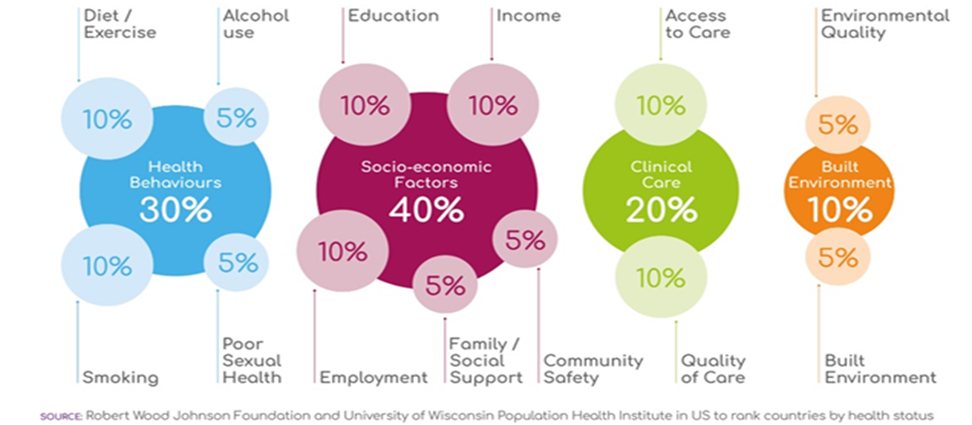
Framework
Analysis of the literature on oral health inequalities using the 'County Rankings Model' to show how different factors highlighted in the model result in oral health inequalities.
https://www.countyhealthrankings.org/explore-health-rankings/measures-data-sources/county-health-rankings-model

Slide 15
Health behaviours
  Alcohol and smoking
  There is a higher risk of oral cancers among drinkers relative to non-drinkers, and the risk is even higher for those who smoke and drink. Heavy drinkers and smokers are 38 times more likely to develop oral cancer ^{[1]}. They also experience higher rates of tooth decay.
  Smoking can lead to gum diseases, tooth staining, tooth loss, and in some severe cases mouth cancer ^{[1]}.
  The impact of harmful drinking and alcohol dependence is much greater for those in the lowest income bracket and those experiencing the highest levels of deprivation due to the effects of other issues affecting people in lower socio-economic groups ^{[2]}.
  Diet
  A diet that is high in free sugars is the principal cause of dental caries. Dental caries are highest in areas with high deprivation ^{[4]}.
  There is a strong relationship between deprivation, obesity and dental caries ^{[4]}.
  Exercise
  Physical exercise is important for emotional and mental wellbeing.
  Lack of physical exercise is associated with common mental health disorders such as stress. There is evidence linking stress to periodontal diseases ^{[5]}.
1. Oral Health Foundation (2022) – Smoking and oral health. https://www.dentalhealth.org/smoking-and-oral-health
2. UHSA (2017) Mouth Cancer Action Month – Reducing the risk - UK Health Security Agency (blog.gov.uk)
3. Hiscock, R & Bauld, L (2013) S top Smoking Services and Health Inequalities 10. SSS + HI v4 (ncsct.co.uk)
4. Public Health England (2015) The relationship between dental caries and obesity in children: an evidence summary Caries_obesity_Evidence_SummaryOCT2015FINAL.pdf (publishing.service)
5. Stress and periodontal disease - Reners - 2007 - International Journal of Dental Hygiene - Wiley Online Library

Slide 16
Socio-economic factors
  Employment
  Evidence suggests that people from manual social class backgrounds may only see dentists if they have symptoms while children from managerial and professional class families, are more likely to attend routine appointments ^{[1]}.
  Income
  Individuals living in deprived communities are more likely to have worse oral health compared with those living in areas of lower relative deprivation ^{[2]}. ​
  The prevalence for tooth decay, tooth loss, oral cancer and gum disease is higher in deprived areas ^{[2]}.
  ​Admission rates for tooth extractions are 4 times higher for those from the most deprived communities ^{[3]}.
  Religion/Ethnicity
  Higher levels of dental caries have been reported in the primary teeth of children of Pakistani or Bangladeshi origin ^{[4]}.
  A number of studies have reported higher incidence and prevalence of specific oral cancers among ethnic minorities than the rest of the population ^{[4]}.
  Vulnerable Groups
  Prisoners have been reported to have higher prevalence of tooth decay and nearly 5 times the prevalence of oral sepsis, compared to the general population ^{[5]}.
  Asylum seekers and refugees are at increased risk of poor oral health outcomes due to exposure to factors such as economic deprivation and social exclusion which are linked to oral health inequalities ^{[5]}.
  People with intellectual disabilities have higher levels of unmet oral health needs and higher levels of untreated decay and gum disease than the general population ^{[6]}.
1. Oral health inequalities remain a major public health concern in the UK (UCL News)
2. Health Matters: Child dental health - UK Health Security Agency (blog.gov.uk),
3. Hospital_teeth_extractions__0-19Y_2016_to_2020.xlsx (live.com)),
4. Marsham, Z., Nower, K., &Wright, D (2013) Oral health and access to dental services for people from black and ethnic minority groups Layout 1 (raceequalityfoundation.org.uk)
5. Public Health England (2021) Inequalities in oral health in England (publishing.service.gov.uk)
6. Nathan J. Wilson, Zhen Lin, Amy Villarosa & Ajesh George (2019) Oral health status and reported oral health problems in people with intellectual disability: A literature review, Journal of Intellectual & Developmental Disability, 44:3, 292-304, DOI: 10.3109/13668250.2017.1409596

Slide 17
Built environment
Research on the built environment and it’s impact on oral health is scarce, however research on the built environment and obesity is emerging. Obesity and poor oral health outcomes are very closely related ^{[1]}.
Addressing risk factors for obesity from the built environment can potentially address some risk factors for poor oral health outcomes that emerge from the built environment.
Data from a cohort of 6000 adults in Cambridgeshire showed that individuals with greatest exposure to takeaway outlets consumed around a third more unhealthy takeaway food per day if they were the poorest educated (47g per day) than if they were highest educated (36g per day). The least educated also had the greatest risk of obesity where the exposure to takeaway outlets was highest ^{[2]}.
It is possible that policy initiatives to tackle obesity by addressing the built environment will also affect oral health inequalities.
The built environment has an impact on levels of physical activity which in turn has an impact on mental wellbeing. Stress increases the risk of developing oral health diseases.
1. England (2015) The relationship between dental caries and obesity in children: an evidence summary Caries_obesity_Evidence_SummaryOCT2015FINAL.pdf (publishing.service
2. Burgoine, T., Forouhi, N. G., Griffin, S. J., Brage, S., Wareham, N. J., & Monsivais, P. (2016). Does neighborhood fast-food outlet exposure amplify inequalities in diet and obesity? A cross-sectional study.. Am J Clin Nutr, 103 1540-1547. https://doi.org/10.3945/ajcn.115.128132

Slide 18
Clinical care
Access to care
Access to primary oral health care allows for early detection and management of oral diseases and can mitigate their negative impacts ^{[1]}.
Access to oral health services is affected by many things including affordability; availability or acceptability.
In 2019, people from Black, Asian and minority ethnic groups were less likely than White people to report that they had been successful in getting an NHS dental appointment in the last 2 years ^{[2]}.
Number of dentists
Spatially unequal distribution of dentists or dental care professionals may lead to a reduction in the access to, and quality of health services resulting in oral health inequalities ^{[2]}.
1. WHO (2022) Oral Health Factsheet Oral health (who.int)
2. Public Health England (2021) Inequalities in oral health in England Inequalities in oral health in England (publishing.service.gov.uk)

Slide 19
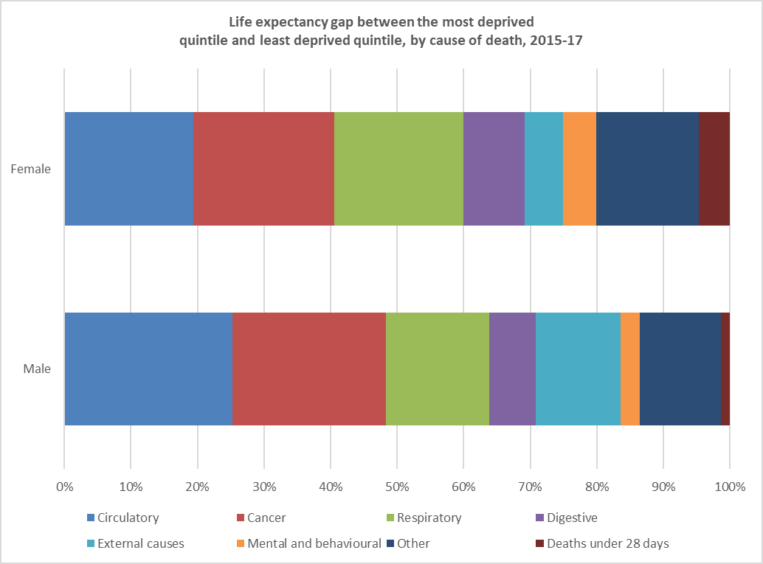
Common risk factor approach
Oral diseases share modifiable risk factors with other non-communicable diseases such as heart disease, cancer and strokes ^{[1]}. These factors include tobacco use, harmful alcohol consumption, and unhealthy diets which are being addressed in various ways by ECC and partners.
The above noncommunicable diseases are the leading causes of morbidity, mortality and inequality in life expectancy in Essex ^{[2]}.
Modifiable risk factors often cluster in individuals or communities increasing risk particularly for those at the lower end of the socioeconomic gradient ^{[1,3]}.
Using the common risk factor approach allows for controlling a small number of risk factors which are known to have an impact on a large number of diseases. This allows for greater use of financial resources and improvement in efficiency and effectiveness ^{[1,3]}.
This requires emphasising and facilitating the coincidental and complementary development and implementation of oral health and other health programmes, to enhance both general and oral health and quality of life ^{[1,3]}.
Analysis of the oral health inequalities and impact of oral health on systemic health indicates that common risk factor approach would be useful for addressing oral health challenges in Essex.
The two graphs at the top right corner indicate alcohol related hospital admissions and smoking prevalence in Essex in 2020/21. The graph at the bottom right is showing health comparisons for males and females from the deprived communities. For example, males from deprived communities are 25% more likely to have circulatory issues compared with those from the least deprived communities.
1.Sheiham A and Watt RG. “The common risk factor approach: a rational basis for promoting oral health”. Community Dent Oral Epidemiology 28.6 (2000): 399-406.
2. Essex JSNA High Level Summary
3. Yale Shweta. “Common risk factor approach: Finding common ground for better health outcomes”. International Journal of Contemporary Medical Research 4.6 (2017): 1367-1370.
4. Data from: Public health profiles - OHID (phe.org.uk), ID 92906
5. Data from: Public health profiles - OHID (phe.org.uk), ID 93454

Slide 20
Effects of oral health on systemic health
  Nearly 100 systemic diseases and 500 medications have oral manifestations ^{[2]}. We will only focus on the leading causes of inequality in life expectancy in Essex, as well as diabetes and HIV/AIDS.
  Cancer ^{[1]}
  Radiation/chemotherapy can lead to several oral complications, especially when undergoing radiation therapy for head and neck cancer
  Oral mucositis (inflammation of the tissues), salivary gland dysfunction, severe dental caries and candida infection are some of the common complications. In rare cases, serious complications such as osteoradionecrosis (radiation induced breakdown of the jawbone) is seen
  These complications can cause pain, change in taste, difficulty in eating, dehydration and deterioration of oral hygiene
  Patients undergoing cancer therapy needs continuous monitoring by a dental team
  Diabetes ^{[2]}
  Periodontal disease is often considered a complication of diabetes​
  Diabetes and periodontitis have a bidirectional relationship. High blood sugars negatively impact oral health and severe periodontitis can negatively impact blood sugar control​
  Individuals with diabetes have an up to three times greater risk of periodontitis than those without diabetes, and suffer from greater amounts of alveolar bone loss, abscess formation and poor healing
  Heart and circulatory disease ^{[2,3]}
  Patients with periodontal disease and poor oral hygiene suffer from frequent gingival inflammation and bacteraemia which activate host inflammatory response.
  There is a stronger evidence to support causal relationship between poor dental health and stroke
  A growing body of evidence indicates that chronic inflammation, infection, and vascular injury from endotoxins are possibly caused by poor oral health
  There is mixed evidence to demonstrate a causal link between poor oral hygiene and myocardial infarction
1. Harris JA, Ottaviani G, Treister NS and Hanna GJ (2022) An Overview of Clinical Oncology and Impact on Oral Health. Front. Oral. Health 3:874332. doi: 10.3389/froh.2022.874332
2. Kane SF. The effects of oral health on systemic health. Gen Dent. 2017 Nov-Dec;65(6):30-34. PMID: 29099363.
3. Scannapieco FA. Systemic effects of periodontal diseases. Dent Clin North Am. 2005 Jul;49(3):533-50, vi. doi: 10.1016/j.cden.2005.03.002. PMID: 15978240

Slide 21
Effects of oral health on systemic health- continued
  Human Immunodeficiency Virus (HIV) and Acquired Immune Deficiency Syndrome (AIDS) ^{[1,2]}
  Oral cavity is often the first sign of clinical illness and approximately 40 varying oral manifestations have been reported since the start of the AIDS pandemic
  Some of the most common oral problems associated with HIV/AIDS are chronic dry mouth, gingivitis, severe periodontitis, rampant dental caries, mouth sores and ulcers, oral candidiasis, hairy leukoplakia (which causes rough white patches on the tongue)
  These oral lesions affect the quality of lives of these patients and often adversely affects their mental health
  Respiratory disease ^{[3]}
  There is moderate evidence of association between oral health with two respiratory diseases: pneumonia and Chronic Obstructive Pulmonary disease (COPD)
  There is strong evidence to suggest that vulnerable populations, such as those living in care facilities and hospital-based patients, have lower incidence and mortality due to pneumonia after regular oral hygiene interventions
  Inflammatory bowel disease (IBD) ^{[4]}
  Patients with IBD have a significantly higher risk of periodontitis and worse oral health compared to non-IBD patients
  Socioeconomic and environmental factors such as smoking are thought to modify the effect of IBD on periodontitis
1. www.paho.org
2. www.nidcr.nihr.gov
3. Manger, D., Walshaw, M., Fitzgerald, R. et al. Evidence summary: the relationship between oral health and pulmonary disease. Br Dent J 222, 527–533 (2017). https://doi.org/10.1038/sj.bdj.2017.315
4. Nijakowski K, Gruszczyński D, Surdacka A. Oral Health Status in Patients with Inflammatory Bowel Diseases: A Systematic Review. Int J Environ Res Public Health. 2021 Nov 2;18(21):11521. doi: 10.3390/ijerph182111521. PMID: 34770034

Slide 22
4. Prevalence of common oral diseases in Children
This sections provides an epidemiological summary of the following oral diseases in children in Essex:
Dental caries (tooth decay)
Gingival diseases
Substantial plaque and calculus
Extraction due to tooth decay

Slide 23
Dental decay involving pulp
According to the Oral Health Survey data from 2019, Rochford (3.4%) and Colchester (3.3%) have the highest percentage of 5-year-olds having one or more teeth with decay involving the pulp*. This is higher than the England (3.3%) and Essex average (2.1%). While Uttlesford has the lowest (0.4%). There was no data available for Braintree ^{[1]}.
Essex has had a 75% increase in children with decay involving the pulp since 2017. Among the Essex districts, Maldon has had the biggest increase (367%) and Castle Point has had the biggest decrease (39%) in 5-year-old children with dental caries involving pulp since 2017.
*A tooth has three layers: enamel, dentine and pulp. When the decay is restricted to enamel, there are usually no symptoms, and is the ideal time for it to be filled. As the decay progresses to the pulp, the person starts to experience sensitivity, discomfort and pain. When a teeth has decay involving pulp, the treatment options are usually more invasive and expensive like root canal treatment or extraction ^{[2]}.
1. Data from Dental Public Health Epidemiology Programme for England: oral health survey of five-year-old children (Biennial publication - latest report 2019)
2. What is dental caries (oralb.co.uk)

Slide 24
Incisor decay
According to the Oral health Survey data from 2019, Colchester (5.6%) has the highest percentage of 5-year-old children with incisor decay. This is much higher than Essex (2.2%) and England average (5.2%). Rochford has the lowest (0.4%) percentage of 5-year-old children with incisor caries ^{[1]}.
Looking at the time series on the right, Essex has had a 16% increase in incisor decay from 2017. Among Essex districts and boroughs, Basildon has had the biggest increase (277%), and Tendring has had the biggest decrease (84%) of 5-year-old children with incisor caries.
Any smooth surface decay in young children is a serious public health problem and constitute early childhood caries. The causes of early childhood caries (ECC) ^{[2]} are multifactorial, but the major contributing factors are improper bottle-feeding practices with sweetened beverages, socioeconomic background, lack of parental education, poor access to dental care. Untreated, it can lead to serious consequences like pain, premature tooth loss, and serious infection ^{[3]}.
1. Dental Public Health Epidemiology Programme for England: oral health survey of five-year-old children (Biennial publication - latest report 2019)
2. d_ecc.pdf (aapd.org)
3. Anil S, Anand PS. Early Childhood Caries: Prevalence, Risk Factors, and Prevention. Front Pediatr. 2017 Jul 18;5:157. doi: 10.3389/fped.2017.00157. PMID: 28770188

Slide 25
Substantial plaque and calculus
According to the Oral Health Survey data from 2019, Brentwood (5.5%) has the highest percentage of 5-year-olds with substantial visible plaque which is nearly 5 times the England and Essex average (1.2%). There is insufficient data for Castle Point, Tendring, Uttlesford, Maldon and Harlow to provide an estimate.
Looking at the time series on the right, Essex has had a 300% increase in 5-year-old children with substantial plaque and calculus since 2017. Among Essex districts and boroughs, Basildon has the biggest increase (529%) ^{[1]}.
Brushing teeth well and daily is the best way to regularly remove tooth plaque. If it is not removed, it can lead to more serious conditions like tooth decay and gingivitis.
According to new statistics from PHE, approximately one quarter of 5-year-old children (23%) had tooth decay. These are preventable conditions which pose a significant cost the NHS – approximately of £3.4 billion pounds per year ^{[2] [3].}
1. Data from Dental Public Health Epidemiology Programme for England: oral health survey of five-year-old children (Biennial publication - latest report 2019)
2. Oral Health Foundation. New statistics on childhood tooth decay suggest concerning lack of progress (www.dentalhealth.org)
3. Child Oral Heath: applying All Our Health (www.gov.uk)

Slide 26
Extractions due to tooth decay
According to the Oral Health Survey data from 2019, Harlow (3.7%) has the highest percentage of 5-year-old with an extraction due to tooth decay, this is nearly 2.5 times the Essex average (1.4%). England has 2.2% of 5-year- old children with extraction due to decay.
The charts on the right illustrate that Essex has had a 40% increase in extraction due to tooth decay since 2017. Among the Essex districts and boroughs, Colchester has had the biggest increase (1200%), and Chelmsford has had the biggest decrease (50%) in extraction due to tooth decay among Essex districts ^{[1]}.
According to OHID, 9 out of 10 tooth extraction due to decay are preventable. While the overall sugar consumption has decreased, children still consume 8 sugar cubes more than the recommended limit. Tooth decay can be prevented by cutting down on sugar and practicing good oral hygiene.
Tooth decay can cause problems eating and sleeping and leads to 60,000 days being missed from school due to hospital extractions alone ^{[2]}.
1. Data from Dental Public Health Epidemiology Programme for England: oral health survey of five-year-old children (Biennial publication - latest report 2019)
2. Public health England Press release (www.gov.uk)

Slide 27
Extractions due to tooth decay - continued
According to the Hospital Episode data from 2019-20, Tendring (135.4) has the highest Finished Consultant Episode (FCE) tooth extraction rate per 100,000 population, and Uttlesford (45.2) has the lowest. Four districts namely: Tendring, Basildon, Braintree and Colchester have rates higher than East of England average (92.9). Maldon, Rochford and Castle Points have very few extractions so rates could not be computed ^{[1]}.
According to the School Health and Wellbeing Survey (2019), Basildon has the highest percentage of primary school children who have chocolates and fizzy drinks on most days (31% and 21% respectively) and Tendring has the highest percentage of secondary school children who have chocolates and fizzy drinks on most days (33% and 20% respectively) ^{[2]}.
9 out of 10 tooth extraction due to decay are preventable. While the overall sugar consumption has decreased, children still consume 8 sugar cubes more than the recommended limit ^{[3]}. Research has shown that tooth extraction due to dental decay is linked to poor food habits and deprivation.
1. Data from Hospital episode statistics from (Office for Health Improvement and Disparities) School Health and Wellbeing survey (2019) from Essex Open Data
2. School Health and Wellbeing survey (2019) from Essex Open Data
3. Public health England Press release (www.gov.uk)​
Note: HES data needs to be interpreted with caution due to unclear diagnosis codes used for extraction

Slide 28
Admission rates for tooth extraction and deprivation
The prevalence for tooth decay, tooth loss, oral cancer and gum disease is higher in deprived areas ^{[1]}.
Table on the left is showing Index for Multiple Deprivation ^{[2]} and Tooth Extraction rate (all diagnoses) ^{[4]}. Higher extraction rate can be seen in Tendring were the IMD is highest in Essex.
The chart below illustrates tooth extraction rate by deprivation quintile in England. Quintile 1 (the first bar on the left) highlights extraction rates in the most deprived whilst quintile 5 shows extraction rates in the least deprived communities.
Tooth extraction rate (all diagnoses) per 100.000 for 2020/21 [4]
IMD score (2019) [2] | District Name | Age 0-5yrs | Age 6-10yrs | Age 11-14yrs | Age 15-19yrs | Total 0-19yrs
30.5 | Tendring | c | c | 240.4 | 287.0 | 135.0
23.2 | Basildon | c | 78.2 | c | 147.0 | 73.0
21.4 | Harlow | c | c | c | c | 42.6
16.8 | Castle Point | c | c | c | c | 104.0
16.8 | Colchester | c | 81.2 | 110.9 | 130.0 | 75.4
15.1 | Epping Forest | c | 124.8 | c | c | 49.1
14.7 | Braintree | c | 105.1 | 128.7 | c | 70.1
14.2 | Maldon | c | c | c | c | 75.6
12.2 | Rochford | c | c | c | c | 53.6
12 | Chelmsford | 82.4 | c | c | 158.0 | 71.9
10 | Brentwood | c | c | c | c | 56.4
9.3 | Uttlesford | c | c | c | c | 89.0
*A cell containing the single letter c indicates that the figure has been suppressed. Counts of less than 8 are suppressed.
1. Health Matters: Child dental health - UK Health Security Agency (blog.gov.uk),
2. English indices of deprivation 2019 - GOV.UK (www.gov.uk),
3. (Hospital_teeth_extractions__0-19Y_2016_to_2020.xlsx (live.com),
4. www.gov.uk/government/statistics/hospital-tooth-extractions-of-0-to-19-year-olds-2021. Table W11.

Slide 29
5. Prevalence of common oral diseases in adults
This sections provides an epidemiological summary of the following oral diseases in adults in Essex :
Dental caries
Gingival diseases
Oral cancer

Slide 30
Bleeding on probing
Bleeding on probing is one of the early signs of gingival inflammation and the primary parameter to diagnose gingivitis. According to the oral health survey of adults attending dental practices (2018), participants living in most deprived parts of the country were 28% more likely to have bleeding on probing compared to participants in least deprived parts of the country ^{[1]}.
Nearly half (51%) the surveyed Essex adults in 2018 had bleeding on probing, and this rate was similar to the England average (52.9%).
Essex has the fourth highest percentage of adults with bleeding on probing among similar counties ^{[1]} Left untreated, gingivitis commonly progresses to underlying tissue and bone loss resulting in periodontitis(inflammation of the supporting structure of teeth), and ultimately tooth loss ^{[2]}
1. Data from National Dental Epidemiology Programme for England, Oral health survey of adults attending dental practices (Latest report 2018)
2. Gingivitis (National Library of Medicine)

Slide 31
Active decay
According to Oral Health Survey data from 2018, nearly 4 out of 10 adults in Essex (38.9%) have active decay which is the highest among similar counties. This is much higher than England (26.8%) and East of England (24.9%) averages ^{[1]}.
Dental caries are the most common non communicable disease with free sugar being the principal dietary factor in the development of dental caries. Studies have reported that lockdowns implemented due to COVID-19 prompted an increase in unhealthy dietary changes, with people having more snacks rich in salt and sugar. With many dental practices being prompted to shut, this is expected have a knock-on effect, and the percentage of adults with an active decay is now expected to be much higher, reflecting a greater need for dental services in the population ^{[2]}.
1. Data from National Dental Epidemiology Programme for England Oral health survey of adults attending dental practices (Latest report 2018)
2. Impact of COVID-19 pandemic on diet behaviour among UK adults: a longitudinal analysis of the HEBECO study Samuel J. Dicken, https://doi.org/10.1101/2021.10.01.21264008

Slide 32
Oral cancer registrations
According to the Oral Cancer Registrations data from 2017-19, Harlow (18.6) and Castle point (16) have the highest oral cancer registration rate per 100,000 population, which are higher than England (15.4) and Essex (13.9) averages. While Uttlesford (12.5) and Braintree (10.3) have the lowest oral cancer registrations in Essex ^{[1]}.
The time series graph at the bottom right is showing that the average oral cancer registrations rate per 100,000 population is lower than England's average since 2007. However, it is important to note the increasing trend in Essex as well as England.
For more details on risk factors for oral cancer, please refer to the section on common risk factor approach.
1. Data from National Cancer Registration and Analysis Service retrieved from the Cancer Analysis System (CAS), NHS Digital, from Fingertips (ID 1206)

Slide 33
Oral cancer mortality
According to the oral cancer mortality data from 2017-19, Colchester (4.5) and Rochford (4.4) have the highest mortality rate per 100,000 population in Essex due to oral cancer, which are much higher than the Essex average (3.9). Castle point has the lowest average (3.4) in Essex, while there is no data for Harlow and Epping forest ^{[1]}.
The chart below illustrated oral cancer mortality between 2008-2019 and demonstrated a rate in Essex similar or lower compared with England.
The most recent data is showing lower oral cancer mortality rate in Essex (3.9/100.000). when compared with England's averages (4.7/100.000).
According to the Public Health England, between 2012 and 2016, almost 11,000 people died from oral cancer in the UK, that is almost 3 thousand people every year and this trend is increasing ^{[2]}.
1. Public health profiles - OHID (phe.org.uk) (ID 92953).
2. Oral cancer in England: a report on incidence, survival and mortality rates of oral cancer in England, 2012 to 2016 (publishing.service.gov.uk)

Slide 34
6. Treatments and access to care
This sections provides a synthesis of evidence from epidemiological data, residents survey and interviews to give an understanding of access to dental services. Access to health care refers to the processes of gaining entry to the healthcare system.
Our analysis is in the five domains of accessibility: 1) Availability and accommodation; 2) Affordability; 3) Appropriateness, 4) Acceptability and 5) Approachability.

Slide 35
Central Findings
Data from the survey and in-depth interviews show that the main barriers to oral health services are related to accessibility. Accessing healthcare is an essential factor in reducing poor oral health outcomes and oral health inequalities.
Thematic analysis of the data revealed five main cross-cutting themes as barriers in using the oral health services:
Theme 1
Theme 2
Theme3
Theme 4
Theme 5
Long waiting time/booking system
Difficulties in getting an NHS dentists
Dental surgeries opening Hours
Affordability (Cost of dental treatment)
Quality of care
Sub-themes:
Long treatment waiting times
Long queues over the phone to book an appointment
Sub-themes:
Deregistration from NHS Dental Surgeries
Go to private healthcare to overcome gaps in NHS services
Sub-themes:
Opening hours of dental practice are not compatible with working hours
Family with children can only book an appointment during school holiday
Sub-themes:
High-cost of private dental care
Dental care is not respecting the NHS values (free care)
Go to private healthcare to overcome gaps in NHS services (affected residents’ finances)
Sub-themes:
Poor and limited services for residents and vulnerable groups
Poor and limited services of dental check-ups
Not enough information on how to access NHS dental health services

Slide 36





The Essex residents' experiences with oral health services are captured using the five domains:
Availability and accommodation
Number of NHS dentists in Essex.
Deregistration from NHS dental surgeries.
Opening hours.
Affordability
Inequity of access based on affordability.
Appropriateness
Quality of service.
Adequacy of service.
Acceptability
Cultural and social factors.
Vulnerable population.
Approachability
Information about a service being made available so that service users who need the service can be able to use it.
Data Source
NHSBSA
Resident panel survey
Deep Interview
Data Source
Resident panel survey
Deep interview
Notes:
We conducted a research using 5 domains - Availability; Affordability; Appropriateness; Acceptability; Approachability: and used data from Essex residents survey as well as NHSBSA

Slide 37
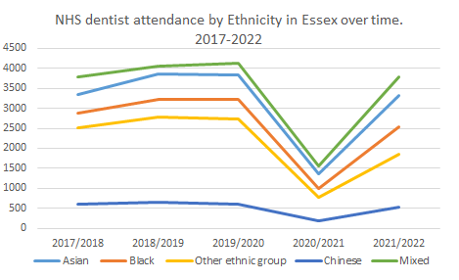
NHS dental access by ethnicity
The time series figure shows that there was reduced activity for NHS dentist attendance for 2020/21 for all the ethnic groups which was impacted by the pandemic.
The lowest drop in attendance was amongst “Mixed” ethnicity category -62%.
Note: Not all patients enter their ethnicity, so these numbers should be interpreted with caution.
Guidance Notes:
This report contains the details from FP17s.
FP17s: This is a count of the number of FP17s and FP17Os scheduled including adjustments for amended and deleted FP17s. Withdrawn FP17s are not included in the total count of FP17s. This figure may be zero or negative if deleted FP17s have been processed.
Ethnic Group joint categories: White (White British/White Irish/Other White background). Declined (Not Available/ Patient declined). Mixed (White & Black Caribbean/White & Black African/White & Asian/Other mixed background). Asian (Asian or Asian British Indian/Asian or Asian British Pakistani/Asian or Asian British Bangladeshi/Other Asian Background). Black (Black or Black British Caribbean/Black or Black British African/Other Black background). Other. Chinese.
1. Data source : NHSBSA.

Slide 38
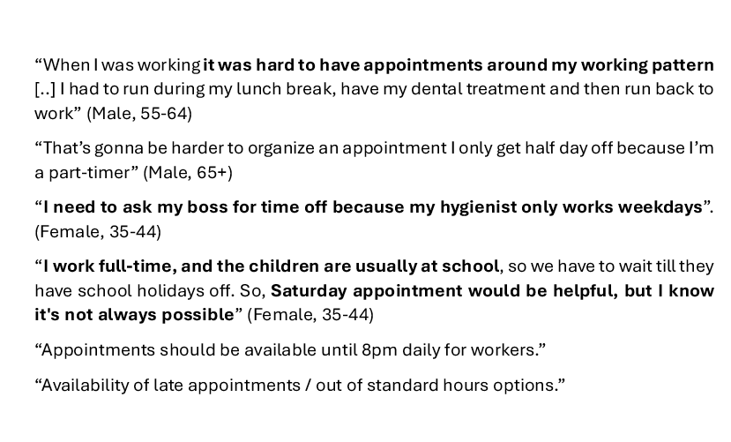
Dental surgeries opening hours
In the qualitative interviews and qualitative data from the survey, residents reported that NHS dental services were often inaccessible due to opening hours. This was one of the factors related to residents being deregistered from dental services due to non-attendance.
Participants reported difficulties in getting an appointment around their working or family commitments. Some families could only book appointments during school holidays.
In addition, some dental surgeries only operate on weekdays; this makes it more difficult for families and workers to find the right time to book an appointment.
However, in the survey data 59% of the residents indicated that they were satisfied with the opening times. This may well be because people in specific areas or situations had more difficulties accessing services due to opening hours.
Are you happy with the opening hours of current NHS dental services?

Slide 39
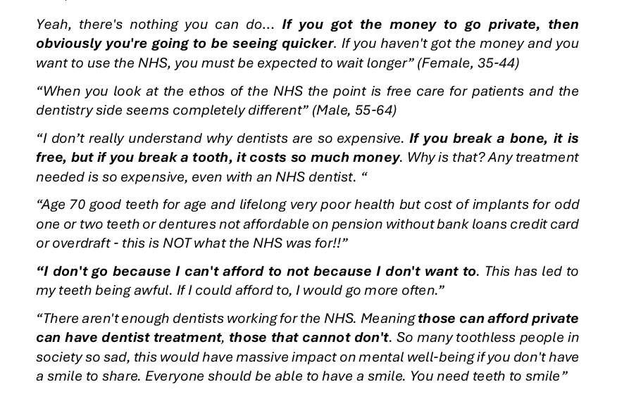
Affordability
Are you happy with the affordability of current NHS dental services?
Affordability has to do with the perceived economic capacity to spend resources on oral healthcare ^{[1]}. Within this domain the key issue raised by residents was inequity of access based on affordability. Costs were a major barrier to accessing oral healthcare.
The survey data showed an equal ratio of those who agree (40%; n=486) and disagree (40%; n=486) with the cost of NHS dental services.
Qualitative data from the survey and interviews indicated that residents felt that the costs of dental care resulted in inequity of access as shown in the quotes.

Slide 40
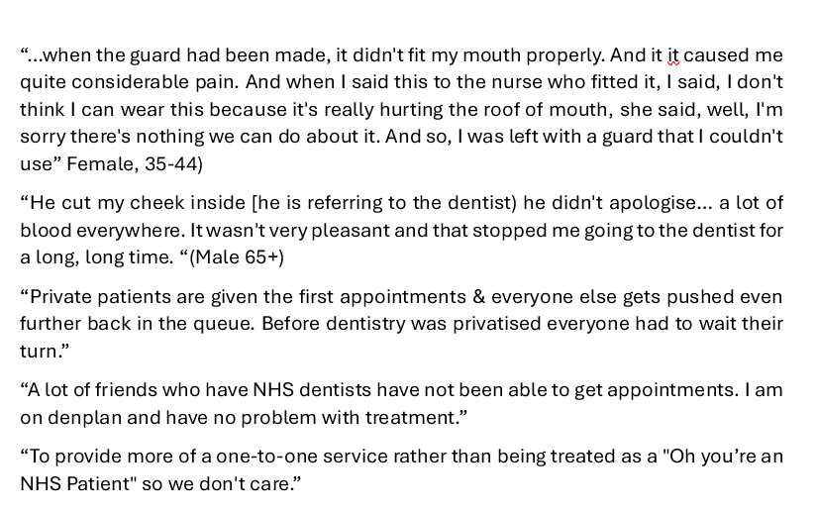
Appropriateness: Quality of service
Appropriateness looks at adequacy of clinical services and quality ^{[1]}.
Data from the qualitative interviews and qualitative survey data suggests that quality of care may be relatively poor in some cases.
On top of that, some residents felt that private patients were given preferential treatment, which was superior to NHS dental health services.
Residents also reported that NHS patients were sometimes undervalued at surgeries or stigmatized.
However, 58% (694) of the residents who responded to the survey were satisfied with the quality of the service, whilst 21% (251) disagreed.
Are you happy with the quality of service of current NHS dental services ?

Slide 41
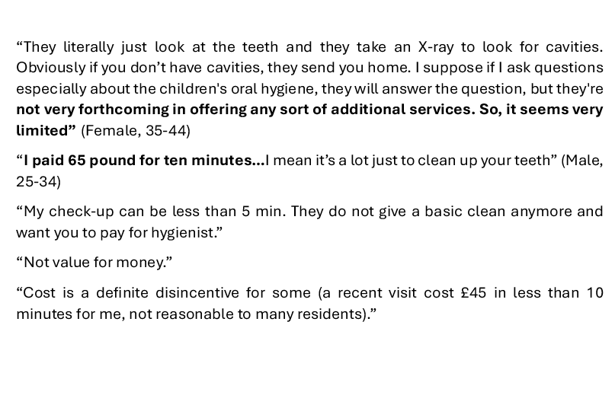
Appropriateness: Adequacy of service
In the qualitative data, some residents considered the NHS dental health services as inadequate and not good value for money particularly for routine appointments.
The care given during routine NHS appointments was also considered inadequate due to a lack of value for money. This perception stemmed from the brevity of the appointments and lack of services such as cleaning of the teeth which must be done separately by a dental hygienist; residents felt that they paid a lot of money and only got minimal service.
This issue was not specifically examined in the residents' survey; however, we explored satisfaction with a range of services offered by the NHS dentists and 54% (650) of the residents indicated that they were satisfied with the current NHS services.
Are you happy with adequacy of current NHS dental services ?

Slide 42
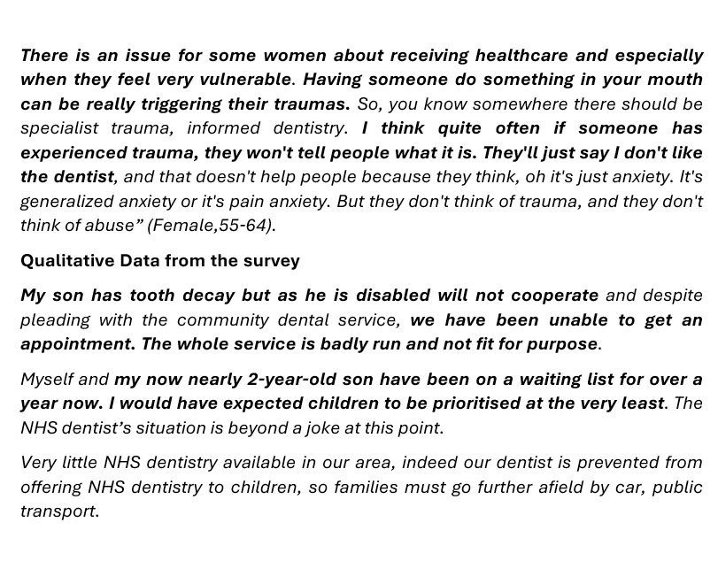
Acceptability
Acceptability relates to cultural and social factors determining the possibility for people to accept the aspects of the service ^{[1]}.
Issues that affect acceptability have already been mentioned in other sections here we focus on vulnerable populations as they often experience poorer oral health outcomes.
In some instances, services were considered unacceptable for specific vulnerable groups such as those with disabilities, pregnant women, children and women who had experienced sexual violence.
1. Levesque, J. F., Harris, M. F., & Russell, G. (2013). Patient-centred access to health care: conceptualising access at the interface of health systems and populations. International journal for equity in health, 12(1), 1-9.

Slide 43
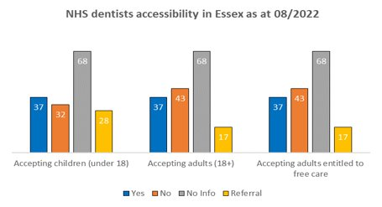
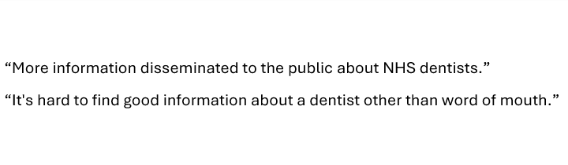
Approachability
Approachability has to do with information about a service being made available so that service users who need the service are be able to use it ^{[1]}. It also has to do with health literacy.
Generally, residents seemed to understand the importance of good oral health, oral hygiene and early detection of problems:
  72% (874) indicated that they brush their teeth twice a day or more.
  97% (1169) agreed with “Seeing your dentist or hygienist regularly can help detect oral problems early before they become more serious”.
  93% (1119) agreed with “Oral diseases such as gum diseases or dental cavities can harm your general health”
  55% (629) saw their dentist more than once a year.
In the qualitative data from the survey, residents indicated that it would be useful for information on how to access NHS dental health services was made widely available including information on which surgeries were accepting NHS patients.
The NHS Dental reform will now require NHS dentists to indicate the services they offer as well as capacity to take on new patients on the NHS website. This is a national priority.

Slide 44
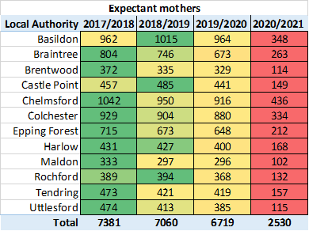
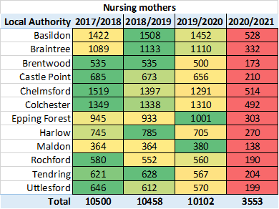
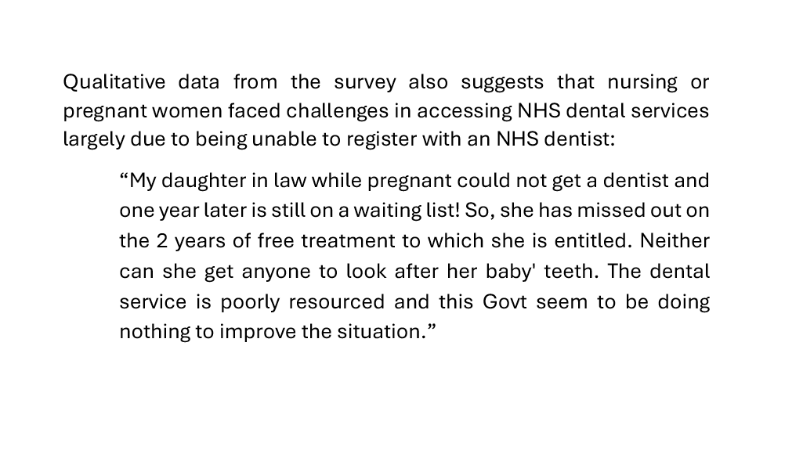
NHS dental access for nursing and expectant mothers
Overall, out of all unique patients in Essex, Expectant mothers accounted for approximately 1% of the NHS dental patients and Nursing mothers approximately 1.5%.
The data is showing, that the impact of pandemic restrictions has also affected Nursing and Expectant mothers. Furthermore, other studies indicated that women were anxious to access health services during the pandemic.
Poor oral health during pregnancy can adversely impact the mother and her baby.
Data requested from NHS Business Services

Slide 45
Unique Patient Count
Unique Patient Count is the total number of unique NHS dental services patients in Essex between 2017 to 2021.
The number of patients seen by NHS dentists significantly dropped in 2020/21 compared to the previous year (-58%, bar chart on the left).
The highest percentage change in Unique Patient Count from 2019 to 2020 was in Epping Forest and Rochford (-61%).
The lowest percentage change in Unique Patient Count from 2019 to 2020 was in Chelmsford, Harlow, and Uttlesford (-54%).
The drop in number of patients seen is consistent with the national picture. Acess to dental services was severely impacted by COVID-19 lockdown measures and the need for enhanced infection prevention and public health measures. This has created a backlog of patients with oral health treatment needs.
Data source: Requested from the NHSBSA.

Slide 46
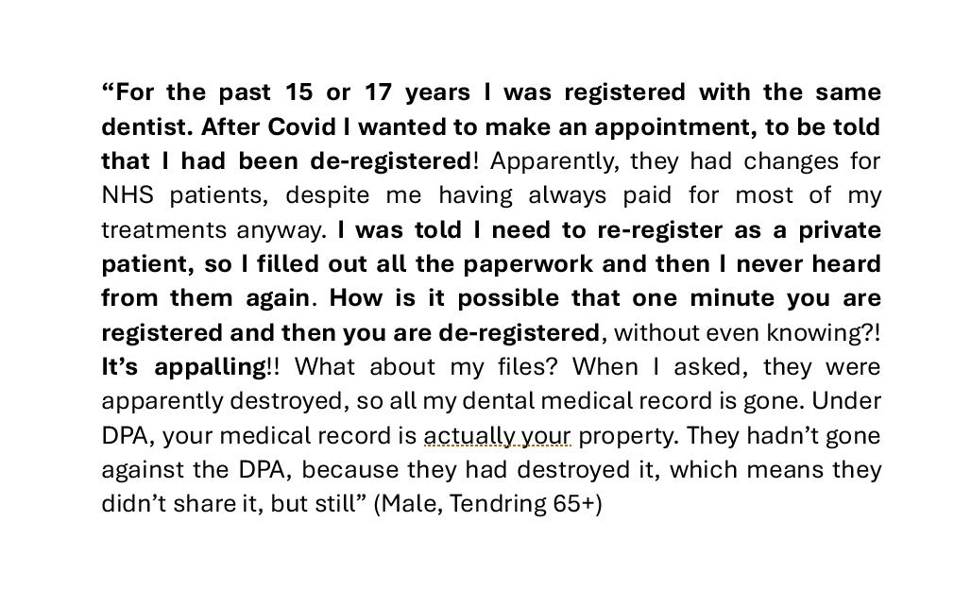
Patients registered with an NHS dentist in Essex
60% (721) of the surveyed residents were registered with an NHS dentist, 27% (329) private, and 11% (136) were not registered at all. The main reason for not being registered, was not being able to find an NHS dentist to register with.
Qualitative data from the survey and in-depth interviews also showed that several residents found themselves without an NHS dentist because they had been deregistered from dental surgeries due to not having attended the surgery in over two years. Some of this was reported because of the busyness of life but for others it was the impact of the pandemic when many patients had routine appointments cancelled and were subsequently removed from the patient register once the two years lapsed.
Note: Although being registered with an NHS dentist is a common misunderstanding, we present views expressed by our residents

Slide 47
NHS dental care activity
Data for 2017-2022 shows that the overall number of dental activity delivered by the NHS dentists in Essex significantly reduced in 20/21 year (-66%). This was largely due to public health control measures for covid [1]. Data for 2021/22 shows that there were more dental activity compared with the previous year, which indicated recovery from the pandemic, although the numbers were still approximately 30% lower compared with pre-pandemic levels such as in year 2017/18.
Overall, the trend for NHS free dental care in Essex is going downwards when compared between 2017/18 to 2021/22.
Overall, the trend for number of urgent treatments in Essex is gradually increasing every year.
 | Total number of FP17's |  |  |  |  | Number of FP17's for free NHS dental care |  |  |  |  | Number of FP17's for Urgent treatment
Local Authority | 2017/18 | 2018/19 | 2019/20 | 2020/21 | 2021/2022 | 2017/18 | 2018/19 | 2019/20 | 2020/21 | 2021/22 | 2017/18 | 2018/19 | 2019/20 | 2020/21 | 2021/22
Basildon | 129,866 | 132,875 | 129,361 | 43,914 | 90,788 | 506 | 442 | 449 | 309 | 208 | 10,719 | 11,065 | 10,740 | 11,286 | 10,566
Braintree | 115,239 | 118,071 | 117,306 | 35,969 | 80,391 | 459 | 357 | 320 | 196 | 208 | 8,510 | 9,181 | 9,616 | 10,070 | 9,633
Brentwood | 49,519 | 50,641 | 50,067 | 16,930 | 34,914 | 316 | 283 | 236 | 154 | 307 | 4,461 | 4,811 | 5,250 | 5,086 | 4,881
Castle Point | 76,009 | 78,803 | 75,128 | 22,919 | 50,439 | 226 | 225 | 207 | 110 | 123 | 6,657 | 7,057 | 6,690 | 6,783 | 7,032
Chelmsford | 136,516 | 137,017 | 133,502 | 50,220 | 97,088 | 392 | 285 | 268 | 217 | 192 | 13,324 | 13,960 | 13,985 | 14,506 | 15,536
Colchester | 118,497 | 122,320 | 118,945 | 42,190 | 84,121 | 300 | 214 | 227 | 416 | 206 | 11,129 | 12,107 | 11,813 | 10,409 | 12,269
Epping Forest | 83,601 | 83,488 | 81,967 | 26,186 | 58,308 | 265 | 244 | 220 | 193 | 192 | 7,039 | 6,887 | 7,433 | 8,406 | 8,457
Harlow | 64,095 | 65,687 | 63,711 | 24,025 | 46,017 | 333 | 328 | 308 | 253 | 178 | 5,486 | 5,569 | 5,706 | 6,825 | 6,457
Maldon | 55,140 | 56,034 | 56,281 | 17,312 | 37,921 | 156 | 139 | 149 | 80 | 91 | 4,640 | 4,602 | 5,031 | 4,301 | 5,113
Rochford | 63,123 | 64,697 | 61,838 | 18,546 | 41,209 | 148 | 127 | 133 | 75 | 89 | 4,823 | 5,072 | 4,944 | 5,063 | 5,008
Tendring | 97,823 | 98,380 | 91,877 | 29,409 | 64,696 | 425 | 402 | 385 | 283 | 271 | 9,878 | 9,660 | 9,496 | 9,448 | 10,038
Uttlesford | 58,979 | 58,058 | 59,837 | 22,111 | 43,498 | 209 | 180 | 132 | 74 | 56 | 5,259 | 5,383 | 5,553 | 5,002 | 5,365
Total | 1,048,407 | 1,066,071 | 1,039,820 | 349,731 | 729,390 | 3,735 | 3,226 | 3,034 | 2,360 | 2,121 | 91,925 | 95,354 | 96,257 | 97,185 | 100,355
Providers submit forms (FP17) detailing dental activity data. The data recorded on the FP17 forms shows the patient charge collected, the number of units of activity performed and treatment banding information [3].
1. COVID-19 Insight 10: Dental access during the pandemic - Care Quality Commission (cqc.org.uk)
2. Data table: Requested from NHSBSA. NHSBSA. Figures reflect total FP17s.
3. Dental activity processing | NHSBSA

Slide 48
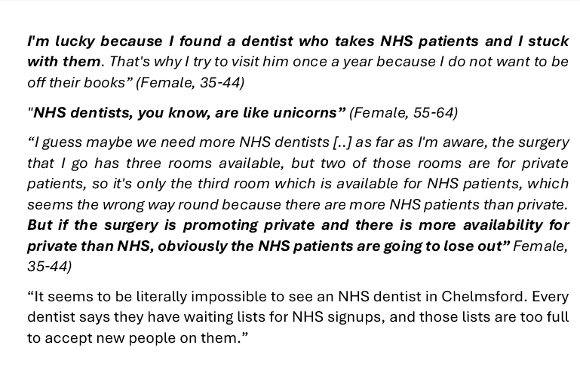
Number of NHS dentists in Essex
Availability of NHS dentists was a key issue raised by our residents as this determined whether they could register with an NHS dentist.
The phrases used by residents on being registered with an NHS dentist highlight the sense of luckiness residents felt about something that should be easily accessible to all.
During the 2020 more than 2000 NHS dentists quit the NHS dentistry which affected service users nationwide ^{[1]}.
In Essex, due to the pandemic restrictions in 2020, there were around 6% less NHS dental services providing dentists compared with the previous year (2019) ^{[2]}.
In 2021 the number of NHS dental services providing dentists increased by around 9% compared with the year before.
1. More than 2,000 dentists quit NHS in last year – Dentistry.
2. Requested from NHSBSA.

Slide 49
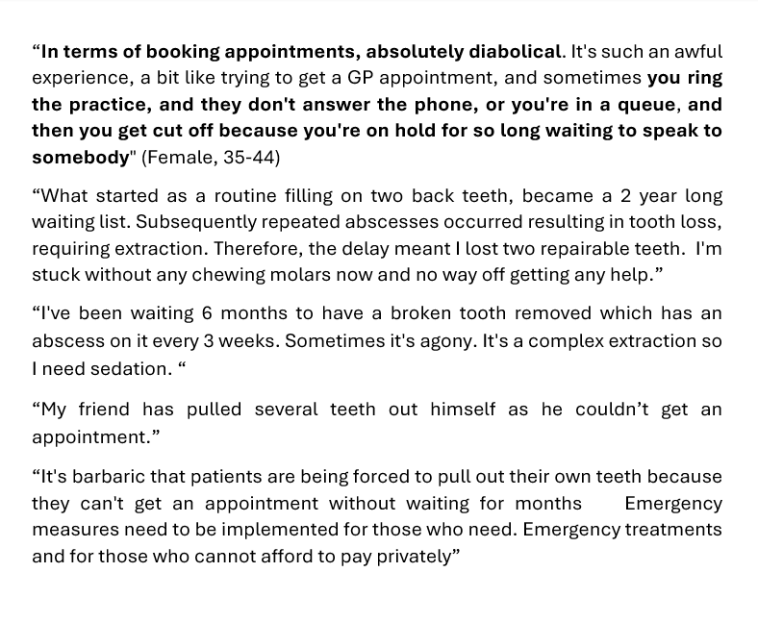
Treatment needs
Having a shortage of NHS dentists, coupled with not being registered with an NHS dentist means that residents find themselves on long waiting lists to access NHS dental services and can have long standing treatment needs.
Long waiting lists and challenges with booking appointments were identified as barriers to timely access to addressing treatment needs.
Nearly two thirds (73.1%) of adults surveyed in Essex in the 2018 national oral health survey indicated that they had existing treatment needs. This is the second highest among comparable counties. Essex has similar averages to East of England (77.1%) and England (70.5%). It is important to note that this survey collected data prior to COVID, and the treatment needs of adults would have increased due to the pandemic ^{[1]}.
1. Data from National Dental Epidemiology Programme for England Oral health survey of adults attending dental practices (Latest report 2018)

Slide 50
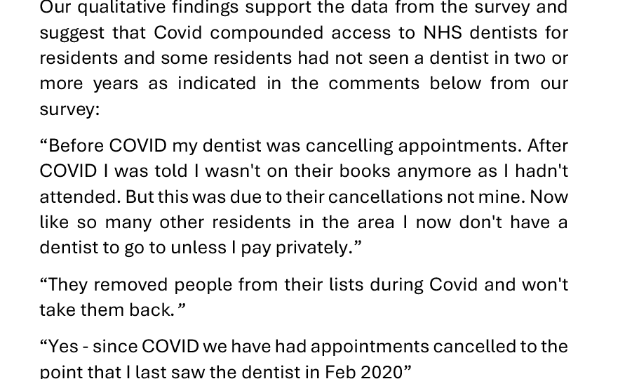
Not seen a dentist in the last two years
According to data from 2018, approximately 1 in 6 adults (16.1%) in Essex haven’t seen a dentist in the last two years. This is highest among similar counties and nearly double the England (7.9%) and East of England average (6.8%) ^{[1]}.
There were significant challenges nationally in accessing NHS dentists before the pandemic, but this was worsened by the pandemic.
Qualitative data also suggests that residents who moved into the area had to wait years before they can access an NHS dentist in their local area.
1. Data from National Dental Epidemiology Programme for England, Oral health survey of adults attending dental practices (Latest report 2018)

Slide 51
7. Recommendations
In this section we present the suggestions on addressing gaps identified through our analysis as well as the recommendations that were made by residents.

Slide 52

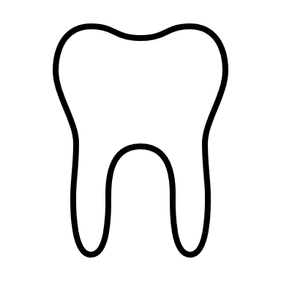



Summary
Rising levels of decay in children throughout Essex.
In general - areas of concern include: Basildon, Brentwood, Harlow, Rochford and Colchester
These areas generally have higher levels of deprivation and unhealthy eating habits.
Significant reduction in dental activity and access with increase in urgent treatment.
Lack of access a significant concern to residents.
Inequity in access.
Harlow has rising rates of oral cancer registration, as well as the highest smoking prevalence.
Limitations – missing data, small sample sizes, COVID, access affecting data.

Slide 53
Recommendations
It is essential to develop an oral health strategy to ensure the integration of oral health improvement into existing public health efforts, to address the modifiable risk factors for the major causes of inequality in life expectancy in Essex.
Oral health diseases share common risk factors with these diseases and an integrated approach would be more cost effective for the local authority than a vertical program on oral health.
Oral health diseases also share the same wider determinants of health as overall health. This presents an opportunity to address the wider determinants of poor oral health by ensuring that oral health is included in all cross-cutting initiative on the wider determinants of health such as the PH Business Plan, Levelling Up, the Obesity strategy. This will ensure that oral health improvement remains high on the agenda.
There is need to commission services and develop policies that address oral health inequalities in Essex.
There is need to ensure equity of access to both preventative and treatment oral health services for residents.
Dental caries remain common in Essex, and it is important to develop oral health promotion services to address the intake of free sugars particularly among children and young people.
Local authorities can engage with communities to assess the feasibility of water fluoridation.

Slide 54
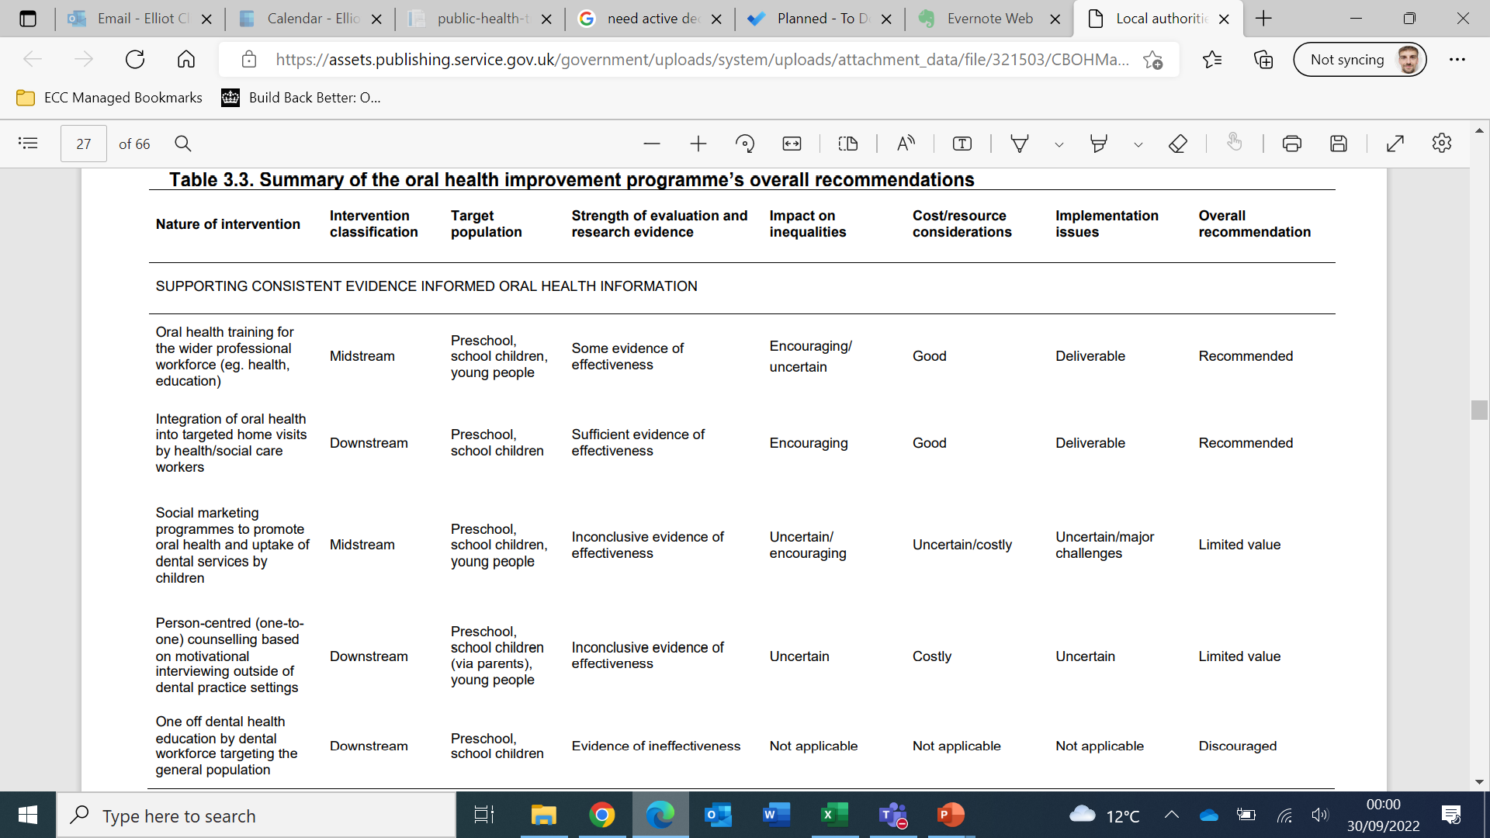
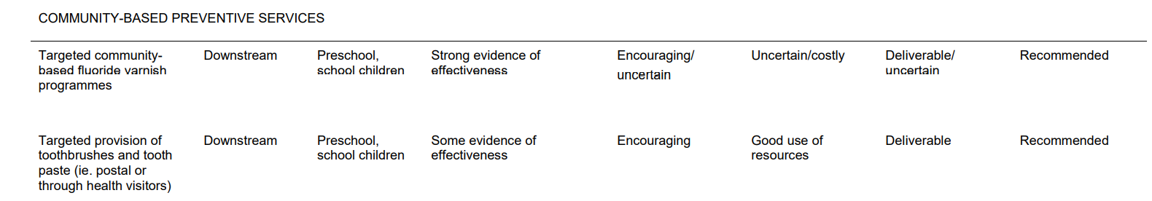
Selected recommendations for C&YP- Part 1
Areas with high extraction (Harlow)
Areas with high plaque and calculus (Brentwood and Basildon)
1. Local authorities improving oral health: commissioning better oral health for children and young people An evidence-informed toolkit for local authorities. Public Health England (2014)

Slide 55
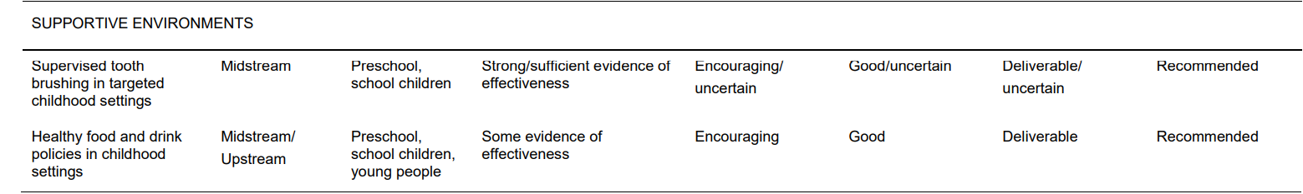
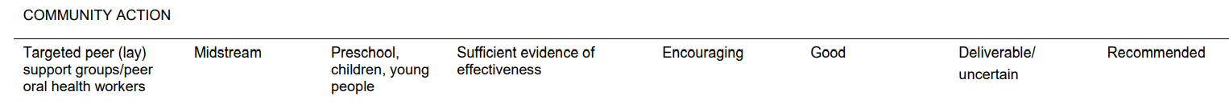
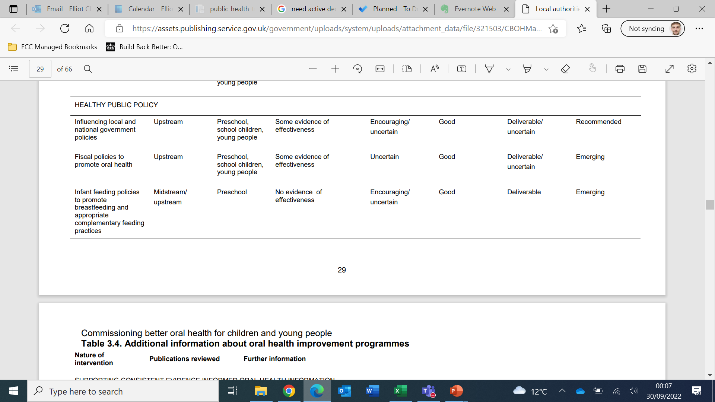
Selected recommendations for C&YP- Part 2
Essex wide intervention
Areas with high plaque and calculus (Basildon and Brentwood)
1. Local authorities improving oral health: commissioning better oral health for children and young people An evidence-informed toolkit for local authorities. Public Health England (2014)

Slide 56





Residents have the following recommendations for improving access to oral health care in Essex
MEDIUM TERM
Increase or implement video consultations for general dental check-ups to free up space for other visits
Weekend opening hours to help residents to book appointments around their working hour's patterns/children during no school time
Online booking system to simplify the booking process and avoid long queues over the phone
Increase the number of NHS dentists and other oral health professionals to overcome the demand by training more dentists and giving them the option to either work for five years for the NHS or pay back the bursary and ensuring
Civic intervention through government policy, such as making it mandatory for all dentists to spend a certain amount of their time attending to NHS patients
Government paying NHS dentists well and providing them with incentives to ensure staff retention this is critical for ensuring continuity of care for patients
LONG TERM STRATEGY

Slide 57
8. Appendix
In the appendix section we present.an overview of the mixed approach. Survey and the in-depth interview guide

Slide 58
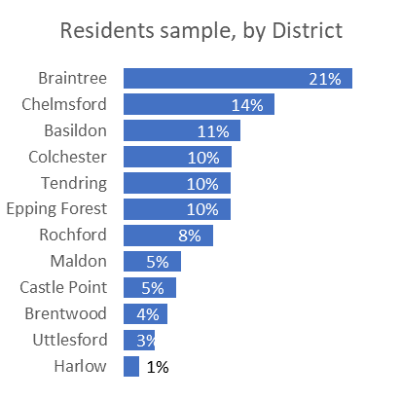
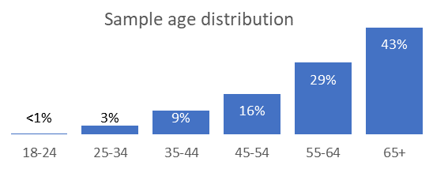
A. Essex residents quantitative survey
In July 2022, Essex County Council carried out the Essex residents survey. The survey was open for two weeks.
The purpose of the survey was to find out about our resident's dental care knowledge, habits and their experience with service accessibility. The survey was sent out to 3000 participants, and 1201 (40%) responses were received. Almost 50% (597) of the participants agreed to take part in a follow up interview.
Sample demographics:
Gender: 57% of the sample were females, and 42% were males. 1% preferred not to disclose or classed as Other.
Age: 43% were aged over 65, 29% -between 55-64, 16% - under 45-54, and 13% under 44 years of age.
Respondents Location: the most respondents were from Braintree (21%) and Chelmsford (14%).
Ethnicity: 92% were White/White British/White Irish. 5% BAME. 3% Preferred not to disclose.
Disability: 76% were non-disabled. 18% were disabled. 5% were not sure or preferred not to disclose.
Employment status: 45% retired, 26% Full-time, 14% Part-time, 12% Volunteering, 9% Self-employed, 6% Other, 4% cannot work or are in education/training.

Slide 59
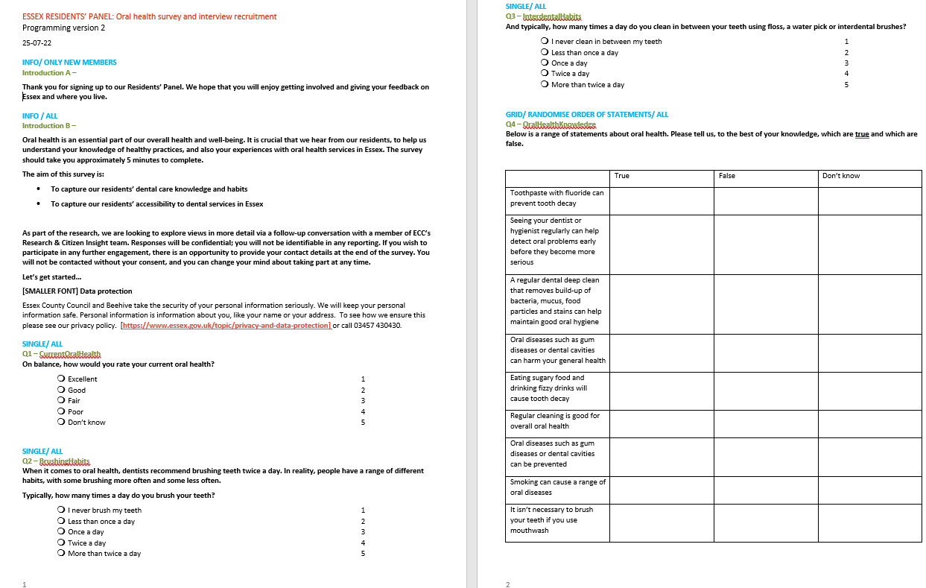
B. Survey questionnaire- Part 1

Slide 60
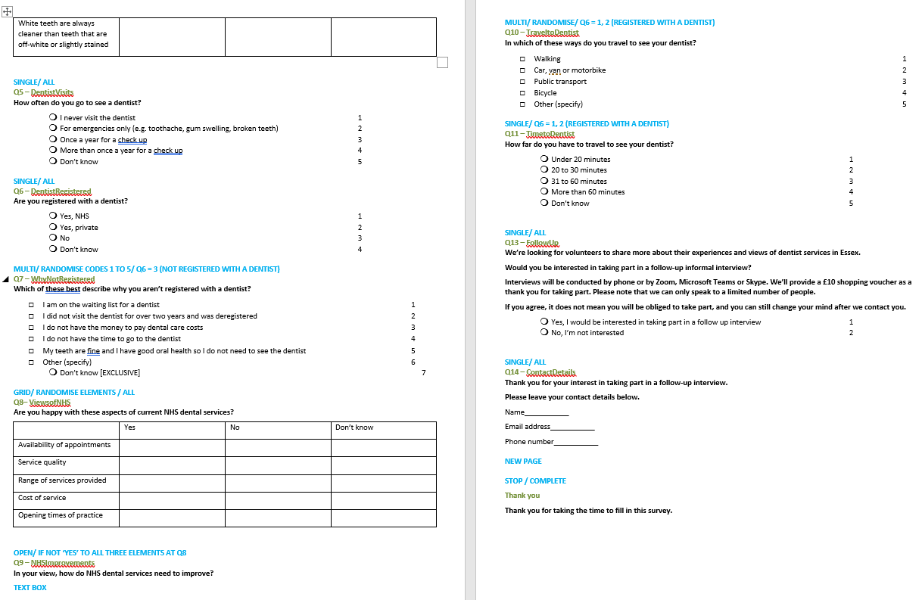
B. Survey questionnaire- Part 2

Slide 61
C. Overview of approach – mixed methods
Online Survey
July 2022
In-depth interviews
August 2022
A survey screener was circulated to the Residents Panel to recruit for the interviews.
597 (50%) of the residents agreed to take part in the follow up qualitative interview. However, only 10 were selected.
The survey aimed to gather top insights into habits and barriers to using primary and secondary oral health services in Essex.
  A self-selection/online sample was used.
10 residents participated in one-to-one interviews;
    6 females; 4 males;
    2 aged 25-34; 2 aged 35-42; 2 aged 45-54; 3 aged 55-64; 1 aged 65+
    6 residents from Ethnic minority background.
An extensive literature review shows that poor oral health remains a significant public health problem in England, particularly among people living in deprived areas. While the links between oral health and ethnicity are complicated and often confounded by socioeconomic status, the prevalence of certain oral diseases is higher in some ethnic groups. For all these reasons, we prioritize interviews with residents from Ethnic minority backgrounds and deprived areas in Essex.
The interview guide was designed to capture the residents’ reality and most importantly understanding their views and experiences of Dental Health Services in Essex.

Slide 62
Interview guide- Part1
Key discussion points | Prompts
INTRODUCTION: Aims: ice breaker and overarching general satisfaction with dental care
WHO ARE THEY? Can you tell me a little bit about you? In general, are you satisfied with your dental care? | E.g. Hobby, age, where do they live what do you do in your spare time? What do they do for a living? How many family members do you have? Check if some family members are affected by mental health illnesses.
Key discussion points | Prompts
Dental care behaviours and Primary and secondary care services Aims: Explore participant's experience with dental primary and secondary care
Could you tell me a little bit about your oral health routine? How often do you and your children brush/floss your teeth? Are you registered with a particular dentist? If yes, is an NHS dentist or a private? How do you and your children feel about going to the dentist? Could you tell me about the last time you went to the dentist, and why? How was your general experience with the dentist/and how easy was it to book the appointment? Have you ever received any dental care advice from your GP, dentist/odontologist or program in schools? If yes, who gave you the information, what kind of advice or information did they give you? Did you find this information useful? Did it have an impact on your actions if so why? Have you or your children been referred to the hospital because of some problems to do with your mouth? If so what worked well, what could have gone better? How long did you have to wait to be seen? | How often do you go to the dentist? How was your experience during the pandemic? Why did you go? What symptoms did you or your children have? What happened? Dental abscesses/ dental decay /caries/ tooth decay /gums pain / bleeding / What do you do? Crowns and bridges/ Root canal treatment /aesthetic treatments/ whitening / Scale and polish.

Slide 63
Interview guide- Part 2
Key discussion points | Prompts
Barriers and facilitators to the use of oral health services Aim: Explore the main barriers to accessing dental care services and what could be done to improve them.
Are there any challenges that you or someone you know have faced when trying to see a dentist or other dental professional as often as you need? Have you faced any challenges when trying to book an appointment in seeing a dentist or other dental professional? In your opinion, what would make it easier or can be done differently to get a visit? | PROBE: Can you afford to go to the dentist? Can you book time off from work to go (e.g., cannot get the time off from work, the dentist does not have convenient office hours)? Can you travel to a dentist easily (e.g., do not have transportation, located too far away)? Do you know if you are eligible for exemption dental fees? Are you afraid of going to the dentist? Why? Do you require a specific gender for your visit or a translator?

Slide 64


This information is issued by:
Essex County Council
Research & Citizen Insight
Contact us:
PHI@essex.gov.uk
Sign up to Keep Me Posted email updates:
Essex.gov.uk/keepmeposted
Essex_CC
Facebook.com/essexcountycouncil
The information contained in this document can be translated, and/or made available in alternative formats, on request.
Published January 2023

