Slide 1
Under 18 Conceptions and Abortions
Statistical update for 2021
Public Health Intelligence
PHI@Essex.gov.uk
ESSEX
Public Health Intelligence
Research and Citizen Insight
Policy Unit
Essex County Council

Slide 2
Teenage Conceptions
In 1999, the government announced its 10-year Teenage Pregnancy Strategy for England, which aimed to reduce the conception rate for women aged under 18 years. This was driven by relatively high conception rates in under 18’s in England and Wales compared with the rest of Europe, and the potential adverse consequences of teenage pregnancy, such as the increased risk of infant mortality among younger mothers.
These initiatives, along with other factors such as a shift in aspirations of young women towards education, led to a decline in conception rates for women aged 15 to 17 years. This decline has been particularly evident since 2007, which also coincided with the start of the global financial crisis (Figure 3). Since our records began in 1969, there has not been such a prolonged decrease in conception rates for women aged under 18 years.
Source: Conceptions in England and Wales - Office for National Statistics

Slide 3
England and Wales findings
The conception rate for women aged under 18 years in England and Wales has more than halved since 2011 when it was 30.9 conceptions per 1,000 women of the same age; in 2021 it was 13.2 per 1,000 women of the same age.
Out of all the age groups, those aged under 16 years saw the biggest percentage change in conception rates over the last decade. The conception rate for those aged under 16 years is around a third of what it was ten years ago, with 2.1 conceptions per 1,000 women of the same age in 2021, compared with 6.1 conceptions per 1,000 women of the same age in 2011.
The conception rates for those aged under 18 years in 2021 indicate a slight increase since 2020, however this may be an effect of the differences in population estimates used. The COVID-19 pandemic may also be impacting data for 2020 and 2021, with disruptions to births registration services in these years or changes in the behaviour of certain groups.
Note: conception rates for 2021 were calculated using provisional mid-year 2021 population estimates. These were the latest population estimates available at the time of production and are Census 2021-based. The 2021 mid-year estimates are due to be revised in 2023 along with the back series to 2012.
Care should be taken when comparing rates from 2021 with 2012 to 2020 rates until the back series has been revised. As such most of the Office for National Statistics and this reporting focuses on differences between 2011 and 2021.
Source: Conceptions in England and Wales - Office for National Statistics

Slide 4
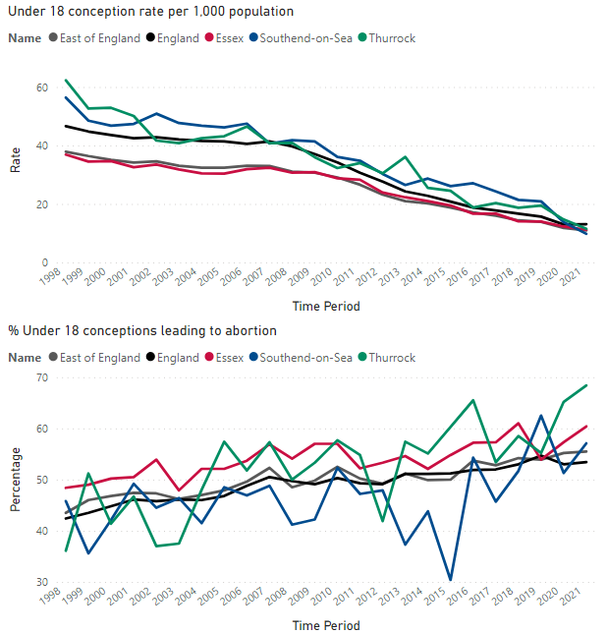
Essex
In Essex, the under 18 conception rate per 1,000 population has seen an overall decreasing trend since 2011 to 2021, similar to the England and East of England (EoE) trends. Essex remains similar to the regional levels, and below that nationally.
The % of under 18 conceptions leading to abortions in Essex has been above the regional and national level consistently. Essex has also seen a larger increase over the last decade since 2011 compared to the increase regionally and nationally.
To note: Limited axis range to show small variations

Slide 5
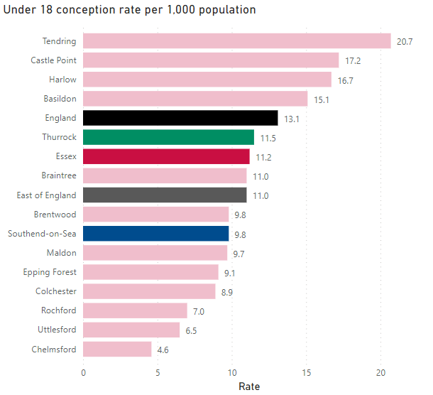
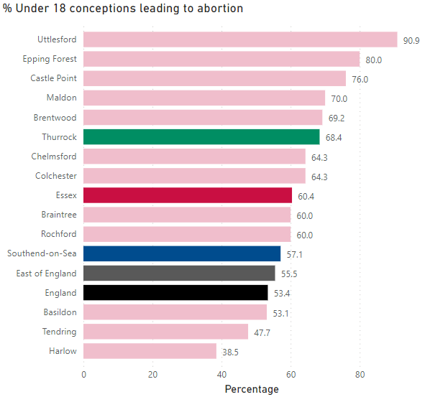
Essex District summary
In 2021, the highest under 18 conception rates across Essex districts was in Tendring, Castle Point, Harlow and Basildon, all above the England, EoE and Essex rates.
All other districts were below these comparator areas, with Uttlesford and Chelmsford having the lowest rates in Essex.
Tendring and Harlow also had the lowest % of under 18 conceptions leading to abortion, the only Essex districts below England and EoE. All other districts were similar to or above these comparators.
Uttlesford, Epping Forest and Castle Point had the highest % across Essex, above the comparator areas.
Note: Limited axis range to show small variations

Slide 6
Essex District summary
Essex has seen an overall decrease in the under 18 conception rate in 2021 since 2011, as did regionally and nationally.
None of the Essex districts saw an increase in this time. The largest decreases were in Colchester and Chelmsford, to now have among lowest levels in Essex. Castle Point and Tendring in contrast saw the smallest decreases, and have the highest levels in Essex in 2021.
The % of under 18 conceptions leading to abortion increased in Essex overall in 2021 since 2011, as did regionally and nationally.
Most Essex districts also saw an increase in this time, largest in Uttlesford and Colchester. Uttlesford had the highest level in 2021.
Three Essex districts saw a decrease, largest in Rochford and Harlow. Harlow had the lowest level in 2021.

Slide 7
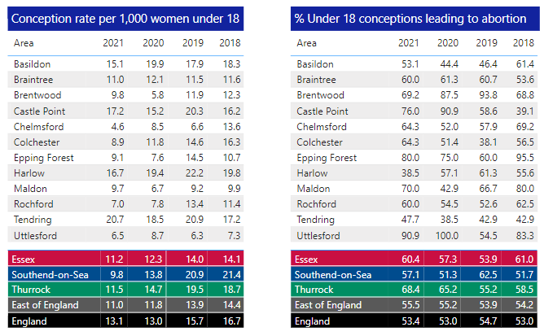
Essex District summary

Slide 8
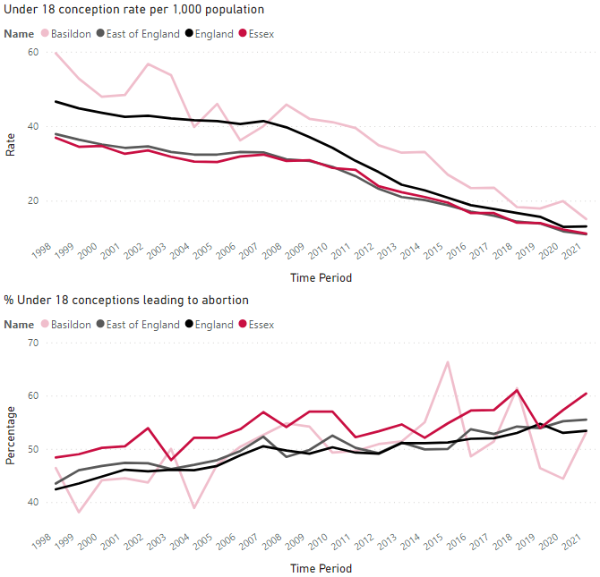
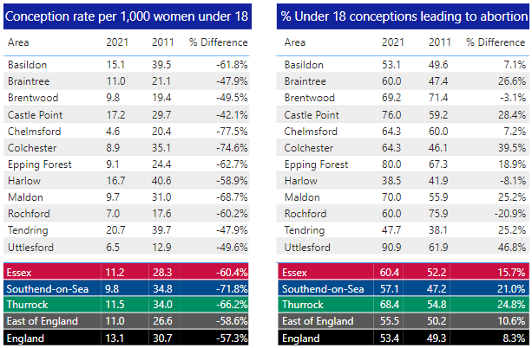
Basildon
In Basildon the under 18 conception rate per 1,000 population has been decreasing over the last decade, similar to the Essex, regional and national trends. Basildon remains above comparator areas, but the gap has been narrowing with relatively larger decreases in Basildon.
The % of under 18 conceptions leading to abortion has been fluctuating to an overall increase since 2011 in Basildon, but increasing slower than regionally and nationally. Caution should be taken comparing 2021 to prior years, but the larger increase in Basildon since 2020 brought it closer to regional and national levels.
To note: Limited axis range to show small variations

Slide 9
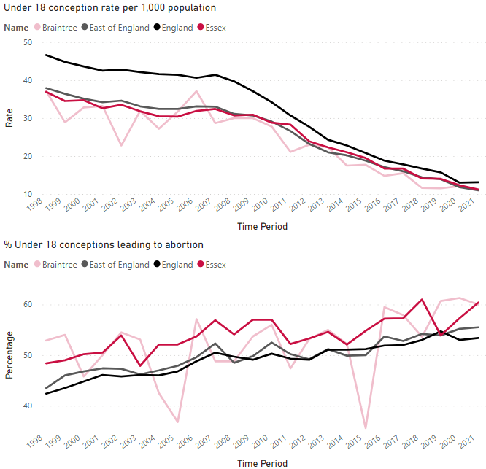
Braintree
In Braintree the under 18 conception rate per 1,000 population has been decreasing over the last decade, but at a slower rate than across Essex, regionally and nationally. This is driven by the relatively stable rate in Braintree since 2018, while comparator areas continued to decrease. The Braintree rate does however remain lower than historically and below the national rate.
The % of under 18 conceptions leading to abortion has been fluctuating with an overall increasing trend since 2011 in Braintree. Braintree has been seeing a quicker increase than across Essex, regionally and nationally.
To note: Limited axis range to show small variations

Slide 10
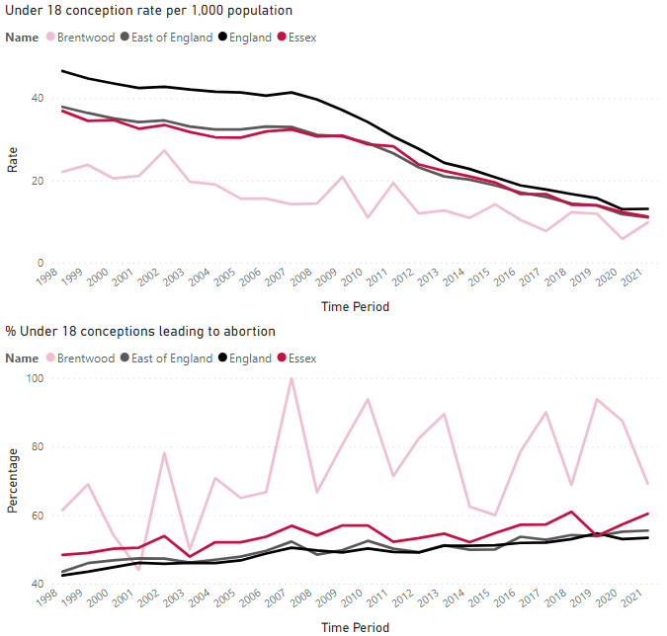
Brentwood
In Brentwood the under 18 conception rate per 1,000 population has been decreased over the last decade since 2011. Brentwood remains below the rate across Essex, regionally and nationally, but the gap has been narrowing with relatively slower decreases in Brentwood.
The % of under 18 conceptions leading to abortion has been consistently above comparator areas in Brentwood. The rate has fluctuated to an overall decrease since 2011, while across Essex, regionally and nationally there was an increase. Caution should be taken comparing 2021 to prior years, but Brentwood has seen a large reduction since 2019 in contrast to comparator areas.
To note: Limited axis range to show small variations

Slide 11
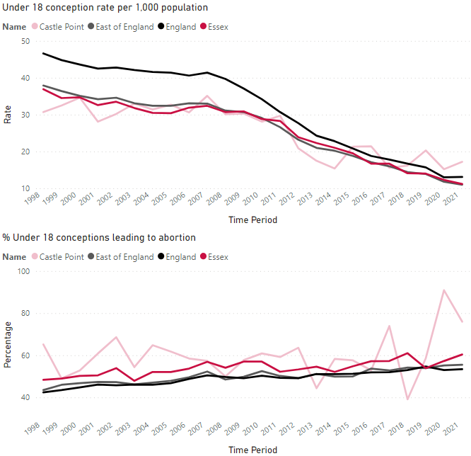
Castle Point
In Castle Point the under 18 conception rate per 1,000 population has been decreasing over the last decade since 2011. The rate across Essex, regionally and nationally has decreased at a quicker rate than in Castle Point, with Castle Point above comparator areas for the last few years.
The % of under 18 conceptions leading to abortion has been fluctuating within an increasing trend overall since 2011 in Castle Point. Castle Point has seen a larger increase than across Essex, regionally and nationally, taking Castle Point well above comparator areas in 2021.
To note: Limited axis range to show small variations

Slide 12
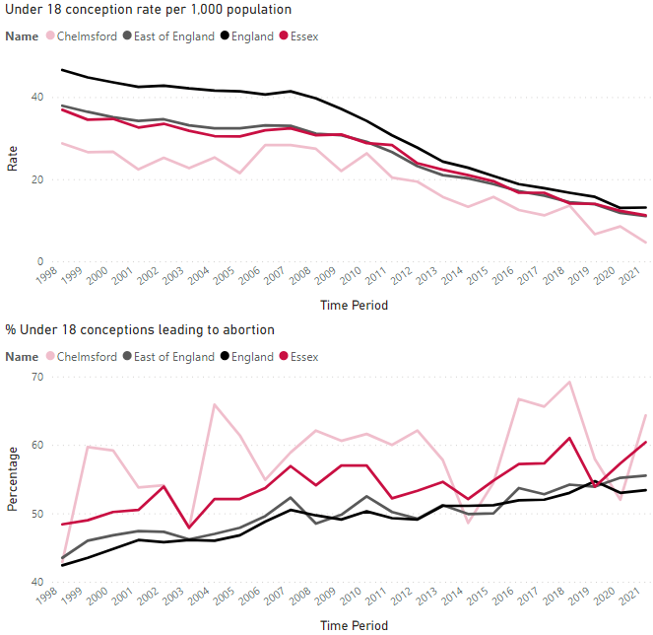
Chelmsford
In Chelmsford the under 18 conception rate per 1,000 population has been decreasing over the last decade since 2011. Chelmsford remains below Essex, regional and national levels, and has been seeing a quicker decrease than these comparator areas in this time.
The % of under 18 conceptions leading to abortion has been mostly above comparator areas in Chelmsford. The % has been fluctuating to an overall increase since 2011 in Chelmsford. This is a smaller increase than across Essex and regionally in this time. Caution should be taken comparing 2021 to prior years, but Chelmsford has seen a large increase since 2020 relative to comparator areas.
To note: Limited axis range to show small variations

Slide 13
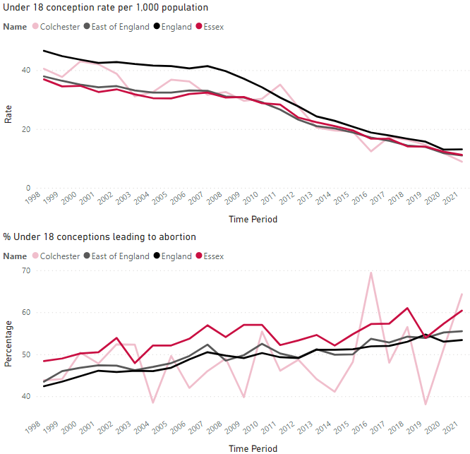
Colchester
In Colchester the under 18 conception rate per 1,000 population has been reducing over the last decade, and at a quicker rate than across Essex, regionally and nationally. The Colchester rate has been similar to the comparator areas most years.
The % of under 18 conceptions leading to abortion has been fluctuating to an overall increase since 2011 in Colchester, with a larger increase than across Essex, regionally and nationally in this time. Caution should be taken comparing 2021 to prior years, but Colchester has seen a large increase since 2019 relative to comparator areas.
To note: Limited axis range to show small variations

Slide 14
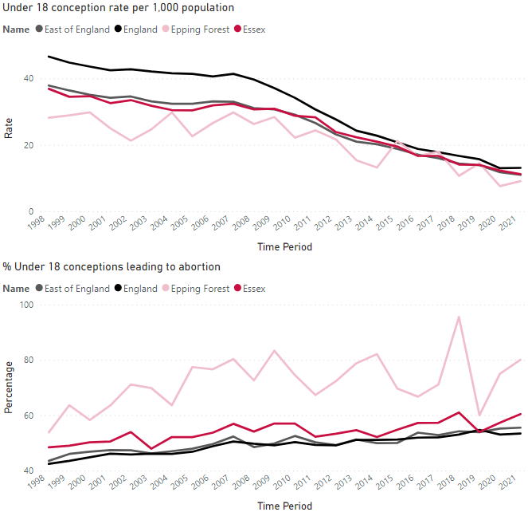
Epping Forest
In Epping Forest the under 18 conception rate per 1,000 population has been decreased over the last decade since 2011, and at a quicker rate than the decrease seen regionally and nationally. Epping Forest has mostly been below comparator areas.
The % of under 18 conceptions leading to abortion has been consistently higher in Epping Forest than across Essex, regionally and nationally. The rate has fluctuated to an overall increase since 2011 in Epping Forest, with a larger increase than comparator areas in this time and especially since 2019.
To note: Limited axis range to show small variations

Slide 15
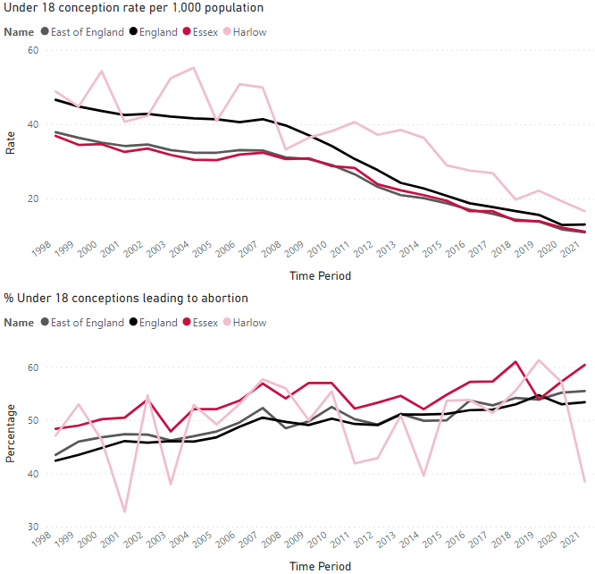
Harlow
In Harlow the under 18 conception rate per 1,000 population has seen an overall decreasing trend since 2011 overall. Harlow has been consistently above the Essex, regional and national rate through these years, but it has shown a similar trend and moved closer to those comparator area levels in recent years.
The % of under 18 conceptions leading to abortion has decreased since 2011 overall, while across Essex, regionally and nationally there was an increase. Caution should be taken comparing 2021 to prior years, but Harlow has seen a large reduction since 2019 in contrast to comparator areas.
To note: Limited axis range to show small variations

Slide 16
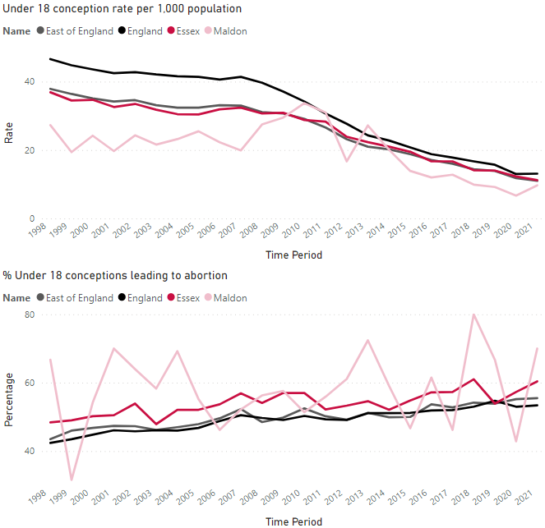
Maldon
In Maldon the under 18 conception rate per 1,000 population has been consistently below the rate across Essex, regionally and nationally over recent years. Maldon has seen an overall decreasing trend since 2011 to 2021, decreasing at a quicker rate than these comparator areas.
The % of under 18 conceptions leading to abortion has been has fluctuating to an overall increase since 2011 in Maldon, with a larger increase than comparator areas in this time and especially since 2020.
To note: Limited axis range to show small variations

Slide 17
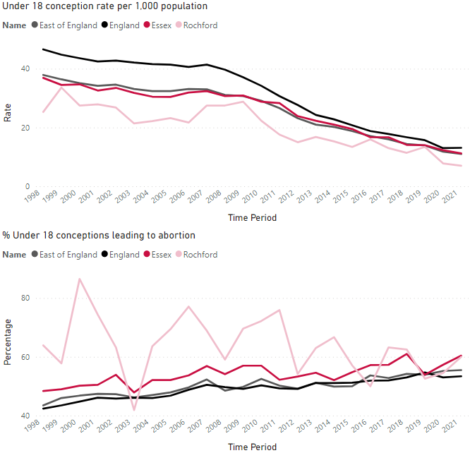
Rochford
In Rochford the under 18 conception rate per 1,000 population has seen an overall decreasing trend over the last decade since 2011 to 2021, similar to the Essex, regional and national trajectory these years. Rochford has been consistently below these comparator area rates.
The % of under 18 conceptions leading to abortion has fluctuated with a decreasing trend since 2011 overall in Rochford. The gap between Rochford and those comparator areas has narrowed, with a contrasting increase seen across Essex, regionally and nationally in this time.
To note: Limited axis range to show small variations

Slide 18
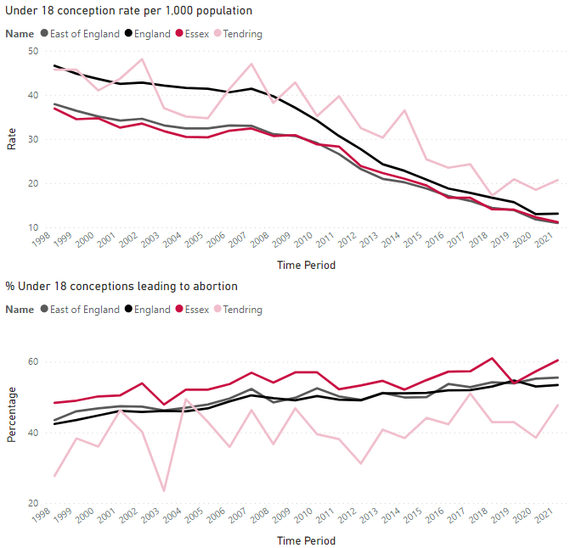
Tendring
In Tendring the under 18 conception rate per 1,000 population has been consistently above the rate across Essex, regionally and nationally over the last decade. Tendring has seen an overall decreasing trend since 2011 to 2021, but decreasing at a slower rate than these comparator areas.
The % of under 18 conceptions leading to abortion has been consistently lower in Tendring than across Essex, regionally and nationally. The rate has increased overall since 2011 in Tendring and at a quicker rate than those comparator areas, bringing Tendring closer to these area’s levels.
To note: Limited axis range to show small variations

Slide 19
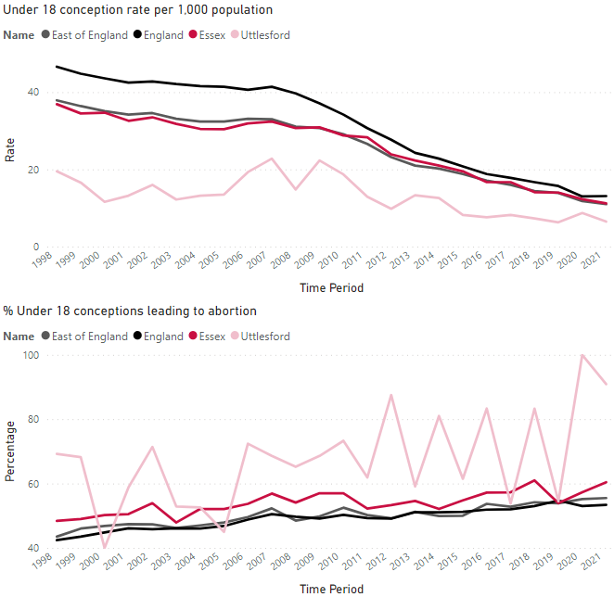
Uttlesford
In Uttlesford the under 18 conception rate per 1,000 population has been consistently below the Essex, regional and national level.
There has been an overall decreasing trend since 2011, but the gap between Uttlesford and these comparator areas narrowing with relatively slower declines in Uttlesford.
The % of under 18 conceptions leading to abortion in Uttlesford has been mostly above Essex, regional and national levels. The % has fluctuated with an increasing trend over the last decade since 2011 overall in Uttlesford. Uttlesford has seen a larger increase than the comparator areas in this time overall, and especially since 2019.
To note: Limited axis range to show small variations

Slide 20
This report was produced by Essex County Council’s Public Health Intelligence Team
For more information email: PHI@essex.gov.uk

