Slide 1
Essex County Council
June 2020
‘Just about managing’ (JAM) families and coronavirus
Final report

Slide 2
Contents
01
02
03
04
05
06
Introduction
The coronavirus context for JAM families
Responses to government guidelines
Financial impact
Children and education
Health and wellbeing
07
08
Perceptions of the long-term impact
Conclusion

Slide 3
01
Introduction

Slide 4
Introduction
Background
Essex County Council previously commissioned BritainThinks to conduct qualitative research with ‘just about managing’ (JAM) families living in the county
  Defined as families earning an income insufficient for a ‘decent’ standard of living, but above a level typical of those experiencing severe deprivation
The final phase of fieldwork for this original project was completed shortly before the announcement of the UK’s lockdown restrictions
In the context of the nationwide uncertainty and upheaval at this moment, Essex County Council expressed a need for in-depth and longitudinal insight in order to understand the impact of lockdown and coronavirus on this audience during lockdown
Sufficient income: able to afford a decent standard of living
Minimum Income Standard
‘Just about managing’: insufficient income for a decent standard of living
Destitute: struggle to meet essential needs such as food, rent and bills

Slide 5
Introduction
Objectives
Previous research conducted with JAM families gave reason to believe that the financial situation and childcare responsibilities of JAM families may make them vulnerable to some of the negative consequences of lockdown and coronavirus
As such, the objective of the research was to understand the experience of JAM families in the county as these unprecedented circumstances developed, with a particular focus on their:
  Responses to self-isolation and/or social distancing;
  Management of additional childcare responsibilities following school closures;
  Experiences of work, including working from home;
  Anxieties and concern related to income and job security;
  Attitudes to health and wellbeing;
  Impact of coronavirus on longstanding issues and stresses.

Slide 6
Introduction
Methodology
Fieldwork was conducted with 14 families living across Essex. Participants had previously taken part in the longitudinal phase of research in the initial project
  The fieldwork team therefore began this piece of work with a detailed understanding of the lives of each family in the sample, ensuring that insight built upon prior knowledge and established moderator-participant relationships
Longitudinal qualitative research was conducted from Thursday 9th April through to Friday 5th June and consisted of the following:
Weeks 1 – 4
9th April – 7th May
Online community in which participants completed a regular diary exercise and weekly, topic-specific questions
Weekly telephone interviews lasting 30-45 minutes each, and each on a different topic (corresponding with the topic covered in the online community)
Weeks 7 – 8
25th May – 5th June
Final ‘check in’ telephone interview lasting 45 minutes in which participants reflected on coronavirus and lockdown and their potential long-term impacts

Slide 7
Introduction
Key findings
1
This has been a hugely stressful and challenging experience for parents. One of their main priorities has been to shield their children from the emotional impacts of the crisis, whilst keeping them safe.
2
The crisis has had an uneven impact on JAM families’ finances, with some better off than before and some worse off. Those who are worst affected have been relying on short-term solutions but are very concerned about the long-term outlook.
3
Education attainment has not been a priority for parents at this time, and overall approaches to home-schooling have been patchy. There are real concerns about what this will mean for long-term prospects of children.
4
Emotional well-being of their children has been by far the greatest health concern of parents at this time. Lack of social interaction is the greatest cause for concern, especially for younger children. Physical activity and healthy eating have been less of a priority.
5
The crisis has exacerbated any pre-existing lack of agency that these families felt towards their futures, and made it even more difficult to plan ahead, even in the short term.

Slide 8
02
The coronavirus context for JAM families

Slide 9



The coronavirus context for JAM families
JAM families were not all entering the coronavirus crisis from the same starting point – some were in more vulnerable positions
Previous research indicated that this audience is best thought of according to three typologies rather than as a homogenous group:
Precarious Worriers: were in an insecure financial situation and struggled to see a way out. In future, they prioritised minimising risk and achieving stability
Stationary Settlers: experienced financial difficulty but were largely able to manage their situation. They didn’t expect this to change much in future
Practical Planners: saw future milestones when their financial situation should improve, even though things may have been difficult currently
These typologies will be referenced throughout the report

Slide 10
The coronavirus context for JAM families
Coronavirus and lockdown had an immediate impact on the work and household income of participants in our sample
Immediate loss of income
Steady income, reduced outgoings
3 x made redundant/lost their jobs
1 x furloughed on 80%
2 x self-employed and lost clients
3 x working from home on the same salary
1 x furloughed on full pay
3 x essential/key workers
“I have just about enough to get us through to June, but if this is going into July and I do not get the self-employed government help, then I will be up a creek with no paddle.”
“For the first time in as long as we can remember we still have money in the bank coming up to payday. We’ve still got a couple of hundred in there. It’s unheard of.”
(Dual parent, Harlow)
(Dual parent, Basildon)

Slide 11
The coronavirus context for JAM families
JAM families identify a lack of routine, lack of control over the situation, and lack of certainty about the future as some of the main issues arising from the situation
Lack of routine
Lack of control
Lack of certainty
All transitioned from busy family lives structured by the working week and children’s activities to a period of little routine each day or week
Many parents in JAM families already felt they were limited in how much control they could exert over the future – lockdown limited their control over the present as well
All feel unsure when their lives might ‘return to normal’, if ever, and that any previous plans for the future were now in doubt, including future job security
“I really miss the structure of a normal working week. I loved my job so I really hope I can go back to it.”
“My stress levels are high and I’m concerned about the finances. It’s something that’s out of my control and it’s affecting the whole family.”
“There’s not going to be secure jobs anymore and everyone’s going to be fighting over money. Everything just feels up in the air.”
(Dual parent, Basildon)
(Dual parent, Colchester)
(Single parent, Harlow)
Previous research indicated that JAM families often have a ‘limited mental bandwidth’ for thinking beyond the here and now. Lockdown did not necessarily give parents more ‘headspace’ – instead they were faced with new issues

Slide 12
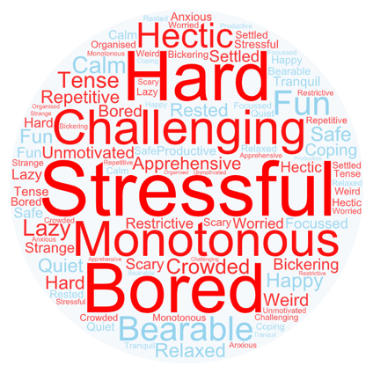
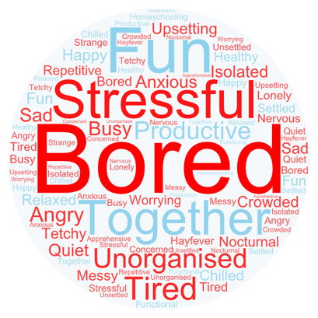
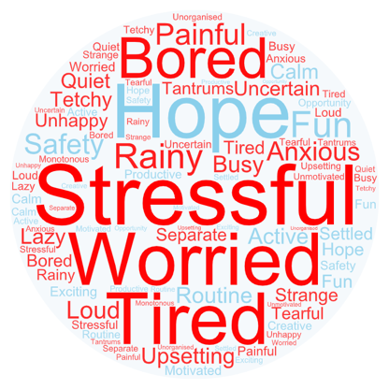
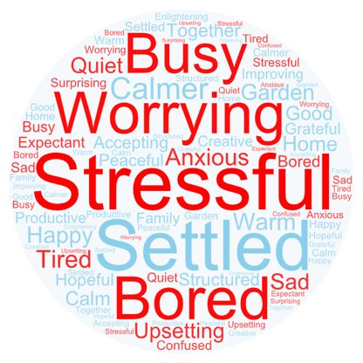
The coronavirus context for JAM families
The overall experience has been incredibly stressful for parents, although there have been some positive experiences, most notably having more time to spend with their children
What 3 words would you use to describe life in your household this week?
Week 1
Week 2
Week 3
Week 4

Slide 13
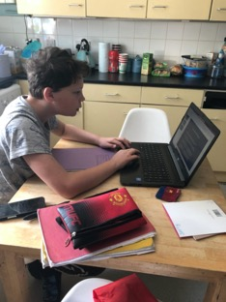
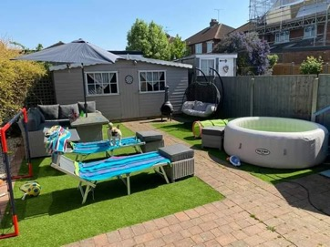
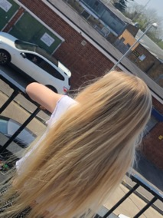
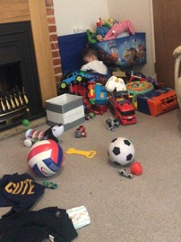

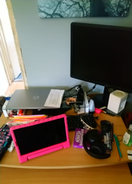
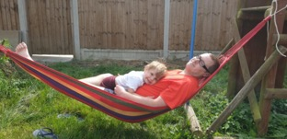
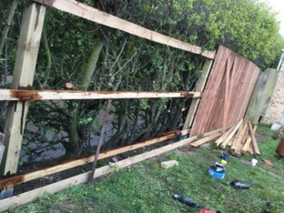
The coronavirus context for JAM families
Family homes have become crowded, with parents and children sharing work and study space
Finding and maintaining housing suitable for growing families has always been a priority for JAM families. Lockdown has reinforced this, and the families in our sample with gardens were at a clear advantage:
vs.
“We are on top of each other as we are over-crowded.”
(Single parent, Harlow)
“If we did not have access to our garden, this would be a different experience.”
(Dual parent, Basildon)
“Having a back garden has now become very advantageous as we can put the youngest’s toys outside and allow him to burn off his excess energy.”
(Single parent, Colchester)
“Space has always been an issue in our home… It feels crammed.”
(Dual parent, Chelmsford)

Slide 14
The coronavirus context for JAM families
Throughout the period of research, the parents of JAM families had three key priorities
1
2
3
Ensuring that children do not view this as a stressful or scary time
Reducing their chances of catching coronavirus
Getting by financially
Children always come first for the parents of JAM families
Given the unavoidable disruption and uncertainty, parents were keen to ensure that their actions did not cause further stress for their children
Fear of coronavirus was the primary health concern for most in our sample
Some were in at-risk categories
All were acting cautiously – in some instances more than required
The financial impact of coronavirus varied considerably across the sample
But all felt uncertain about what the future may hold and were acting cautiously
For those worst affected financially, getting by was a struggle
These priorities inform attitudes and behaviours under lockdown described in subsequent sections

Slide 15
03
Responses to government guidelines

Slide 16
Responses to government guidelines
JAM families in our sample all reported adhering strictly to the government guidance, which was felt to be clear (at the start)
The parents of JAM families reported following the government guidance on social distancing closely
  Some expressed concern with others in the community not doing the same
Indeed, some chose to exercise greater caution than mandated by the restrictions
  Limiting time spent outdoors to less than the allowed daily exercise
  Wearing masks and face coverings
  Even as restrictions began to be eased, the behaviour of most in our sample did not change drastically
“I’ve been really strict on what we do and where we go. We haven’t been to the supermarket for 5 weeks now. We go to a farm shop once a week for collection, and there’s a deli that doesn’t have queues. I’m trying to avoid going to places with lots of people because of my daughter’s asthma.”
(Dual parent, Colchester)
“I’ve just tried to simplify things in my head, as trying to understand it all is not easy. There have been times where I've not even been sure whether I can go and collect my own things from the other house.”
(Dual parent [Co-parenting], Harlow)

Slide 17
Responses to government guidelines
There was some confusion over the guidance around co-parenting
There was a lack of clarity regarding whether children could travel between households or not, with participants who found the guidance in other areas clear citing mixed messages from the government:
“The thing that me and most of my friends were confused about was sharing children in mixed families, it was mainly that. Everyone I know has been social distancing properly. But it took 8 or 9 days to really understand the rules around children of separated families. It wasn’t clear enough that the children were able to travel between families. Which is why [my daughter] didn’t go to her dad’s for three weekends. So it was a little bit hard, but I do understand it’s a hard situation.”
(Dual parent, Colchester)
“Gove came out at the beginning to say not to do that, and then he corrected himself and said where you can, you should. But we’re still not meant to travel so it’s been very ambiguous. Most of the discussion of it online, and this was my initial reaction, was that they should be in one home or the other but now it seems that isn’t the advice.”
(Dual parent, Basildon)

Slide 18
Responses to government guidelines
Lack of clarity around co-parenting resulted in some difficult situations for families in our sample
Varying interpretations of the guidance led to arrangements that in normal circumstance would have felt very unusual:
  One participant moved in with her ex-husband
  Others did not see their children for weeks as a result
Although the advice was clarified, participants typically stuck with the arrangements they had settled on at the beginning
This placed an extra strain on relationships between some participants and their ex-partners, leading to serious disagreements and breakdown in relations:
  One participant is being taken to court by his ex-wife
  Another is no longer allowing her daughter to go to her ex-husband’s as they are not following social distancing
Case study: Melissa*
“I’m not somebody who likes to break the rules and I wouldn’t want confrontation, so I’m not sure it is clear enough what we are and aren’t allowed to do. Everybody's circumstances are so different.”
Lockdown for Melissa presented a real challenge for her mixed family. Due to the ambiguity of the rules, particularly at the beginning of lockdown, Melissa moved back in with her ex-husband so that all her four kids could be in one house without needing to move around. This has worked fine for her, However, she feels that had the rules been made clearer, she would not have needed to take matters into her own hands to the same extent.

Slide 19
Responses to government guidelines
In the final interviews, families were less sure of the guidelines and were continuing to err on the side of caution
By the time of the final interviews, certain restrictions had been lifted, and JAM families felt there was less clarity on what they should be doing
In this context, most reported that they would continue to be cautious
  But there was concern that others they knew or read about in the news were acting ‘as if lockdown was over’
Nonetheless, many were clearly making small changes to their behavior while remaining cautious
  Mostly consisting of visiting gardens of friends and family members
  Or going to the shops more regularly
“I’m not really listening to the Government at all. We’re still basically isolating as a family. Though when they relaxed the non-essential travel rules we have been going out once a week to drive to granddad’s. Because it’s an hour away we couldn’t have done that earlier, but now we go and shout at him through the window basically.”
(Dual parent, Colchester)
“All the neighbours have got the kids playing outside in the front which is mad because kids just don’t understand if you tell them to stay 2 metres away.”
(Dual parent, Harlow)

Slide 20
Responses to government guidelines
JAM families said they felt closer to their neighbours as a result of lockdown, but tensions were emerging as restrictions are eased
There is positivity about the newfound sense of community seen to have emerged under lockdown
And a sense that many are more conscious of the lonely and vulnerable living nearby
Some in our sample were actively involved in volunteering and local mutual aid groups
Many also report caution in interactions with strangers and anxiety about others not social distancing properly
With crowded photos of Southend beach cited as a reason to be concerned
Suggesting that further tensions may emerge as restrictions are eased
but…
“I don’t think the need for volunteering will go away for a while. I think we’ll have realized how much people do need help.”
(Single parent, Colchester)
“We don’t know whether other parents from nursery will have been to the beach, sitting close to everyone else. We’d be worried about that.”
(Dual parent, Basildon)

Slide 21
04
Financial impact

Slide 22
Financial impact
Coronavirus had an uneven impact on these families, with three new groups emerging in terms of financial stability
Feeling the pain
Fine for now
Secure
Self-employed for under a year
Furloughed on 80%
Employed & WFH
Freelancers
Self-employed
Key workers
Zero-hour contracts
Furloughed on 100%
Those in insecure or casual working arrangements prior to lockdown suffered precipitous drops in their income due to loss of earnings. Whilst some have accessed government support, others describe ‘falling through the cracks’ of the system:
  Self-employed for under a year
  Between jobs or on temporary contracts which ended as lockdown began
  Agency workers – approaches taken by agencies varied within our sample: some agencies furloughed their staff while others did not

Slide 23

Financial impact
Families from across the different typologies have been vulnerable to the shock resulting from coronavirus
Precarious Worriers
Feeling the pain
Stationary Settlers
Fine for now
Practical Planners
Secure
  Some families previously in a strong financial situation have had the ‘rug pulled from under them’ due to, for instance, falling through the cracks for income support
  Whilst other families who were struggling to get by previously are now finding that they have more money in the bank

Slide 24
Financial impact
Family finances have therefore been affected in different ways, with some finding that they are better off than they were before
Case study: Danielle*
Case study: Jo*
Case study: Jake*
“I’m just in the same process of looking for work, applying, calling, doing interviews. There’s just not much to apply for, this is the problem.”
“I’m not going to have what I wanted in terms of working my way up in the prison, but to be honest I just want to progress somewhere and get into the management side of things.”
“I’ve got a desk set up in the corner of the lounge and it’s annoying for them because they have to be quiet when I take a phone call. But there’s nothing we can do. We’re lucky I can still work.”
Just 3 weeks prior to lockdown, Danielle secured a new role as a contractor in business analysis. Once lockdown began, her contract was put on hold for several weeks without pay, until the client decided to bring it entirely to an end. The agency she had secured this role through did not offer any kind of support, financial or otherwise. The paychecks Danielle had received were vital in helping to get through the first few weeks of lockdown.
As a key worker, the first impact Jo experienced working in a prison was a big reduction and limitation of the number of shifts she received. This was concerning and left Jo unsure of how she would pay her bills going forward. Soon after, Jo heard rumours of redundancies, and so began searching for a new role. With her experience, she quickly secured another key worker role supporting adults with disabilities and is now waiting to start and receive her first paycheck.
Jake now works from home in his role as a customer service agent at a gas company. Despite not previously having any savings, Jake has built up £2000 from no longer commuting into London. With this money, Jake and his partner will carry out some home improvements and treat their three children at Christmas time. Looking forward, Jake has reservations about how permanent these changes will be, particularly if he returns to the office.

Slide 25
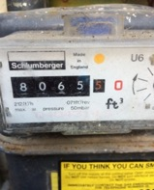
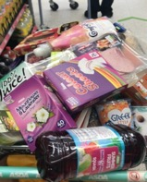
Financial impact
All have seen outgoings decrease – but this is not enough to compensate those who have seen their income decrease
All spent more on heating and electricity bills at the beginning of lockdown, and some spent more on children’s toys and/or learning resources
“My gas meter. The trading was just as high as a full winter one.”
(Single parent, Harlow)
More
The natural reduction in outgoings resulting from changes to expenditure in lockdown does not make up the difference for those who have suffered a drop in income – many in this position further cut back as a result
Views on how spending on food changed were mixed – some were spending more to feed the whole family, but others were ‘shopping smarter’
“Two trips to Asda in four days. Spending on food shopping is outrageous.”
(Dual parent, Basildon)
All were saving money on travel and eating out, and most were also holding back on making ‘big purchases’
“As a family, we’re saving £760 on petrol and train travel each month. It’s a huge amount.”
(Dual parent, Colchester)
Less

Slide 26

Financial impact
And some feel there are hidden costs to lockdown
Upload a picture that sums up your week:
Some parents have spent more due to the need to keep children entertained
  Single parents and those who are working from home feel more in need of ‘quick fixes’
  Sometimes resulting in purchases later on in lockdown when children were becoming particularly frustrated
In addition, in normal times, many JAM families rely on informal childcare support offered by family and friends
  When children eat dinner at their grandparents’ houses, or are taken out for treats by other family members, for instance, this is money parents do not have to spend
  This is not possible during lockdown, in part explaining increased food bills
Many parents also reported that it costs more for them to provide lunch at home than they were previously spending on school dinners
“I’m spending more than I expected on activities for the kids, it’s straining my budget… I got this for the kids last Friday which means I get some peace and quiet downstairs, which has been lovely actually.”
(Single parent, Harlow)

Slide 27
Financial impact
Those who are financially worst affected are relying on short-term solutions to tide things over – but they are running out of options
Previous research indicated that JAM families have little-to-no financial resilience, very limited savings, and were already likely to be severely impacted by unexpected costs
Those experiencing the most severe drops in income have very few options to rely on in the immediate term
As a result, most are relying on piecemeal sources of money to get by in the short term, including:
  Eking out final pay cheques
  Small ‘rainy day’ or ‘emergency’ savings pots
  Universal Credit
  Credit
  Support from family
These families are in unprecedented financial difficulties – at risk of increasing personal debt and being unable to cover the essentials
“I’ve paused my mortgage for three months, but I’ve not paused credit card payments or personal loan payments. Martin Lewis said only to do that as a last resort because of the interest. There’s no petrol money, very little food money, and I just hope I don’t fall through the cracks of HMRC as well.”
(Dual Parent, Basildon)
“I don’t like looking at my savings at the moment because I’ve been using them to get by. It was money I had been saving for holidays and birthdays, and I just can’t wait to be able to put money back in there.”
(Single Parent, Colchester)

Slide 28

Financial impact
Some have turned to Universal Credit, but this is not seen as a long-term solution
Upload a picture that sums up how you feel about your finances:
Prior experience of the benefits system varied within the sample
  For some participants this was their first time claiming benefits
Applying for Universal Credit is seen as a short-term solution to financial difficulty
  Families say this is not a sustainable solution in the long term as it does not go anywhere near replacing the income they’ve lost
The experience of applying for Universal Credit has been dispiriting for many
  Families report finding it difficult to get through to case workers, and that there are delays in the system
  Those who have used UC before say they have had worse experiences this time round
“We are stuck… My partner doesn’t qualify for the government assistance for self-employed people… So Universal Credit is the only option. We’ve spent 5 hours on the phone, have an interview scheduled next month, but won’t get the money until 7 weeks after.”
(Dual parent, Colchester)

Slide 29
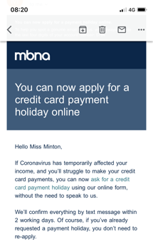
Financial impact
Financial assistance that involves taking on debt is seen as a ‘last resort’
Most are aware of the assistance on offer from banks and mortgage and credit providers
  Some participants took mortgage holidays early on in the crisis
But there is a reluctance to take up these offers
  Many in this audience have prior experience of debt, and there are concerns that payment holidays are simply another form of debt
Mortgage and credit payment holidays are seen as risky, and there is a reluctance to take advantage of them until absolutely necessary
  Many fear that they will end up paying more in the long-term
  Some cited Martin Lewis’ advice about only taking them as a last resort
“It’s just stress you don’t need. If you’re in a situation where you do rely on credit cards, the amount of interest you would have to pay back could get you in a lot of trouble.”
(Single parent, Harlow)
Upload a screenshot of any communication received from financial firms:
“I’ve had this offer but I’ve chosen not to. If things change and lockdown is extended I’ll consider it.”
(Dual parent, Harlow)
“I decided not to go for a mortgage holiday in the end because I wasn’t sure it wouldn’t affect my credit score. We’ve had to cut down a lot on shopping and other unnecessary buying.”
(Single parent, Basildon)

Slide 30
Financial impact
Lack of routine and lack of certainty about the future has disrupted prior approaches to money management
Approaches to money management prior to the crisis differed according to typology:
Precarious Worriers: felt that finances were out of their control, with debt being allowed to build and a lack of certainty about how things can get better
Stationary Settlers: often felt they had their finances ‘down to a T’ and that they were able to keep things on an even keel
Practical Planners: were in control of their finances and had future milestones where income might increase to look ahead to and plan for
The lack of routine and feeling of lack of control has meant many are slipping out of established habits:
  Those whose incomes have decreased are focused more on getting by in the immediate term by necessity
  While even those in a more stable position report growing less ‘disciplined’ throughout lockdown when it became clear that outgoings had settled to a level below the norm
  And all feel that the lack of certainty about the future has made financial planning for the future nearly impossible

Slide 31
Financial impact
All are being more cautious with their money, while those in the most vulnerable position are cutting back considerably
The context of uncertainty has led JAM families to be cautious with their money. The reduction in expenditure resulting from lockdown is being used to offset loss of income or to save:
Those who have lost income are cutting back considerably
They are cancelling all ‘unnecessary’ direct debits and subscriptions and trying only to spend money on the weekly food shop
Two families in the sample report going down to two meals a day – this is justified partly as a response to a more sedentary lifestyle, but it is also a cost-cutting measure
Those with stable incomes are largely seeing this as an opportunity to save any money left over
The exceptions are a couple of instances in which participants are spending more on materials to keep children entertained and/or on longstanding house improvement/DIY projects
Due to uncertainty about the future, this money is being kept aside for emergencies for now

Slide 32
05
Children and education

Slide 33
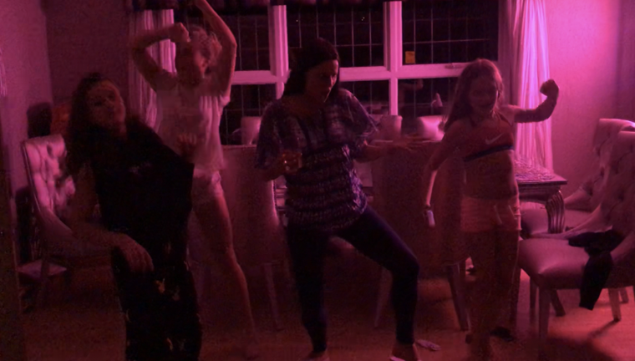
Children and education
The priority for parents at this time has been to minimise the emotional stress for their children, and keep them safe
Upload a picture that sums up your week:
Parents say that they want to ensure that the family can enjoy increased time spent together, and that their children do not feel that a difficult situation is compounded by pressure or stress at home
Alongside this, parents have been fearful of the health risks to their children, despite awareness that they are in lower risk groups overall
“On Friday we decided to have a bit of an impromptu party night and we had some drinks and put on loud music and all danced around the living room… The kids needed it, they’re in their rooms a lot so it felt good to be social.”
(Dual parent, Basildon)
“My biggest concern is going to work and bringing the virus home. I don’t want to see my children be unwell.”
(Single parent, Harlow)

Slide 34
Children and education
Education has not been a high priority for JAM parents at this time
Do not want to add to the stress of their children
Find home schooling challenging
Do not have access to usual support
“We have to protect her because she already doesn’t like hearing about the deaths.”
(Dual parent, Harlow)
“Sometimes I just need a break myself. We are not teachers and we are not child psychologists.”
“He’d usually be going to his nan’s every Wednesday as well as nursery twice a week.”
(Dual parent, Basildon)
(Single parent, Basildon)

Slide 35
Children and education
Most parents describe a relatively ‘hands off’ approach to home-schooling, though this does vary
Precarious Worriers: have limited time and confidence in their ability to help and instead prioritise their children’s happiness
Stationary Settlers: largely let their children get on with it and check in periodically rather than aiming to be surrogate teachers
Practical Planners: take a more hands on approach, particularly with younger children. Some even say they will continue to do so over the summer holidays
This suggests that some children will be at a disadvantage upon the return to school, and that lockdown will likely contribute to an increasing attainment gap – even within this cohort

Slide 36
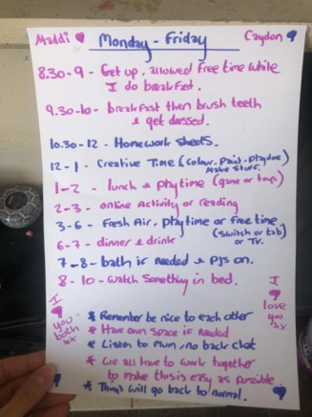
Children and education
Even the most enthusiastic ‘teacher-parents’ struggled to maintain their children’s and their own motivation as time went on
Week 1
Week 4
“We struggled doing schoolwork this week. My little chart hasn’t been followed… They don’t want to do it. I’m not motivated to get them to try to do it. It’s still confusing as to what they have to do. I’m getting links to different websites that they could learn from but there’s nothing actually set for them.”
(Single parent, Harlow)
“I did this schedule one week into lockdown… It benefits me and the kids to have a routine.”
(Single parent, Harlow)

Slide 37
Children and education
There is variation in what schools have provided, and in general parents feel school could have given more support
The schoolwork and support from schools varied massively across the sample according to:
  Stage of lockdown – with provision changing as schools grew more accustomed to the circumstances
  Age of children
  And from school to school, with no consistent approach between schools
The schoolwork provided varied according to:
  Contact with teachers: virtual lessons or email contact
  Type of work: online activities or printable worksheets
  Regularity of contact: weekly schedules or daily activities
Those felt to be at a disadvantage included:
  Children due to sit GCSEs and A-levels, who were mostly left with no work to do
  Children with special educational needs who were not receiving necessary one-to-one sessions
Although experiences varied, overall parents in our sample wanted more contact and help from their children’s schools
“I literally haven’t heard anything from any of my teachers. I think we should have been given some guidance for what we should be doing to keep us afloat, we’re already at that next stage of our life, just a bit of guidance and acknowledgement of the situation would have been good.”
(GCSE student, Single parent family, Harlow)
“My daughter had printed work from the school, whereas for my middle child, the teacher sets work every morning and they submit it online at the end of the day, and then my oldest one has virtual lessons. Whether it’s the same approach or not, its still hard to manage.”
(Single parent, Harlow)

Slide 38
Children and education
Views on returning to school were mixed – suggesting that differences in parents’ approach will endure beyond lockdown
Three families in our sample had children in Reception, Year 1 or Year 6: two of whom chose to send their children back, while the other decided not to due to health concerns
Views from other parents on whether they will send their children back to school or nursery when they re-open were mixed
  There was some caution about the health risk, but also concern that the experience of a socially-distanced classroom will be so different as to make the prospect ‘not worth the risk’
  Most don’t expect other year groups to return until September, and are unsure of the benefits of returning for just a few weeks before the summer holidays in any case
There are concerns about children falling behind across the sample – but differences in how much parents feel they can do about it
“The school explained what would happen if we sent them in: they will be there for 2 hours, they won’t be fed, they won’t be teaching new curriculum… So we said no.”
(Dual parent, Harlow)
“It’s too confusing for her at this age having all this time off, then it can re-open for some years, then the option is given to others, then there are only three weeks left of term. I don’t see the point of making the upheaval… Three weeks [back at school before the holidays] isn’t long enough to make it worthwhile.”
(Dual parent, Colchester)
As some parents feel there is nothing they can do, while others may continue home-schooling over the summer, our evidence suggests that significant attainment gaps may emerge between children within this cohort

Slide 39
06
Health and wellbeing

Slide 40
Health and wellbeing
At the start of the project, fear of infection from coronavirus was the main health concern of JAM families
Several in our sample were in the at-risk group and therefore were taking extra precautions
But even those who were not in a vulnerable group had very high levels of concern over coronavirus at the start of the project
  This led to some very strict approaches to lockdown
In some cases this superseded other health concerns e.g. keeping children inside as much as possible rather than encouraging them to go outside for walks
Maria has two children, one of whom has asthma. Throughout lockdown, she has gone further than the guidelines set out in observing social distancing; she has avoided supermarkets, she has been spraying their post with disinfectant and she’s been making the family wear neck tubes when outside.
Case study: Maria*
“My biggest focus is to minimise household risk of one of us developing coronavirus which is why I’ve been strict with our shopping, cleaning, washing.”

Slide 41



Health and wellbeing
However, as time went on, this fear subsided and other concerns became higher priority – nearly all spontaneous concerns were mental health related
Children finding lack of social contact harder and harder to deal with
Worrying trends in behavior among younger children
Increasing tendency in older children to stay in their rooms/spend all their time on screens

Slide 42

Health and wellbeing
Lack of social contact was seen by parents to be the hardest aspect of lockdown for their children
Parents express concern that this prolonged period of isolation may have long-lasting implications for the development of their children’s social skills
This is of a particular concern for younger children, who often find it more difficult to interact with friends and family over video calls
There are some indications this has been harder for boys, who may feel less able to reach out to their friends
Case study: Emma*
\
Emma is a single parent with three children. Over time she’s noticed changes in her youngest son, who is 5 years old. He has taken to following her around the house, and says he feels afraid to be left alone. Over the whole of lockdown he has only spoken to his friends twice, in comparison to his older sister, who is 8, and who is on the phone to her friends every day.
“I didn’t think it was bothering [my son] too much. Typical boy taking it in his stride. Didn’t think he was missing his friends that much. But now I’ve noticed he doesn’t like to be left alone.”

Slide 43
Health and wellbeing
Over time, parents said they noticed changes in their children indicative of worsening mental and emotional well-being
The form this took varied for younger and older children:
Younger children:
Older children:
Parents of primary- and pre-school-age children describe them ‘acting up’, having mood swings and displaying previously never seen behaviours e.g. following them wherever they go
Some parents of pre-school children worry that they are becoming more insular and express concern over how they will interact with other children when they return to nursery.
“My little one is really struggling to cope without her usual structure of nursery. I’ve been dealing with her tiredness and tantrums, and I think she might be putting on a little bit of weight as she’s got used to the idea of snacking.”
(Dual parent, Harlow)
Parents reported finding it increasingly difficult to keep older children motivated as time went on – especially those who had exams cancelled as a result of coronavirus
Many said their teenage children ended up spending more time alone in their rooms as lockdown went on
“I try and talk to him sometimes about things, but I just can’t get through to him. He’s got no ‘get up and go’ and gets short tempered with me. He’s lethargic and seems to just be waiting for his exam results. I think he is worried about what he might get.”
(Single parent, Chelmsford)

Slide 44
Health and wellbeing
Physical health was less of a top-of-mind concern for JAM families, despite most seeing a significant decline in physical activity during this time
Previous research indicated that physical activity tended not to be a priority for this audience and that the main source of physical activity for children was through school and after-school clubs
8/14 of the sample said they were less physically active than they used to be, but few raised this as a spontaneous concern
  Whilst many said they initially had exercise routines in place, adherence to these tended to decline over time as motivation decreased
  Three participants spontaneously reported weight gain
Many said they generally felt less healthy at this time, with a few commenting that they have been drinking more than usual
Case study: Sally*
Sally is a single parent with a teenage son. At the start of lockdown Sally and her son came up with separate exercise routines. But over time they have both found themselves lacking in motivation and their activity levels have been going steadily down.
“I’m definitely not doing enough exercise, I kind of got lazy with it. It’s got worse and worse for both of us. He’s on his phone all the time now.”

Slide 45
Health and wellbeing
Similarly, healthy eating has not been a primary health concern for JAM families at this time
Families report two key challenges to healthy eating during lockdown:
Whilst parents say they have tried to maintain healthy eating during this time, they also say it has not been a top priority, with the emphasis instead on keeping everyone happy
Boredom and lack of routine: Boredom seems to have driven an increased appetite amongst children, and this combined with less routine, has led to increased tendency to snack.
Difficulty of going to the shops: Some report this leading to increase in consumption of frozen foods and pre-prepared foods rather than fresh
“We’re not being strict. I don’t want them to remember this as a really awful time. I would like them to remember it quite fondly because it is time together. It’s bringing us closer.”
(Single Parent, Colchester)
“I think they enjoy being at home and eating when they want. It is so tricky because it’s not like you can lock the cupboards!”
(Dual parent, Harlow)
“I’ve put on a stone since lockdown. I bought a lot of freezer foods like chicken nuggets and pizzas because I was worried about getting to the shops.”
(Single Parent, Harlow)

Slide 46
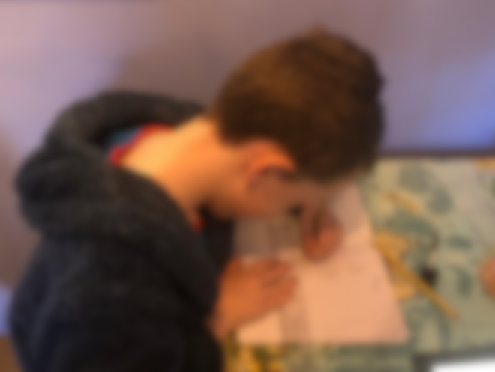
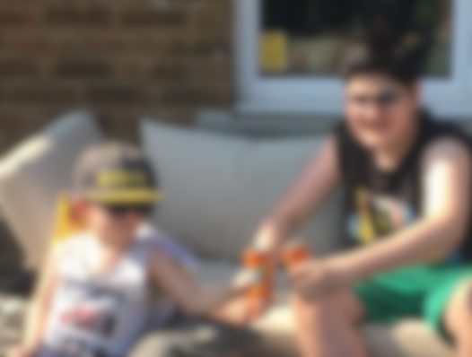


Health and wellbeing
Parents have taken differing approaches to health and well-being at this time
Routine
Having fun
Regular meal teams and bedtimes
Daily activity plan
Bedtimes and mealtimes vary
Exercise sporadic
More likely to be Practical Planners
More likely to be Precarious Worriers

Slide 47
Health and wellbeing
But all have said it has become harder to hold onto good habits over time
Case study: Melissa*
Case study: Danielle*
\
With four children of varying ages, Melissa has found it difficult to impose structure in the children’s days. Space at home is limited so it’s difficult for all the children to do their schoolwork at the same time. Over time, all sense of routine has disappeared, and arguments are breaking out regularly.
At the start of lockdown, Danielle involved her children in creating their own schedule to stick to each day. While their motivation to do schoolwork decreased over time, this sense of structure meant their eating and sleep routine stayed relatively constant throughout lockdown, while Danielle also ensured they got outside for physical exercise in the garden.
“I get worried they will put on a bit of weight and they’re lacking motivation to go to the park too. It’s just that out of control thing, and me thinking how can I deal with this better.”
“They have drawn up a pattern and schedule for themselves, so we put ourselves into a kind of routine. They chose to systematically and wisely do their work first, which is OK for me, then they can go onto anything else they want to do.”

Slide 48
Health and wellbeing
JAM families were reluctant to access all but essential healthcare services during lockdown
Having appointments cancelled
Putting off ‘minor’ ailments
Having difficulty accessing support
Most of the families in our sample had at least one appointment with a healthcare provider due to take place during lockdown which was subsequently cancelled
Not seeking GP advice when they normally would for fear of placing extra burden on the NHS
One participant in our sample was pregnant during the research, and found the reduction in contact with her midwife difficult to cope with
“My dentist cancelled our appointments. If I had an urgent issue I would contact them as I trust him, but they haven’t been rescheduled yet.”
(Single parent, Harlow)
“I had chest pains the other week and would usually have rung the doctor. I didn’t want to be a burden though so I waited it out.”
(Single parent, Colchester)
“My midwife told me to self-isolate for 12 weeks and gave me an emergency number. That’s all. And when I rang the number it’s a robot answering, not her.”
(Dual parent, Colchester)

Slide 49
07
Perceptions of the long-term impact

Slide 50
Perceptions of the long-term impact
Long-term planning has largely been shelved – all JAM families are focusing on getting through the next few months
Previous research indicated that there were stark differences in the extent to which JAM families felt able to think about and plan for the future:
Precarious Worriers: previously focused on minimising risk for the future and were limited in how far they felt able to plan ahead
Stationary Settlers: felt it was unlikely that much would change in their lives but were reasonably happy to ‘keep on keeping on’
Practical Planners: had milestones in their future that they were working toward and expected some small improvements in their circumstances
All are now focused on the short term. Even those whose circumstances have remained stable throughout lockdown are unsure of what may change in future

Slide 51

Perceptions of the long-term impact
Priorities in the next few months include keeping children occupied and keeping or finding stable work – but much is uncertain
Keeping children occupied
Stable work
Parents are running low on ideas for how to keep their children entertained
Most anticipate that they won’t be back in school until September
Cancelled summer holidays make this prospect seem challenging
Most are anxious to retain stable jobs, or search for new work if employers don’t survive coronavirus
However, this is seen as largely out of their control, with the prospect of finding new work in the current circumstances seen as unlikely
But most simply didn’t know the situation they or the country could be in over the next few months
“We want to have fun but we’re not really going to make changes. We wanted to go to the Lake District. But so do half the country probably.”
(Single parent, Colchester)
“It’s all hinging on our jobs. I chose a career in primary education, but that might be stopped. I might have to do whatever job I can find.”
(Dual parent, Chelmsford)
“I don’t know. My one-year plan is on pause… We need to wait until we’re settled, and things are back to normal.”
(Single parent, Harlow)

Slide 52
Perceptions of the long-term impact
JAM families find it hard to assess what the long-term impact of the situation will be on their finances
Feeling the pain
Fine for now
Secure
Those who have been made redundant are unsure what benefits they can claim making income hard to predict
Job market uncertainty makes it difficult to know what prospects they can expect
Those who are furloughed wonder whether they will be made redundant
Self-employed feel very uncertain about future earning potential
Those in secure work wonder whether the crisis will have impacted their future progression prospects
“I’m searching for jobs but there isn’t much to apply for unfortunately. If this continues I’ll be unable to pay my bills.”
(Single parent, Basildon)
“I think my clients will trickle back but I just don’t know. The uncertainty isn’t very pleasant, that’s for sure.”
(Dual parent, Basildon)
“I think they’ll continue to need us but the doubt is niggling in the back of my mind, and it really throws the idea of moving to office work into doubt.”
(Single parent, Colchester)

Slide 53
Perceptions of the long-term impact
The crisis has increased the already prevalent feeling amongst JAM families that their future is outside of their control
Previous research found that JAM families struggled to plan beyond the medium term
There is concern about factors outside their control:
  Rise in the cost of living
  Rise in VAT to pay back government spending
  Impact on housing market
And many feel that tough economic conditions will leave them with little choice in terms of employment
  Some who have been made redundant say this made them consider whether they should retrain, but feel unsure whether the costs for this would be prohibitive
“Obviously money has to be clawed back somehow, VAT perhaps. I don’t think we’ll avoid a recession and I don’t know what that’ll do to house prices.”
(Dual parent, Basildon)
“If I haven’t heard anything from my employer in September then I’ll have to look elsewhere. But it’s going to be hard, a lot of people will be in the same boat.”
(Dual parent, Basildon)

Slide 54
08
Conclusion

Slide 55
Conclusion
Key findings
1
This has been a hugely stressful and challenging experience for parents. One of their main priorities has been to shield their children from the emotional impacts of the crisis, whilst keeping them safe.
2
The crisis has had an uneven impact on JAM families’ finances, with some better off than before and some worse off. Those who are worst affected have been relying on short-term solutions but are very concerned about the long-term outlook.
3
Education attainment has not been a priority for parents at this time, and overall approaches to home-schooling have been patchy. There are real concerns about what this will mean for long-term prospects of children.
4
Emotional well-being of their children has been by far the greatest health concern of parents at this time. Lack of social interaction is the greatest cause for concern, especially for younger children. Physical activity and healthy eating have been less of a priority.
5
The crisis has exacerbated any pre-existing lack of agency that these families felt towards their futures, and made it even more difficult to plan ahead, even in the short term.

Slide 56
Conclusion
The parents of JAM families had a number of ideas about how Essex County Council could support families in future
Financial support
Mental health
Childcare
In the form of council tax breaks or subsidy of meals for children in place of school dinners
Support for parents and children in the immediate term, and to deal with the ‘knock-on’ effects of lockdown
Socially-distanced activities over the summer
And support for single parents and children of key workers
“Children are costing me more because of being at home. They could help like they do with school dinners.”
(Single parent, Harlow)
“Mental health is going to be a big thing in the next few years. I do think there will be a knock-on effect.”
(Dual parent, Harlow)
“Key workers have had no childcare provision. They could run play schemes with distancing.”
(Dual parent, Chelmsford)

Slide 57
For more information:
Lucy Bush, Research Director | lbush@britainthinks.com
Michaela Rhode, Associate Director | mrhode@britainthinks.com
Tom Brookes, Senior Research Executive | tbrookes@britainthinks.com
Alice Haywood, Research Executive | ahaywood@britainthinks.com
BritainThinks
Somerset House
Strand
London
WC2R 1LA

