Slide 1
ESSEX INSIGHT PACK

Slide 2
Glossary Index
Front Cover
Glossary Index
STRATEGIC AIM 1: ENABLE INCLUSIVE ECONOMIC GROWTH
Qualifications
The skills gap between Essex and the rest of the UK is increasing
The proportion of people with no qualifications in Essex has reduced by 7.1% points in the last decade, faster than England
Employment
Economic Activity has grown faster than the national average over the last decade. However has fallen by nearly 10% points in Harlow in the same time period
Essex employment is higher than regional and national comparators and has been growing at the same pace over the last decade
For the majority of Essex districts the proportion of part time work has decreased over the last decade
Essex has a lower proportion of individuals in professional and technical occupations than nationally and regionally. This may be attributed to the skills deficit.
The labour market is highly skewed for women with 40% of women working in public services.
Businesses
There has been a 41% growth in the last decade in professional, scientific and technical businesses in Essex.
Essex sees lower growth than National, if Essex had grown at the national rate there would be almost 2,500 more businesses.
Income
The gap between Essex and Eastern residential earnings is 10 times larger than the gap for workplace earnings.
The earnings gap of Essex residents across its districts is amongst the highest in the country.
An estimated 70,000 more Essex residents live in the 20% most deprived areas since 2007
Essex has a low productivity economy and the gap is growing
Commuting
It takes over 50% longer to travel by public transport to Essex city centres than by private transport
STRATEGIC AIM 2: HELP PEOPLE GET THE BEST START AND AGE WELL
More Essex children are entering KS1 education with a good level of development than nationally
Maldon is the only district which performs better than national comparisons for Reading, Writing & Maths.
Despite an overall reduction in child poverty across Essex (workless and low income families) Tendring sees an increase above England averages.
Vulnerable Adults
Essex has 5% points more economically active core or work limiting disabled than the national average.
Older People
Essex has nearly 20% more old age dependents than the national average
Health
The Female life expectancy gap in Essex has widened by 0.6 years since 2010
The life expectancy gap between Males in Essex has widened by 0.8 years since 2010
Essex proportion of physically active adults is the same as Great Britain.
Essex has more overweight adults than the national average
In the last 5 years alcohol related admissions have risen 114% for Tendring females; compared to 24% growth in Essex and 2% nationally

Slide 3
Glossary Index
STRATEGIC AIM 3: HELP CREATE GREAT PLACES TO GROW UP, LIVE AND WORK
Crime
Rates of crime in Basildon and Harlow are twice that of Maldon and Rochford
Violent crime and violence rates leading to hospitalisation in Essex are lower than other authorities in and around London, with the exception of Tendring. Less than 2% of Violent crime is attributable to Gangs.
Nearly half of residents in Essex are worried about being victims of crime, the highest rates of fear seem to reflect other measures of crime.
Whilst feelings of safety during the day have remained consistent over the last decade, feelings of safety after Dark continue to fluctuate, returning to 48% in 2017/18.
Communities
The feelings and motivations of Communities indicated by residents of Essex remain fairly consistent.
Environment
CO2 Emissions in Essex are lower than the Regional and National average and are reducing in line with the national rate
Energy from Renewables increasing steadily in Essex with strong growth in Maldon and Braintree
Domestic electricity consumption is higher than the National average, but is reducing.
Homes
The majority of homes in Essex are owner occupied Detached or Semi-detached homes.
Median House prices have grown 70% in Essex the last 10 years, with highest growth seen in Epping Forest.
Essex homes have become 31% less affordable in the last decade
On average Homelessness in Essex is higher than England. There are stark differences between districts, the rate of homelessness in Harlow is 4.5 times higher than the rate in Brentwood.
Migration
International net migration has decreased 41% in Essex in the last 2 years
Internal migration to Essex has fallen 16% compared with great falls of 42% for Eastern region and 51% fall nationally.
STRATEGIC AIM 4: TRANSFORM THE COUNCIL TO ACHIEVE MORE WITH LESS
Council Tax
Essex has a lower proportion of dwellings paying 100% of the council tax rate.
Budget Savings
Technology/Digital
The number of bring your own devices have almost doubled since the last report.
Workforce
Essex is in the top 10 most productive English councils

Slide 4
STRATEGIC AIM 1: ENABLE INCLUSIVE ECONOMIC GROWTH

Slide 5
Qualifications

Slide 6
The skills gap between Essex and the rest of the UK is increasing
LATEST PICTURE
ESSEX | SELEP | NATIONAL
33.8% | 35.2% | 42.8%
Qualifications – NVQ 4+ economically active 16-64 year olds.
There is an increasing gap between the proportion of people who are qualified at HND, degree and higher degree level qualifications in Essex compared to the rest of the UK. In 2017, there were almost 10% less graduates for the Essex labour market than the national average meaning a lower level of skills available.
There is a wide disparity between districts Castle Point has 1.4 graduates for every 10 people which is 3 times less than Uttlesford’s 4.47 graduates for every 10 people. Therefore it is unlikely that businesses with high skilled vacancies can be encouraged to set up in Castle Point without skills investment.
2017 Percentage of NVQ4+ by district
Source: ONS Annual Population Survey

Slide 7
The proportion of people with no qualifications in Essex has reduced by 7.1% points in the last decade, faster than England
LATEST PICTURE
ESSEX | SELEP | NATIONAL
5.3% | 4.8% | 4.9%
Qualifications – No Qualifications
The proportion of economically active with no qualifications has fallen faster in Essex than the rest of the UK, and is now in line with the national and regional average. Individuals with no qualifications are more likely to be in less skilled work with lower productivity levels.
Harlow and Castle Point both have nearly twice as many people with no qualifications compared to the National and Essex average.
2017 Percentage of People with no qualifications by district
Note: there is no data for Brentwood and Uttlesford for 2017.
Source: ONS Annual Population Survey

Slide 8
Employment

Slide 9
Economic Activity has grown faster than the national average over the last decade. However has fallen by nearly 10% points in Harlow in the same time period
LATEST PICTURE
ESSEX | SELEP | NATIONAL
81.6% | 79.9% | 78.4%
Economic Activity Rate (16-64)
There is a higher proportion of economically active in Essex than compared to regional and national levels, it has grown faster over the last decade. Economically active includes people in employment or unemployed who are looking for employment. Higher economic activity is negatively correlated with productivity levels.
The fact that Brentwood has the lowest percentage of economically active people in Essex shows that the factors driving these indicators may be very different in different parts of he county for example it is likely that there are high rates of early retirement or high levels of non-labour income for Brentwood residents.
2018 Economic Activity Rate
Source: ONS Annual Population Survey

Slide 10
Essex employment is higher than regional and national comparators and has been growing at the same pace over the last decade
LATEST PICTURE
ESSEX | SELEP | NATIONAL
78.2% | 76.6% | 75%
Employment Rate
Employment is slightly higher in Essex than the rest of the Great Britain on average, however the growth is fairly similar. There is a high level of disparity between districts, Tendring has only 70.2% employment compared with 83.6% in Castle Point. A high employment rate is not necessarily good for productivity – Castle Point has the highest employment rate but the lowest GVA per head in 2018.
2018 Employment Rate
Source: ONS Annual Population Survey
Notes:
Deleted unemployment rate slide – essentially the inverse of the information here.
People who did some paid work in the reference week (whether as an employee or self employed); those who had a job that they were temporarily away from (eg, on holiday); those on government-supported training and employment programmes; and those doing unpaid family work.
** what has driven the growth in employment in castle point
** what is keeping people from not looking for employment
* Difference between employment and economic activity

Slide 11
For the majority of Essex districts the proportion of part time work has decreased over the last decade
LATEST PICTURE - % part time work
ESSEX | SELEP | NATIONAL
26% | 26.2% | 25%
The growth in % of employed who are part time workers (16-64) has grown only 0.6% in Essex and regionally in line with the 0.5% growth nationally. This is contradictory to the popular belief that part time work has grown significantly recently. The level of growth differs across districts, north east Essex districts have seen positive growth in part time work whereas other districts have seen negative growth over the same period. Chelmsford and Colchester have the highest numbers of people working in the sales occupation in 2018, which is known to make up a relative high proportion of part time work in the East of England.
The value of part time work measured by the median part time earnings per week has increased over the last decade. The growth in part time earnings is twice as much as the growth in full time earnings in the same time period. Essex part time workers are working longer hours than in 2008, there has been a 2.6% point increase in the last decade in proportion of workers working 10-34hrs.
2007 - 2017 Percentage Point Growth of Part Time Employment
Part time work as a % of all work
Part time work £ over time
Source: ONS Annual Population Survey and ASHE
Notes:
The growth in part time workers has grown only 0.6% in Essex and regionally in line with the 0.5% growth nationally. This is contradictory to the popular belief that part time work has grown significantly recently. The level of growth differs across districts, north east Essex districts has seen positive growth in part time work whereas other districts have seen negative growth over the same period.

Slide 12
Essex has a lower proportion of individuals in professional and technical occupations than nationally and regionally. This may be attributed to the skills deficit.
LATEST PICTURE
ESSEX | SELEP | NATIONAL
31.8% | 33.8% | 34.8%
2017/18 Proportion of professional & technical
% all in employment who are in different SOC classifications
Occupations are classified according to the Standard Occupation Classification 2010
For 2017/18, in Essex the highest proportion of workers are in professional occupations and associate professional and technical occupations (15.9% for both) together smaller than both the regional and national average.
Notes:
The proportion of professional occupations is smaller than the whole Eastern region and Great Britain. Essex does however have a higher proportion of managerial, director and senior officials. We also have a lower proportion of the population working in elementary occupations.
** why does rochford have such a high proportion of professional occupations?

Slide 13
The labour market is highly skewed for women with 40% of women working in public services.
Source: ONS Annual Population Survey
% in employment who work for different occupations (SIC 2007)
The 2017/2018 labour market is distinctly different for men and women however the Essex labour market distribution is similar to the regional and national picture.
For women, the market is highly skewed towards public admin, education and health with 42.4% working across these industries.
For men, the labour market is more evenly distributed across the standard industry classifications, nevertheless men most frequently work in the banking, finance and insurance industries.
Notes:
** might want to think about the wages associated with these standard industry classifications

Slide 14
Businesses

Slide 15
There has been a 41% growth in the last decade in professional, scientific and technical businesses in Essex.
* ROUNDED ESTIMATES
Source: Office for National Statistics, UK Business Counts - local units by industry, 2017 figures shown
ONS, Business Register and Employment Survey
Sector Strengths Essex
 | Number employed* (2017) | Number of Businesses (2017) | Business Growth – number of businesses (2010-2017)
Human health & social work | 83,000 | 3,575 | 23%
Retail | 61,000 | 5,920 | 1%
Professional, scientific and technical | 55,000 | 11,190 | 41%
Education | 52,000 | 1,645 | 18%
Business administration & support services | 50,000 | 6,040 | 23%
Construction | 44,000 | 11,850 | 20%
Manufacturing | 43,000 | 3,795 | 3%
Accommodation & food services | 41,000 | 3,450 | 6%
Transport & storage (inc postal) | 30,000 | 2,855 | 19%
Top 10 categories by largest number of employees in 2017
Notes:
Comments as I have not been able to fit these on the above slide
Information and communication and mining, quarrying and utlities areas have seen the highest levels of growth between 2010 to 2017 of 44%
Of those industries with the highest number of employeees professional, scientific and technical industry has seen the highest growth of businesses in Essex.
Enterprises are defined as an overall business – made up all of the individual sites or workplaces.
Defined as the smallest combination of legal units (generally based on VAT and/or PAYE records) that has a certain degree of autonomy within an enterprise group.
Local unit – individual site (for example a factory or shop) associated with an enterprise. Can also be referred to as a workplace.

Slide 16
Essex sees lower growth in business formation than the National average, if Essex had grown at the national rate there would be almost 2,500 more businesses in the county.
2018 | ESSEX | EAST | ENG
Job Density | 0.79 | 0.85 | 0.87
Businesses
Essex has:
72,110 businesses (local units) / 70,405 enterprises(1)
704,000 jobs(2) On average there are 58,500 jobs across districts but with the number of jobs across districts being reflective of overall size (with Basildon, Chelmsford and Colchester having highest numbers > 95,000).
Essex has seen:
An increase in Job density but rates are still below National averages. Chelmsford & Uttlesford have the best improvement in Job density (number of jobs available per working age resident) since 2013. Current rates are also above Essex and England averages(2) (0.95 and 0.99) respectively.
An 18% increase in the number of businesses (local units) between 2010-18, this is below national growth rates which has seen a 22% increase overall (1). Basildon, Brentwood, Epping Forest and Harlow have seen increases above national averages.
A 10% increase in the number of jobs between 2013-17 (from 632,000) which is inl ine with England and East of England (2) Greatest increases have been seen in Braintree (20%) and Uttlesford (21%). Conversely Brentwood has seen a decrease in the number of jobs (- 5%).
Source: Inter Departmental Business Register (ONS), 2018. An Enterprise is the smallest combination of legal units (generally based on VAT and/or PAYE records) which has a certain degree of autonomy within an Enterprise Group. An individual site (for example a factory or shop) in an enterprise is called a local unit.
Source: ONS Jobs Density, 2016. Total jobs includes employees, self-employed, government-supported trainees and HM Forces.
Source: ONS Business Demography 2016: Enterprise Births, Deaths and Survivals.

Slide 17
Income

Slide 18
The gap between Essex and East of England residential earnings is 2 times larger than the gap for workplace earnings.
LATEST PICTURE
 | ESSEX | EAST | NATIONAL
Resident | £618.6 | £590.3 | £571.1
Workplace | £560.7 | £558.1 | £570.9
Earnings by Place of Residence and Workplace (Full Time)
Essex has higher residential earnings than both regional and national averages however it has lower workplace earnings than the national average. The relatively large gap between residential and workplace earnings in Essex may be due to the many residents commuting to London for better paid jobs.
Rochford median residential earnings have grown 37% in the last decade. However there remains a large gap between the district with the highest residential earnings, Brentwood (£754.1), and the lowest, Tendring (£543.9).
2018 Median and workplace Resident earnings
Source: ONS Annual Survey of Hours and Earnings
Notes:
** how much are the London residential and workplace earnings

Slide 19
The earnings gap of Essex residents across its districts is amongst the highest in the country.
LATEST PICTURE
 | ESSEX | NATIONAL
Resident | 4,579 | 6,674
Workplace | 2,282 | 5,453
Earnings Variance by Place of Residence and Workplace (Full Time)
Essex has the 4th highest difference in median residential full time earnings out of the higher tier authorities listed below. Workplace earnings are less different across the districts, with around half the variance of residential earnings.
Source: ONS Annual Survey of Hours and Earnings
Notes:
Variance – measures the spread between values in the dataset

Slide 20
An estimated 70,000 more Essex residents live in the 20% most deprived areas since 2007
LATEST PICTURE
 | ESSEX | NATIONAL
Average Rank | 13923 (112) | 17306
Average Score | 17.1 (113) | 23.0
Proportion of LSOAs in most deprived 20% | 10.3% | 20%
Income IMD
The Income Deprivation domain provides a measure on the proportion of the population that experience low income deprivation and is built through a range measures of income related benefits, including those people that are out-of-work, and those that are in work but who have low earnings.
In 2016, there was an estimated 154758 individuals in Essex who lived in the bottom 20% of income deprived areas, up from 83158 in 2007. In 2007 54 Essex areas were in the 20% most deprived areas in the country this increased to 90 areas in the 2015 IMD. Basildon and Tendring both have higher representation of the proportion of their LSOAs which are in the most deprived 20% of all LSOAs nationally.
Number of people estimates living in top 20% deprived areas by district (2016)
% of LSOAs in most deprived 20%
Source: English indices of deprivation 2007 and 2015, Ministry of Housing, Communities & Local Government
Notes:
Information
Average rank – population weighted average of the combined ranks for all LSOAs in a larger area.
This measure is calculated by averaging all of the LSOA ranks in each larger area after they have been population weighted.
The average rank scores for the larger scores are then ranked with 1 for the most deprived and given to the area with the highest score.
Average score – population weighted average of the combined scores for the LSOAs in a larger area.
The average score summary measure is calculated by averaging the LSOA scores in each larger area after they have been population weighted. The resultant scores for the larger areas are then ranked, where the rank of 1 (most deprived) is given to the area with the highest score.
Proportion of lower layer super output areas in the most deprived 10% nationally.
Proportion of a larger area’s LSOAs that fall in the most deprived 10% of LSOAs nationally.
The score is the proportion of the larger area’s LSOAs that fall in the most deprived 10% of LSOAs nationally. The scores for the larger areas are then ranked, where the rank of 1 (most deprived) is given to the area with the highest score.
** find 2010 data and rerun analysis and compare

Slide 21
Essex has a low productivity economy and the gap is growing
LATEST PICTURE
ESSEX | NATIONAL
21,584 | 27,060
GVA (Gross Value Added) Per Head
A key measure of productivity is GVA. Essex GVA per head was £21,234 in 2016, 80% of the national figure. Since 2006 it has grown 18% compared to 25% nationally. The productivity gap between Essex and the rest of the UK is therefore widening. Similar to earnings there is a wide disparity in GVA per head. Castle Point has only £13,769 which is almost as little as half of national GVA per head, whereas Brentwood and Uttlesford are both higher than the national average. Chelmsford and Epping Forest are the only two districts where productivity grew faster than the national average between 2006 to 2016. Tendring and Braintree have also increased relatively more than would be expected considering their low relative performance in other indicators e.g. low levels of NVQ4+ qualifications
.
2016 GVA per head by district
% GVA growth between 2006 to 2016
Essex and England GVA over time
Source: ONS Annual Survey of Hours and Earnings

Slide 22
Commuting

Slide 23
It takes over 50% longer to travel by public transport to Essex city centres than by private transport
 | LATEST PICTURE
Journey Time to city centre | ESSEX | NATIONAL
Public Transport | 127.6 | 120
Car | 83.8 | 84
It takes 52% longer to travel to Essex city centres than driving by car, this would likely discourage commuters from shifting to public transport. Despite efforts to promote modal shift, driving to work still remains the most popular method of commuting to work, 71.3% of Essex commuters choose this method in 2016. There has been a fall in ‘active’ methods of commuting, between 2007 and 2016 34% fewer commuters in Essex cycled to work and 36% fewer walked to work.
There have been large increases in those using train and underground growing 18% and 12% respectively indicating the increase in Essex residents commuting to London.
Method of travel to work over time for Essex
Travel in minutes to city centre 2015
Source: Labour Force Survey and ONS method of travel to work
Notes:
Wanted to include a comparator i.e. kent used 2015 as 2016 is a little tricky to get
The slide with data from census 2011 has been removed as I felt the data was quite out of date and we would not be able to make meaningful conclusions from it.

Slide 24
STRATEGIC AIM 2: HELP PEOPLE GET THE BEST START AND AGE WELL

Slide 25
More Essex children are entering KS1 education with a good level of development than nationally
LATEST PICTURE
 | ESSEX | NATIONAL
2017 | 74% | 71%
2018 | 74% | 72%
A higher percentage of Essex children are achieving a good level of development before key stage 1 education than the national average. However some districts are performing well below the Essex average, i.e. Harlow, which puts these students at an early life disadvantage. The worst performing districts at KS1 education scores tend to remain the worst performing for attainment 8 scores which measures student development almost a decade later.
% of students achieving a good level of development at early years
Attainment 8 scores – range of score for year 8 pupils
Source: NEXUS, DfE, SFRs
Notes:
Achieving a good level of development is a demonstration of a child’s development and achievement at the end of the Reception year.
On average a higher percentage of Essex children are achieving a good level of development before key stage 1 education. However not all Essex districts are achieving more than the national average, and Harlow is performing well below the other Essex districts putting Harlow students at an early disadvantage.
Looking at early years foundation stage (EYFS)
2014 – 61.4% (56)
2015 – 67.7% (52)
2016 – 71.9% (35)
2017 – 73.5% (33)
2018 – 73.8% (38)
() ranking in brackets

Slide 26
Maldon is the only district which performs better than national comparisons for Reading, Writing & Maths.
KS1-2 Progress Scores | Essex (in respect to National)
Reading | -0.2
Writing | 0.0
Maths | -0.3
KS1-2 Progress Scores
Pupil’s results are compared to the actual achievements of other pupils nationally with similar prior attainment.
A score of 0 means pupils on average do about as well at KS2 as those with similar prior attainment nationally.
A positive score means pupils are relatively better
A negative score means pupils are relatively worse
Overall Essex is performing worse than national comparisons for reading and maths scores. Maldon is the only district where students are performing better on all 3 measures and is the only district in the County where Maths performance is above the national average.
There are multiple districts which perform worse on all 3 measures (Tendring, Epping Forest, Colchester, Brentwood and Basildon).
Source: NEXUS, DfE, SFRs
Notes:
Looking at the provisional 2018 figures, Essex is doing worse than Reading and Maths against the National average. Tendring is notably poor in Maths in relation to the national average and Balisdon particularly poor in Reading. On the other hand Maldon is over 1 point higher than the national average in Writing.
Overall Essex is performing worse than national comparisons for reading and maths scores. Maldon is the only district where students are performing better on all 3 measures to national comparisons, whereas there are multiple districts which perform worse on all 3 measures (Tendring, Epping Forest, Colchester, Brentwood and Basildon). The poor relative performance means that Essex students are not achieving the same level of skills nationally putting them at a disadvantage for future schooling and ultimately skills for the labour market.

Slide 27
There are 25,000 workless households in Essex with dependent children.
LATEST PICTURE
 | Essex | EAST | NATIONAL
Working households (Children under 16) | 39.7% | 38.4% | 34.4%
(Dependent Children) | 41.3% | 40.3% | 35.9%
Low income families | 13.8% | 13.6% | 16.0%
In terms of Child poverty there are 25,000 workless households in Essex with dependent children. Although workless households are reducing in Essex, England has seen a greater reduction of 21% over the last decade compared to Essex. Despite currently having a higher proportion of families on a low income (16.6%), Harlow is the only district which has seen a greater reduction than England over the last decade (24%). Tendring has the highest percentage of households on a low income (23%) and is the the only district that has seen an increase in the percentage of low income families over the last decade.
Proportion of working households
Trend of low income families
Source: ONS Annual Survey of Hours and Earnings
Notes:
The proportion of working households with dependent children in the East region has grown 7.1% in the last decade 3 percentage points higher than nationally
There are 25,000 workless households in Essex with dependent children

Slide 28
Vulnerable Adults
Notes:
Is there anything on vulnerable adults

Slide 29
Essex has 5% points more economically active core or work limiting disabled than the national average.
LATEST PICTURE
ESSEX | SELEP | NATIONAL
63.5% | 61.3% | 58.2%
Proportion of economically active EA core disabled
Essex has a higher proportion of individuals who are core disabled (which substantially limits their day to day activities) or work limited (they have a disability which affects the kind of work they might do) who are economically active compared to the SELEP and national average.
Some districts are performing better to help core and work limiting disabled to be economically active, in Brentwood 75% are economically active compared with only 52% in Harlow and Basildon.
2017 % of economically active EA core or work limiting disabled
Source: Annual Population Survey
Notes:
The time series is not available before 2014 because the definition of disability changed.
The latest picture is ye september 2018 – this is not included in the time series as there is an overlap with end of 2017 calendar year data
What is it about Basildon which is meaning that they are able to realise the potential of those with core or work limiting disabilities much better than other parts of the county?
Types of disability in those regions
Age of people with disabilities
Types of jobs available
Better support

Slide 30
Older People
Notes:
Is there anything on vulnerable adults

Slide 31
Essex has nearly 20% more old age people per working age person than the national average
LATEST PICTURE
ESSEX | NATIONAL
335.5 | 286.8
The old age dependency ratio (OADR) is the number of people over 65 years old for every 1,000 people aged between 16 and 64 years old. The dependency is forecasted to increase by 21.7% between 2019 and 2039 for Essex which is lower than the national forecasted increase of 25.8%.
There is a wide disparity forecasted for 2019 within Essex, with Tendring projected to have twice the number of old age dependents than Harlow (544 vs. 242). It would be expected that there would be more services targeted at aiding older people in Tendring than in Harlow.
Old Age Dependency Ratio 20 Year Projected Change
Ratio of Working Age to Residents Aged 65+
Source: ONS 2016
Notes:
**might want to investigate whether there is an increasing number of older people in Tendring and whether it is distributed evenly across the district

Slide 32
Health
Notes:
Deleted first slide on life expectancy as it is almost identically replicated later on

Slide 33
The Female life expectancy gap in Essex has widened by 0.6 years since 2010
 | LATEST PICTURE
 | ESSEX | EAST | NATIONAL
Females | 6 | 5.8 | 7.4
The slope index of inequality is the measure of the social gradient in life expectancy, i.e. how much life expectancy varies with deprivation. This represents the range in years of life expectancy across the social gradient from most to least deprived.
In Essex, there are substantial differences in life expectancies between the district areas, women in the most deprived areas in Essex are living 6 fewer years than women in the least deprived areas. This has been an ongoing trend with a rise in the gap of 0.6 years between 2010 and 2017.
Slope Index of Inequality – Females
Source: R&CI
Notes:
Thinking of merging these two slides

Slide 34
The life expectancy gap between Males in Essex has widened by 0.8 years since 2010
 | LATEST PICTURE
 | ESSEX | EAST | NATIONAL
Males | 7.7 | 8 | 9.4
In Essex, there are substantial differences in life expectancies between the district areas, which means men in the most deprived areas in Essex are living 7.7 fewer years than men in the least deprived areas. This has been a rise in the gap of 0.8 years between 2010 and 2017.
There is a higher level of inequality for men than there is for women in Essex. 3 districts have higher levels of inequality than England (Tendring, Brentwood and Basildon). Brentwood is surprisingly high considering the high relative performance on other indicators.
Slope Index of Inequality
Source: ??

Slide 35
Essex proportion of physically active adults is the same as Great Britain.
 | LATEST PICTURE
 | ESSEX | NATIONAL
Physically active % | 66 | 66
Walking once a month | 78.9 | 80.6
Cycling once a month | 13.9 | 14.5
The proportion of physically active adults in Essex is very similar to the national average over the last 5 years. The higher proportion of physically active adults in Uttlesford and Brentwood are likely causing better predicted life expectancies compared to those with the lowest proportions of physically active adults. The life expectancy for Tendring males is 77.8 years compared with Uttlesford’s 82 years.
2016/17 % of physically active adults
Source: Public Health England
Notes:
This data is from previous work Hannah had conducted for the localities work – was only able to find information for districts for the latest year of data
Definition change from 2015 to 2016 which lead to the large increase in that year.

Slide 36
Essex has more overweight adults than the national average
 | LATEST PICTURE
 | ESSEX | NATIONAL
Adult | 63.6% | 61.3%
Year 6 | 31.6% | 31.7%
The prevalence of overweight adults has increased in Essex over the last decade. At Year 6 the Essex proportion is relatively similar to the rest of England, however by adulthood the Essex proportion is higher indicating that the problem grows during the school years. Obesity is a majorcost pressure for public services – according to the NHS Long Term Plan…
2016/17 % of overweight or obese children
% of overweight or obese year 6 pupils
Source: Public Health England

Slide 37
In the last 5 years alcohol related admissions have risen 114% for Tendring females; compared to 24% growth in Essex and 2% nationally
 | LATEST PICTURE
 | ESSEX | NATIONAL
Female | 380 | 460
Male | 630 | 820
The narrow measure of alcohol related hospital admissions per 100,000 of the population includes only those admissions where alcohol is directly attributable. Essex’s rate is lower than the national average, however the female rate of admissions has increased 24% in Essex between 2012/13 to 2016/17 compared to a 2% national growth.
There has been a substantial increase in Tendring, in the last 5 years alcohol related admission rates have grown 114%. This contrasts with Harlow which had the highest absolute rate for 2017 but has seen its relative proportion decline by 20% in female admissions and 15% in male admissions over the last 5 years.
2016/17 % of hospital admissions attributable to alcohol
Source: Public Health England
Notes:
Alcohol related hospital admissions per 100,000 population (narrow measure)
The narrow measure of alcohol related hospital admissions includes only those admissions where alcohol is directly attributable. Essex’s rate is lower than the national average, however the female rate of admissions has increased 24% in Essex between 2012/13 to 2016/17 compared to a 2% national growth.
The higher growth rate in Essex is mainly caused by the substantial increase in Tendring, in the last 5 years alcohol related admission rates for Tendring have grown 114%. This contrasts with Harlow which had the highest rates but have been decreasing with a 20% reduction in female admissions and 15% reduction for male admissions.

Slide 38
STRATEGIC AIM 3:HELP CREATE GREAT PLACES TO GROW UP, LIVE AND WORK

Slide 39
Crime

Slide 40
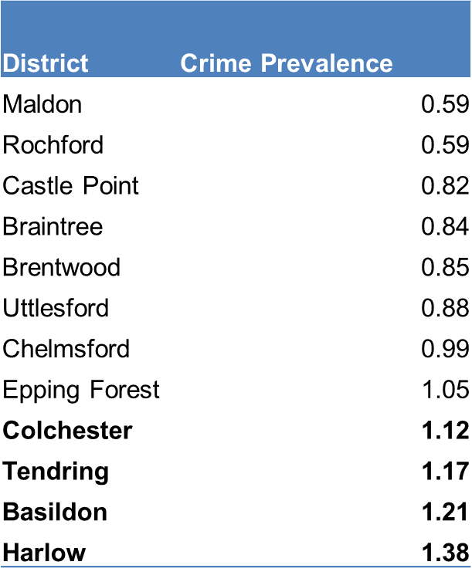
Rates of crime in Basildon and Harlow are twice that of Maldon and Rochford
40
LATEST PICTURE
ESSEX | NATIONAL
74 | 83
Insert Contextual Data here
In terms of recorded crime, Essex has a lower rate of recorded crimes compared to those seen nationally in 2018. Violence against the person makes up a third of all recorded crime.
Harlow has the highest instances of recorded crime in 2018, 89 instances per 1000 population. Maldon has the lowest instances with 42.6 per 1000 population in 2018. Basildon has had the largest drop in crime between 2002 and 2018 of -25%. Whereas Epping Forest has increased in crime by 7% in the same time period.
Crime prevalence is related to population size. All 4 of Essex’s localities have the highest crime prevalence for 2018.
Offence rate per 1,000 Population (17-18)
N/B Crime is recorded at the point of incidence rather than residential area of the criminal
Notes:
This is based on the latest data available.
The distribution of crime type is fairly similar in Harlow and Basildon compared to Essex and England.
Merged two slides together here

Slide 41
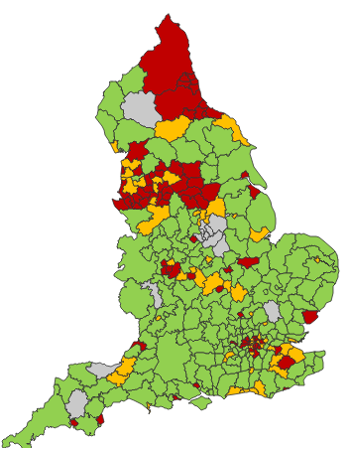
Violent crime and violence rates leading to hospitalisation in Essex are lower than other authorities in and around London, with the exception of Tendring. Less than 2% of Violent crime is attributable to Gangs.
41
Insert Contextual Data here
Essex has a violent crime rate of 7.60 per 1,000 population, this is slightly higher that Herts (7.24) but lower than the Metropolitan Police (8.37), and Kent (10.99 per 1,000 population)*. Recent analysis shows that less than 2% of all violence in Essex can be attributed to the households which were flagged and marked as gangs and serious drug related violence.
A&E and Hospital Episode Statistics are perhaps a better indication of violence rates (map shown below). Tendring is the only district in Essex with an admission rate for violence slightly above the average for England (shown as red).
Alcohol attributable hospital admissions are another indication of criminal and anti-social behaviour. These are highest in Basildon, Colchester and Tendring.
2016/17 hospital admissions attributable to alcohol
* It is important to note, that for latest crime integrity inspections, Kent police were adjudged by HMICFRS to have recorded 96.6% of their crime reports; this is significantly higher than Met Police and Hertfordshire, which were in low 80% last inspections – Essex integrity inspection results not yet available*
Notes:
Considering the differences for the population statistics crime is over represented in all 4 localities. Surprisingly with harlow top followed by Basildon.

Slide 42
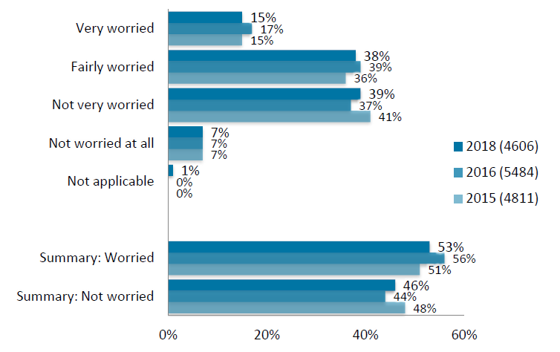
Nearly half of residents in Essex are worried about being victims of crime, the highest rates of fear seem to reflect other measures of crime.
Since 2015 Survey respondents were asked in general how worried they are about being a victim of crime. Each year, roughly half of residents have said they are worried about becoming victims of crime.
Maldon residents were the least worried about being a victim of crime stating either not very worried or not worried at all, 65% of all responses.
This contrasts with Basildon where there are significantly more people very worried or fairly worried about being a victim of crime (65%) than not worried 35%.
Source: ECC Residents Survey
Notes:
Wanted to include more on this slide however there is not much else to include

Slide 43
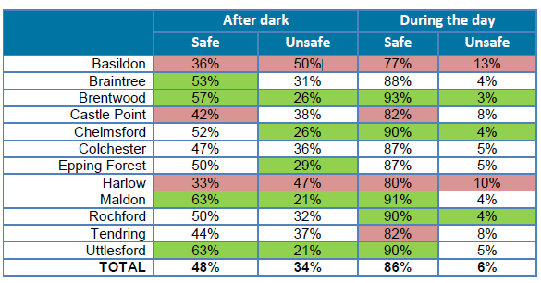
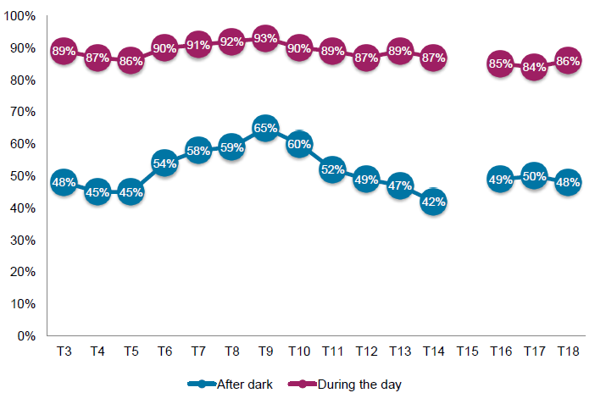
Whilst feelings of safety during the day have remained consistent over the last decade, feelings of safety after Dark continue to fluctuate, returning to 48% in 2017/18.
Since 2007 Survey respondents have been asked about how safe they feel during the day and after dark , in general feelings of safety during the day have remained consistent.
Fear of crime after Dark has fluctuated, peaking in 2010 at 65%, with a recent fall back to 2007 levels of 48%. As with other perception measures the highest rates of fear are seen in Basildon.
Key driver analysis indicates that safety perceptions, anxiety about crime and homes being broken into is significantly higher in urban areas, amongst disabled residents, and amongst female residents compared to male.
Source: ECC Residents Survey

Slide 44
Communities

Slide 45
By and large community cohesion levels in Essex are consistently high – although there is less evidence of any shift to pro-social volunteering behaviour.
Community cohesion measures of ‘satisfaction with the local area’ and ‘getting on well’ continue to indicate that there is generally high satisfaction with the local area but there is little change in uptake of activities to support communities. The percentage of residents voluntarily participating did however increase significantly between 2013 to 2014.
Residents of Epping Forest and Maldon have higher levels of agreement on all measures that are the same or higher than the average. Conversely, Harlow residents have lower than average levels of agreement on all community cohesion measures.
Local area a place where people from different backgrounds get on well together
Source: Essex residents survey.

Slide 46
Environment

Slide 47
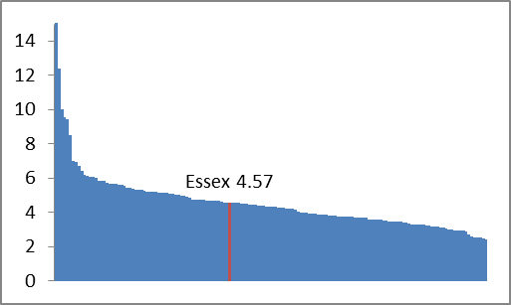
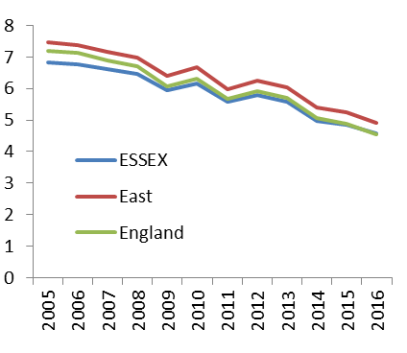
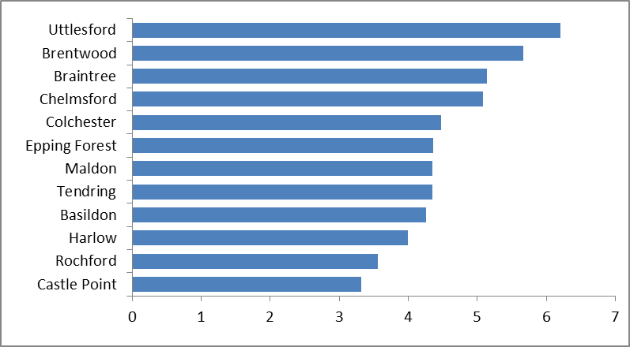
CO2 Emissions in Essex are lower than the Regional and National average and are reducing in line with the national rate
CO2 Emissions
In 2016 Essex ranked 62/152 Local Authorities (with 1 being the highest) on emission levels per capita.
Essex CO2 emissions per capita have reduced by one third between 2005 and 2016. The trend is similar for England and the East Region with Essex tracking the trend at a lower rate.
There is a mirrored reduction across each district. In 2016 Uttlesford had the highest levels at 6.2 tonnes per person and Castle Point the lowest at 3.3 tonnes
CO2 emissions per capita within local authority control
LAs in England rankings - 2016
CO2 emissions per capita within local authority control – 2005-2016
CO2 emissions per capita within local authority control by district 2016

Slide 48
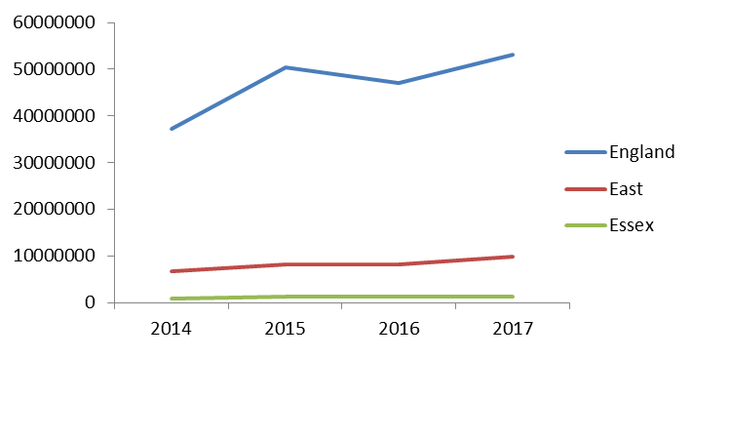
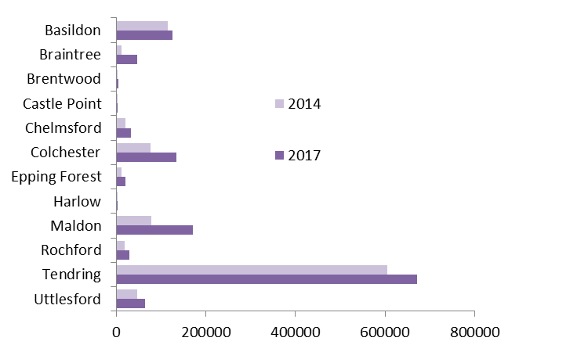
Energy from Renewables increasing steadily in Essex with strong growth in Maldon and Braintree
Energy generated from renewable sources has increased in Essex by 32% points between 2014 and 2017. This is below the East of England region (47%) and England (43%)
51% of energy from renewables generated in the whole of Essex was in Tendring largely due to the large windfarms based in the district.
The largest growth areas in the same period were Maldon (+122%) due to additional wind turbines and Braintree (+290%) due to the opening of a new anaerobic digestion plant.
Energy (MWh) generated from renewables
Energy (MWh) generated from renewables by district 2014 v 2017

Slide 49
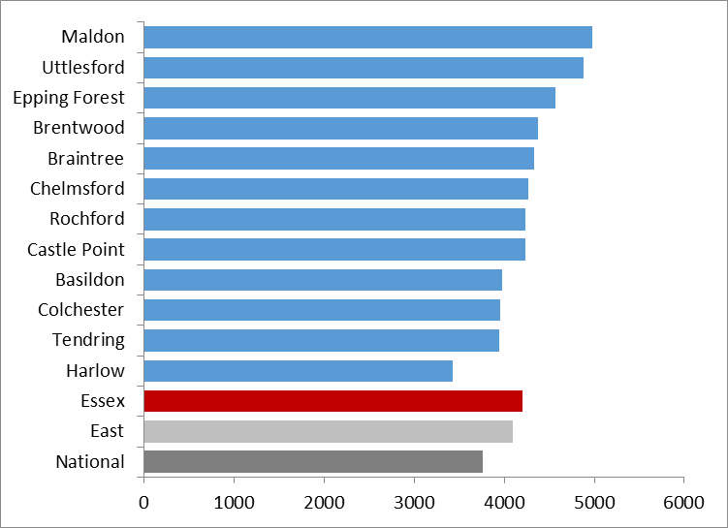
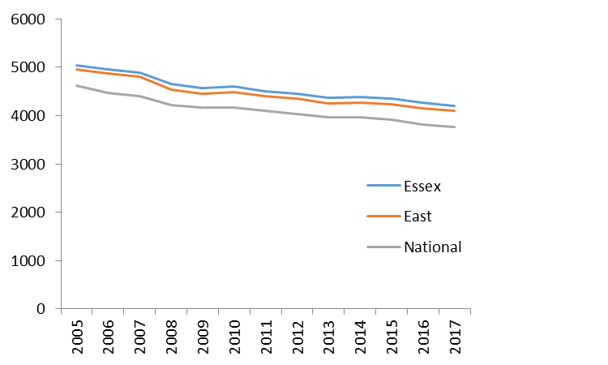
Domestic electricity consumption is higher than the National average, but is reducing.
Domestic electricity consumption (kWh) is higher in Essex (4,200) than the regional average (4,100) and the national (3,760)
Maldon (4,970) and Uttlesford (4,880) are the districts with highest consumption. Harlow has the lowest average consumption (3,420).
Consumption is reducing in Essex in line with both regional and national rates.
Essex (53%) household recycling rates are above both the East of England (49%) and national rate (44%).
Rochford has the highest rate across the districts, with Maldon second, however Maldon has seen the greatest increase between 2014-15 and 2016-17, and increase of 12 percentage points from 46% to 58%.
Electricity – domestic use per household 2017 (kWh)
Electricity – domestic use per household 2017 (kWh) over time
Notes:
Taken out slide on recycling rates and included the text within this slide

Slide 50
Homes
Notes:
Anything for homes which could be included?

Slide 51
The majority of homes in Essex are owner occupied Detached or Semi-detached homes.
Type of housing
The majority of housing in Essex is either Detached (23.7%) or Semi-detached (28.2%). There is a wide disparity in the proportion of flats between districts, Maldon has only 7% flats compared to Colchester and Chelmsford which have 19% and 17% respectively.
Housing Tenure
The majority of homes are owner occupied in Essex (72.8%). There is however a disparity between districts, Harlow has only 56% of properties owner occupied compared with 85% in Rochford.
This would likely impact on the quality of homes as privately owned homes tend to be better maintained.
Source: Experian MOSAIC household Segmentation

Slide 52
Median House prices have grown 70% in Essex in the last 10 years, with the highest growth seen in Epping Forest.
2018 | Average Price: All Properties | Average Price: Detached Houses | Average Price: Semi-detached houses | Average price: Terraced houses | Average price: Flats and maisonettes
ESSEX | £310,594 | £481,554 | £315,796 | £261,544 | £198,069
EAST | £289,392 | £433,327 | £292,599 | £241,360 | £196,266
The median property price in Essex in 2018 was £310,594. For all common property types the Essex median price was higher in 2018 than the East of England median. Essex median house prices have grown 70% between 2009 and 2015, compared with national growth of 48% and regional growth of 65%. Epping Forest had the highest growth rate, 83%, in the same time period. The lowest growth was in Tendring with only 52% growth indicating that the disparity between house prices in Essex will widen. This will likely lead to social mobility issues pricing people out of an area.
Median property price over time
Median property price by district for 2018
Source: ONS, HPSSA Dataset 9, Median House Prices for Administrative Areas

Slide 53
Essex homes have become 31% less affordable in the last decade
LATEST PICTURE
 | ESSEX | EAST | ENGLAND
Workplace | 10.28 | 9.66 | 7.91
Resident | 9.27 | NA | 10.1
The median housing affordability ratio is a comparison of the median property price compared to median earnings in the same area. The higher the ratio the less affordable housing in the local area. Essex is less affordable than England if using workplace earnings but more affordable when considering resident earnings.
Rochford has the most affordable properties in relation to resident earnings and Maldon the least affordable. There may be differing factors affecting the affordability levels one being the types of properties being sold, as flats tend to be cheaper than houses and properties closer to London tend to be less affordable.
Ratio of median property price to median earnings
Housing affordability ratio over time
Source: ONS
Notes:
* Despite the affordability are people willing to live there?

Slide 54
On average Homelessness in Essex is higher than England. There are stark differences between districts, the rate of homelessness in Harlow is 4.5 times higher than the rate in Brentwood.
LATEST PICTURE
ESSEX | ENGLAND
2.41 | 1.95
Essex has a higher rate of homelessness per 1000 households (2.41) than England (1.95). Over the last decade the homelessness rate for England fell 0.41 but only fell 0.07 for Essex indicating an increasing gap between the rate of homelessness in Essex and England.
There are stark differences within Essex, Harlow has 3.8 homeless people per 1000 households compared to the Brentwood rate of 0.8. Chelmsford is concerning as the rate of growth has been an extra 2 homeless people per 1000 households in the last decade – the highest growth in Essex.
Source: MHCLG
Notes:
Essex has a higher rate of homelessness (2.41) than compared to England (1.95).

Slide 55
Migration

Slide 56
International net migration has decreased 41% in Essex in the last 2 years
 | LATEST PICTURE
 | ESSEX | EAST | NATIONAL
2016 to 2017 change | -21% | -31% | -30%
In the last couple of years net migration into Essex has decreased 41% (between 2014/15 to 2016/17) however over a longer period (2010 to 2017) the net migration declined only by 1% for Essex compared with 33% decrease for the entire Eastern region. The recent reduction is likely due to migrants worrying about potential restrictions from Brexit.
In 2017, Colchester had the highest number of net international migration (945) which is 10 times higher than the lowest 3 Essex districts (Rochford 51, Castle Point 80 and Maldon 90).
Net International Migration (2017)
Source: ONS, Migrations Suite
Notes:
England and eastern region have been removed from the graph as it was skewing the perspective making it difficult to read

Slide 57
Internal migration to Essex has fallen 16% compared with falls of 42% for East of England and 51% nationally.
 | LATEST PICTURE
 | ESSEX | EAST | NATIONAL
2016 to 2017 change | -16% | -42% | -51%
These show the internal migration figures from within England. Tending had the highest net inflow into the district for 2017 followed by Chelmsford. Unfortunately the data does not inform us of traits of those individuals migrating into the district. Between 2008 and 2017 internal migration for Essex decreased 16% however this is not as large as the fall in internal migration for the East of England (falling 42% in the same time period) or for England (falling 51% in the same time period).
Net Internal Migration (2017)
Net Internal Migration over time
Source: ONS, Migrations Suite

Slide 58
STRATEGIC AIM 4: TRANSFORM THE COUNCIL TO ACHIEVE MORE WITH LESS

Slide 59
Council Tax

Slide 60
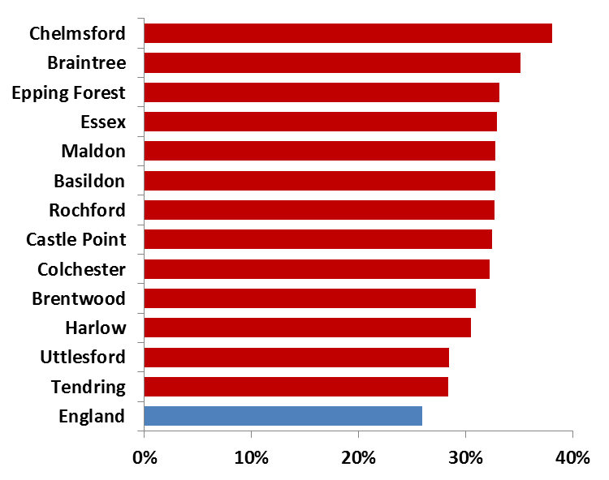
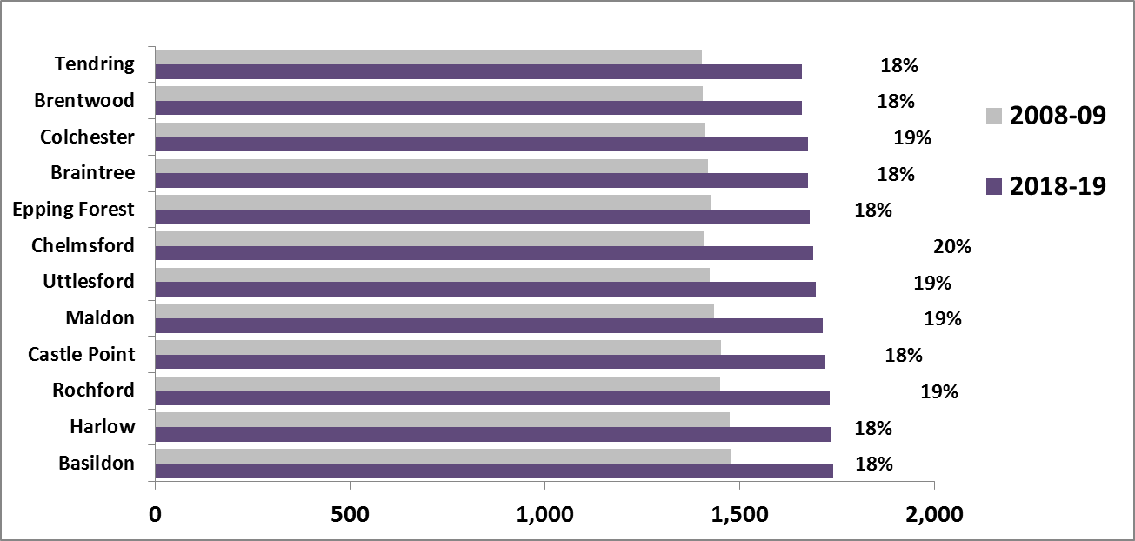
Essex has a lower proportion of dwellings paying 100% of the council tax rate than the national average.
There are more dwellings with only one eligible resident adult or more student only households in Essex than the national average. This means that on average per dwelling, Essex will receive a lower amount of council tax than the national average.
For 10 of the 12 Essex districts the band D council tax is higher than the England average, exceptions being Tendring and Brentwood. When ranked against other local authorities in England according to council tax rates (for band D), every local authority was relatively lower when comparing 2018-19 rates to 2008-9 rates.
The average council tax increase in Essex was 19% over the last decade lower than the average national increase of 22% during the same time period. Meaning that council tax rates have become relatively cheaper over the last decade in Essex compared to the national average.
% of dwellings with a 25% reduction in council tax
Average Band D cost (£) 08/09 and 2018/19
Notes:
Accumulated two slides together here
Are there more flats than the national average
Skewed by the number of students living in the area?

Slide 61
Technology/Digital

Slide 62
The number of bring your own devices have almost doubled since the last report.
Below shows the current performance of digital measures across Essex County Council. Many of these measures have only just been created meaning there is not much trend data.
However there have been large improvements in the bring your own devices conversion, the number of bring your own devices at Essex County Council almost doubling against the last reported figure. The windows 10 roll out across the County Council has also made improvements increasing 7% points since the last report.
It is hoped that the conversion to windows 10 and bring your own devices will improve the productivity of council workers.
Crime
Source: OPR

Slide 63
Workforce

Slide 64
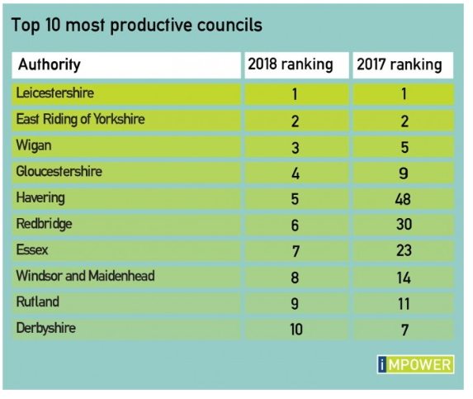
Essex is in the top 10 most productive English councils
Impower annually assesses councils for their productivity through six different lenses: children’s social care, older people, all age disability, health and social care interface, housing and homelessness and waste and recycling.
In the latest league table, Essex is within the top 10 most productive councils.
Essex County Council has improved in all areas however is relatively best at providing children’s services (ranking 3rd) and health & social care (ranking 17th).
It is performing relatively worst in the waste and recycling lense (ranking 68th).
Source: imPower
Notes:
Using the latest updates (as at October 2018), we have included 3 ranking tables in this report: Top 10 most
productive councils, Top 10 productivity rankings across the six lenses, and Top 10 most improved councils.
Leicestershire and East Riding of Yorkshire retain their 2017 positions as the most productive councils in
England. Wigan, Gloucestershire and Derbyshire have also stayed in the Top 10. There are also five
newcomers in the list, with Havering and Redbridge having made the most progress to claim their spot.

Slide 65
This information is issued by:
Strategy, Insight and Engagement
Essex County Council
E1, County Hall, Chelmsford,
Essex CM1 1QH
You can contact us in the following ways:
By email: denise.lovett@essex.gov.uk
By telephone: 03330 320834
Visit our Council website: www.essex.gov.uk
Read our online magazine at www.essex.gov.uk/ew
Follow us on Twitter Essex_CC
Find us on facebook.com/essexcountycouncil

