Slide 1
Essex climate and weather data
Historic and projected temperature and rainfall data and visualisations in Essex
DATA & ANALYTICS

Slide 2
Data source
Information on the Met Office’s UK Climate Projections data

Slide 3
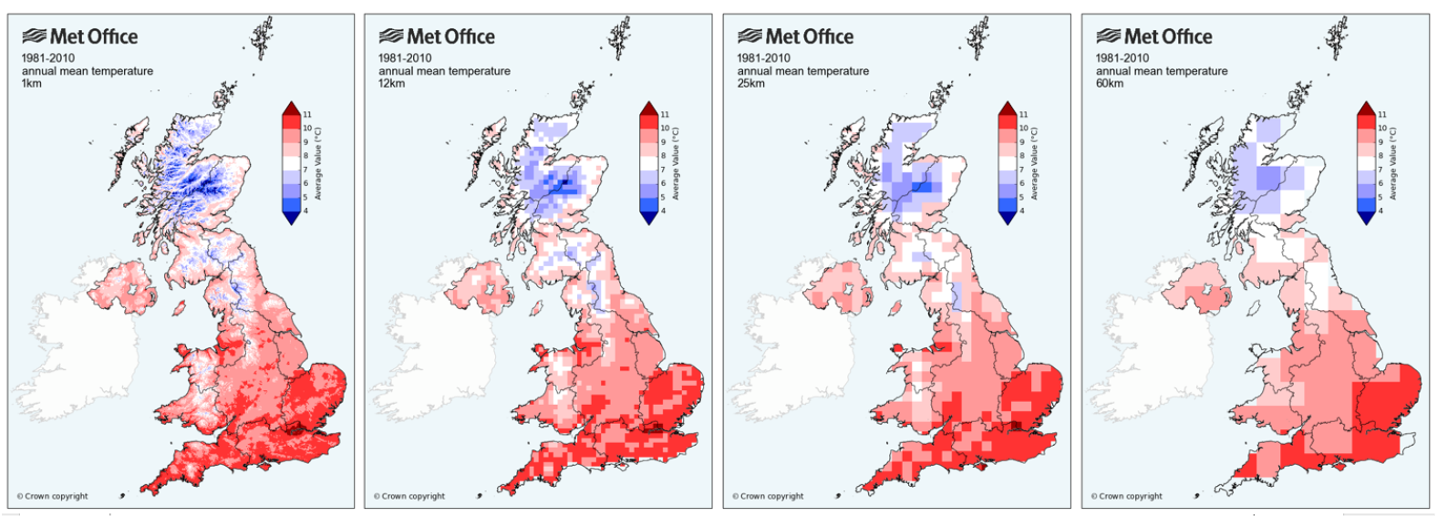
The HadUK Grid System
Very localised
Less localised
Note: if you want local data (1km) at a daily temporal average, you will have to pull lots of datasets. 1km data is easiest to work with in a monthly, seasonal or yearly temporal average (you can drag and select the area you’d like).

Slide 4
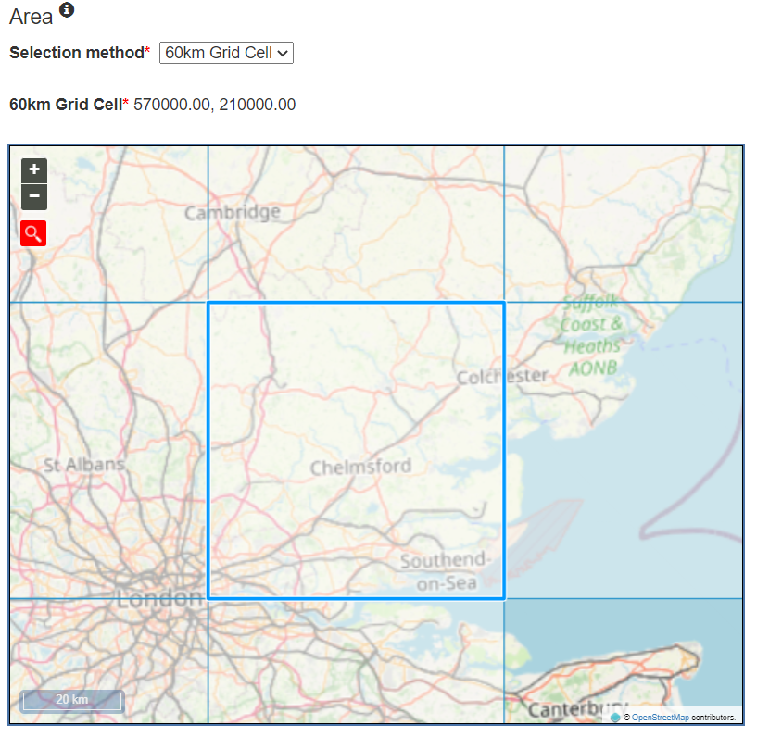
The HadUK Grid System: Essex 60km
The associated data and visualisations in this presentation use 60km resolutions to facilitate comparison with climate projections provided by the UKCP18 project.
Met Office; Hollis, D.; McCarthy, M.; Kendon, M.; Legg, T.; Simpson, I. (2019): HadUK-Grid Gridded Climate Observations on a 60km grid over the UK, v1.0.1.0 (1862-2018). Centre for Environmental Data Analysis, 14 November 2019. doi:10.5285/75f2c9746d8245b29ad80c04a6a202fd. https://dx.doi.org/10.5285/75f2c9746d8245b29ad80c04a6a202fd

Slide 5
What’s on Essex Open Data?
UKCP18 includes a comprehensive set of observations of weather and climate covering the UK, with some the records extending back to the 1800s and projections until 2100 (sometimes even 2300). Historical data is based on observations from weather stations.
Essex County Council’s Data and Analytics team have cleaned and analysed the historic and projected climate and weather data to inform ECC’s upcoming water strategy.
Examples of how the data has been used are in the upcoming slides.
What variables are on Essex Open Data?
Daily rainfall (mm/day) January 1960 – November 2099
Maximum air temperature at 1.5m (°C) 1960 – November 2099
Minimum air temperature at 1.5m (°C) 1960 – January 2022
Processed rainfall data (yearly rainfall, number of consecutive days without rainfall, number days with rainfall by mm)
…More are available on the Met Office UKCP website, but data availability depends on desired temporal average and location granularity

Slide 6
Projections
Broadly, the same data available as observations are also available as projections (variables, temporal average and HadUK Grid).
You will be able to extract projection data based on different climate scenarios e.g. the RCP2.6 low emissions scenario, the RCP8.5 high emissions scenario and some in between.
These scenarios relate to greenhouse gas emissions, attempts to mitigate or reduce our climate impact and forecasts on global temperature increase relative to pre-industrialisation.
But not all scenarios are available on the Met Office UKCP website at regional or local levels due to ‘high computational costs’.
Brief notes on projections…
It is not just one “simple” dataset but 12 variants of the HadGEM3-GC3.05 global climate model.
The projections represent 12 equally plausible realisations of the evolution of the climate under your selected scenario. This is like starting twelve weather forecasts and running for 100 years.
Projections typically use a 360-day calendar (this is visible in the file metadata) of 12 months with 30 days each. There are workarounds for this in R.

Slide 7
Climate scenarios
The below gives a brief overview of the four Representative Concentration Pathways (RCPs). More information of RCPs is provided by the Met Office and van Vuuren et al (2011).
RCP 2.6 Low Emissions Scenario
RCP 4.5 Moderate Stabilization Scenario
RCP 8.5 High Emissions Scenario
RCP 6.0 Stabilization Scenario
RCP 8.5 is a pathway where greenhouse gas emissions continue to grow unmitigated, leading to a best estimate global average temperature rise of 4.3°C by 2100.
RCP 2.6 represents a pathway where greenhouse gas emissions are strongly reduced, resulting in a best estimate global average temperature rise of 1.6°C by 2100 compared to the preindustrial period.
RCP 4.5 is a stabilization scenario. It is described by IPCC as a moderate scenario in which emissions peak around 2040 and then decline. The scenario represents a best estimate global average temperature rise of 2.4°C by 2100.
The RCP 6.0 is another stabilization scenario which uses a high greenhouse gas emission rate. This scenario represents a best estimate global average temperature rise of 2.8°C by 2100.
The climate and weather projection data available on Essex Open Data is according to the RCP 8.5 High Emissions Scenario.

Slide 8
Where to find UKCP?
UKCP18 is available online, through a dedicated website. Users need to make an account.
https://ukclimateprojections-ui.metoffice.gov.uk/ui/home
Data from the UKCP is available under an Open Government Licence.

Slide 9
Historic climate data
Historic temperature and rainfall data

Slide 10
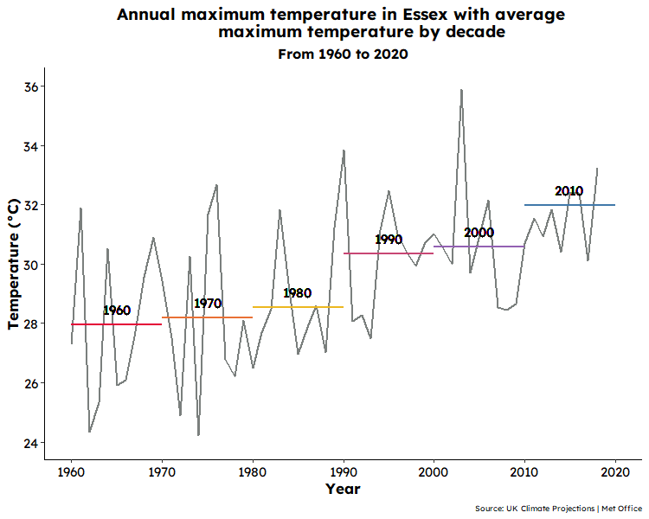
Historic maximum temperature
The highest maximum daily temperature observed occurred in 2019, at 36.19651 degrees Celsius.
The 2010s has the highest mean maximum daily temperature at 31.96895 degrees Celsius, which is more than 5 degrees higher than the 1960s (26.33839 degrees Celsius).
Data Source: Met Office Hadley Centre | UKCP

Slide 11
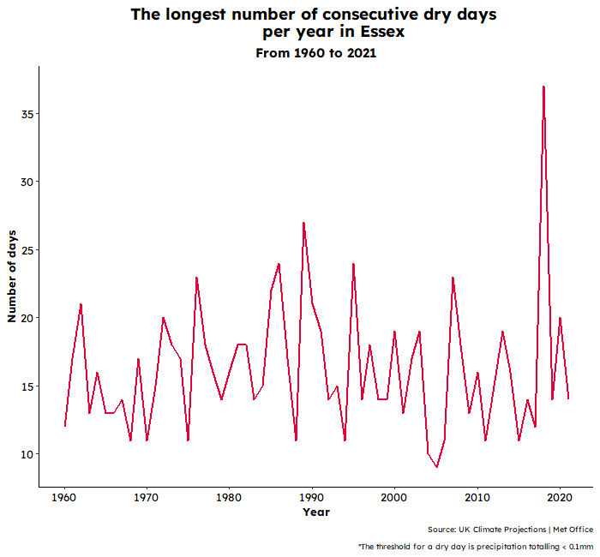
Historic precipitation patterns
2018 had the highest number of consecutive dry days (when daily precipitation is less than 0.1mm) at 37 days.
This is 10 days more than the next highest, which happened in 1989.
Data Source: Met Office Hadley Centre | UKCP

Slide 12
Projected climate data
Future projected temperature and rainfall data

Slide 13
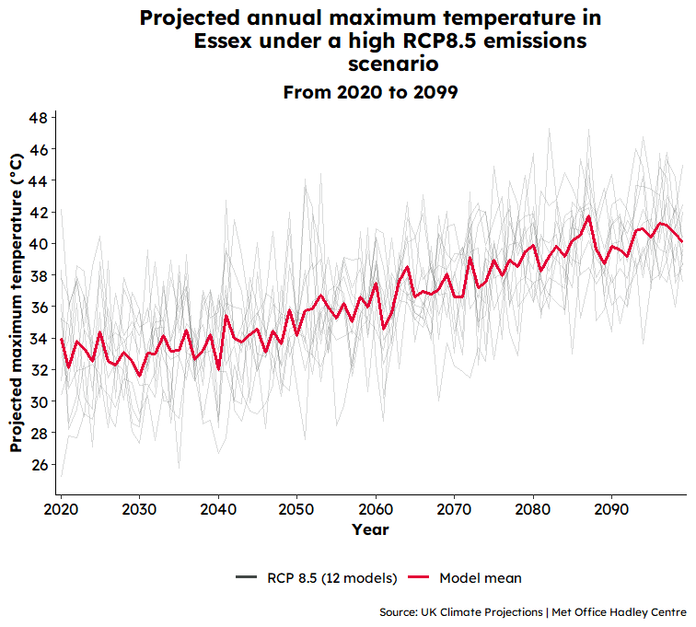
Projected maximum temperature
Assuming continued increases in greenhouse gas emissions under a high RCP8.5 emissions or “business as usual” scenario, Essex can expect a continued upward trend in temperatures, as well as generally…
Hotter summers
  12 Models: The highest projected maximum temperature is 47.28 degrees Celsius, which is expected to occur by July 2082.
  Ensemble mean: the highest projected maximum temperature is 41.74 degrees Celsius, which is projected to happen by 2087.
Warmer winters
  Daily maximum temperatures in the Winter period daily could reach as high as 19 degrees Celsius by 2070.
Data Source: Met Office Hadley Centre | UKCP

Slide 14
Projected rainfall data
Assuming continued increases in greenhouse gas emissions under a high RCP8.5 emissions or “business as usual” scenario, Essex can expect…
Drier summers
  According to the LTA 1991-2020 summertime rainfall ranged from a low of 48.0mm in July to 56.4mm in August.
  The projected LTA rainfall in 2051-2080 is expected to fall significantly in the summer months to as low as 22.1mm in August.
Wetter winters
  The projected LTA rainfall in 2051-2080 is as much as 87mm in January (87.5mm) and December (87.8mm). This is 30mm more than January (53.3mm) and December (57.1mm) in the 1991-2020 LTA.
Data Source: Met Office Hadley Centre | UKCP

